Slide 1
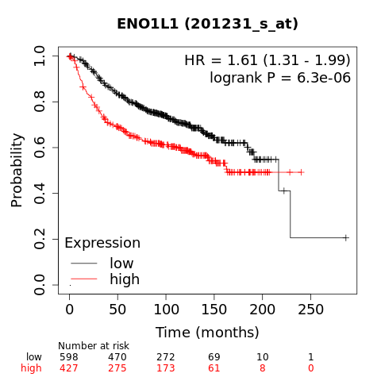
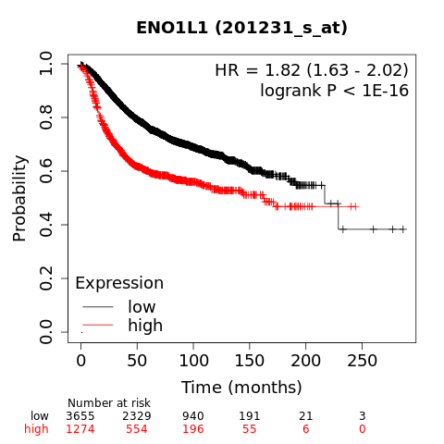
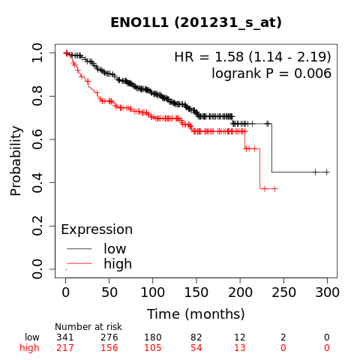
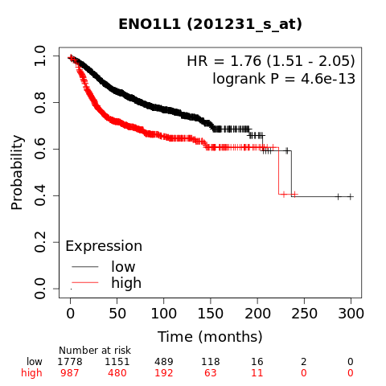
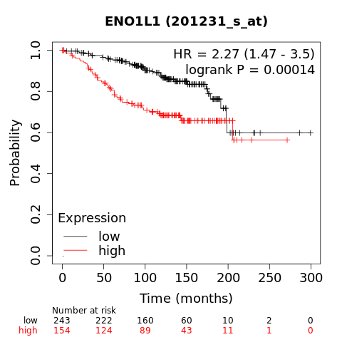
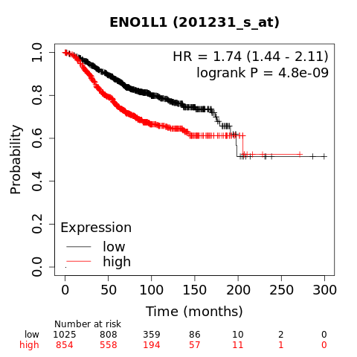
Supplementary Figure 1
systemically untreated patients
systemically treated patients
A.
Relapse-Free Survival (RFS)
B.
Distant Metastasis-Free Survival (DMFS)
C.
Overall Survival (OS)
Effect of high mRNA expression of ENO1 on relapse free survival, distant metastasis-free survival and overall survival in systemically untreated and systemically treated patients (data obtained from KM Plotter).

Slide 2
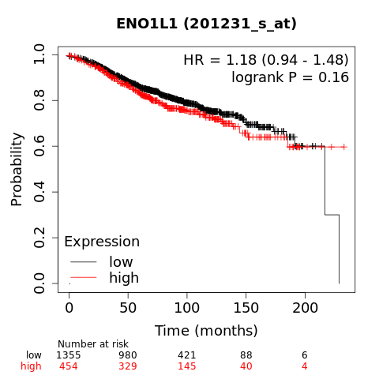
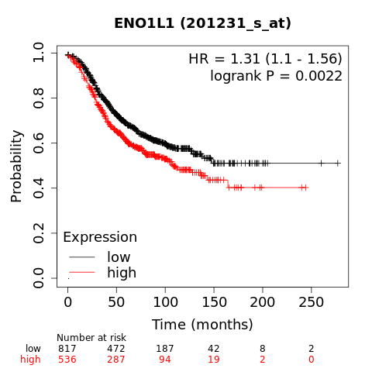
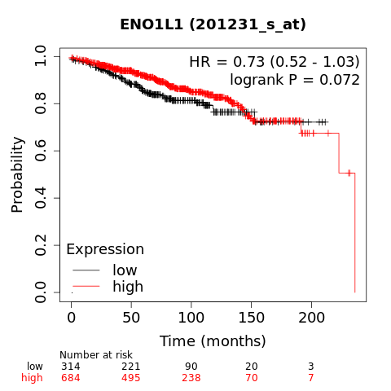
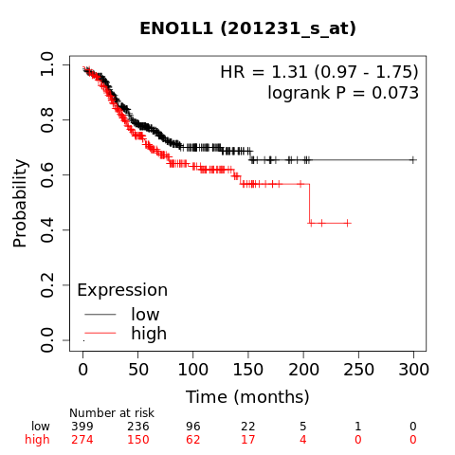
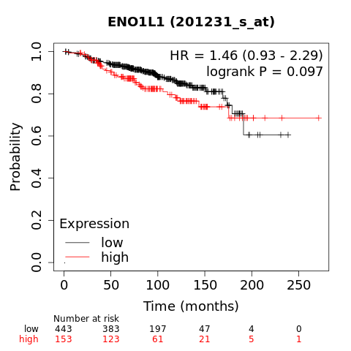
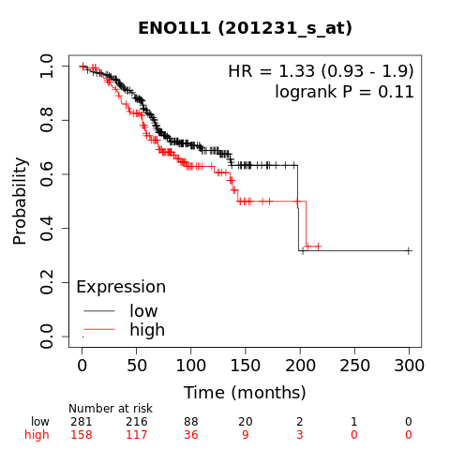
Supplementary Figure 2
Luminal A
Luminal B
A.
Relapse-Free Survival (RFS)
B.
Distant Metastasis-Free Survival (DMFS)
C.
Overall Survival (OS)
Effect of high rRNA expression of ENO1 on relapse free survival, distant metastasis-free survival and overall survival in luminal A and luminal B breast cancers (data obtained from KM plotter).

Slide 3
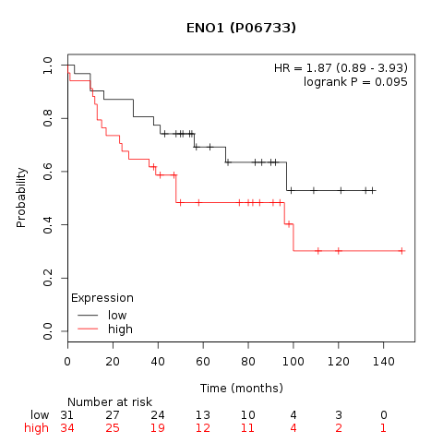
Supplementary Figure 3
Effect of high protein expression of ENO1 on overall survival (data obtained from KM plotter).

Slide 4
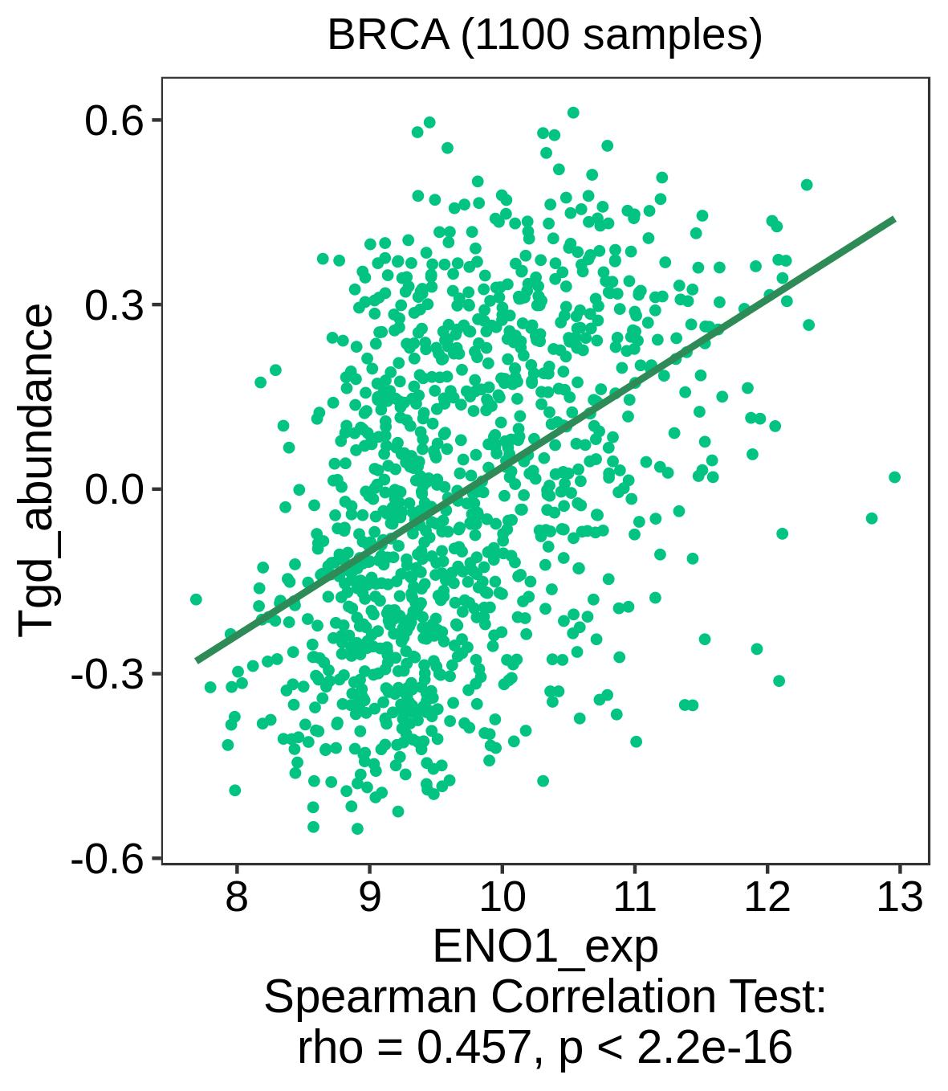
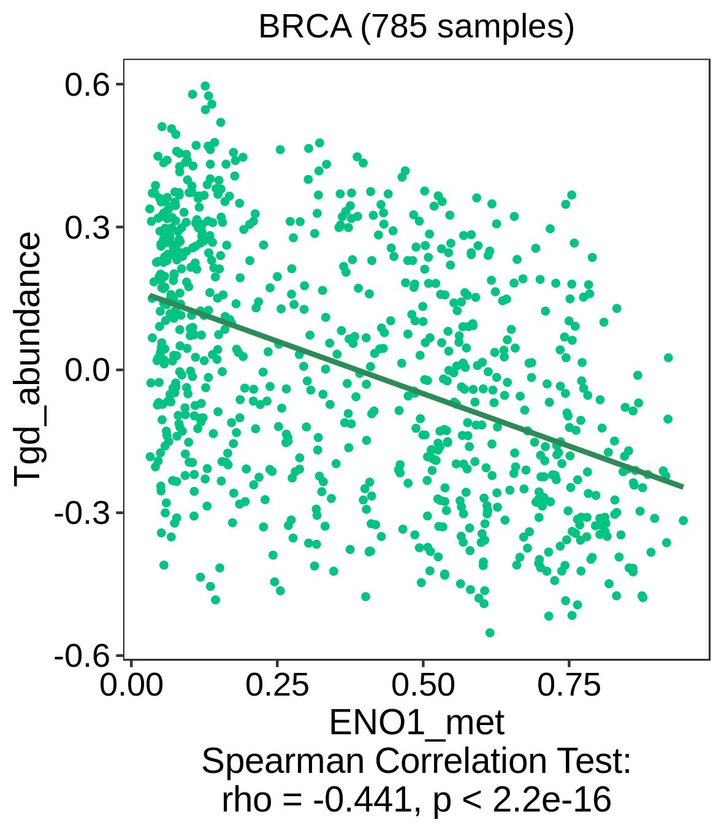
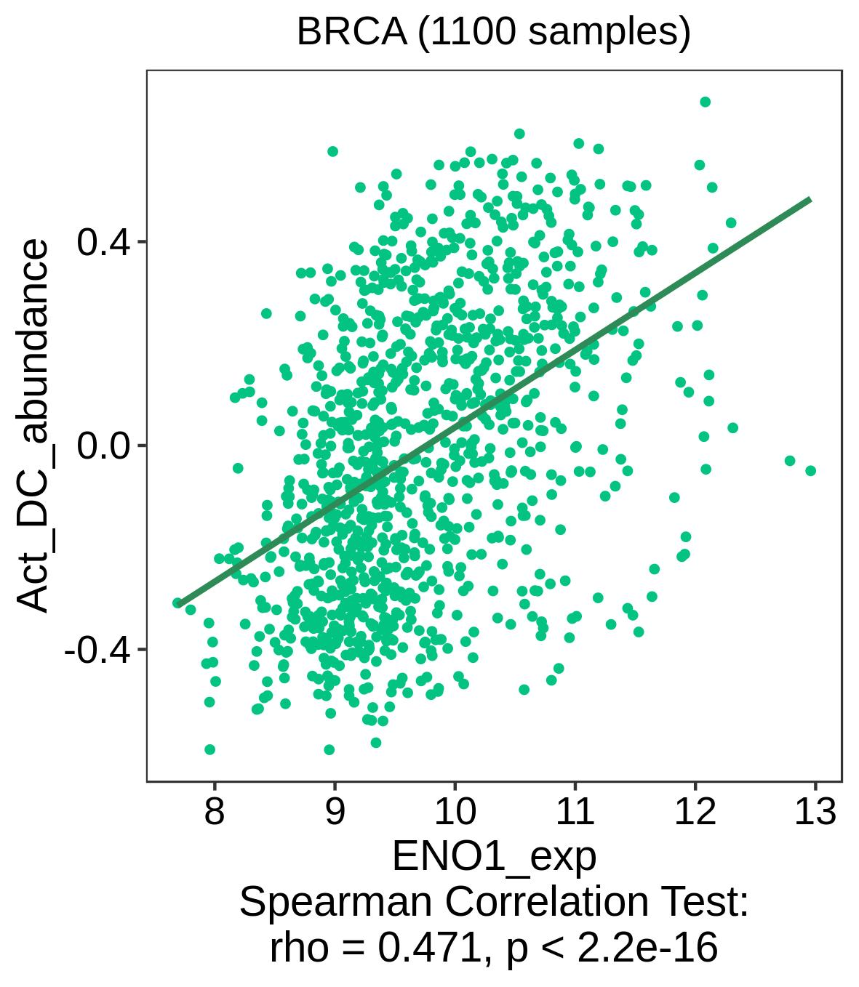
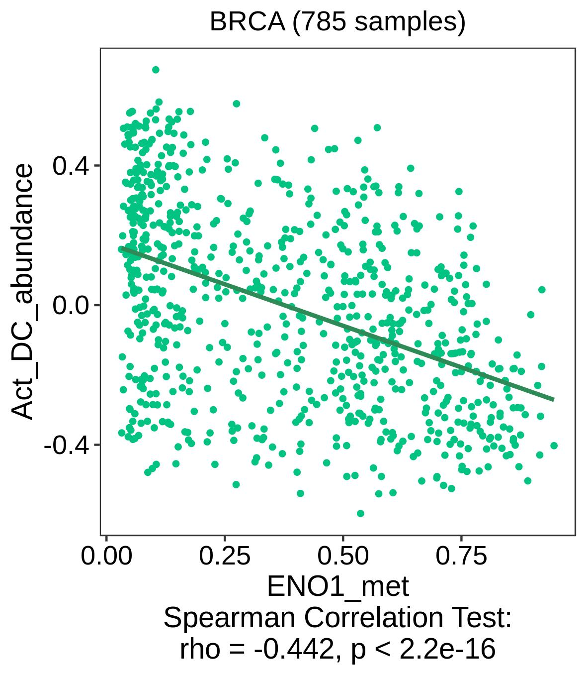
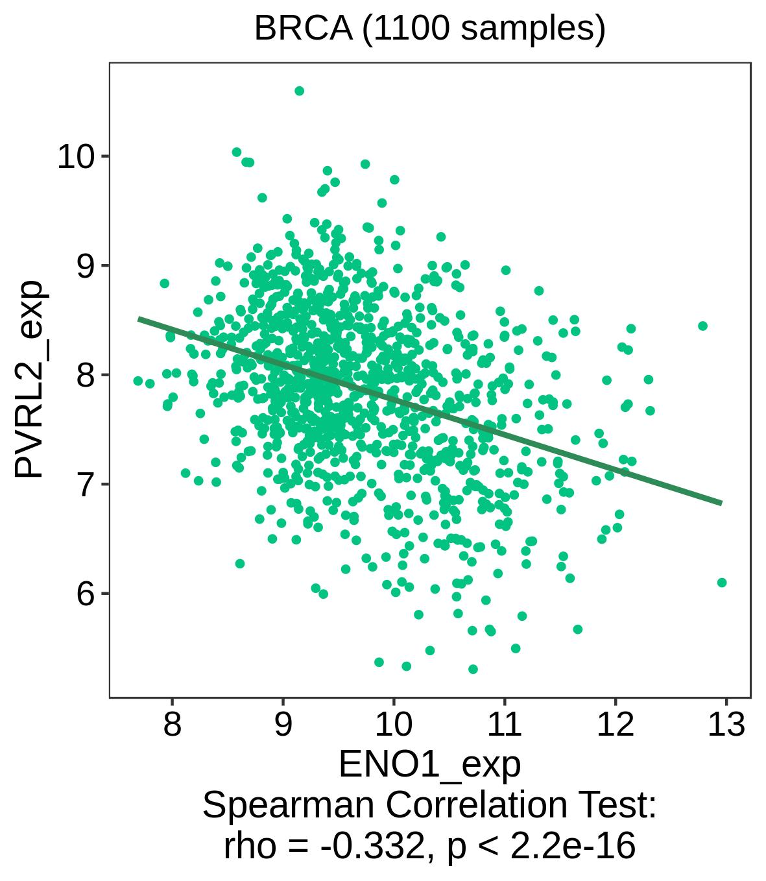
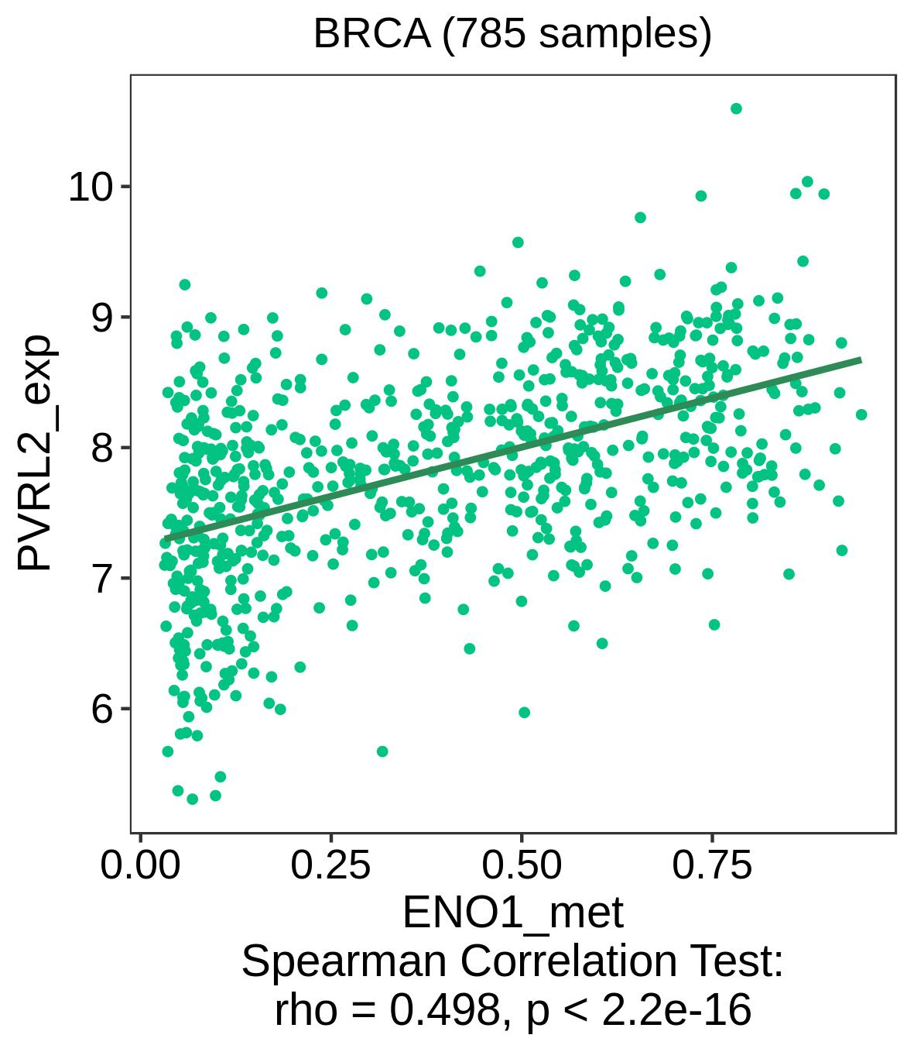
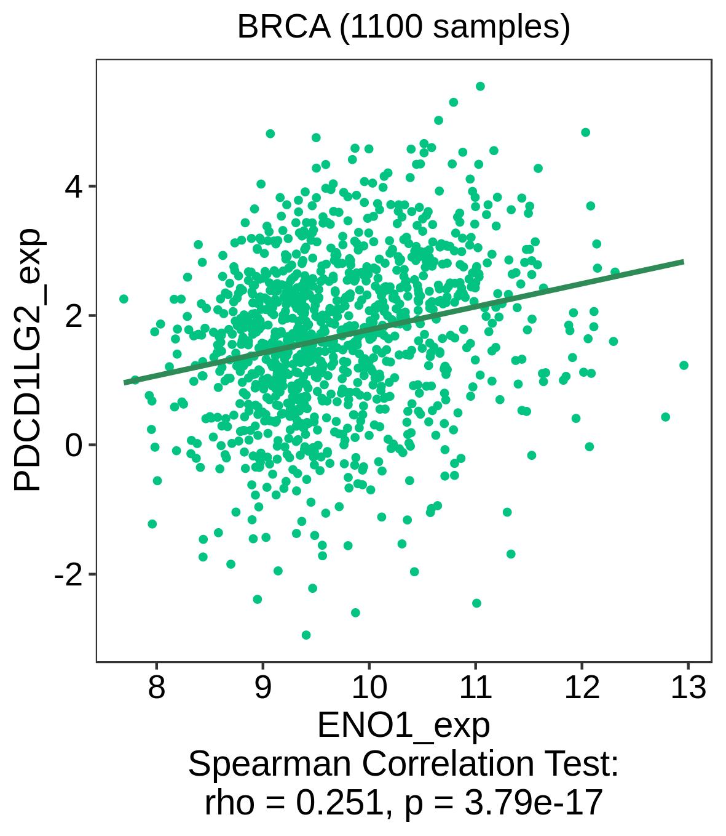
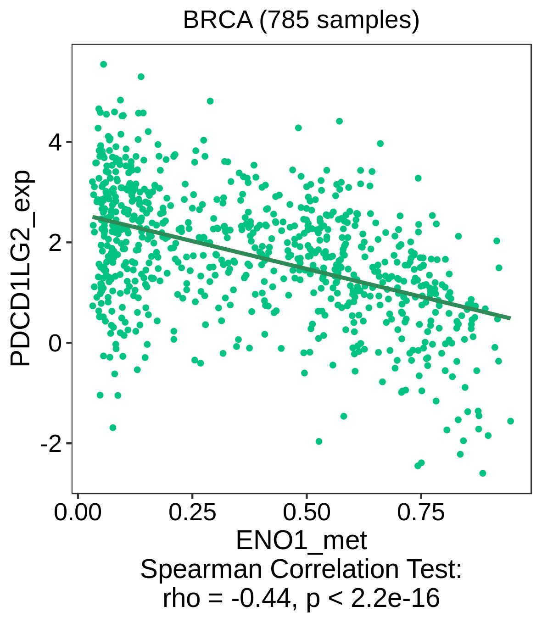
Supplementary Figure 4
A.
ENO1 expression
B.
ENO1 methylation
The most significant correlations of ENO1 expression (A) and ENO1 methylation (B) with tumour infiltrating immune cells (top 2 panels) and immune markers (bottom 2 panels) (data obtained from TISIDB Portal).

