Slide 1
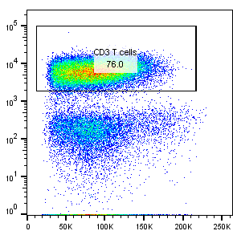
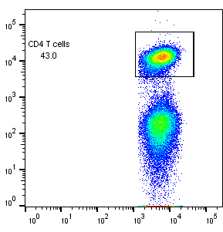
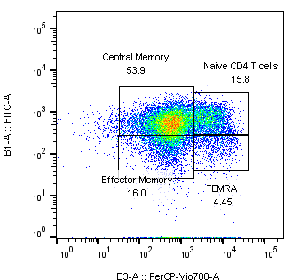
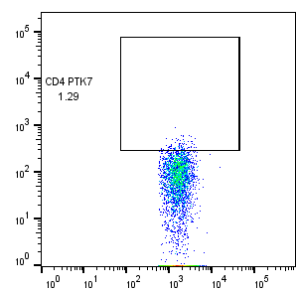
A
B
C
D
CD3
CD4
CCR7
PTK7
Central
memory
Naïve
Effector
memory
EMRA
FSC
CD8
CD45RA
E
F
G
CD69
RORγ
Foxp3
Regulatory
T cells
Th17 cells
CD4
CD25
Supplementary Figure 1: T cell subset gating strategy.

