Slide 1
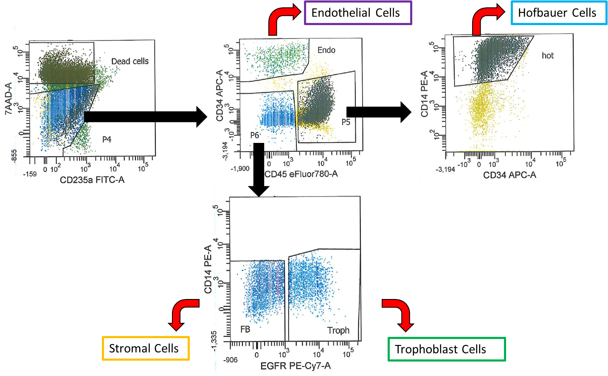
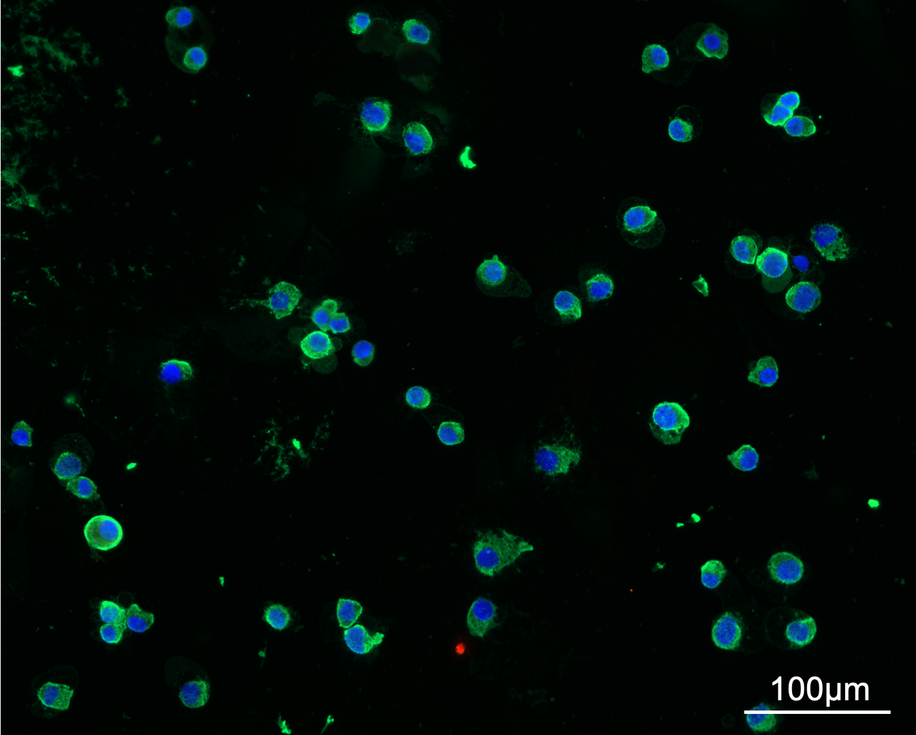
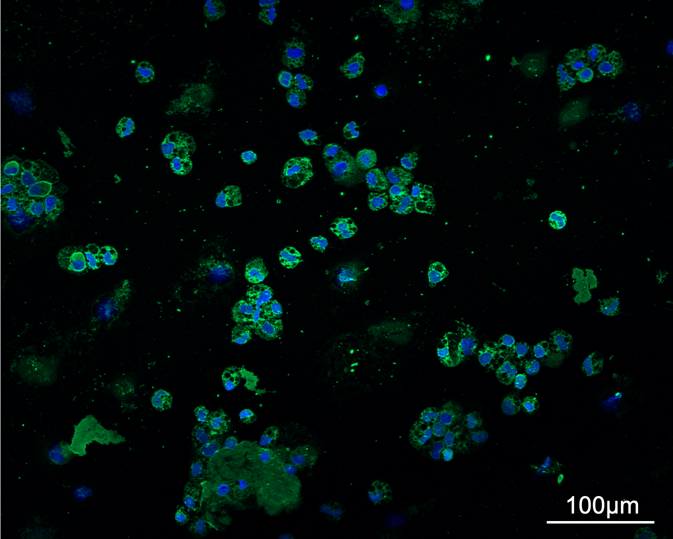
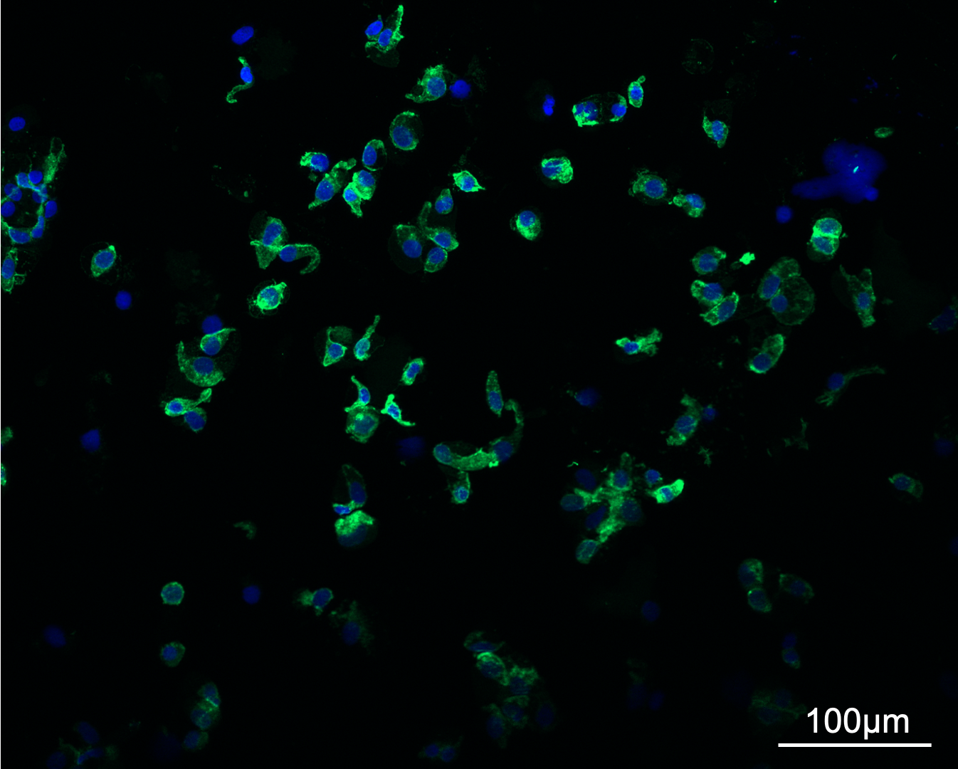
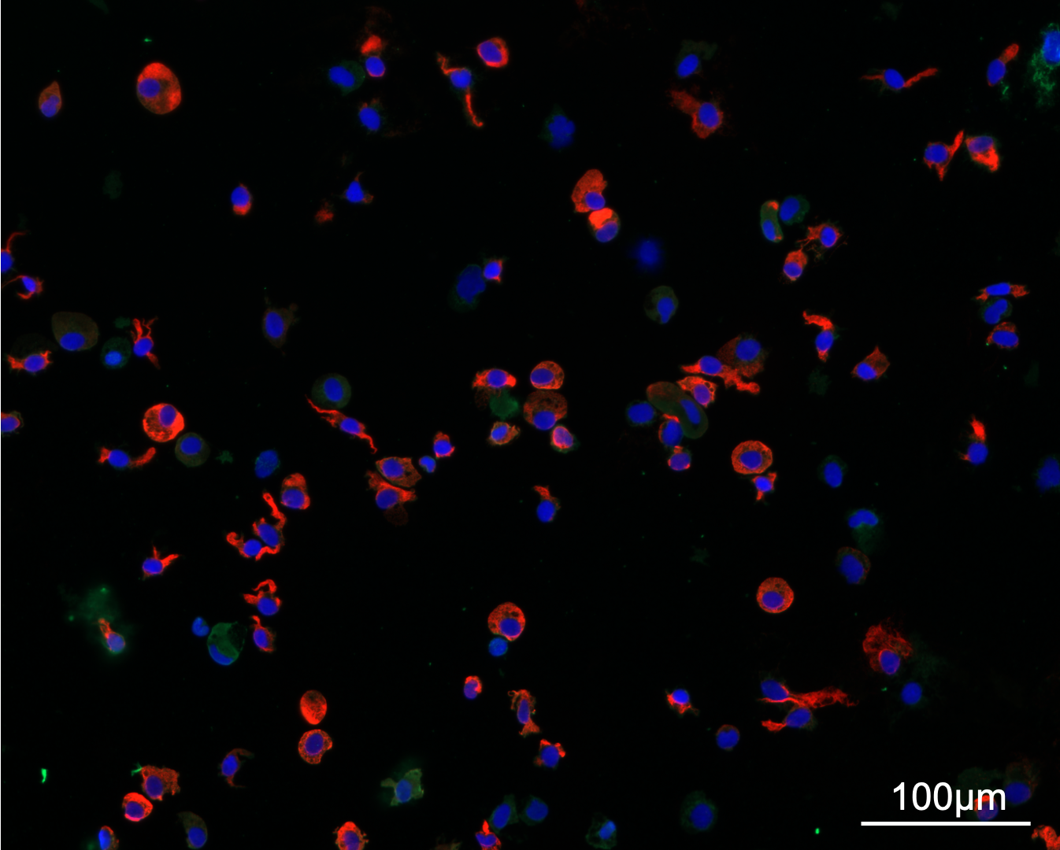
A)
Hof
B)
DAPI KRT7 VIM
C)
DAPI CD68
D)
DAPI CD31
E)
DAPI KRT7 VIM
Figure S1. Fluorescence-activated cell-sorting and immune fluorescence staining. A) Fluorescence-activated cell-sorting (FACS) workflow schematic. B-E) Immunofluorescence staining (IF) of term cell-sorted sample with known characteristic cell type markers that were not selected for in the FACS procedure. Nuclei are shown via DAPI staining (blue). Scale bars: 100 µm. B) Trophoblasts (KRT7: green, VIM: red). C) Hofbauer cells (CD68: green). D) Endothelial cells (CD31: green). E) Stromal cells (VIM: red).

Slide 2

A)
B)
PL289
1.0
Trophoblasts
0.73
Genetic
0.8
correlation
Stromal
0.99
0.81
1.0
Normalized
0.6
Endothelial
0.93
0.92
0.97
0.9
Y intensity
F
0.8
0.4
PL296 Trophoblasts
M
Hofbauer
0.71
0.99
0.78
0.90
0.7
0.2
PL289 Trophoblasts
PL289 Hofbauer
Villi
Stromal
Endothelial
0.7
0.8
0.9
1.0
Trophoblasts
C)
Normalized X intensity
100%
Endothelial
Hofbauer
Stromal
Trophoblasts
Villi
First Trimester
50%
0%
100%
Term
50%
0%
SNPs (n=59)
D)
E)
50%
40%
P(SNP is outlier)
30%
20%
10%
0%
0.4
0.6
0.8
F)
Normalized Y intensity
1. Fit linear model
in males
2. Predict on females
3. Normalize
distribution
4. Reverse, such
that 1 = 100%
1.00
to 0-1
Measure of
0.75
Sex
maternal
0.50
F
contamination
0.25
M
0.00
0.7
0.8
0.9
1.0
0.7
0.8
0.9
1.0
0.7
0.8
0.9
1.0
0.7
0.8
0.9
1.0
Genetic correlation to reference
Figure S2. Identifying maternal contamination. A) Total intensity over all probes from X and Y chromosomes normalized to total autosomal intensity can be used to determine sex. B) Within-donor sample-sample correlation on SNP probes. C) SNP distributions (n = 59 probes). D) Theoretical relationship between the average probability SNP is an outlier from the expected distribution, and maternal contamination. E) Empirically observed relationship between the average probability a SNP is an outlier, and normalized Y intensity, in male samples. Normalized Y intensity is a quantifiable measure of maternal contamination in male samples. F) Training a linear predictor of maternal contamination in male samples, then applying it to female samples.

Slide 3
Tissue
Trimester
P value
Sex
> 0.05
TECH_Batch_BSC
< 0.05
TECH_Row_factor
< 0.01
TECH_Row_numeric
< 0.001
TECH_Chip_number
TECH_Week
1
2
3
4
5
6
7
8
9
10
PC
11
12
13
14
15
16
17
18
19
20
40
30
% variance explained
20
10
0
1
2
3
4
5
6
7
8
9
10
11
12
13
14
15
16
17
18
19
20
PC
Figure S3. Principal component (PC) associations with phenotype variables. Principal components were tested for their association with various biological and technical sample variables. Each PC was tested individually in a simple linear model with each sample variable.

Slide 4
*
Enriched
Expected frequency
(bonferroni p < 0.001)
More Methylated
Less Methylated
shore
*
*
*
*
*
*
*
shelf
*
*
*
sea
*
*
*
*
*
*
island
*
*
*
*
*
*
*
*
*
enhancer
*
*
*
*
*
promoter
*
*
*
*
*
*
*
*
*
intronexonboundary
*
*
*
*
*
*
*
*
intron
*
*
*
*
*
*
*
*
intergenic
*
*
*
*
*
exon
*
*
*
*
*
*
*
5UTR
*
*
*
*
*
*
*
*
3UTR
*
*
*
1to5kb
*
*
*
*
*
*
*
*
*
pmd
*
*
*
*
*
*
*
0%
50%
100%
0%
*
50%
100%
Figure S4. First trimester differentially methylated CpGs enrichment for genomic location. First trimester differentially methylated CpGs were tested for enrichment at various genomic features (e.g. CpG island, enhancers, gene transcripts, PMDs).

Slide 5
GCM1
DMCS
MMP2
Endothelial
Endothelial
Hofbauer
Hofbauer
Stromal
Stromal
Trophoblasts
Trophoblasts
Villi
Villi
uc003pbp.3
uc002ehz.4
uc010jzr.2
uc010ccc.3
52 995 000
53 010 000
uc010vhd.2
55 515 000
55 530 000
position
position
promoters
exons
introns
GATA3
SLC1A5
Endothelial
Endothelial
Hofbauer
Hofbauer
Stromal
Stromal
Trophoblasts
Trophoblasts
Villi
Villi
uc002pfq.3
uc001ijy.1
GATA3
uc001ijz.3
uc002pfr.3
GATA3
uc001ika.3
uc002pfs.3
GATA3-AS1
uc001ijx.1
GATA3-AS1
uc010qbe.1
uc010xyh.2
GATA3-AS1
uc010qbf.1
47 280 000
47 295 000
GATA3-AS1
uc010qbg.1
8 100 000
8 115 000
position
position
Figure S5. Mean DNAm for each cell type across CpGs in selected functionally-relevant genes. Average term placental cell-specific DNA methylation across select genes. Differentially methylated regions (defined as regions with a high density of differentially methylated CpGs), are highlighted with a grey background.

Slide 6
JUNB
TEAD3
Endothelial
Endothelial
Hofbauer
Hofbauer
Stromal
Stromal
Trophoblasts
Trophoblasts
Villi
Villi
TEAD3
uc003okt.3
uc002mvc.3
TEAD3
uc003oku.4
TEAD3
uc010jvx.3
TULP1
uc003okv.4
12 895 000
12 900 000
TULP1
uc003okw.4
35 445 000
35 460 000
position
promoters
exons
introns
NDRG1
CGA
Endothelial
Endothelial
Hofbauer
Hofbauer
Stromal
Stromal
Trophoblasts
Trophoblasts
Villi
Villi
uc003yue.2
uc003yuf.1
uc003plj.2
uc003yug.2
uc003yuh.2
uc003yui.1
uc010mee.2
uc010mef.2
uc021zci.1
uc011ljh.1
uc011lji.1
134 250 000
134 275 000
134 300 000
87 805 000
87 807 500
position
Figure S6. Mean DNAm for each cell type across CpGs in selected preeclampsia genes. Average term placental cell-specific DNA methylation across select genes. Differentially methylated regions (defined as regions with a high density of differentially methylated CpGs), are highlighted with a grey background.

Slide 7
A)
Ubiquitous
6
(# CpGs = 1085)
4
75%
72%
75%
68%
74%
2
0
Placental-specific
6
(# CpGs = 981)
4
55%
9%
48%
72%
83%
2
0
50%
100%
50%
100%
50%
100%
50%
100%
50%
100%
Endothelial
Hofbauer
Stromal
Trophoblasts
Villi
B)
DNA methylation
Maternal (# CpGs = 895)
4
73%
70%
73%
65%
72%
First Trimester
3
2
1
0
4
68%
66%
68%
63%
68%
Term
3
2
1
0
50%
100%
50%
100%
50%
100%
50%
100%
50%
100%
Endothelial
Hofbauer
Stromal
Trophoblasts
Villi
C)
DNA methylation
Paternal
(# CpGs = 190)
4
86%
78%
87%
84%
86%
First Trimester
3
2
1
0
4
81%
79%
81%
80%
84%
Term
3
2
1
0
50%
100%
50%
100%
50%
100%
50%
100%
50%
100%
Endothelial
Hofbauer
Stromal
Trophoblasts
Villi
DNA methylation
Figure S7. Density graphs of CpGs in imprinted regions. A) Density plots (y-axis) of imprinted regions divided into those that are imprinted in more than one tissue (top) and placental-specific (bottom). The percentage of CpGs falling within 25%-75% is labelled in each plot. First trimester samples are shown. B) Maternal imprinted regions. Density of DNAm at CpGs in maternally imprinted regions. The total percentage of CpGs that have 25% - 75% DNAm are shown in each plot. C) Paternally imprinted regions.

Slide 8
A)
FGF8
100%
Trimester: Third
DNA
50%
methylation
0%
Relation to CpG Islands
Annotations
Imprinted DMR (Placenta)
Imprinted DMR (General)
Placental PMD
Enhancer
uc010qqe.1 (OGA)
Transcripts
uc009xws.2 (OGA)
uc001ktv.2 (OGA)
Endothelial
uc001ktu.2 (OGA)
uc001ktt.3 (NPM3)
Hofbauer
uc021pxg.1 (FGF8)
Stromal
uc009xwr.2 (FGF8)
uc001kts.2 (FGF8)
Trophoblasts
uc001ktr.2 (FGF8)
uc001ktq.2 (FGF8)
Villi
uc001ktp.2 (FGF8)
CpG
B)
FGF12
Sea
Present
Shelf
Absent
Trimester: Third
Shore
100%
Island
1to5kb
promoter
DNA
5UTR
methylation
50%
exon
intron
3UTR
0%
Relation to CpG Islands
Annotations
Imprinted DMR (Placenta)
Imprinted DMR (General)
Placental PMD
Enhancer
uc003fsy.3 (FGF12)
Transcripts
uc003fsx.3 (FGF12)
CpG
Figure S8. DNAm at imprinted regions for specific genes. A) Cell-specific DNAm at placental-specific imprinted regions for genes FGF8 and B) FGF12.

Slide 9
A)
JMJD1C
100%
Term
DNA
50%
methylation
0%
Relation to CpG Islands
Annotations
Imprinted DMR (Placenta)
Imprinted DMR (General)
Placental PMD
Enhancer
Endothelial
Transcripts
Hofbauer
Stromal
uc010qir.2 (JMJD1C-AS1)
Trophoblasts
uc001jmr.1 (JMJD1C)
Villi
uc001jmn.3 (JMJD1C)
CpG
B)
FGF14
Sea
Present
Shelf
Absent
Trimester: Third
Shore
100%
Island
1to5kb
promoter
5UTR
DNA
exon
methylation
50%
intron
3UTR
0%
Relation to CpG Islands
Annotations
Imprinted DMR (Placenta)
Imprinted DMR (General)
Placental PMD
Enhancer
uc021rme.1 (MIR2681)
Transcripts
uc001vpf.2 (FGF14)
uc001vpe.2 (FGF14)
CpG
Figure S9. DNAm at imprinted regions for specific genes. A) Cell-specific DNAm at placental-specific imprinted regions for genes JMJD1C and B) FGF14.

Slide 10
A)
RASGRF1
100%
Term
DNA
Endothelial
methylation
50%
Hofbauer
Stromal
Trophoblasts
Villi
0%
Relation to CpG Islands
Annotations
Imprinted DMR (Placenta)
Sea
Present
Imprinted DMR (General)
Shelf
Absent
Placental PMD
Shore
Enhancer
Island
uc002ber.4 (RASGRF1)
Transcripts
uc010blm.1 (RASGRF1)
1to5kb
uc002beq.3 (RASGRF1)
promoter
uc002bep.3 (RASGRF1)
5UTR
CpG
exon
intron
Figure S10. DNAm at imprinted regions for specific genes. A) Cell-specific DNAm at placental-specific imprinted regions for genes RASGRF1.

Slide 11
A)
Term
p<0.001
90%
Endothelial
Endothelial
p<0.001
Hofbauer
Hofbauer
80%
p<0.001
Stromal
p=0.02
Trophoblasts
Stromal
Trophoblasts
p=0.04
Villi
Mean DNAm
70%
p<0.001
Villi
60%
p<0.001
p=0.036
50%
All probes
Alu
L1
B)
C)
First trimester
100%
80%
p<0.001
p<0.001
p<0.001
p<0.001
70%
p<0.001
Mean DNAm
60%
Mean DNAm
50%
75%
All probes
Alu
L1
REMP_Alu
REMP_L1
Figure S11. DNAm summarized over repetitive elements. A) Repetitive element DNA methylation. CpG sites overlapping Alu and Line 1 (L1) elements were determined using the ‘rmsk’ track from UCSC. Mean DNAm over these CpGs was calculated for each term cell-sorted and villi sample. B) First trimester mean DNAm across repetitive elements and all 850k CpGs. C) REMP-predicted repetitive element DNAm in term samples.

Slide 12
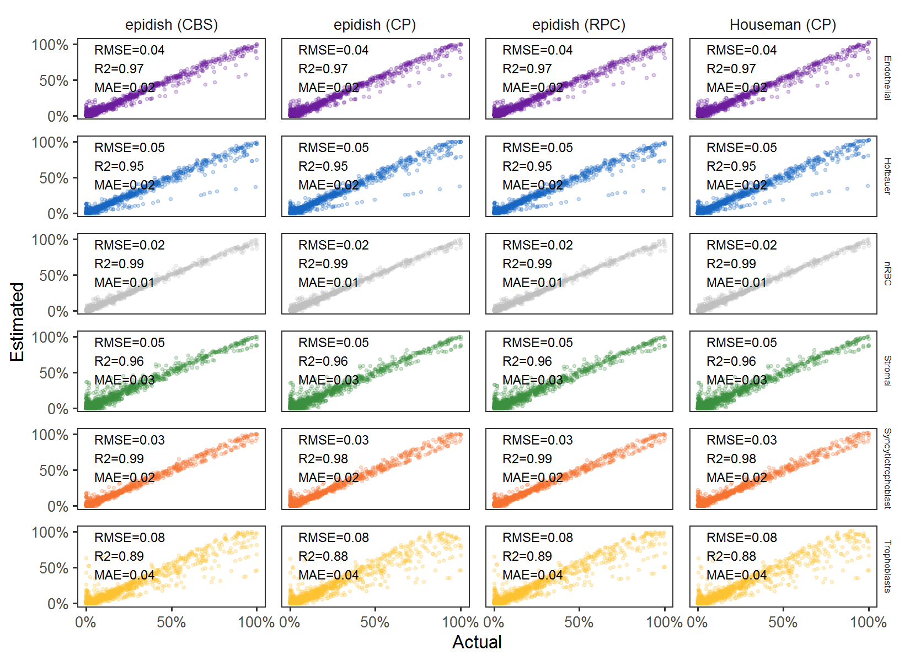
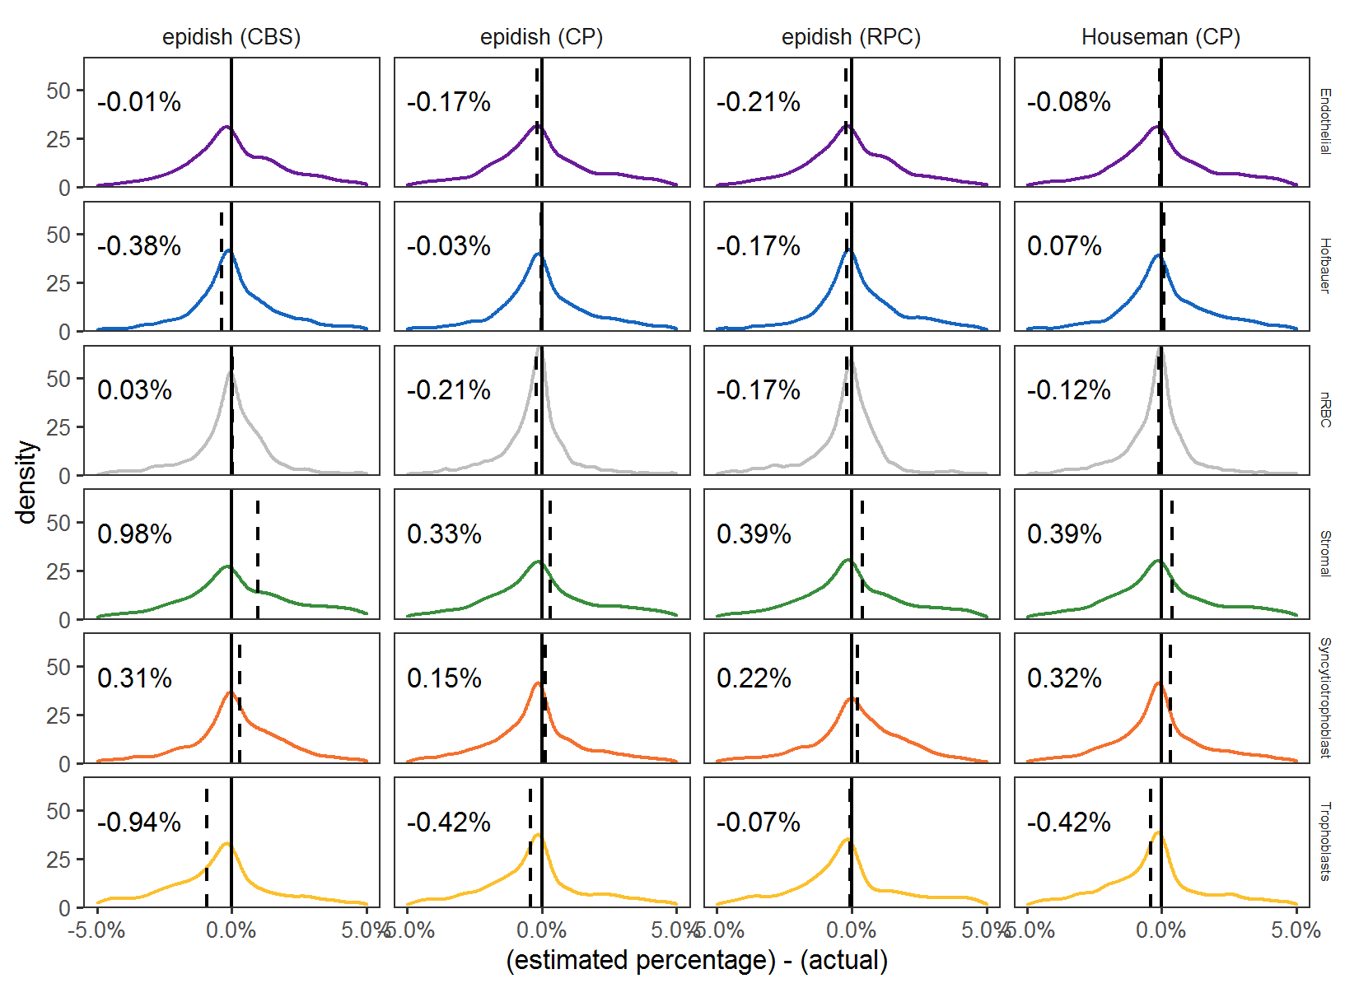
A)
B)
Figure S12. Comparison of cell deconvolution algorithms. A) Estimated percentage by deconvolution (y-axis) by actual percentage used to construct in silico mixtures (x-axis). Performance metrics are shown for each algorithm and cell type. RMSE, root mean squared error; R2, R squared; MAE, mean absolute error. B) Distribution of deviations from deconvolution estimates and actual percentages for in silico mixtures. The mean deviation (estimated minus actual) is labelled in each panel as text, and as the dotted vertical line.

