Slide 1
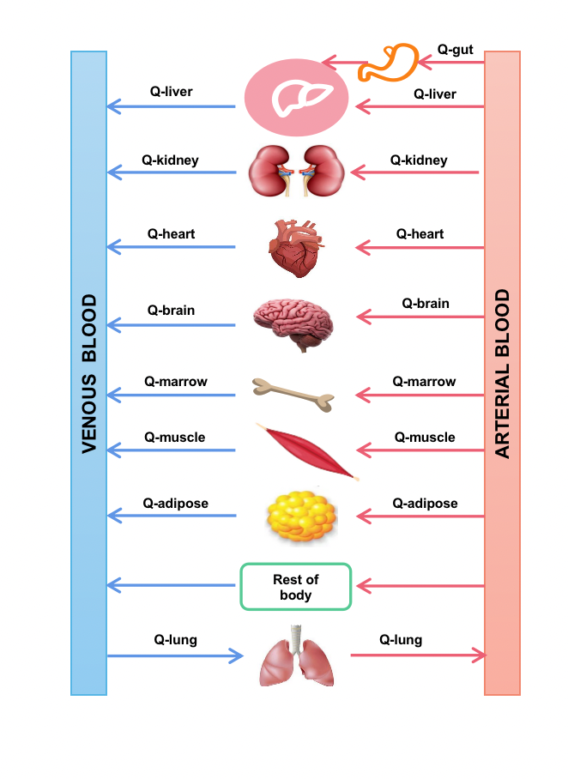
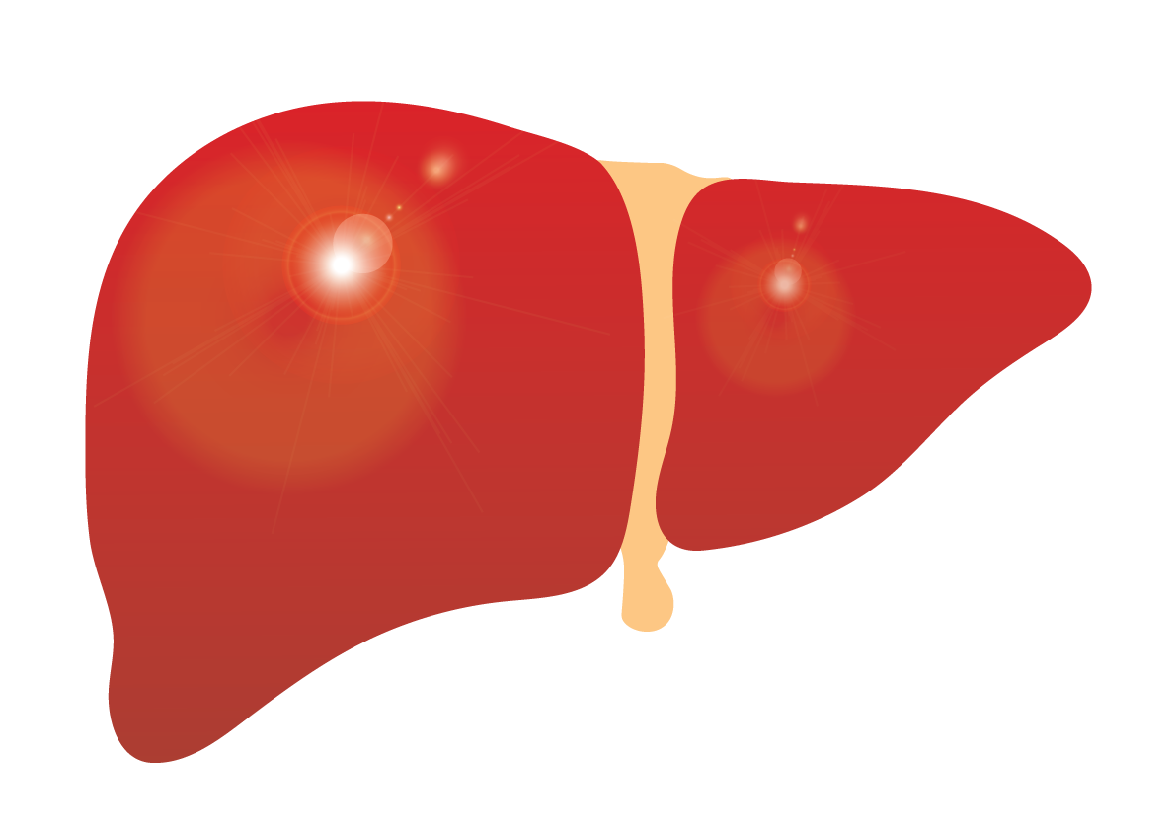
Model Development
DDI Prediction
Model Application
Docetaxel
Epirubicin
CYP3A4
P-gp
Cyclophosphamide
Metabolism
Inhibition
Induction

