Slide 1
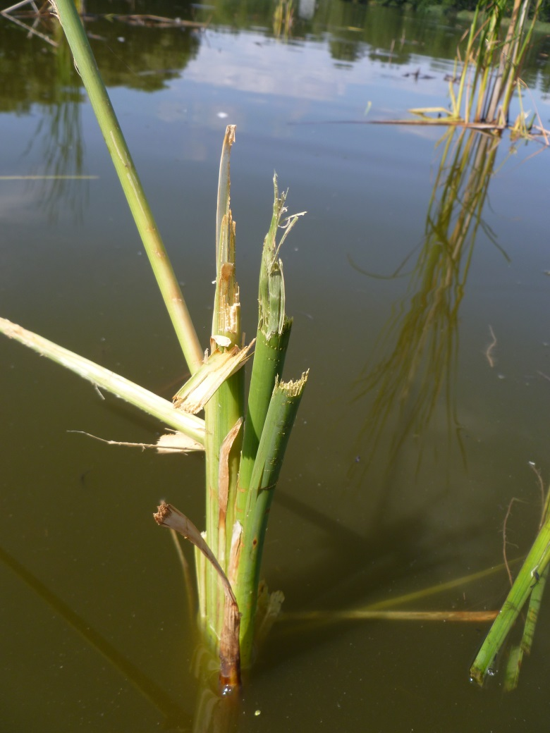
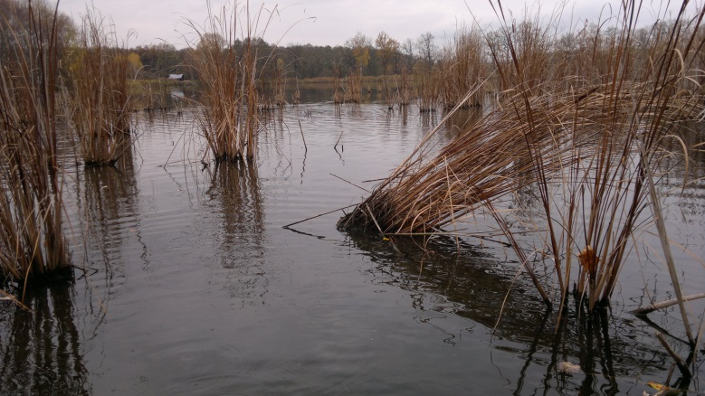
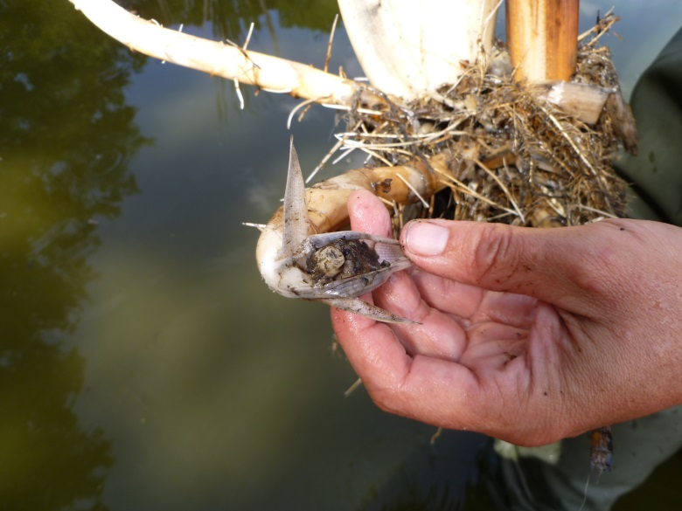
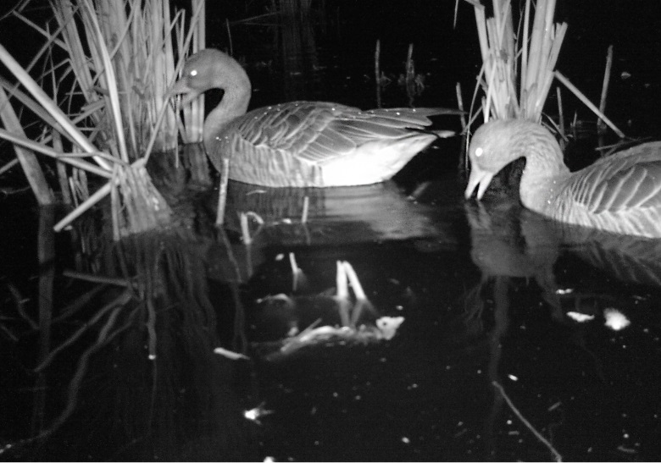
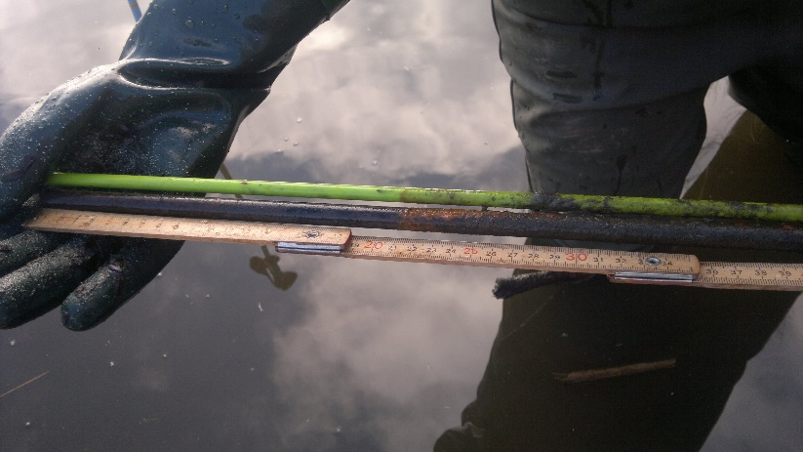
b
a
c
ox
red
c
d
e
Online resource 3. Photographic documentation of the condition of T. angustifolia biotopes; a – shoots damaged by grazing in a sparse stand; b – uprooted clumps in a sparse stand; c – broken rhizome apex in an uprooted plant; d – Graylag geese grazing in a sparse stand (night photo from a camera trap); e – a green fibre-glass stick labelling a site and an iron stick indicating the redox conditions in water and sediments. The arrows show the interface between the oxidied and reduced zones on the stick, respectively.

