Slide 1
Supplemental Figures

Slide 2
Supplemental Fig 1
Mutation sites in ADAR1 protein
P193A
K999N
ADAR1
A879T
R892H
D1113H
Z Binding
DRBM
Deaminase
I872T
G1007R
Y1112F

Slide 3
Supplemental Fig 2
Sequence alignment between mouse and human ADAR1 proteins
MOUSE SRSPDAHPKTLPLSGSTFHDQIAMLSHRCFNALTNSFQPSLLGRKILAAIIMKRDPEDMGVVVSLGTGNR 772-841
HUMAN SRSPEAQPKTLPLTGSTFHDQIAMLSHRCFNTLTNSFQPSLLGRKILAAIIMKKDSEDMGVVVSLGTGNR 823-892
MOUSE CVKGDSLSLKGETVNDCHAEIISRRGFIRFLYSELMKYNHHTAKNSIFELARGGEKLQIKKTVSFHLYIS 842-911
HUMAN CVKGDSLSLKGETVNDCHAEIISRRGFIRFLYSELMKYNSQTAKDSIFEPAKGGEKLQIKKTVSFHLYIS 893-962
MOUSE TAPCGDGALFDKSCSDRAVESTESRHYPVFENPKQGKLRTKVENGEGTIPVESSDIVPTWDGIRLGERLR 912-981
HUMAN TAPCGDGALFDKSCSDRAMESTESRHYPVFENPKQGKLRTKVENGEGTIPVESSDIVPTWDGIRLGERLR 963-1032
MOUSE TMSCSDKILRWNVLGLQGALLTHFLQPVYLKSVTLGYLFSQGHLTRAICCRVTRDGKAFEDGLRYPFIVN 982-1051
HUMAN TMSCSDKILRWNVLGLQGALLTHFLQPIYLKSVTLGYLFSQGHLTRAICCRVTRDGSAFEDGLRHPFIVN 1033-1102
MOUSE HPKVGRVSVYDSKRQSGKTKETSVNWCMADGYDLEILDGTRGTVDGPGKELSRVSKKNIFLQFKKLCSFR 1052-1121
HUMAN HPKVGRVSIYDSKRQSGKTKETSVNWCLADGYDLEILDGTRGTVDGPRNELSRVSKKNIFLLFKKLCSFR 1103-1172
MOUSE ARRDLLQLSYGEAKKAARDYDLAKNYFKKSLRDMGYGNWISKPQEEKNFYLCPV 1122-1175
HUMAN YRRDLLRLSYGEAKKAARDYETAKNYFKKGLKDMGYGNWISKPQEEKNFYLCPV 1173-1226
Reference sequences:
MOUSE: Q99MU3
HUMAN: P55265

Slide 4
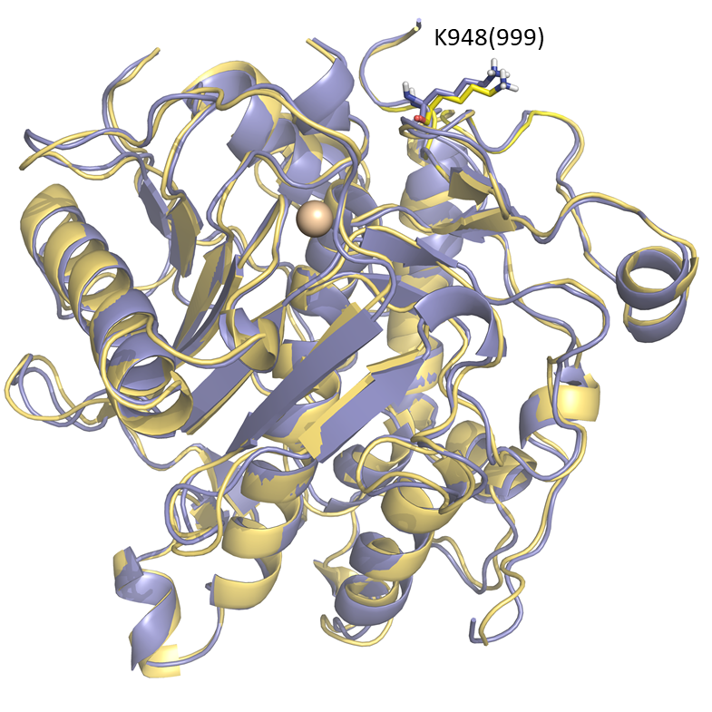
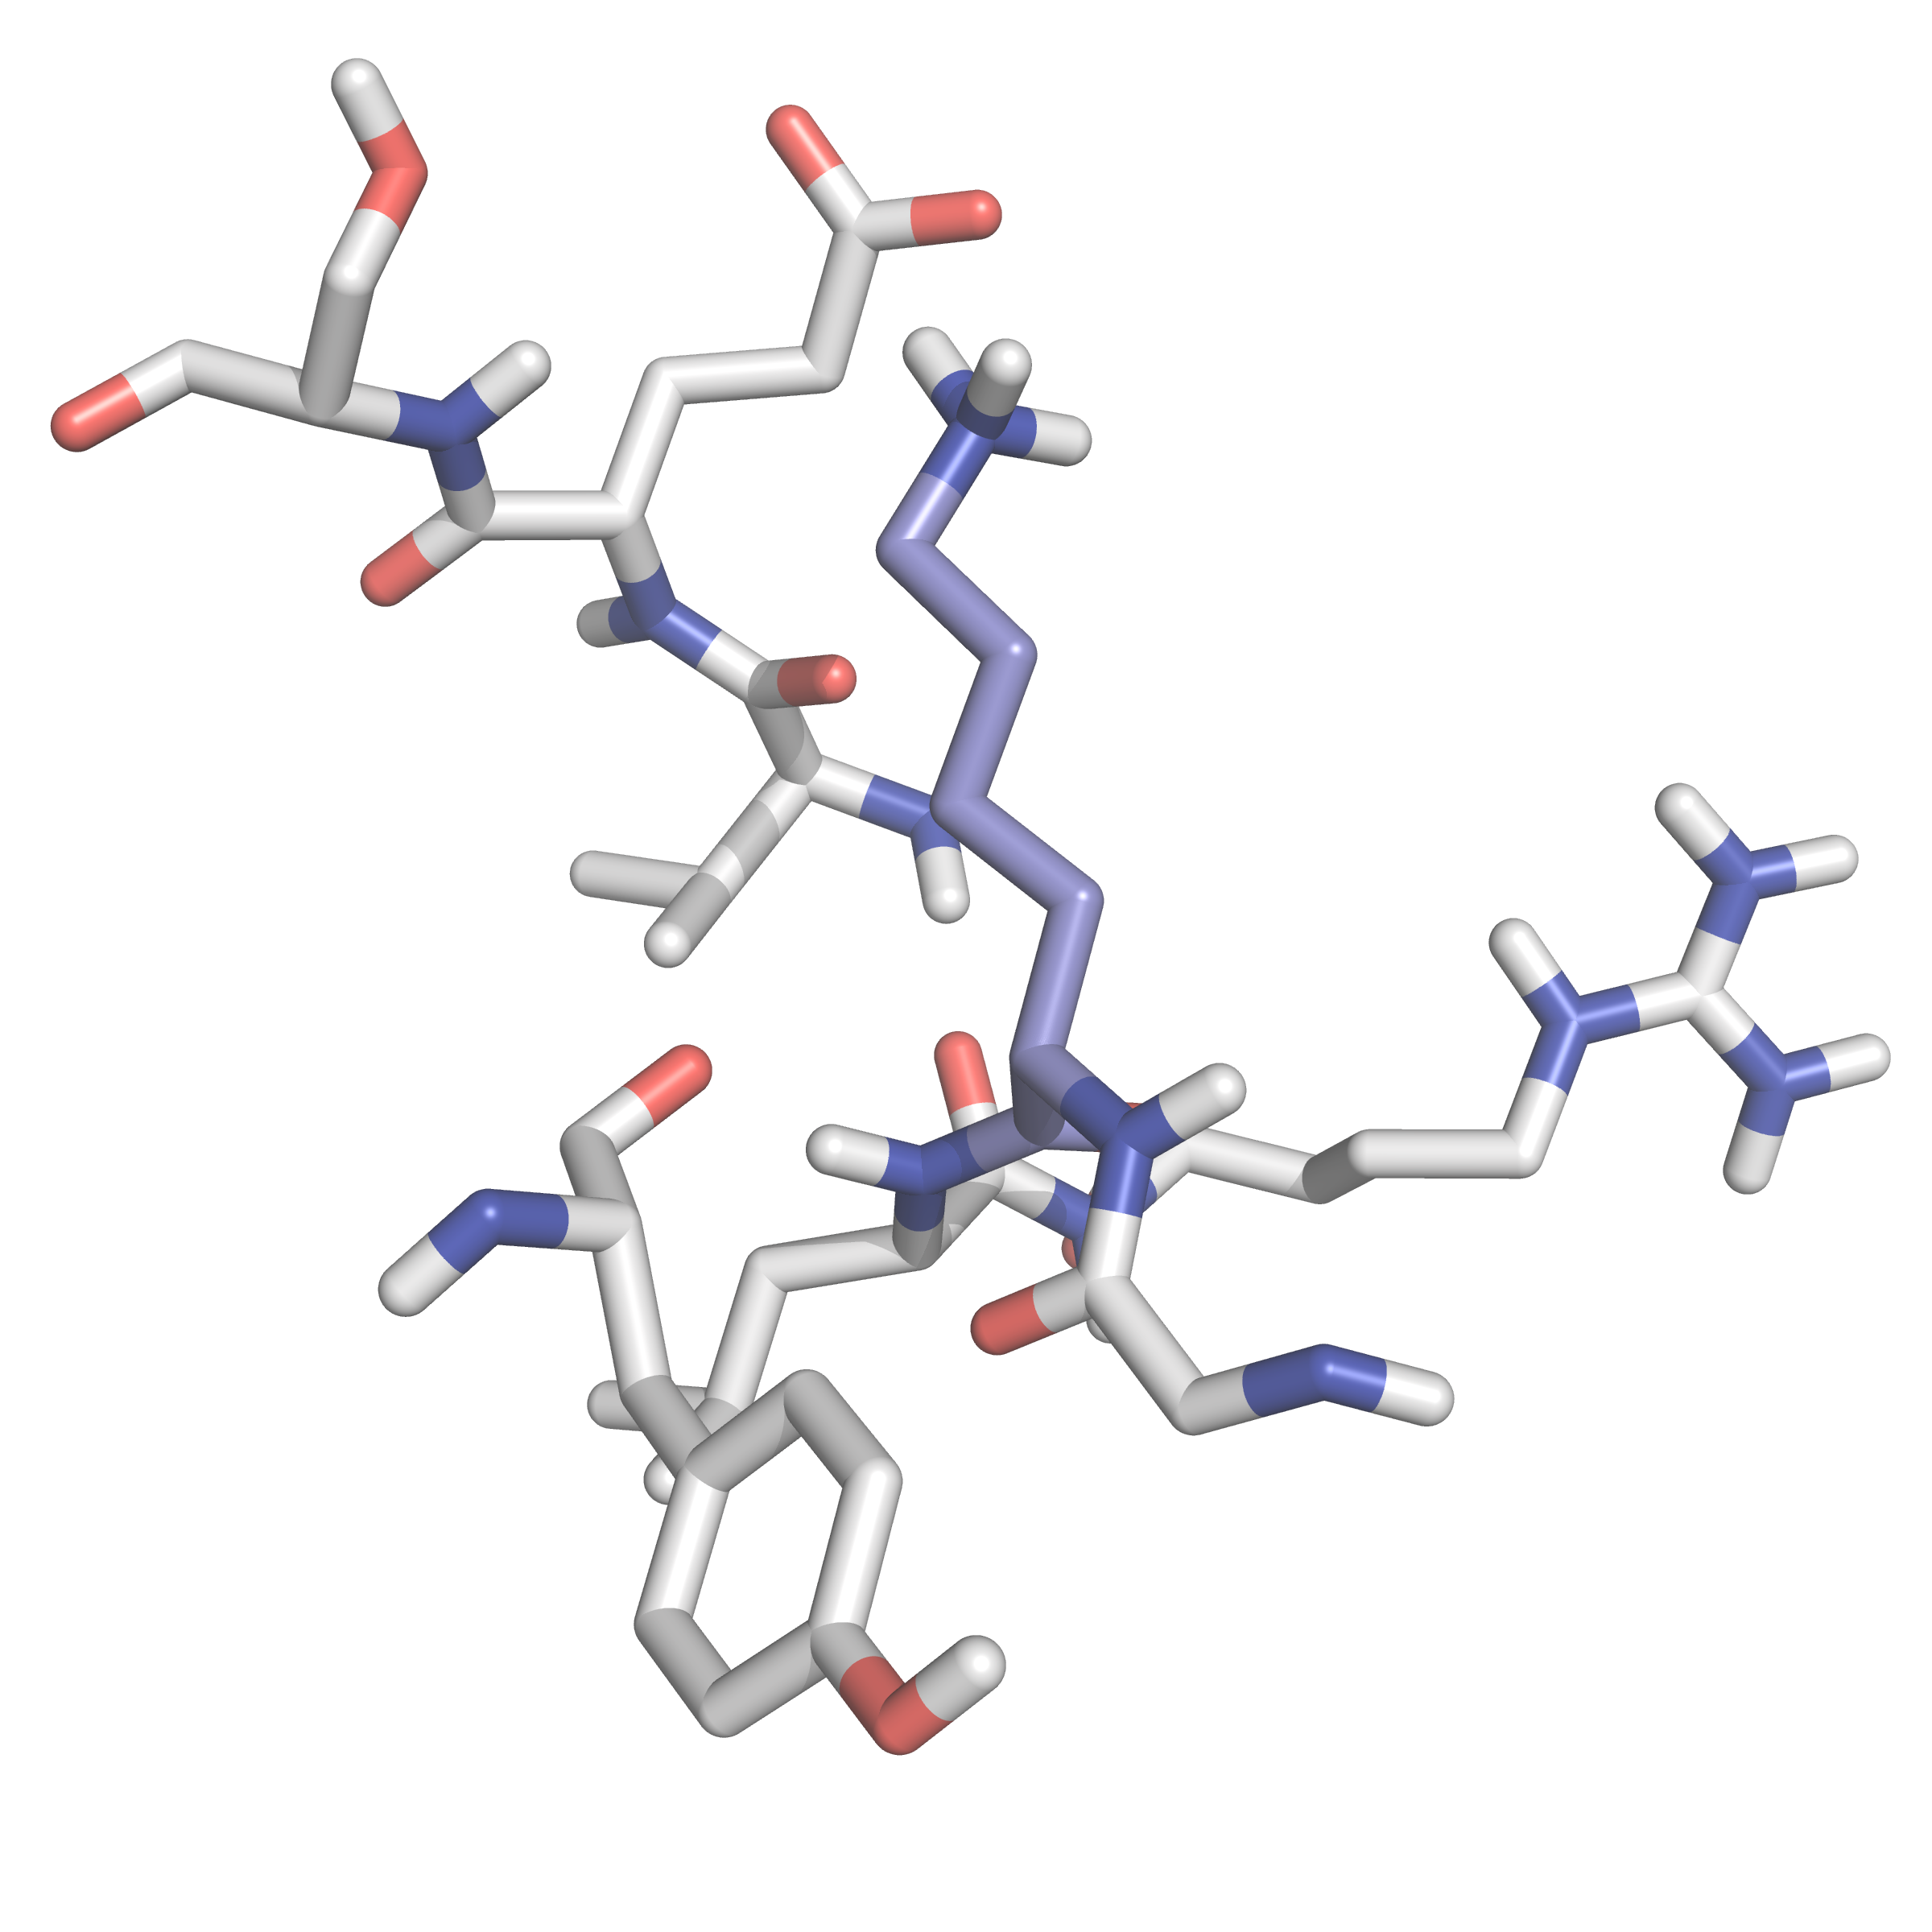
Supplemental Fig 3
A
B
E963(1014)
3.2
S964(1015)
K948(999)
V962(1013)
R950(1001)
L949(1000)
Y1157(1208)
G947(998)

Slide 5
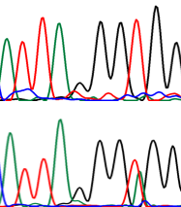
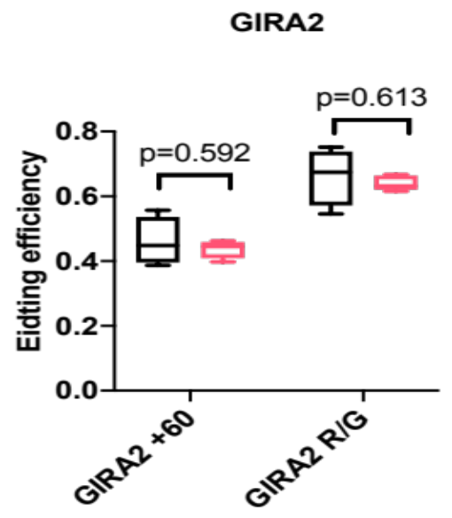
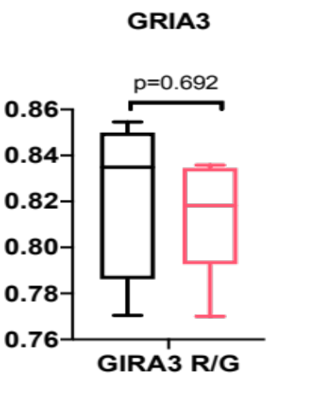
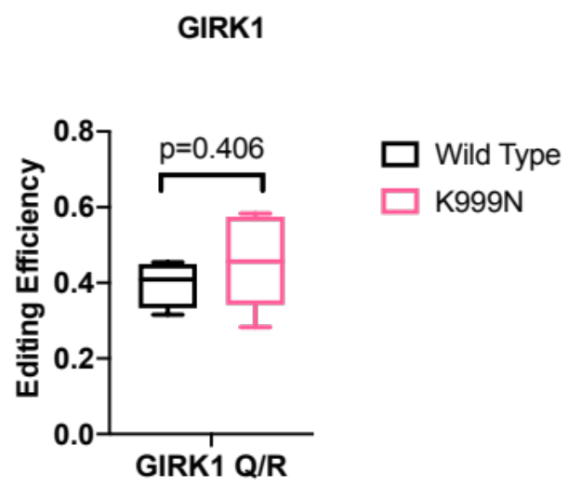
Supplemental Fig 4
Editing site
A
GRIA2 +60
GRIA2 R/G
C
GRIA3 R/G
E
GRIK1 Q/R
Wt
Wt
Wt
K999N
K999N
K999N
A
A
A
A
A T T T T G G T C
A T T A G G T G G
A T T A G G T G G
A T G C G C A A G
G
G
G
G
B
D
F

Slide 6
Supplemental Fig 5

Slide 7
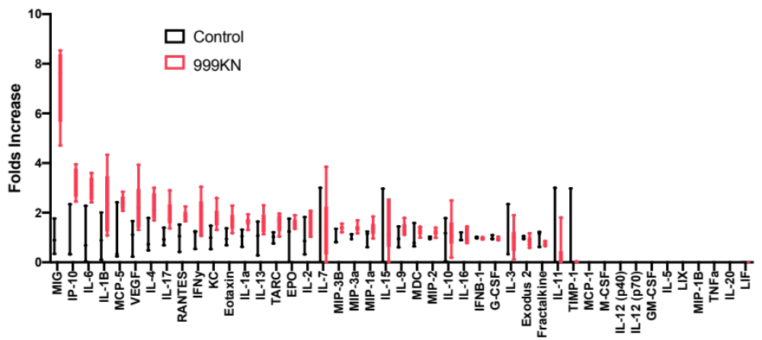
Supplemental Fig 6
Luminex
*
*
*
*
*
*
*
*
*
*
*

Slide 8
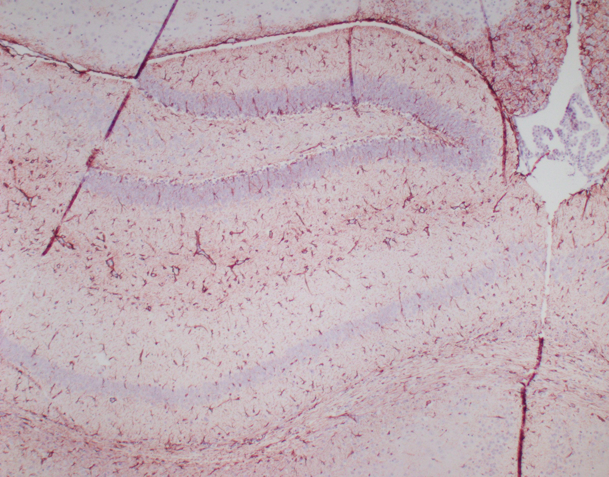
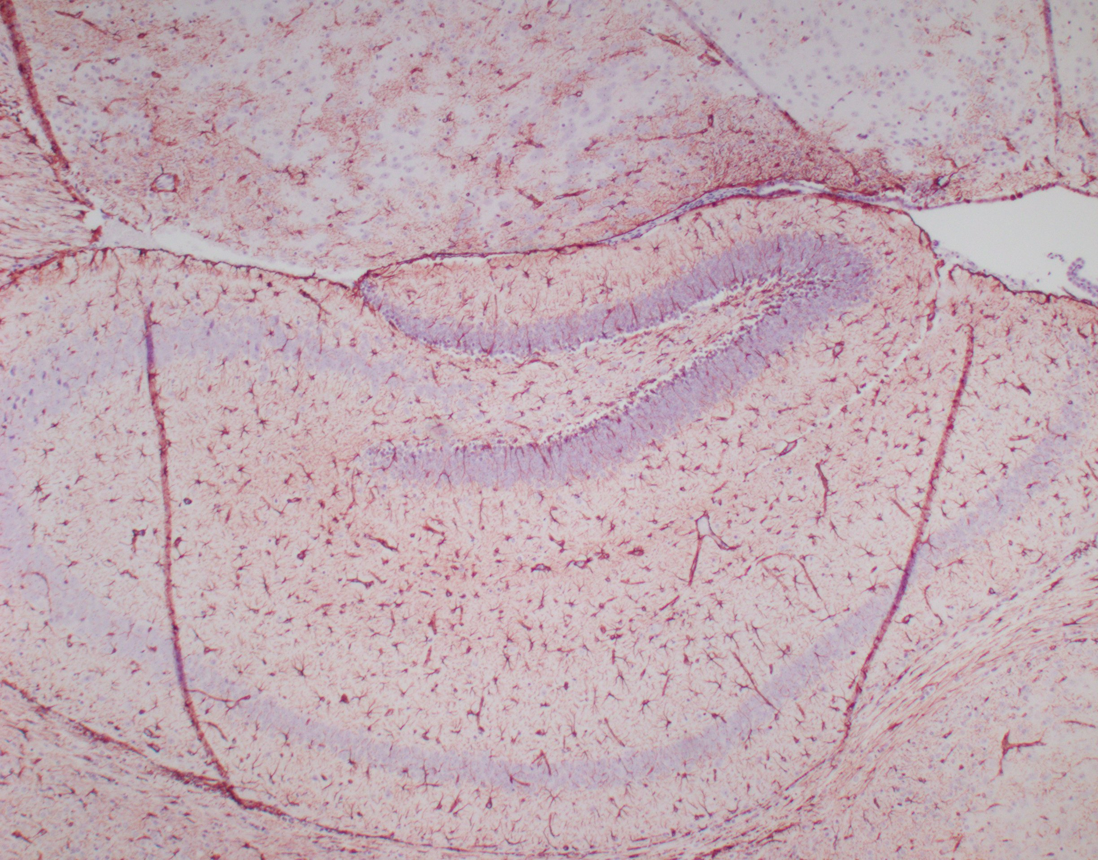
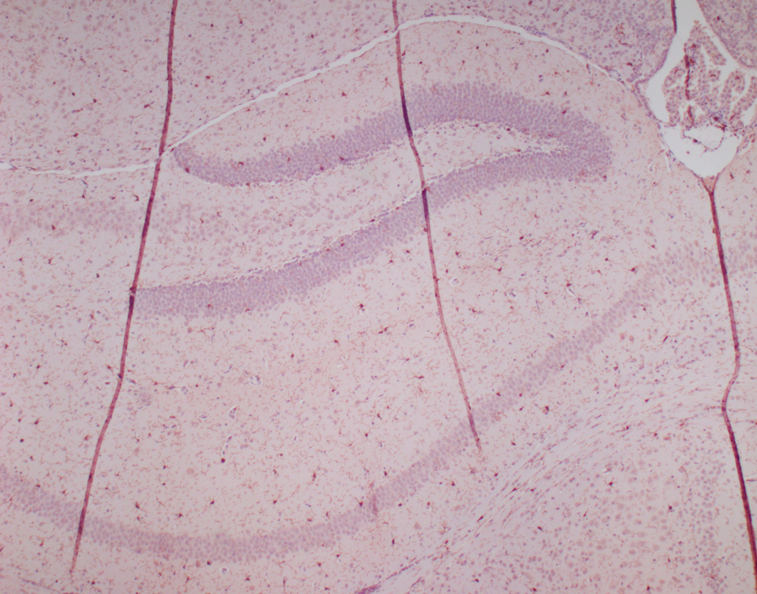
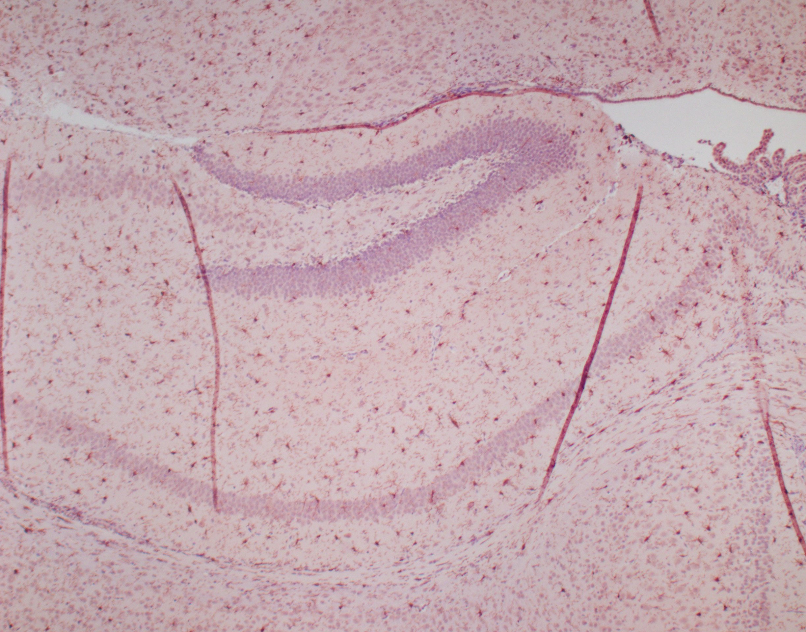
Wildtype Mutant
Supplemental Fig 7
GFAP
IBA1

Slide 9
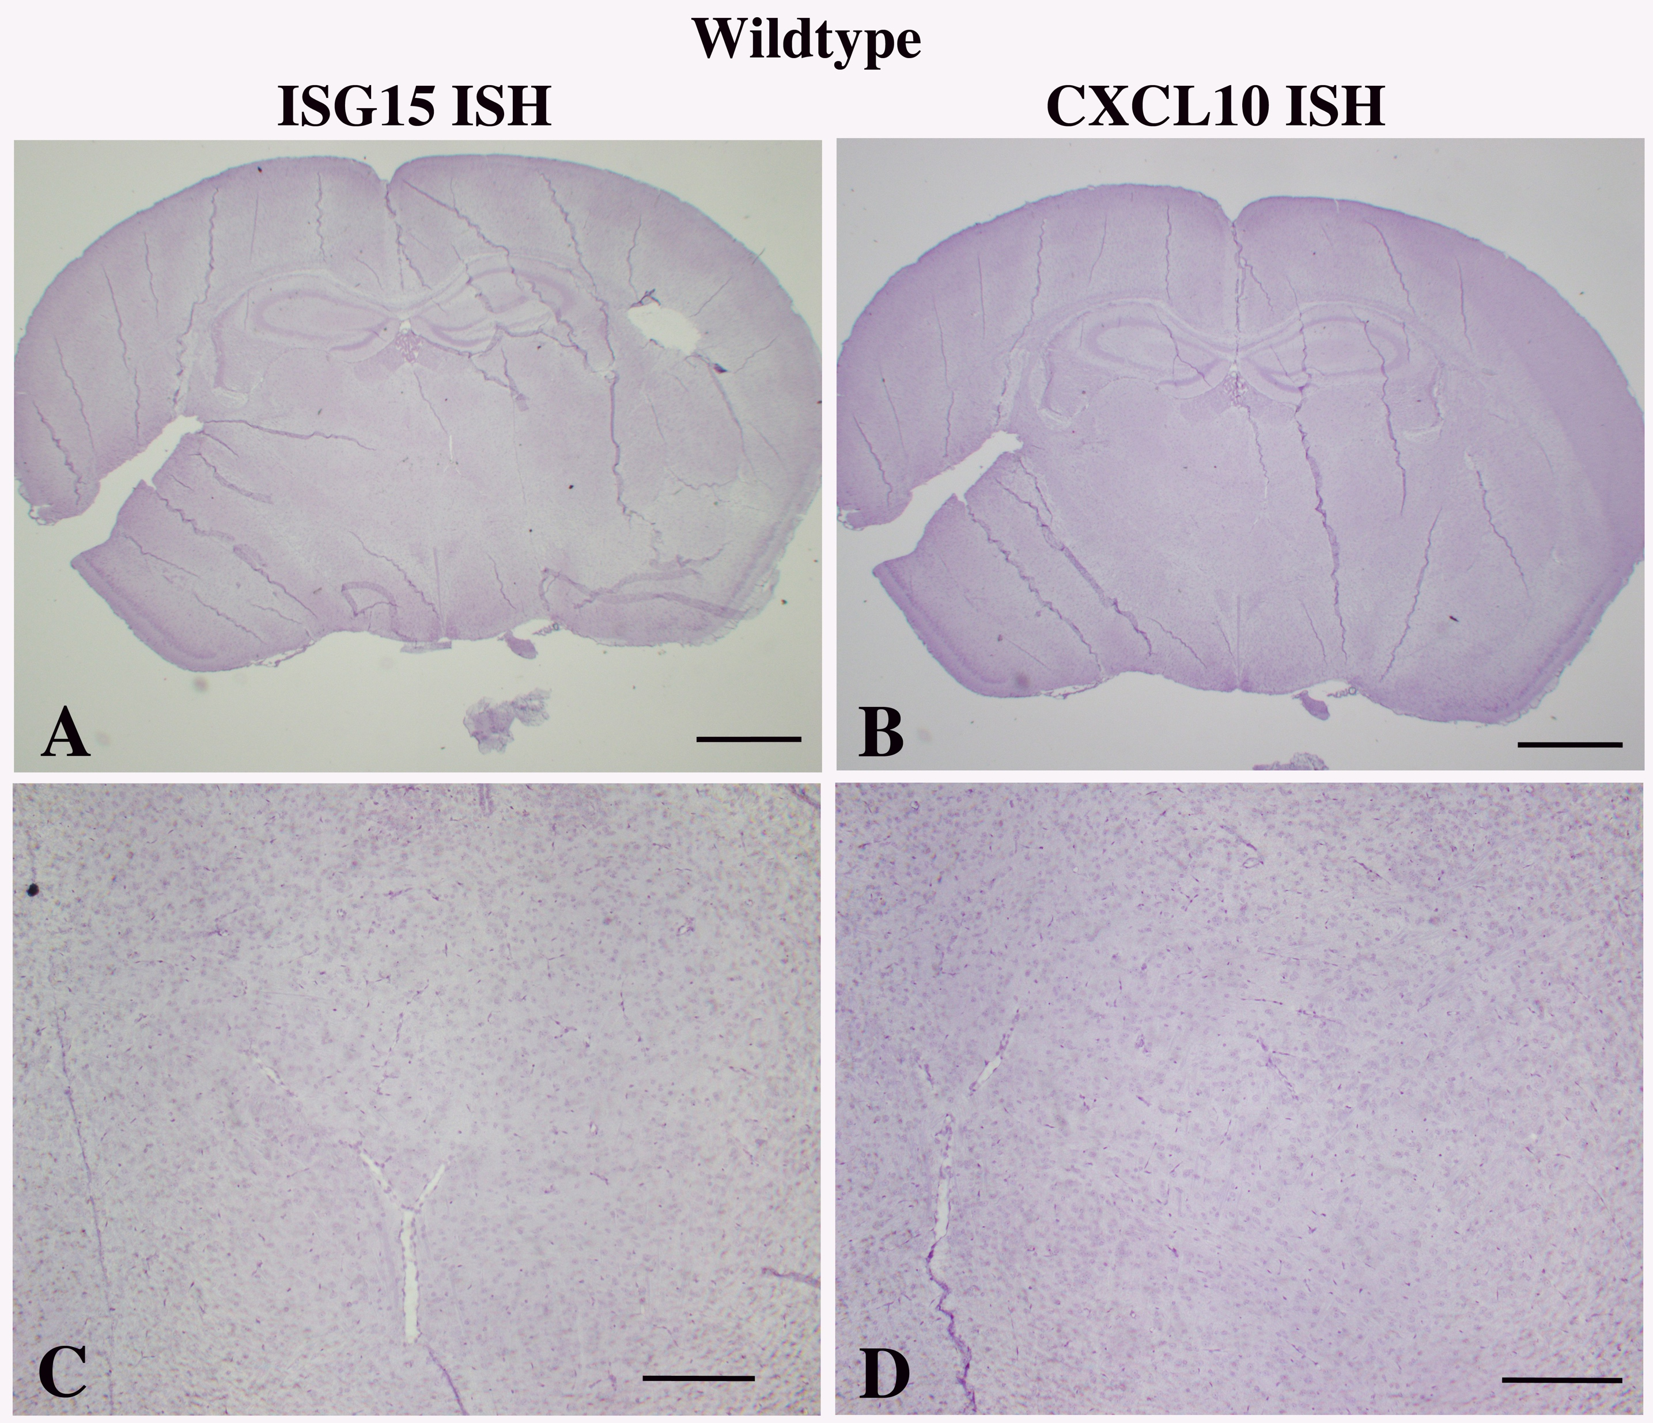
Supplemental Fig 8

Slide 10
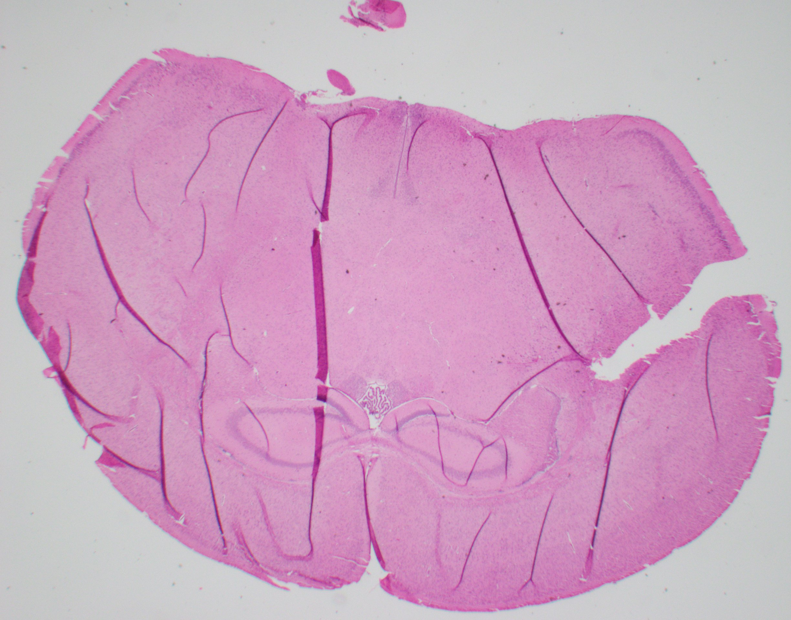
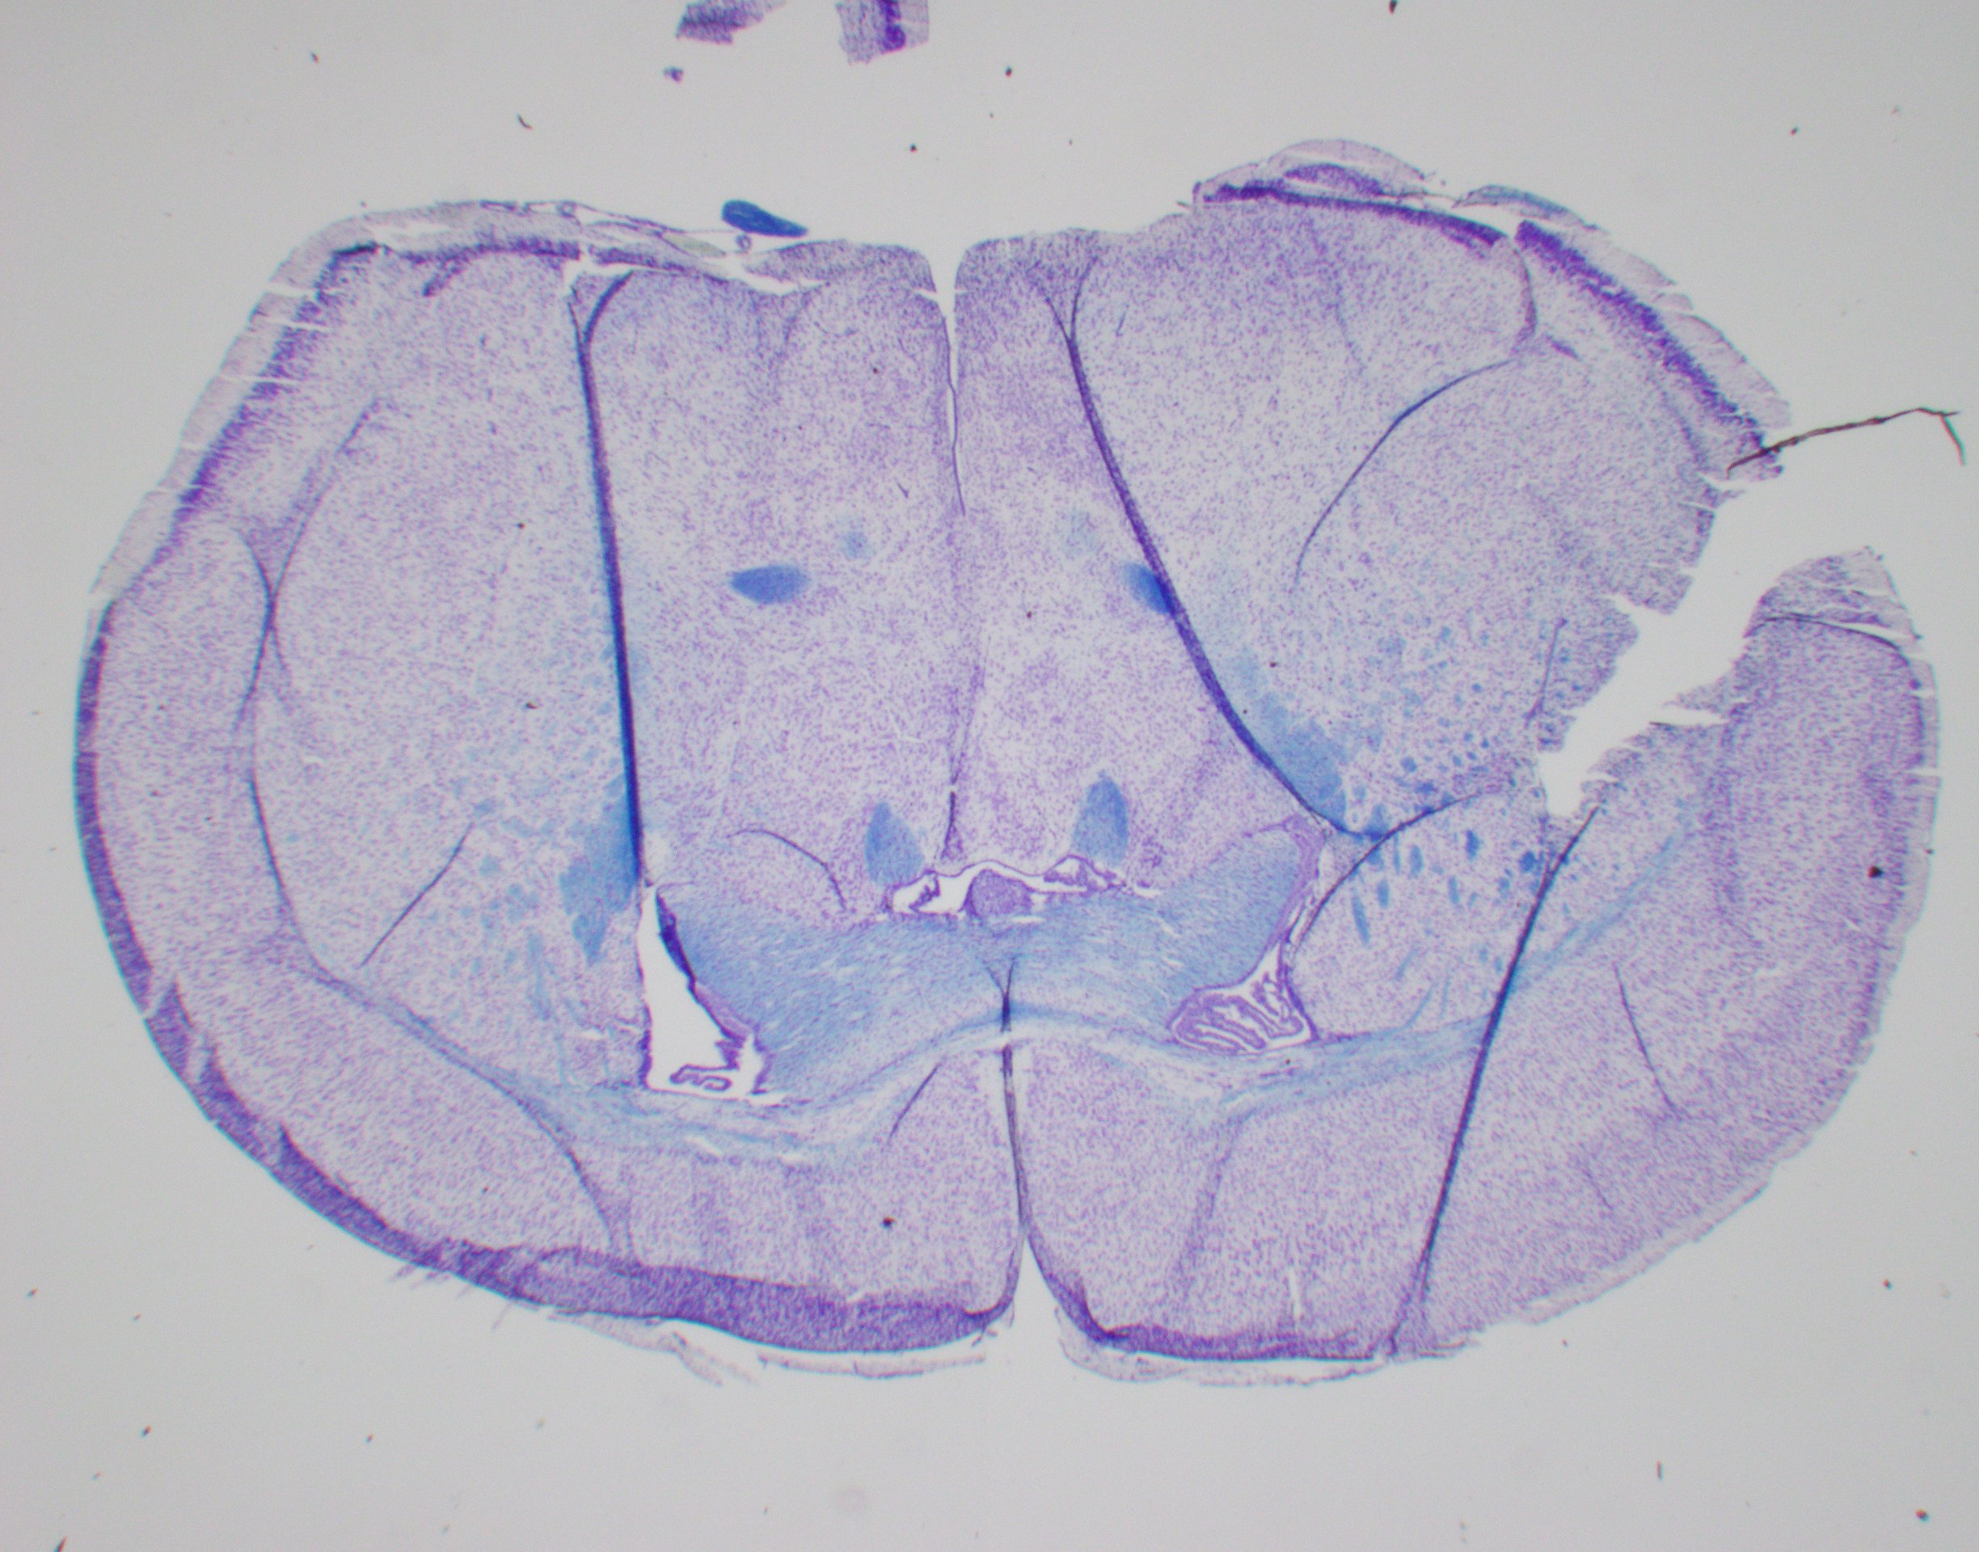
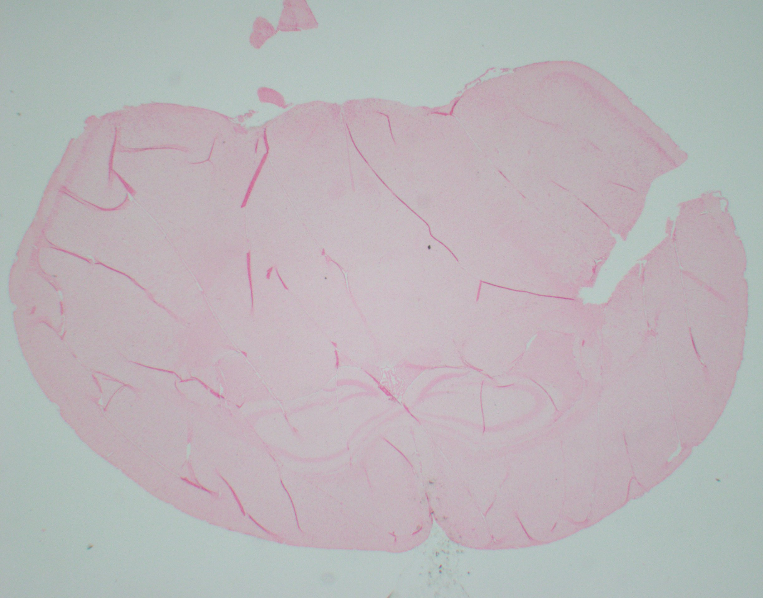
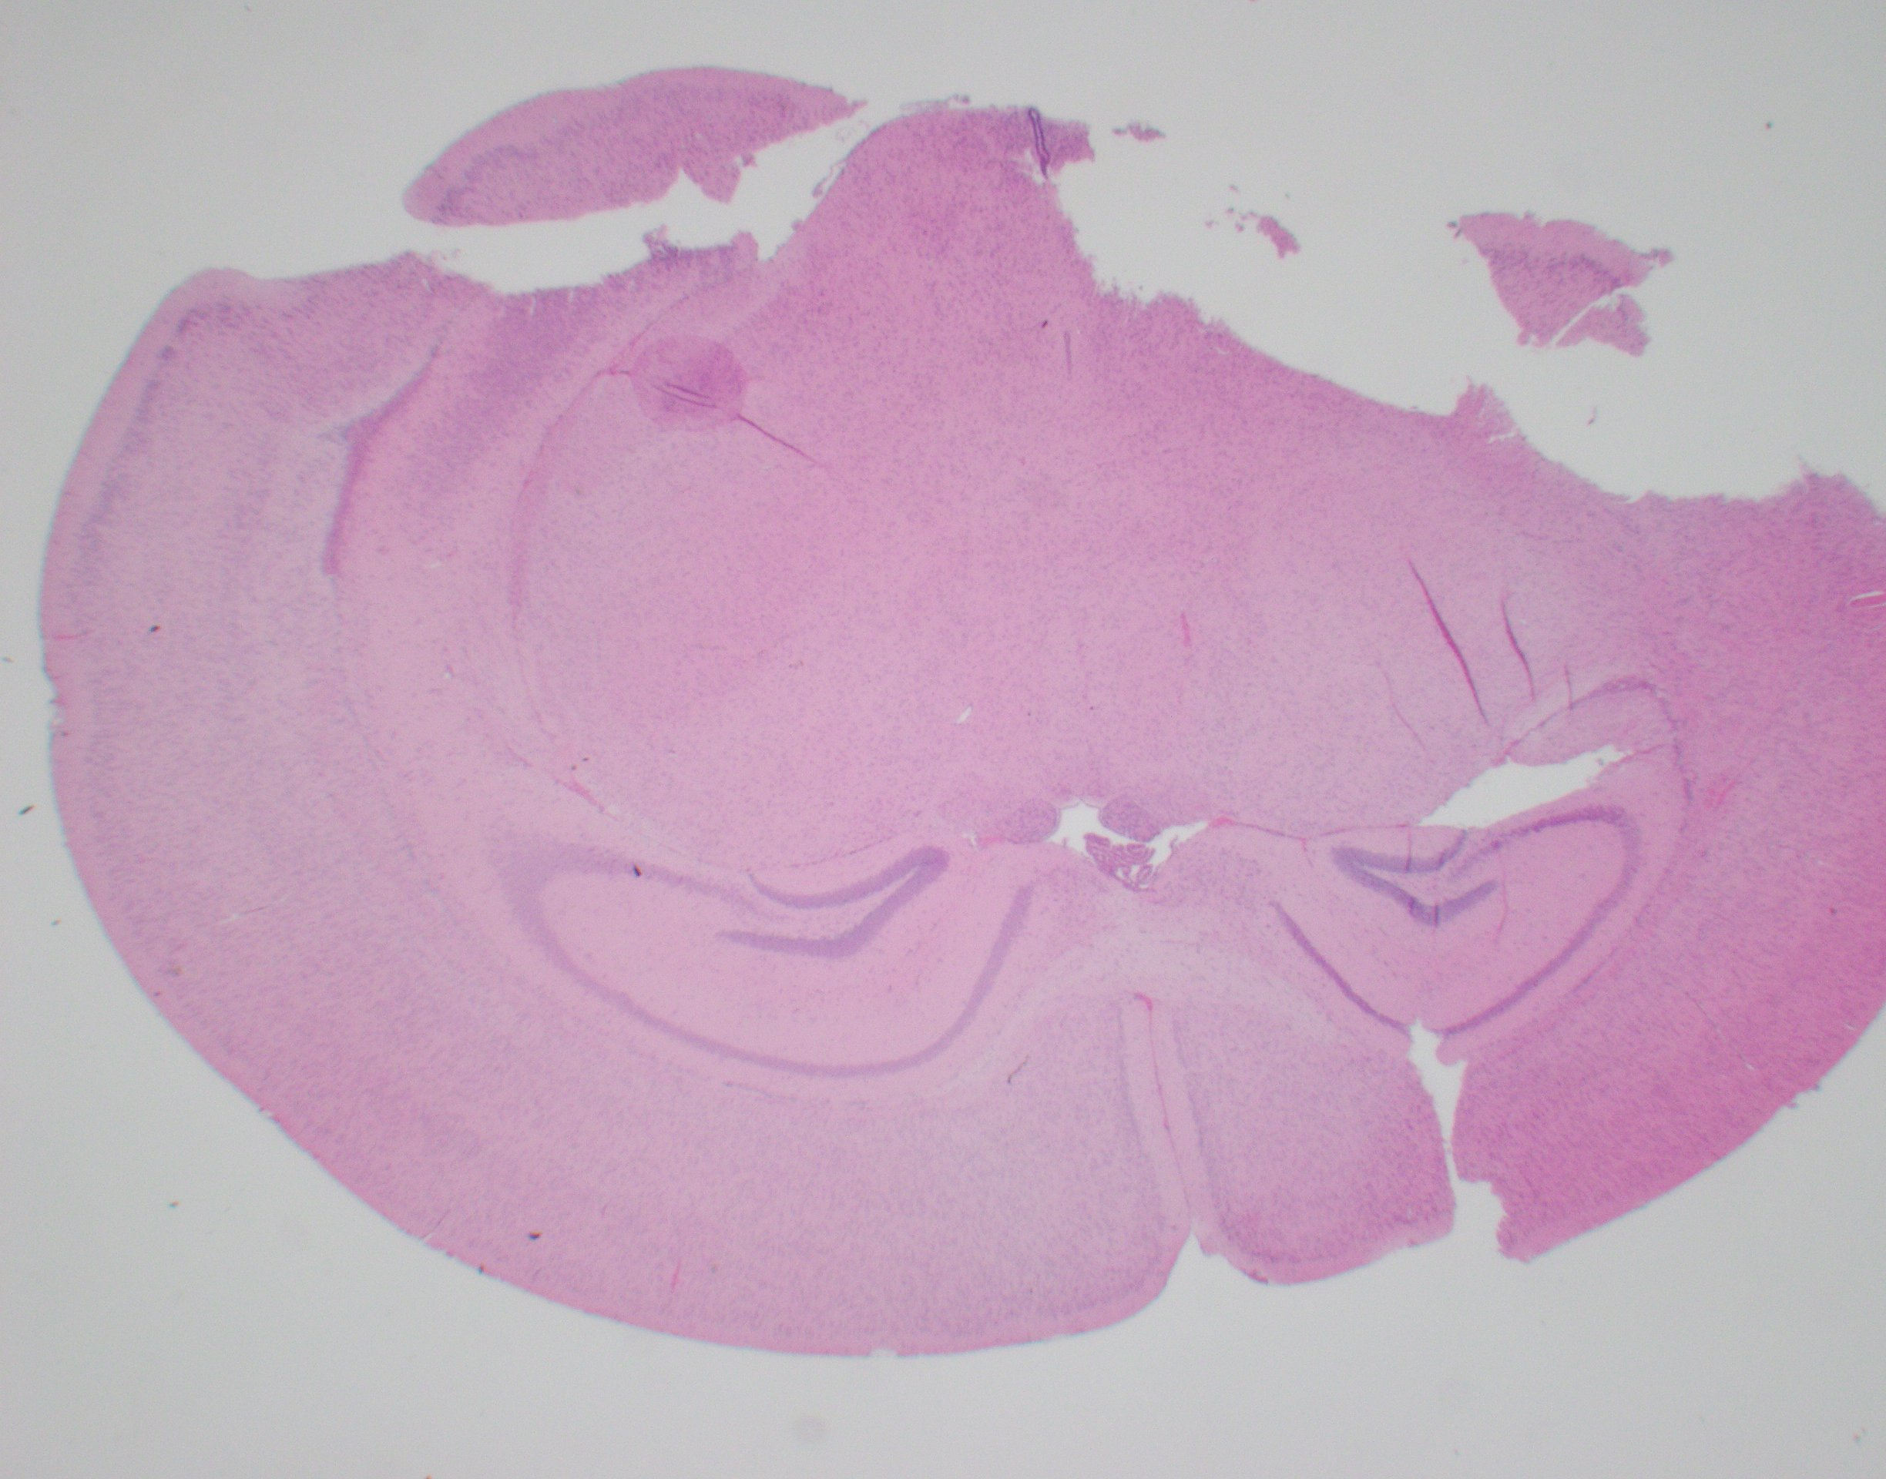
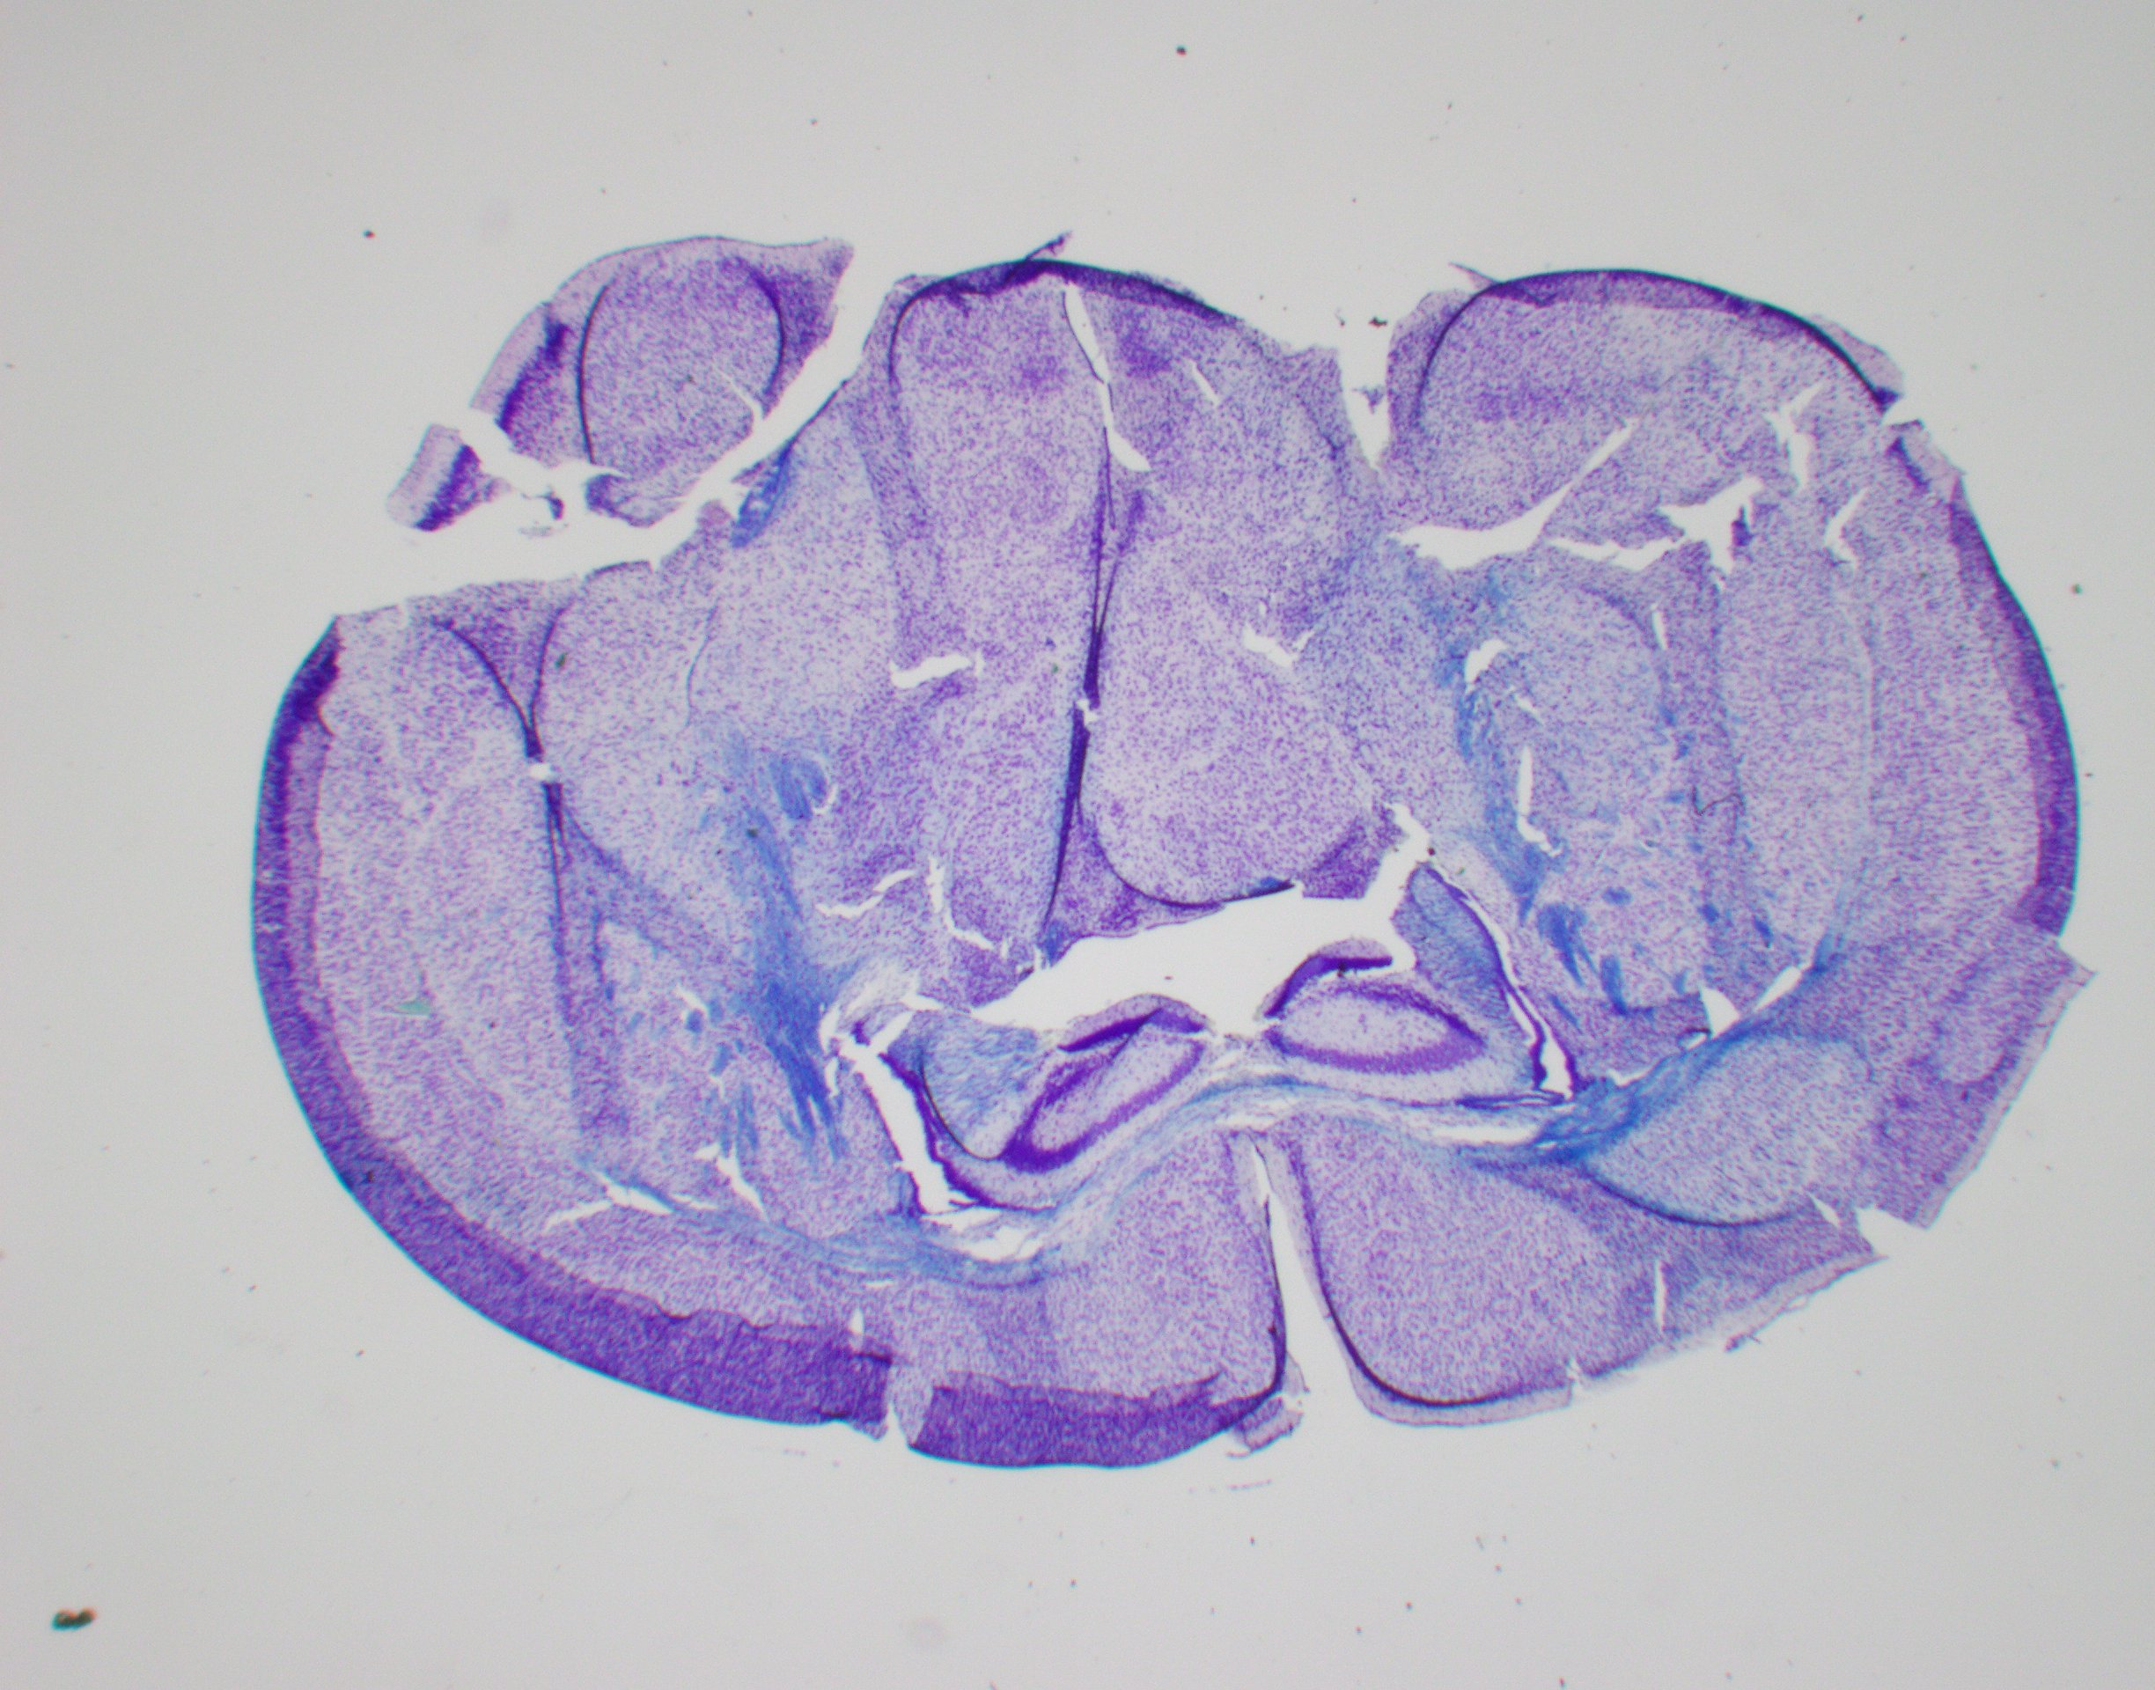
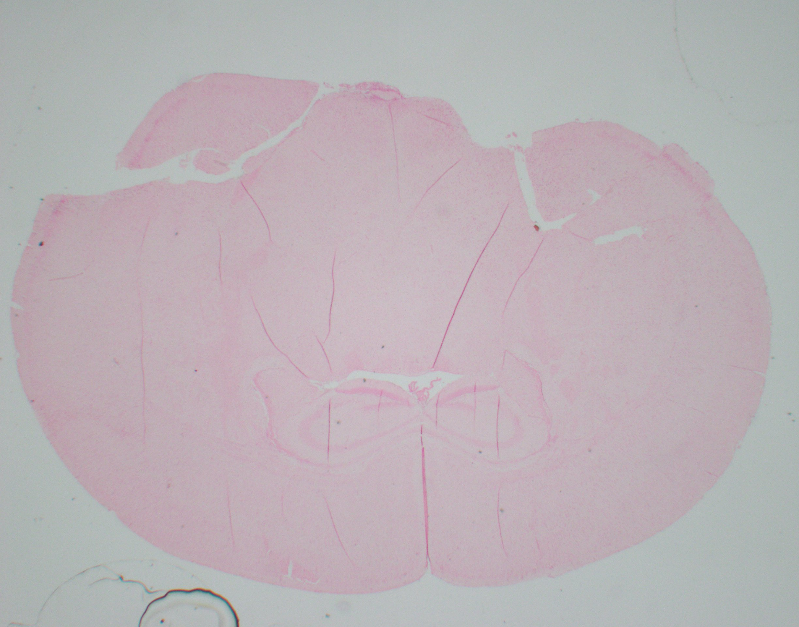
H&E LFB VonKossa
Supplemental Fig 9
Wildtype
Mutant

Slide 11
Supplemental Fig 10
Blot stained w/ anti ADAR1 and tubulin
ADAR1 signal
150 kd
110 kd
Cut for
separate exposures
A-tubulin signal

