Slide 1
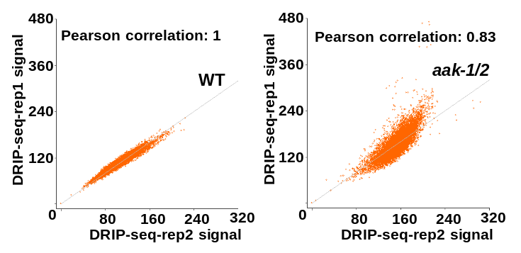
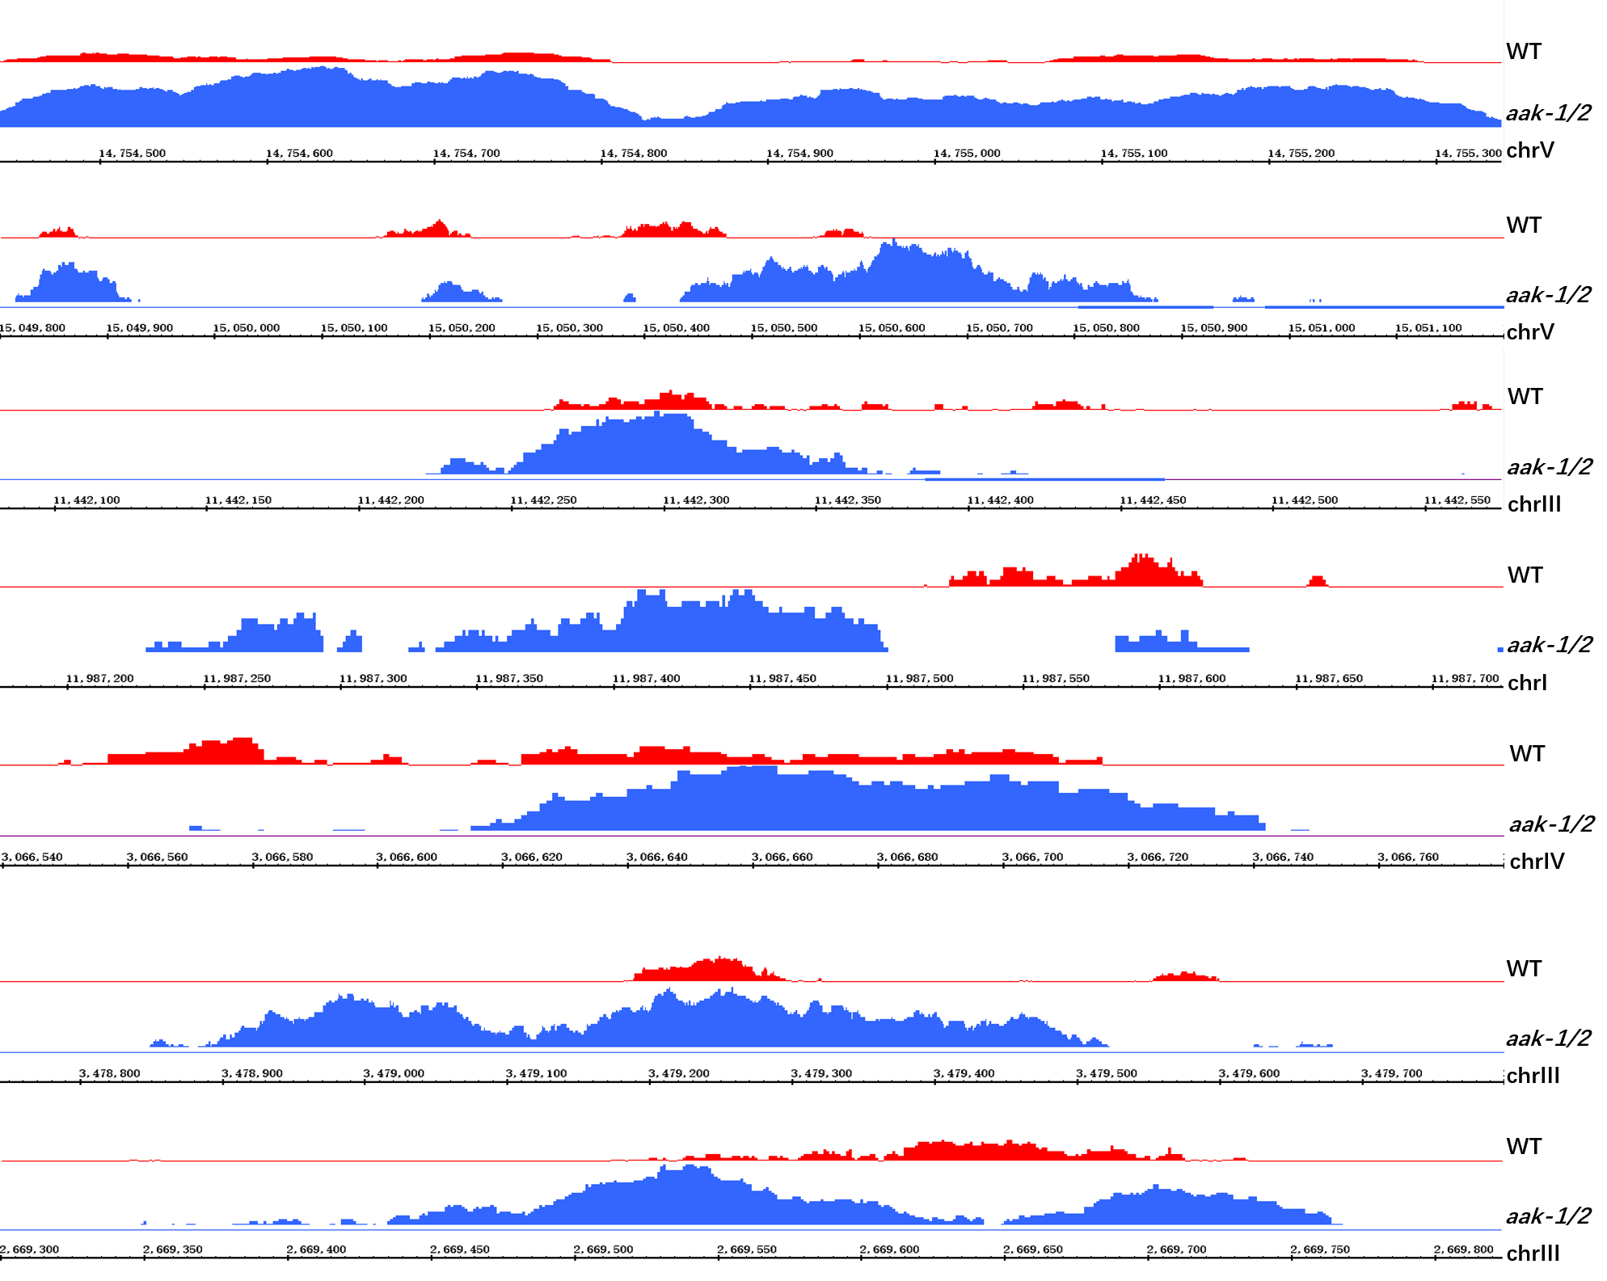
Figure S5
a
b
c
WT
1409
aak-1/2
3708
aak-1/2
3173
WT
e
3724
d

