Slide 1
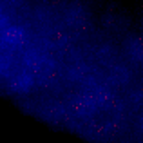
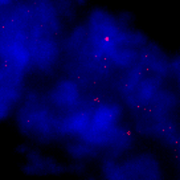
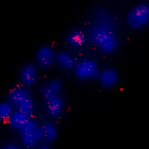
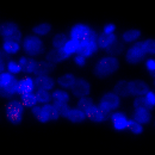

Figure S3
a
WT
aak-1/2
c
S9.6
DAPI
b
PBS
RNH
S9.6
DAPI
S9.6
DAPI
S9.6
d
DMSO
DRB
S9.6
DAPI
S9.6

