Slide 1
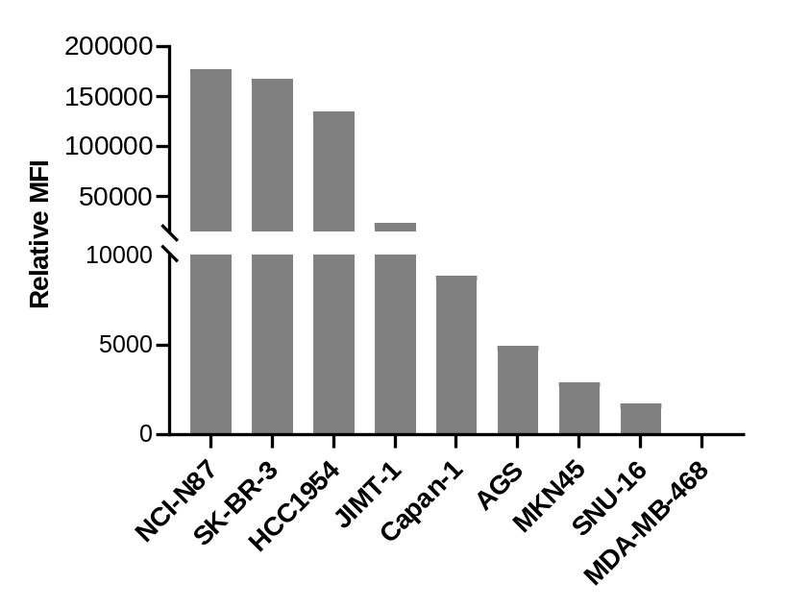
Figure S1. The relative mean fluorescence intensity (MFI) of cells by FACS analysis of HER2 expression

Slide 2



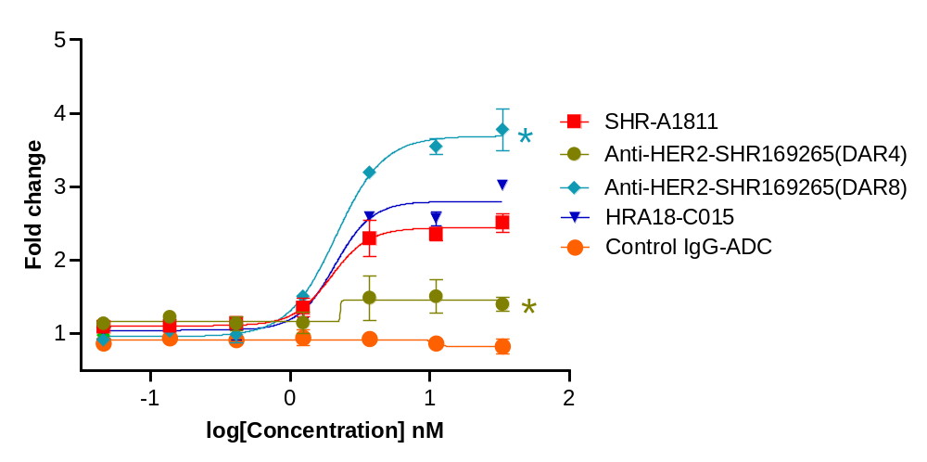
A
Anti-HER2-SHR169265
(DAR 4)
Anti-HER2-SHR169265
(DAR 8)
HRA18-C015
Control IgG-ADC
Trastuzumab
SHR-A1811
P-H2A.X
HSP70
Cleaved PARP
GAPDH
B
Figure S2. Anti-HER2-SHR169265 ADCs induced histone H2A.X phosphorylation, cleaved PARP (A) and caspase 3/7 activation (B) in SK-BR-3 cells. *P<0.05 versus HRA18-C015.

Slide 3
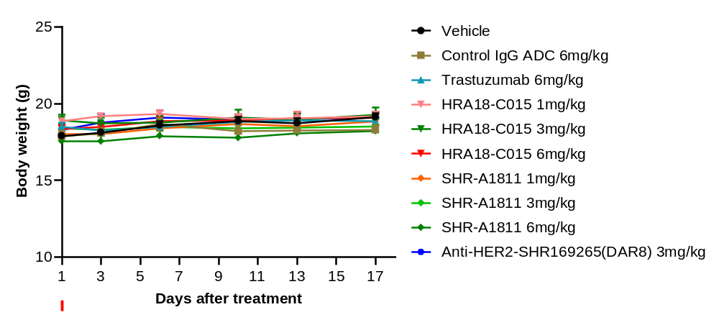
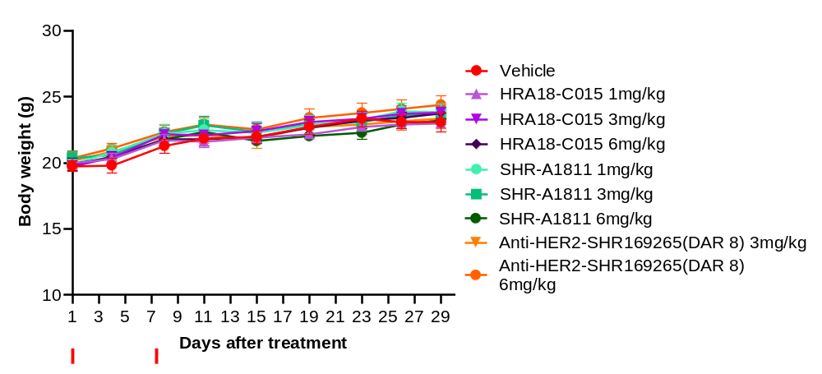
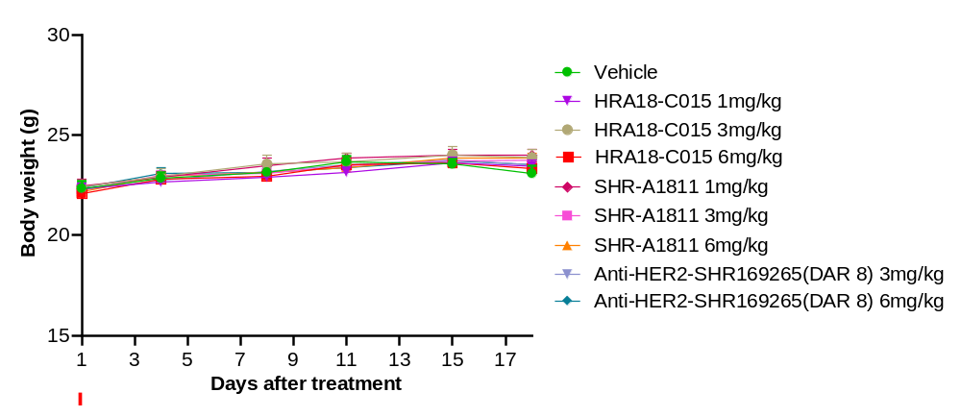
A
NCI-N87
B
JIMT-1
C
Capan-1
Figure S3. Body weight changes in NCI-N87 (A), JIMT-1 (B) and Capan-1 (C) xenograft models after SHR-A1811 treatment.

