Slide 1
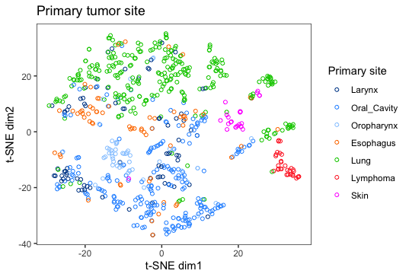
2/3 data split – training set (true entity)

Slide 2
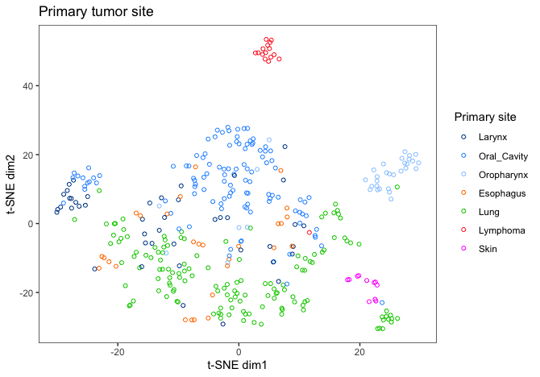
1/3 data split - test set (prediction)

