Slide 1
Sup Figure 1
A
Cerebral Organoid Protocol
Seed 9,000 iPSC
Transfer 24 well plate
Embed in Matrigel
Transfer to shaker
Days
in Vitro
0 1 2 3 4 5 6 7 8 9 10 11 12 13 14 15 16 17 18 19 20+
KSR Media
(FGF & Y2 Day 0-4)
Induction
Media
CODM
- Vitamin A
CODM
+ Vitamin A
B
Forebrain Organoid Protocol
Seed 9,000 iPSC
Embed in Matrigel
Transfer to shaker
Days
in Vitro
0 1 2 3 4 5 6 7 8 9 10 11 12 13 14 15 16 17 18 19 20+
DS media +SB, DM
(Y2 Day 0-4)
Induction Media
(+SB +CHIR)
CODM
+ Vitamin A
C
Engineered Cerebral Organoid Protocol
18,000 iPSC on PLGA Fibres
Transfer to 24 well plate
Embed in Matrigel
Transfer to shaker
Days
in Vitro
0 1 2 3 4 5 6 7 8 9 10 11 12 13 14 15 16 17 18 19 20 21 / 40+
KSR Media
(FGF & Y2 Day 0-4)
Induction
Media
IDM - Vitamin A
(CHIR Pulse D13-16)
IDM + Vitamin A
+Vitamin C & HEPES

Slide 2
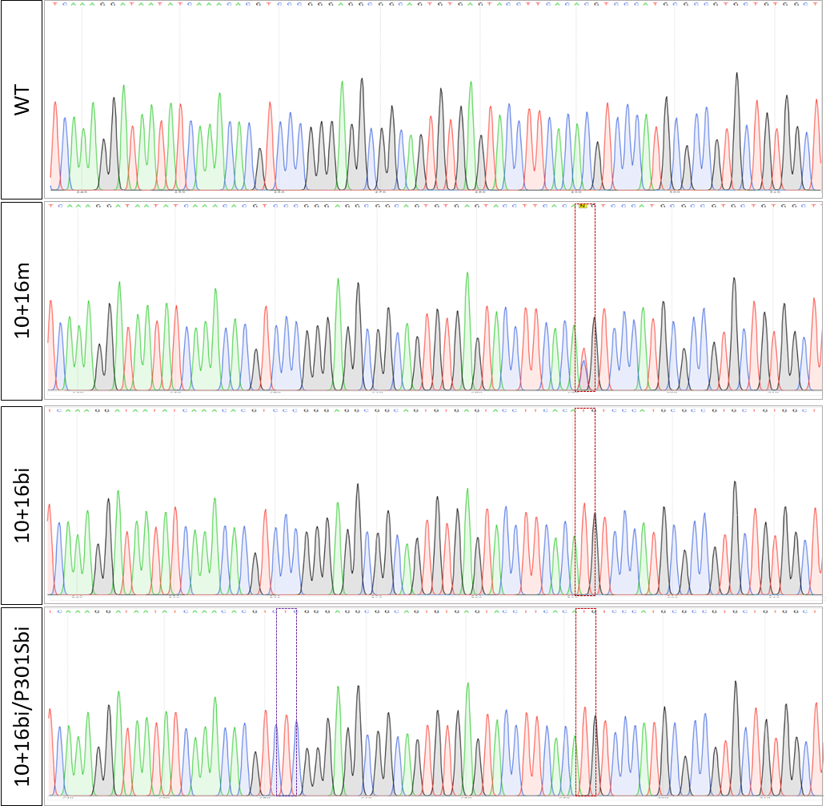
Sup Figure 2
A

Slide 3
Sup Figure 3
A
B

