Slide 1
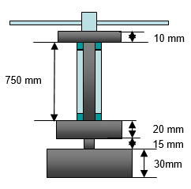
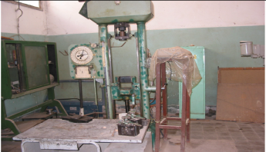
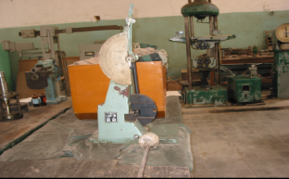

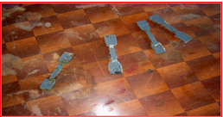
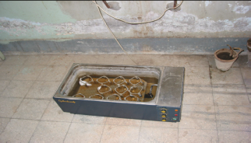
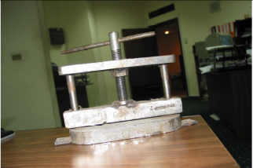
The Effect of Fiber-Adhesive Composite on Bond Strength of Plastic Plates- Part IV: The Effect of Temperature on the Mechanical Behavior and Mechanical Properties
Recommendations
Strength of PVC/PVC sandwich plates having glass fiber decreases depending on increasing temperature by 72% in case of epoxy, in case of polyester decreased by 62%, 48% in case of polyvinyl acetate.
Energy to fracture of PVC/PVC sandwich plates having glass fiber blended with adhesive decreases with increasing temperature by 69% in case of epoxy, 63% in case of polyester and 67 % in case of polyvinyl acetate compared to the original case.
Adhesion shear of PVC/PVC sandwich plates having glass fiber blended with adhesive decrease with increasing temperature, and the effect of increasing temperature on adhesion shear of polyvinyl acetate is lower than epoxy and polyester.
The activation energy of PVC /PVC sandwich plates having glass fiber as a reinforced material blended with polyvinyl acetate is the largest compared with epoxy and polyester.
Adhesion Shear Test Device
Impact Test Device
Special stamp
Specimen
Water Bath Heater
Special Press Device
Experimental work
Effect of Temperature on the Mechanical Behavior of PVC/PVC Sandwich Plates 0.95 Wt. % Glass Fiber with 2.5 mm Adhesive Thickness
Elastic Modulus of PVC/PVC Sandwich Plates 2.5 mm Thickness of Adhesives Blended with Different Wt. % Glass Fiber at pH=7, Temp. = 35 ºC
Activation Energy of PVC/PVC Sandwich Plates 0.95 Wt. % Glass Fiber with 2.5 mm Adhesive at Different Temperatures and Times
Abdelaziz A. Noaman1, *
1Chemical Engineering, Faculty of Engineering - Minia University, Egypt.
* Corresponding Author

