Slide 1
RESULTS
Comparison of 1th and 2nd month SFI results of Autograft group. a Wilcoxon matched-pairs signed-ranks test.
N | Autograft Group
 | 1st mo. | 2nd mo | ªP value
1 | -25.6 | -50.9
2 | -49.7 | -62.5
3 | -62.4 | -58.7
4 | -47.3 | -60.6
5 | -77.3 | -45.9
6 | -45.1 | -46.0
7 | -48.1 | -53.9
8 | -58.2 | -62.9
9 | -60.1 | -54.2
Mean | -52.6 | -55.1
SD | 14.3 | 6.6
Median | -49.7 | -54.2 | 0.4961
Min | -77.3 | -62.9
Max | -25.6 | -45.9
Comparison of 1th and 2nd month SFI results of Graft group. a Wilcoxon matched-pairs signed-ranks test.
N | Graft Group
 | 1st mo | 2nd mo | ªP value
1 | -60.1 | -55.8
2 | -66.0 | -65.7
3 | -67.0 | -63.9
4 | -54.3 | -53.8
5 | -56.4 | -62.5
6 | -65.9 | -63.4
7 | -67.6 | -58.3
8 | -55.4 | -55.6
9 | -67.6 | -63.0
Mean | -62.3 | -60.2
SD | 5.7 | 4.4
Median | -65.9 | -62.5 | 0.1289
Min | -67.6 | -65.7
Max | -54.3 | -53.8
Comparison of 1th and 2nd month SFI results of Graft+SC group. a Wilcoxon matched-pairs signed-ranks test.
N | Graft + SC Group
 | 1st mo | 2nd mo | ªP value
1 | -64.05 | -65.1
2 | -62.5 | -48.3
3 | -44.4 | -43.4
4 | -62.4 | -60.1
5 | -67.5 | -70.3
6 | -57.0 | -54.3
7 | -71.8 | -72.9
8 | -58.2 | -56.1
9 | -55.1 | -54.4
Mean | -59.9 | -58.3
SD | 8.3 | 9.8
Median | -60.3 | -56.1 | 0.4258
Min | -71.8 | -72.9
Max | -44.4 | -43.4
Tables comparing SFI results

Slide 2
RESULTS
N | Autograft Group |  |  |  |  |  |  |  | P value
 | 1st month |  |  |  | 2nd month
 | Left EMG | Right EMG | Differance | CMAP Rate | Left EMG | Right EMG | Differance | CMAP Rate
1 | 221 | 800 | 579 | 0.276 | 200 | 415 | 215 | 0.482
2 | 429 | 786 | 357 | 0.546 | 80 | 520 | 440 | 0.154
3 | 440 | 783 | 343 | 0.562 | 860 | 950 | 90 | 0.905
4 | 400 | 850 | 450 | 0.471 | 645 | 700 | 55 | 0.921
5 | 89 | 255 | 166 | 0.349 | 370 | 650 | 280 | 0.569
6 | 210 | 445 | 235 | 0.472 | 300 | 630 | 330 | 0.476
7 | 490 | 700 | 210 | 0.700 | 494 | 770 | 276 | 0.642
8 | 50 | 865 | 815 | 0.058 | 175 | 565 | 390 | 0.310
9 | 397 | 898 | 501 | 0.442 | 232 | 428 | 196 | 0.542
Mean | 303 | 709 | 406 | 0.43 | 373 | 625 | 252 | 0.56 | ^{a,y} 0.1641 ^{a,z} 0.1641
SD | 163 | 217 | 206 | 0.19 | 251 | 170 | 128 | 0.25
Median | 397 | 786 | 357 | 0.47 | 300 | 630 | 276 | 0.54
Min | 50 | 255 | 166 | 0.06 | 80 | 415 | 55 | 0.15
Max | 490 | 898 | 815 | 0.70 | 860 | 950 | 440 | 0.92
P value | ^{b,x} 0.0012 |  |  |  | ^{b,x} 0.0244
Table. Comparison of left and right (control) sided EMG and CMAP values of Autograft group at 1st and 2nd month. a Wilcoxon matched-pairs signed-ranks test, b Mann-Whitney Test, x comparison of left and right (control) sided values, y comparison of 1st and 2nd month EMG differences (of two side in each subject), z comparison of CMAP rates in 1st and 2nd month, P<0.05 for statistical significance of EMG ve CMAP rates.
Notes:
Bu bulgu otogreft uygulanan ratlarda CMAP açısından zamana bağlı bir düzelme eğilimi olduğunu düşündürdü.

Slide 3
RESULTS
N | Graft Group |  |  |  |  |  |  |  | P value
 | 1st month |  |  |  | 2nd month
 | Left EMG | Right EMG | Differance | CMAP Rate | Left EMG | Right EMG | Differance | CMAP Rate
1 | 690 | 720 | 30 | 0,958 | 155 | 573 | 215 | 0,271
2 | 680 | 760 | 80 | 0,895 | 185 | 711 | 440 | 0,260
3 | 580 | 670 | 90 | 0,866 | 238 | 245 | 90 | 0,971
4 | 380 | 420 | 40 | 0,905 | 288 | 516 | 55 | 0,558
5 | 402 | 590 | 188 | 0,681 | 116 | 454 | 280 | 0,256
6 | 332 | 495 | 163 | 0,671 | 101 | 605 | 330 | 0,167
7 | 511 | 752 | 241 | 0,680 | 314 | 602 | 276 | 0,522
8 | 620 | 830 | 210 | 0,747 | 389 | 453 | 390 | 0,859
9 | 510 | 810 | 300 | 0,630 | 153 | 578 | 196 | 0,265
Mean | 523 | 672 | 149 | 0,78 | 215 | 526 | 252 | 0,46 | ^{a,y} 0.0547 ^{a,z} 0.0195
SD | 131 | 142 | 94 | 0,12 | 98 | 133 | 128 | 0,29
Median | 511 | 720 | 163 | 0,75 | 185 | 573 | 276 | 0,27
Min | 332 | 420 | 30 | 0,63 | 101 | 245 | 55 | 0,17
Max | 690 | 830 | 300 | 0,96 | 389 | 711 | 440 | 0,97
P value | ^{b,x} 0.0400 |  |  |  | ^{b,x} 0.0003
Table. Comparison of left and right (control) sided EMG and CMAP values of Graft group at 1st and 2nd month. a Wilcoxon matched-pairs signed-ranks test, b Mann-Whitney Test, x comparison of left and right (control) sided values, y comparison of 1st and 2nd month EMG differences (of two side in each subject), z comparison of CMAP rates in 1st and 2nd month. P<0.05 for statistical significance of EMG ve CMAP rates.
Notes:
2 taraf arası farkta; Bu artışın muhtemel sebebi biyosellüloz materyalin immunojenik potansiyeli olan alloantijenler içermesine bağlandı.
CMAP oranlarında azalma; Bu bulgu greft uygulanan ratlarda CMAP açısından zamana bağlı fonksiyonlarda bir bozulma eğilimi olduğunu düşündürdü.

Slide 4
RESULTS
N | Graft + SC Group |  |  |  |  |  |  |  | P value
 | 1st month |  |  |  | 2nd month
 | Left EMG | Right EMG | Differance | CMAP Rate | Left EMG | Right EMG | Differance | CMAP Rate
1 | 277 | 576 | 299 | 0.481 | 525 | 742 | 217 | 0.708
2 | 140 | 548 | 408 | 0.255 | 575 | 931 | 356 | 0.618
3 | 640 | 660 | 20 | 0.970 | 106 | 722 | 616 | 0.147
4 | 488 | 690 | 202 | 0.707 | 262 | 642 | 380 | 0.408
5 | 387 | 734 | 347 | 0.527 | 237 | 978 | 741 | 0.242
6 | 743 | 760 | 17 | 0.978 | 551 | 668 | 117 | 0.825
7 | 450 | 520 | 70 | 0.865 | 755 | 955 | 200 | 0.791
8 | 576 | 711 | 135 | 0.810 | 583 | 802 | 116 | 0.727
9 | 435 | 562 | 127 | 0.774 | 392 | 508 | 219 | 0.772
Mean | 460 | 640 | 181 | 0.71 | 443 | 772 | 329 | 0.58 | ^{a,y} 0.0547 ^{a,z} 0.3008
SD | 183 | 90 | 143 | 0.24 | 207 | 159 | 220 | 0.25
Median | 450 | 660 | 135 | 0.77 | 525 | 742 | 219 | 0.71
Min | 140 | 520 | 17 | 0.26 | 106 | 508 | 116 | 0.15
Max | 743 | 760 | 408 | 0.98 | 755 | 978 | 741 | 0.82
P value | ^{b,x} 0.0305 |  |  |  | ^{b,x} 0.0040
Tablo. Comparison of left and right (control) sided EMG and CMAP values of Graft+SC group at 1st and 2nd month. a Wilcoxon matched-pairs signed-ranks test, b Mann-Whitney Test, x comparison of left and right (control) sided values, y comparison of 1st and 2nd month EMG differences (of two side in each subject), z comparison of CMAP rates in 1st and 2nd month. P<0.05 for statistical significance of EMG ve CMAP rates.
Notes:
2 ayak arası fark; Bozulma lehine olan aradaki farkın artışının, istatistiksel olarak anlamlı çıkma sınırında olduğu saptandı (p=0.0547). Ancak 2.ayda Greft+KH grubundaki bu artış, greft grubundakilerden daha düşük bulunsa da istatistiksel olarak anlamlı değildi (sırasıyla 219(116-741)’e karşı 338(7-526); p=0.8633). Bu bulgunun muhtemel sebebi biyosellüloz materyalin immunojenik potansiyeli olan alloantigenler içermesine bağlandı. Ancak ilave kök hücre uygulamasının immunmodülatör özelliği nedeni ile enflamasyonu sınırlandırmış olabileceğini düşündürdü.
CMAP oranına bakıldığında anlamlı fark yoktu. Bu bulgu greft + KH uygulanan grupta, CMAP açısından zamana bağlı bir bozulma olmadığını gösterdi. Bunun muhtemel sebebi, kök hücrelerin bir immunmodülatör gibi davranarak immün cevabı sınırlandırırken anti-enflamatuvar etki göstererek enflamasyonu engellemesine bağlandı.

Slide 5
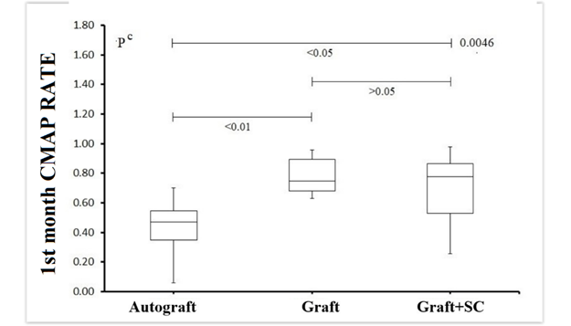
RESULTS
N | 1st month CMAP rate |  |  | ^{c} P value
 | Autograft (A) | Graft (B) | Graft+SC (C)
1 | 0.276 | 0.958 | 0.481
2 | 0.546 | 0.895 | 0.255
3 | 0.562 | 0.866 | 0.970
4 | 0.471 | 0.905 | 0.707
5 | 0.349 | 0.681 | 0.527
6 | 0.472 | 0.671 | 0.978
7 | 0.700 | 0.680 | 0.865
8 | 0.058 | 0.747 | 0.810
9 | 0.442 | 0.630 | 0.774
Mean | 0.43 | 0.78 | 0.71
SD | 0.19 | 0.12 | 0.24
Median | 0.47 | 0.75 | 0.77 | 0.0046
Min | 0.06 | 0.63 | 0.26
Max | 0.70 | 0.96 | 0.98
Comparisons, P: A-B: <0.01 A-C: <0.05 B-C: >0.05
Table. Comparison of the CMAP rates of the three groups at month 1. c Kruskal-Wallis Test (Nonparametric ANOVA) with post test (Dunn's Multiple Comparisons Test), If P<0.05, an intergroup comparison test is performed (A-B, A-C and B-C, respectively). Image. Comparison of the 1nd month CMAP ratio values of all groups. Both graft and graft+SC groups had better CMAP rates than autograft group (p<0.05).
CMAP rates of Graft group is higher than Autograft group at 1st month and this is statistically significant (p<0.01).
CMAP rates of Graft + SC group is higher than Autograft group at 1st month and this is statistically significant (p<0.05).

Slide 6
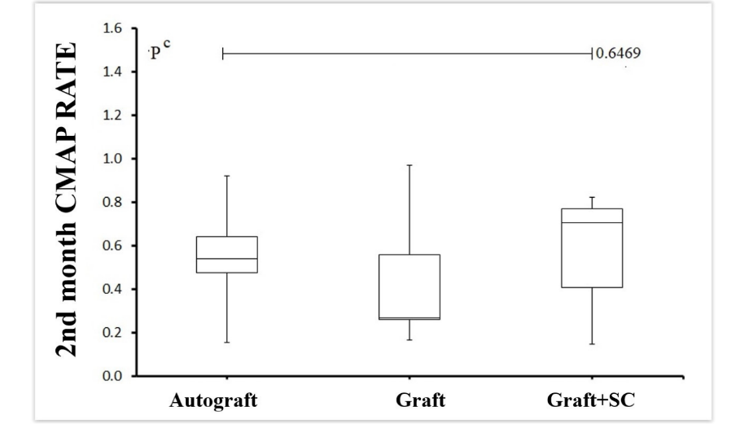
RESULTS
N | 2nd Month CMAP Rate |  |  | ^{c} P value
 | Autograft (A) | Graft (B) | Graft+SC (C)
1 | 0.482 | 0.271 | 0.708
2 | 0.154 | 0.260 | 0.618
3 | 0.905 | 0.971 | 0.147
4 | 0.921 | 0.558 | 0.408
5 | 0.569 | 0.256 | 0.242
6 | 0.476 | 0.167 | 0.825
7 | 0.642 | 0.522 | 0.791
8 | 0.310 | 0.859 | 0.727
9 | 0.542 | 0.265 | 0.772
Mean | 0.56 | 0.46 | 0.58
SD | 0.25 | 0.29 | 0.25
Median | 0.54 | 0.27 | 0.71 | 0.6469
Min | 0.15 | 0.17 | 0.15
Max | 0.92 | 0.97 | 0.82
Table. Comparison of the 2nd month CMAP rates of the three groups. c Kruskal-Wallis Test (Nonparametric ANOVA) with post test (Dunn's Multiple Comparisons Test), If P<0.05, an inter-group comparison test was performed (A-B, A-C and B-C, respectively). Image. Comparison of the 2nd month CMAP ratio values of all groups.
In comparison of CMAP rates of all three groups at 2nd month, even though Graft + SC group has higher CMAP rates, there are no statistically significant difference (p<0.6469).

