Slide 1
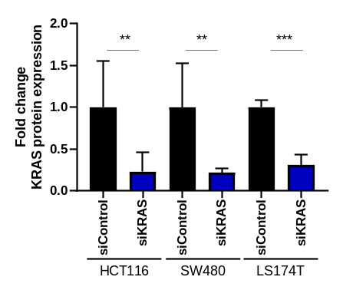
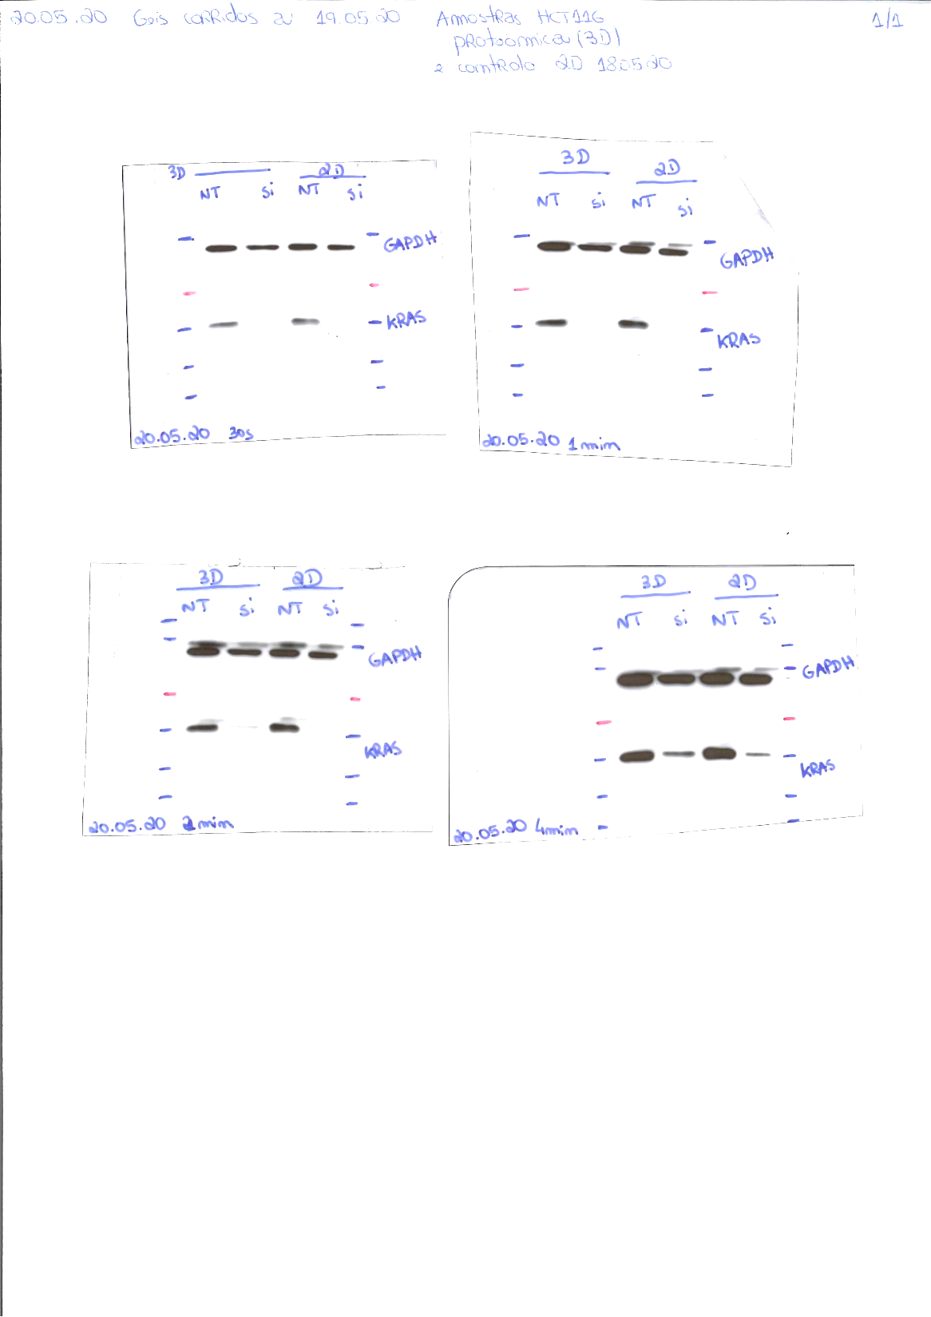
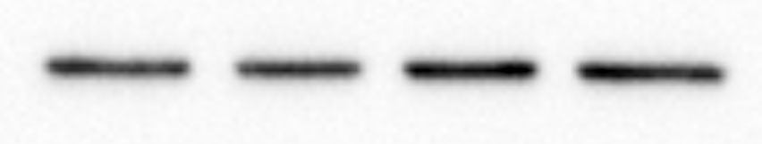
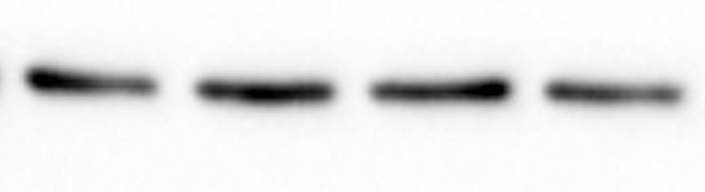
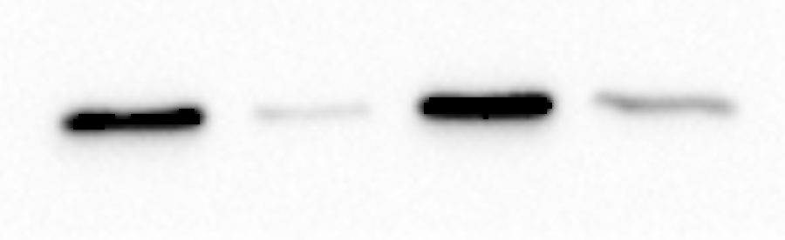

Figure S1
A
B
HCT116
SW480
LS174T
siControl
siKRAS
siControl
siControl
siKRAS
siKRAS
GAPDH
KRAS
Figure S1. KRAS inhibition confirmation. A Representative western blotting of KRAS silencing efficacy in HCT116, SW480 and LS174T cells. GAPDH was used as loading control. B Quantification of KRAS silencing; Data is expressed as mean ± SEM. Graphs represent the fold change relative to siControl condition of at least four biologic replicates. T-test or its non-parametric equivalent were used to perform all analysis; *P≤0.05; **P ≤0.01; ***P ≤0.001.

Slide 2
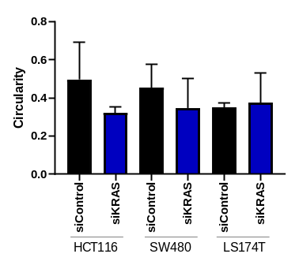
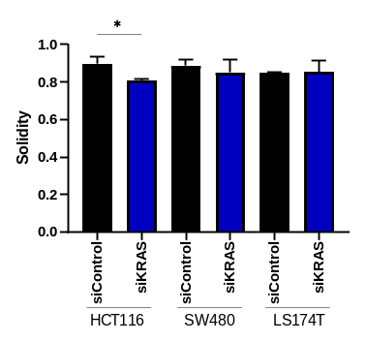
Figure S2
Circularity
Solidity
Figure S2. Quantification of spheroid circularity and solidity. Circularity and solidity of spheroids were calculated using Fiji upon acquisition of spheroids images with an automated widefield microscope (IN Cell Analyzer 2000). Data is expressed as mean ± SEM. Graphs represent quantification of three biologic replicates. T-test or its non-parametric equivalent were used to perform all analysis; *P≤0.05; **P ≤0.01; ***P ≤0.001.

Slide 3
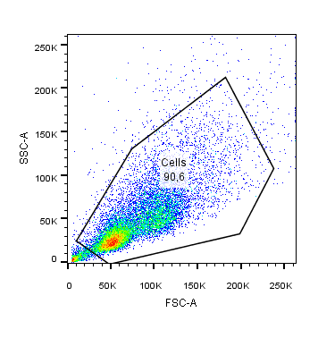
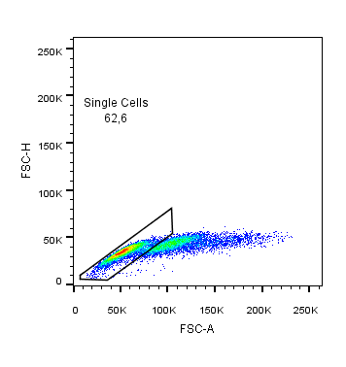
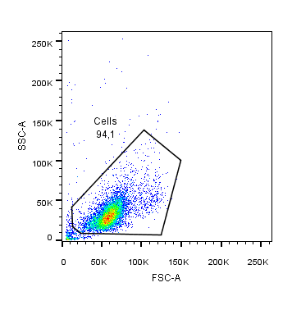
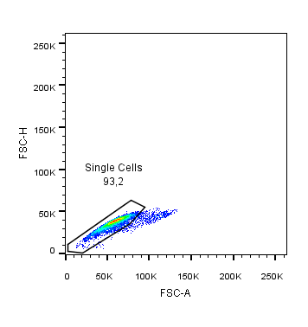
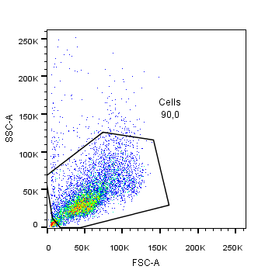
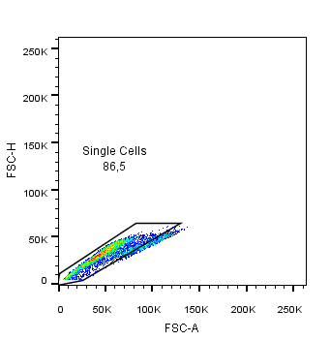
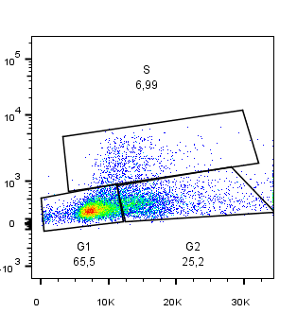
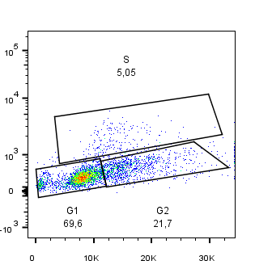
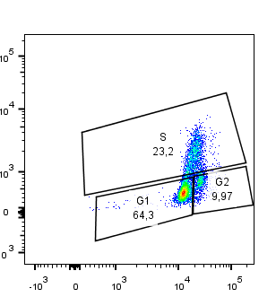
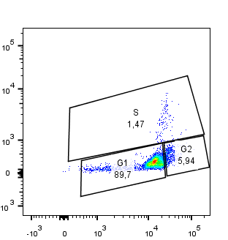
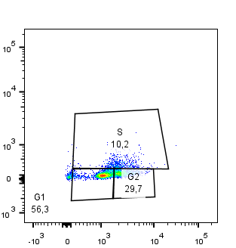
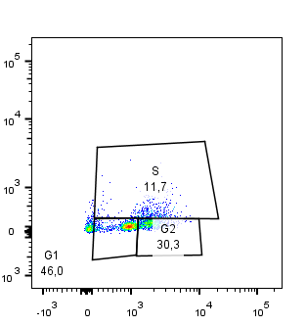
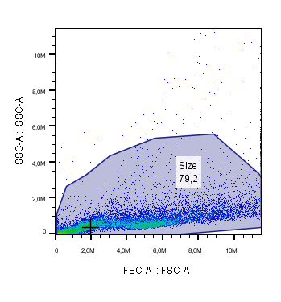
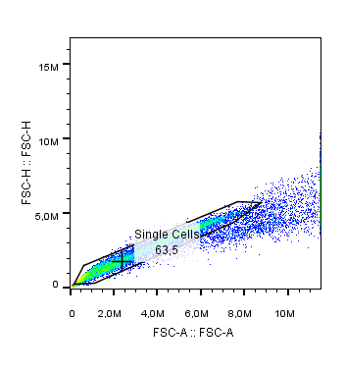
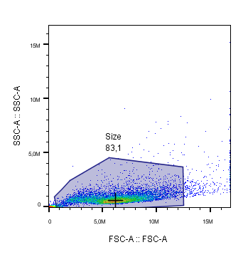
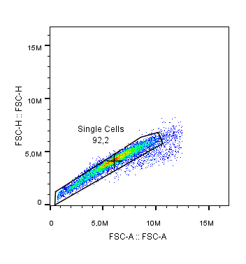
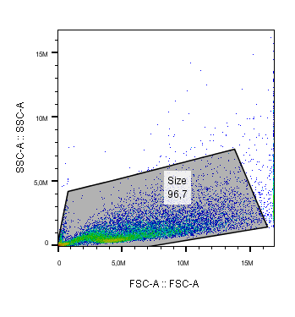
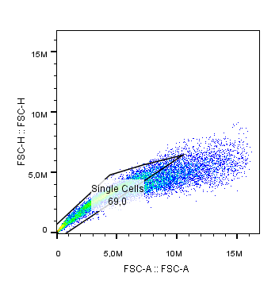
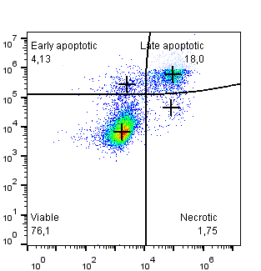
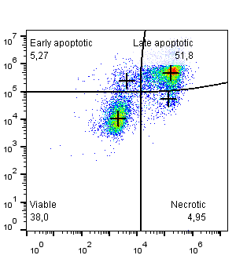


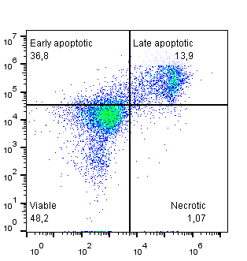
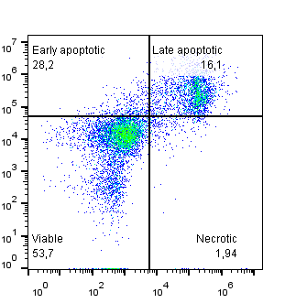
Figure S3
A
HCT116
SW480
LS174T
3D siControl
3D siKRAS
3D siControl
3D siKRAS
3D siControl
3D siKRAS
Click it EdU 462 (APC)
B
Propidium Iodide
HCT116
SW480
LS174T
3D siControl
3D siKRAS
3D siControl
3D siKRAS
3D siControl
3D siKRAS
Annexin V
Propidium Iodide
Figure S3. Gating strategy and representative plots of cell cycle and apoptosis analysis by flow-cytometry. A Cell cycle analysis by Click it Edu 462/Propidium Iodide (PI) double staining. Pseudo-color plots display the gating strategy created with Flow Jo for flow cytometry. Cell population was selected based on FSC-A/SSC-A, which represents the distribution of cells in the light scatter based on cell size and granularity, respectively. Single cells were selected based on FSC-A/FSC-H. Pseudo-color plots with representation of Click it Edu and Propidium Iodide staining in all conditions. B Apoptosis analysis by Annexin-V/PI double staining. Pseudo-color plots display the gating strategy created with Flow Jo for flow cytometry. Cell population was selected based on FSC-A/SSC-A, which represents the distribution of cells in the light scatter based on cell size and granularity, respectively. Single cells were selected based on FSC-A/FSC-H. Pseudo-color plots with representation of Annexin V and Propidium Iodide staining in all conditions.

Slide 4
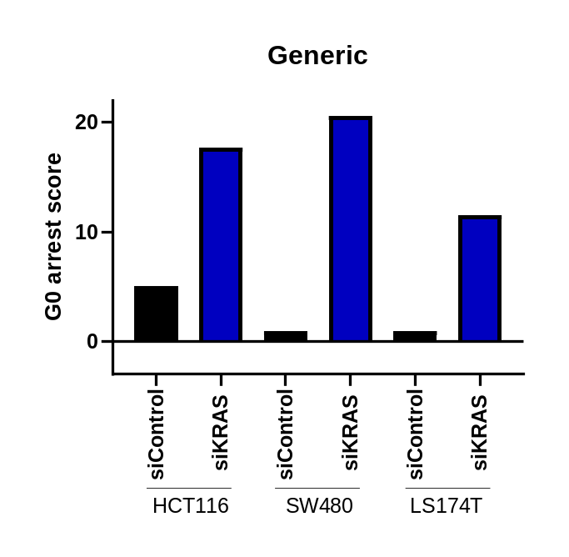
Figure S4
Figure S4. G0 arrest levels of cells. The generic G0 arrest score refers to scores calculated using the original list of 139 genes differentially expressed across all forms of G0 arrest [28]. The other G0 arrest scores refers to scores calculated using subset of those 139 genes, as identified in [28].

Slide 5
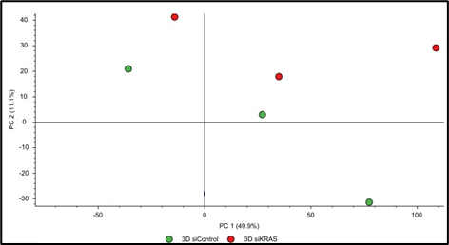
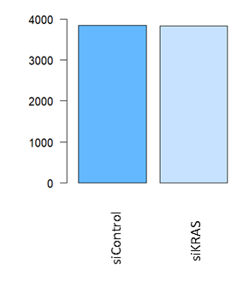
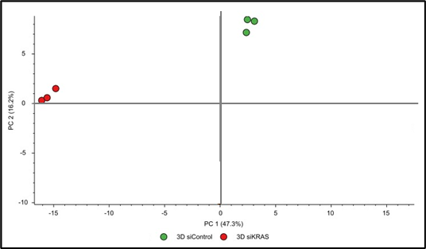
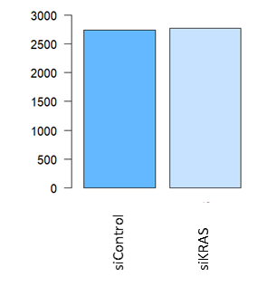
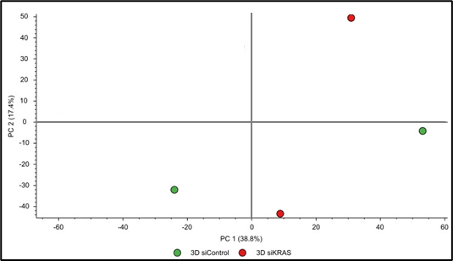
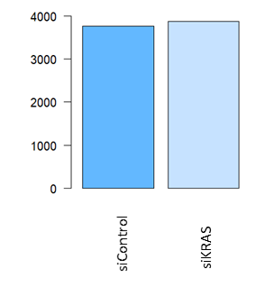
Figure S5
A
B
C
Figure S5. Principal component analysis (PCA) for all proteins identified and number of identified proteins. PCA plot of the first two principal components (PC1 and PC2) illustrating the distribution of proteins identified in siControl cells (green dots) and siKRAS cells (red dots); replicates are identified as individual dots. Bar plot depicting the number of identified proteins in proteomic analysis for each cell line in each condition. A HCT116. B SW480. C LS174T.

Slide 6


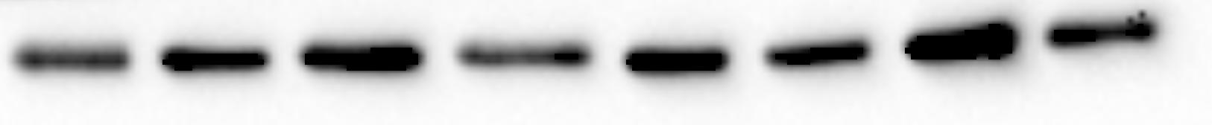




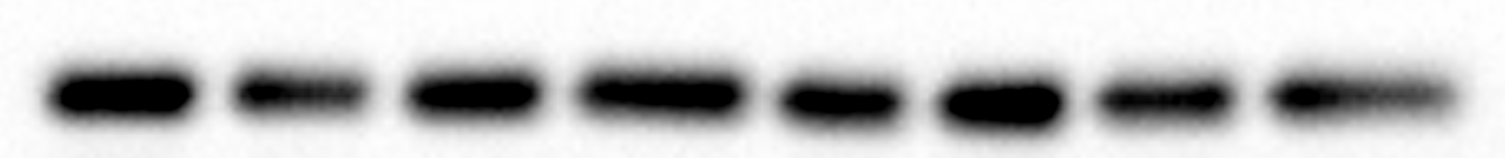



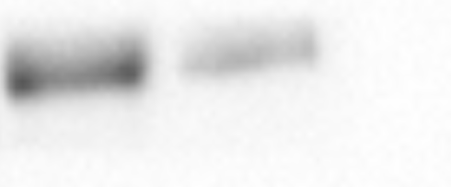
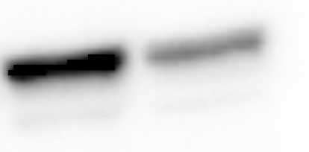
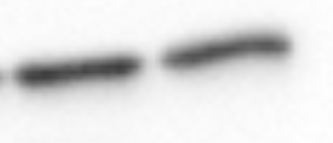
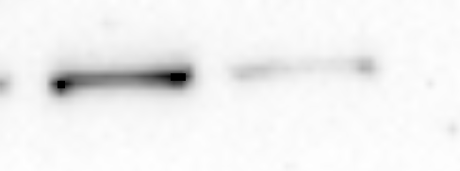
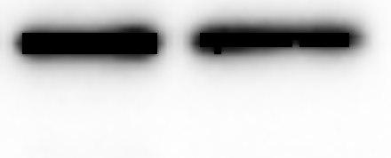
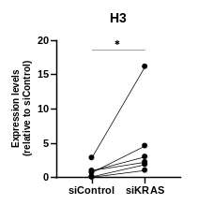
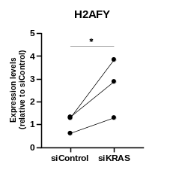
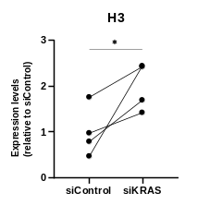
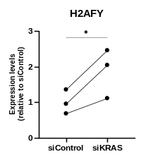
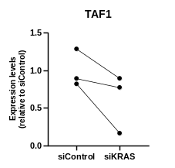
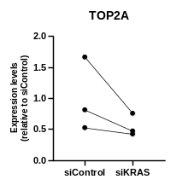
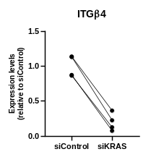





Figure S6
A
HCT116
SW480
LS174T
siControl
siKRAS
siControl
siKRAS
siControl
siKRAS
Histone H3
Histone H3
TAF1
GAPDH
H2AFY
TOP2A
GLUT1
H2AFY
GAPDH
H2AFY
GAPDH
GAPDH
ITGβ4
EPHA2
LMNA/C
GAPDH
ITGα6
GAPDH
B
HCT116
SW480
LS174T
Figure S6. Validation of proteomic data. A Representative western blotting of proteins identified in the proteomics data. GAPDH was used as loading control. B Densitometry of western blots was performed on at least three separate experiments. Data is expressed as mean ± SEM. Graphs represent the fold change relative to siControl condition. Paired t-test or its non-parametric equivalent was used to compare siControl with siKRAS condition; *P≤0.05, **P ≤0.01.

Slide 7






Figure S7
A
Up-regulated
Down-regulated
B
Up-regulated
Down-regulated
C
Up-regulated
Down-regulated
Figure S7. Networks of up- or down-regulated proteins in siKRAS versus siControl HCT116, SW480 and LS174T. A String networks of up- and down-regulated proteins identified in siKRAS HCT116 cells; red and blue protein networks in the up-regulated proteins represent nucleosome and mRNA splicing clusters, respectively. B String networks of up- and down-regulated proteins identified in siKRAS SW480 cells; red network represent nucleosome cluster; the red network of down-regulated proteins represent chromosome a condensation cluster. C Up- and down-regulated proteins found in siKRAS LS174T cells did not form any specific cluster. Up and down-regulated proteins were considered with p-value ≤0.05 and fold-change ≥2. Protein data was uploaded to STRING and networks predicted with high confidence (0.7).

Slide 8


Figure S8
A
B
Figure S8. Histone post-translational modifications (PTM). A Histone 3 PTM identified in HCT116, SW480 and LS174T cell lines in proteomic analysis. (B) Histone 4 PTM identified in HCT116, SW480 and LS174T cell lines in proteomic analysis. Gain or loss was considered taking into account the spectral counts for the peptides that provided evidence for the indicated modifications.

Slide 9















Figure S9
A
B
C
HCT116
SW480
Figure S9. Histone PTM analysis. A Representative western blotting for validation of histone PTM identified in the proteomics data derived from HCT116 and SW480 and of other histone PTM marks. B Densitometry of western blots was performed on at least three separate experiments. Data is expressed as mean ± SEM. Total protein staining was used to normalize protein expression for core histones fraction. Graphs represent the fold change relative to siControl condition. Paired t-test or its non-parametric equivalent was used to compare siControl with siKRAS condition; *P≤0,05, **P ≤0,01. C Representative western blots for validation of histone PTM identified in the proteomics data in LS174T cells and of other histone PTM marks that were analyzed. H3k18ac corresponds to acetylation of lysine 18 in histone H3. H3k27ac corresponds to acetylation of lysine 27 in histone H3. H3k4me3 corresponds to trimethylation of lysine 4 in histone H3. H3k36me3 corresponds to trimethylation of lysine 36 in histone H3. H3k27me3 corresponds to trimethylation of lysine 27 in histone H3. H3 corresponds to Histone H3 without considering any PTM.

Slide 10




Figure S10
A
siControl
siKRAS
B
siControl
siKRAS
Figure S10. A/B compartments analysis upon KRAS inhibition. A. Figure displays data of A/B compartments distribution in several chromosomes in siControl and siKRAS conditions for HCT116 cells. B. Figure displays data of A/B compartments distribution in several chromosomes in siControl and siKRAS conditions for LS174T cells. Data was obtained through eigenvector.

Slide 11









Figure S11
A
HCT116
SW480
LS174T
B
KRAS
HSC70
C
Figure S11. KRAS inhibition confirmation in RNA sequencing experiments at the different timepoints. A Counts for the KRAS gene in siControl and siKRAS samples at the different timepoints analyzed. B Representative western blotting to confirm the efficacy and reproducibility of siRNA-mediated KRAS silencing in HCT116, SW480 and LS174T cells at the different timepoints, from the same conditions used for RNA sequencing. HSC70 was used as loading control. C Bar graph depicts densitometric analysis of western blotting.

Slide 12






Figure S12
A
B
C
Figure S12. Raw number of counts and multidimensional scaling (MDS) plot in RNA sequencing analysis. Bar plot depicts the number of total raw counts in RNA sequencing analysis for each condition, in each cell line. MDS plot illustrates the distribution of each samples according to dimension 1 (dim1) against dimension 2 (dim2). Each timepoint is represented by a different color. A HCT116. B SW480. C LS174T.

Slide 13






Figure S13
A
siControl_48h
siControl_72h
siKRAS_48h
siKRAS_72h
B
siControl_48h
siControl_72h
siKRAS_48h
siKRAS_72h
C
siControl_48h
siControl_72h
siKRAS_48h
siKRAS_72h
Figure S13. Venn diagrams depicting the number of exclusive and shared DEGs at 48- and 72-hour timepoints in siControl cells (left) and siKRAS (right). A HCT116. B SW480. C LS174T.

