Slide 1
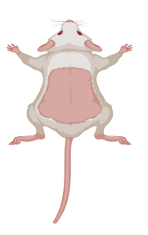
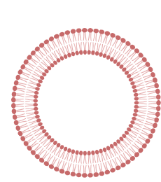
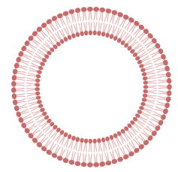
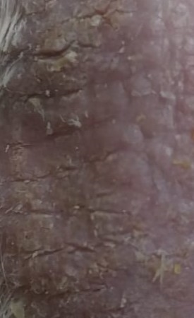
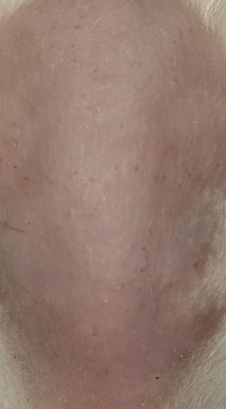
Kojic acid
Edge activators
(Birj 35 and Cremophor rh40)
Mouse with imiquimod induced psoriasis
Span 60
Topical application of kojic acid spanlastics
Before treatment
After treatment

