Slide 1
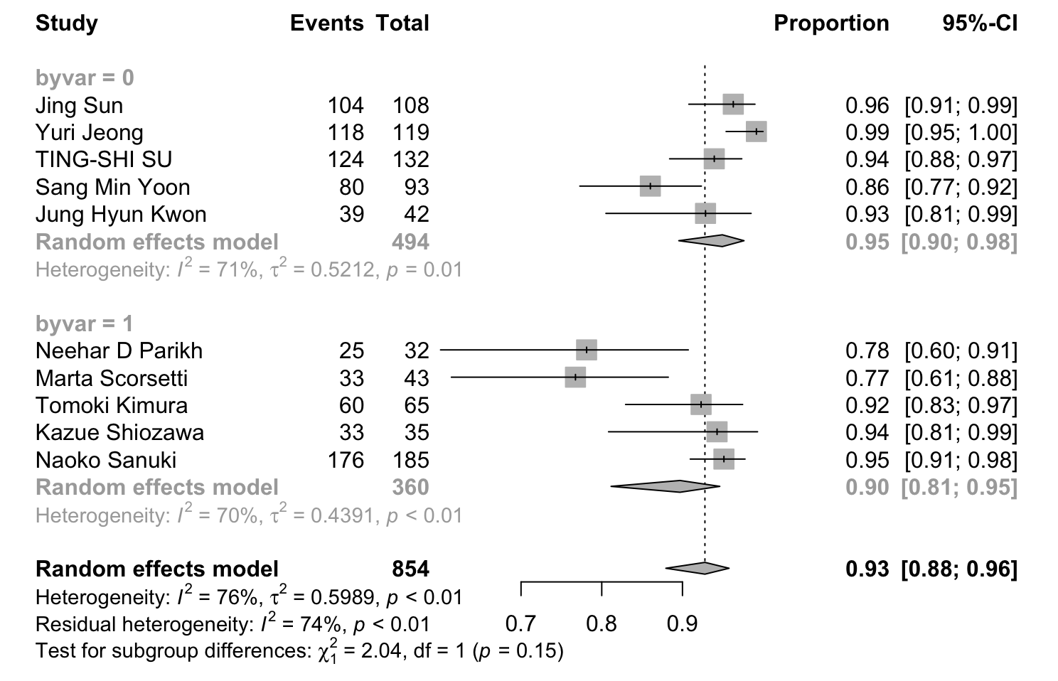
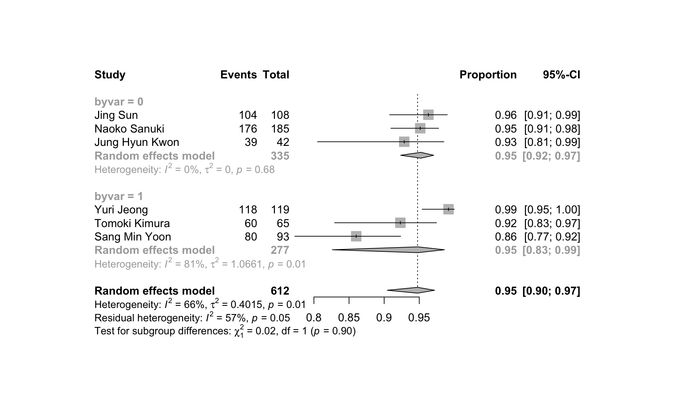
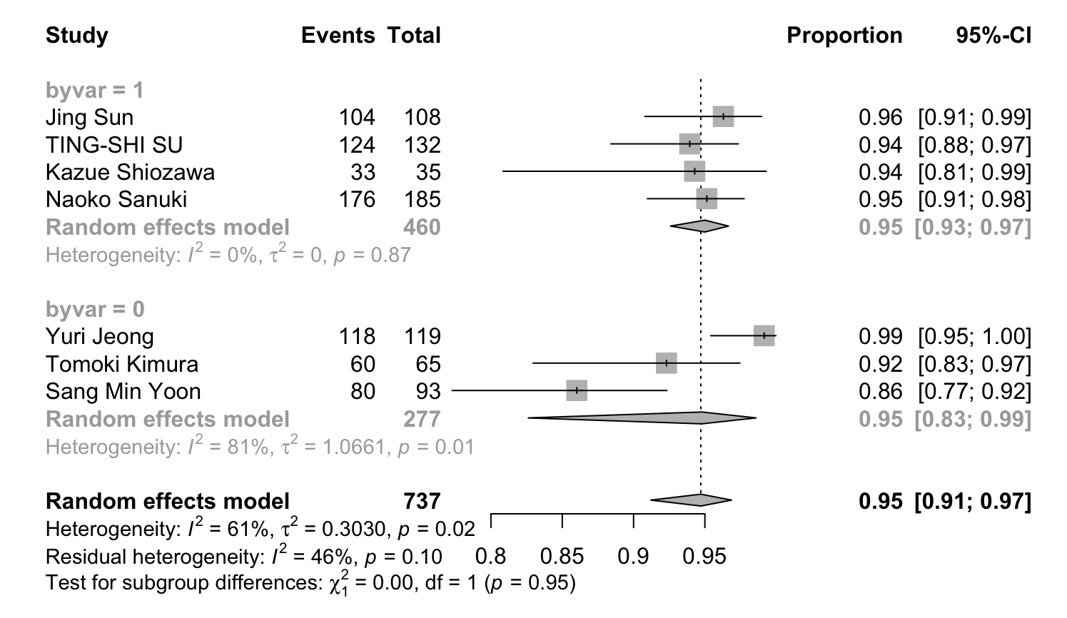
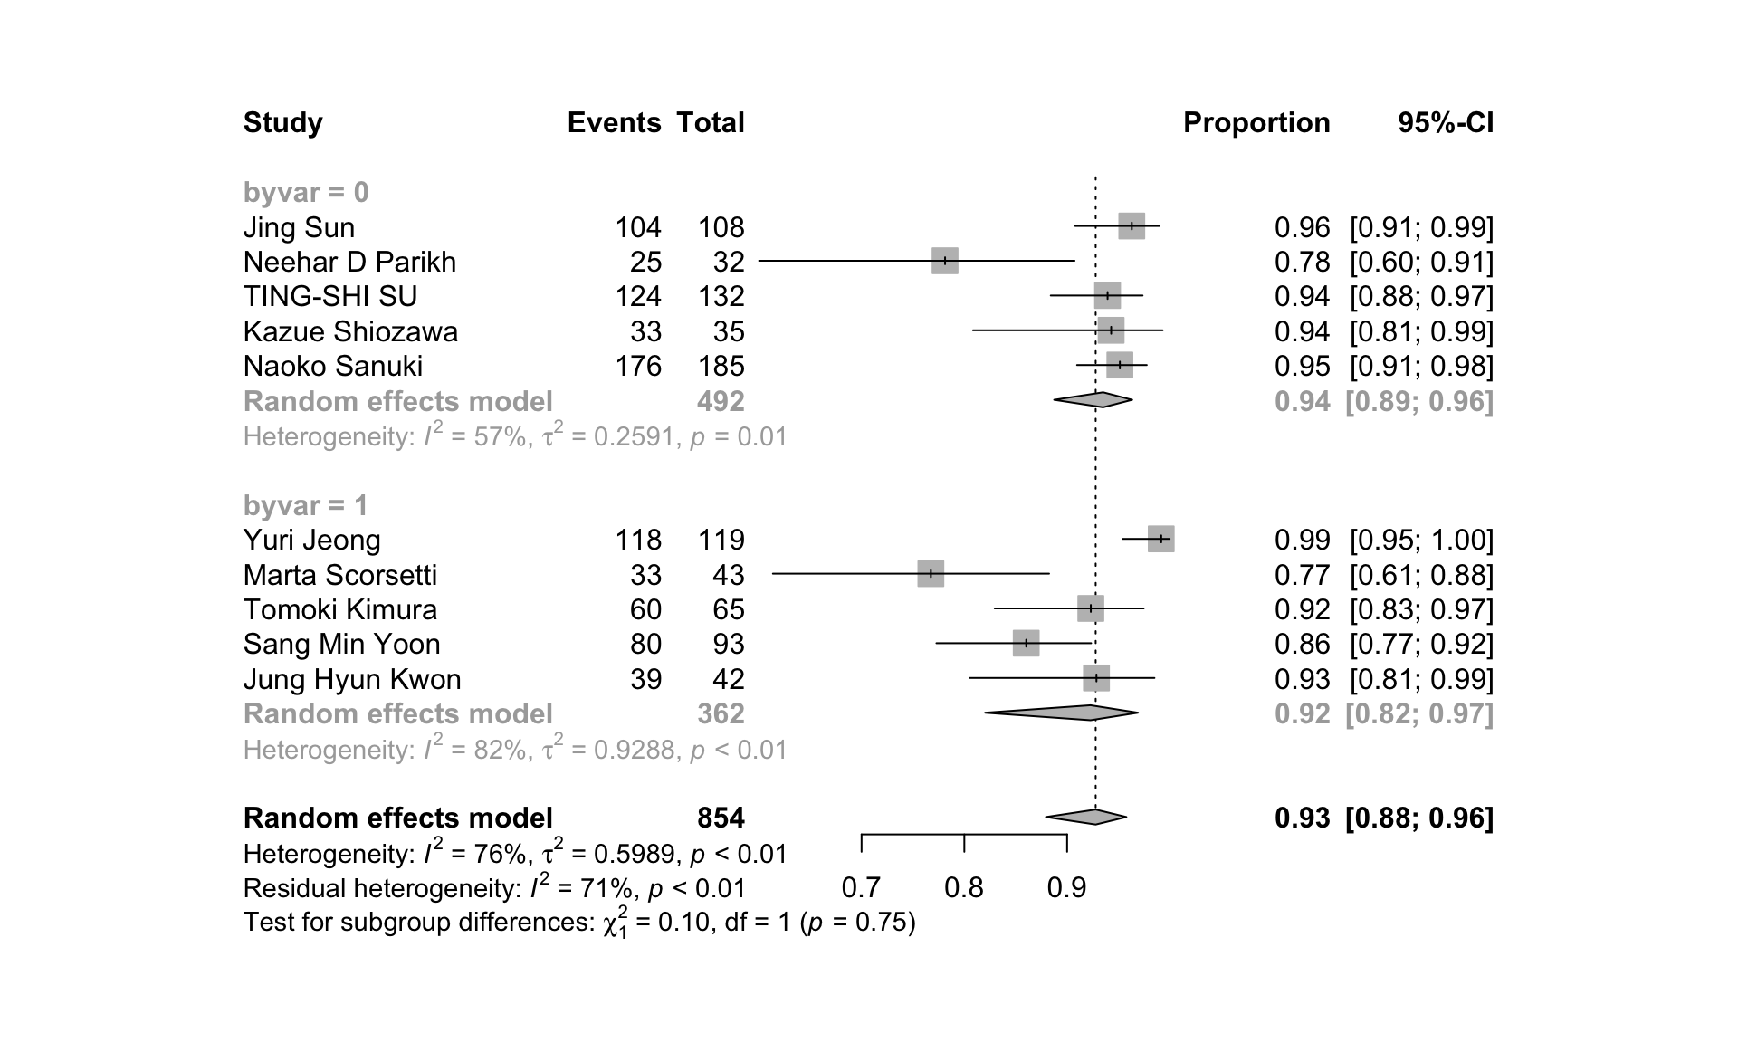
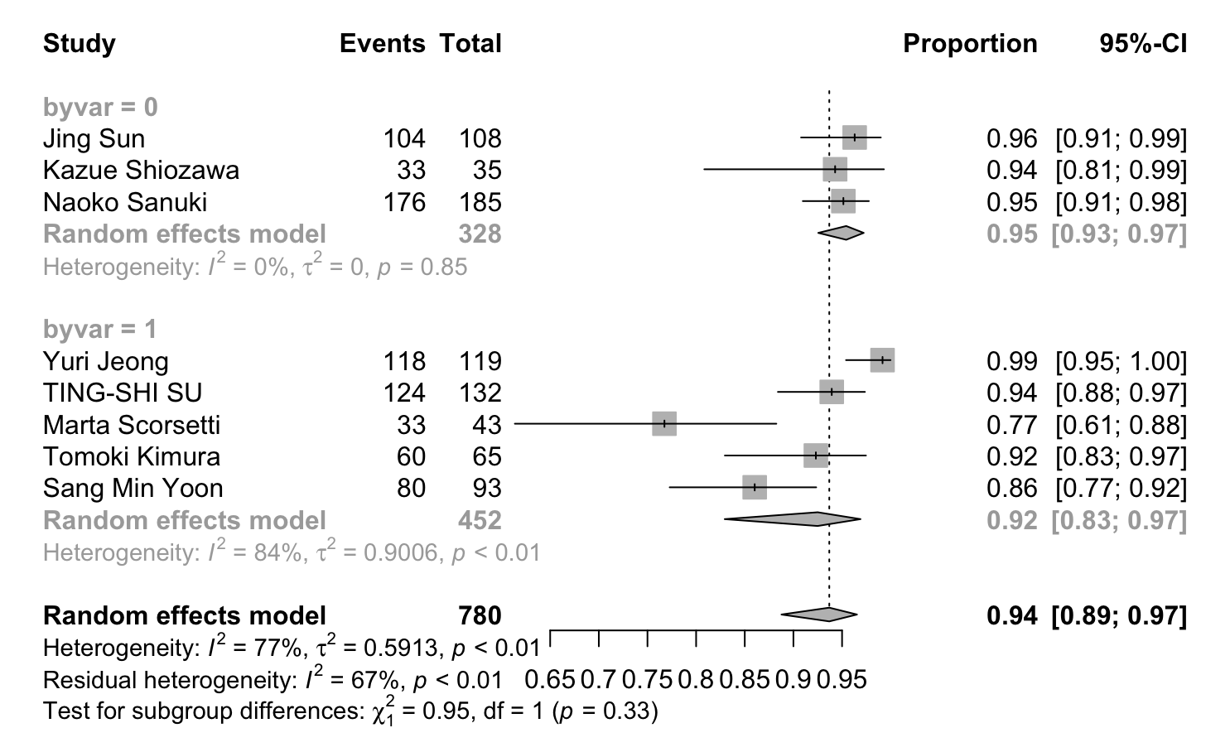
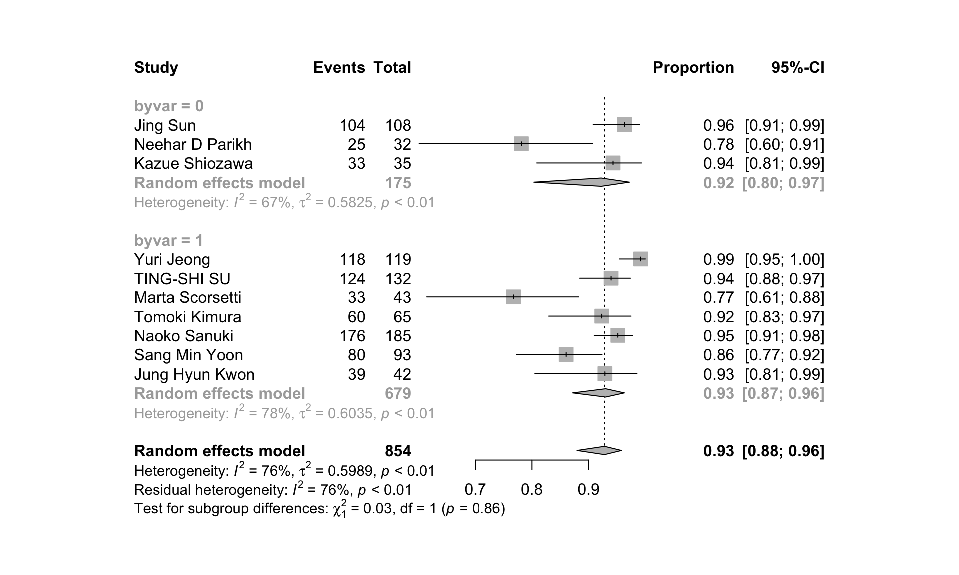
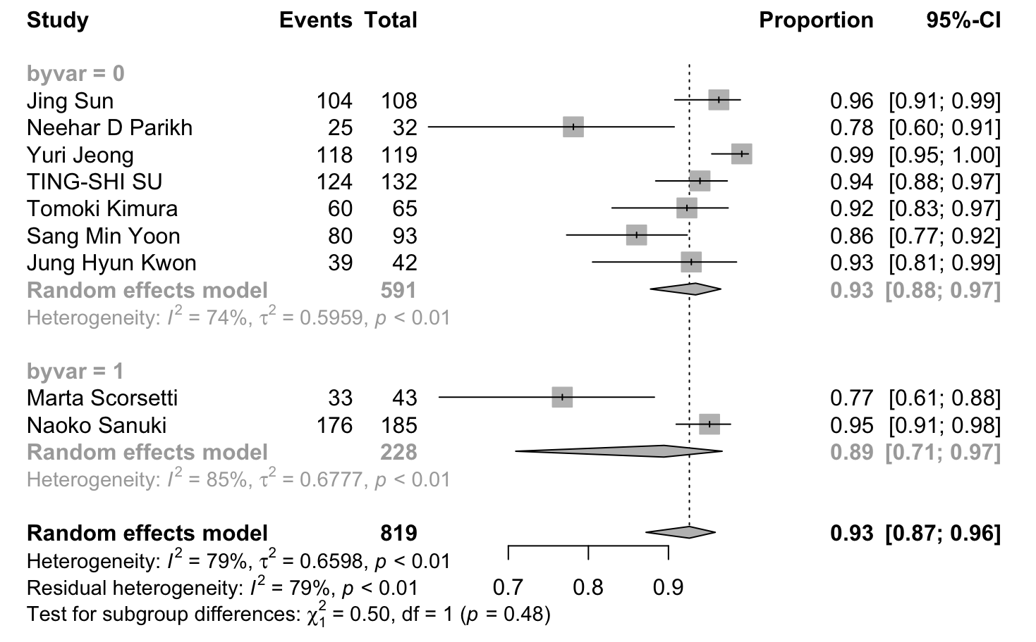
A
B
C
D
E
F
G
Supplementary Figure 1: Forest plots of subgroup comparisons for 1-year OS showing (A) age (median/mean age of <65: 0; ≥65: 1); (B) BED₁₀ dose (median BED₁₀ estimates of ≤100Gy: 0; >100Gy: 1); (C) tumor size (median/mean longest diameter of ≤2cm: 0; >2 cm: 1); (D) tumor size (maximum diameter ≤5cm : 0; 5-6cm : 1); (E) number of lesions (all patients with single lesion: 0; patients with ≤ 3 lesions: 1) (F) pretreatment situation (initial patients: 0; some pretreated: 1); (G) macrovascular invasion (No: 0; Yes: 1).

Slide 2
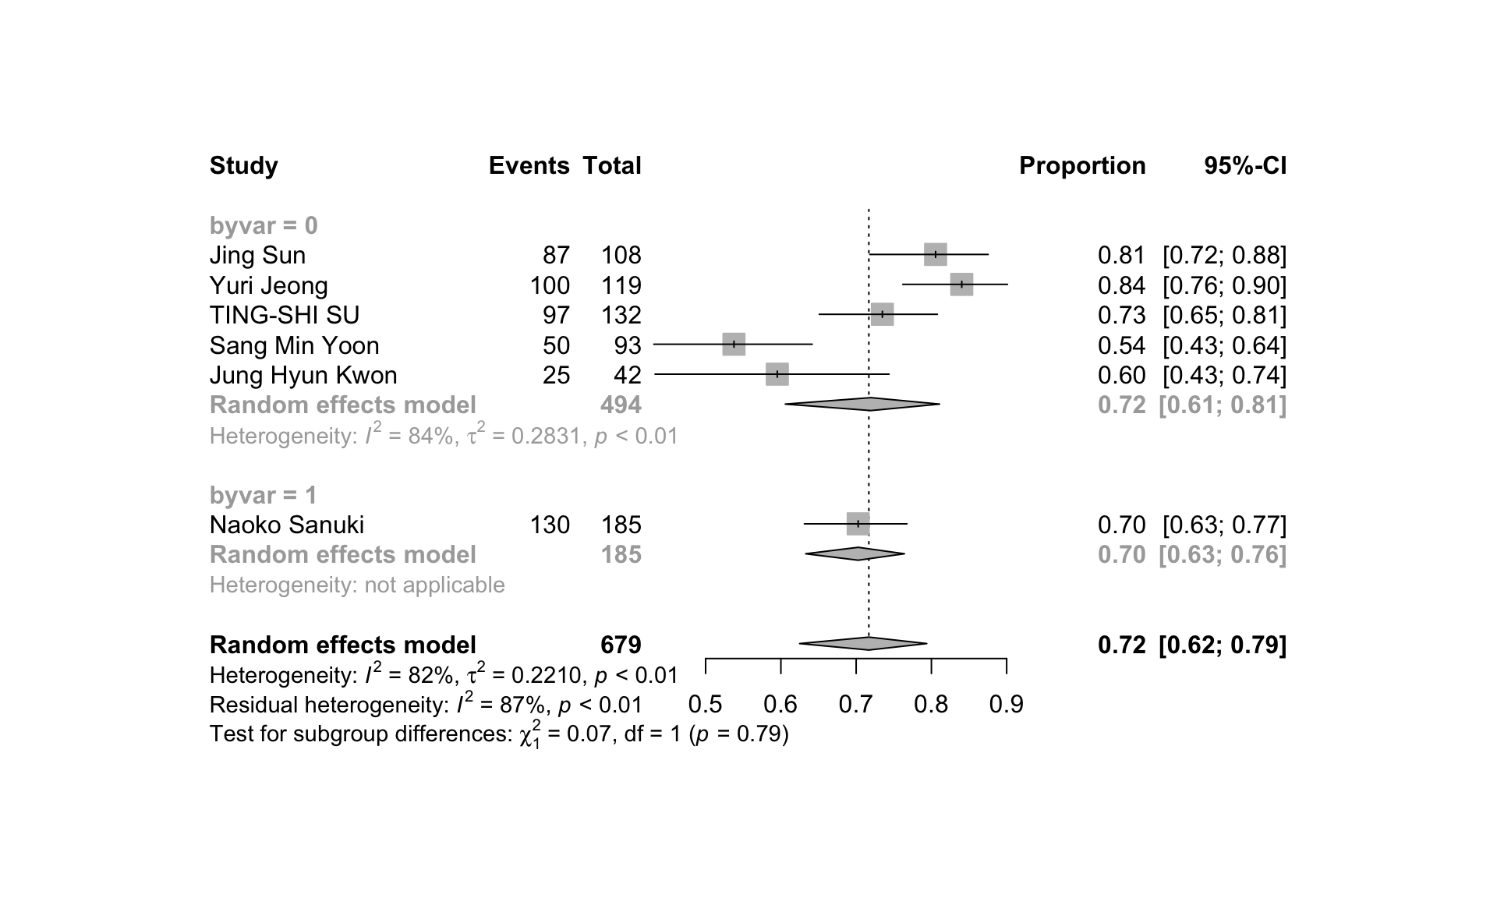
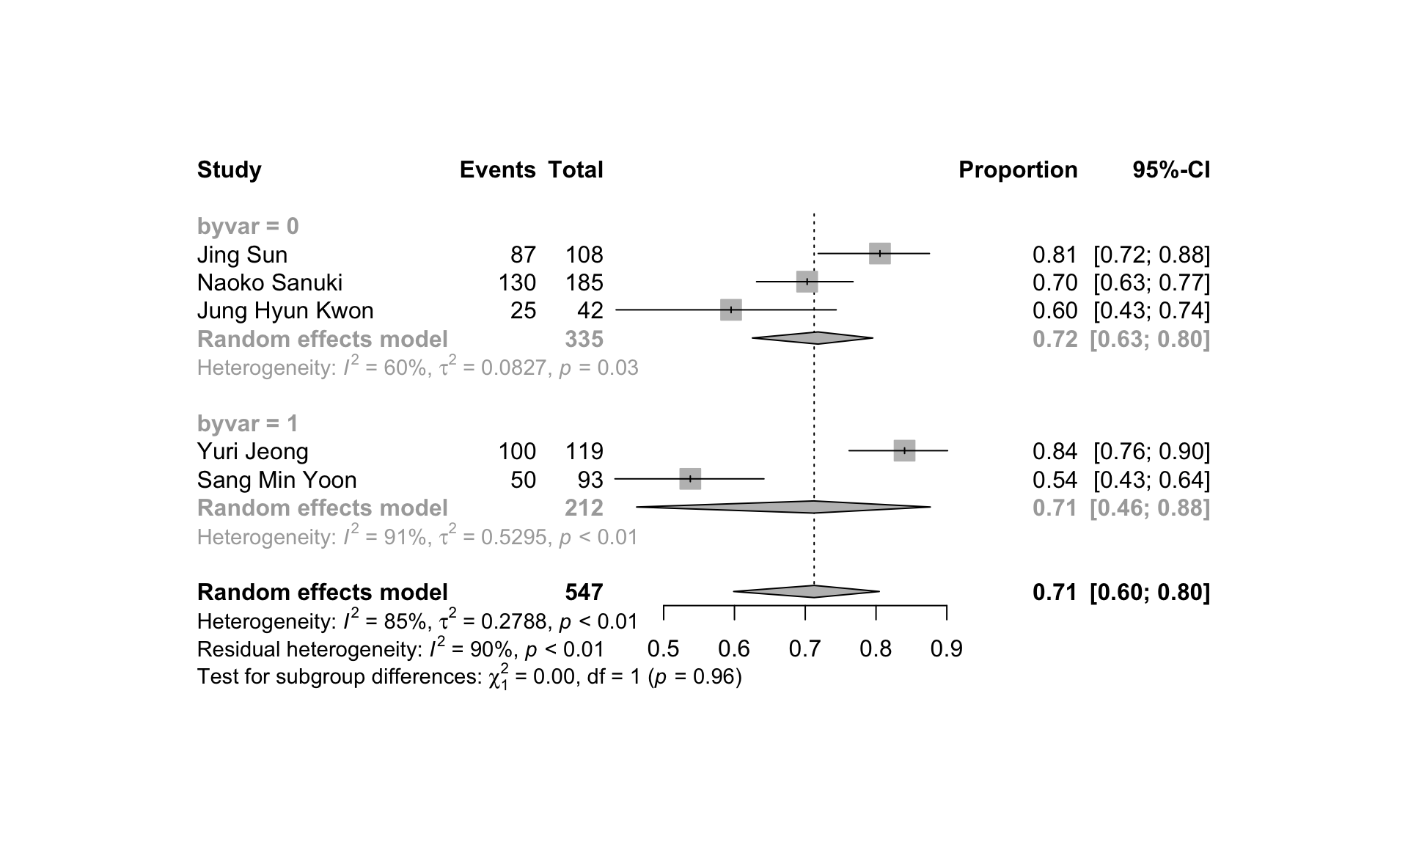
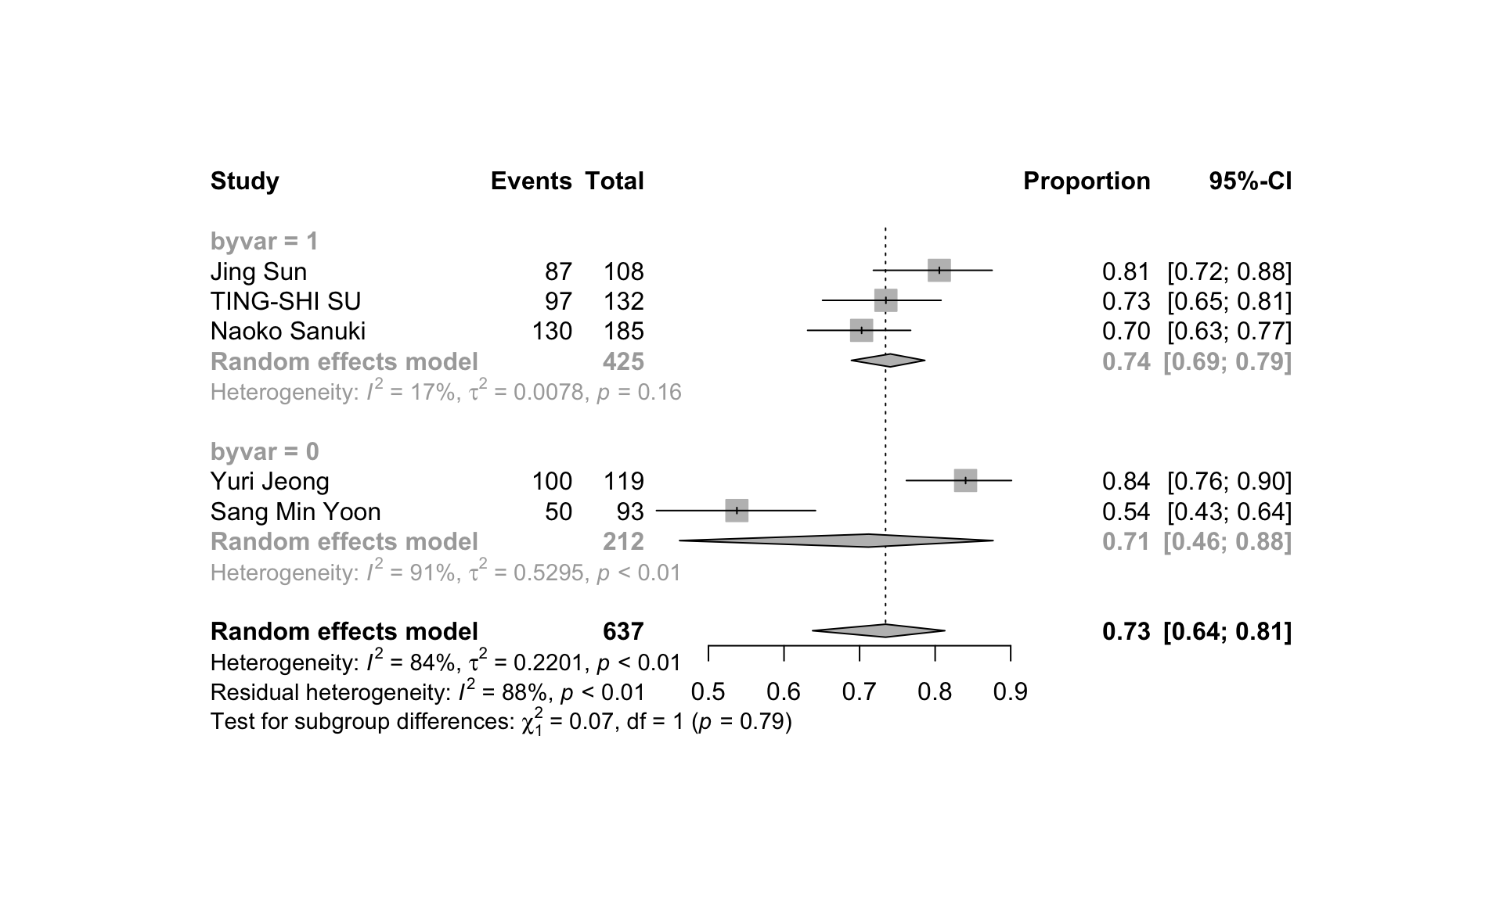
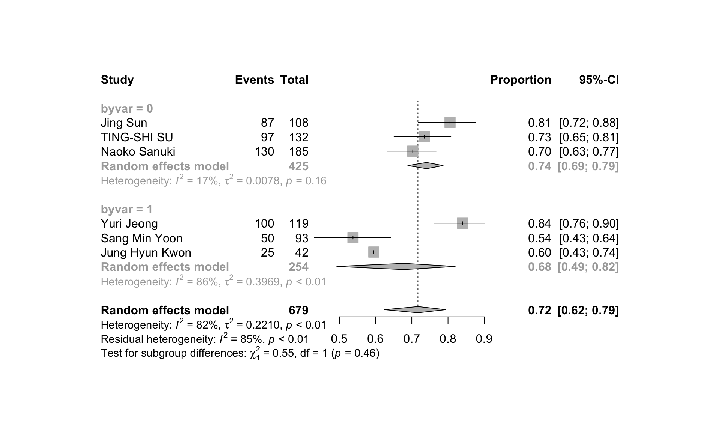
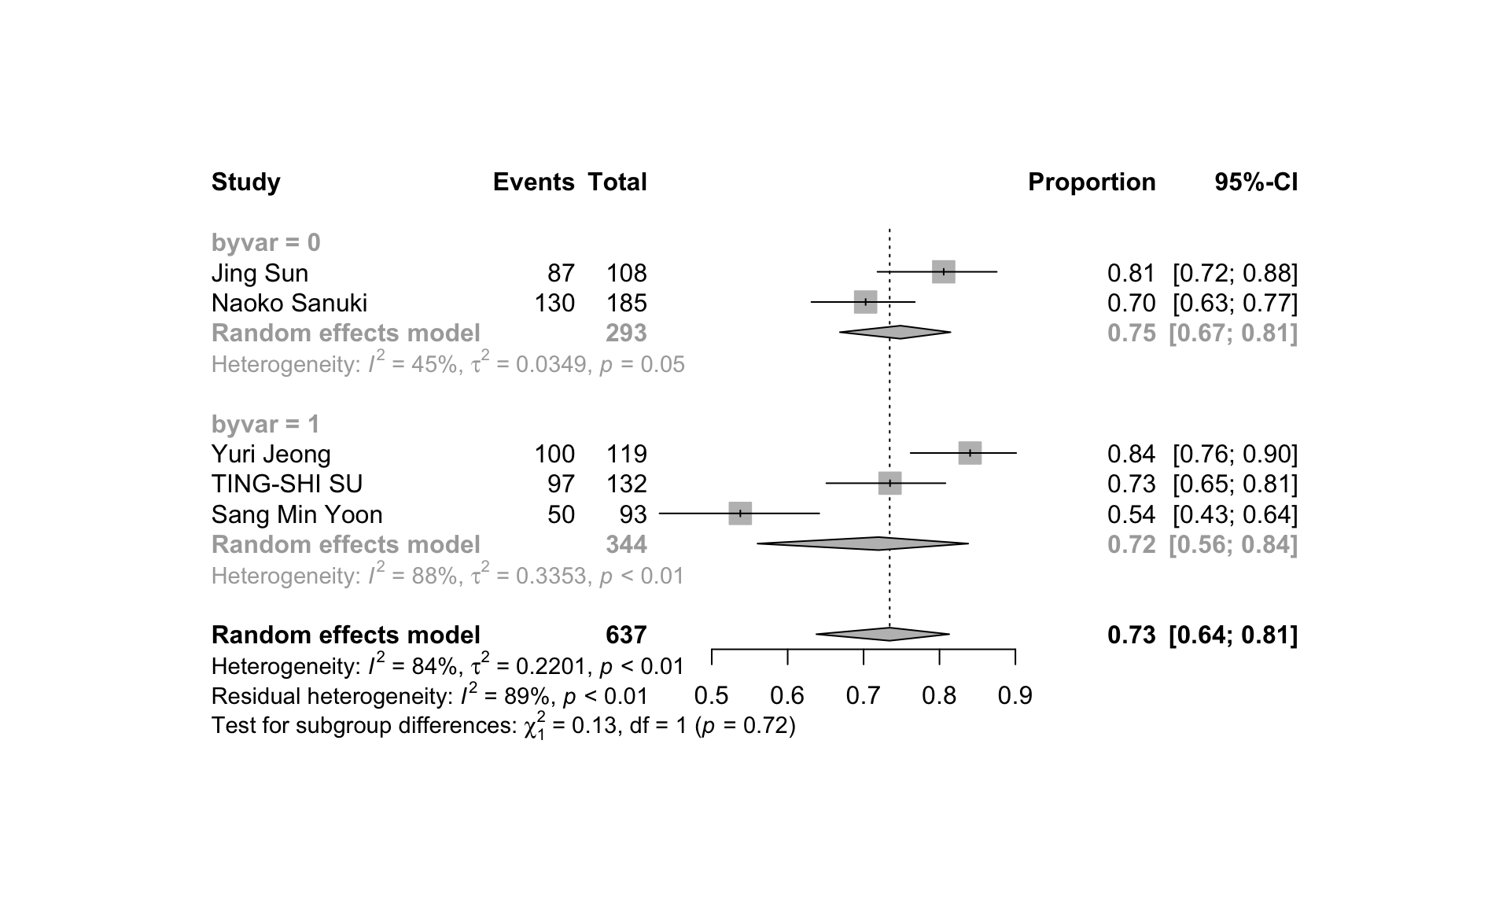
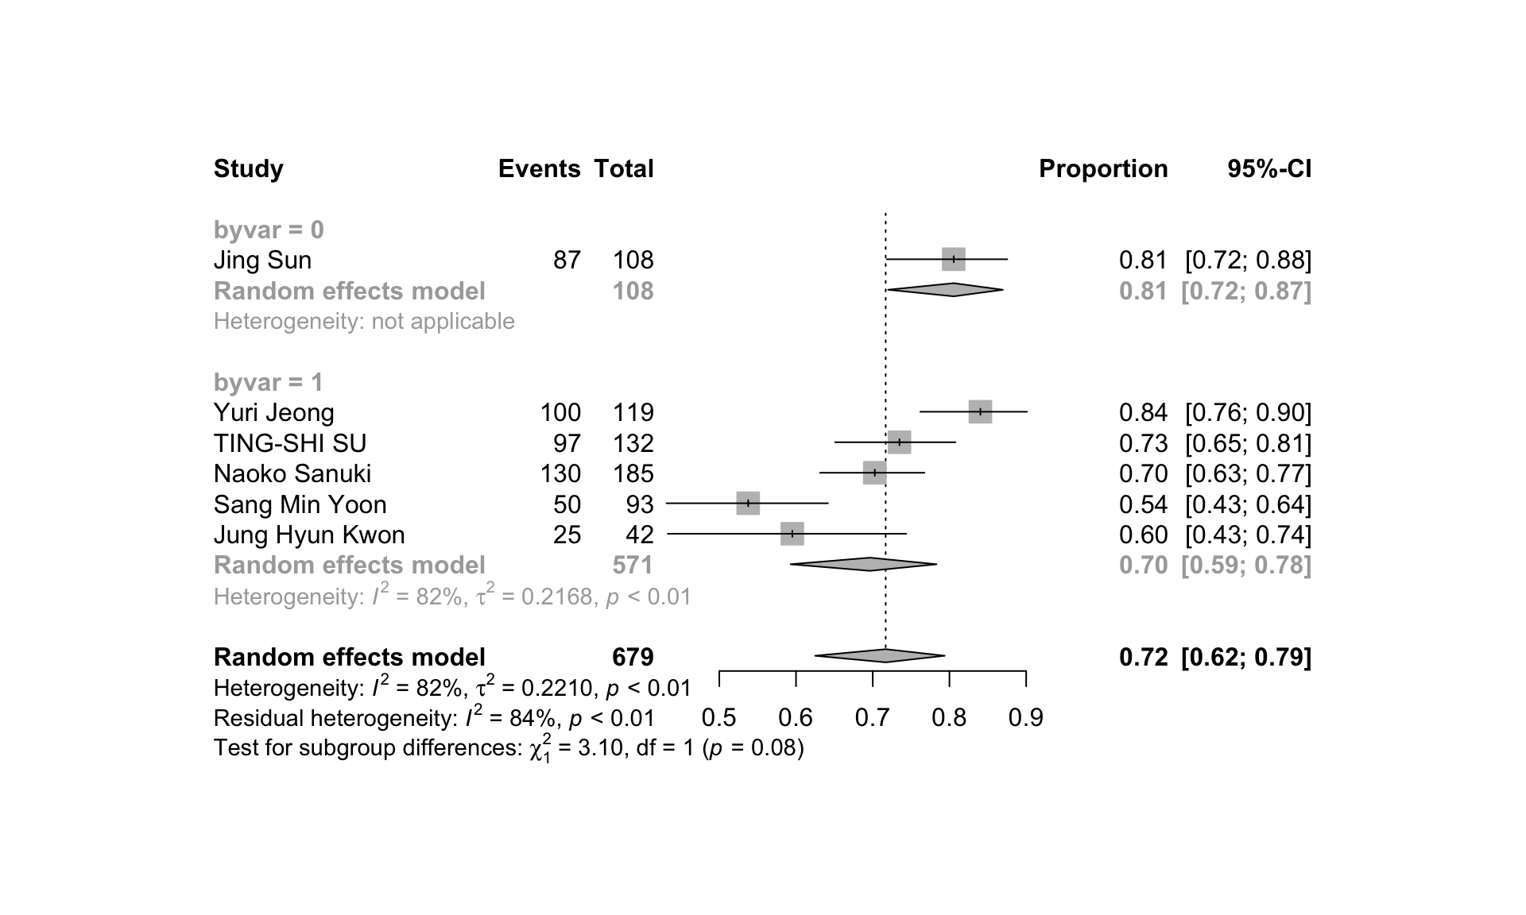
A
B
C
D
E
F
G
Supplementary Figure 2: Forest plots of subgroup comparisons for 3-year OS showing (A) age (median/mean age of <65: 0; ≥65: 1); (B) BED₁₀ dose (median BED₁₀ estimates of ≤100Gy: 0; >100Gy: 1); (C) tumor size (median/mean longest diameter of ≤2cm: 0; >2 cm: 1); (D) tumor size (maximum diameter ≤5cm : 0; 5-6cm : 1); (E) number of lesions (all patients with single lesion: 0; patients with ≤ 3 lesions: 1) (F) pretreatment situation (initial patients: 0; some pretreated: 1); (G) macrovascular invasion (No: 0; Yes: 1).

Slide 3
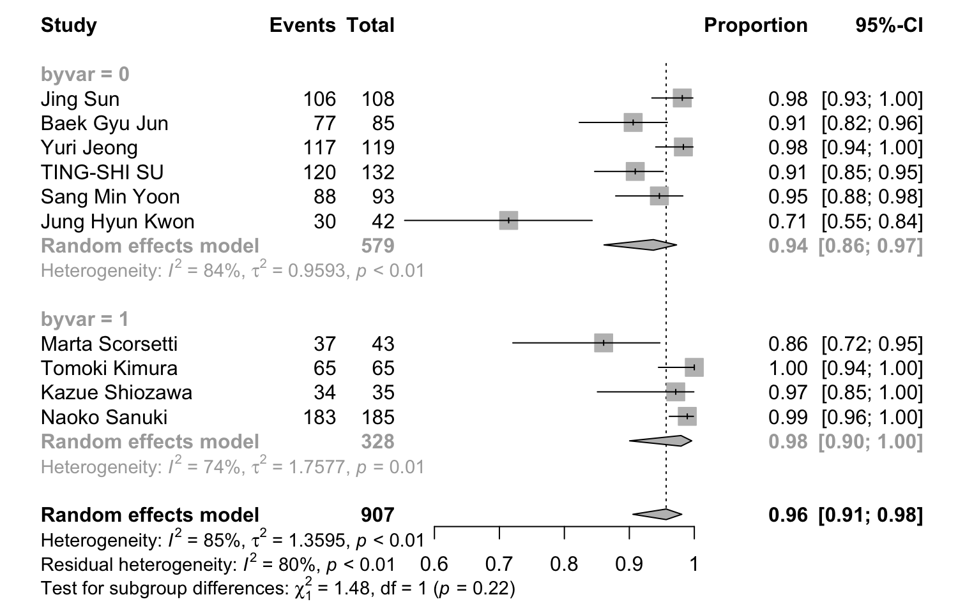
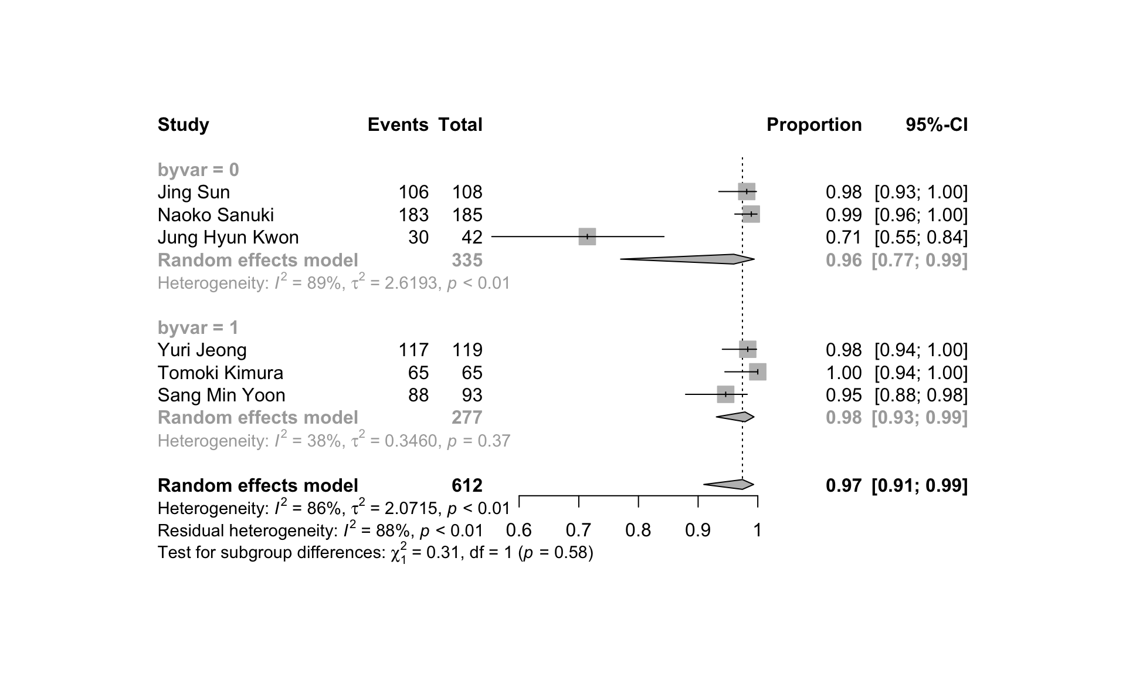
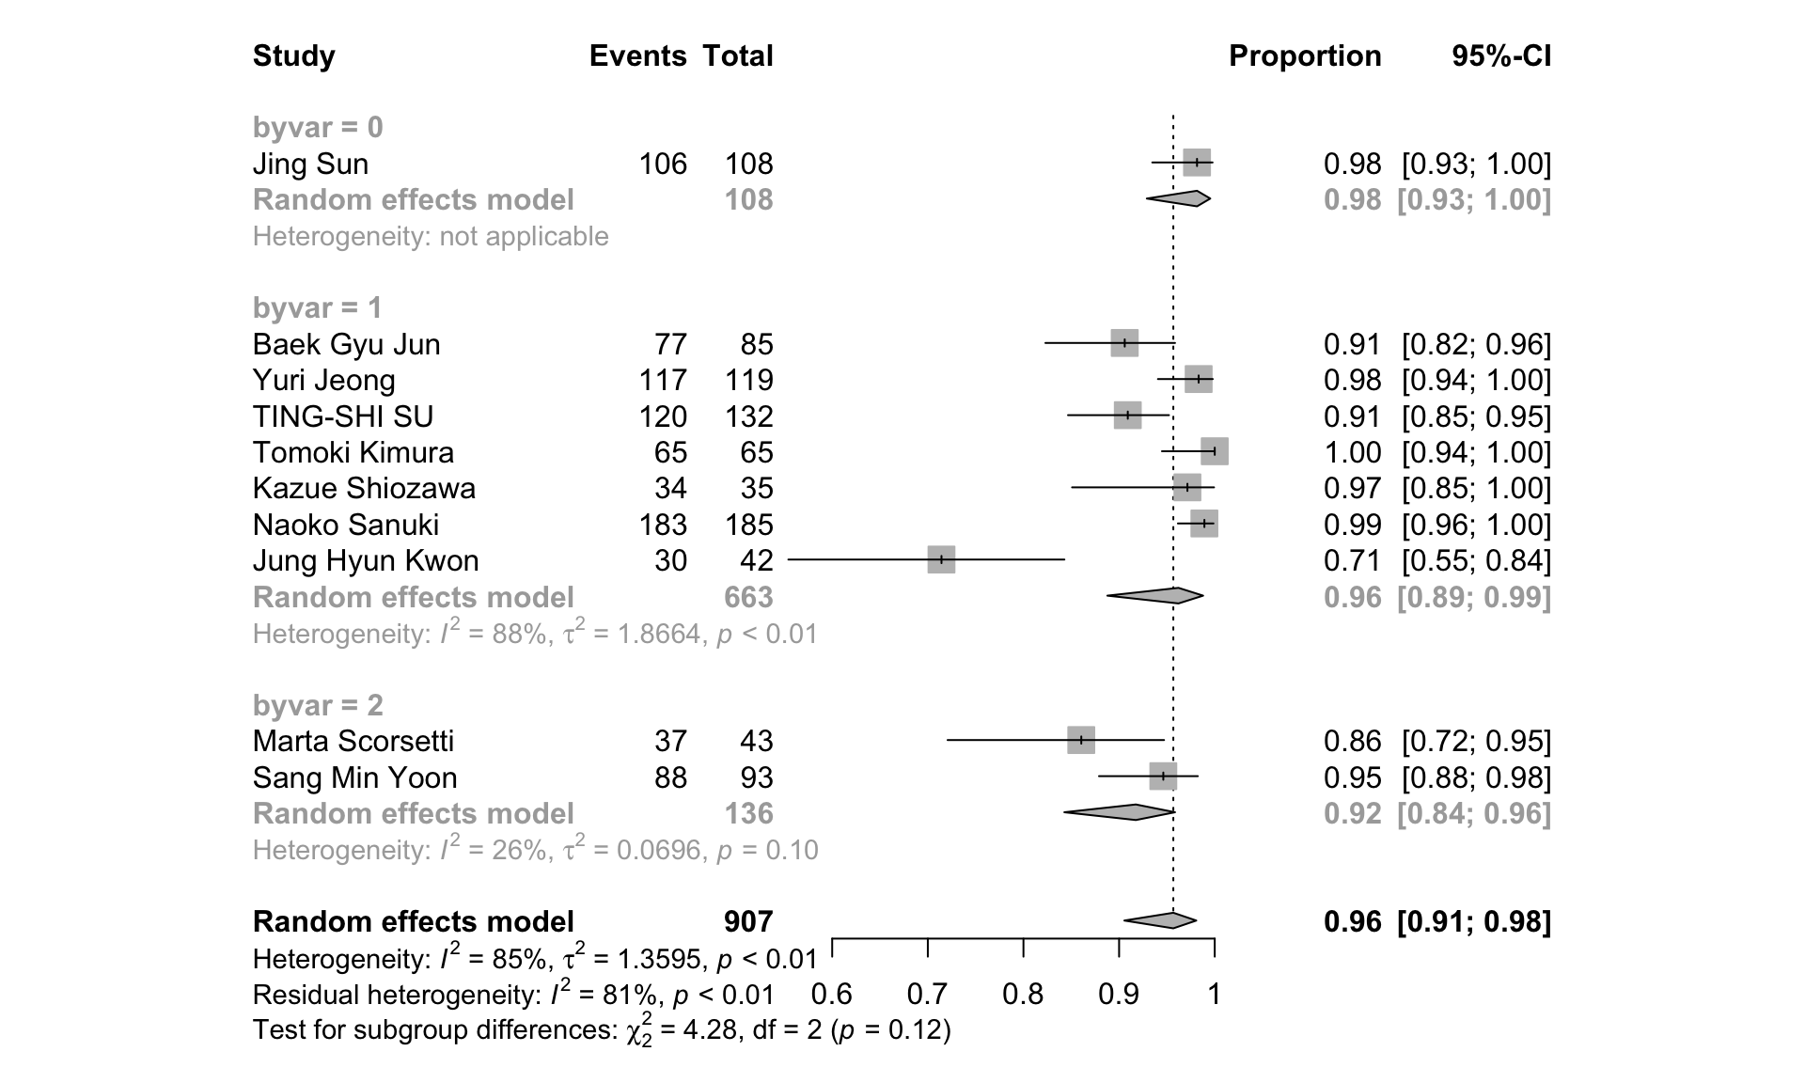
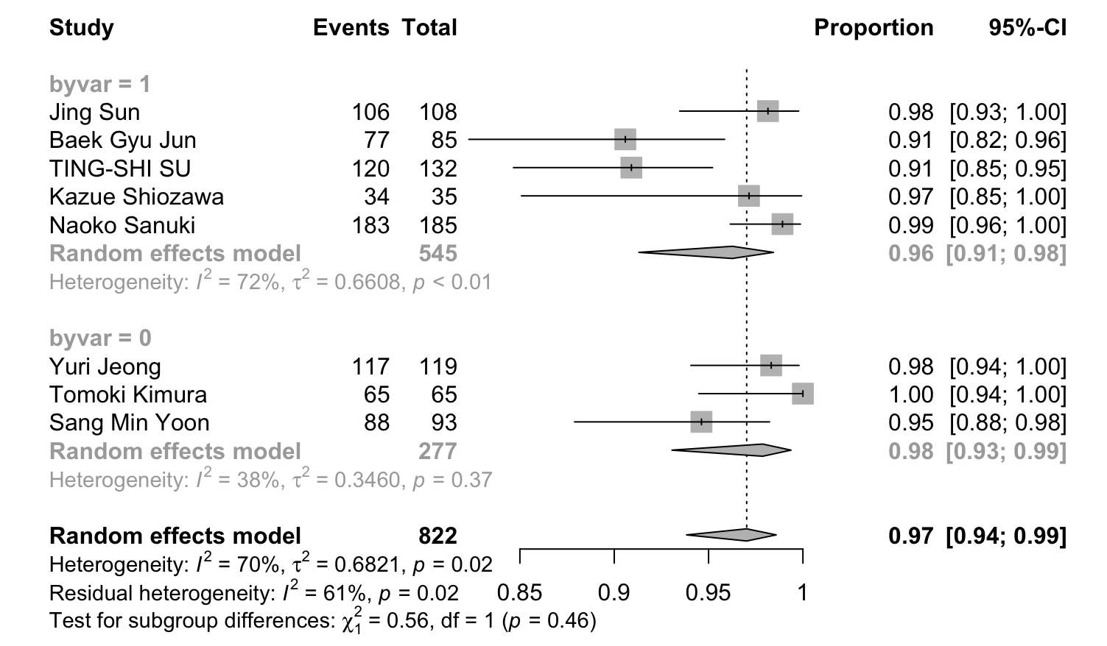
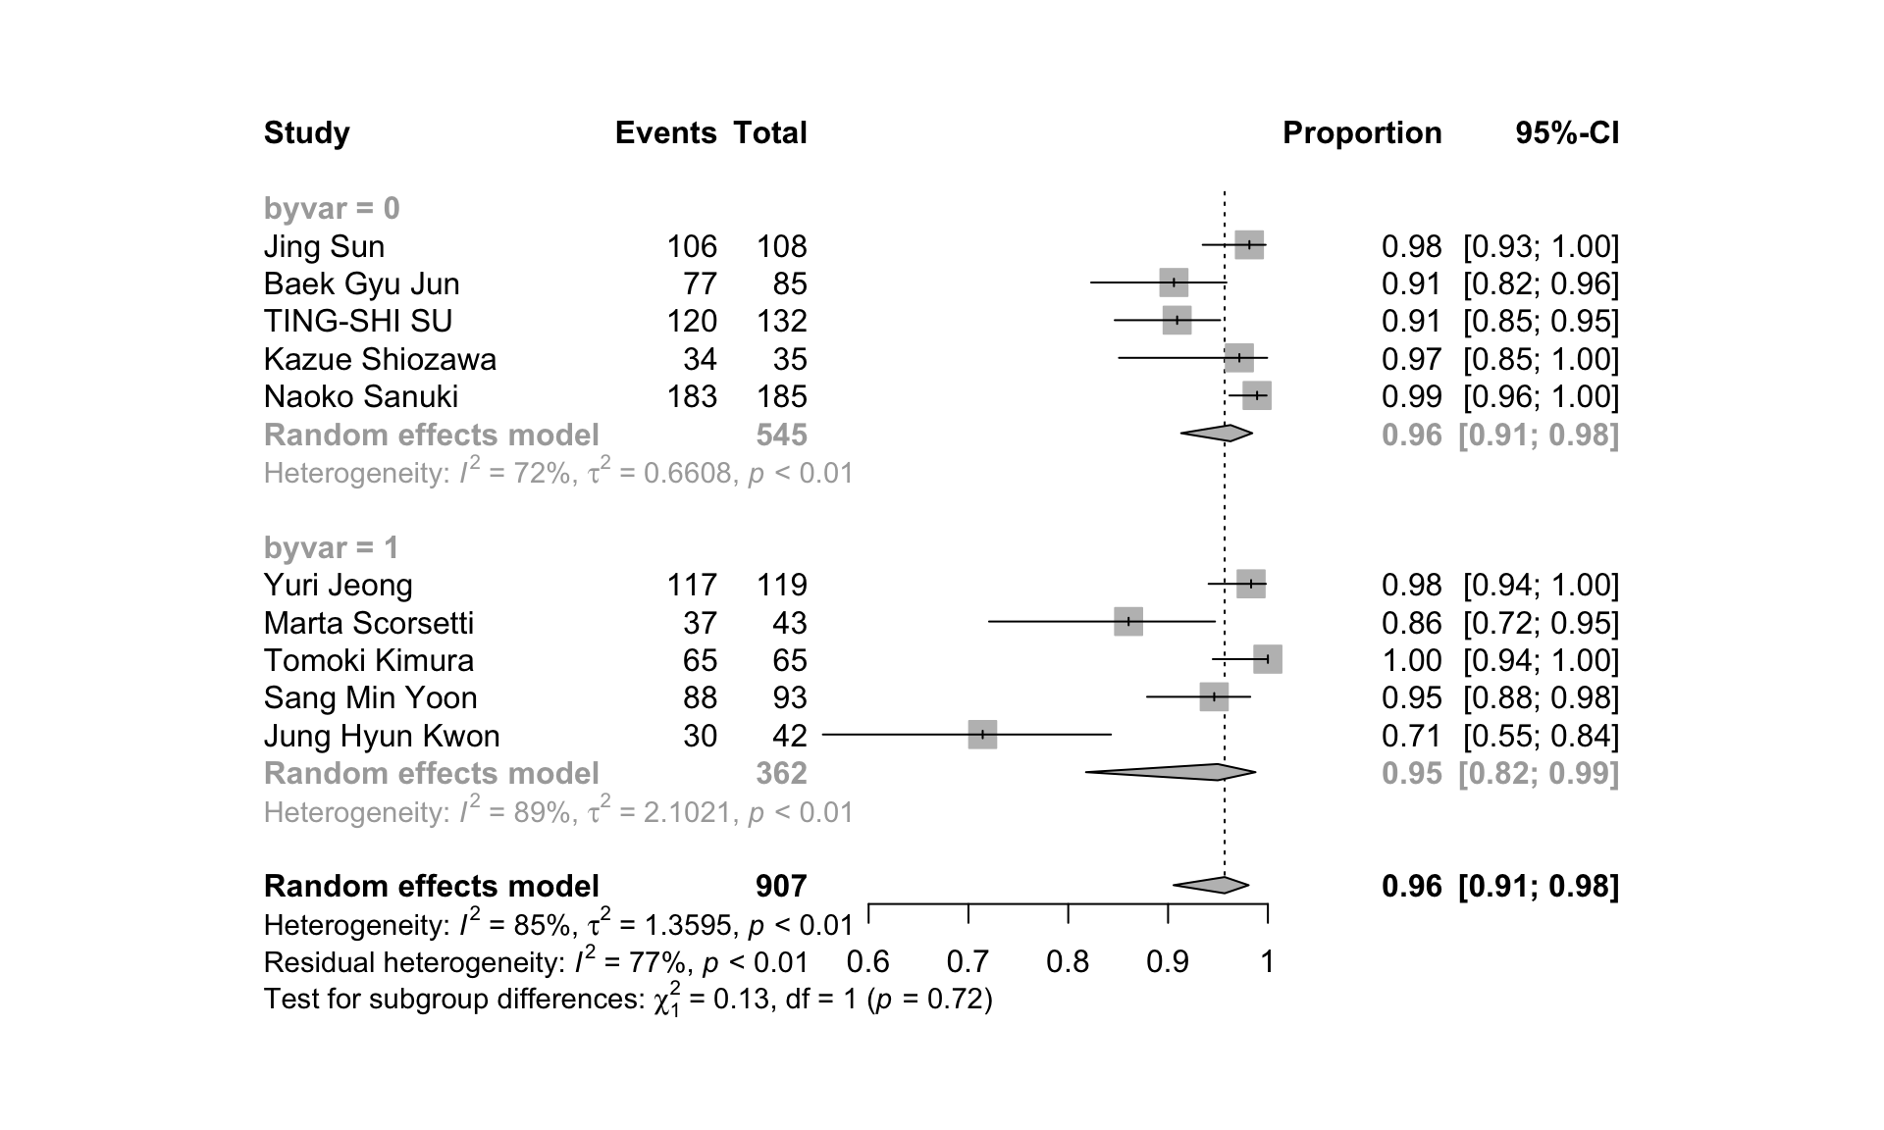
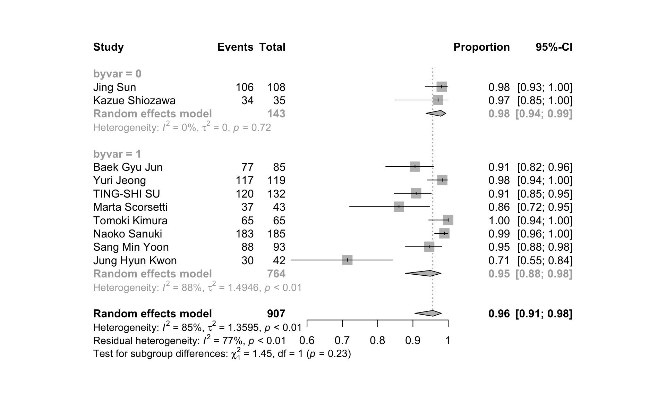
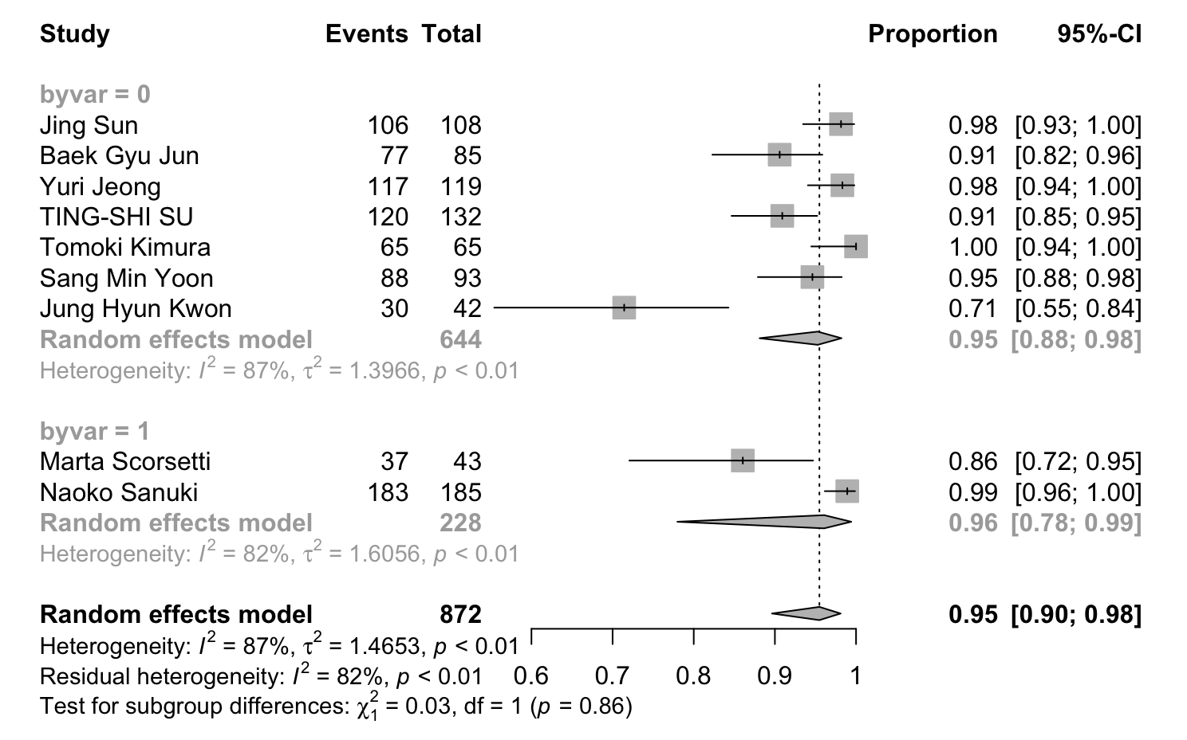
A
B
C
D
E
F
G
Supplementary Figure 3: Forest plots of subgroup comparisons for 1-year LC showing (A) age (median/mean age of <65: 0; ≥65: 1); (B) BED₁₀ dose (median BED₁₀ estimates of ≤100Gy: 0; >100Gy: 1); (C) CP-A percentage (100%: 0; 75-100%: 1; 50-75%: 2); (D) tumor size (median/mean longest diameter of ≤2cm: 0; >2 cm: 1); (E) tumor size (maximum diameter ≤5cm : 0; 5-6cm : 1); (F) pretreatment situation (initial patients: 0; some pretreated: 1); (G) macrovascular invasion (No: 0; Yes: 1).

Slide 4
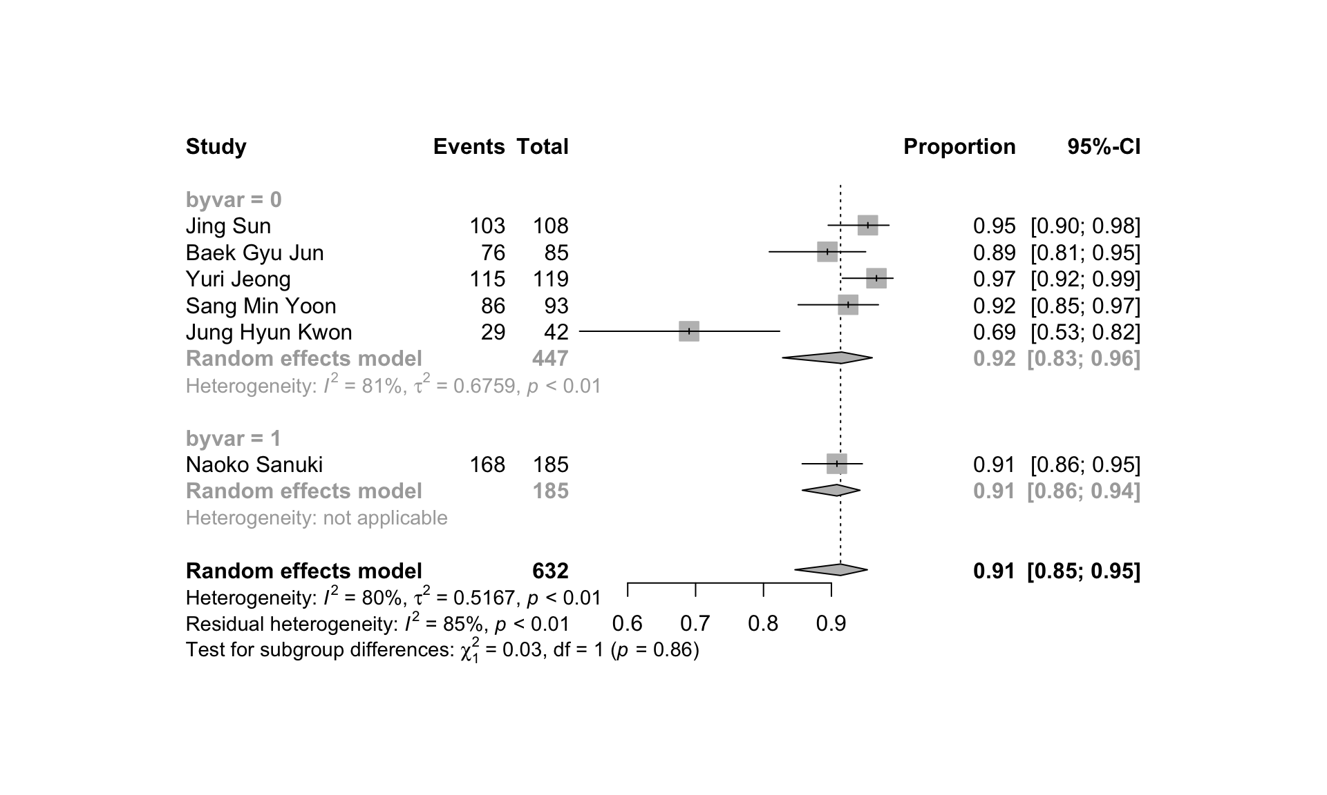
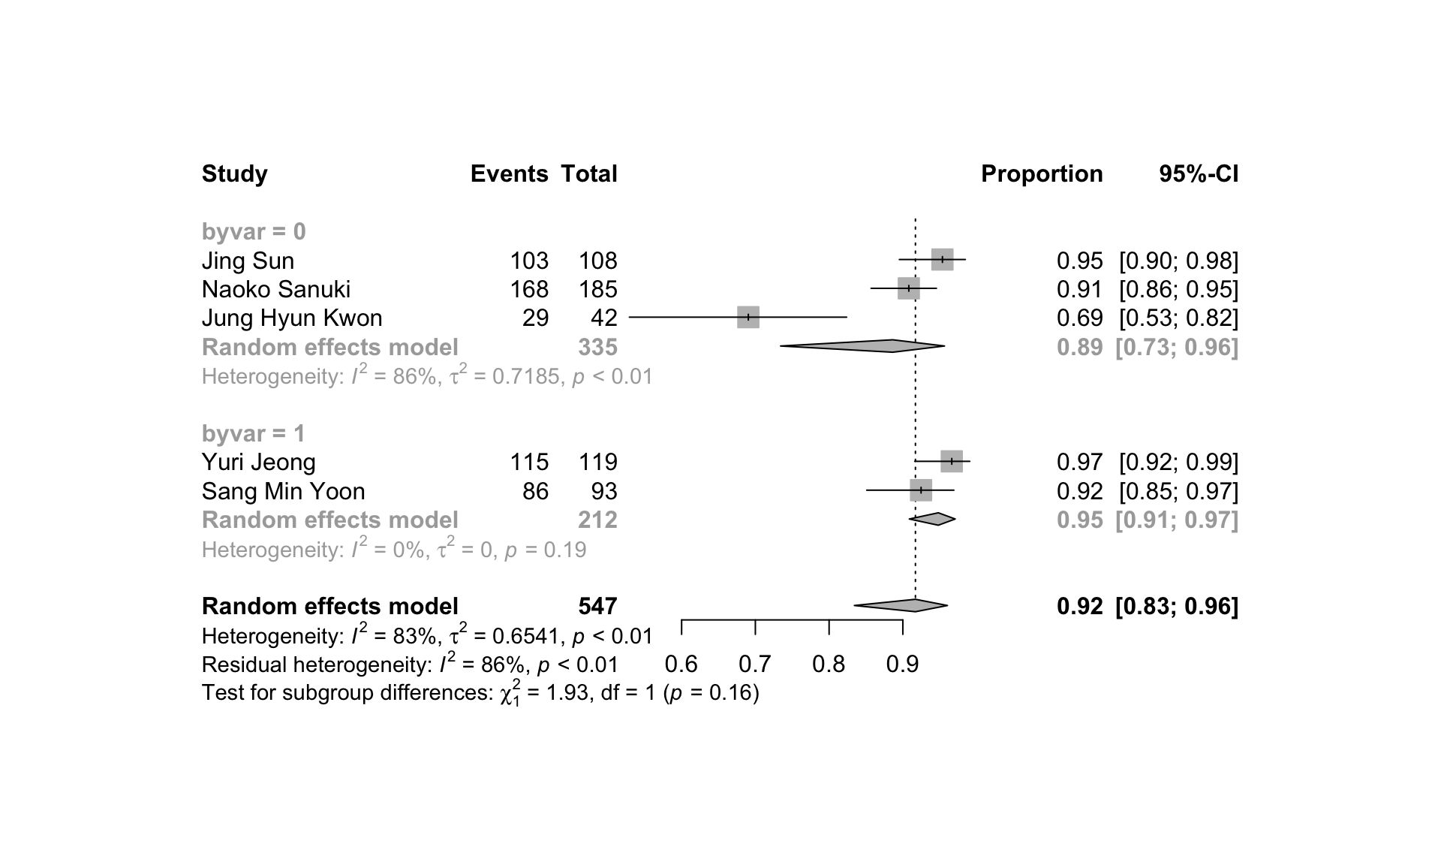
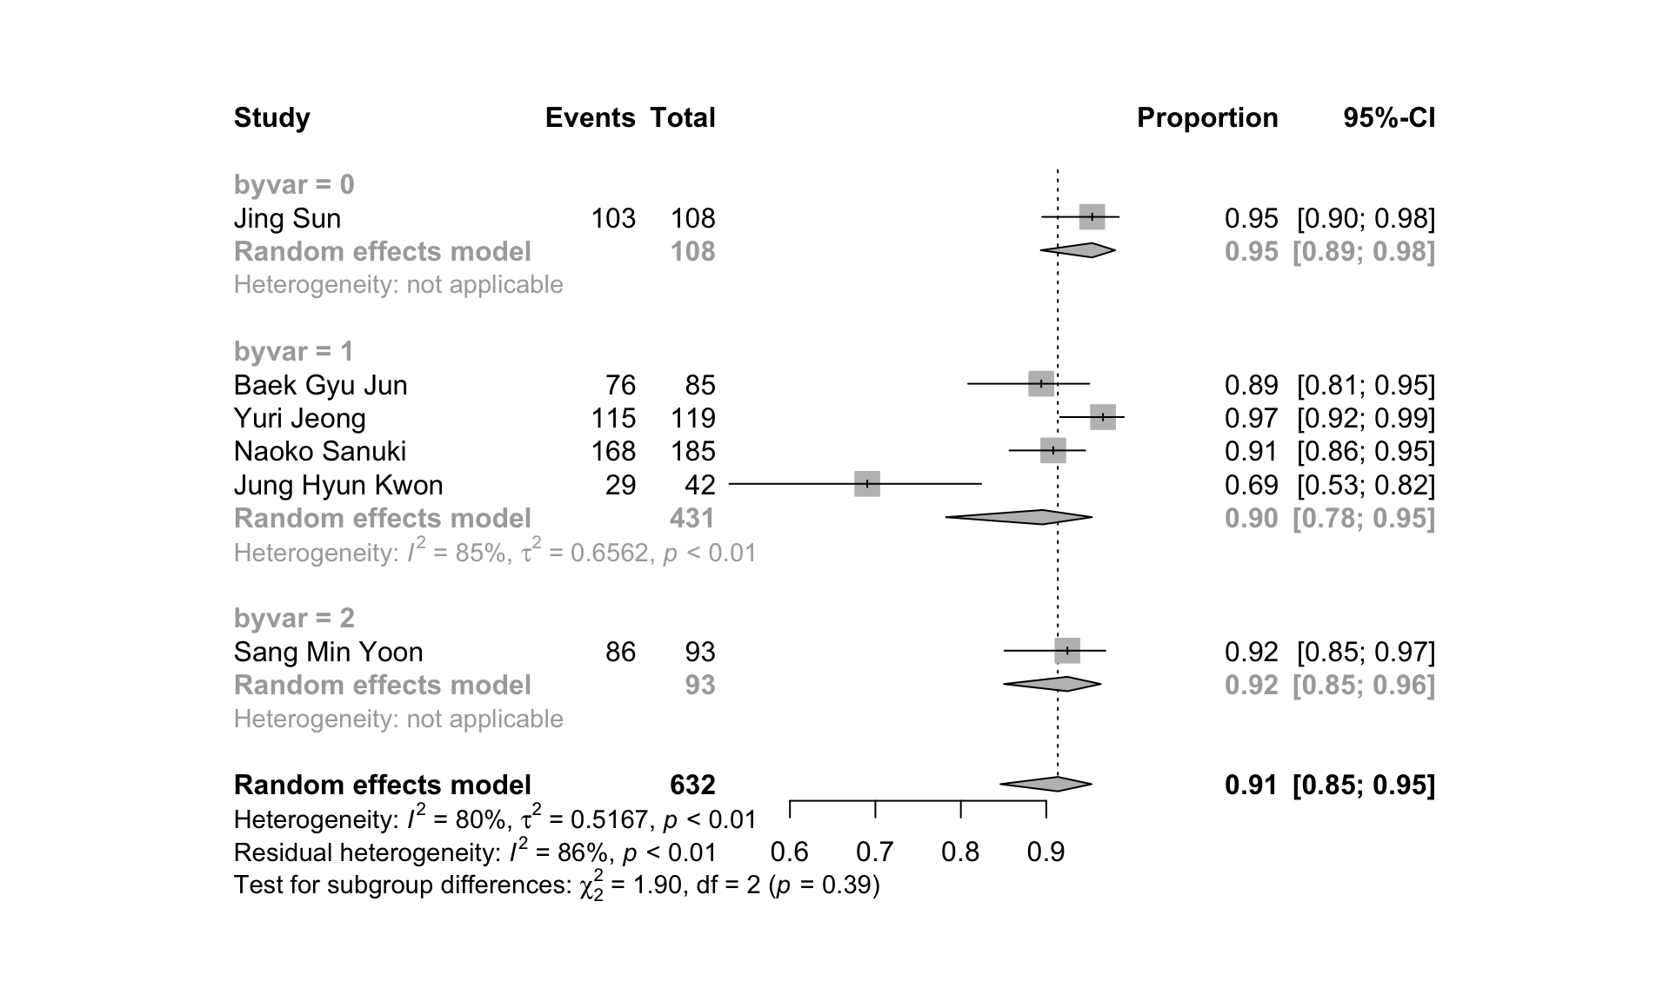
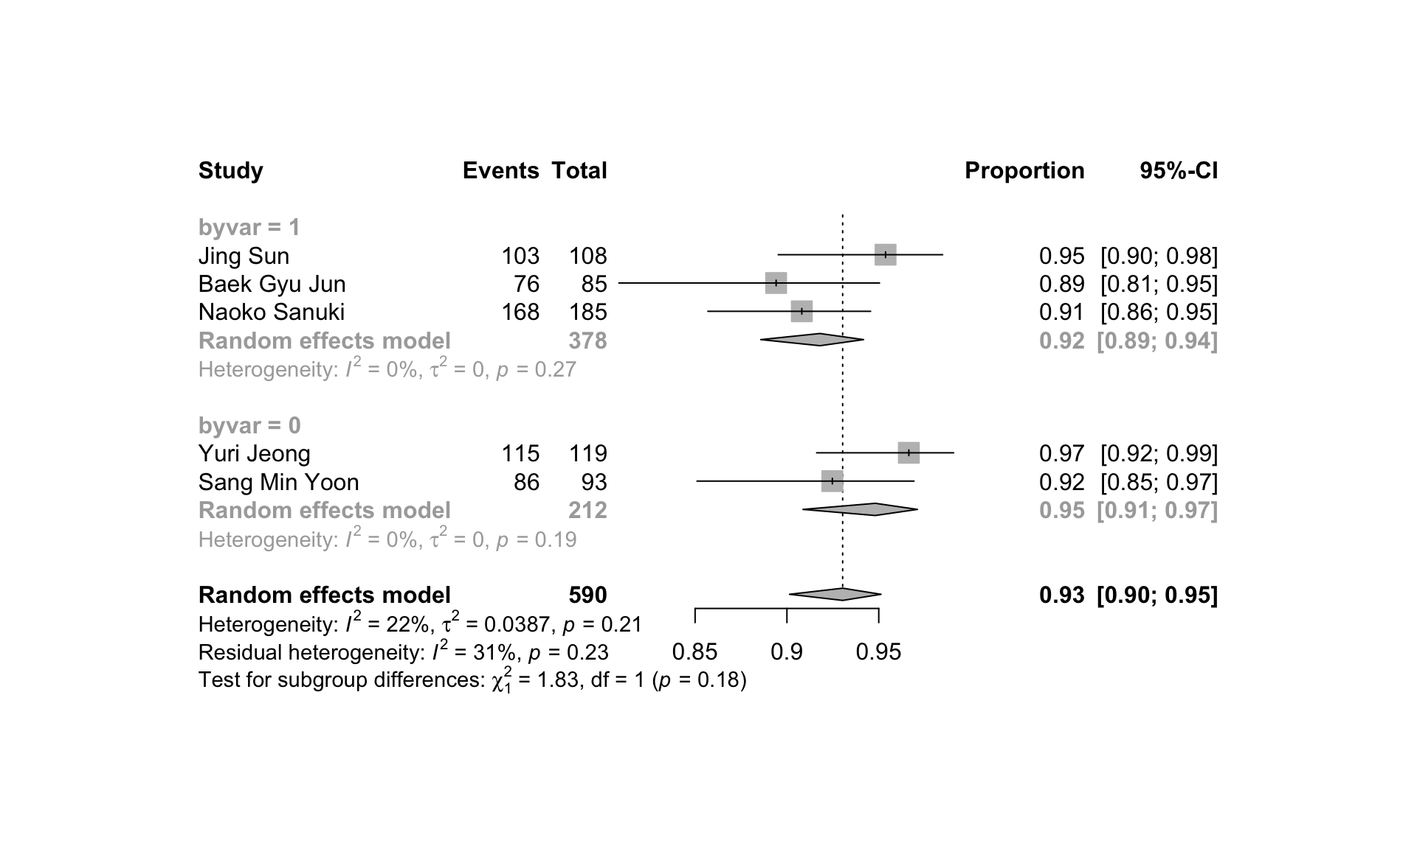
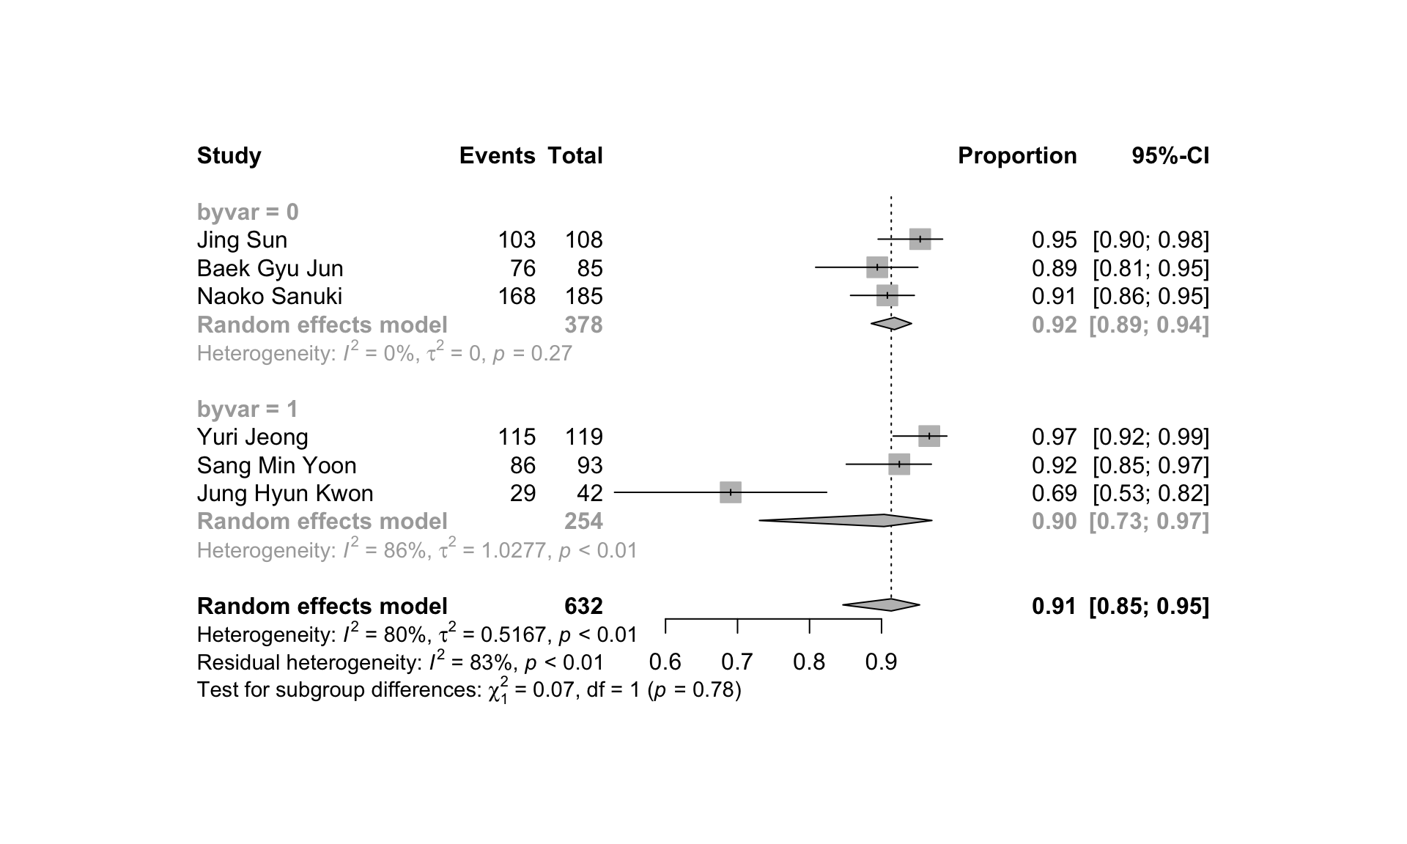
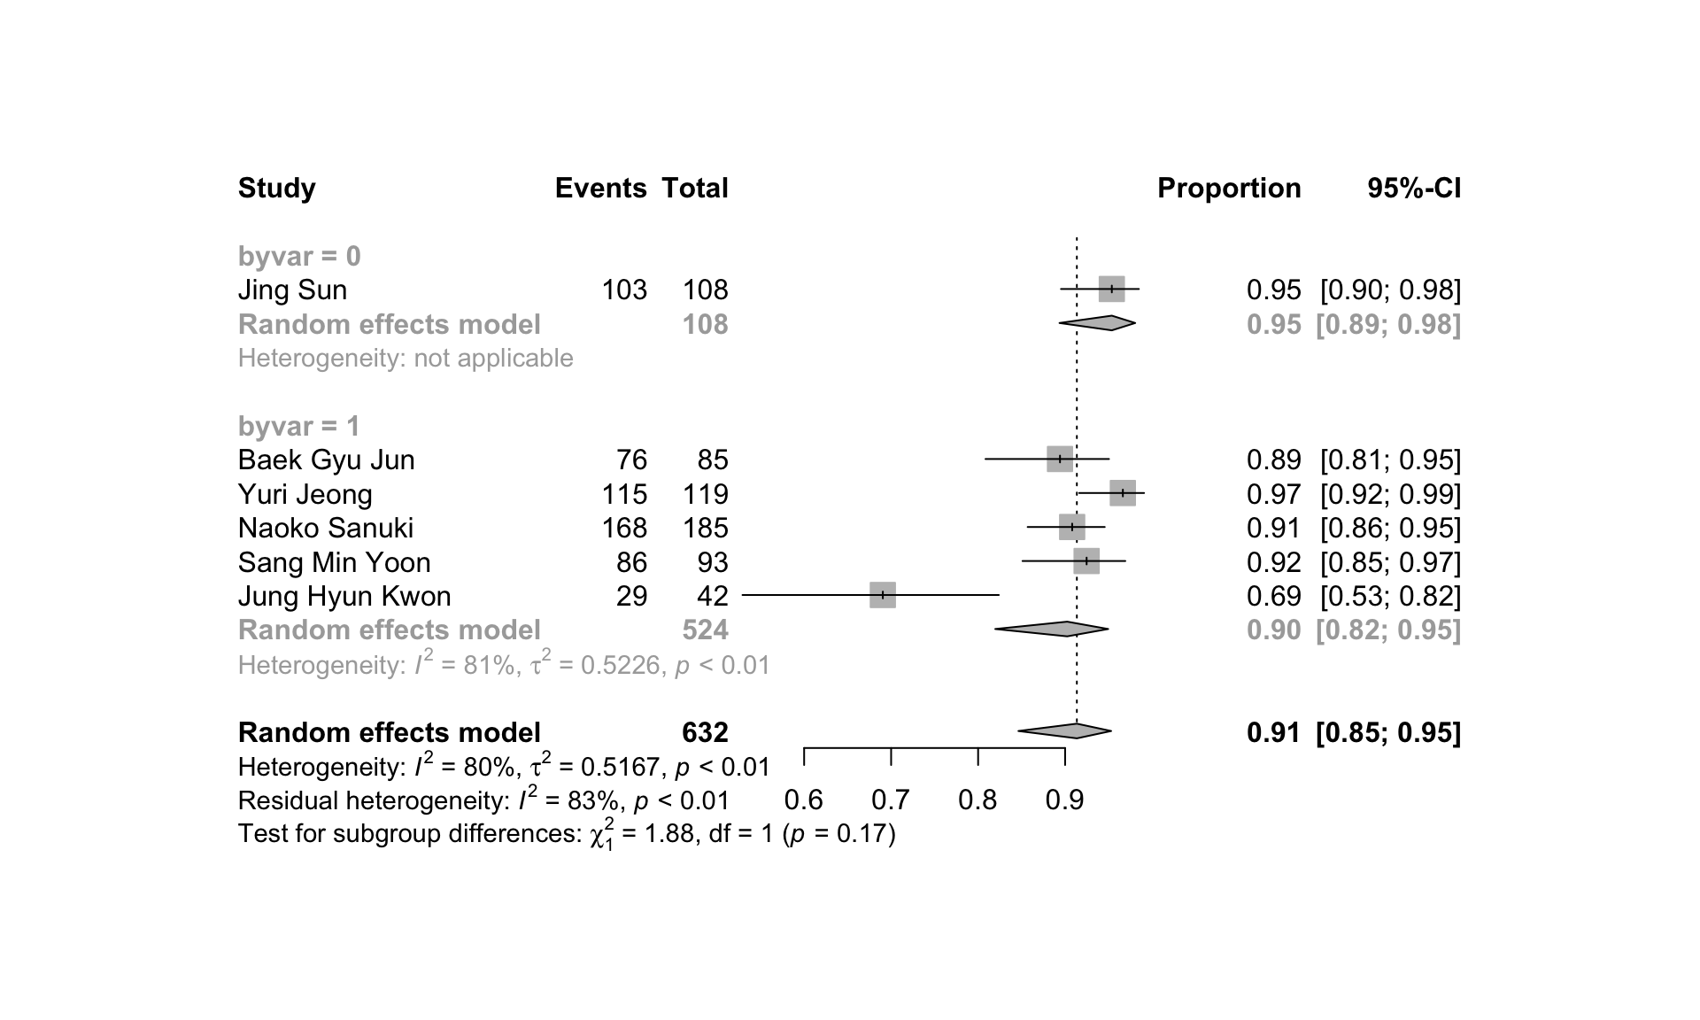
A
B
C
D
E
F
G
Supplementary Figure 4: Forest plots of subgroup comparisons for 3-year LC showing (A) age (median/mean age of <65: 0; ≥65: 1); (B) BED₁₀ dose (median BED₁₀ estimates of ≤100Gy: 0; >100Gy: 1); (C) CP-A percentage (100%: 0; 75-100%: 1; 50-75%: 2); (D) tumor size (median/mean longest diameter of ≤2cm: 0; >2 cm: 1); (E) tumor size (maximum diameter ≤5cm : 0; 5-6cm : 1); (F) pretreatment situation (initial patients: 0; some pretreated: 1); (G) macrovascular invasion (No: 0; Yes: 1).

