Slide 1
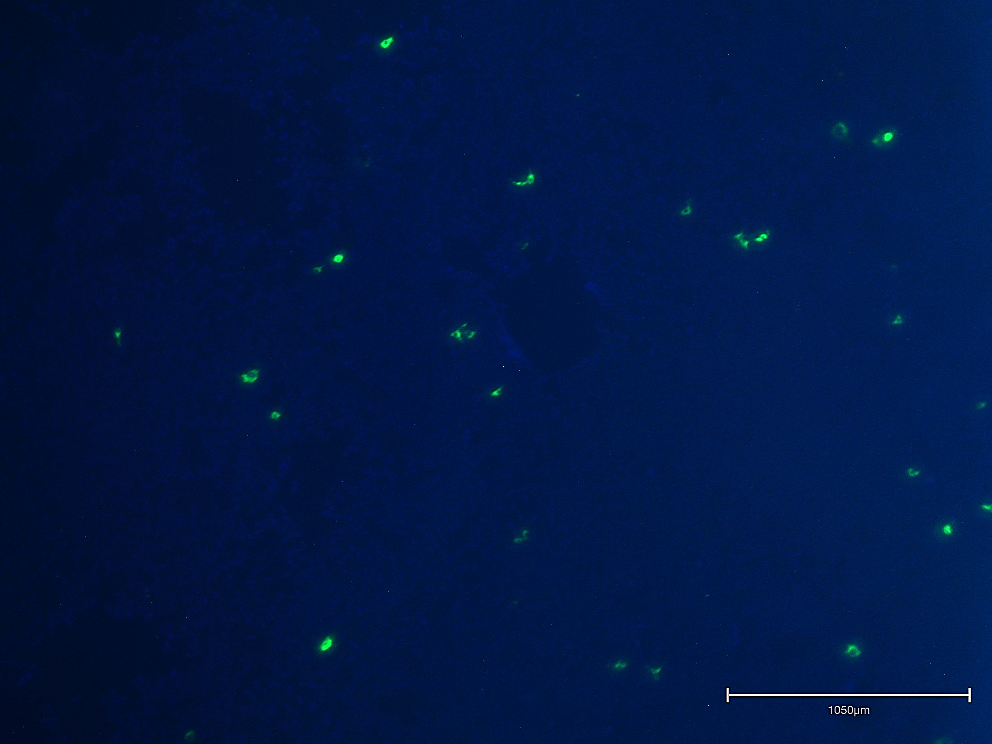
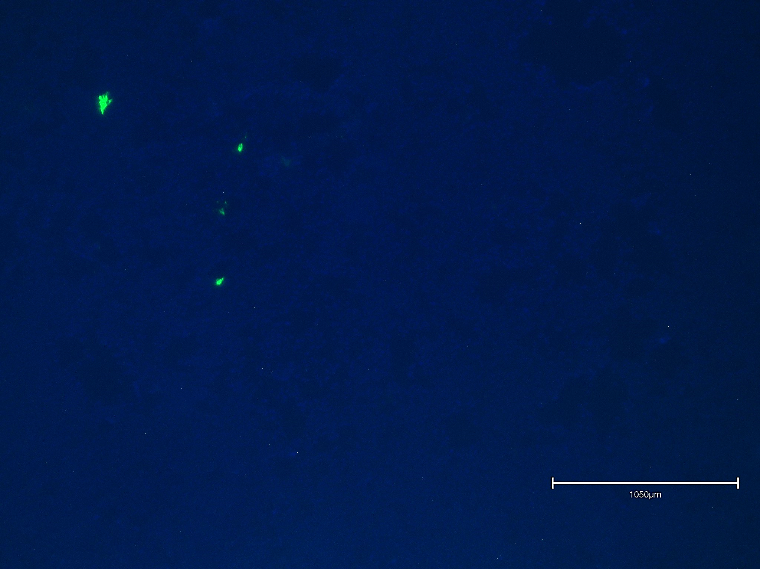
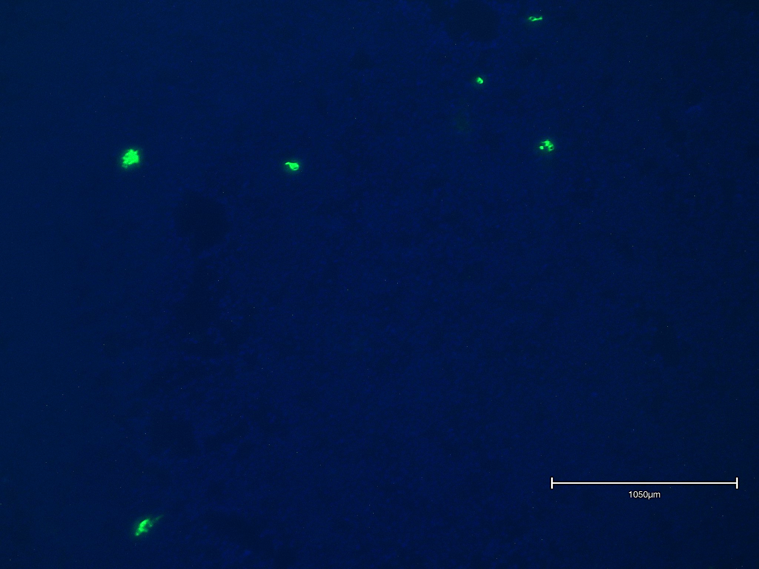
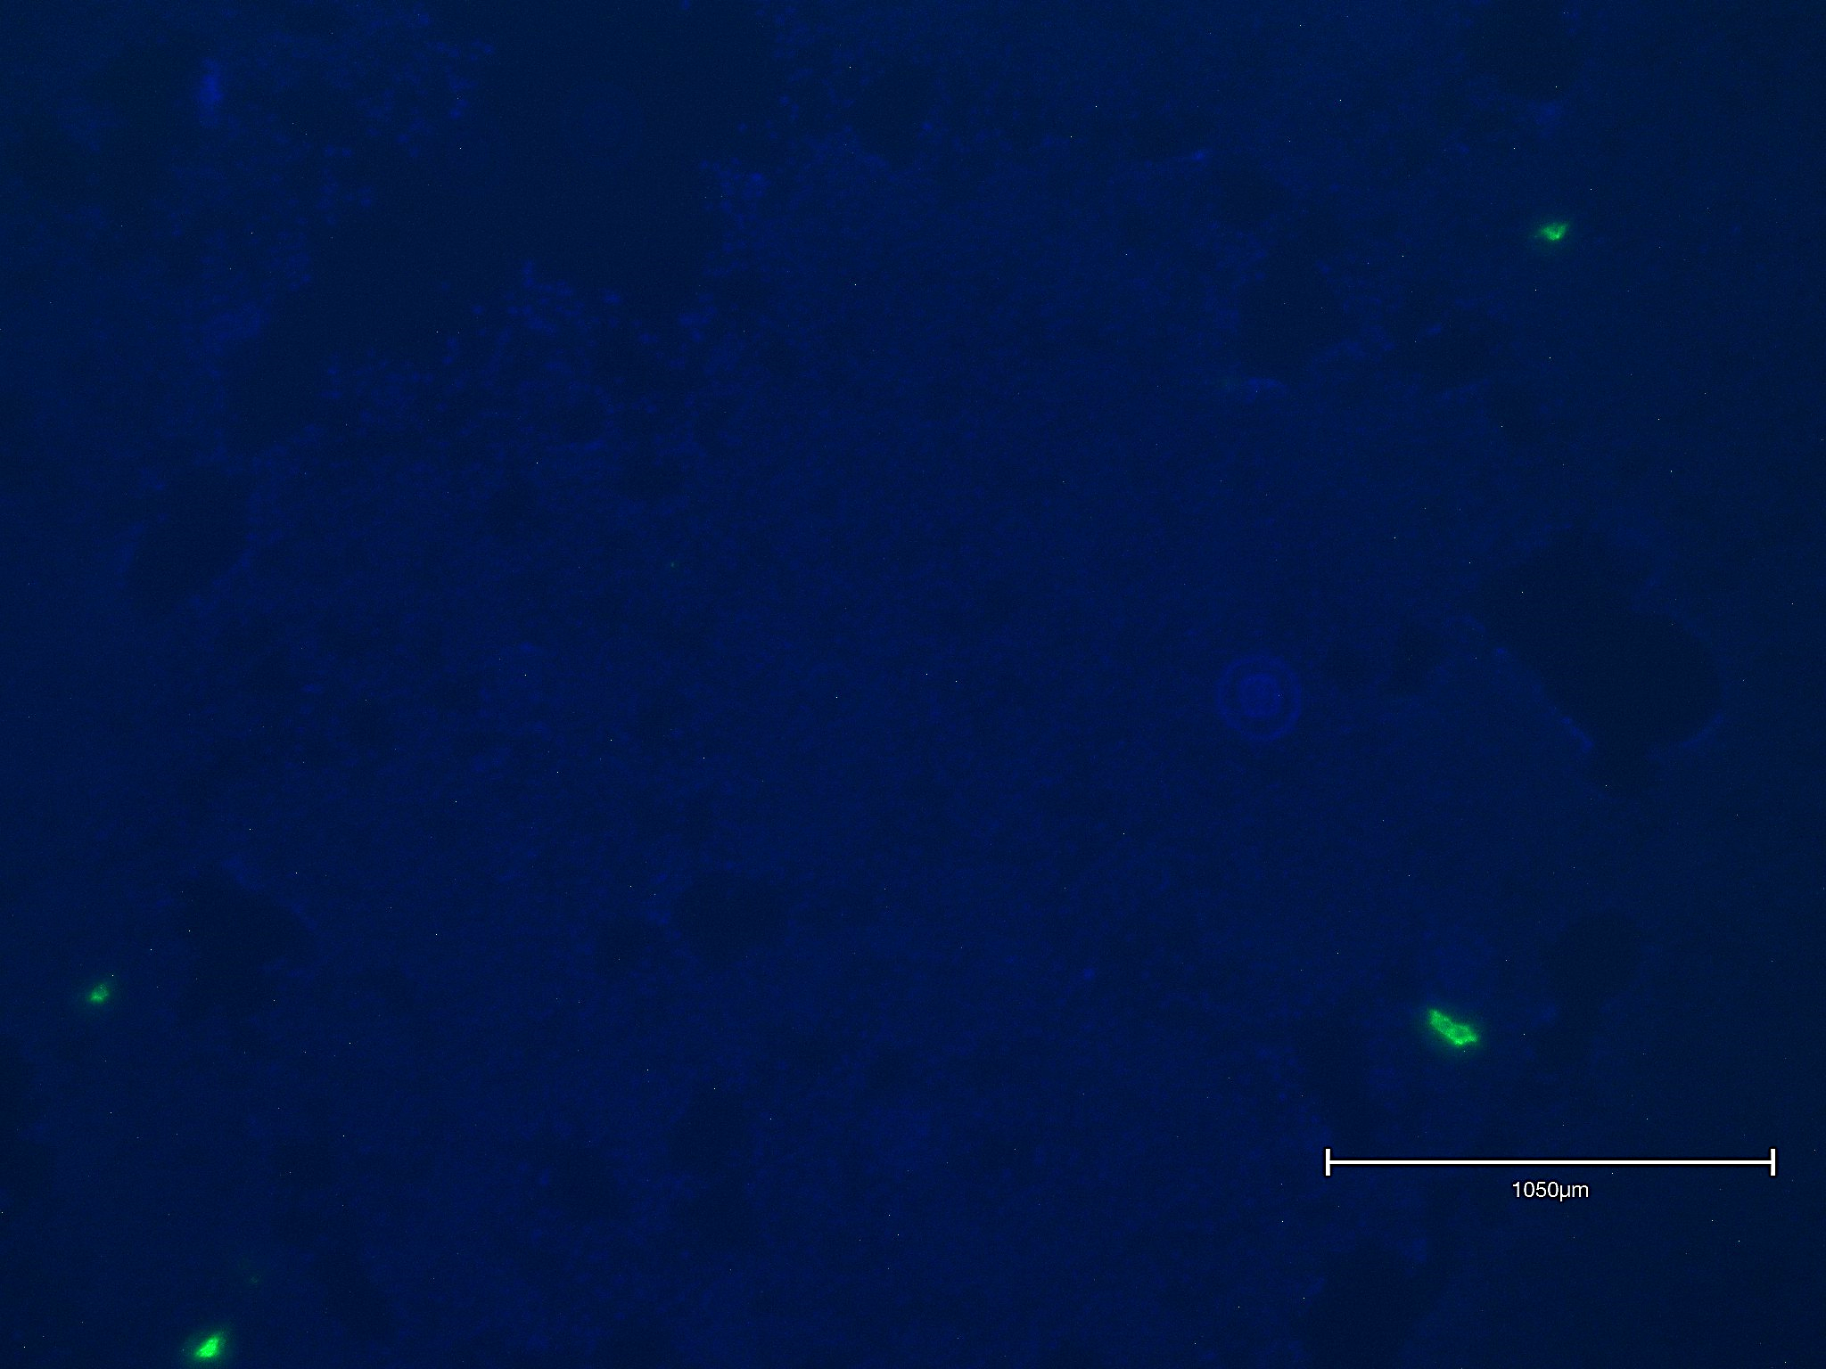
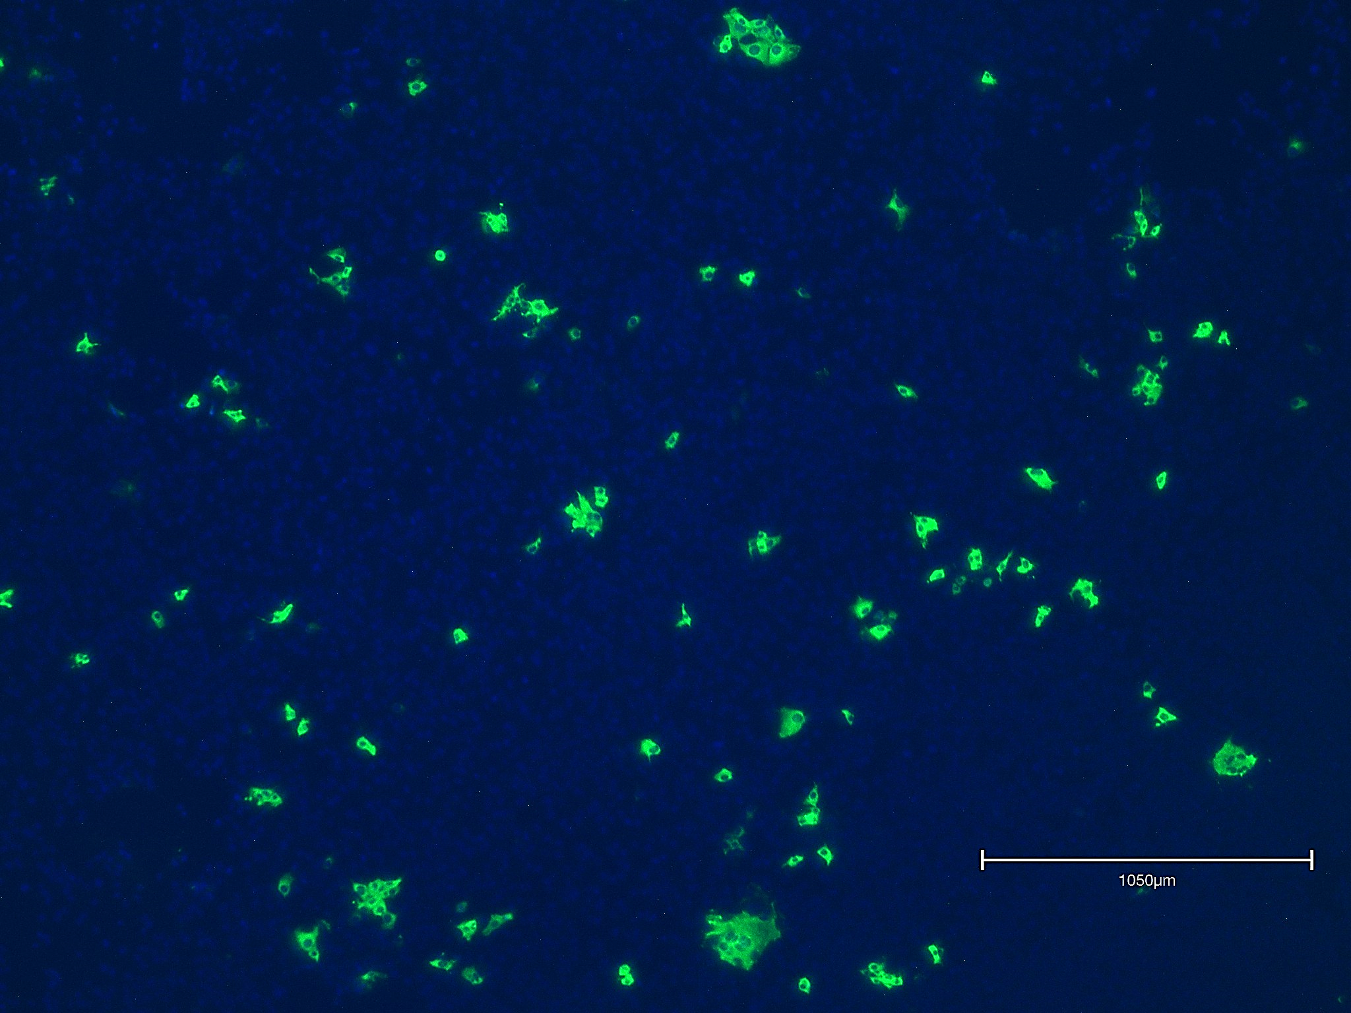
Fig.S1
A
ELISA
B
Neutralization
22C10
42H3
46E6
67B12
Mock

Slide 2
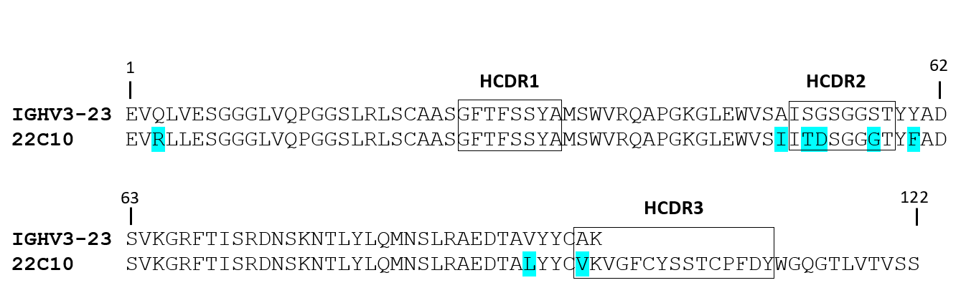
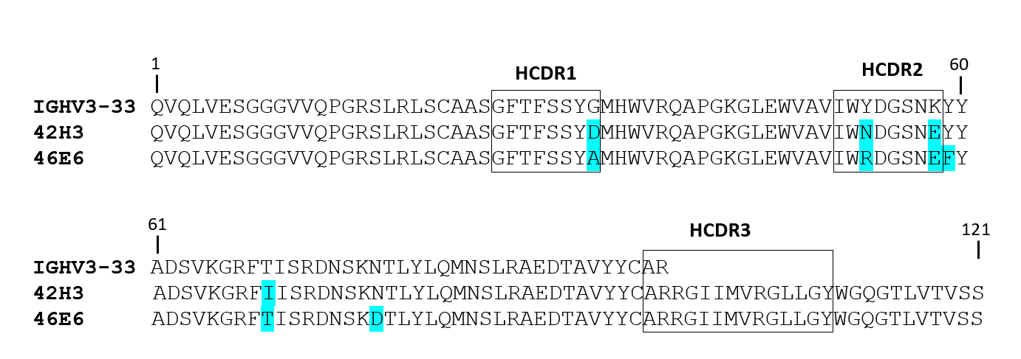
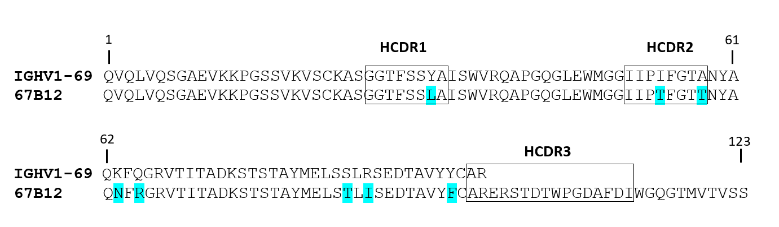
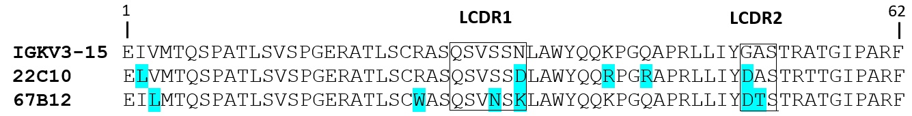
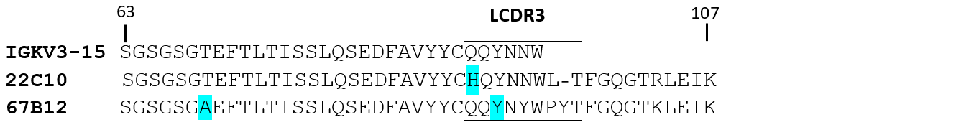
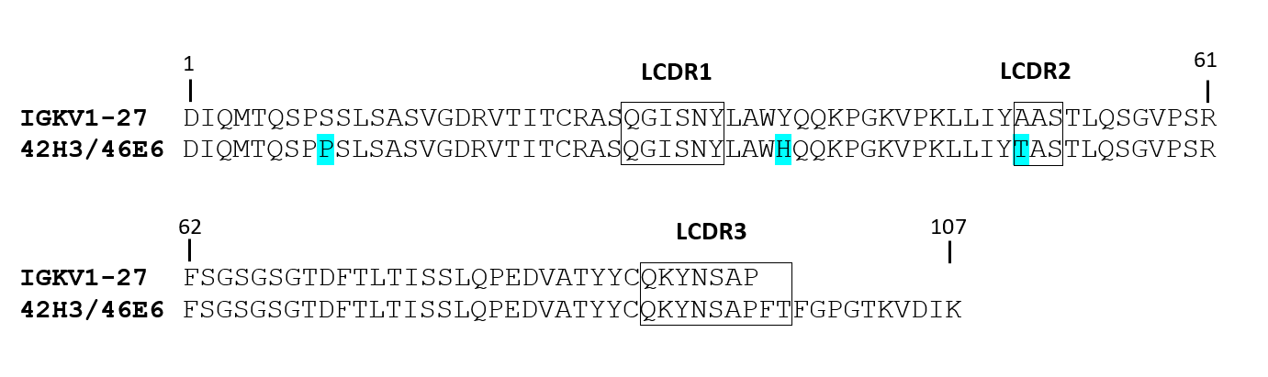
Fig.S2
VH
VL

Slide 3
Fig.S3
A
Binding competition
mAb1
Buffer
mAb2
mAb1
Buffer
mAb2
mAb1
Buffer
mAb2
42H3
46E6
67B12
B
APN receptor binding inhibition

Slide 4
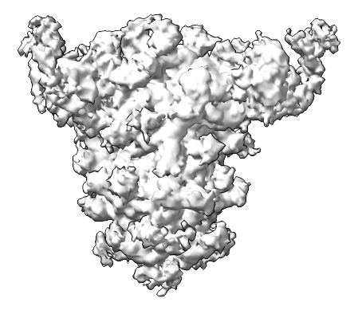
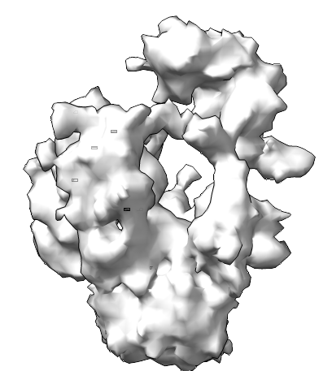
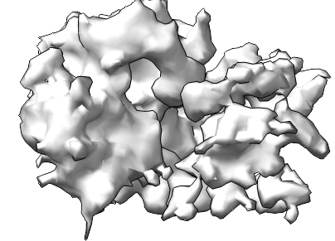
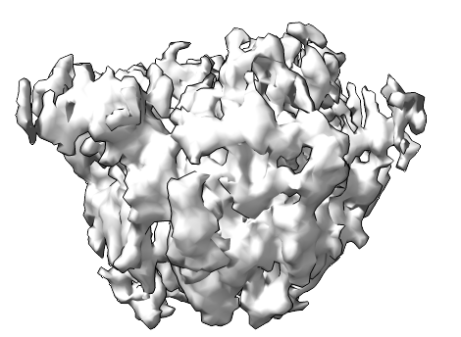
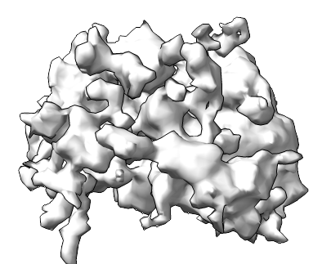
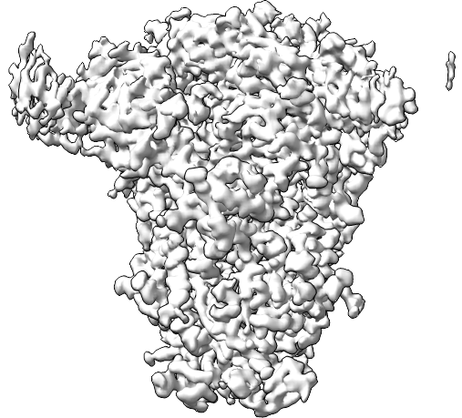
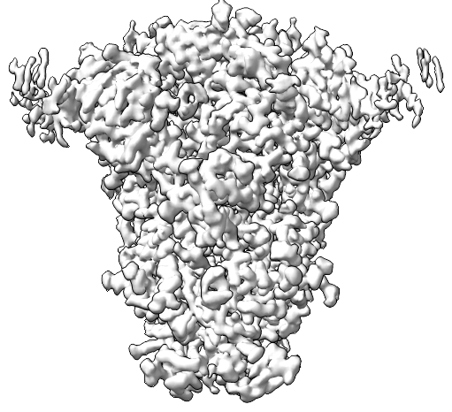
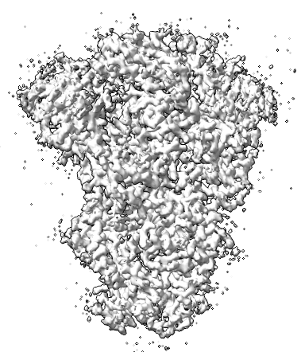
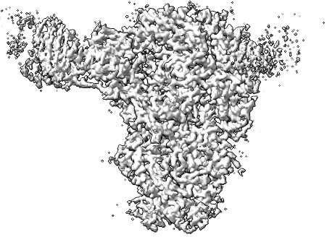
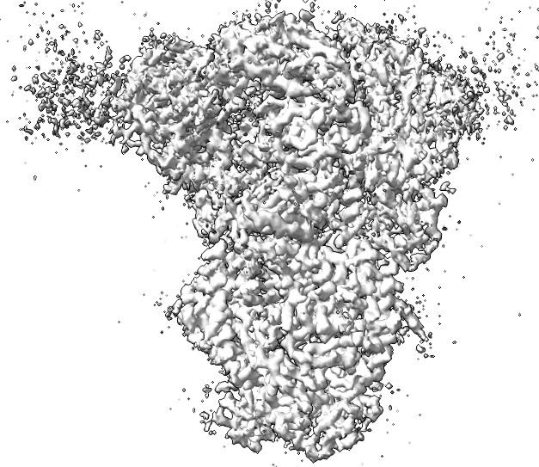
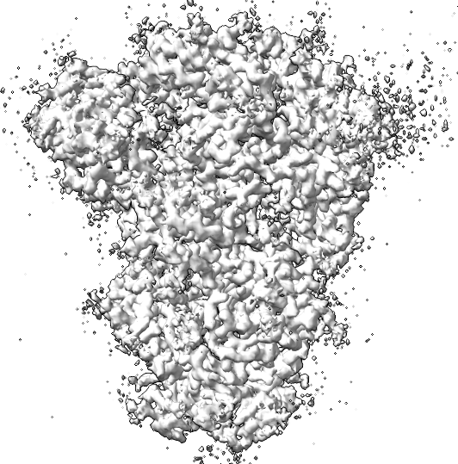
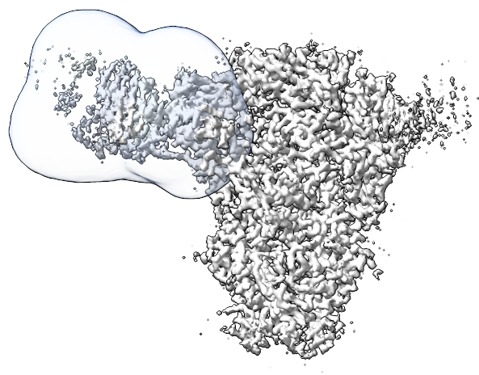
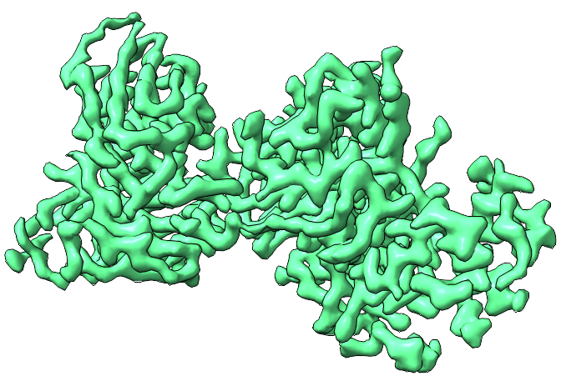
Fig.S4
3,014 movies (0.73 Å/pixel)
cryoSPARC Live
Motion Correction (Output F-crop factor = 0.5)
CTF Estimation
Select micrographs with CTF estimation <10 Å
Blob picker (Min. 150 Å / Max 250 Å)
Extract in 156-pixel box (4.17 Å/pixel)
533,609 particles and 3,013 micrographs
cryoSPARC
1 x 2D classification
Select spike classes
Extract in 360-pixel box (1.92 Å/pixel)
258,686 particles
Ab-initio Reconstruction
Class 1
65.55%
Class 2
5.69%
Class 3
17.16%
Class 4
5.84%
Class 5
5.73%
Non-uniform Refinement
3.10 Å (C1)
168,789
2.96 Å (C3)
168,789
Symmetry expansion
3D variability analysis
Cluster 1
12.42%
Cluster 2
43.58%
Cluster 3
33%
Cluster 4
11%
Local refinement
Mask
3.12 Å (C1)
112,743

Slide 5
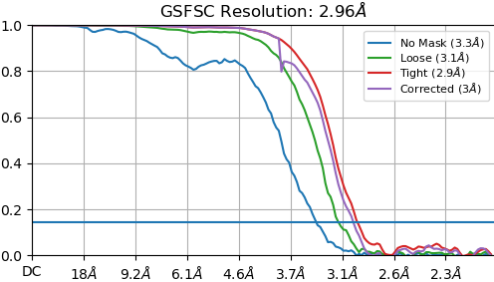
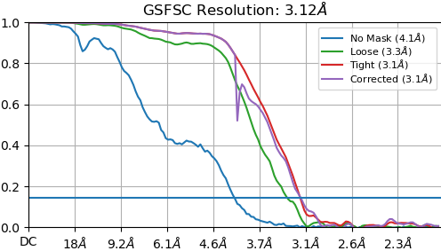
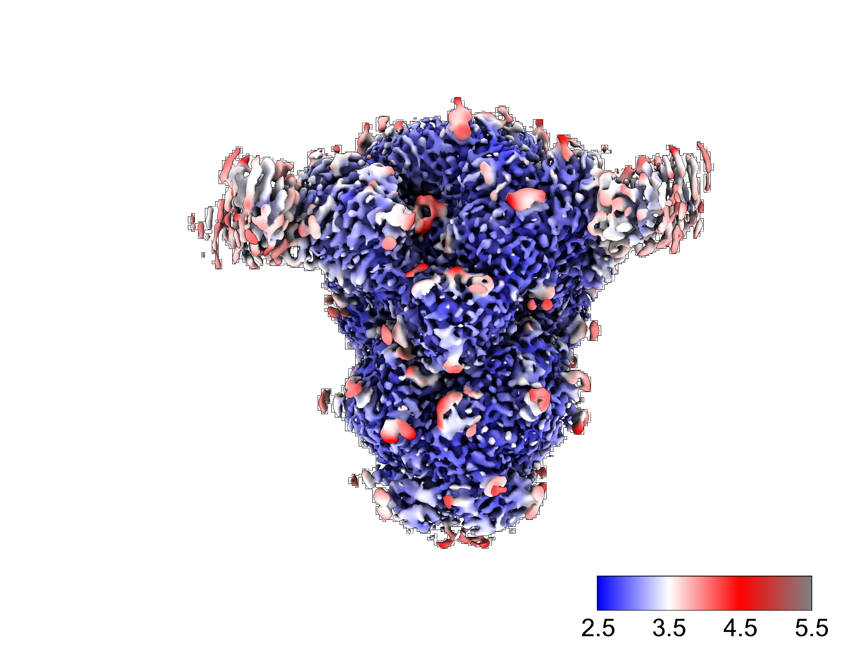
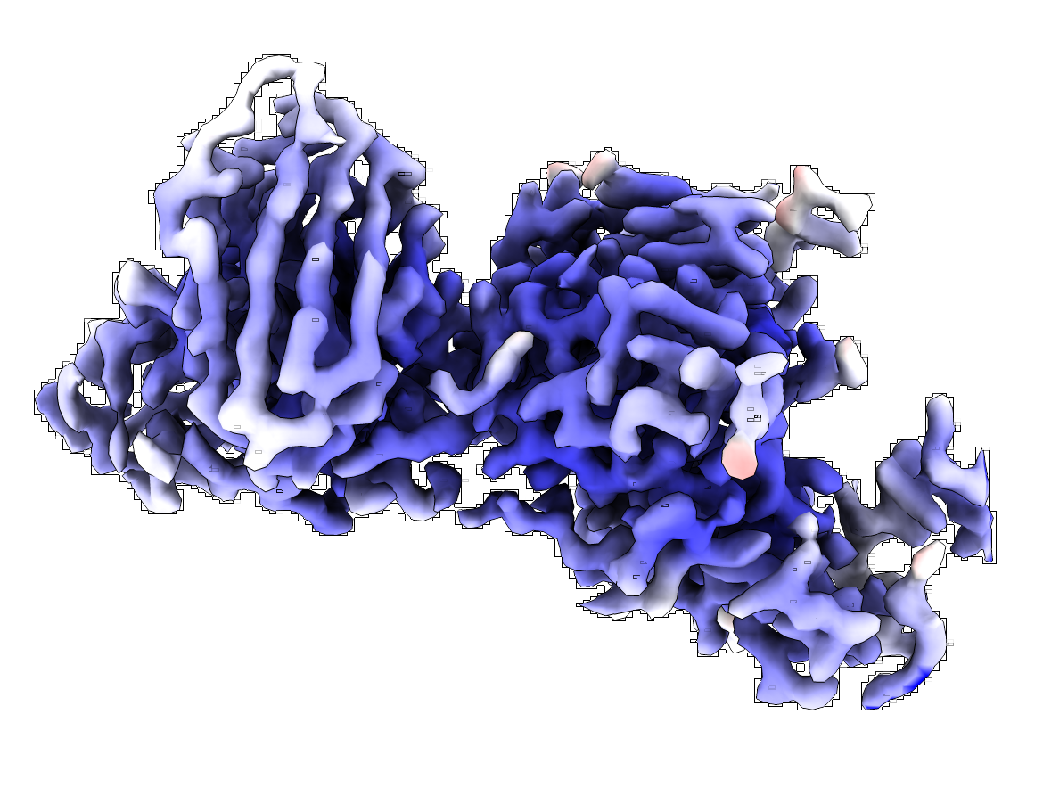
Fig.S5
A
B
C
D

Slide 6
Fig.S6

Slide 8
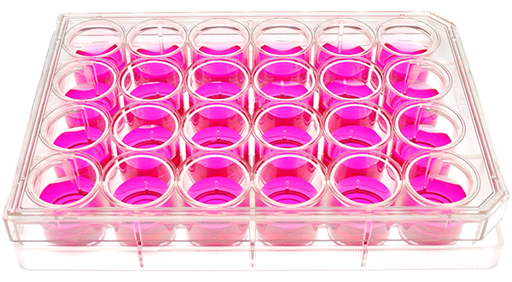
Fig.S7
A
P1
P2
P3
P4
P5
mAb concentration
B
 |  |  | S mutations identified in PDCoV following antibody selection
 | mAb | Clone | S1A | S1B |  | S2
S1A binder | 22C10 | #1 | S231F
 | 22C10 | #2 | del232-234
S1B binder | 42H3 | #1 |  | S362R
 | 42H3 | #2 |  |  | E410G
 | 46E6 | #1 |  | D359A | E410Q
 |  | #2 |  | S362R
 | 67B12 | #1 |  |  |  | V709G
 | 67B12 | #2 |  |  |  | I705S
 | 67B12 | #3 |  |  |  | I705T
 | 67B12 | #4 |  |  |  | I705T | Q1072K
 |  | #5 |  |  | N331T | I705T | Q1072K
 | MOCK1
 | MOCK2

Slide 9
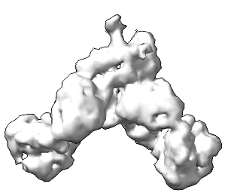
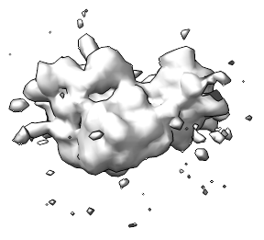
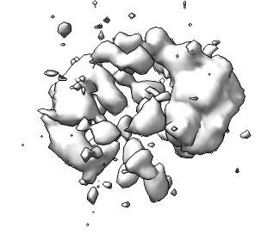
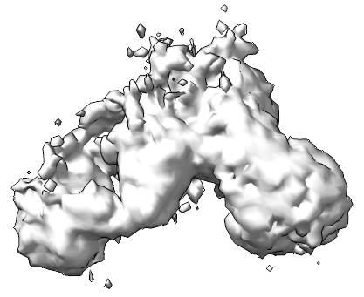
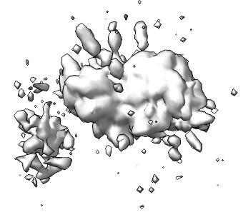
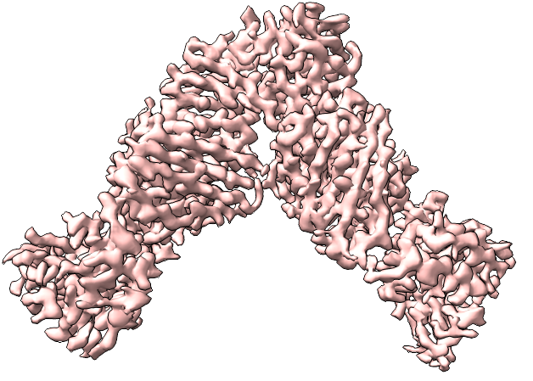
Fig.S8
4,736 movies (0.73 Å/pixel)
Motion Correction (Output F-crop factor = 0.5)
CTF Estimation
cryoSPARC Live
Select micrographs with CTF estimation <10 Å
Blob picker (Min. 50 Å / Max 100 Å)
Extract in 100-pixel box (5.48 Å/pixel)
688,404 particles and 4,733 micrographs
cryoSPARC
1 x 2D classification
Select complex classes
290,120 particles
Ab-initio Reconstruction
Select complex classes
Class 1
51.87 %
Class 2
6.26 %
Class 3
5.89 %
Class 4
28.51 %
Class 5
7.47 %
148,945 particles and 4,674 micrographs
Extract in 300-pixel box (1.83 Å/pixel)
Non-uniform Refinement
3.00 Å (C1)
148,945

Slide 10
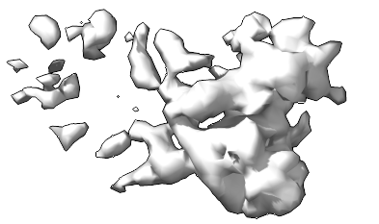
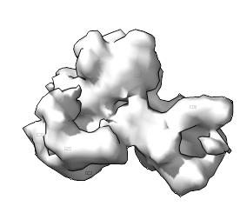
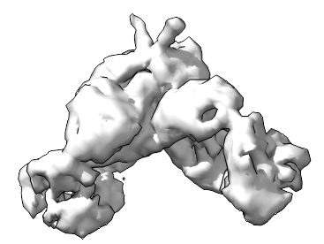
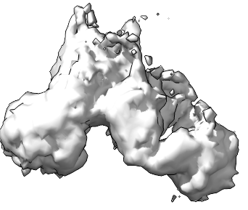
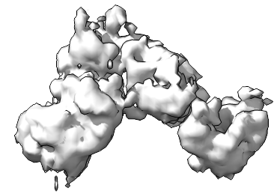
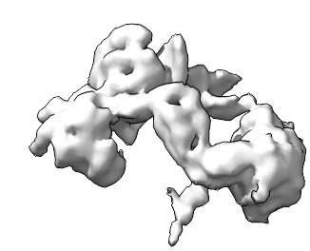
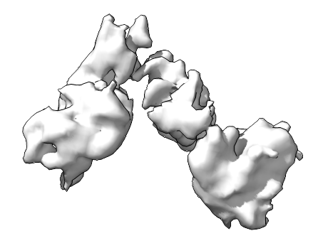
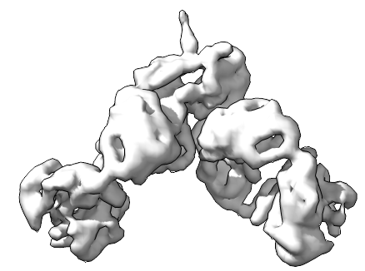
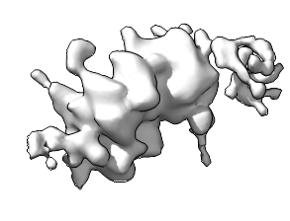
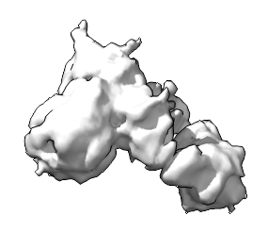
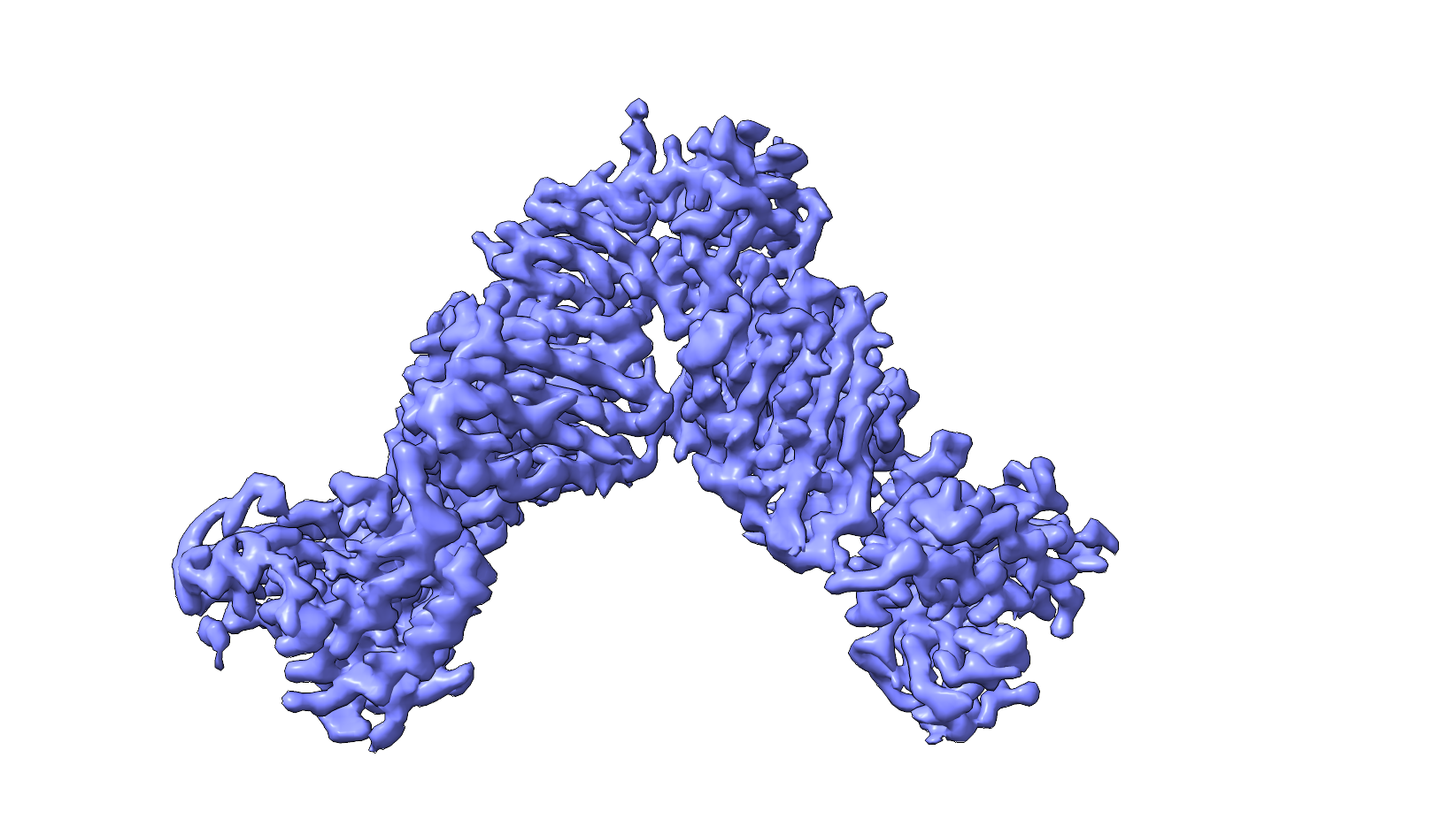
Fig.S9
5,808 movies (0.73 Å/pixel)
Motion Correction (Output F-crop factor = 0.5)
cryoSPARC Live
CTF Estimation
Select micrographs with CTF estimation <10 Å
Blob picker (Min. 50 Å / Max 100 Å)
Extract in 100-pixel box (5.48 Å/pixel)
770,966 particles and 5,796 micrographs
cryoSPARC
1 x 2D classification
320,184 particles
Select complex classes
Ab-initio Reconstruction
Reference volumes
Class 1
11.14%
Class 2
21.93 %
Class 3
32.63 %
Class 4
7.97 %
Class 5
26.96 %
692,375 particles
Hetero Refinement
Class 1
14.78 %
Class 2
17.82 %
Class 3
40.08 %
Class 4
9.59 %
Class 5
17.73 %
1 x 2D classification
Select complex classes
245,068 particles and 5,706 micrographs
Extract in 300-pixel box (1.83 Å/pixel)
Non-uniform Refinement
2.85 Å (C1)
245,068

Slide 11
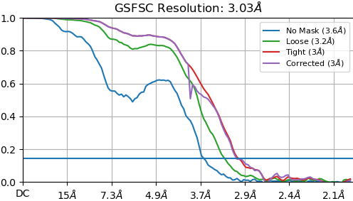
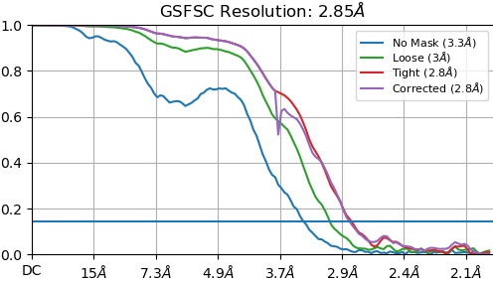
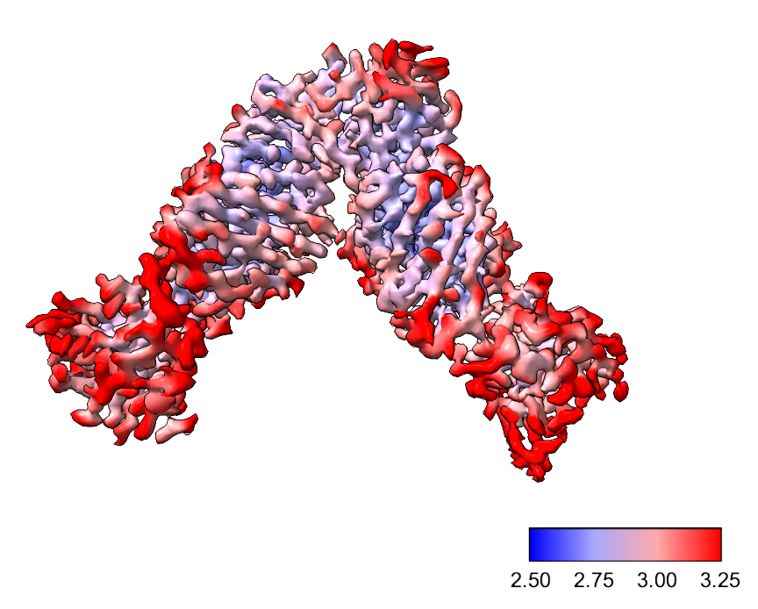
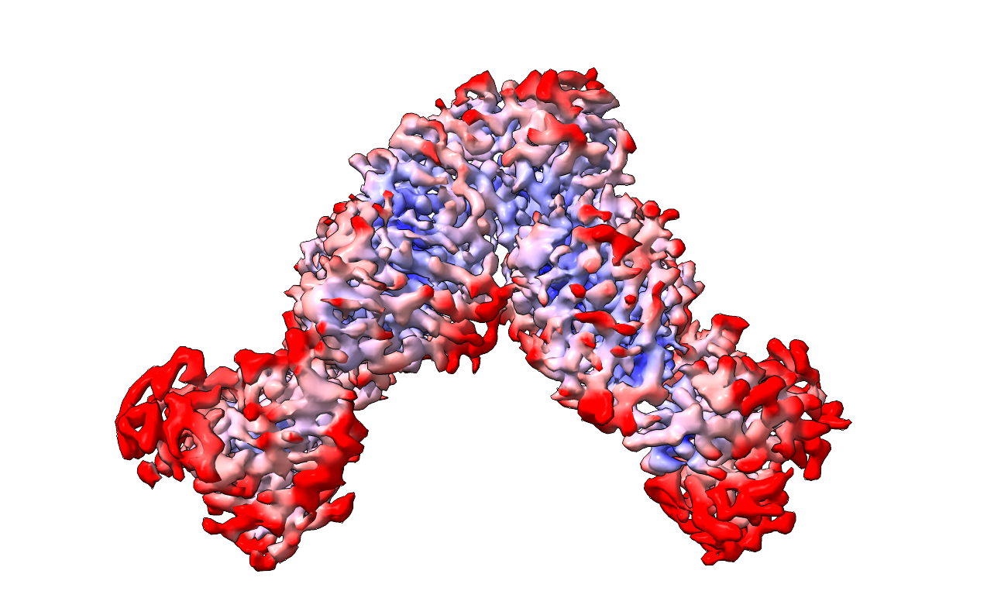
Fig.S10
A
B
C
D

Slide 12






Fig.S11
A
S1B
67B12
S1B
42H3
67B12
S1B
42H3
B
Notes:
No binding of S1B binders to Secto-treated with either 50C, 70C, 80C . Only the 60C works out.

Slide 13




Fig.S12
A
S1/S2
B
S1/S2
NTD
S1B
S1C
S1D
F
FPPR
S1C
S1D
FPPR
P
52
NTD
277
S1B
14
306
301
422
485
564
689
712
768
331
528
591
686
816
828
853
910
S1B
S1B
S1C
S1C
FPPR
S1D
S1D
FPPR
C
D
S1C
S1C
FPPR
I705
FPPR
S1D
K854
D614
V709
S1D

Slide 14
Table.S1 Cryo-EM data collection, refinement and validation statistics

