Slide 1
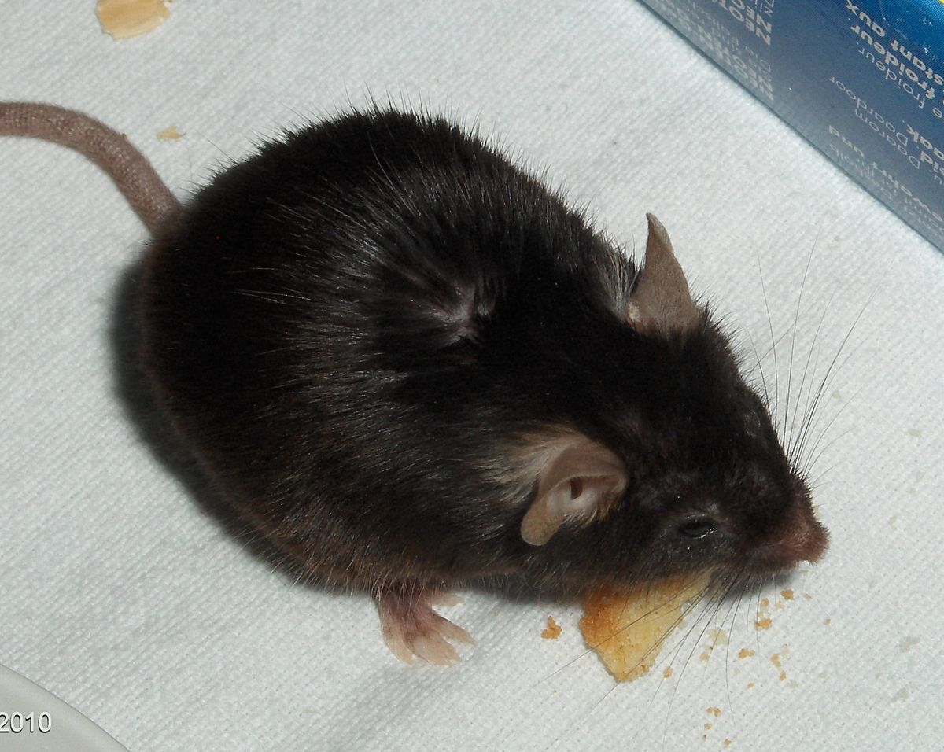
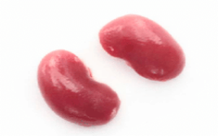

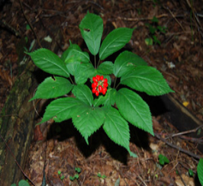

Graphical abstract
North American ginseng root (oral gavage 200 mg/Kg b.w for 1 and 2 months)
High Glucose 25 mM
Streptozotocin-induced diabetic mice
5’-Aza-Dc
Genomic DNA
HUVECs and HMECs (24,48 and 72 h)
Kidney
Genomic DNA
Oxidative stress
Bisulfite conversion of genomic DNA
Hot-start PCR of Alu, B1 and LINE-1 elements
Oxidative stress
TRANSCRIPTIONAL ACTIVATION & GENE UPREGULATION
Quantification of
methylated DNA by ELISA
DNA methylation status of the
FN1, VEGF, and EDN1 gene promoters
analysed by EpiTect Methyl II PCR

