Slide 1
Table 1
Groups | Body wt. (g) | Blood Glucose (mmol/L) | Glycohemoglobin (%) | Plasma insulin mU/L
C1 (1 month) | 32±2.4 | 8.85±2.7 | 6.23±0.9 | 2.81±0.3
CT1 (1 month) with ginseng | 32±2.1 | 8.88±2.5 | 6.33±0.8 | 2.83±0.35
D1(1month) | 18.1±1.3 | 28.4 ±8.5 | 8.9± 0.9 | 1.48±0.14
DT1 + ginseng (1month) | 29.2±2.7 | 14.28±4.5 | 6.75±0.5 | 1.89±0.14
C2 (2 months) | 30±4.5 | 7.9±1.52 | 6.0±1.4 | 2.79±0.13
CT2 (2 months) with ginseng | 31±3.5 | 7.8±1.42 | 6.1±1.3 | 2.81±0.12
D2 (2 months) | 22.5±1.12 | 27.96 ±5.72 | 10.1±2.10 | 1.18±0.24
DT2 + ginseng (2 months) | 29.6±2.1 | 9.26±2.5 | 7.34±0.7 | 2.1±0.24
*C: Controls (C1: 1 month and C2: 2 months), CT: Control Treated (CT1: 1 month and CT2: 2 month) D1: Diabetic (1 month), DT1: Diabetic treated with ginseng for 1 month, D2: Diabetic (2 months) and DT2: Diabetic treated with ginseng for 2 months, * p<0.05 vs. corresponding controls and ginseng treated groups.

Slide 2
Table 2: DNA methylation status of the CpG islands associated with FN, VEGF and EDN1 gene promoters. M: Methylated; UM: Unmethylated; LG Vs HG for HUVECs and HMECs p<0.05, Control Vs Diabetic p<0.05.
HUVECs |  | LG (5mmol Glucose) |  | HG (25mmol Glucose)
 |  | M | UM | M | UM
 | VEGF | 79.25±2.04 | 20.75±2.01 | 92.5±0.96 | 7.5±1.035
 | FN | 77.25±2.03 | 22.75±3.04 | 90.35±0.86 | 9.65±0.81
 | EDN1 | 75.15±3.03 | 24.85±2.50 | 80.25±2.86 | 19.75±1.86
HMECs
 | VEGF | 77.65±2.07 | 22.35±4.07 | 89.5±0.99 | 11.5±1.045
 | FN | 70.25±4.09 | 29.75±1.04 | 88.35±0.66 | 11.65±0.51
 | EDN1 | 76.15±2.09 | 25.85±4.04 | 85.35±3.65 | 14.65±1.51
Renal Tissues |  | Control |  | Diabetic
 | VEGF | 65.65±2.17 | 34.35±4.67 | 79.5±1.21 | 21.5±1.10
 | FN | 70.25±4.09 | 29.75±1.04 | 82.5±1.66 | 17.5±.2.50
 | EDN1 | 78.45±3.90 | 21.55±3.20 | 87.15±2.66 | 12.85±.1.90

Slide 3
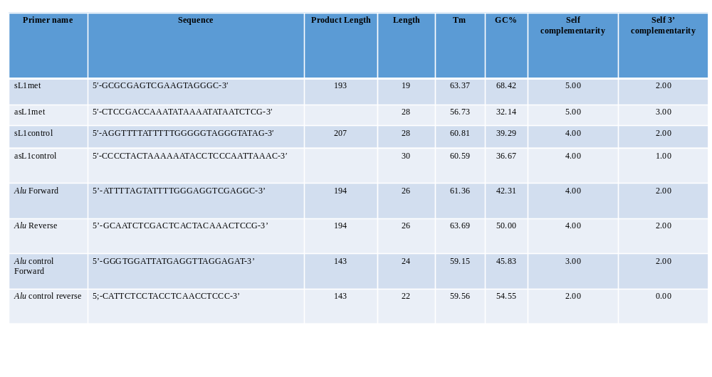
Table3

