Slide 1
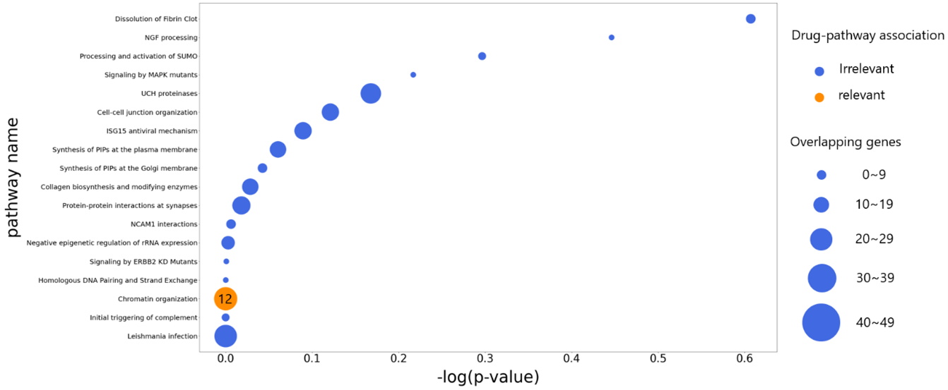
Supplementary Fig. 3
Pathway
Dissolution of Fibrin Clot
NGF processing
Processing and activation of SUMO
Signaling by MAPK mutants
UCH proteinases
Cell-cell junction organization
ISG15 antiviral mechanism
Synthesis of PIPs at the plasma membrane
Synthesis of PIPs at the Golgi membrane
Collagen biosynthesis and modifying enzymes
Protein-protein interactions at synapses
NCAM1 interactions
Negative epigenetic regulation of rRNA expression
Signaling by ERBB2 KD Mutants
Homologous DNA Pairing and Strand Exchange
Chromatin organization
Initial triggering of complement
Leishmania infection
Drug-pathway association
Irrelevant
Relevant
Overlapping genes
0-9
10-19
20-29
30-39
40-49
-log(p-value)
Supplementary Figure 3. Enriched signaling pathways and overlapping genes. The x-axis represents the significance of gene expression in the signaling pathways, where higher values indicate more significant expression of the important genes within the pathways. The y-axis represents the signaling pathways derived from the analysis of these important genes. The orange color represents the signaling pathways associated with Panobinostat. The size of the circles corresponds to the overlap of important genes in the signaling pathways, with larger circles indicating a greater degree of overlap.

