Slide 1
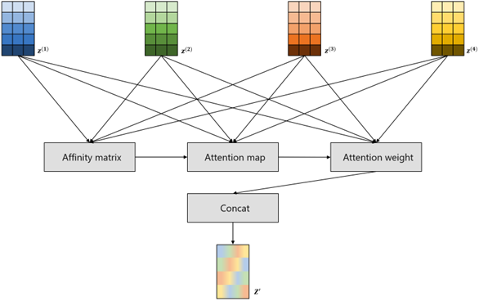
Supplementary Fig. 2
Z⁽¹⁾
Z⁽²⁾
Z⁽³⁾
Z⁽⁴⁾
Affinity matrix
Attention map
Attention weight
Concat
Z’
Supplementary Figure 2. The architecture of the attention module. The module incorporates information exchange between omics data through learnable matrices to learn the affinity matrices for each pair of omics data.

