Slide 1
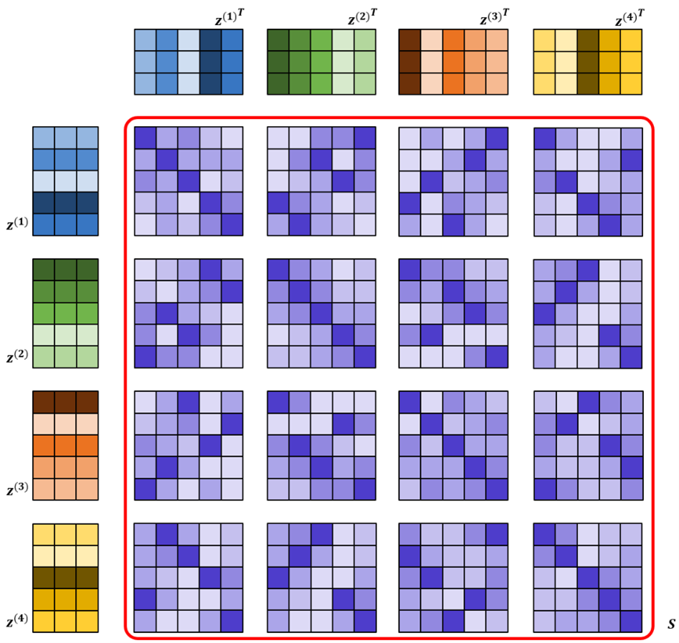
Supplementary Fig. 1
Supplementary Figure 1. Schematic representation for calculating sample similarity in the latent alignment module. This enables us to capture the differences between each omics data in the same sample in the latent space.

