Slide 1
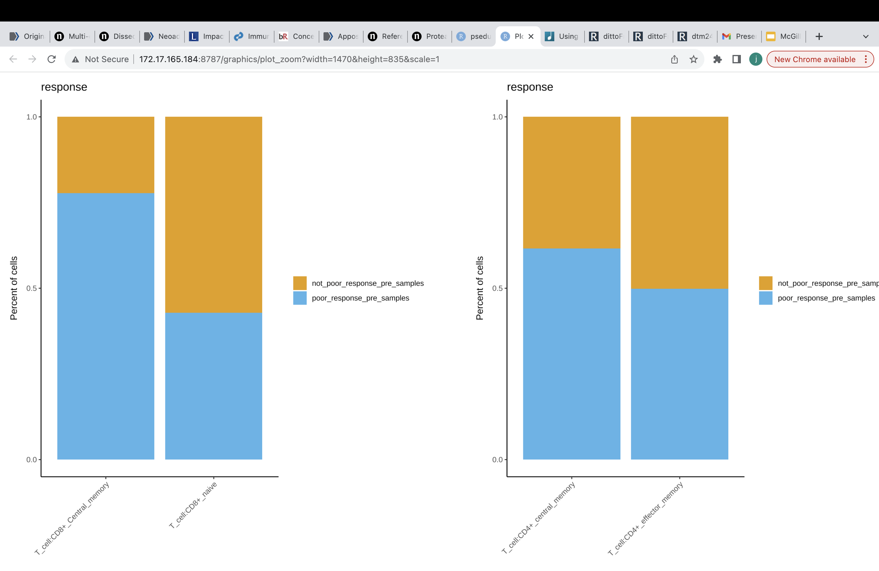
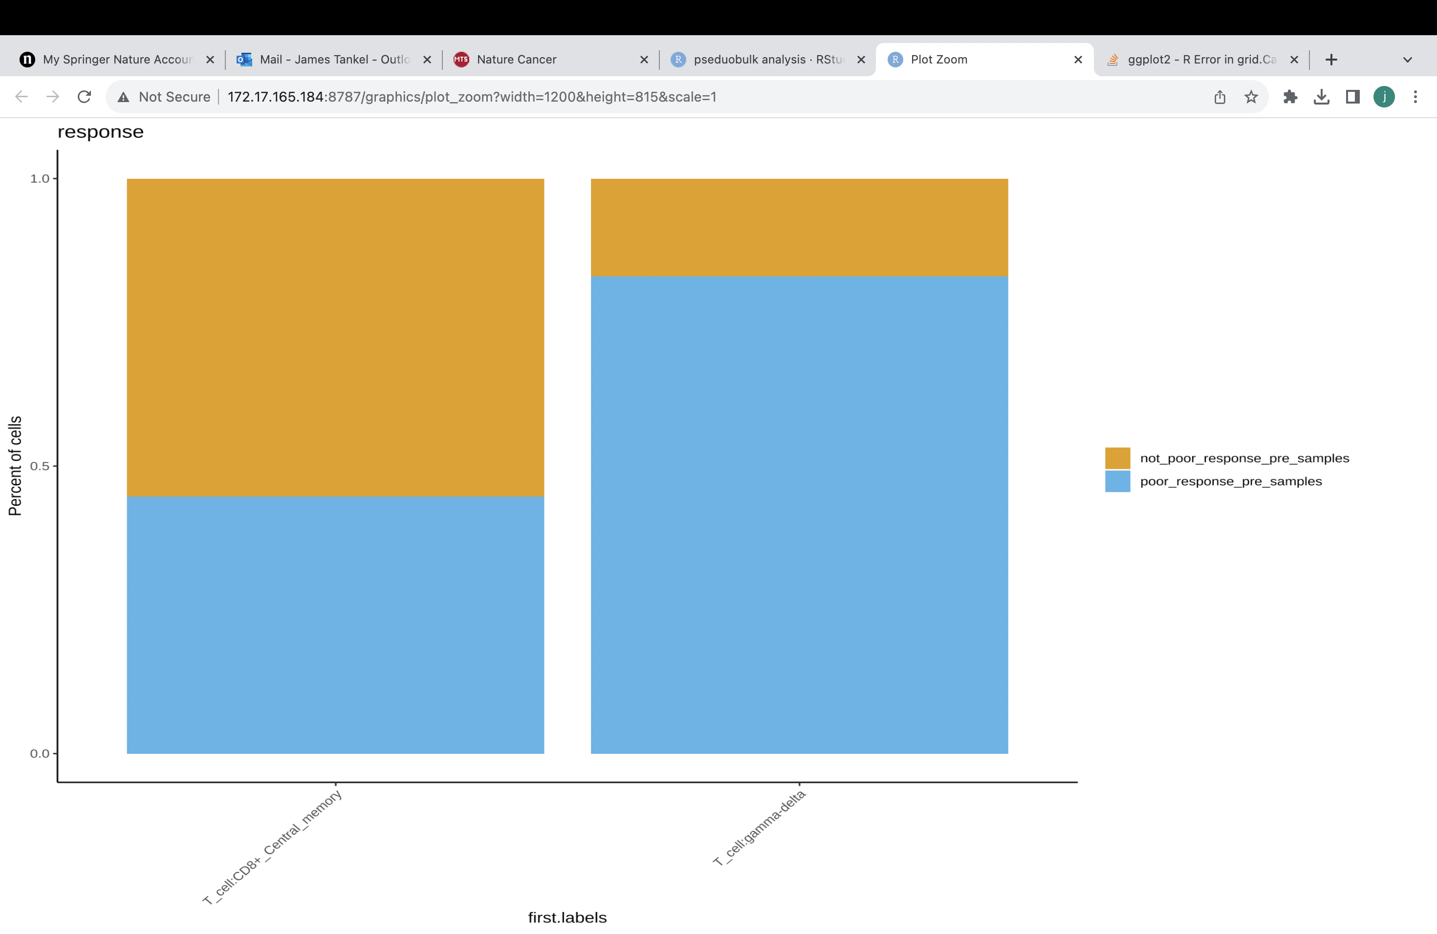
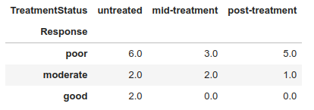
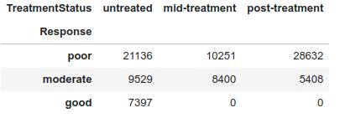
Supplementary figure 2
Ai
B
Samples
Cells
Percentage of cells
TRG 0/1/2
TRG 3
Aii
Gamma-delta T cell
CD8+ central memory cell
CD4+ central memory T cell
CD4+ effector memory T cell

