Slide 1
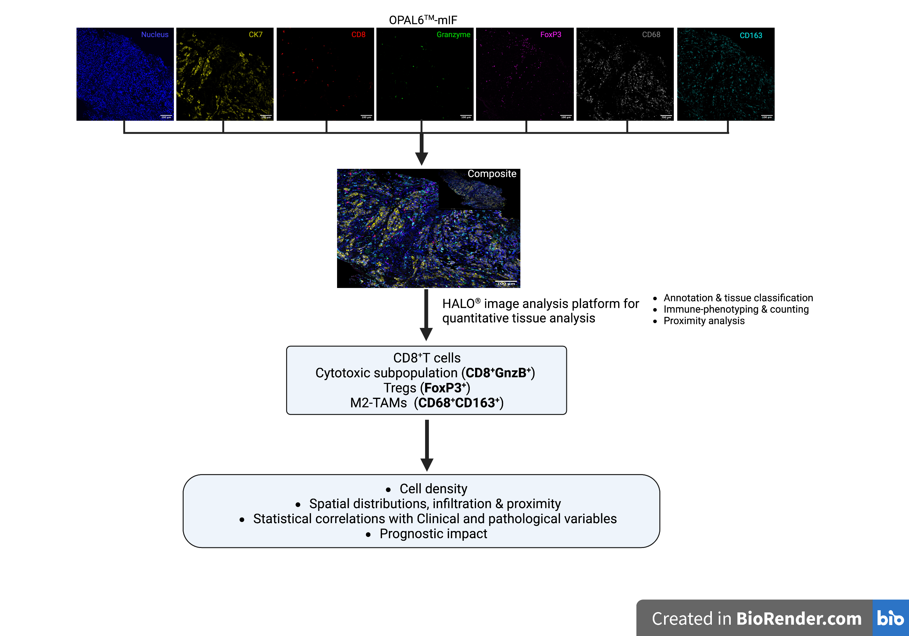
Supplementary figure 1

