Slide 1
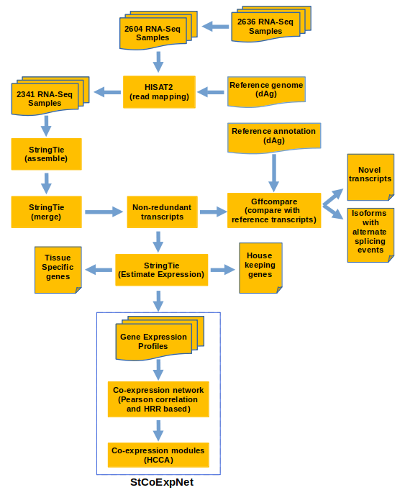
Figure S1: Workflow used to construct the potato expression atlas and co-expression network. Both the expression atlas and co-expression networks were stored in a web server called StCoExpNet for interactive exploration of expression and co-expression data.

Slide 2
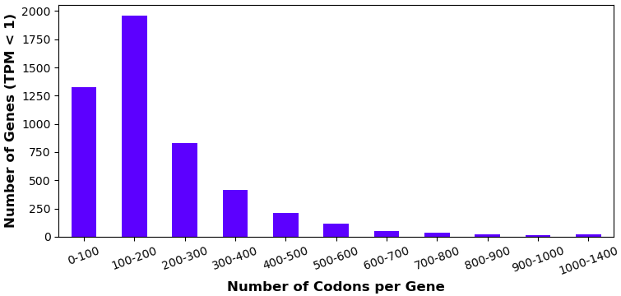
Figure S2: Bar plot for number of genes with transcripts per million (TPM) < 1 versus number of codons per gene.

Slide 3
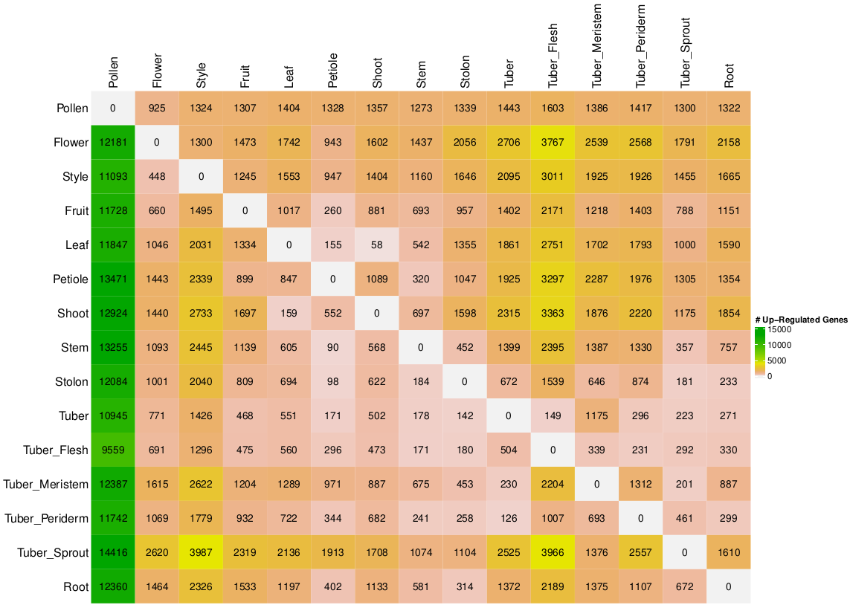
Figure S3: Heatmap shows number of genes that were up-regulated in tissues arranged in rows as compared to those in columns.
The criteria used to identify up-regulated genes were a log2 (fold-change) value of at least 2 and an adjusted P-value ≤ 0.05,
determined through the moderated t-statistic in the LIMMA package.

Slide 4
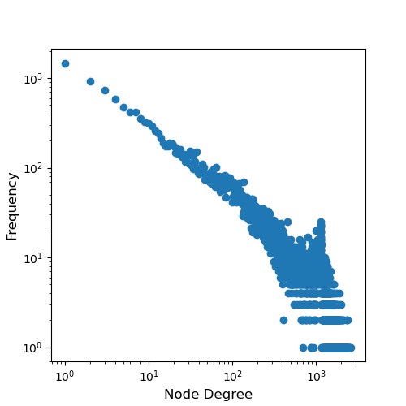
Figure S4: The graph displays a power law distribution based on potato gene expression data. The logarithmically transformed x-axis represents the degree of nodes, or the number of connections associated with a particular gene, while the y-axis reflects the frequency of a particular degree. Both axes have been transformed using a base-10 logarithmic scale.

Slide 5
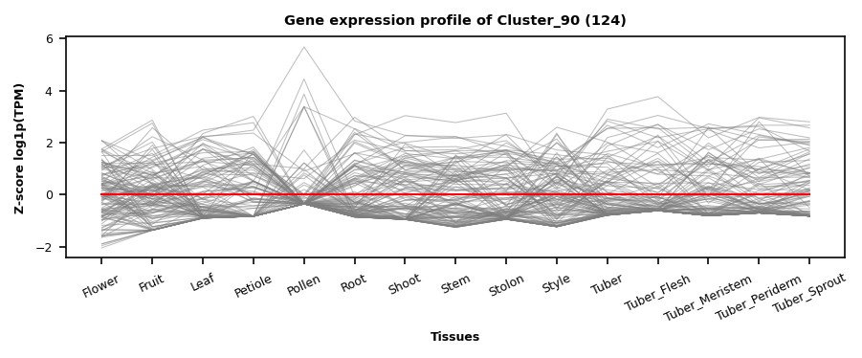
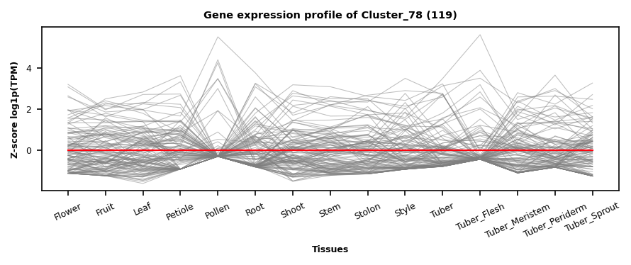
Figure S5. The gene expression profile of co-expression clusters, Cluster_90 and Cluster_78. Numbers in parentheses in the graph's title indicate the number of genes in the respective clusters. The line plots show that the tissues are on the x-axis, and the genes are on the y-axis. The thick red line indicates the average Z score of the cluster, and the thin grey lines indicate the Z score of individual genes.

Slide 6
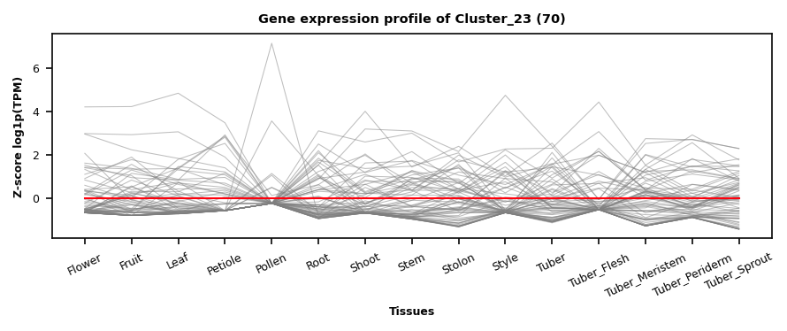
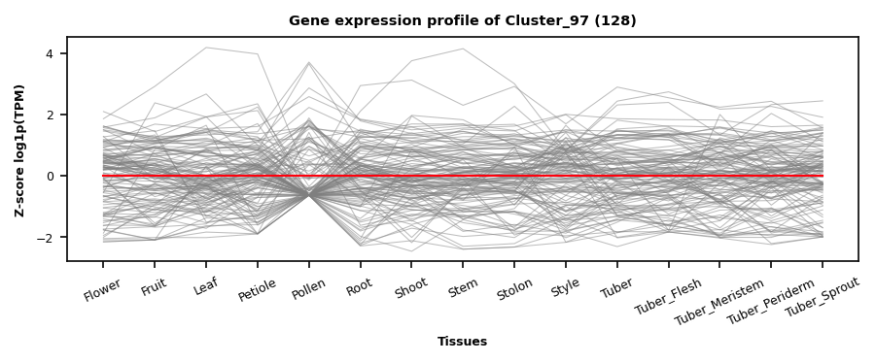
Figure S6. The gene expression profile of co-expression clusters, Cluster_23 and Cluster_97. Numbers in parentheses in the graph's title indicate the number of genes in the respective clusters. The line plots show that the tissues are on the x-axis, and the genes are on the y-axis. The thick red line indicates the average Z score of the cluster, and the thin grey lines indicate the Z score of individual genes.

Slide 7
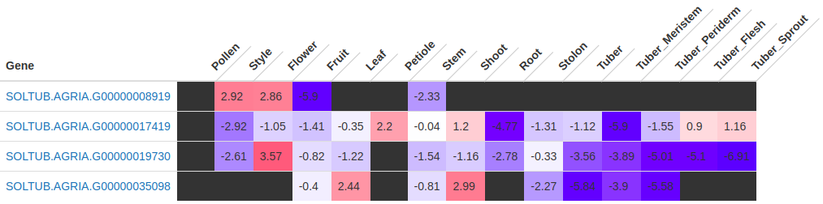
Figure S7: Heatmap shows Zlog-transformed TPM values of homologs of PhAN2 across tissues.
Dark gray: 0 TPM; Blue: Below average expression; Red: Above average expression; White: Average expression.

