Slide 1

10
µg/mL
0.100
 | Victoria | Alpha | Beta | Gamma | Delta
BA.4/5-1 | 0.004 | 0.008 | 0.006 | 0.008 | 0.017
BA.4/5-2 | 0.01 | 0.005 | 0.006 | 0.003 | 0.011
BA.4/5-3 | 0.019 | 0.01 | 0.008 | 0.007 | 0.003
BA.4/5-4 | 0.039 | 0.011 | 0.008 | 0.007 | 0.013
BA.4/5-6 | 0.008 | 0.011 | 0.009 | 0.004 | 0.013
BA.4/5-7 | 0.018 | 0.01 | 0.929 | 0.087 | 0.014
BA.4/5-8 | 0.015 | 0.008 | 0.003 | 0.004 | 0.013
BA.4/5-9 | 0.013 | 0.016 | 0.032 | 0.022 | 0.025
BA.4/5-10 | 0.011 | 0.011 | 0.005 | 0.002 | 0.005
BA.4/5-11 | 0.007 | 0.01 | 0.006 | 0.005 | 0.006
BA.4/5-12 | 0.029 | 0.023 | 0.014 | 0.013 | 0.017
BA.4/5-13 | 0.013 | 0.009 | 0.003 | 0.004 | 0.014
BA.4/5-15 | 0.017 | 0.008 | 0.014 | 0.012 | 0.019
BA.4/5-17 | 0.005 | 0.01 | 0.004 | 0.007 | 0.01
BA.4/5-18 | 0.009 | 0.008 | 0.007 | 0.012 | 0.008
BA.4/5-20 | 0.023 | 0.016 | 0.015 | 0.021 | 0.023
BA.4/5-21 | 0.002 | 0.006 | 0.004 | 0.004 | 0.009
BA.4/5-22 | 0.008 | 0.005 | 0.004 | 0.005 | 0.022
BA.4/5-23 | 0.032 | 0.014 | 0.012 | 0.006 | 0.01
BA.4/5-24 | 0.001 | 0.002 | 0.003 | 0.003 | 0.003
BA.4/5-25 | 0.021 | 0.01 | 0.003 | 0.002 | 0.004
BA.4/5-28 | 0.019 | 0.016 | 0.007 | 0.009 | 0.018
BA.4/5-31 | 0.013 | 0.011 | 0.008 | 0.015 | 0.013
BA.4/5-32 | 0.017 | 0.015 | 0.002 | 0.002 | 0.012
BA.4/5-33 | 10 | 10 | 10 | 0.076 | 10
BA.4/5-34 | 0.004 | 0.004 | 0.002 | 0.002 | 0.403
BA.4/5-35 | 0.009 | 0.007 | 0.003 | 0.002 | 0.01
BA.4/5-36 | 10 | 0.019 | 10 | 10 | 10
0.001
Figure S1

Slide 2
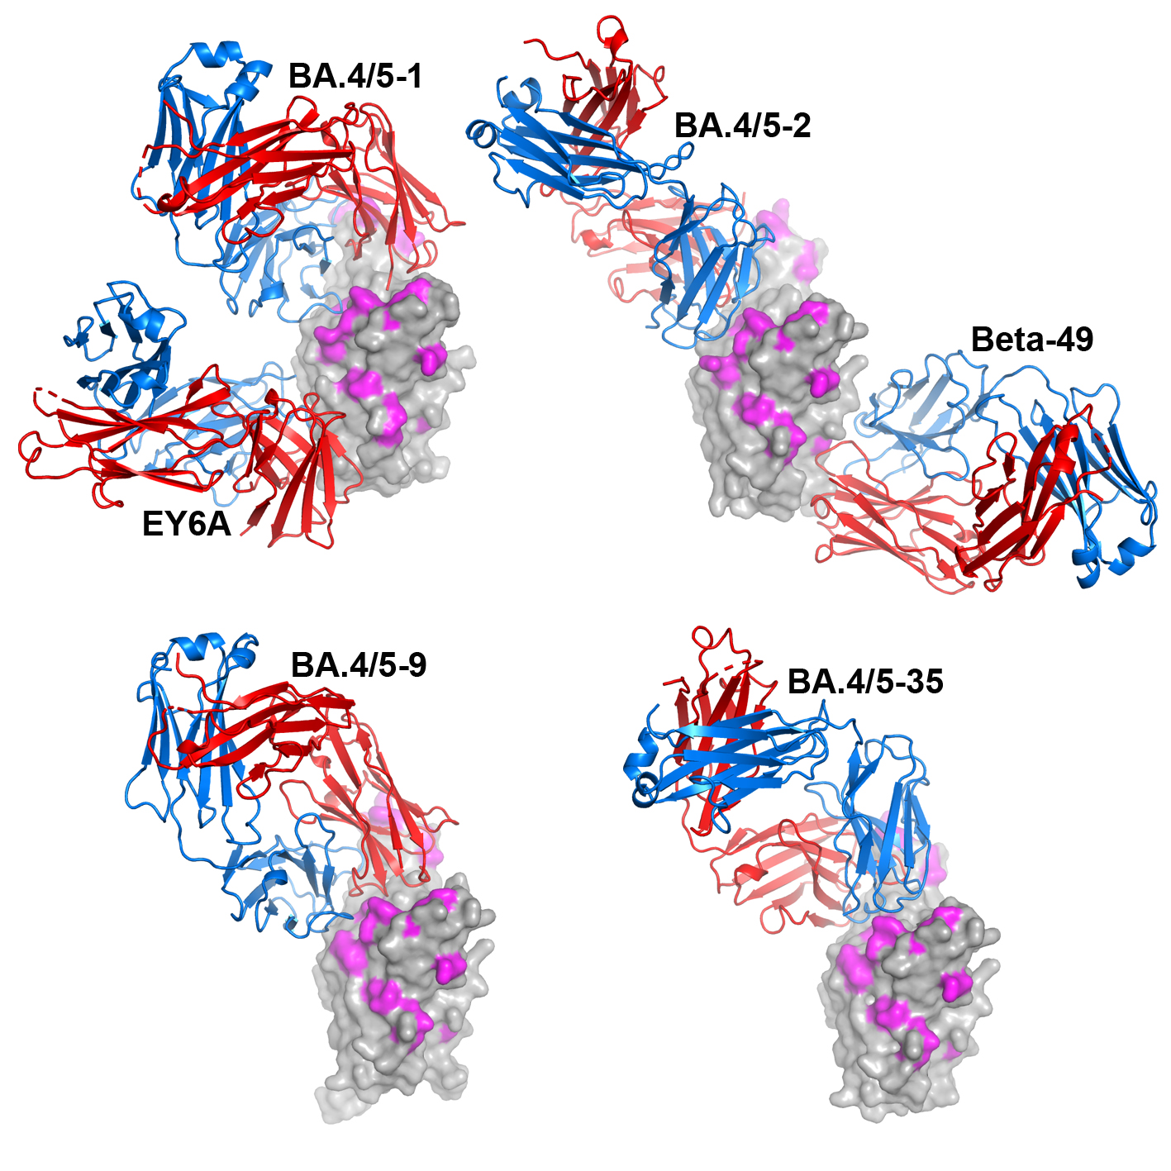
A
B
C
D
Figure S2

Slide 3
Table S1. Ig variable gene usage for BA.4/5 mAb
Ab id. | Protein-Specific | Heavy Chain |  |  |  | Light Chain
 |  | V-REGION Nb of AA changes | V-GENE and allele | J-GENE and allele | D-GENE and allele | Light Chain | V-REGION Nb of AA changes | V-GENE and allele | J-GENE and allele
BA.4/5-1 | RBD | 5 | 4-39*01 F | 4*02 F | 1-26*01 F | K | 7 | 1-NL1*01 F | 2*01 F
BA.4/5-2 | RBD | 14 | 3-30*03 F, or 3-30*18 F or 3-30-5*01 F | 6*02 F | 2-15*01 F | K | 5 | 3-11*01 F | 3*01 F
BA.4/5-3 | RBD | 16 | 4-61*02 F, or 4-61*11 | 4*02 F | 1-26*01 F | K | 9 | 1-5*01 F | 1*01 F
BA.4/5-4 | RBD | 11 | 1-3*01 F, or 1-3*04 | 6*03 F | 6-25*01 F | K | 5 | 1-5*01 F | 4*01 F
BA.4/5-6 | RBD | 10 | 3-53*04 F | 4*02 F | 4-17*01 F | K | 9 | 3-20*01 F | 2*02
BA.4/5-7 | RBD | 14 | 3-53*02 F | 4*02 F | 4-17*01 F | K | 5 | 3-15*01 F | 1*01 F
BA.4/5-8 | RBD | 6 | 3-66*02 F | 6*02 F | 1-26*01 F | K | 4 | 1-33*01 F, or 1D-33*01 F | 2*01 F
BA.4/5-9 | RBD | 13 | 1-46*01 F, or 1-46*02 F or 1-46*03 F | 4*02 F | 4-23*01 ORF | K | 6 | 3-11*01 F | 2*03
BA.4/5-10 | RBD | 2 | 3-66*02 F | 6*02 F | 1-26*01 F | K | 5 | 1-33*01 F, or 1D-33*01 F | 2*01 F
BA.4/5-11 | RBD | 6 | 3-33*01 F, or 3-33*03 F or 3-33*06 F | 3*02 F | 3-22*01 F | K | 3 | 1-39*01 F, or 1D-39*01 F | 2*01 F
BA.4/5-12 | RBD | 9 | 3-30*03 F, or, 3-30*18 F, or 3-30-5*01 F | 6*02 F | 3-9*01 F | K | 8 | 1-33*01 F,or 1D-33*01 F | 5*01 F
BA.4/5-13 | RBD | 9 | 1-69*01 F, or 1-69D*01 F | 6*02 F | 5-18*01 F | λ | 14 | 1-33*01 F, or 1D-33*01 F | 3*01 F
BA.4/5-15 | RBD | 6 | 3-9*01 F | 6*02 F | 3-9*01 F | λ | 9 | 1-44*01 F | 1*01 F
BA.4/5-17 | RBD | 8 | 3-53*04 F | 6*02 F | 6-19*01 F | λ | 4 | 1-51*01 F | 1*01 F
BA.4/5-18 | RBD | 11 | 1-69*01 F, or 1-69D*01 F | 6*02 F | 5-18*01 F | K | 18 | 1-33*01 F, or 1D-33*01 F | 3*01 F
BA.4/5-20 | RBD | 11 | 3-9*01 F | 6*02 F | 3-9*01 F | λ | 8 | 1-44*01 F | 1*01 F
BA.4/5-21 | RBD | 11 | 3-9*01 F | 4*02 F | 3-22*01 F | K | 12 | 1-9*01 F | 4*01 F
BA.4/5-22 | RBD | 13 | 1-69*01 F, or 1-69D*01 F | 4*02 F | 5-12*01 F | K | 11 | 2-30*01 F | 1*01 F
BA.4/5-23 | RBD | 15 | 3-53*01 F | 4*02 F | 4-17*01 F | K | 12 | 3-20*01 F | 1*01 F
BA.4/5-24 | RBD | 9 | 3-9*01 F | 5*02 F | 3-22*01 F | K | 17 | 1-9*01 F | 3*01 F, or 4*01 F
BA.4/5-25 | RBD | 16 | 1-69*09 F | 4*02 F | 5-18*01 F | K | 9 | 1-5*01 F | 2*02
BA.4/5-28 | RBD | 10 | 3-66*01 F, or 3-66*04 F | 6*02 F | 1-1*01 F | λ | 16 | 3-21*04 F | 2*01 F, or 3*01 F or 3*02 F
BA.4/5-31 | RBD | 6 | 4-39*01 F | 4*02 F | 1-26*01 F | K | 15 | 1-NL1*01 F | 2*01 F
BA.4/5-32 | RBD | 12 | 3-66*02 F | 3*01 F | 3-10*02 F | λ | 10 | 3-21*02 F | 1*01 F
BA.4/5-33 | NTD | 13 | 3-23*04 F | 4*02 F | 5-18*01 F | K | 5 | 3-15*01 F | 2*01 F
BA.4/5-34 | RBD | 12 | 1-69*01 F, or1-69D*01 F | 4*02 F | 5-12*01 F | K | 8 | 2-30*01 F | 1*01 F
BA.4/5-35 | RBD | 12 | 3-66*01 F, or 3-66*04 F | 4*02 F | 1-26*01 F | K | 6 | 3-15*01 F | 2*01 F
BA.4/5-36 | NTD | 13 | 4-4*02 F | 3*02 F | 2-21*01 F | K | 16 | 1-5*01 F | 1*01 F

Slide 4
Table S2. Data collection, structure determination and refinement statistics
Structure | Delta-RBD/BA.4/5-1/EY6A | Delta-RBD/BA.4/5-2/Beta-49 | Delta-RBD/BA.4/5-9 | Delta-RBD/BA.4/5-35
PDB ID | 8CBD | 8CBE | 8QZR | 8CMA
Data collection
Space group | C2 | P2₁2₁2 | I23 | C2
a, b, c (Å) | 242.0, 139.4, 168.5 | 179.9, 147.0, 52.2 | 251.6, 251.6, 251.6 | 195.8, 85.1, 57.0
α, β, γ (°) | 90, 115.6, 90 | 90, 90, 90 | 90, 90, 90 | 90, 102.0, 90
Resolution (Å) | 75–3.52 (3.58–3.52)ª | 60–3.16 (3.21–3.16) | 59-3.77 (3.84–3.77) | 48–3.29 (3.35–3.29)
R_{merge} | 0.325 (---) | 0.345 (---) | 0.414 (---) | 0.298 (---)
R_{pim} | 0.133 (1.192) | 0.098 (0.994) | 0.065 (1.027) | 0.121 (1.270)
I/σ(I) | 4.9 (0.4) | 6.1 (0.5) | 8.0 (0.4) | 5.6 (0.5)
CC_{1/2} | 0.984 (0.351) | 0.991 (0.322) | 0.998 (0.351) | 0.982 (0.340)
Completeness (%) | 99.7 (98.4) | 100 (99.2) | 100 (100) | 98.9 (94.6)
Redundancy | 7.1 (6.7) | 13.3 (13.2) | 41.8 (42.8) | 7.0 (6.8)
Refinement
Resolution (Å) | 75–3.52 | 57–3.16 | 59–3.77 | 48–3.29
No. reflections | 59185/3023 | 23351/1206 | 25675/1319 | 13161/681
R_{work} / R_{free} | 0.219/0.267 | 0.227/0.268 | 0.251/0.300 | 0.231/0.268
No. atoms
Protein | 24090 | 8087 | 8671 | 4718
Ligand/ion/water | 14 | 49 | 38 | 14
B factors (Å²)
Protein | 169 | 108 | 196 | 125
Ligand/ion/water | 207 | 123 | 230 | 192
r.m.s. deviations
Bond lengths (Å) | 0.003 | 0.002 | 0.002 | 0.002
Bond angles (°) | 0.5 | 0.5 | 0.5 | 0.4
ª Values in parentheses are for highest-resolution shell.

