Slide 1
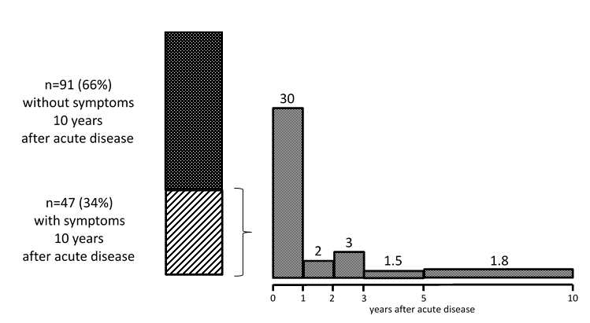
Outcome 10 years after STEC-HUS*:
importance of long-term follow up
HYPOTHESIS: Evaluate outcome of pediatric STEC-HUS* 10 years after acute disease
36% presented sequelae for the first time
> 1 year after acute disease
DESIGN & OUTCOMES:
44% presented: low eGFR, proteinuria, hypertension and/or neurological symptoms
489 children with STEC-HUS*
66% completely recovered
138 available after 10 years
Prospective multicentre study
Patients needing extracorporeal treatments during the acute phase were at higher risk of presenting symptoms after 10 years
*STEC-HUS: shigatoxin producing Eschericia coli (STEC) associated hemolytic uremic syndrome (HUS)
CONCLUSION: Long-term sequelae can still occur after a period of apparent recovery. Patients with STEC-HUS* should be followed-up for at least 10 years. Initial critical illness is the strongest predictor for poor outcome
Rosales et al. 2023

