Slide 1
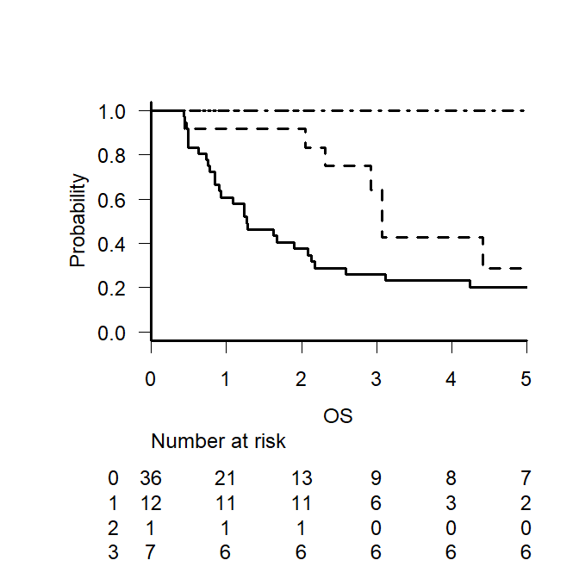
Supplemental figure 1a
P=0.0040
+GDP plus +Romi (n=7)
1
0.8
-GDP plus +Romi (n=1)
0.6
+GDP plus -Romi (n=12)
Overall Survival (probability)
0.4
0.2
-GDP plus -Romi (n=49)
0
0
1
2
3
4
5
Time after diagnosis (years)
-GDP plus -Romi
+GDP plus -Romi
-GDP plus +Romi
+GDP plus +Romi

Slide 2
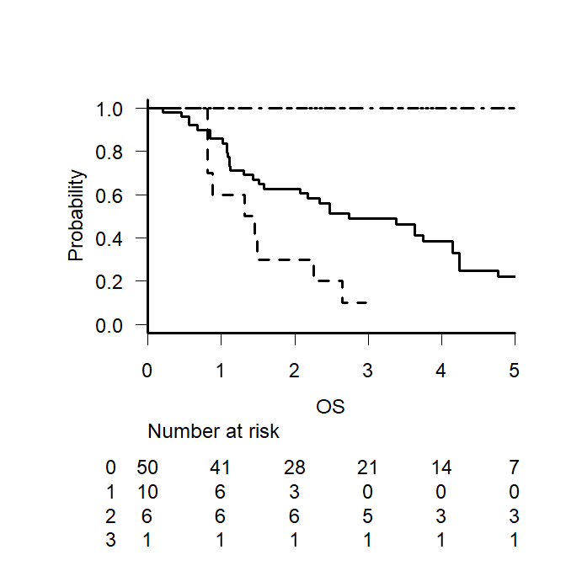
Supplemental figure 1b
P<0.001
+GDP plus +Romi (n=1)
1
0.8
-GDP plus +Romi (n=6)
0.6
Overall Survival (probability)
0.4
0.2
-GDP plus -Romi (n=50)
0
+GDP plus -Romi (n=10)
0
1
2
3
4
5
Time after diagnosis (years)
-GDP plus -Romi-
+GDP plus -Romi-
-GDP plus +Romi
+GDP plus +Romi

Slide 3
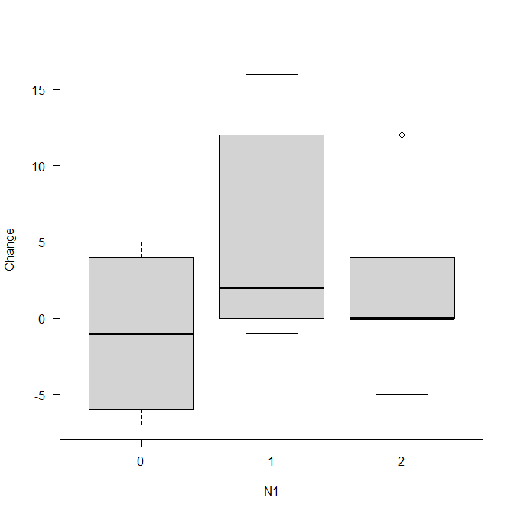
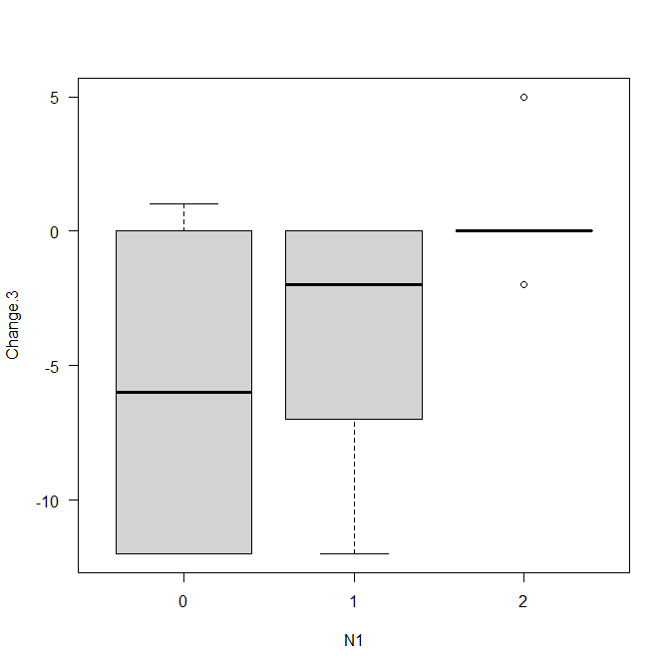
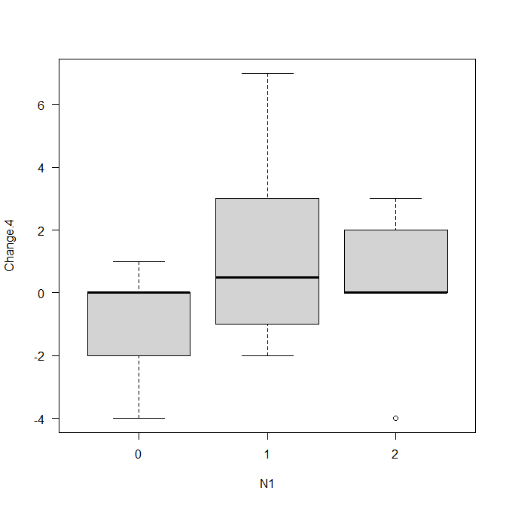
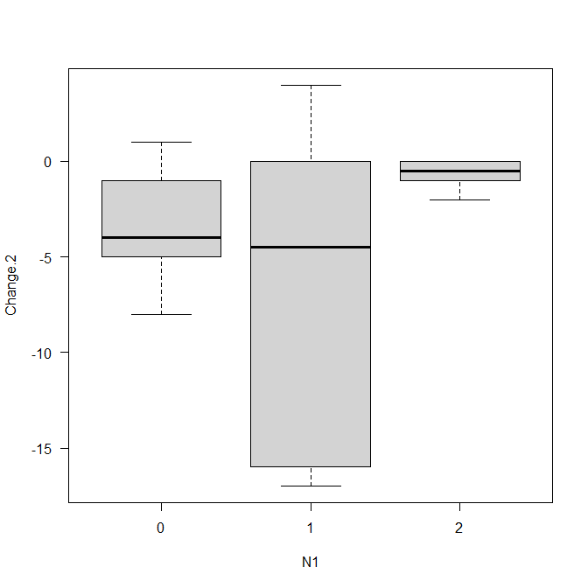
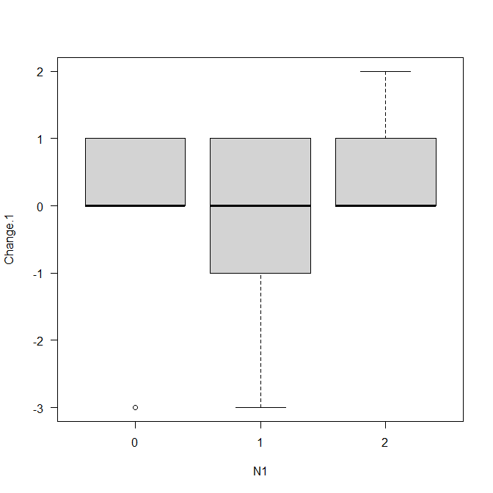
Supplemental figure 2a
DaA
PhC
PsC
SoA
FaS
5
0
-5
Score change from baseline
-10
-15
-20
M
E
S
M
E
S
M
E
S
M
E
S
M
E
S

Slide 4
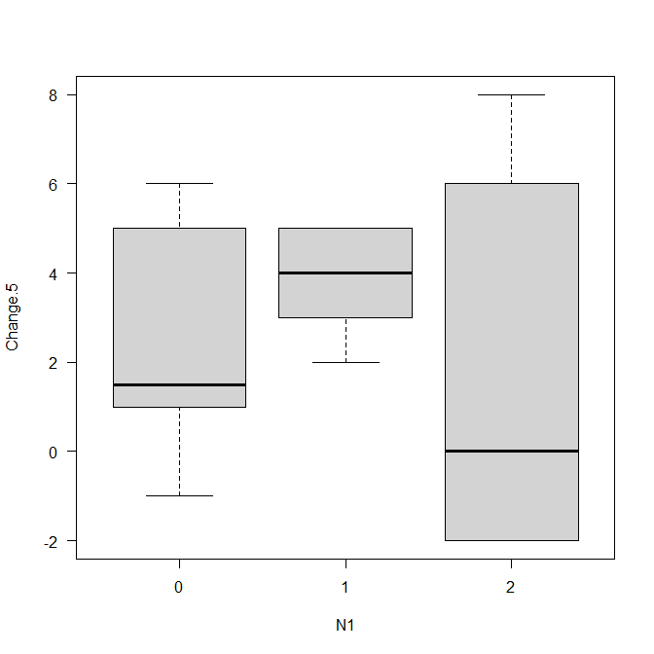
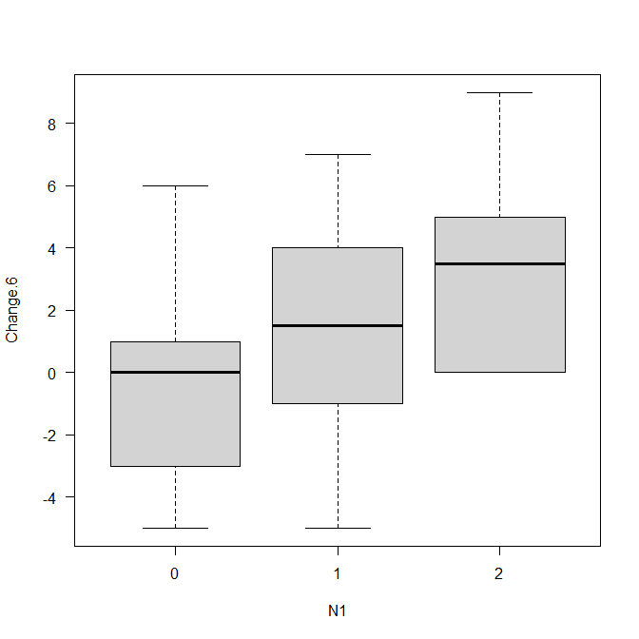

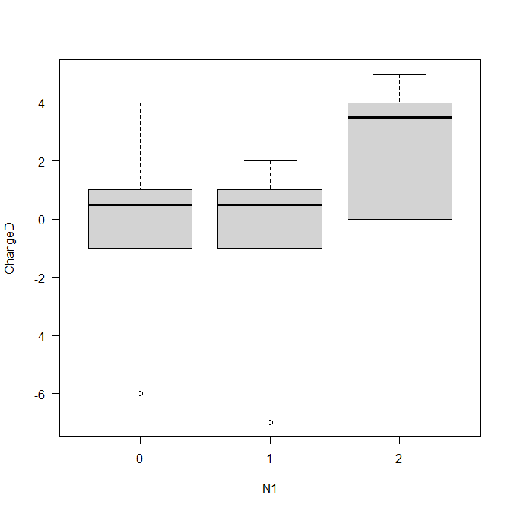
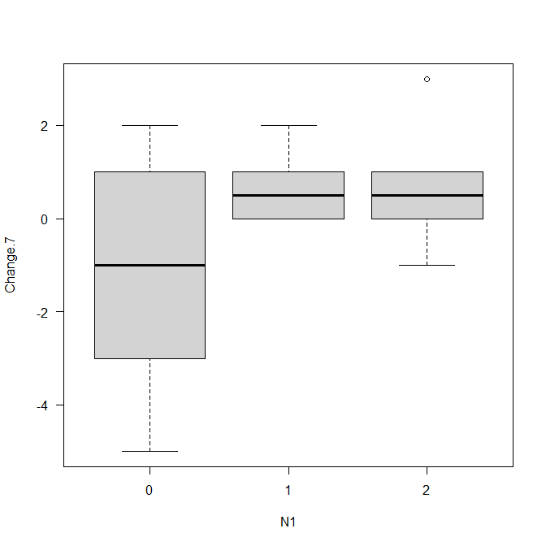
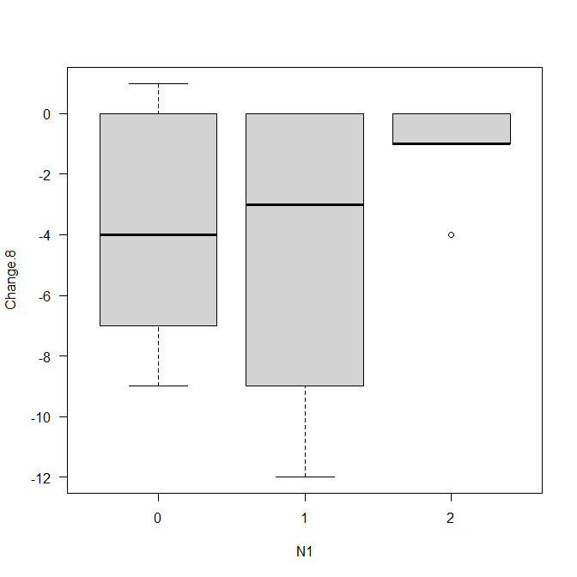


Supplemental figure 2b
PF
RP
BP
GH
VT
SF
RE
MH
10
5
0
Score change from baseline
-5
-10
-15
-20
M
E
S
M
E
S
M
E
S
M
E
S
M
E
S
M
E
S
M
E
S
M
E
S

