Slide 1
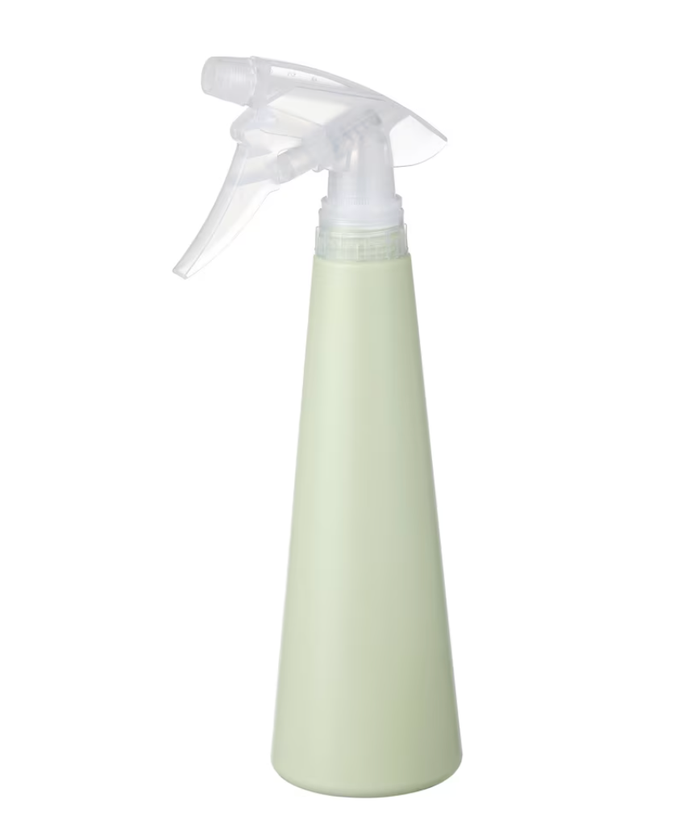
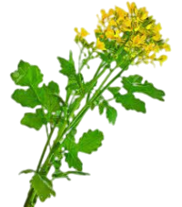
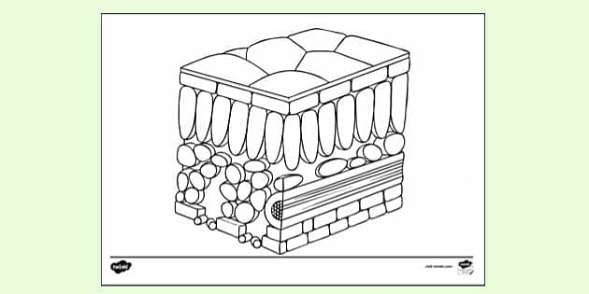
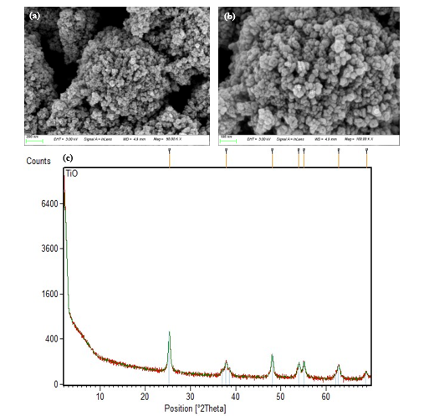
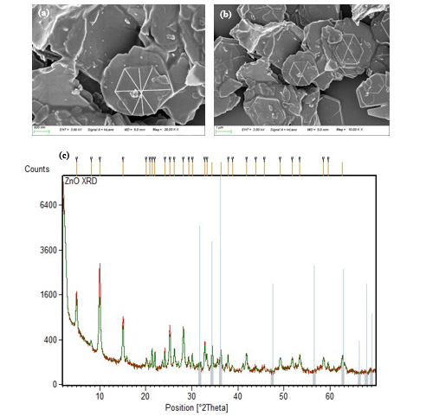
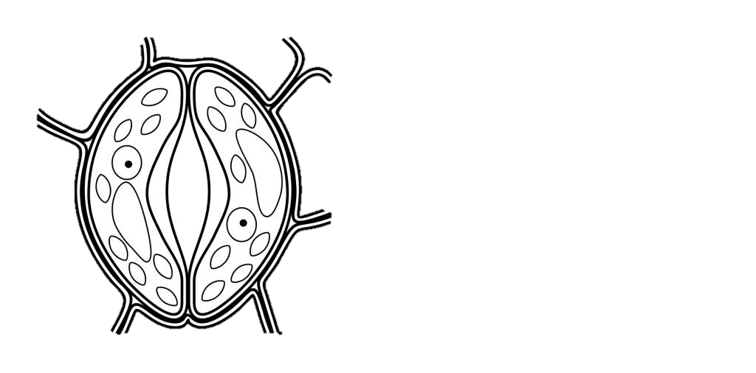

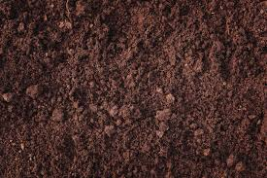
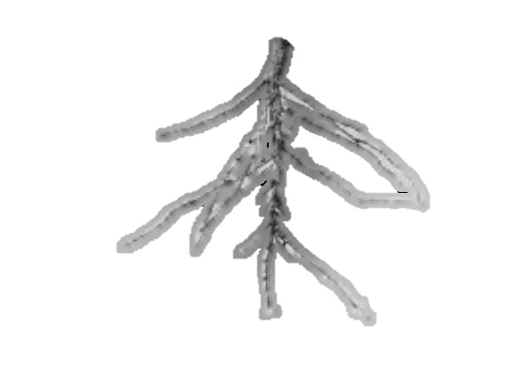

Results
Characterization of Nanoparticles
TiO2
ZnO
Upper
Epidermis
Metal Toxicity
Stomata
Growth Parameters
Mechanism
Flow of nanoparticles
within the cell
Chlorophyll Content
Gas Exchange Attributes
Antioxidant Enzymes
Oxidant
Nutrients Profiling
Ck
Metal Content
Nanoparticles
(ZnO + TiO2)
Pb
300 (mg/kg)
ZnO
TiO2
ZnO
TiO2
ZnO
TiO2
25 (mg/L)
50 (mg/L)
100 (mg/L)

