Slide 1
TITLE: Discovering the antitumor potential of a novel PDC of Hsp70-TAA complex with Docetaxel for sustained and prolonged release of docetaxel to increase its efficacy and reduce drug resistance in OSCC
Khushwant Singh¹, Pramod Kumar Gautam^{1*}, Hitesh Verma², Sandeep Bhoriwal³
^{1*}Department of Biochemistry, All India Institute of Medical Sciences, New Delhi-110029, INDIA
²Department of Otorhinolaryngology, All India Institute of Medical Sciences, New Delhi-110029, INDIA
³Department of Surgical Oncology, Dr. B.R.A. IRCH, All India Institute of Medical Sciences, New Delhi-110029, INDIA
^{1*}Corresponding Author:
Dr. Pramod K. Gautam
Associate Professor
Department of Biochemistry
All India Institute of Medical Sciences
New Delhi-110 029, INDIA
Email - gautam@aiims.edu

Slide 2
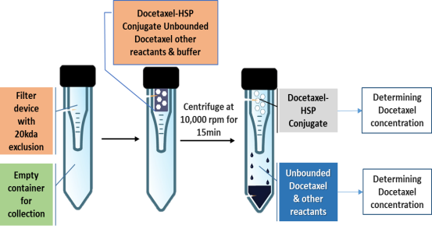
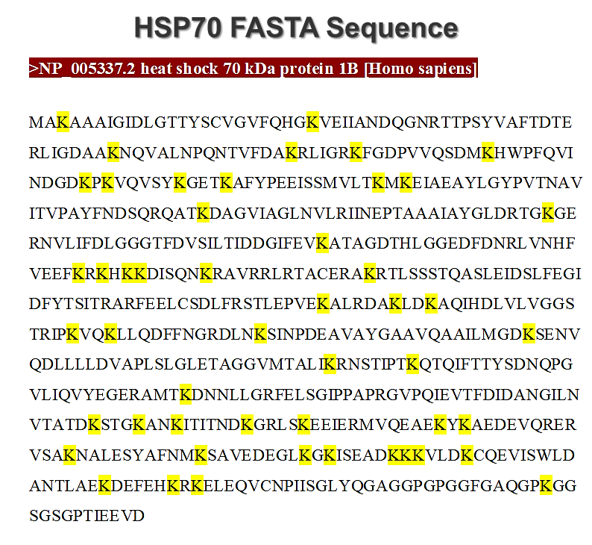
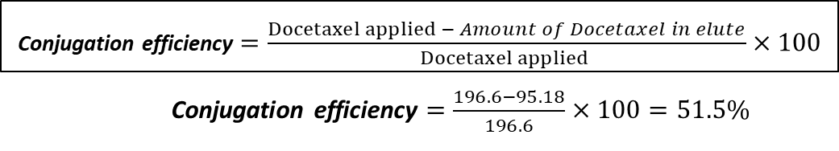
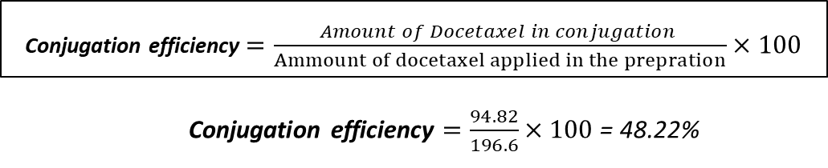
A.
B.
C.
D.
Supplementary Figure 1: Spectrophotometric analysis and determination of stoichiometric ratio of docetaxel: HSP70 in the DHSP conjugate. (A) Absorbance spectrum scan of the docetaxel in DMSO and PBS (1:9 DMSO: PBS) showing maximum absorption at 377.6 nm. (B) Separation of unbound docetaxel and conjugated Docetaxel-HSP70 to evaluate the stoichiometric ratio. (C) Quantification of docetaxel in the elute (unconjugated docetaxel) and concentrated conjugate (DHSP) by spectrophotometry and representative calculation of the conjugation efficiency based on the amount of docetaxel interpolated from the standard curve. (D) The lysine content in HSP70 was found to be 50 residues.

Slide 3
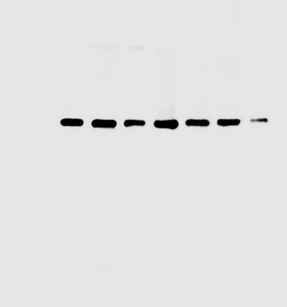
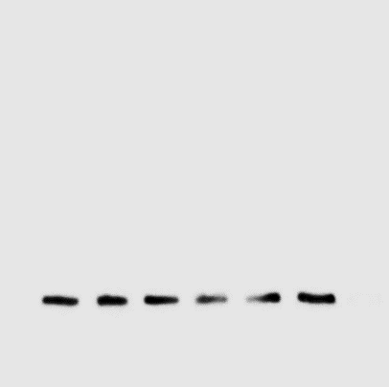
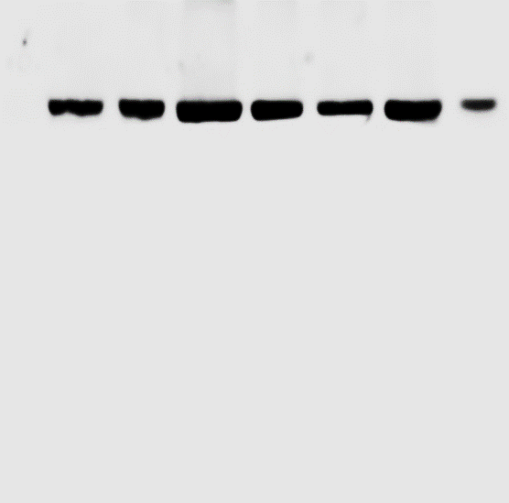
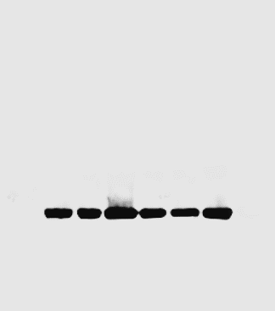
A.
SCC4
70 kDa HSP70
42 kDa ß-actin
B.
CAL33
70 kDa HSP70
42 kDa ß-actin
Supplementary Figure 1: (A-B) Western blot of HSP70 and ß-actin protein with pure HSP70 protein as a positive control in SC cells and CAL33 cells.

Slide 4
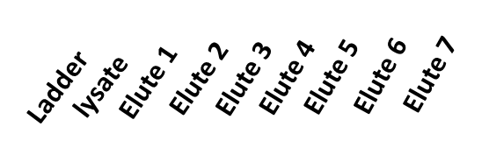
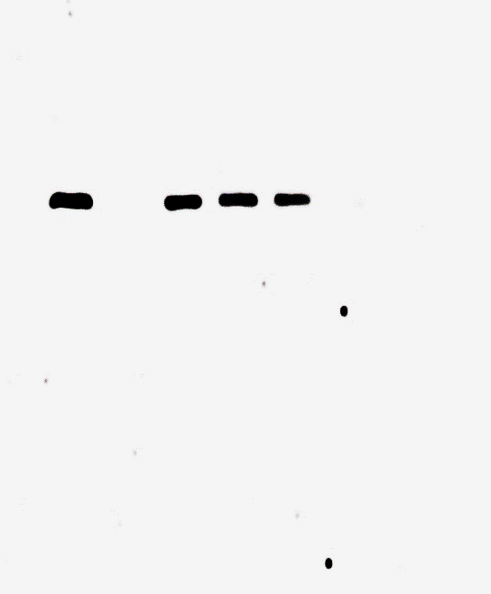
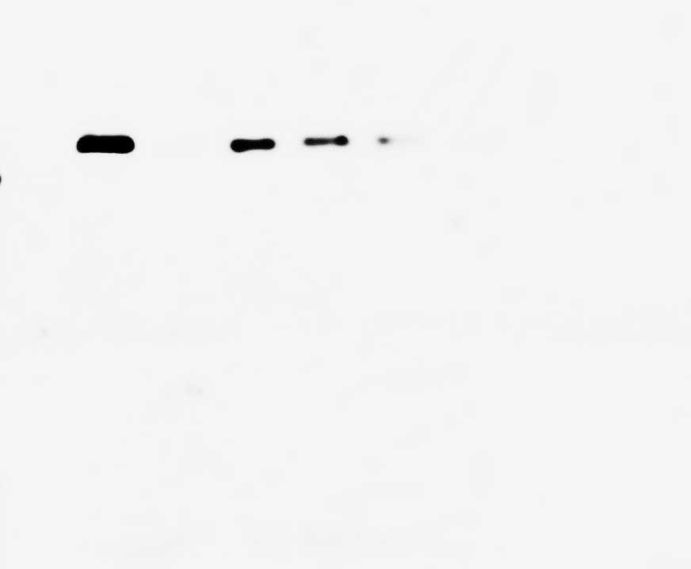
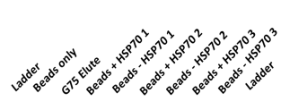
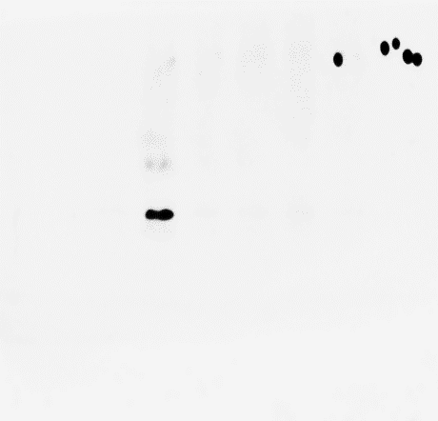

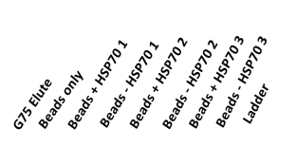
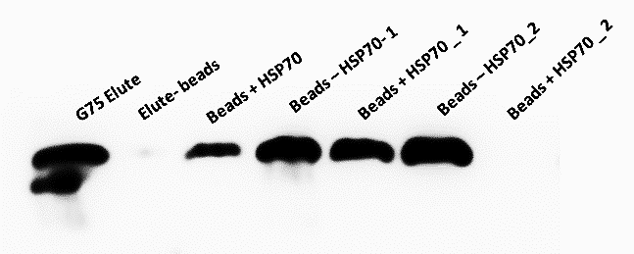
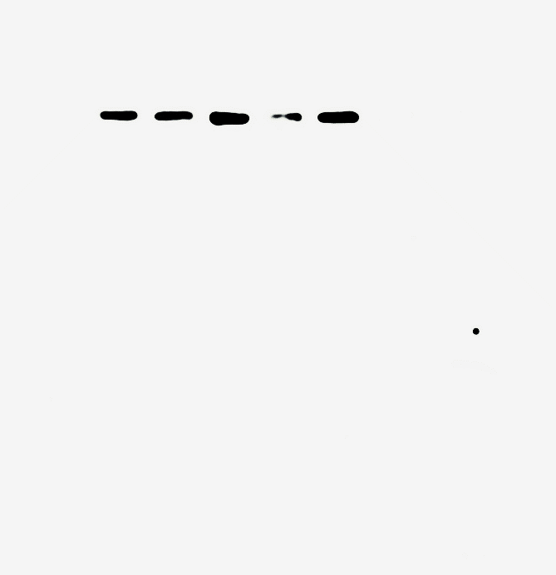
A.
SCC4
B.
CAL33
70 kDa HSP70
C.
D.
42 kDa ß-actin
IgG 48kDa Heavy chain
E.
G.
CAL33
SCC4
70 kDa HSP70
70 kDa HSP70
Supplementary Figure 1: (A-B) Western blot for HSP70 protein in Sephadex G75 elutes collected from SCC4 and CAL33, (C) Western blot image showing the presence of β-actin protein in Sephadex G75 elutes from SCC4. (D) Western blot image showing the absence of heavy chain of the HSP70 antibody in the elution from the Protein-L cross-linked HSP70 monoclonal antibody-conjugated beads. (E-F) Western blot image showing the elution of HSP70 from the Protein-L cross-linked HSP70 monoclonal antibody-conjugated beads in SCC4 and CAL33 G75 elutes

