Slide 1
Table 1: Detail Growth (Mean±SE) of coral nubbins during the study
Place | Feb'21 | May'21 | Aug'21 | Nov'21 | Feb'21 | May'21 | Aug'21
 | 0 month | 3 months | 6 months | 9 months | 12 months | 15 months | 18 months
Thonithurai Set 1
Frame 1 | 5.73±0.54 | 6.49±0.51 | 7.35±0.56 | 9.16±0.75 | 11.61±0.83 | 14.00±0.88 | 16.49±1.13
Frame 2 | 5.89±0.61 | 6.73±0.55 | 7.83±0.64 | 9.02±0.90 | 10.26±1.01 | 11.28±0.96 | 12.92±1.22
Frame 3 | 6.16±0.78 | 6.93±0.70 | 8.17±0.82 | 9.43±0.87 | 10.84±0.96 | 12.38±1.03 | 14.16±1.16
Frame 4 | 6.17±0.76 | 7.14±0.66 | 8.23±0.74 | 9.60±0.85 | 11.16±1.04 | 12.94±1.10 | 14.59±1.20
Frame 5 | 5.71±0.67 | 6.26±0.63 | 6.76±0.71 | 7.37±0.88 | 7.93±0.87 | 8.37±0.68 | 9.03±0.72
Munaikadu Set 1
Frame 1 | 5.84±0.65 | 6.74±0.68 | 8.26±0.79 | 10.46±1.07 | 12.94±1.14 | 15.30±1.14 | 17.94±1.17
Frame 2 | 5.90±0.74 | 6.65±0.78 | 7.78±0.84 | 9.33±0.89 | 10.24±1.06 | 13.13±1.09 | 15.47±1.10
Frame 3 | 5.04±0.43 | 5.80±0.41 | 6.99±0.48 | 8.46±0.69 | 10.29±0.94 | 12.24±1.20 | 14.40±1.36
Frame 4 | 5.16±0.49 | 6.00±0.52 | 7.11±0.62 | 8.58±0.69 | 10.62±0.88 | 12.68±0.83 | 15.14±0.71
Frame 5 | 5.16±0.49 | 5.60±0.51 | 6.19±0.53 | 6.90±0.58 | 7.71±0.76 | 8.69±0.95 | 9.73±1.20
Thonithurai Set 2 (Deployment done in Monsoon_November 2020)
Frame 1 | 5.34±0.43 | 5.78±0.44 | 6.27±0.38 | 7.05±0.30
Frame 2 | 5.39±0.50 | 5.83±0.51 | 6.67±0.47 | 7.95±0.38
Frame 3 | 5.49±0.45 | 6.03±0.65 | 6.86±0.45 | 8.01±0.38
Frame 4 | 5.57±0.48 | 5.97±0.44 | 6.78±0.43 | 7.82±0.40
Frame 5 | 4.68±0.53 | 5.11±0.54 | 5.76±0.62 | 6.65±0.70
Munaikadu Set 2 (Deployment done in Monsoon_November 2020)
Frame 1 | 5.53±0.45 | 6.47±0.52 | 7.93±0.48 | 9.54±0.49
Frame 2 | 5.65±0.46 | 6.43±0.52 | 7.45±0.53 | 9.00±0.67
Frame 3 | 5.01±0.64 | 5.73±0.64 | 6.77±0.63 | 8.41±0.88
Frame 4 | 5.09±0.61 | 5.81±0.65 | 6.93±0.55 | 8.68±0.48
Frame 5 | 4.95±0.73 | 5.48±0.76 | 6.33±0.76 | 7.39±0.76

Slide 2
Table 2: Statistical Summary of fish assemblage in coral restoration site
 | Scaridae | Terapontidae | Acanthuridae | Signidae | Pempheridae | Pomacentridae | Lethrinidae
N | 12 | 12 | 12 | 12 | 12 | 12 | 12
Min | 0 | 14 | 0 | 0 | 0 | 0 | 0
Max | 17 | 41 | 11 | 37 | 12 | 12 | 40
Sum | 67 | 372 | 53 | 236 | 59 | 58 | 215
Mean | 5.583 | 31.000 | 4.417 | 19.667 | 4.917 | 4.833 | 17.917
Std. error | 1.559 | 2.412 | 0.996 | 3.617 | 1.294 | 1.242 | 3.706
Variance | 29.174 | 69.818 | 11.902 | 156.970 | 20.083 | 18.515 | 164.811
Stand. dev | 5.401 | 8.356 | 3.450 | 12.529 | 4.481 | 4.303 | 12.838
Median | 5 | 33 | 4 | 21 | 5 | 4.5 | 16.5
25 prcntil | 0.5 | 27 | 2.25 | 6.75 | 0 | 0.25 | 7
75 prcntil | 8.5 | 37.75 | 6.5 | 30 | 9.25 | 9.25 | 29.5
Skewness | 0.919 | -0.921 | 0.756 | -0.458 | 0.291 | 0.342 | 0.211
Kurtosis | 0.300 | 0.263 | 0.081 | -1.122 | -1.327 | -1.292 | -1.100
Geom. mean | 0.000 | 29.704 | 0.000 | 0.000 | 0.000 | 0.000 | 0.000
Coeff. var | 96.740 | 26.954 | 78.110 | 63.706 | 91.148 | 89.026 | 71.653

Slide 3
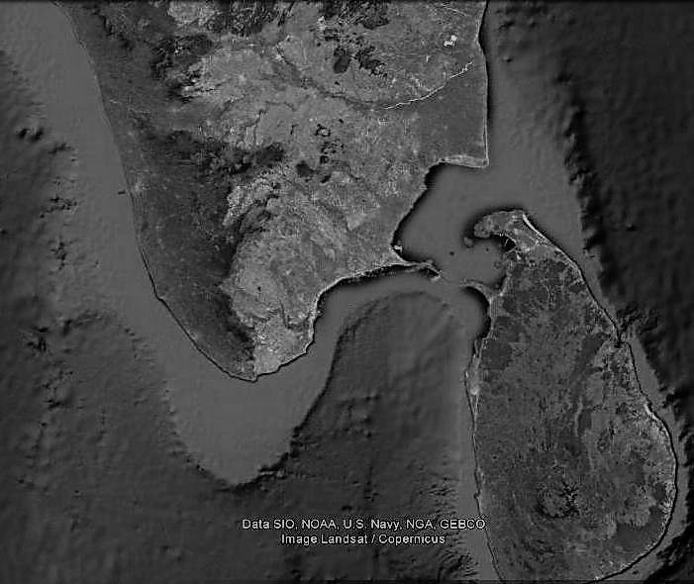
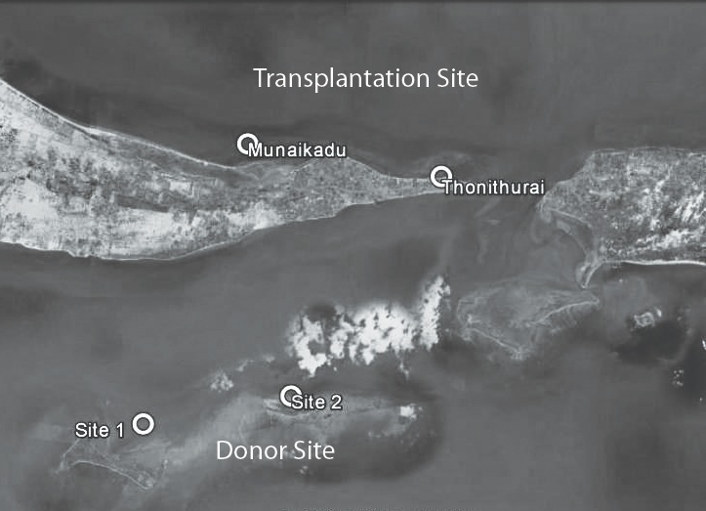
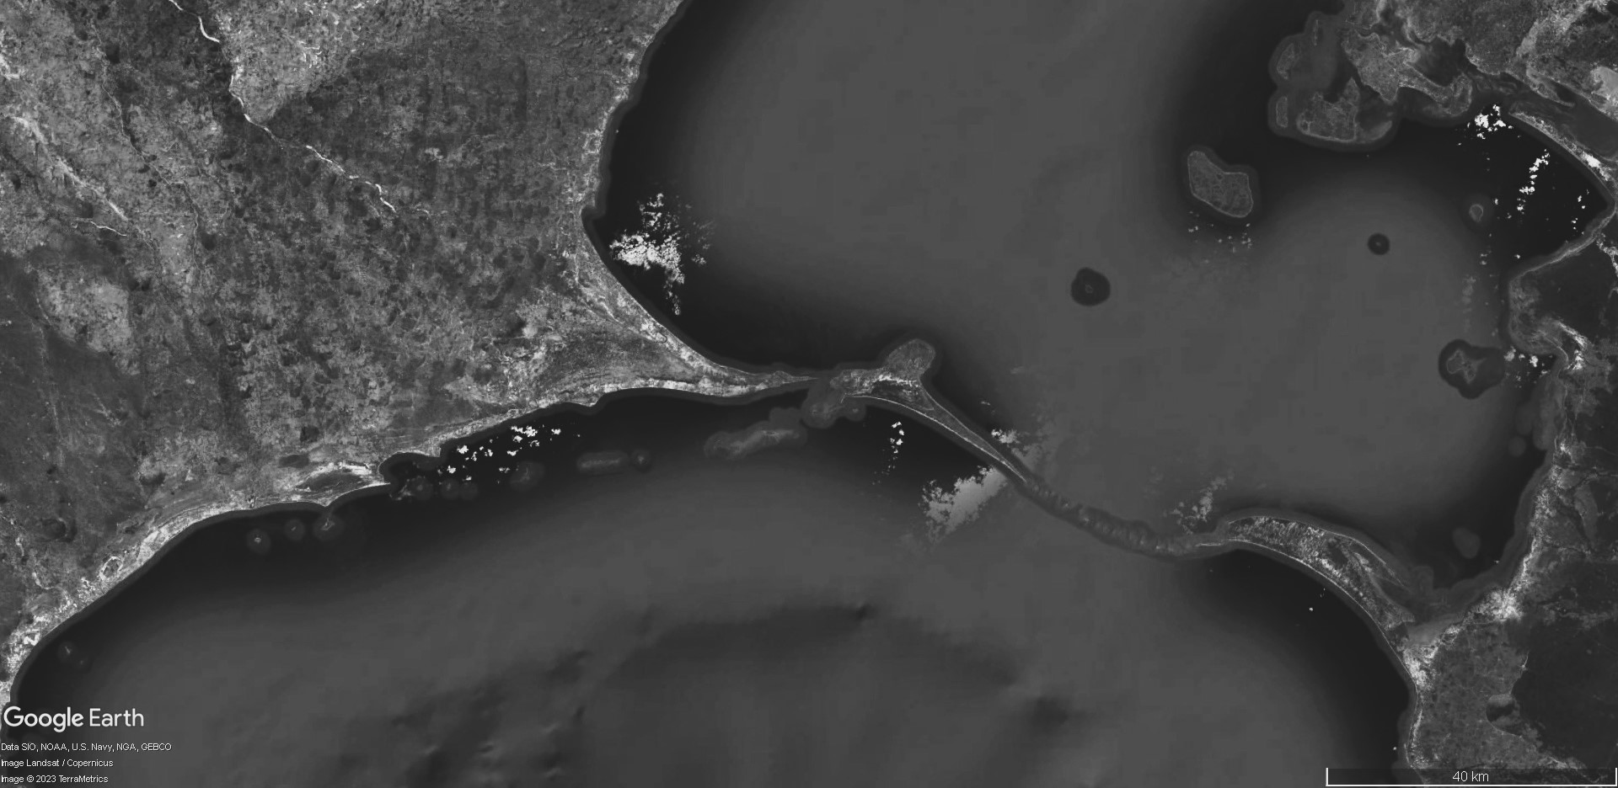
Palk Bay
Gulf of Mannar
Figure 1. Study Area map showing the location of donor site and transplantation site

Slide 4
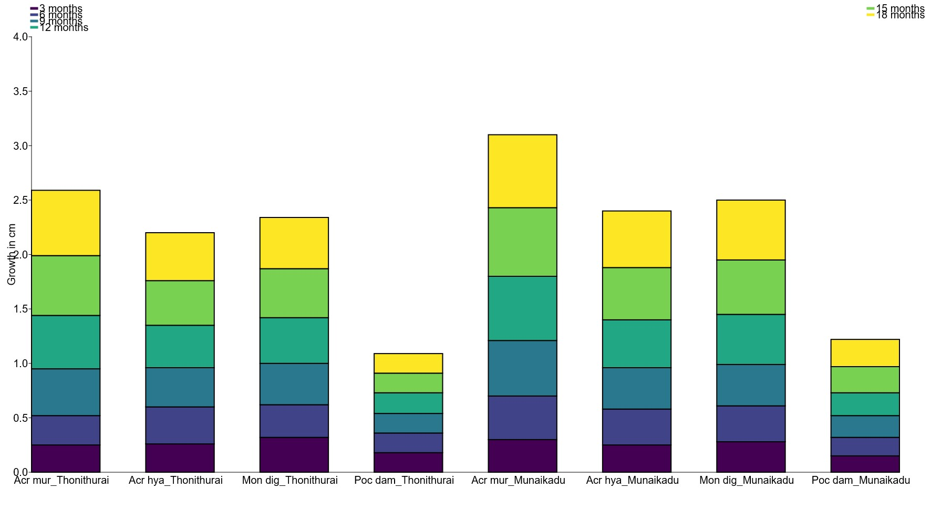
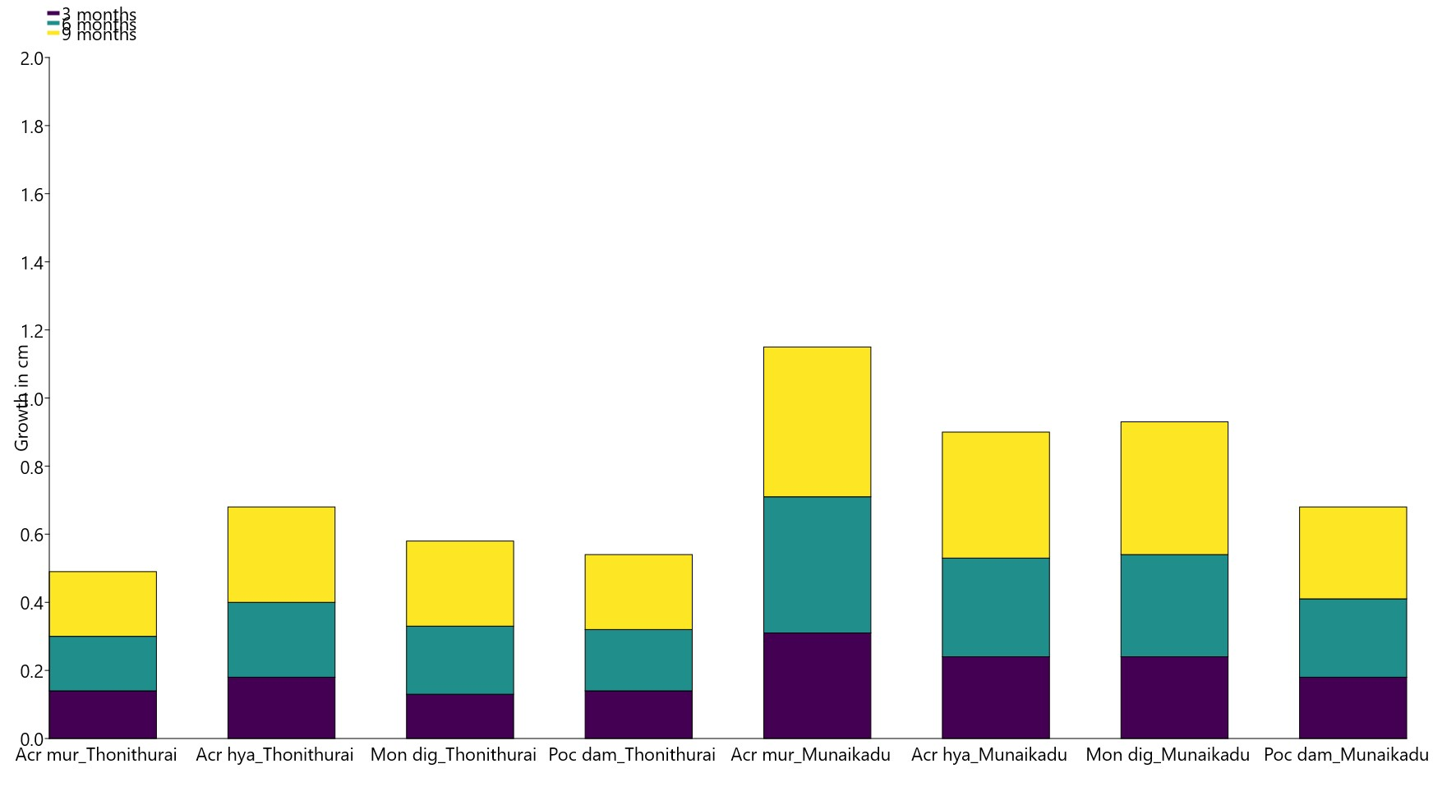
A)
B)
Fig. 2 Monthly growth rate of coral species : A) – 18 months of restoration – 1st set; B) – 9 months of restoration – 2nd sets.

Slide 5
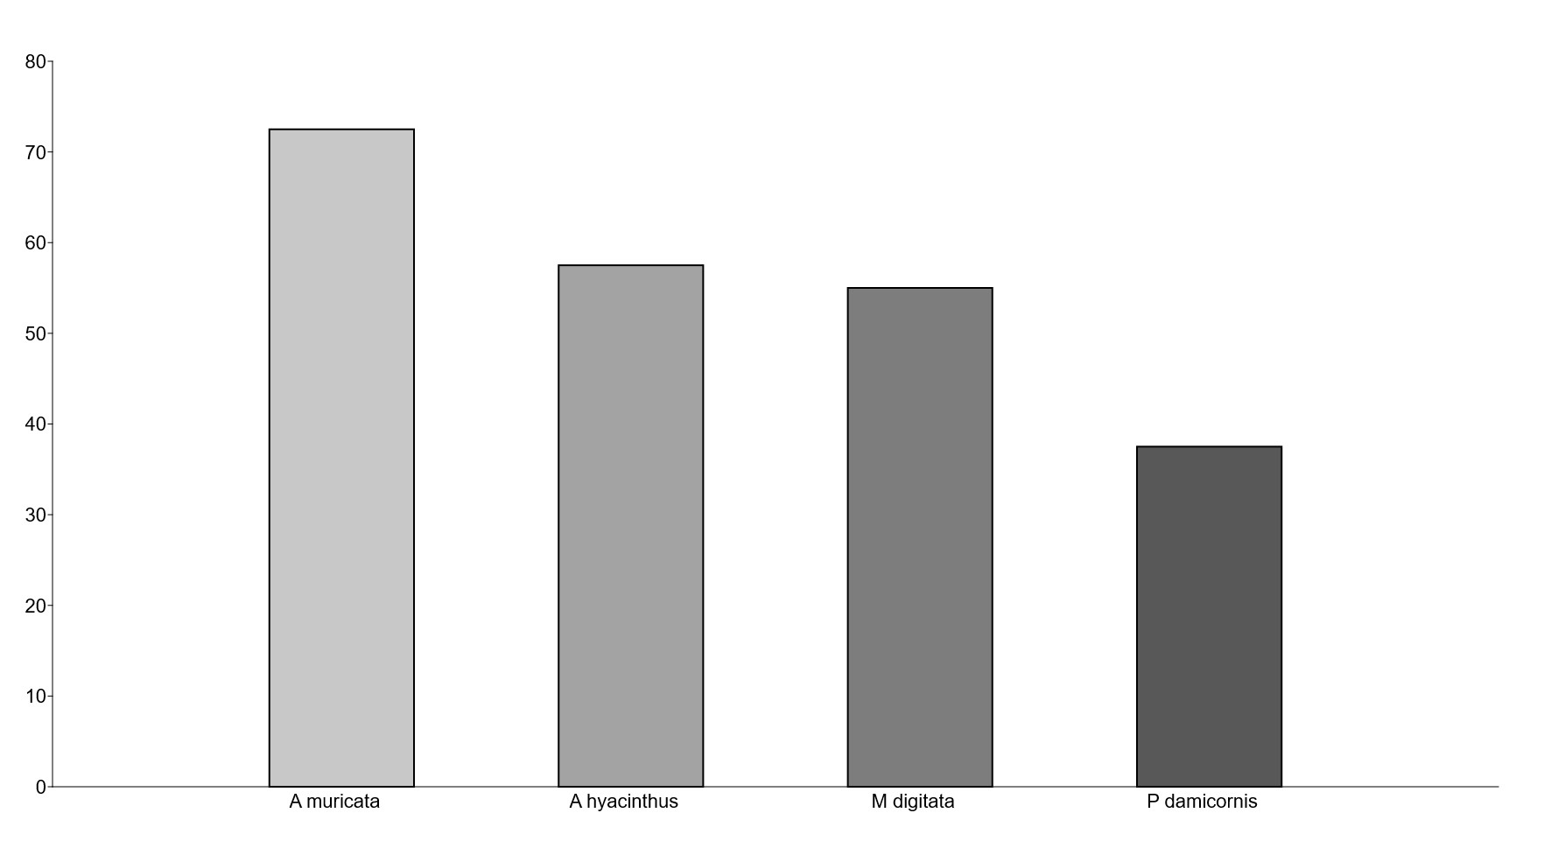
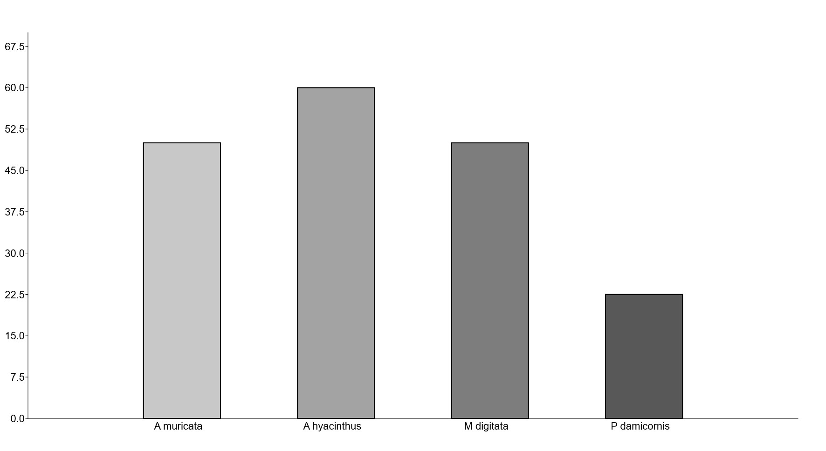
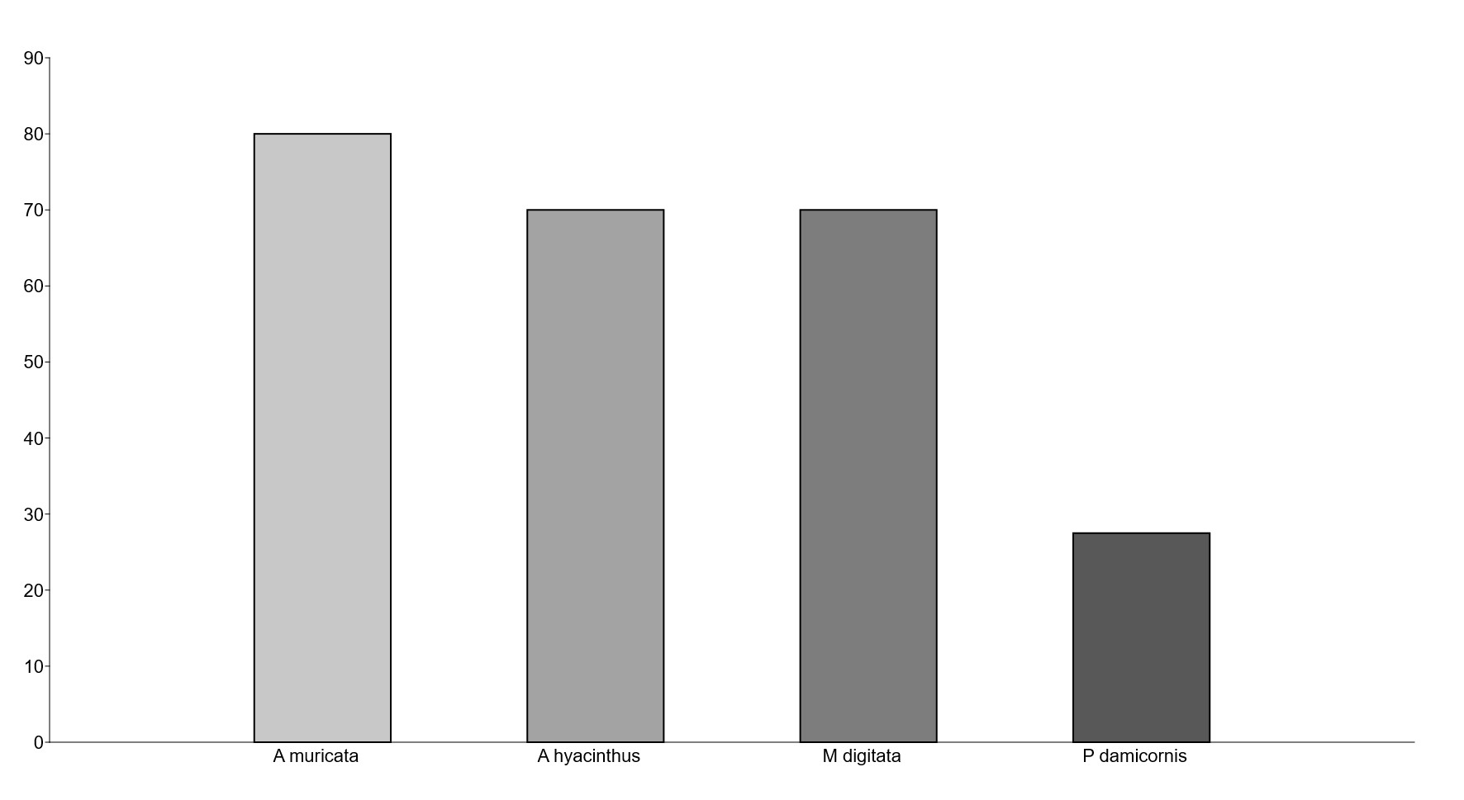
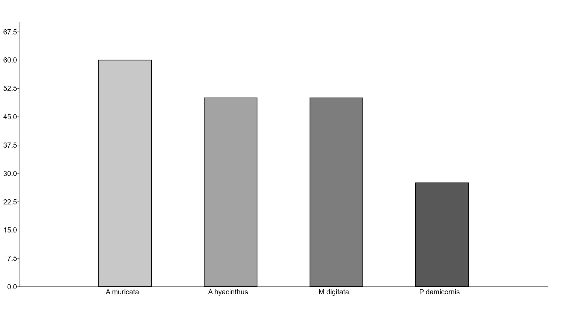
Munaikadu_Set1
A)
Thonithurai_Set1
B)
Munaikadu_Set2
c)
Thonithurai_Set2
D)
Figure 3. Survivability of coral species at different study sites.

Slide 6
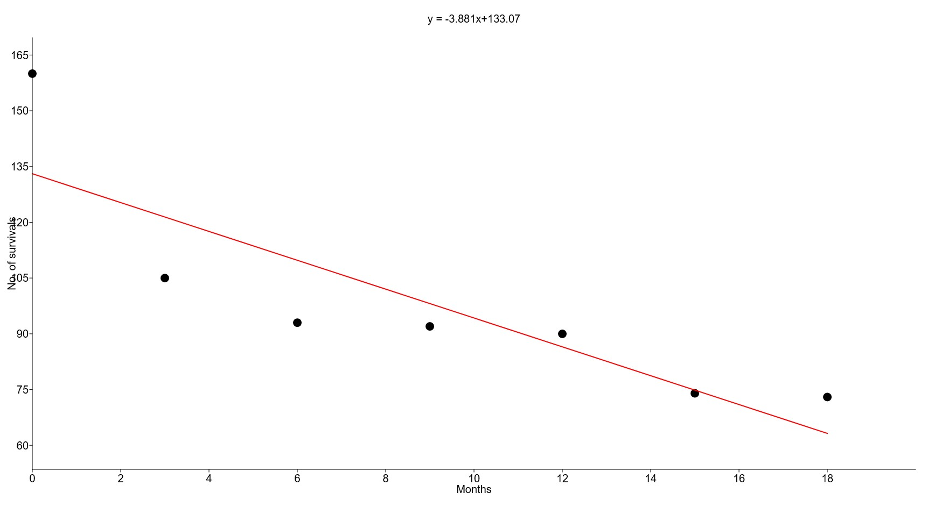
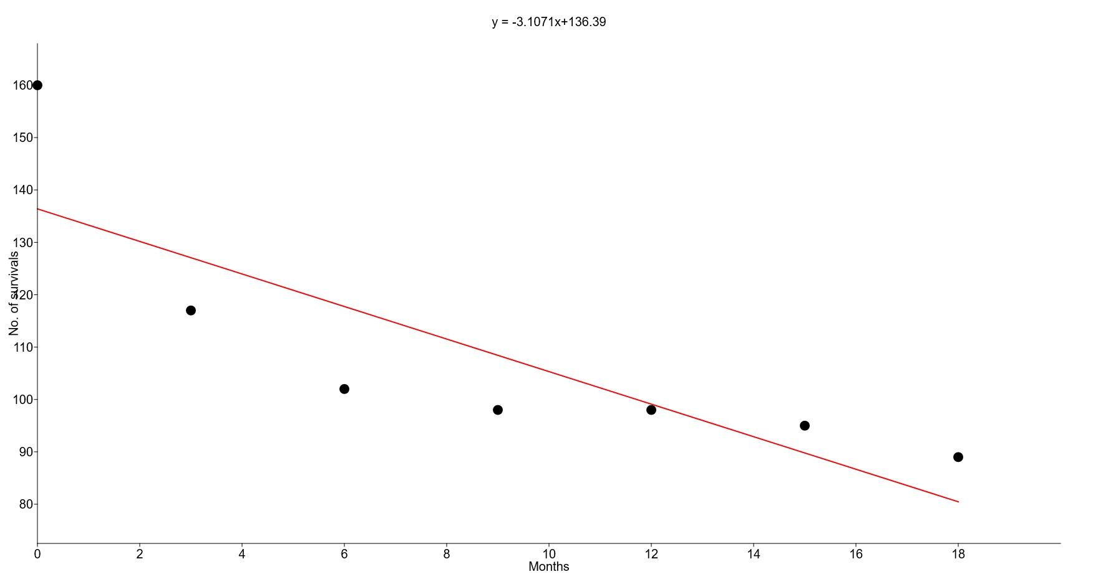
Munaikadu
Thonithurai
Figure 4. Linear Regression curve for number of survivals during restoration.

Slide 7
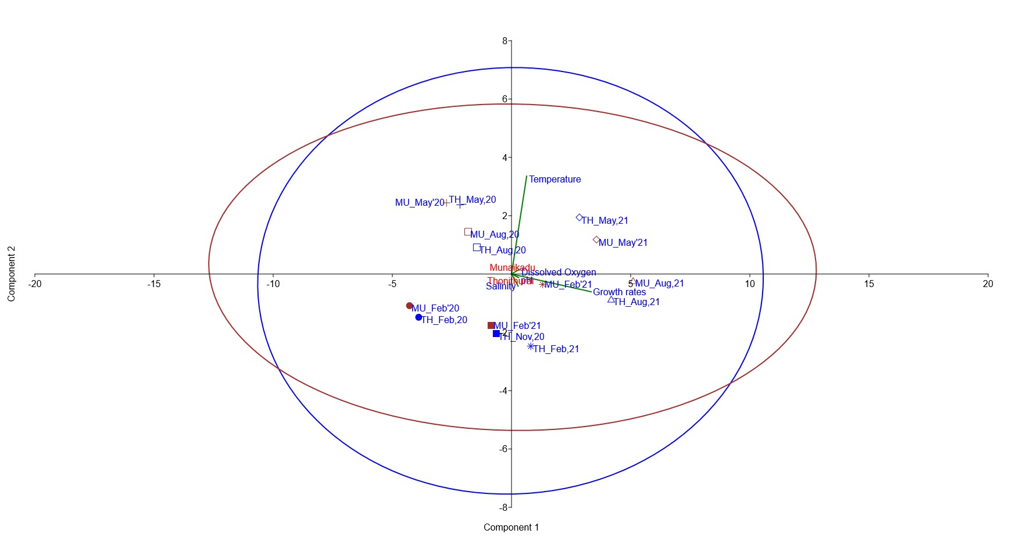
Figure 5. Principal Component Analysis of Monthly water quality parameters and growth rate variance of Thonithuria and Munaikadu

Slide 8
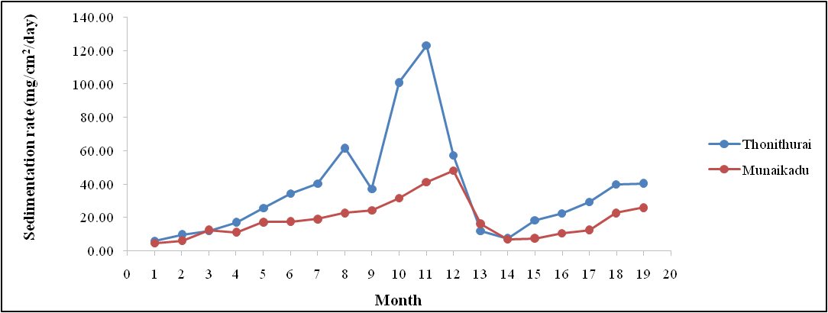
Figure 6. Variation in sedimentation rate (mg/cm2/day) during coral restoration

Slide 9
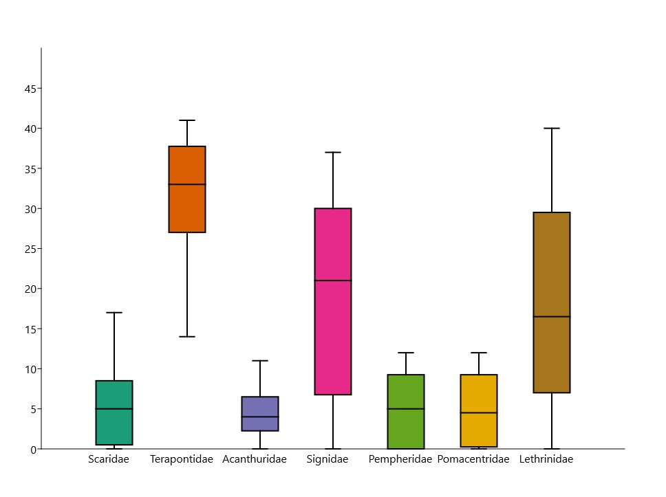
Figure 7. Box-Whisker analysis for the occurrence of fishes at restoration sites in Palk Bay. Boxes indicate the 25th to 75th percentile range, the band in the middle represents the median value, lower and upper bands indicate minimum and maximum values respectively.

Slide 10
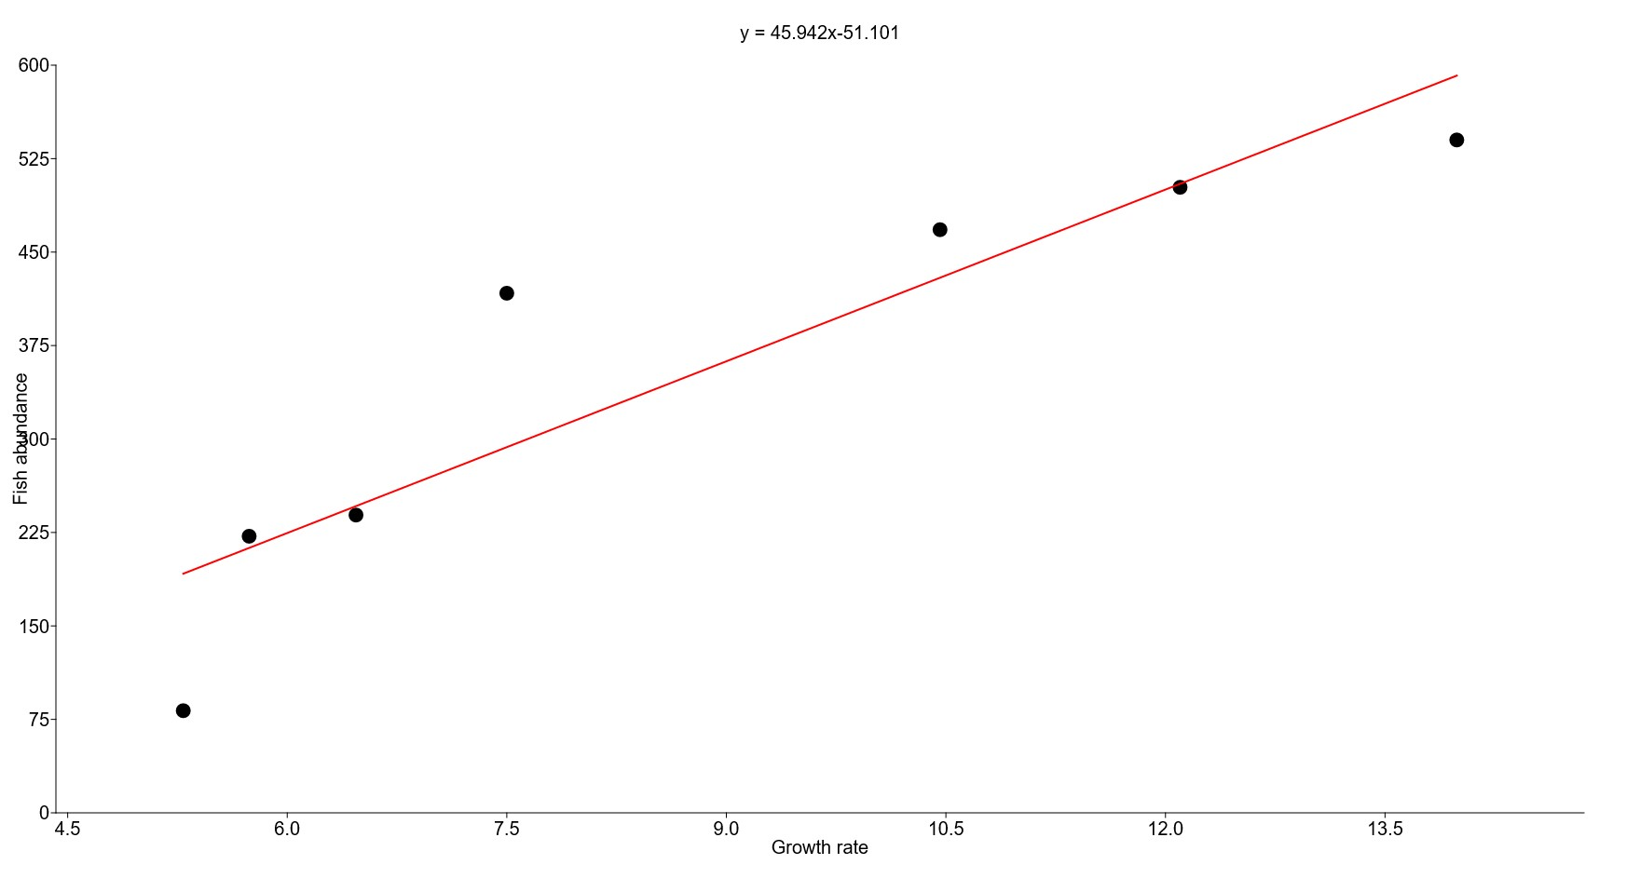
Figure 8. Linear regression curve of fish abundance in response to coral growth.

Slide 11
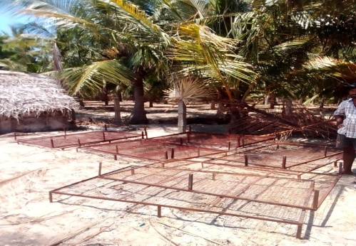
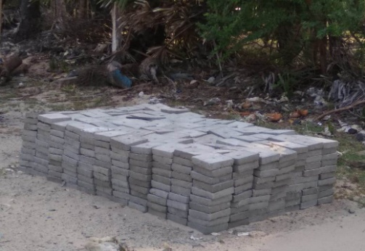
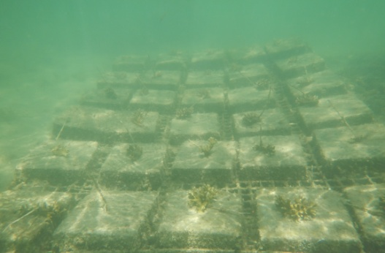
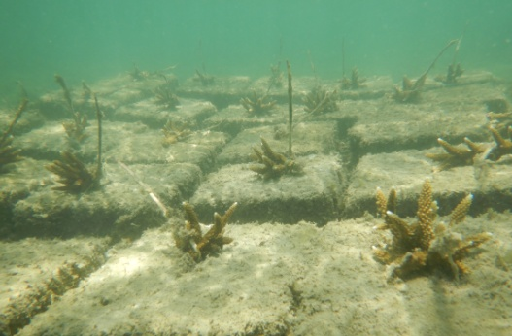
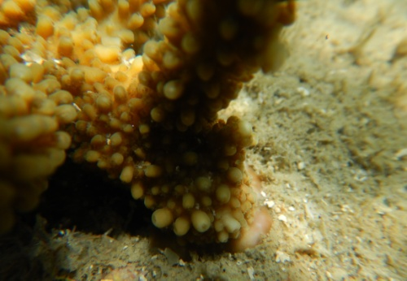
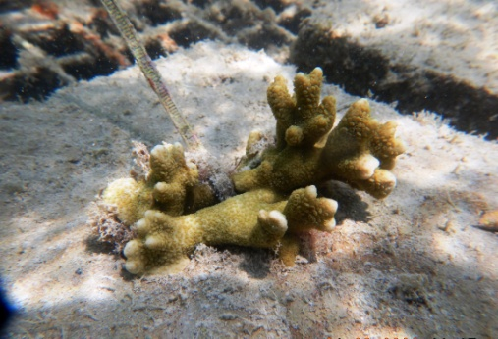
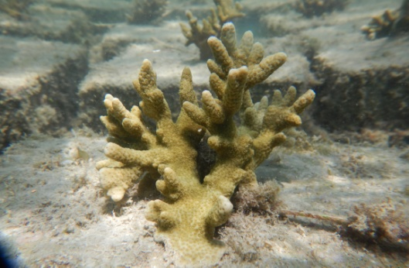
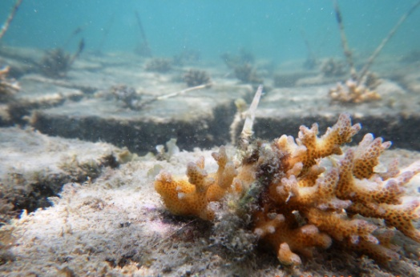
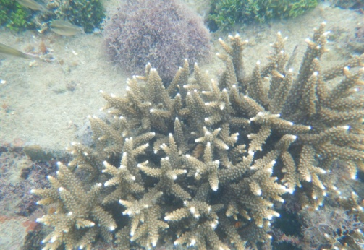
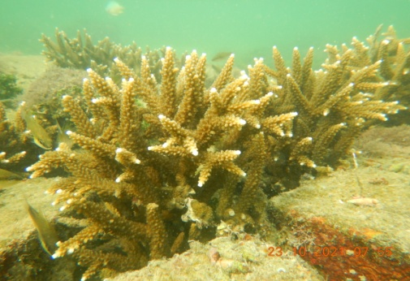
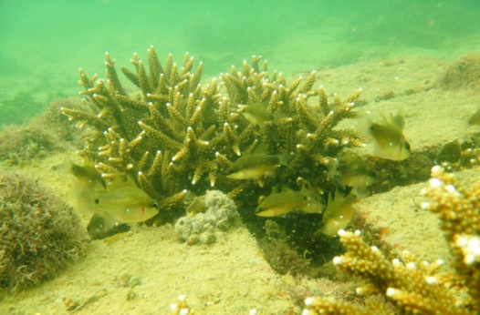
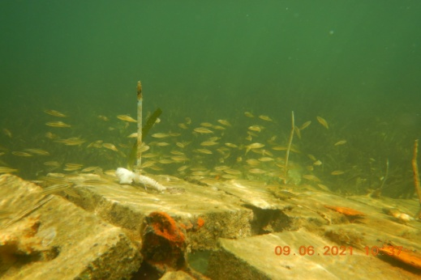
a
b
c
d
e
f
g
h
i
j
k
l
Fig.9: Restoration activities in Palk Bay (2020-2021): a-b: Frames and slabs structure used in restoration studies; c-d: coral fragments at initial stages of restoration; e-h: coral accretion occurred after the installation of coral fragments on cement slabs; i-j: Coral growth after 18 months of restoration; k-l: fish assemblage found on restoration site in Palk Bay.

