Slide 1
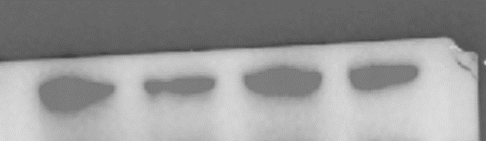
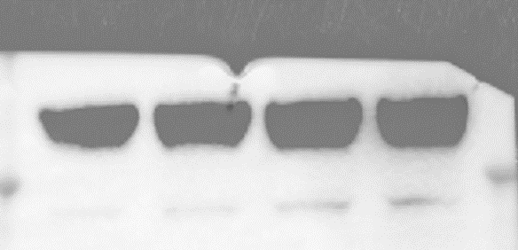
Oringinal Western blot
Figure2B
HN4
CAL27
si-Scr
si-RRAD
si-Scr
si-RRAD
RRAD
32KD
GAPDH
37KD

Slide 2
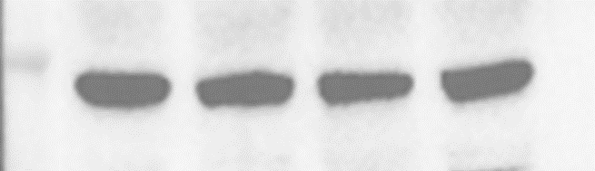
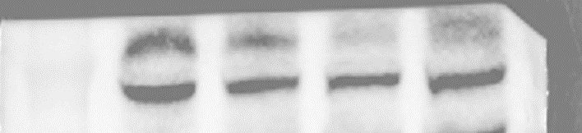
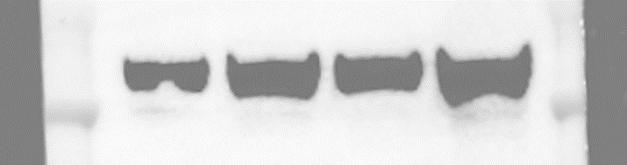
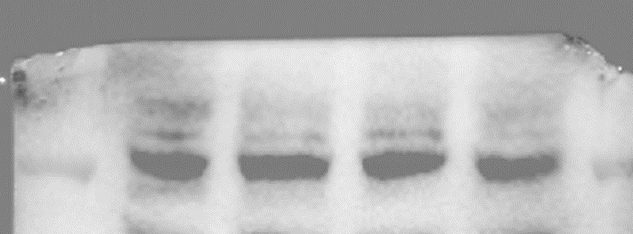
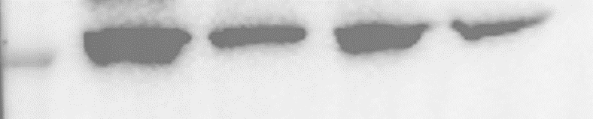
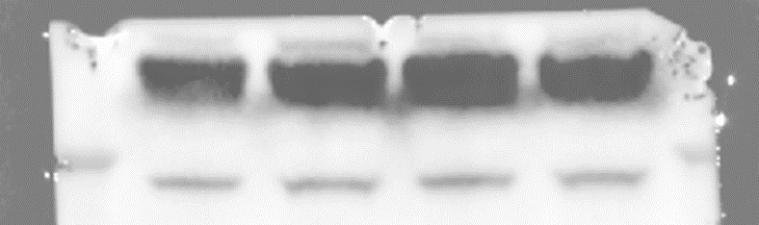
Figure3I
HN4
CAL27
si-Scr
si-RRAD
si-RRAD
si-Scr
GLUT1
54KD
GLUT2
54KD
GLUT3
54KD
GLUT4
54KD
RRAD
32KD
GAPDH
37KD

Slide 3
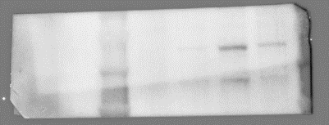
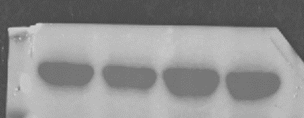
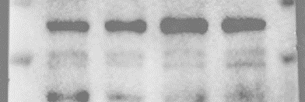
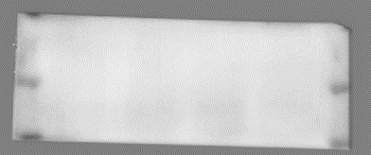
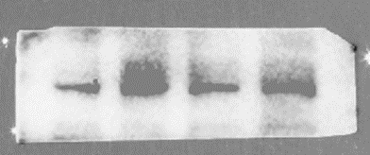
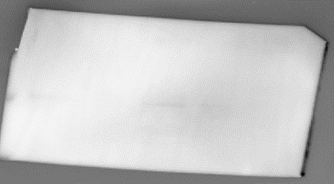
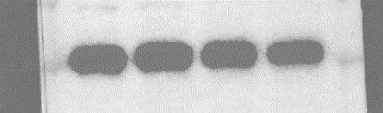

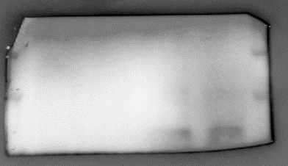
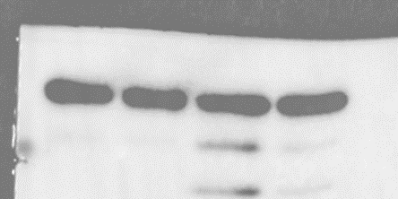
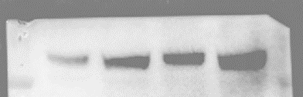

Figure4B
Cytoplasm
HN4
CAL27
HN4
CAL27
si-RRAD
si-Scr
si-RRAD
si-Scr
si-RRAD
si-Scr
si-RRAD
HN4
CAL27
si-Scr
Nucelus
si-RRAD
CAMKIV
58KD
si-Scr
si-Scr
si-RRAD
GAPDH
37KD
CAMKIV
58KD
P-CAMKIV
52KD
P-CAMKIV
52KD
CREB1
43KD
CREB1
43KD
P-CREB1
43KD
P-CREB1
43KD
H3
15KD
GLUT3
54KD
RRAD
32KD

Slide 4
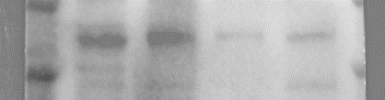
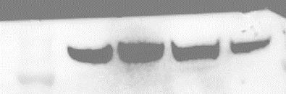
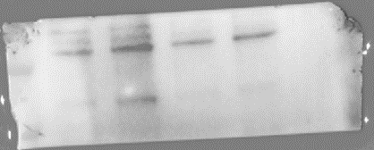

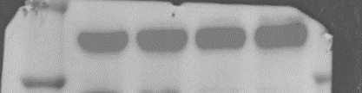

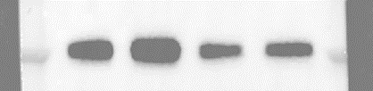
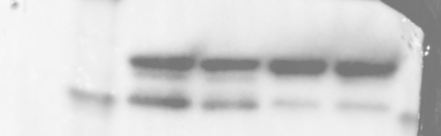
Figure4C
HN4
Nucleus
Cytoplasm
si-Scr
si-RRAD
si-CAMKIV
si-CAMKIV
+si-RRAD
si-CAMKIV
si-CAMKIV
+si-RRAD
si-Scr
si-RRAD
CAMKIV
58KD
GLUT3
54KD
RRAD
32KD
P-CAMKIV
52KD
GAPDH
37KD
CREB1
43KD
P-CREB1
43KD
H3
15KD

Slide 5
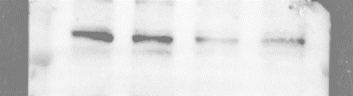

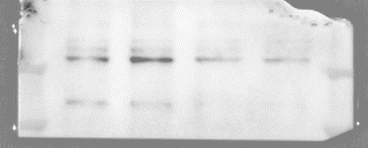

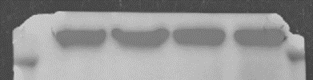
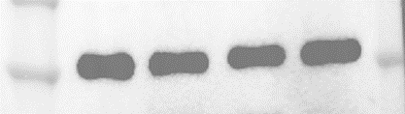

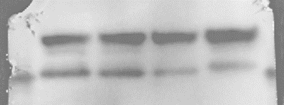
Figure4C
Nucleus
CAL27
si-Scr
si-RRAD
si-CAMKIV
si-CAMKIV
+si-RRAD
Cytoplasm
si-Scr
si-RRAD
si-CAMKIV
si-CAMKIV
+si-RRAD
CAMKIV
58KD
GLUT3
54KD
P-CAMKIV
52KD
RRAD
32KD
GAPDH
37KD
CREB1
43KD
P-CREB1
43KD
H3
15KD

