Slide 1
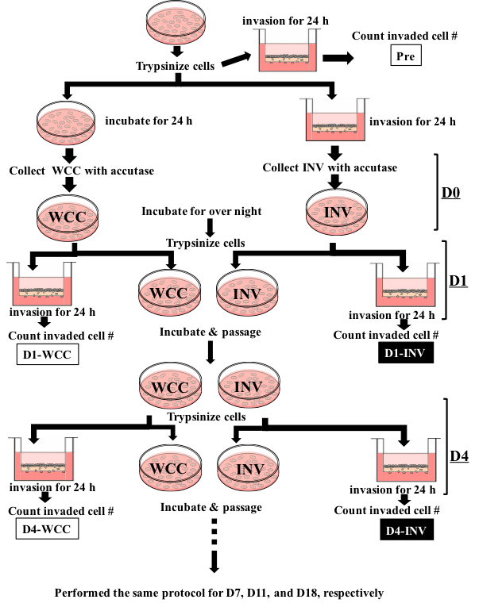
Supplemental Figure 1
Performed the same protocol for D7, D12, and D19
Supplemental Figure 1. Protocol for re-invasion assay
Whole cultured SUM 149 (WCC) and invasive SUM 149 cells collected from underneath of trasnswell membrane (INV) were used for re-invasion assay at each time point. (modified from ref. 29)

Slide 2
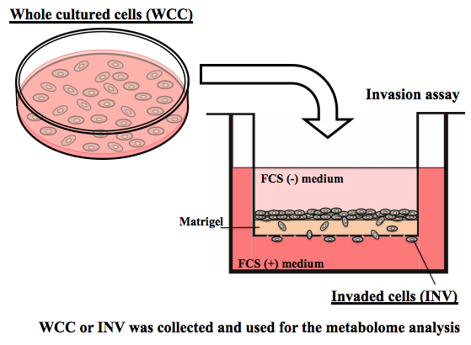
Supplemental Figure 2
Supplemental Figure 2. Collection of WCC and INV for the metabolome analysis
The collection methods of the whole cultured SUM149 (WCC) and the invaded SUM149 (INV) for the metabolome analysis are summarized.

Slide 3
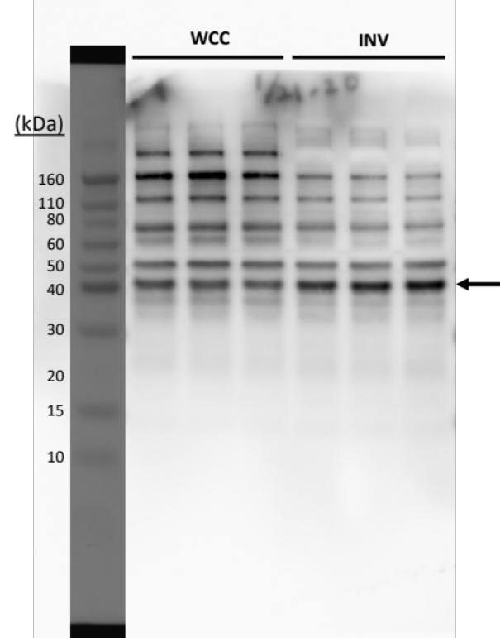
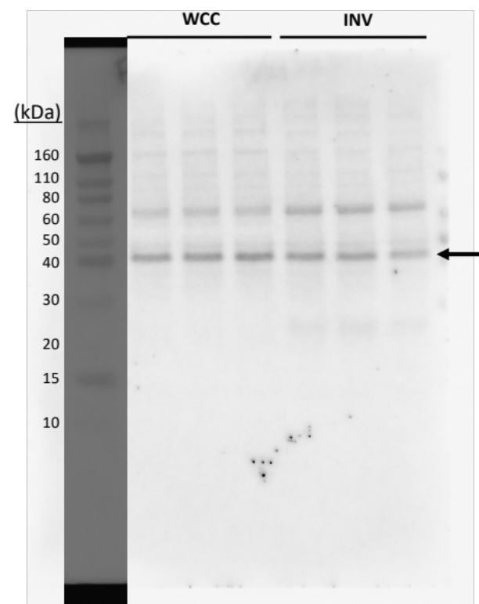
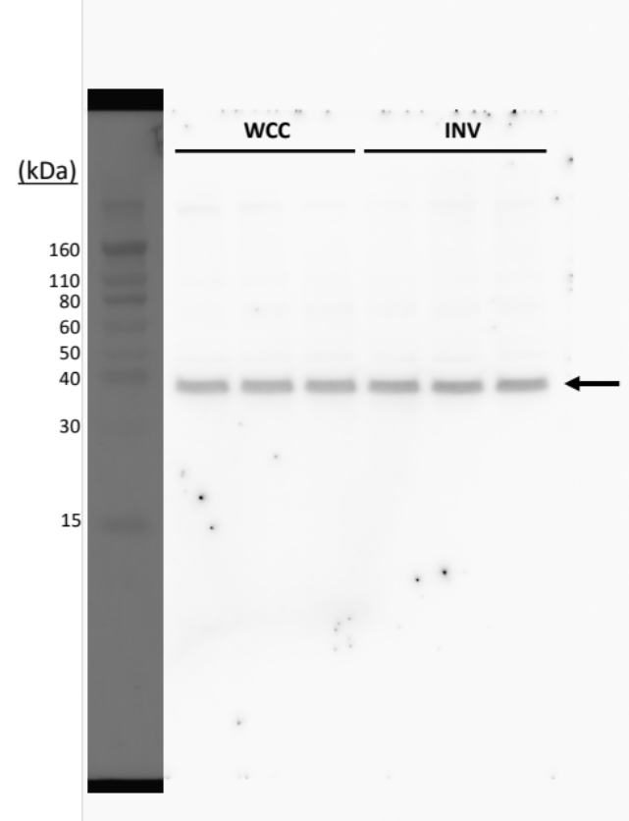
Supplemental Figure 3
A
pPDH (300)
PDH
GAPDH

Slide 4
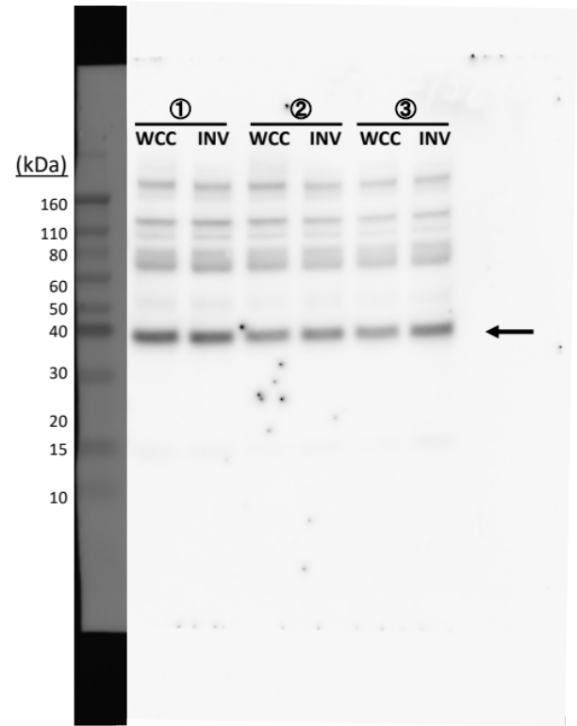
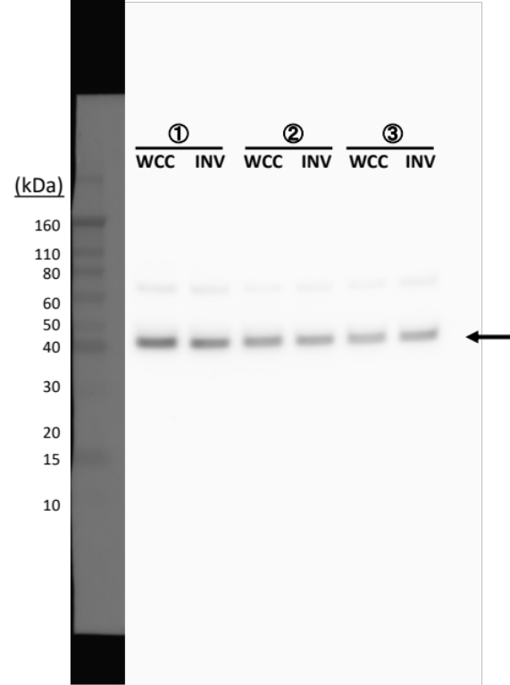
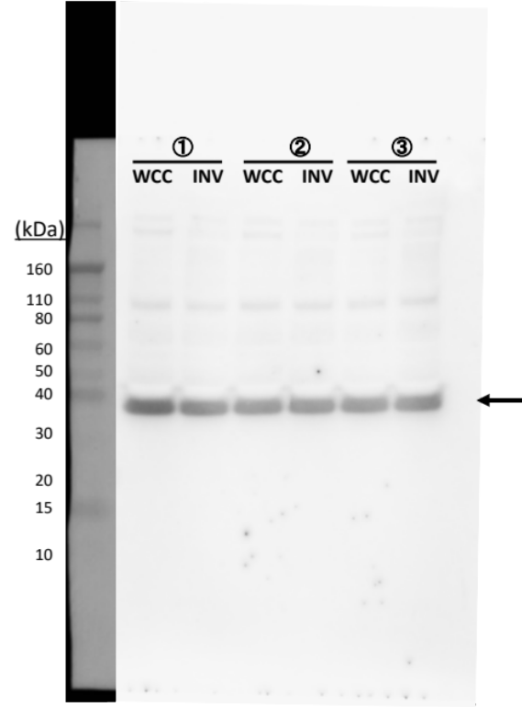
Supplemental Figure 3
B
pPDH (232)
PDH
GAPDH

Slide 5
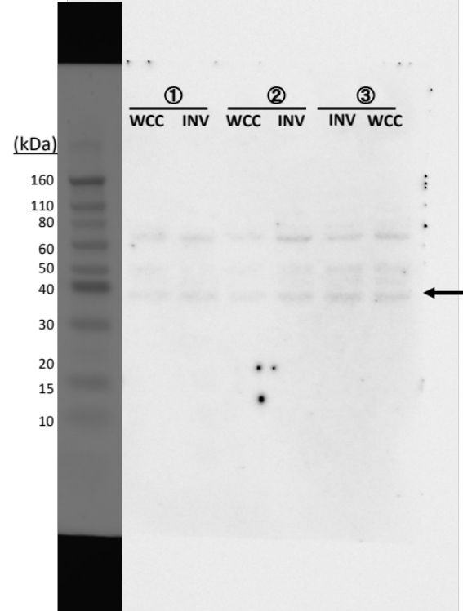
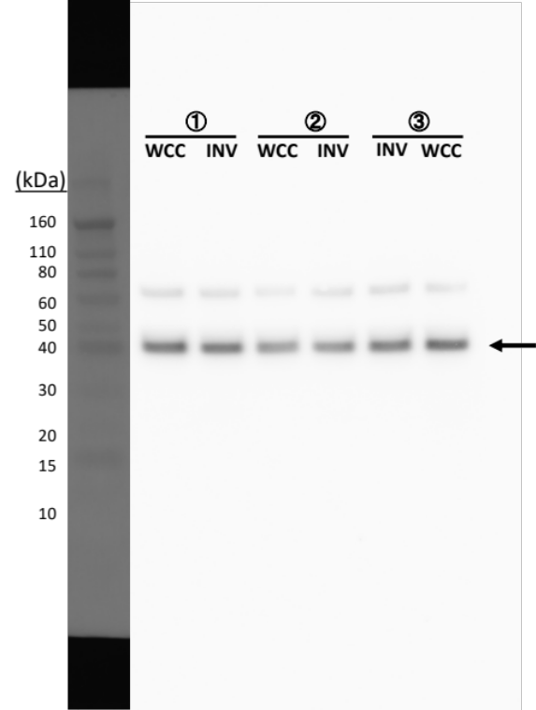
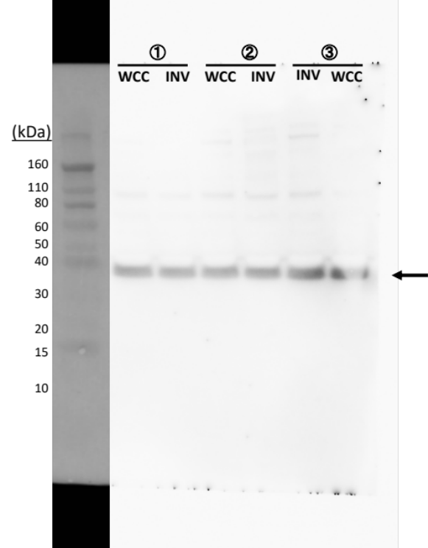
Supplemental Figure 3
C
pPDH (293)
PDH
GAPDH
Supplemental Figure 3. Full-length blot images used for Figure 3
Phosphorylated-PDH were determined with western blotting analysis, and bands were detected with ECL. Membrane was then stripped and re-blotted with PDH antibody, followed by stripped and re-blotted with GAPDH. Full-length blot images for pPDH (S300), PDH, GAPDH were shown in (A), pPDH (S232), PDH, GAPDH were shown in (B), and pPDH (S293), PDH, GAPDH were shown in (C), respectively. Arrow shows the band of expected molecular weight. Data are presented as triplicate samples.

Slide 6
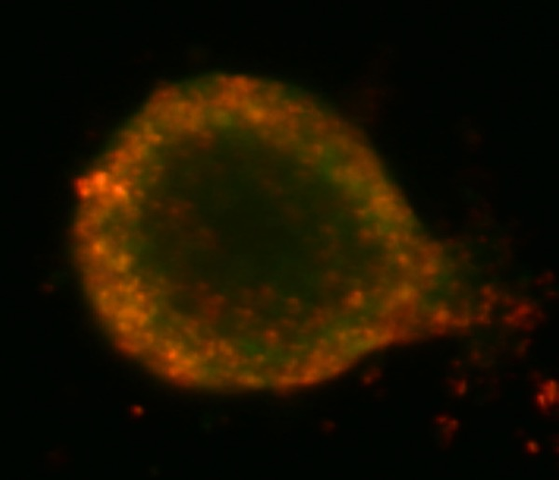
Supplemental Figure 4
0h
24h
Mitochondria
with low ΔΨm
Mitochondria
with high ΔΨm
Merge
Supplemental Figure 4. Mitochondrial membrane potential of SUM149 invading cells
SUM149 spheroid was treated with JC-1, mitochondrial membrane potential detection indicator, embedded into collagen gel, and florescent signals were photographed at 0 h and 24 h after the spheroid invasion assay was performed. Green color indicated the mitochondria with high membrane potential (Upper panel), and red color indicated the mitochondria with low membrane potential (Middle panel). Lower panel showed the merge of green and red signals. Left panels represents the magnified image of lower right of middle panels. Arrow shows the cells moving outwards from the spheroid and invading the collagen gel. Scale bar: 100 μm.

Slide 7
Supplemental Figure 5
A
SUM149
3-NP
(mM)
-
0.25
0.75
1.5
Nucleus
Mitochondria
with low ΔΨm
Mitochondria
with high ΔΨm
Merge

Slide 8
Supplemental Figure 5
B
MDA-MB-231
3-NP
(mM)
-
0.25
0.75
1.5
Nucleus
Mitochondria
with low ΔΨm
Mitochondria
with high ΔΨm
Merge

Slide 9
Supplemental Figure 5
C
HCC1937
3-NP
(mM)
-
0.25
0.75
1.5
Nucleus
Mitochondria
with low ΔΨm
Mitochondria
with high ΔΨm
Merge
Supplemental Figure 5. Effects of 3-NP on mitochondrial membrane potential
Cells were plated on glass slide chamber with phenol red free medium for 24 h and then stained with JC-1, mitochondrial membrane potential detection indicator, and NucBlue Live Ready Probes. Fluorescent signals of SUM149, MDA-MB-231, and HCC1937, were photographed and shown in (A), (B), and (C), respectively. Blue: nucleus, Green: mitochondria with low membrane potential, Red: mitochondria with high membrane potential, lower panel represents the merge. Scale bar: 200 μm.

Slide 10
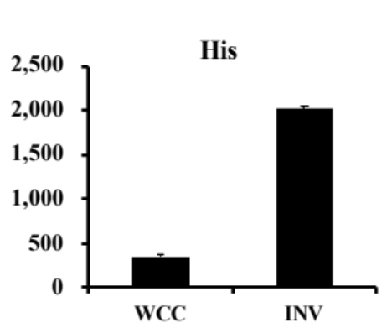
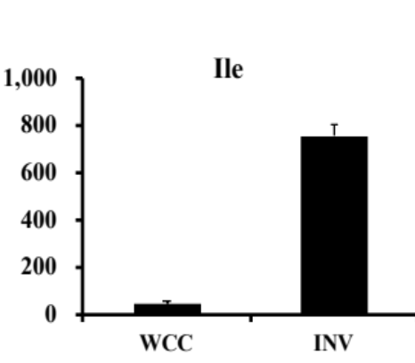
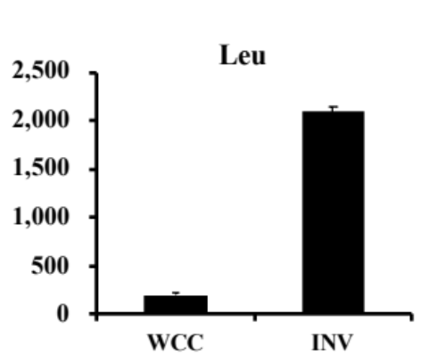
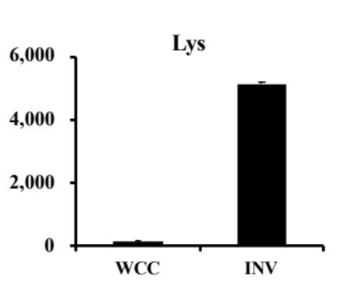
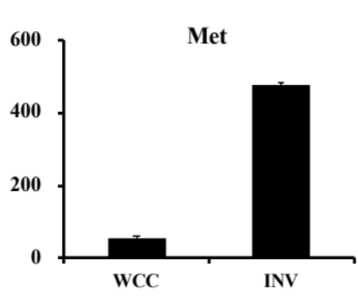
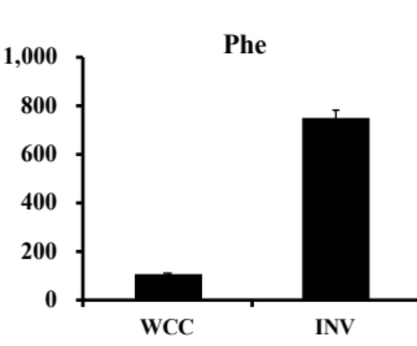
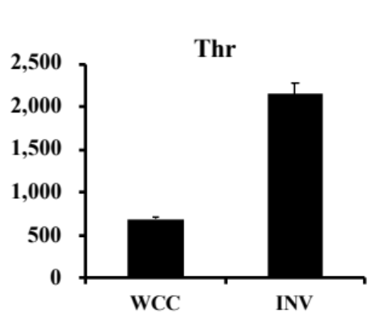
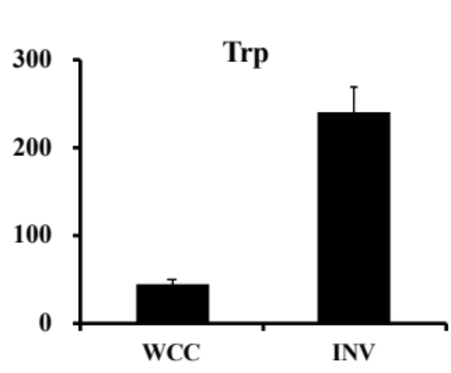
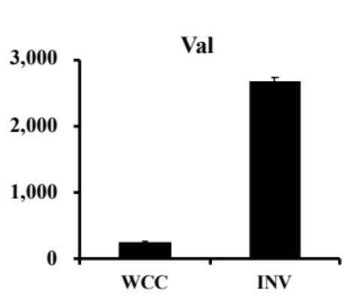
Supplemental Figure 6
A
Essential amino acids
Y axis:
pmol / 10⁶ cells
***
***
***
***
***
***
***
***
***

Slide 11
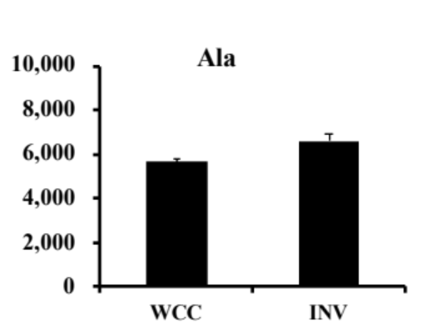
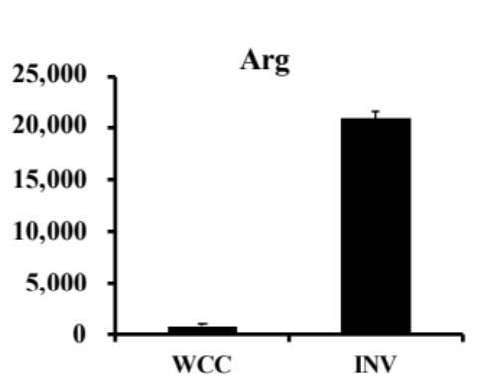
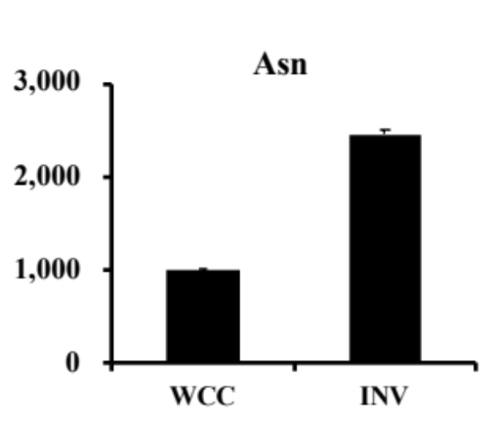
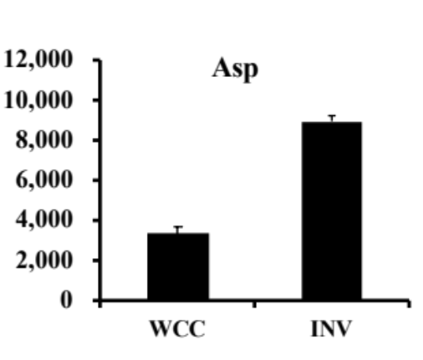
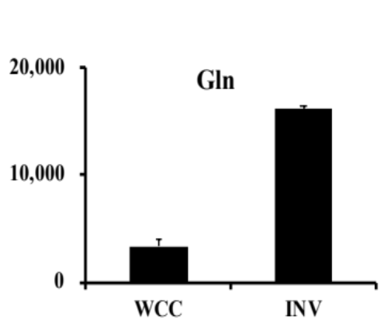
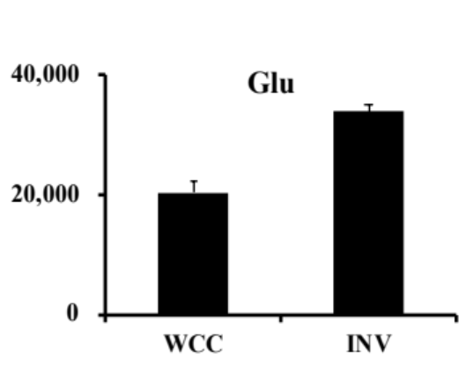
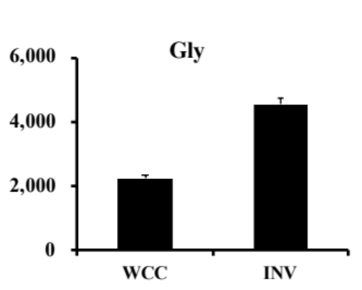
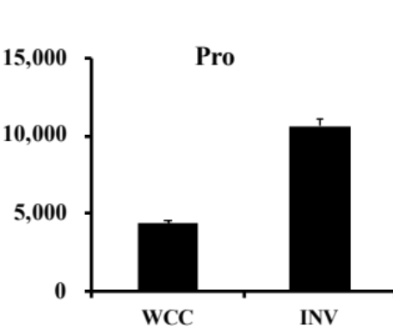
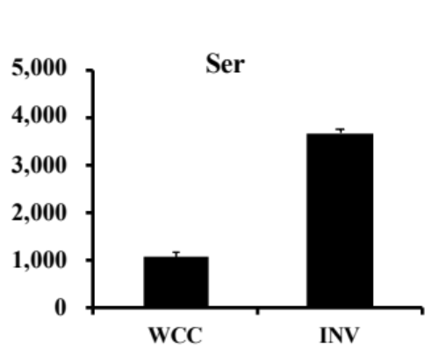
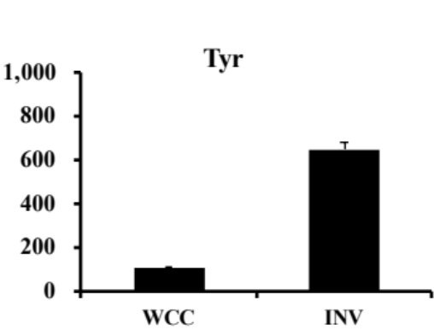
Supplemental Figure 6
B
Non-essential amino acids
Y axis:
pmol / 10⁶ cells
***
***
*
***
***
***
***
***
***
***
Supplemental Figure 6. Levels of amino acids in WCC and INV
Levels of essential (A) and non-essential (B) amino acids of SUM149 WCC and INV were analyzed by CE-TOFMS, and concentrations were shown in graph. Data are presented as mean ± SDs of triplicate samples. *p < 0.05, ***p< 0.001

Slide 12
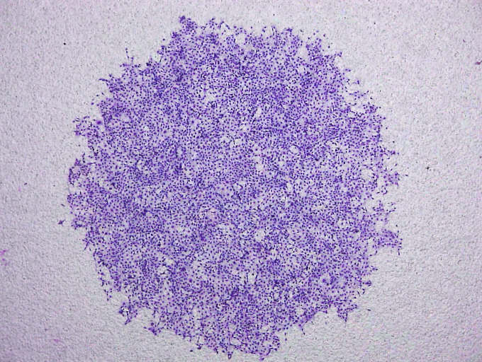
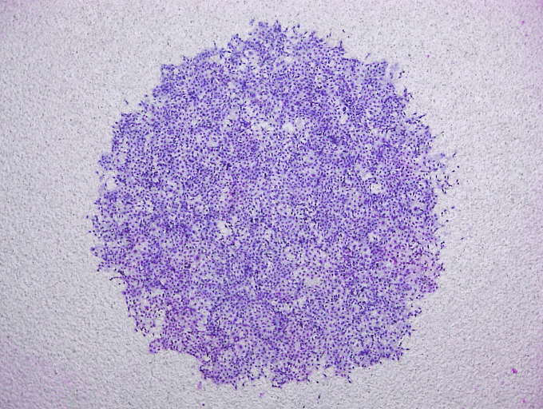
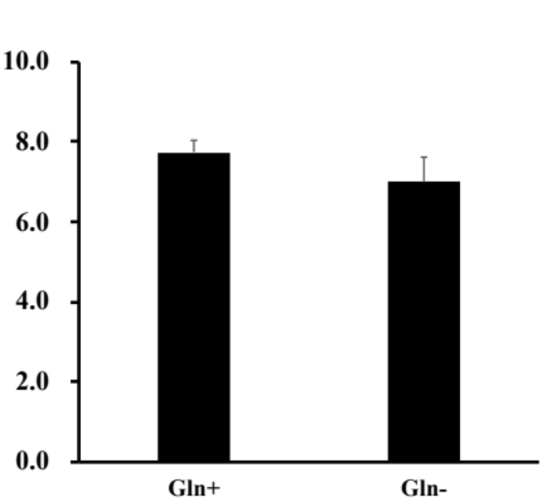
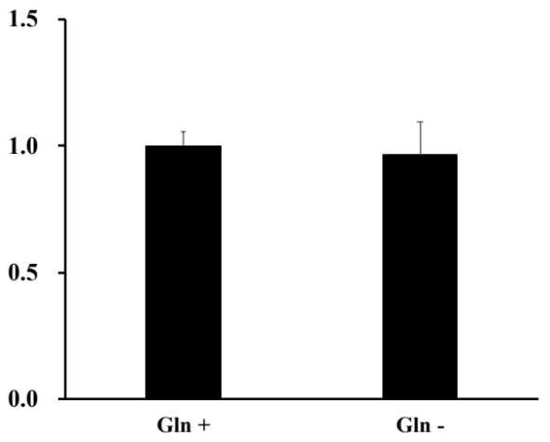
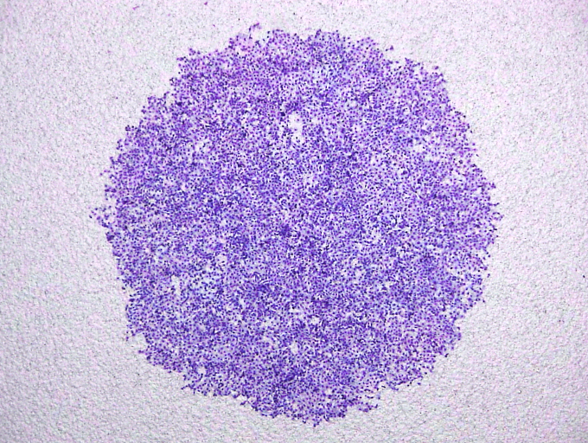
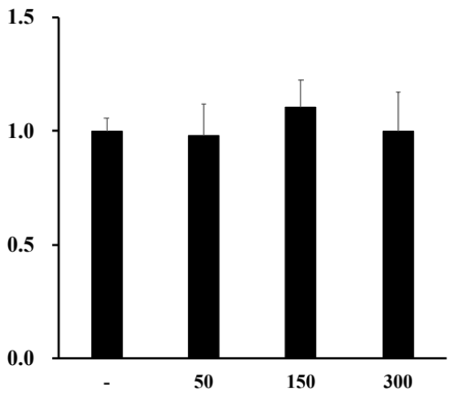
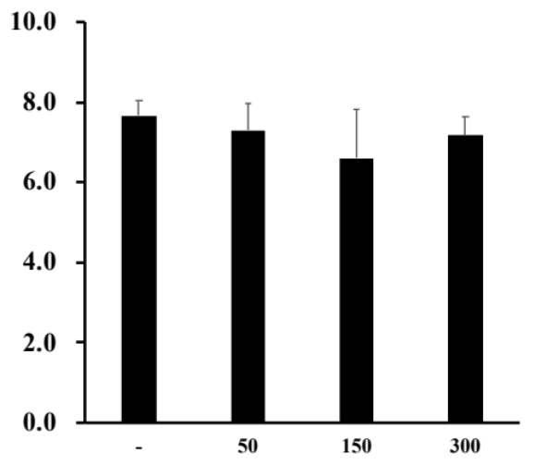
Supplemental Figure 7
A
Surviving fraction
% of invaded cells
B
Surviving fraction
% of invaded cells
CB-839 (nM)
CB-839 (nM)
Supplemental Figure 7. Glutamine had no significant effects on SUM149 invasiveness
SUM149 Surviving fraction and invasiveness were determined treated with Glutamine free medium (A), or Glutaminase 1 inhibitor, CB-839 (B) for 16 h. Number of surviving cells or invaded cells were counted, and summarized in graph. Data are presented as mean ± SDs of triplicate samples.

Slide 13
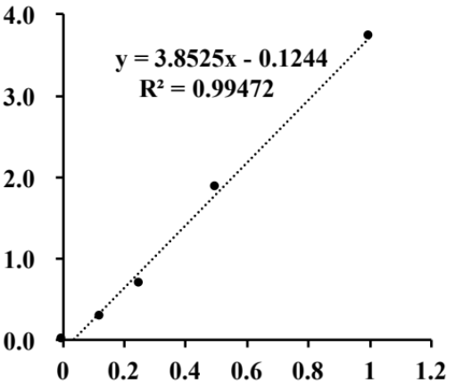
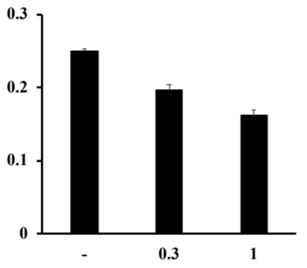
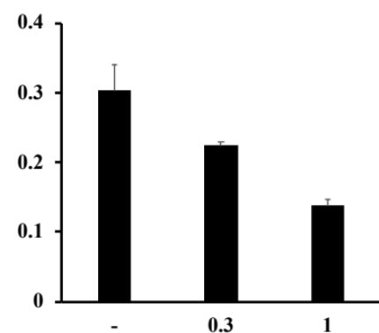
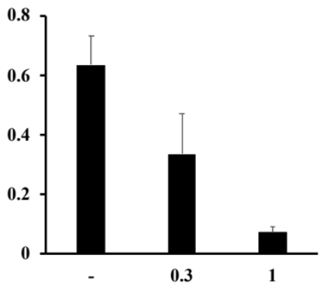
Supplemental Figure 8
A
Absorbance
Lactate (mmol/l)
B
C
D
SUM149
MB231
HCC1937
*
**
***
***
*
Lactate (mmol/l)
***
2-DG (mM)
2-DG (mM)
2-DG (mM)
Supplemental Figure 8. Lactate measurement
(A) Calibration curve for lactate was prepared with using Lactate standard solution by serial dilution with ddH2O: 1, 0.5, 0.25, 0.125, 0.0625, 0.0313, 0.0157 and 0 mmol/l, and reacted with working solution, according to the manufactures protocol (Dojindo). The absorbance at 450 nm was measured by using a microplate reader. (B) SUM149, MDA-MB-231, and HCC193 cells were treated with 0.3 or 1 mM 2-DG for 16 h, and lactate productions were measured and calculated by using a calibration curve. *p < 0.05, **p< 0.01, ***p< 0.001.

