Slide 1
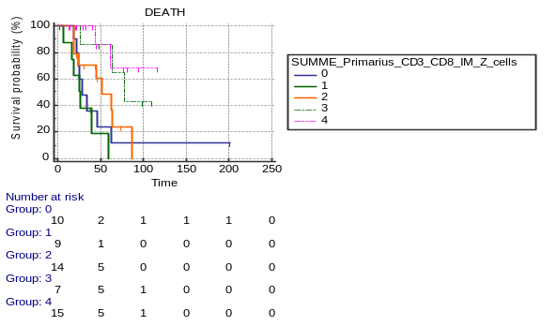
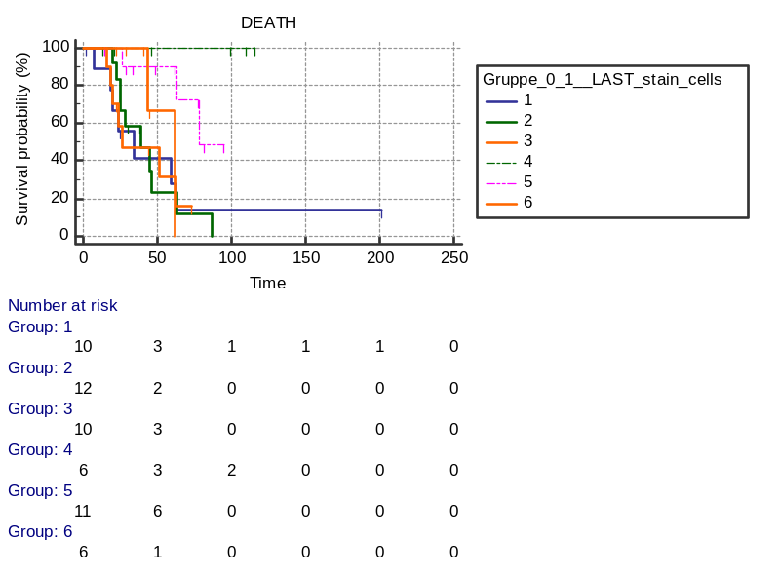
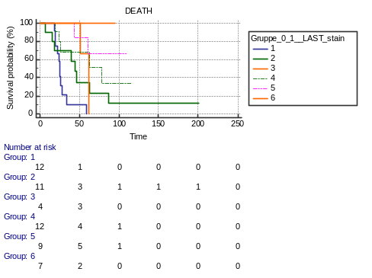
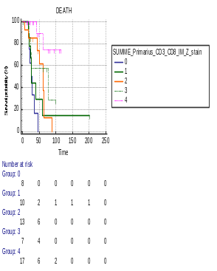
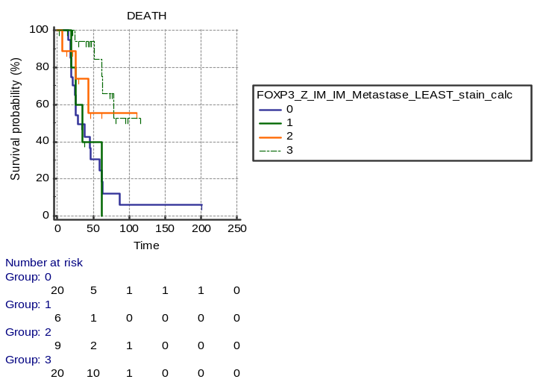
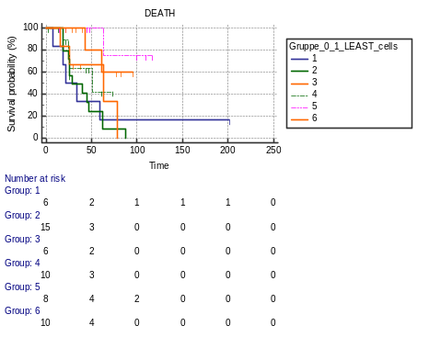
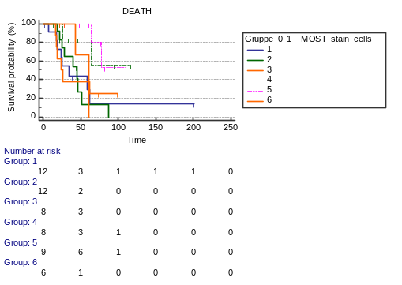
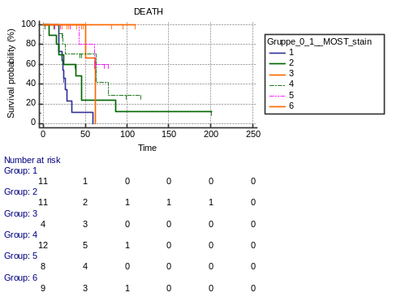
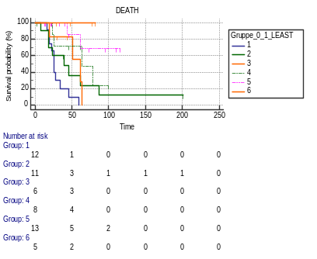
A
B
E
F
p = 0.0002
p = 0.0042
p = 0.0002
p < 0.0001
primary CRC
primary CRC
primary CRC + Mx(last resected)
primary CRC + Mx(last resected)
CD3-CD8 [cellcount/mm²]
CD3-CD8 [stain-area/mm²x10^5]
C
D
G
H
p = 0.0035
p = 0.00257
p < 0.0001
p < 0.0001
primary CRC + Mx(least infiltrated)
primary CRC + Mx(most infiltrated)
primary CRC + Mx(least infiltrated)
primary CRC + Mx(most infiltrated)
Abbreviations: Mx= Metastases; primary CRC= primary colorectal cancer

Slide 2
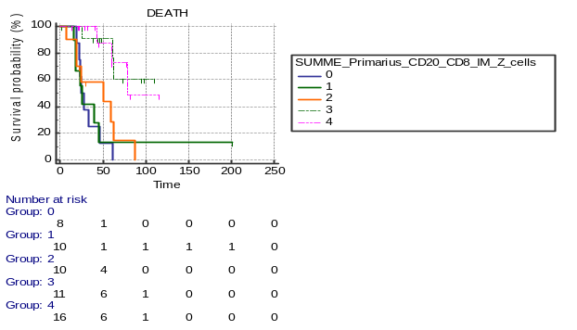
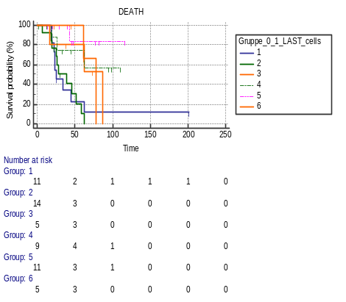
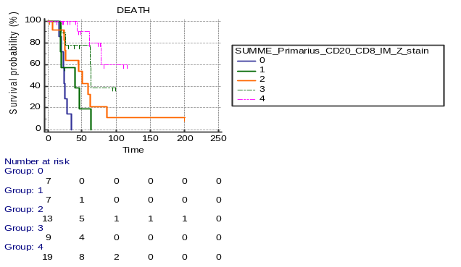
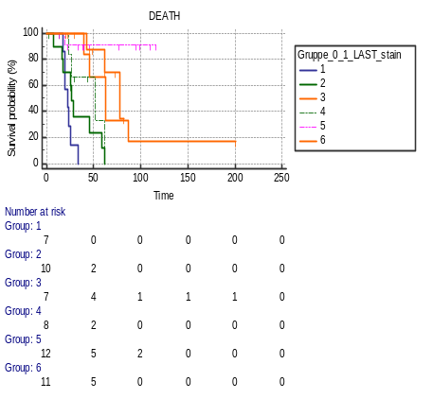
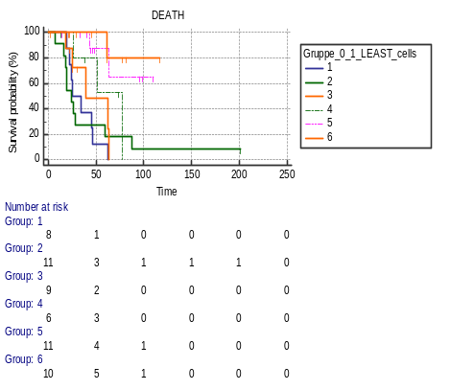
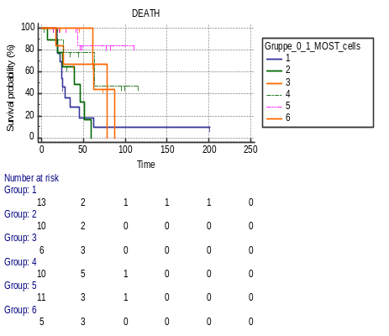
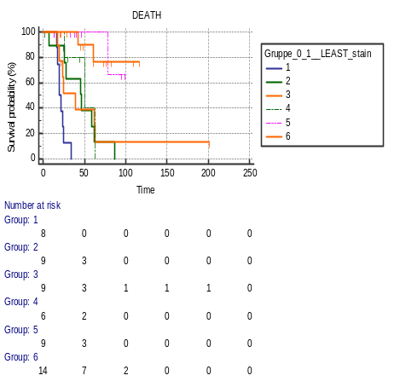
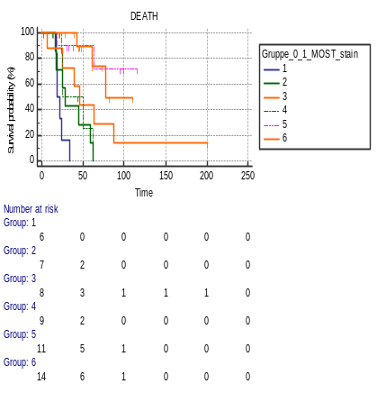
A
B
E
F
p < 0.0001
p = 0.0001
p < 0.0001
p < 0.0001
primary CRC
primary CRC
primary CRC + Mx(last resected)
primary CRC + Mx(last resected)
CD8-CD20 [cellcount/mm²]
CD8-CD20 [stain-area/mm²x10^5]
C
D
G
H
p = 0.0001
p = 0.0001
p < 0.0001
p < 0.0001
primary CRC + Mx(least infiltrated)
primary CRC + Mx(most infiltrated)
primary CRC + Mx(least infiltrated)
primary CRC + Mx(most infiltrated)
Abbreviations: Mx= Metastases; primary CRC= primary colorectal cancer

Slide 3
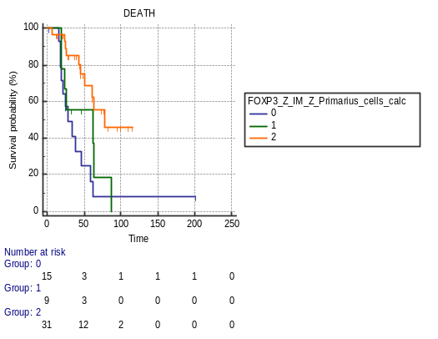
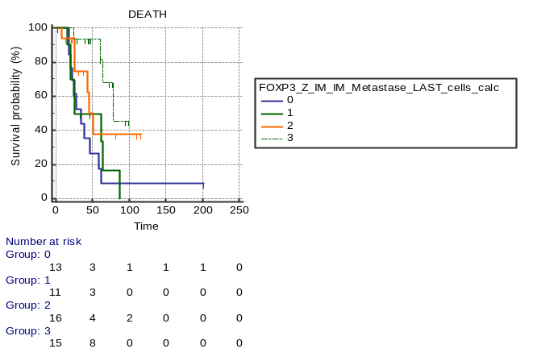
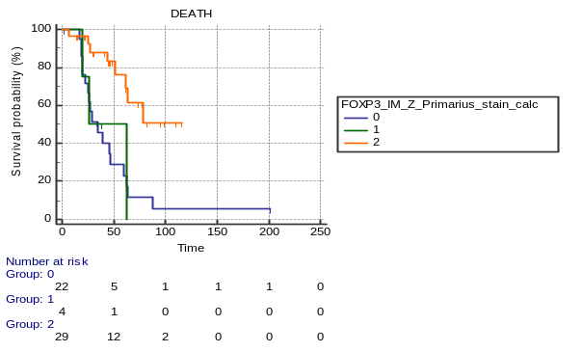
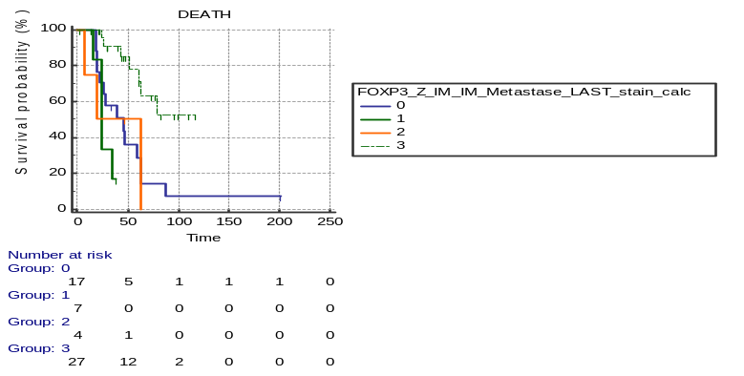
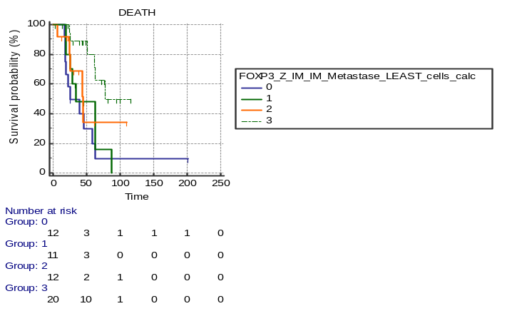
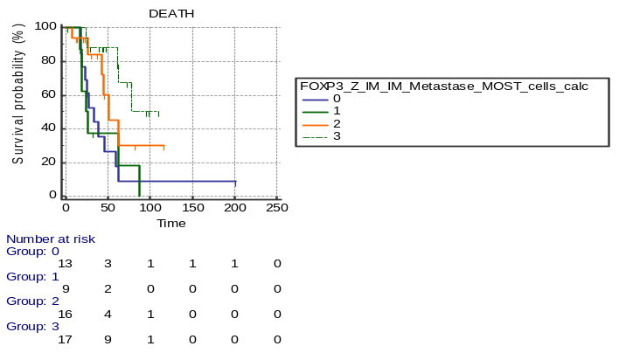
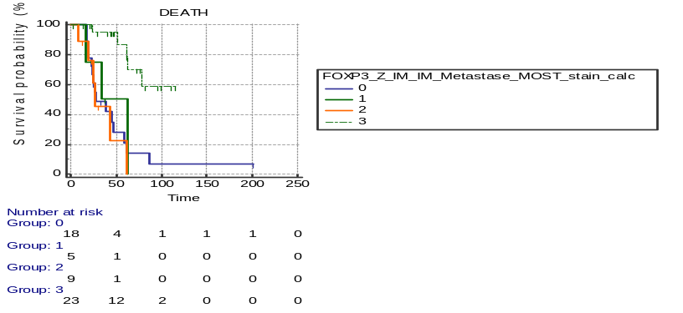
A
B
E
F
primary CRC
p = 0.0019
p = 0.0058
primary CRC
p = 0.0006
p = 0.0002
primary CRC + Mx(last resected)
primary CRC + Mx(last resected)
FOXP3 [cellcount/mm²]
FOXP3 [stain-area/mm²x10^5]
C
D
G
H
p = 0.0081
p = 0.0015
p = 0.0001
p = 0.0020
primary CRC + Mx(least infiltrated)
primary CRC + Mx(most infiltrated)
primary CRC + Mx(least infiltrated)
primary CRC + Mx(most infiltrated)
Abbreviations: Mx= Metastases; primary CRC= primary colorectal cancer

Slide 4
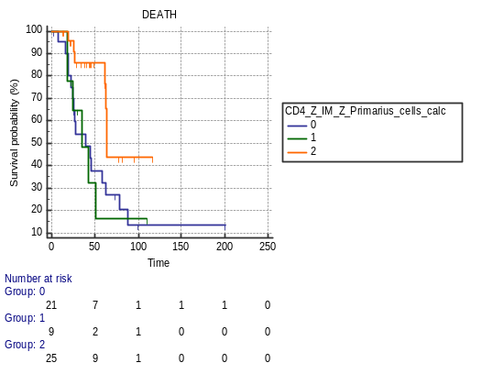
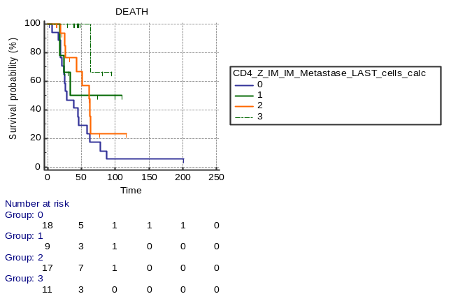
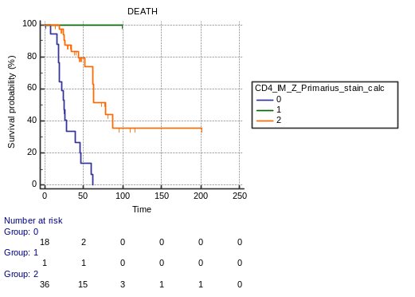
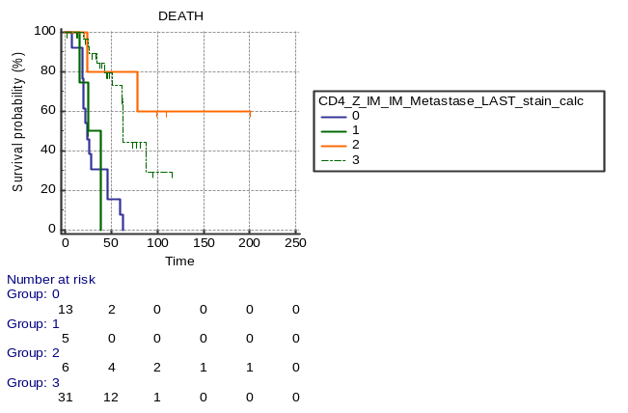
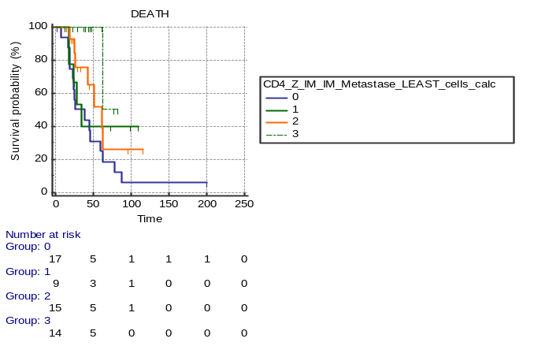
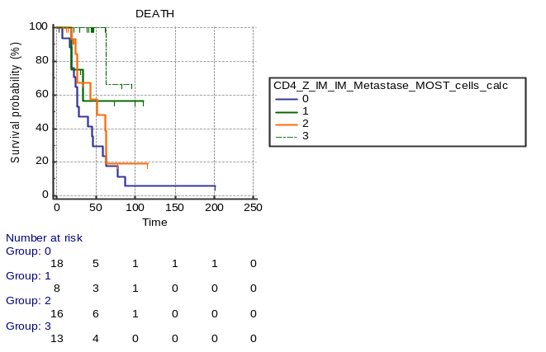
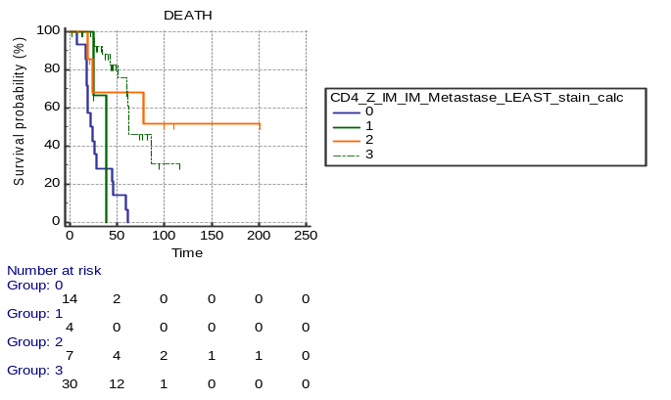
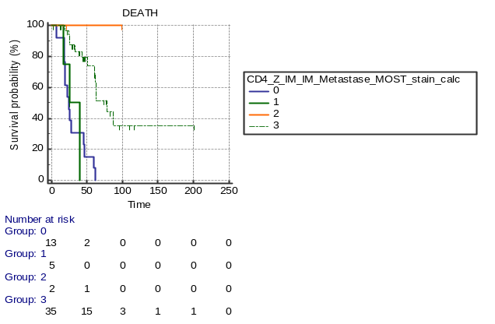
A
B
E
F
p = 0.0227
p = 0.0059
p < 0.0001
p < 0.0001
primary CRC
primary CRC
primary CRC + Mx(last resected)
primary CRC + Mx(last resected)
CD4 [cellcount/mm²]
CD4 [stain-area/mm²x10^5]
C
D
G
H
p = 0.0126
p = 0.0028
p < 0.0001
p < 0.0001
primary CRC + Mx(least infiltrated)
primary CRC + Mx(most infiltrated)
primary CRC + Mx(least infiltrated)
primary CRC + Mx(most infiltrated)
Abbreviations: Mx= Metastases; primary CRC= primary colorectal cancer

Slide 5
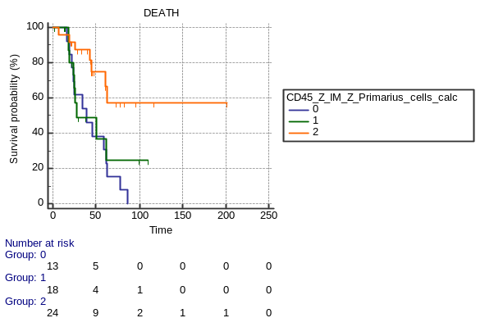
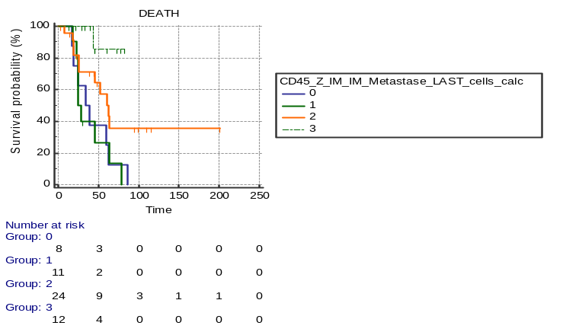
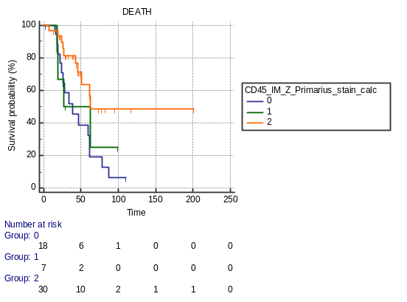
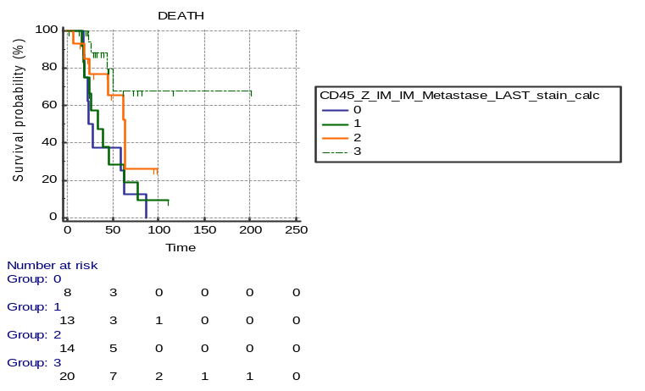
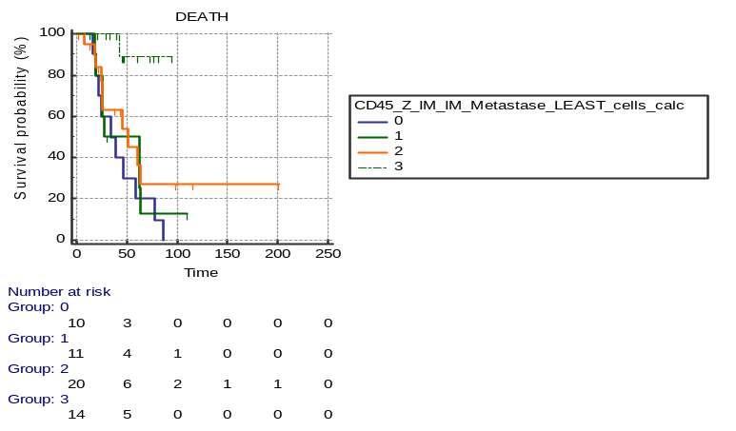
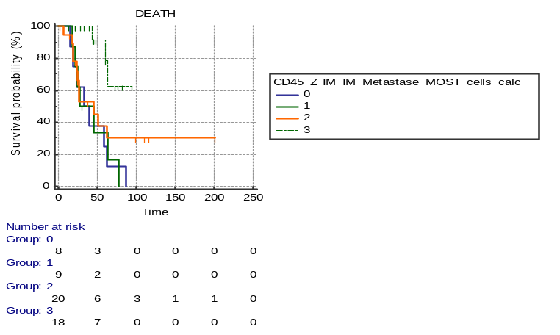
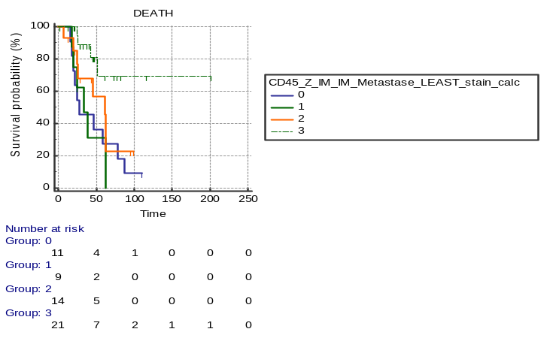
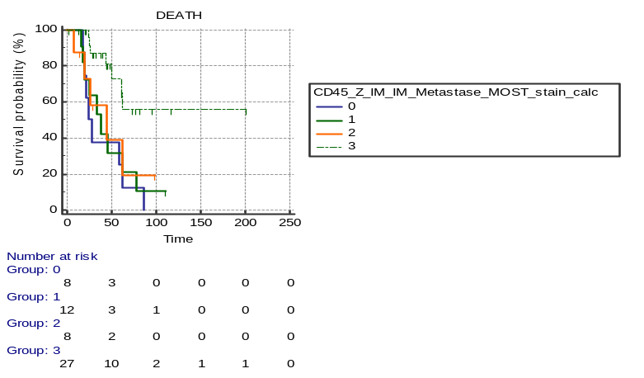
A
B
E
F
p = 0.0072
p = 0.0022
p = 0.0327
p = 0.0048
primary CRC
primary CRC
primary CRC + Mx(last resected)
primary CRC + Mx(last resected)
CD45R0 [cellcount/mm²]
CD45R0 [stain-area/mm²x10^5]
C
D
G
H
p = 0.0039
p = 0.0049
p = 0.0058
p = 0.0054
primary CRC + Mx(least infiltrated)
primary CRC + Mx(most infiltrated)
primary CRC + Mx(least infiltrated)
primary CRC + Mx(most infiltrated)
Abbreviations: Mx= Metastases; primary CRC= primary colorectal cancer

Slide 6
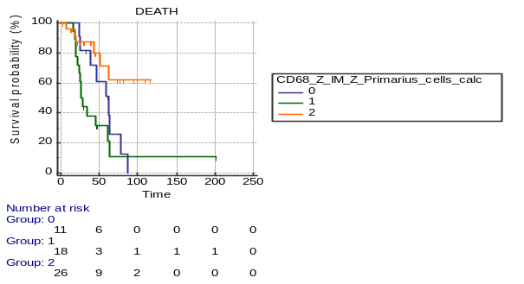
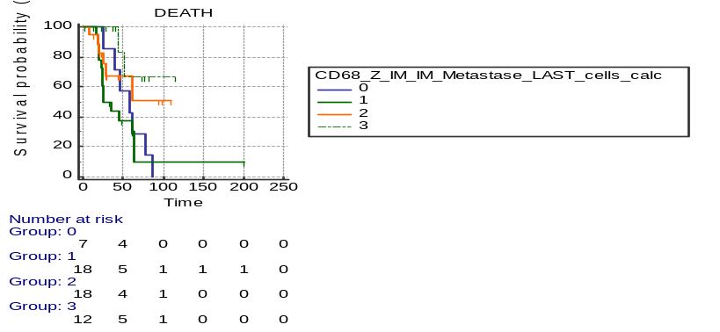
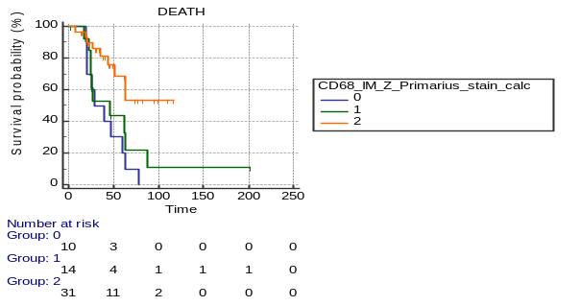
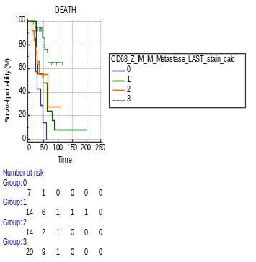
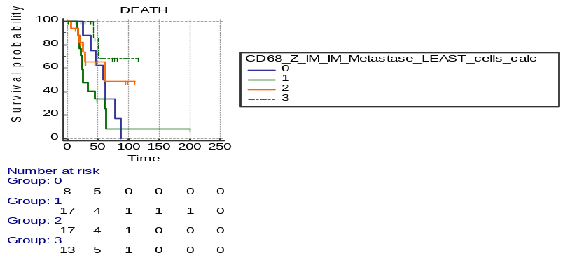
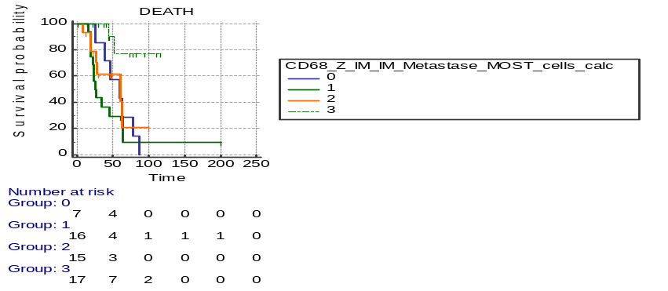
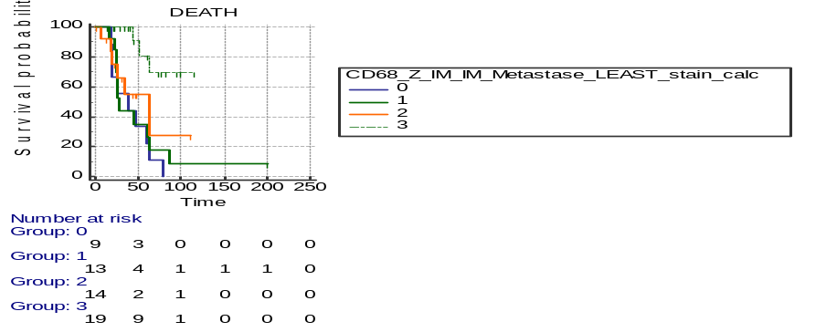
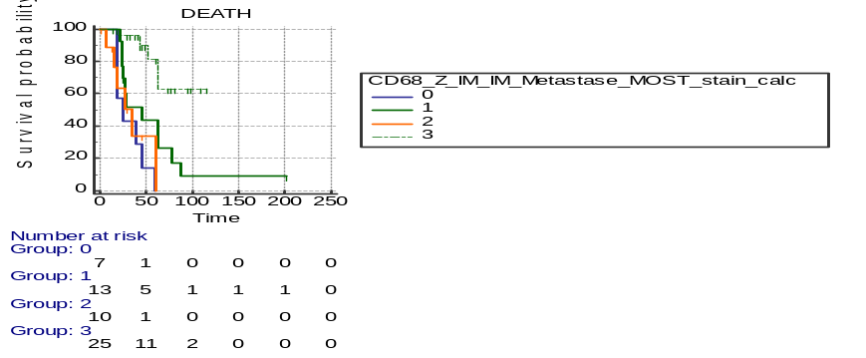
A
B
E
F
p = 0.0039
p = 0.0262
p = 0.0021
p = 0.0004
primary CRC
primary CRC
primary CRC + Mx(last resected)
primary CRC + Mx(last resected)
CD68 [cellcount/mm²]
CD68 [stain-area/mm²x10^5]
C
D
G
H
p = 0.0134
p = 0.0044
p = 0.001
p < 0.0001
primary CRC + Mx(least infiltrated)
primary CRC + Mx(most infiltrated)
primary CRC + Mx(least infiltrated)
primary CRC + Mx(most infiltrated)
Abbreviations: Mx= Metastases; primary CRC= primary colorectal cancer

Slide 7
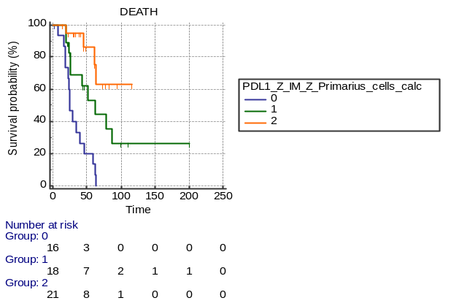
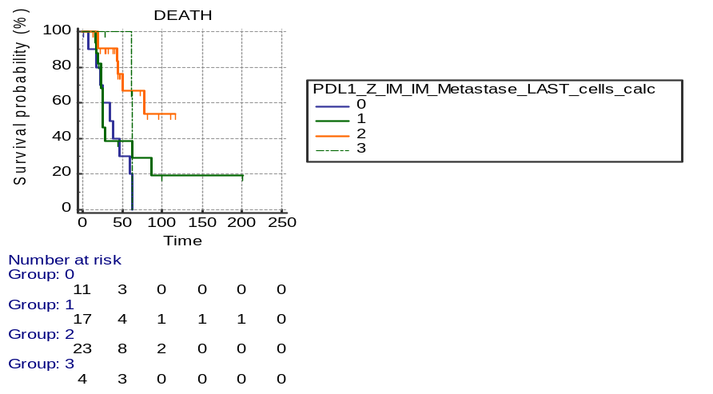






A
B
E
F
p < 0.0001
p = 0.0038
p = 0.0001
p < 0.0001
primary CRC
primary CRC
primary CRC + Mx(last resected)
primary CRC + Mx(last resected)
PD-L1 [cellcount/mm²]
PD-L1 [stain-area/mm²x10^5]
C
D
G
H
p = 0.0001
p = 0.0038
p < 0.0001
p < 0.0001
primary CRC + Mx(least infiltrated)
primary CRC + Mx(most infiltrated)
primary CRC + Mx(least infiltrated)
primary CRC + Mx(most infiltrated)
Abbreviations: Mx= Metastases; primary CRC= primary colorectal cancer

Slide 8








A
B
E
F
p = 0.1491
p = 0.0481
p = 0.0002
p < 0.0001
primary CRC
primary CRC
primary CRC + Mx(last resected)
primary CRC + Mx(last resected)
PD1 [cellcount/mm²]
PD1 [stain-area/mm²x10^5]
C
D
G
H
p = 0.1303
p = 0.0127
p < 0.0001
p < 0.0001
primary CRC + Mx(least infiltrated)
primary CRC + Mx(most infiltrated)
primary CRC + Mx(least infiltrated)
primary CRC + Mx(most infiltrated)
Abbreviations: Mx= Metastases; primary CRC= primary colorectal cancer

