Slide 1
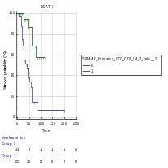
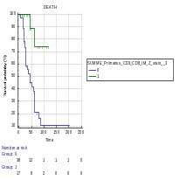
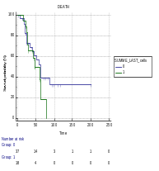
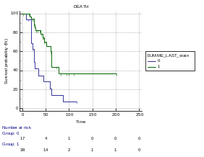
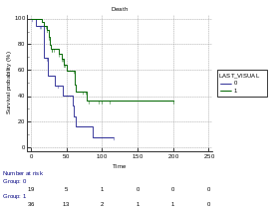
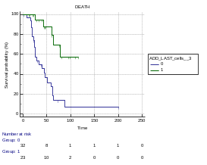
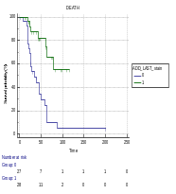
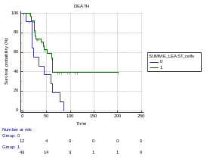
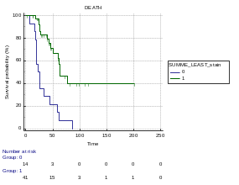
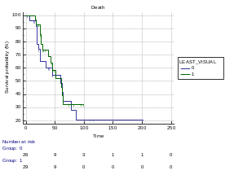
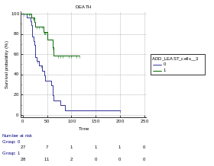
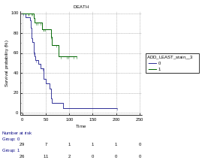
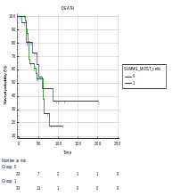
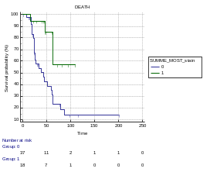
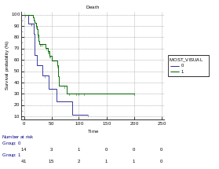
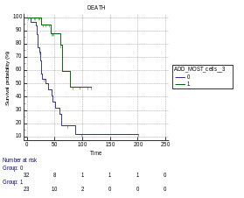
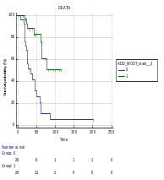
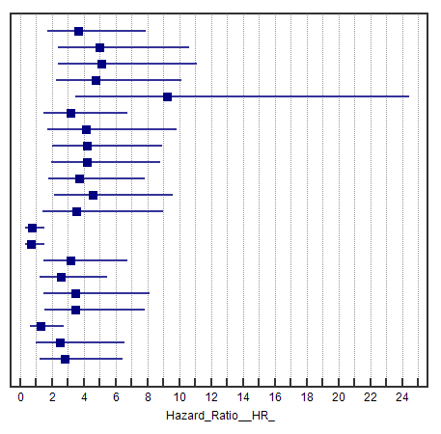
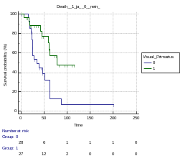
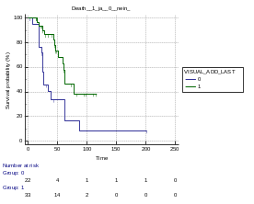
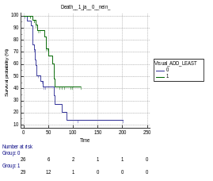

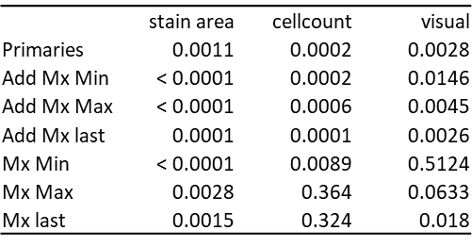
ROC- cut off
CD3-CD8
    CD3-CD8 [cell-count/mm²]
    CD3-CD8 [stain-area/mm²x10^5
    CD3-CD8 [cell-count/mm²]
    CD3-CD8 [stain-area/mm²x10^5
    CD3-CD8 [visual]
Primary CRC
Mx (last)
Primary CRC +
Mx (last)
Mx (Min)
Primary CRC +
Mx (Min)
Mx (Max)
Primary CRC +
Mx (Max)
Primary CRC
Add Mx Min
Add Mx Max
Add Mx last
Mx Min
Mx Max
Mx last
Primary CRC
Add Mx Min
Add Mx Max
Add Mx last
Mx Min
Mx Max
Mx last
Primary CRC
Add Mx Min
Add Mx Max
Add Mx last
Mx Min
Mx Max
Mx last
stain area
cell-count
Primary CRC
Primary CRC+
Mx(last)
visual
    CD3-CD8 visual]
low
Primary CRC+
Mx (Min)
Primary CRC+
Mx (Max)
high

Slide 2
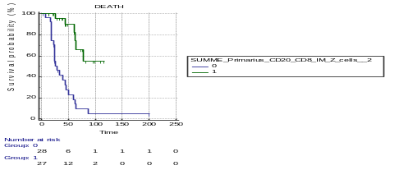
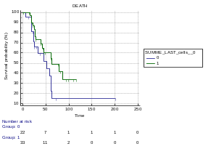
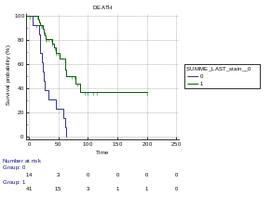
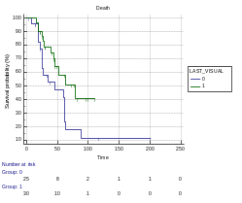
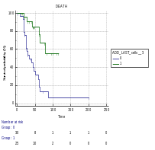
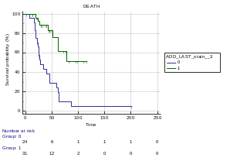
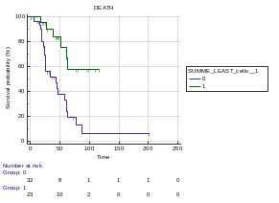
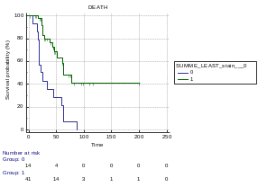
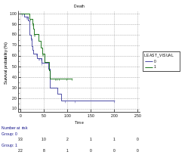

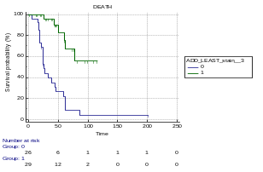
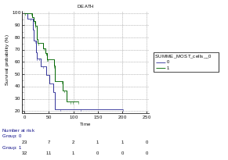
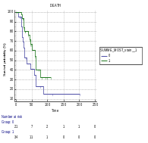
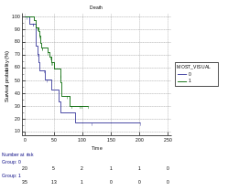
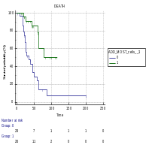
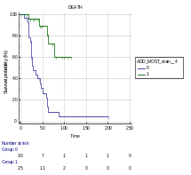
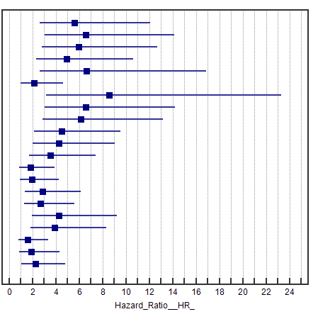
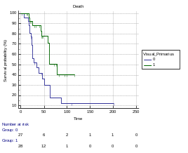
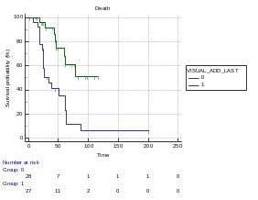
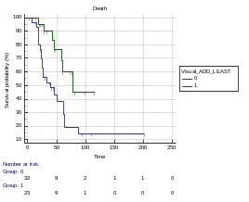
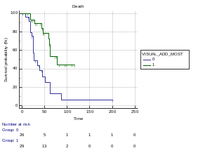
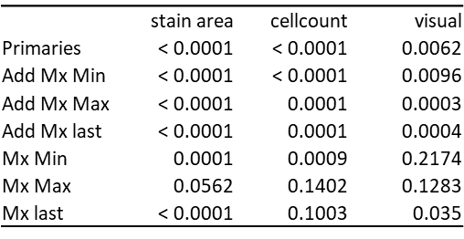
ROC- cut off
CD8-CD20
    CD8-CD20 [cell-count/mm²]
    CD8-CD20 [stain-area/mm²x10^5
    CD8-CD20 [cell-count/mm²]
    CD8-CD20 [stain-area/mm²x10^5
    CD8-CD20 [visual]
Primary CRC
Mx (last)
Primary CRC +
Mx (last)
Mx (Min)
Primary CRC +
Mx (Min)
Mx (Max)
Primary CRC +
Mx (Max)
Primary CRC
Add Mx Min
Add Mx Max
Add Mx last
Mx Min
Mx Max
Mx last
Primary CRC
Add Mx Min
Add Mx Max
Add Mx last
Mx Min
Mx Max
Mx last
Primary CRC
Add Mx Min
Add Mx Max
Add Mx last
Mx Min
Mx Max
Mx last
stain area
cell-count
Primary CRC
Primary CRC+
Mx(last)
visual
    CD8-CD20 [visual]
low
Primary CRC+
Mx (Min)
Primary CRC+
Mx (Max)
high

Slide 3
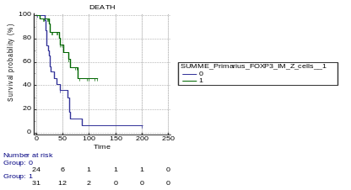
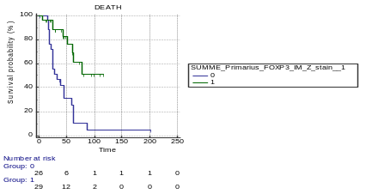
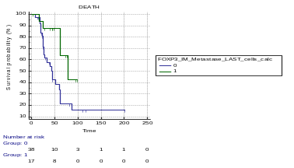
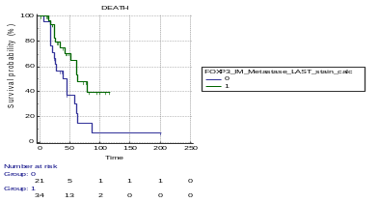
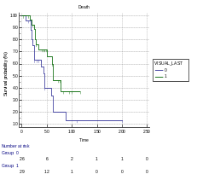
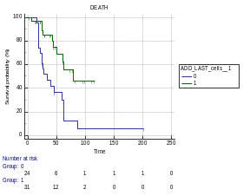
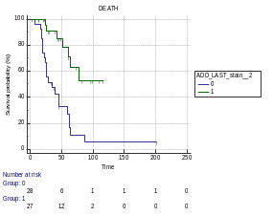
















ROC- cut off
FOXP3
    FOXP3
    [cell-count/mm²]
    FOXP3 [stain-area/mm²x10^5
    FOXP3
    [cell-count/mm²]
    FOXP3 [stain-area/mm²x10^5
    FOXP3 [visual]
Primary CRC
Mx (last)
Primary CRC +
Mx(aktuell)
Mx (Min)
Primary CRC +
Mx (Min)
Mx (Max)
Primary CRC
Add Mx Min
Add Mx Max
Add Mx last
Mx Min
Mx Max
Mx last
Primary CRC
Add Mx Min
Add Mx Max
Add Mx last
Mx Min
Mx Max
Mx last
Primary CRC
Add Mx Min
Add Mx Max
Add Mx last
Mx Min
Mx Max
Mx last
Primary CRC +
Mx (Max)
stain area
cell-count
Primary CRC
Primary CRC +
Mx (last)
visual
    FOXP3 [visual]
Primary CRC +
Mx (Min)
Primary CRC +
Mx (Max)
low
high

Slide 4























ROC- cut off
CD4
    CD4 [cell-count/mm²]
    CD4 [stain-area/mm²x10^5
    CD4 [cell-count/mm²]
    CD4 [stain-area/mm²x10^5
    CD4 [visual]
Primary CRC
Mx (last)
Primary CRC +
Mx (last)
Mx (Min)
Primary CRC +
Mx (Min)
Mx (Max)
Primary CRC +
Mx (Max)
Primary CRC
Add Mx Min
Add Mx Max
Add Mx last
Mx Min
Mx Max
Mx last
Primary CRC
Add Mx Min
Add Mx Max
Add Mx last
Mx Min
Mx Max
Mx last
Primary CRC
Add Mx Min
Add Mx Max
Add Mx last
Mx Min
Mx Max
Mx last
stain area
cell-count
Primary CRC
Primary CRC +
Mx (last)
visual
    CD4 [visual]
Primary CRC +
Mx (Min)
Primary CRC +
Mx (Max)
low
high

Slide 5






















ROC- cut off
CD45R0
    CD45R0 [cell-count/mm²]
    CD45R0 [stain-area/mm²x10^5
    CD45R0 [cell-count/mm²]
    CD45R0 [stain-area/mm²x10^5
    CD45R0 [visual]
Primary CRC
Mx (last)
Primary CRC +
Mx (last)
Mx (Min)
Primary CRC +
Mx (Min)
Mx (Max)
Primary CRC
Add Mx Min
Add Mx Max
Add Mx last
Mx Min
Mx Max
Mx last
Primary CRC
Add Mx Min
Add Mx Max
Add Mx last
Mx Min
Mx Max
Mx last
Primary CRC
Add Mx Min
Add Mx Max
Add Mx last
Mx Min
Mx Max
Mx last
Primary CRC +
Mx (Max)
stain area
cell-count
Primary CRC
Primary CRC +
Mx (last)
visual
    CD45R0 [visual]
Primary CRC +
Mx (Min)
Primary CRC +
Mx (Max)
low
high

Slide 6























ROC- cut off
CD68
    CD68 [cell-count/mm²]
    CD68 [stain-area/mm²x10^5
    CD68 [cell-count/mm²]
    CD68 [stain-area/mm²x10^5
    CD68 [visual]
Primary CRC
Mx (last)
Primary CRC +
Mx (last)
Mx (Min)
Primary CRC +
Mx (Min)
Mx (Max)
Primary CRC
Add Mx Min
Add Mx Max
Add Mx last
Mx Min
Mx Max
Mx last
Primary CRC
Add Mx Min
Add Mx Max
Add Mx last
Mx Min
Mx Max
Mx last
Primary CRC
Add Mx Min
Add Mx Max
Add Mx last
Mx Min
Mx Max
Mx last
Primary CRC +
Mx (Max)
stain area
cell-count
Primary CRC
Primary CRC +
Mx (last)
visual
    CD68 [visual]
Primary CRC +
Mx (Min)
Primary CRC +
Mx (Max)
low
high

Slide 7























ROC- cut off
PD-L1
    PD-L1 [cell-count/mm²]
    PD-L1 [stain-area/mm²x10^5
    PD-L1 [cell-count/mm²]
    PD-L1 [stain-area/mm²x10^5
    PD-L1 [visual]
Primary CRC
Mx (last)
Primary CRC +
Mx (last)
Mx (Min)
Primary CRC +
Mx (Min)
Mx (Max)
Primary CRC
Add Mx Min
Add Mx Max
Add Mx last
Mx Min
Mx Max
Mx last
Primary CRC
Add Mx Min
Add Mx Max
Add Mx last
Mx Min
Mx Max
Mx last
Primary CRC
Add Mx Min
Add Mx Max
Add Mx last
Mx Min
Mx Max
Mx last
Primary CRC +
Mx (Max)
stain area
cell-count
Primary CRC
Primary CRC +
Mx (last)
visual
    PD-L1 [visual]
Primary CRC +
Mx (Min)
Primary CRC +
Mx (Max)
low
high

Slide 8























ROC- cut off
PD1
    PD1 [cell-count/mm²]
    PD1 [stain-area/mm²x10^5
    PD1 [cell-count/mm²]
    PD1 [stain-area/mm²x10^5
    PD1 [visual]
Primarius
Mx (last)
Primary CRC +
Mx (last)
Mx (Min)
Primary CRC +
Mx (Min)
Mx (Max)
Primary CRC
Add Mx Min
Add Mx Max
Add Mx last
Mx Min
Mx Max
Mx last
Primary CRC
Add Mx Min
Add Mx Max
Add Mx last
Mx Min
Mx Max
Mx last
Primary CRC
Add Mx Min
Add Mx Max
Add Mx last
Mx Min
Mx Max
Mx last
Primary CRC +
Mx (Max)
stain area
cell-count
Primary CRC
Primary CRC +
Mx (last)
visual
    PD1 [visual]
Primary CRC +
Mx (Min)
Primary CRC +
Mx (Max)
low
high

Slide 9
















MEDIAN- cut off
CD3-CD8
    CD3-CD8 [cell-count/mm²]
    CD3-CD8 [stain-area/mm²x10^5]
    CD3-CD8 [cell-count/mm²]
    CD3-CD8 [stain-area/mm²x10^5]
Primary CRC
Mx (last)
Primary CRC +
Mx (last)
Mx (Min)
Primary CRC +
Mx (Min)
Mx (Max)
Primary CRC +
Mx (Max)
Primary CRC
Add Mx Min
Add Mx Max
Add Mx last
Mx Min
Mx Max
Mx last
Primary CRC
Add Mx Min
Add Mx Max
Add Mx last
Mx Min
Mx Max
Mx last
Primary CRC
Add Mx Min
Add Mx Max
Add Mx last
Mx Min
Mx Max
Mx last
stain area
cell-count
low
high
visual

Slide 10
















MEDIAN-
cut off
CD8-CD20
    CD8-CD20 [cell-count/mm²]
    CD8-CD20 [stain-area/mm²x10^5]
    CD8-CD20
    [cell-count/mm²]
    CD8-CD20
    [stain-area/mm²x10^5]
Primary CRC
Mx (last)
Primary CRC +
Mx (last)
Mx (Min)
Primary CRC +
Mx (Min)
Mx (Max)
Primary CRC +
Mx (Max)
Primary CRC
Add Mx Min
Add Mx Max
Add Mx last
Mx Min
Mx Max
Mx last
Primary CRC
Add Mx Min
Add Mx Max
Add Mx last
Mx Min
Mx Max
Mx last
Primary CRC
Add Mx Min
Add Mx Max
Add Mx last
Mx Min
Mx Max
Mx last
stain area
cell-count
visual
low
high

Slide 11
















MEDIAN- cut off
FOXP3
    FOXP3 [cell-count/mm²]
    FOXP3 [stain-area/mm²x10^5]
    FOXP3 [cell-count/mm²]
    FOXP3 [stain-area/mm²x10^5]
Primary CRC
Mx (last)
Primary CRC +
Mx (last)
Mx (Min)
Primary CRC +
Mx (Min)
Mx (Max)
Primary CRC
Add Mx Min
Add Mx Max
Add Mx last
Mx Min
Mx Max
Mx last
Primary CRC
Add Mx Min
Add Mx Max
Add Mx last
Mx Min
Mx Max
Mx last
Primary CRC
Add Mx Min
Add Mx Max
Add Mx last
Mx Min
Mx Max
Mx last
Primary CRC +
Mx (Max)
stain area
cell-count
visual
low
high

Slide 12
















MEDIAN- cut off
CD4
    CD4 [cell-count/mm²]
    CD4 [stain-area/mm²x10^5]
    CD4
    [cell-count/mm²]
    CD4 [stain-area/mm²x10^5]
Primary CRC
Mx (last)
Primary CRC +
Mx (last)
Mx (Min)
Primary CRC +
Mx (Min)
Mx (Max)
Primary CRC
Add Mx Min
Add Mx Max
Add Mx last
Mx Min
Mx Max
Mx last
Primary CRC
Add Mx Min
Add Mx Max
Add Mx last
Mx Min
Mx Max
Mx last
Primary CRC
Add Mx Min
Add Mx Max
Add Mx last
Mx Min
Mx Max
Mx last
Primary CRC +
Mx (Max)
stain area
cell-count
visual
low
high

Slide 13
















MEDIAN- cut off
CD45R0
    CD45R0 [cell-count/mm²]
    CD45R0 [stain-area/mm²x10^5]
    CD45R0
    [cell-count/mm²]
    CD45R0 [stain-area/mm²x10^5]
Primary CRC
Mx (last)
Primary CRC +
Mx (last)
Mx (Min)
Primary CRC +
Mx (Min)
Mx (Max)
Primary CRC
Add Mx Min
Add Mx Max
Add Mx last
Mx Min
Mx Max
Mx last
Primary CRC
Add Mx Min
Add Mx Max
Add Mx last
Mx Min
Mx Max
Mx last
Primary CRC
Add Mx Min
Add Mx Max
Add Mx last
Mx Min
Mx Max
Mx last
Primary CRC +
Mx (Max)
stain area
cell-count
visual
low
high

Slide 14
















MEDIAN- cut off
CD68
    CD68 [cell-count/mm²]
    CD68 [stain-area/mm²x10^5]
    CD68
    [cell-count/mm²]
    CD68 [stain-area/mm²x10^5]
Primary CRC
Mx (last)
Primary CRC +
Mx (last)
Mx (Min)
Primary CRC +
Mx (Min)
Mx (Max)
Primary CRC
Add Mx Min
Add Mx Max
Add Mx last
Mx Min
Mx Max
Mx last
Primary CRC
Add Mx Min
Add Mx Max
Add Mx last
Mx Min
Mx Max
Mx last
Primary CRC
Add Mx Min
Add Mx Max
Add Mx last
Mx Min
Mx Max
Mx last
stain area
Primary CRC +
Mx (Max)
cell-count
visual
low
high

Slide 15
















MEDIAN- cut off
PD-L1
    PD-L1 [cell-count/mm²]
    PD-L1 [stain-area/mm²x10^5]
    PD-L1
    [cell-count/mm²]
    PD-L1 [stain-area/mm²x10^5]
Primary CRC
Mx (last)
Primary CRC +
Mx (last)
Mx (Min)
Primary CRC +
Mx (Min)
Mx (Max)
Primary CRC
Add Mx Min
Add Mx Max
Add Mx last
Mx Min
Mx Max
Mx last
Primary CRC
Add Mx Min
Add Mx Max
Add Mx last
Mx Min
Mx Max
Mx last
Primary CRC
Add Mx Min
Add Mx Max
Add Mx last
Mx Min
Mx Max
Mx last
stain area
Primary CRC +
Mx (Max)
cell-count
visual
low
high

Slide 16
















MEDIAN- cut off
PD1
    PD1 [cell-count/mm²]
    PD1 [stain-area/mm²x10^5]
    PD1
    [cell-count/mm²]
    PD1 [stain-area/mm²x10^5]
Primary CRC
Mx (last)
Primary CRC +
Mx(last)
Mx (Min)
Primary CRC +
Mx (Min)
Mx (Max)
Primary CRC
Add Mx Min
Add Mx Max
Add Mx last
Mx Min
Mx Max
Mx last
Primary CRC
Add Mx Min
Add Mx Max
Add Mx last
Mx Min
Mx Max
Mx last
Primary CRC
Add Mx Min
Add Mx Max
Add Mx last
Mx Min
Mx Max
Mx last
Primary CRC+
Mx (Max)
stain area
cell-count
visual
low
high

