Slide 1
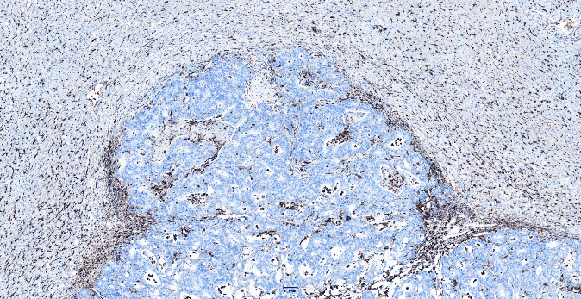
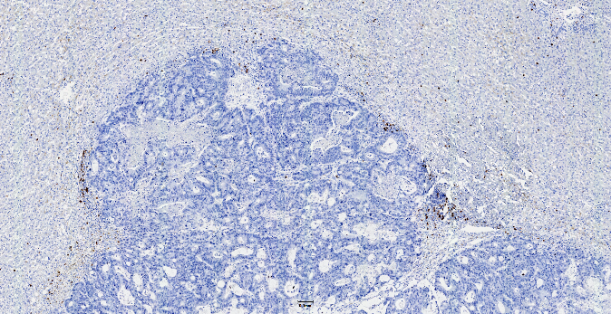
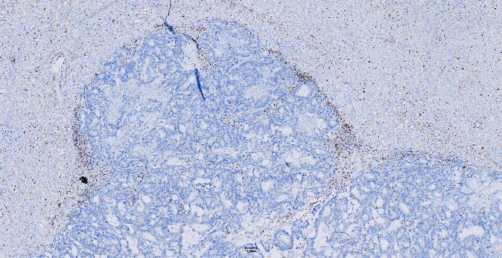
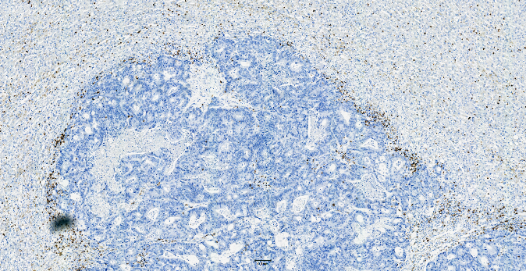
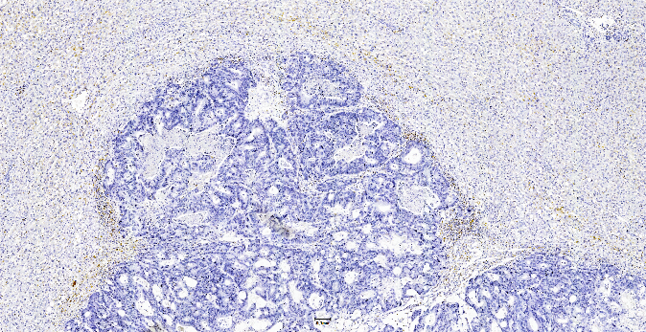
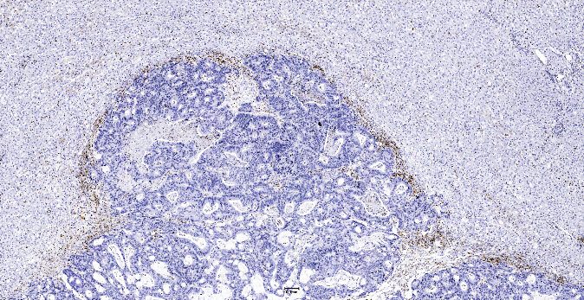
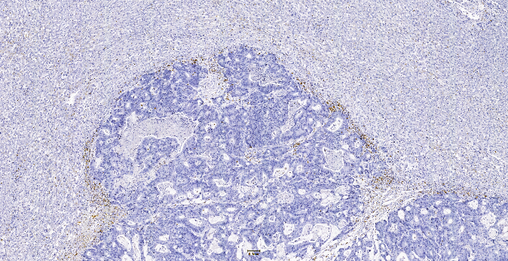
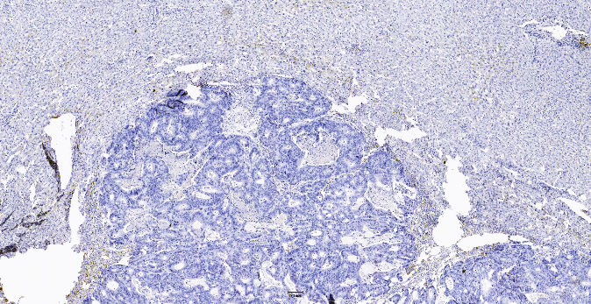
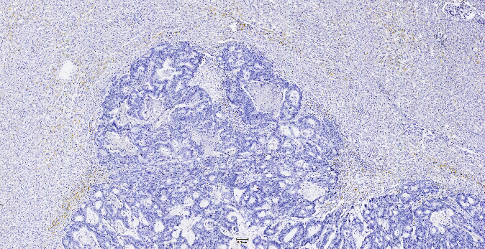
A
CD68
CD20
CD3
300 µm
300 µm
300 µm
CD8
CD4
CD45R0
300 µm
300 µm
300 µm
PD1
PDL1
FOXP3
300 µm
300 µm
300 µm
Notes:
Supplement Figure 3: Depicted are immune infiltrates for two hepatic metastases of colorectal carcinoma. For patient A, all immune infiltrates were visually assessed as low grade (the proportion of tumor area that is occupied by the positively stained cells was below 1% for CD3, CD4, CD8, CD20, CD45R0, FOXP3, PD1, PD-L1 and 20% for CD68) and for patient B as high grade (the proportion of tumor area that is occupied by the positively stained cells was: CD3 = 40%, CD4 = 40%, CD8 = 30%, CD20 = 30%, CD45R0 = 40%, FOXP3 = 10%, PD1 = 10% and PD-L1 = 10%, CD68 = 70%).

Slide 2
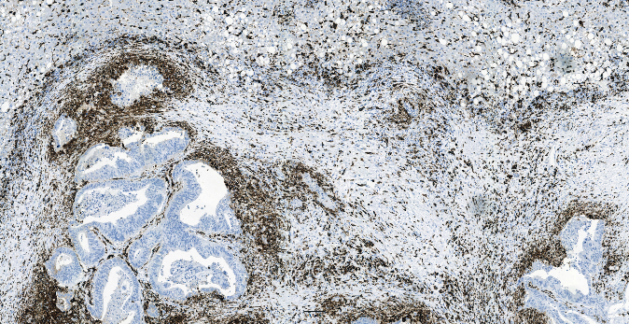
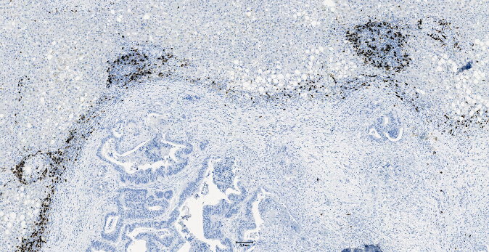
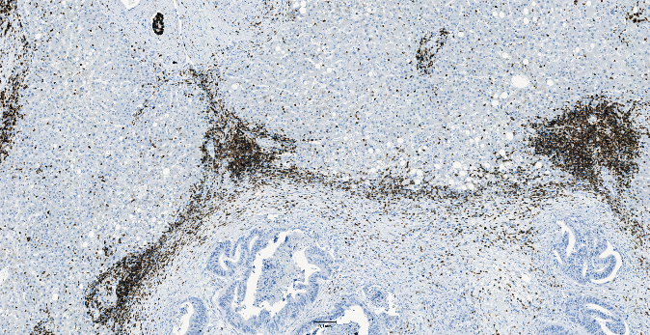
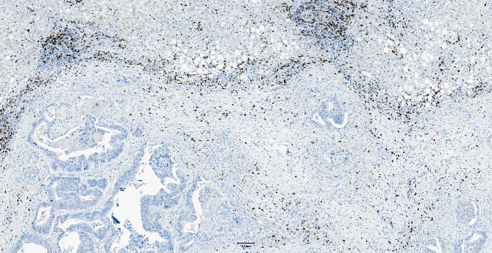
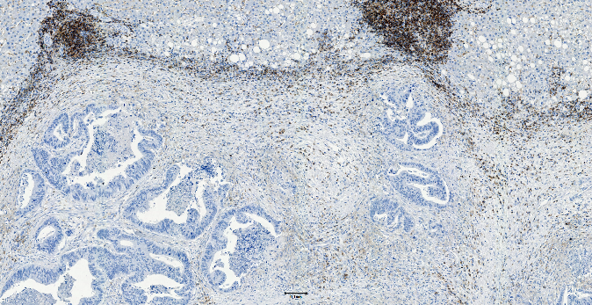
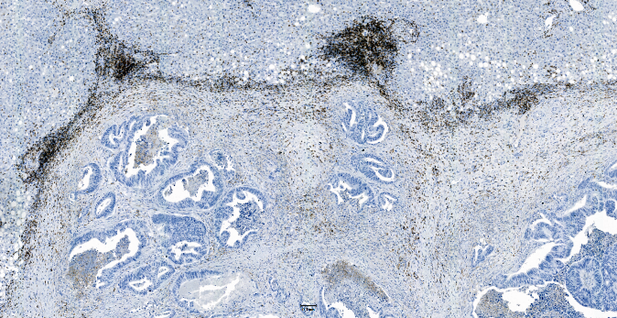
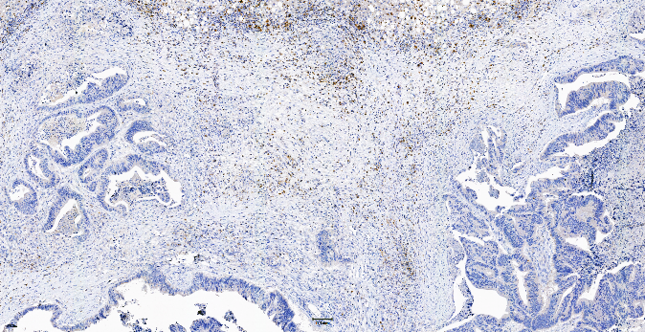
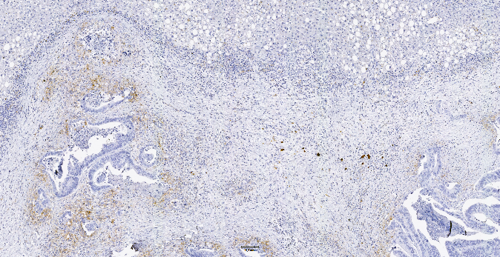
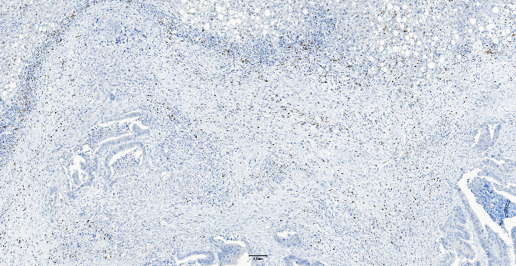
B
CD68
CD20
CD3
300 µm
300 µm
300 µm
CD8
CD4
CD45R0
300 µm
300 µm
300 µm
PD1
PDL1
FOXP3
300 µm
300 µm
300 µm
Notes:
Supplement Figure 3: Depicted are immune infiltrates for two hepatic metastases of colorectal carcinoma. For patient A, all immune infiltrates were visually assessed as low grade (the proportion of tumor area that is occupied by the positively stained cells was below 1% for CD3, CD4, CD8, CD20, CD45R0, FOXP3, PD1, PD-L1 and 20% for CD68) and for patient B as high grade (the proportion of tumor area that is occupied by the positively stained cells was: CD3 = 40%, CD4 = 40%, CD8 = 30%, CD20 = 30%, CD45R0 = 40%, FOXP3 = 10%, PD1 = 10% and PD-L1 = 10%, CD68 = 70%).

