Slide 1
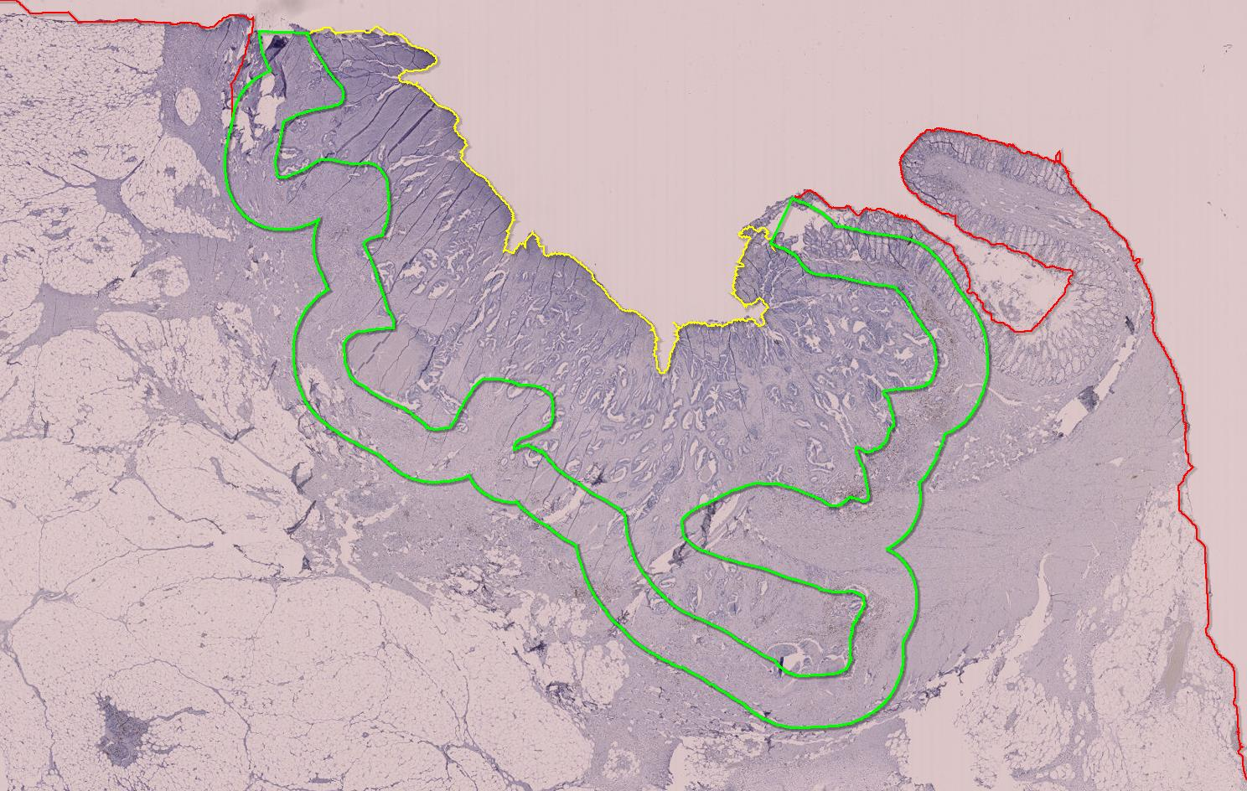
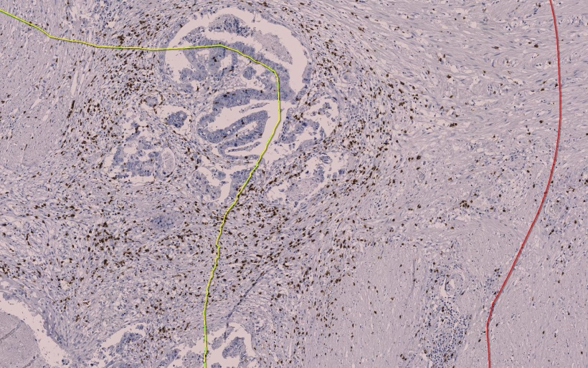
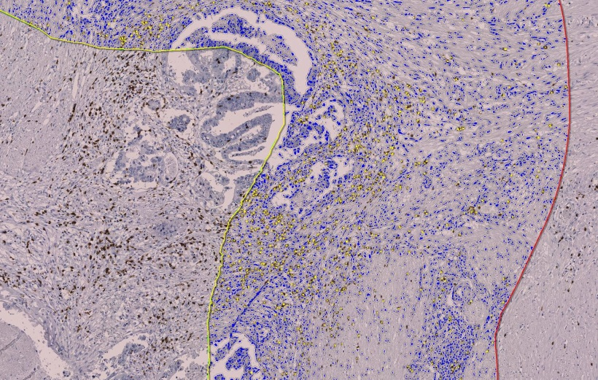
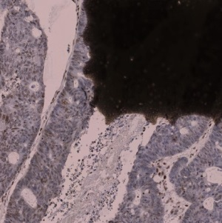
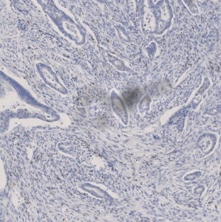
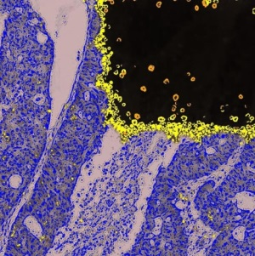
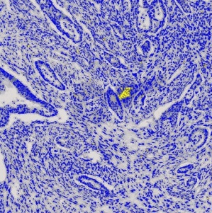
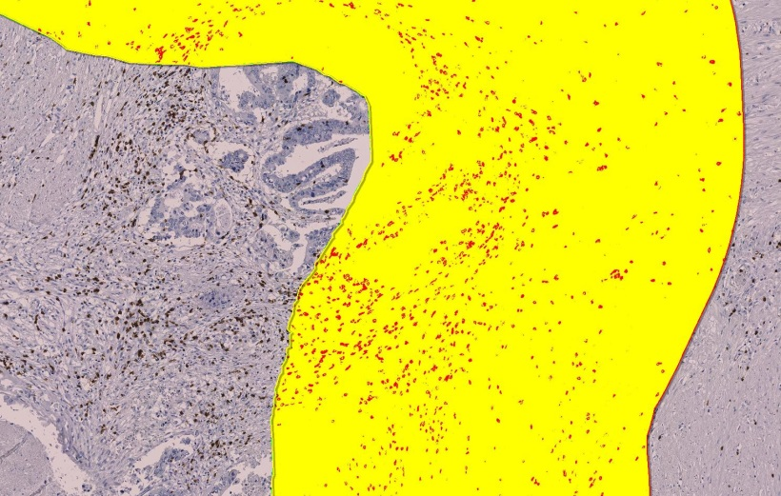

A-
defining
invasive margin and
tumor center
B-
digital
image
analysis
tumor
center
invasive margin
(1000 µm)
CD8
C-
manual
correction
of artifacts
CD8
[cell-count/mm²]
CD8 – slide label
CD8 – air bubble
CD8
[stain area/mm²x10⁵]

