Slide 1
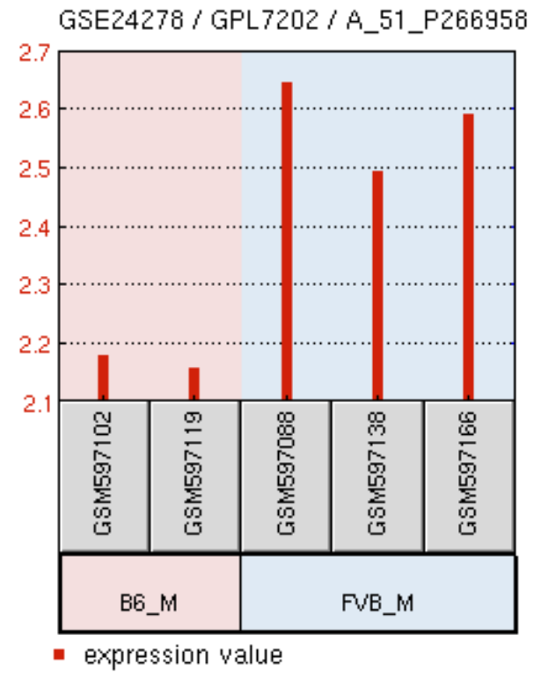
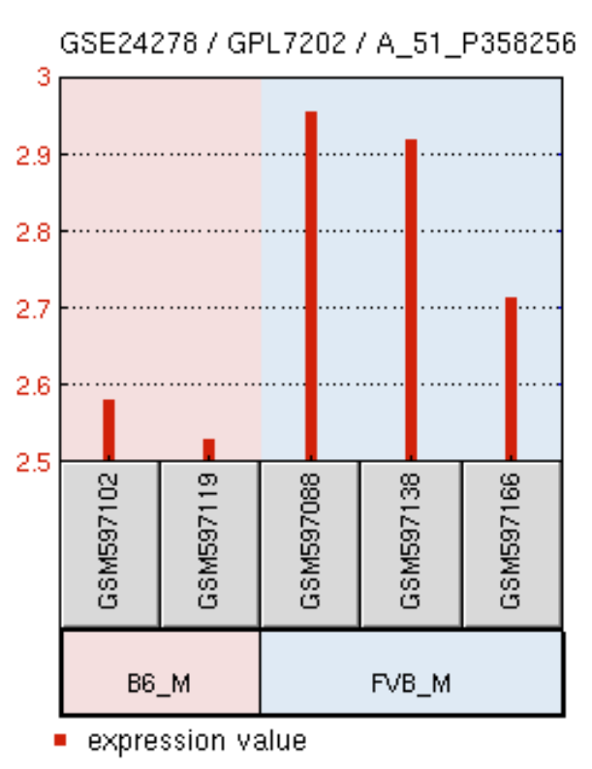
Supplemental Figure 1
PXR
CAR
A
B
Relative expression
Data were re-analyzed from Bradford et al., 2011

Slide 2
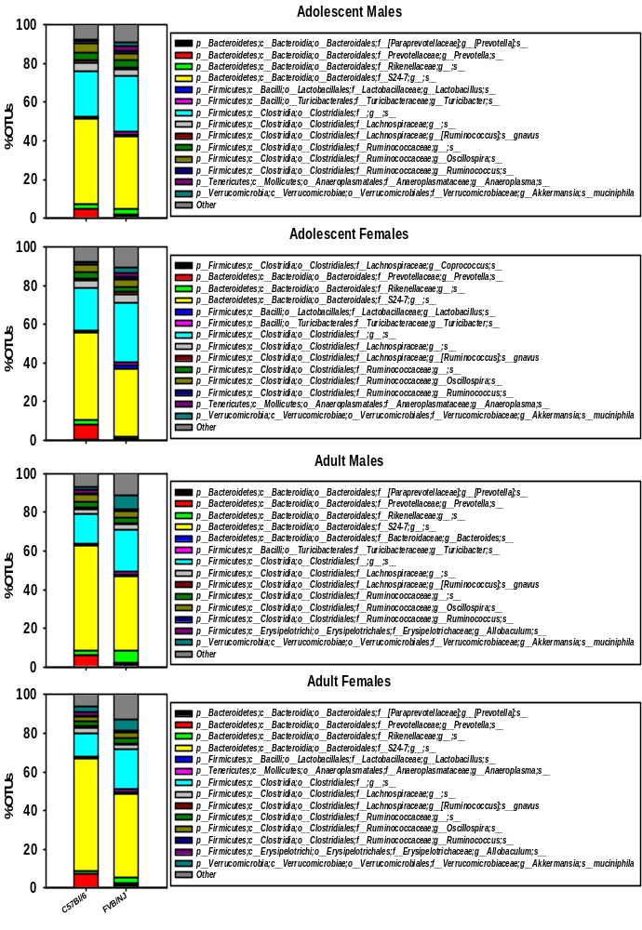
Supplemental Figure 2
A
*
*
*
*
*
B
*
*
*
*
*
C
*
*
*
*
D
*
*
*
*
*
*
*
*
Notes:
Supplemental Figure 2. Proportional OTUs in C57BL/6 and FVB/NJ mice. Stacked bar chart illustrating the percentage of differentially regulated taxa in fecal samples in C57BL/6 and FVB/NJ male and female, adolescent and adult mice. The top 14 differentially abundant taxa in each group were plotted and all other detected taxa were summed together to form the Other category. Asterisks represent statistically significant differences compared to C57BL/6 mice (t test, p < 0.05).
the compositional changes at the species level as measured by percentage of operational taxonomic units (OTUs), in which OTUs are groups of closely related individuals.
Prevotellaceae Prevotella spp. had lower relative abundance in all four groups, and this genus has been noted for its high species variability, with links to both improved glucose handling and pro-inflammatory functions
Paraprevotellaceae Prevotella spp., which is associated with IBD, increased in all groups except for adolescent female FVB/NJ mice (28993566).
Akkermansia muciniphila, a notable anti-inflammatory species of bacteria, had higher abundance in adolescent female and adult male FVB/NJ mice, with a tendency in this direction in the other groups as well.
The genus Anaeroplasma had higher relative abundance in FVB/NJ mice compared to C57Bl/6 mice in all groups except for adult males, signifying that these mice are more at risk for pathogen infection, as the Anaeroplasma genus are opportunistic pathogens which may cause inflammation and exacerbate disease
Adolescent male FVB/NJ mice had lower relative abundance of bacteria in the Oscillospira genus. The Oscillospira genus has been associated with leanness and are purported to be butyrate producers

Slide 3
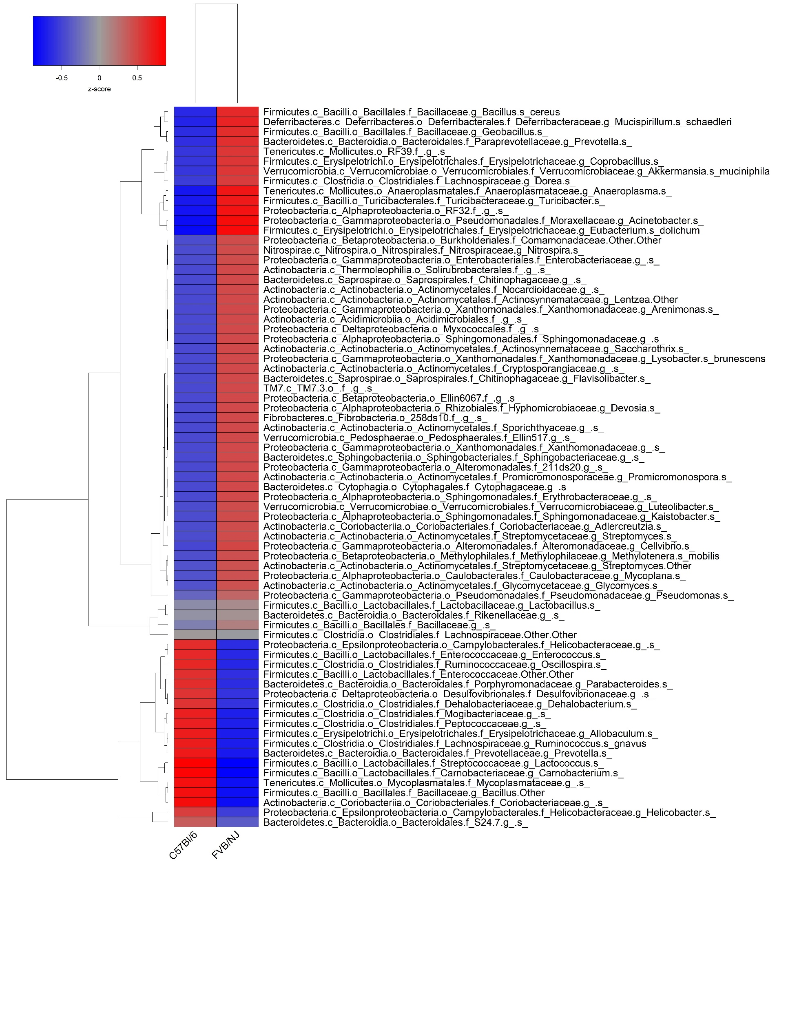
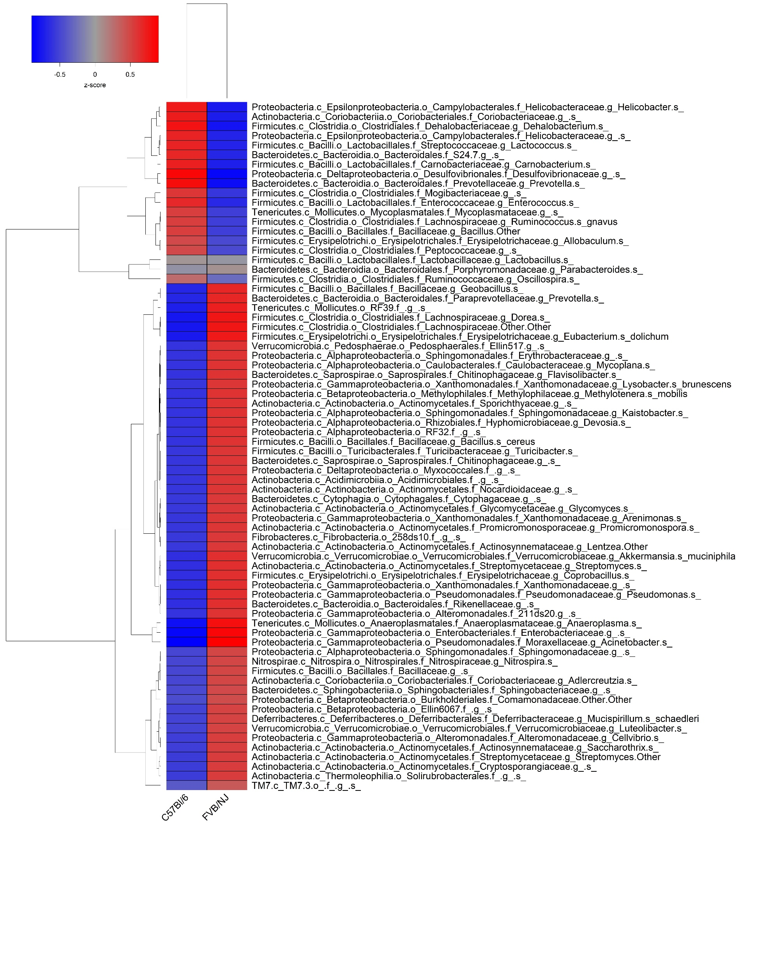
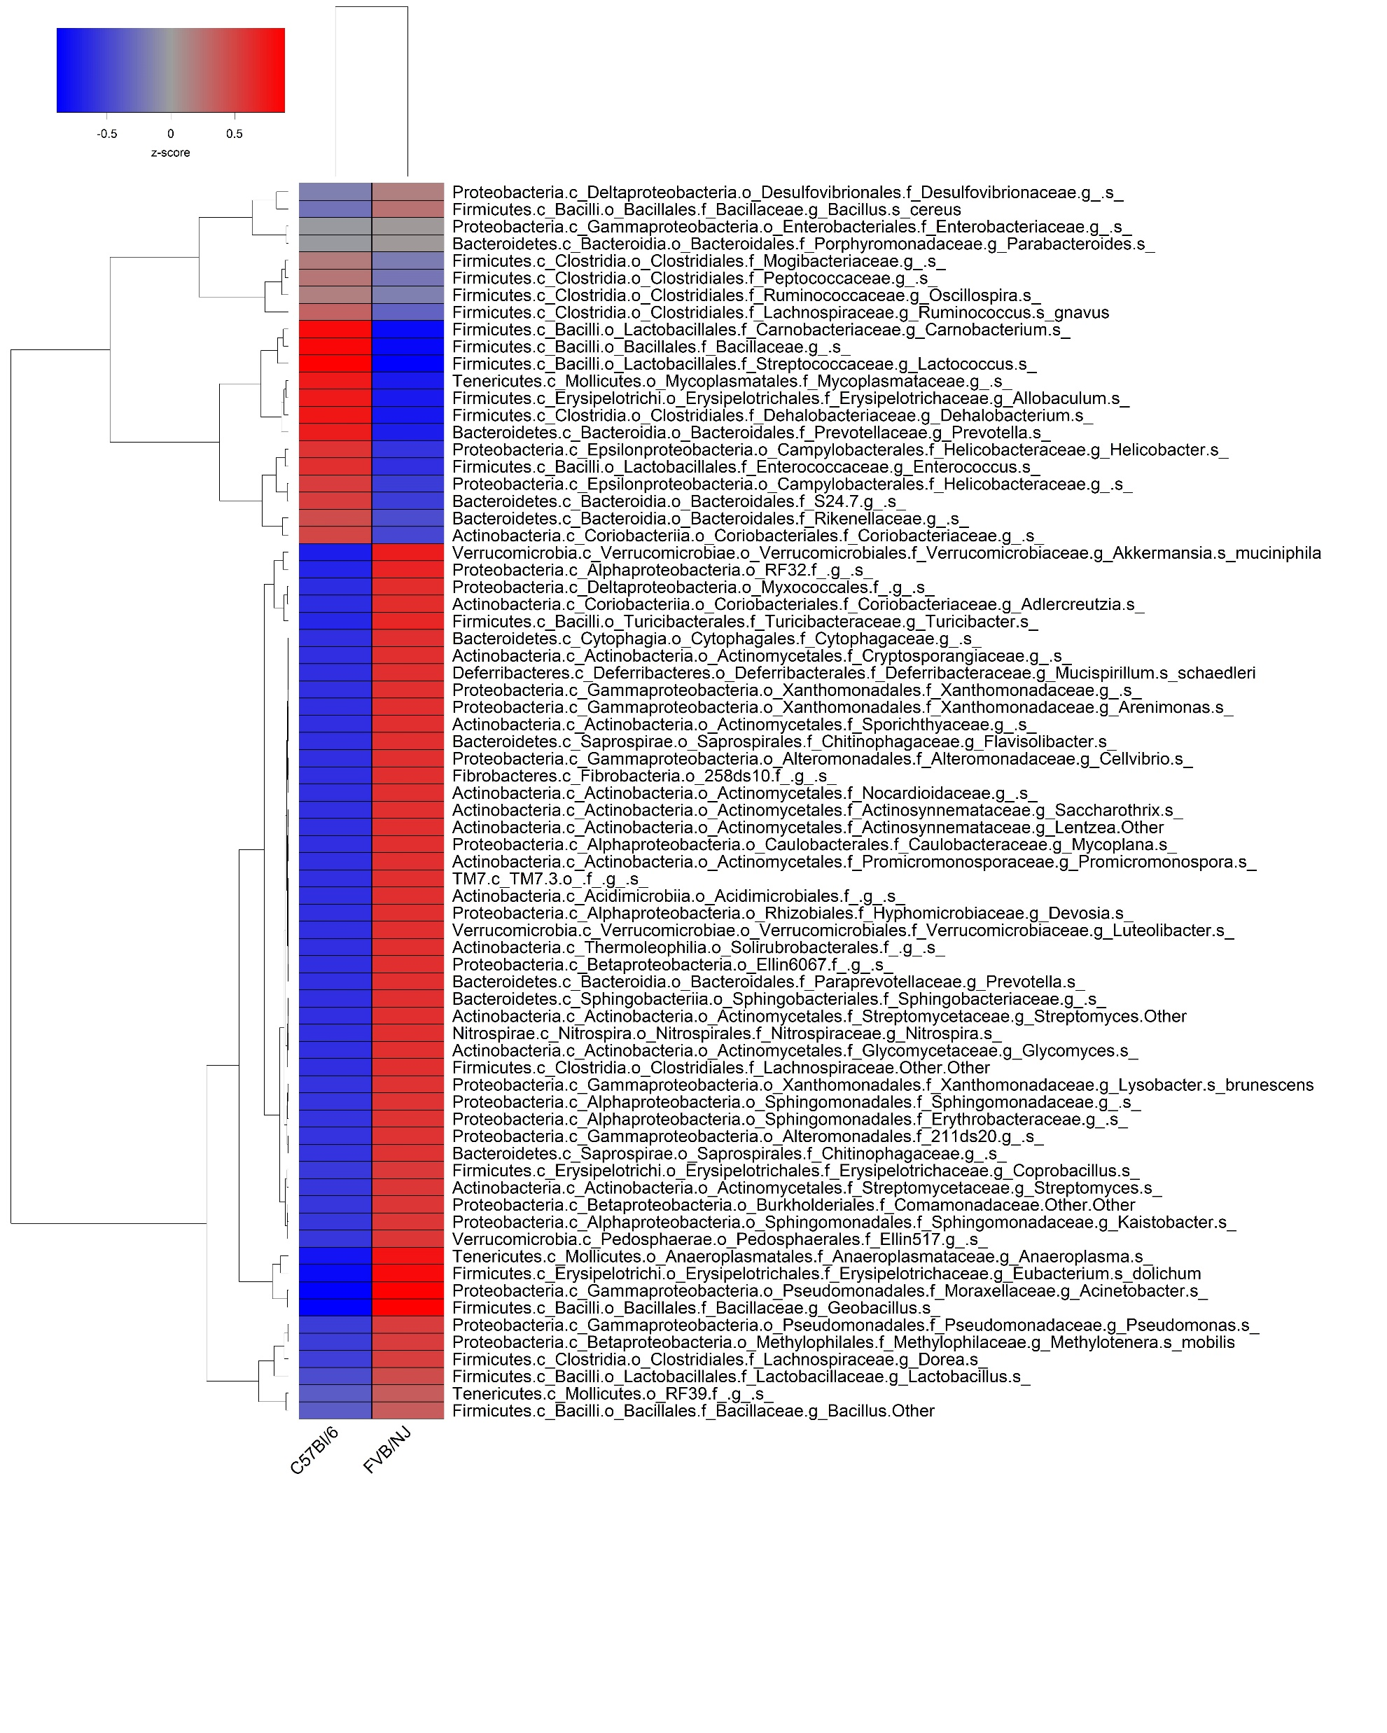

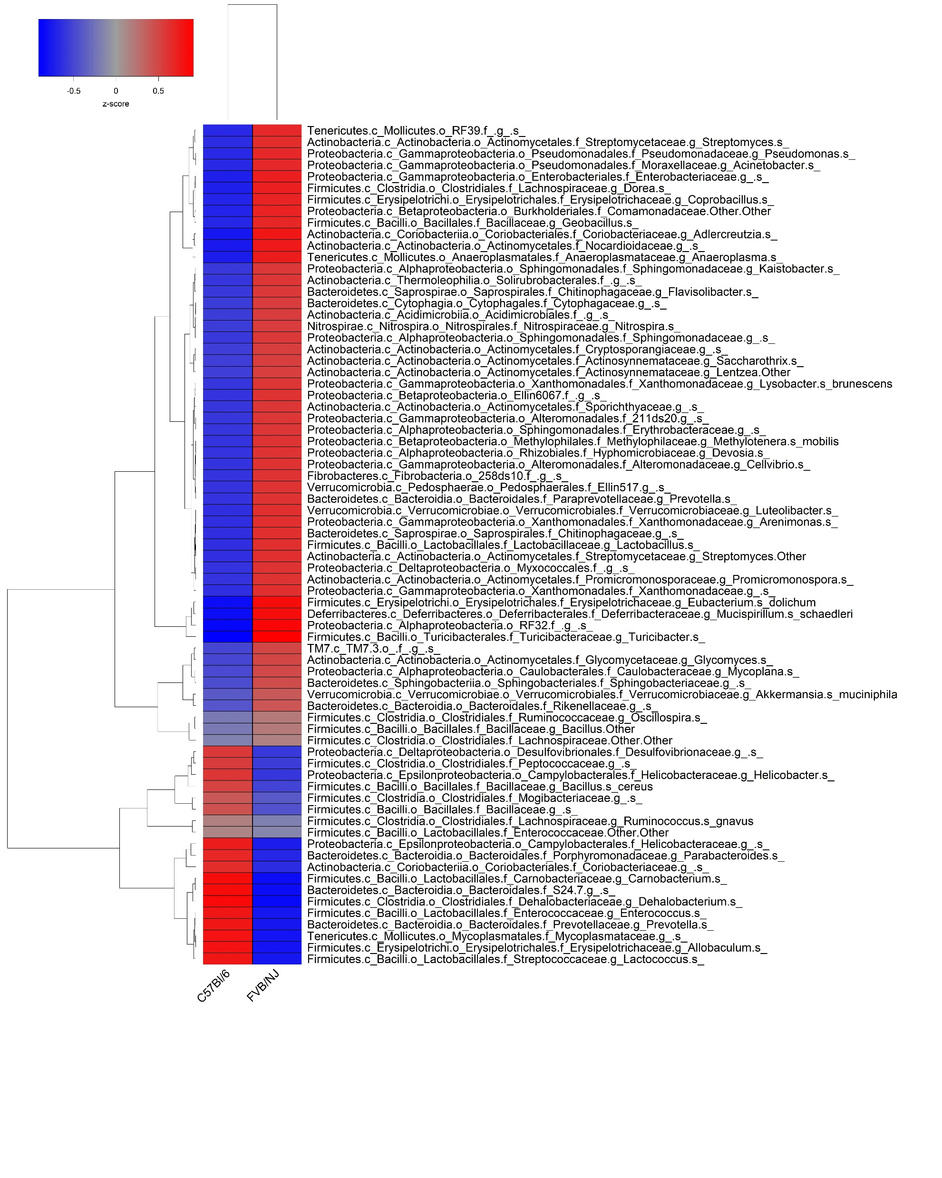
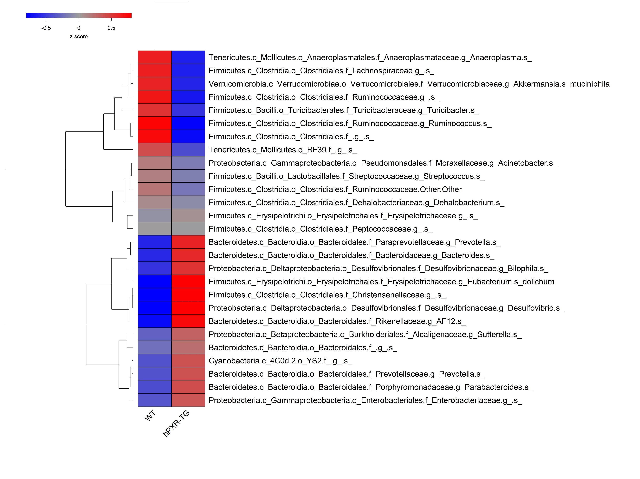
Supplemental Figure 3
A. Adolescent Males
B. Adult Males
*
*
*
*
*
*
*
*
*
*
*
*
*
*
*
*
*
*
*
*
*
*
*
*
*
*
*
*
*
*
*
*
*
*
*
*
*
*
*
*
*
*
*
*
*
*
*
*
*
*
*
*
*
*
*
*
C. Adolescent Females
D. Adult Females
*
*
*
*
*
*
*
*
*
*
*
*
*
*
*
*
*
*
*
*
*
*
*
*
*
*
*
*
*
*
*
*
*
*
*
*
*
*
*
*
*
*
*
*
*
*
*
*
*
*
*
*
*
*
*
*
*
*
*
*
*
*
*
*
*
*
*
*
*
*
*
*
*
*
*
*
*
*
*
*
*
*
*
*
*
*
*
*
*
*
*
*
*
Notes:
Anaeroplasma increased in all 4. The Anaeroplasma bacteria are negative by Gram stain, and they are parasites/opportunistic pathogens which elicit various host immune responses in numerous human diseases including colon cancer [70], [71] https://www.fasebj.org/doi/abs/10.1096/fasebj.31.1_supplement.435.5
But another paper says they are anti inflammatory.
RF32 increased in all 4. positively correlated with colonic inflammation https://www.hindawi.com/journals/grp/2016/4953120/
Acinetobacter increased in all 4.

Slide 4
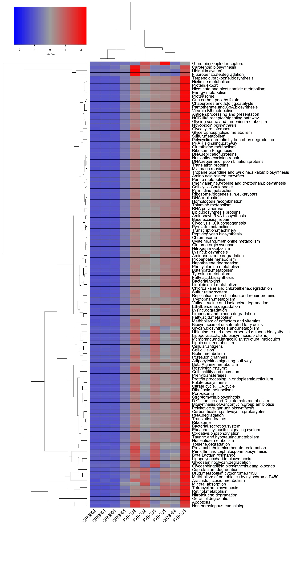
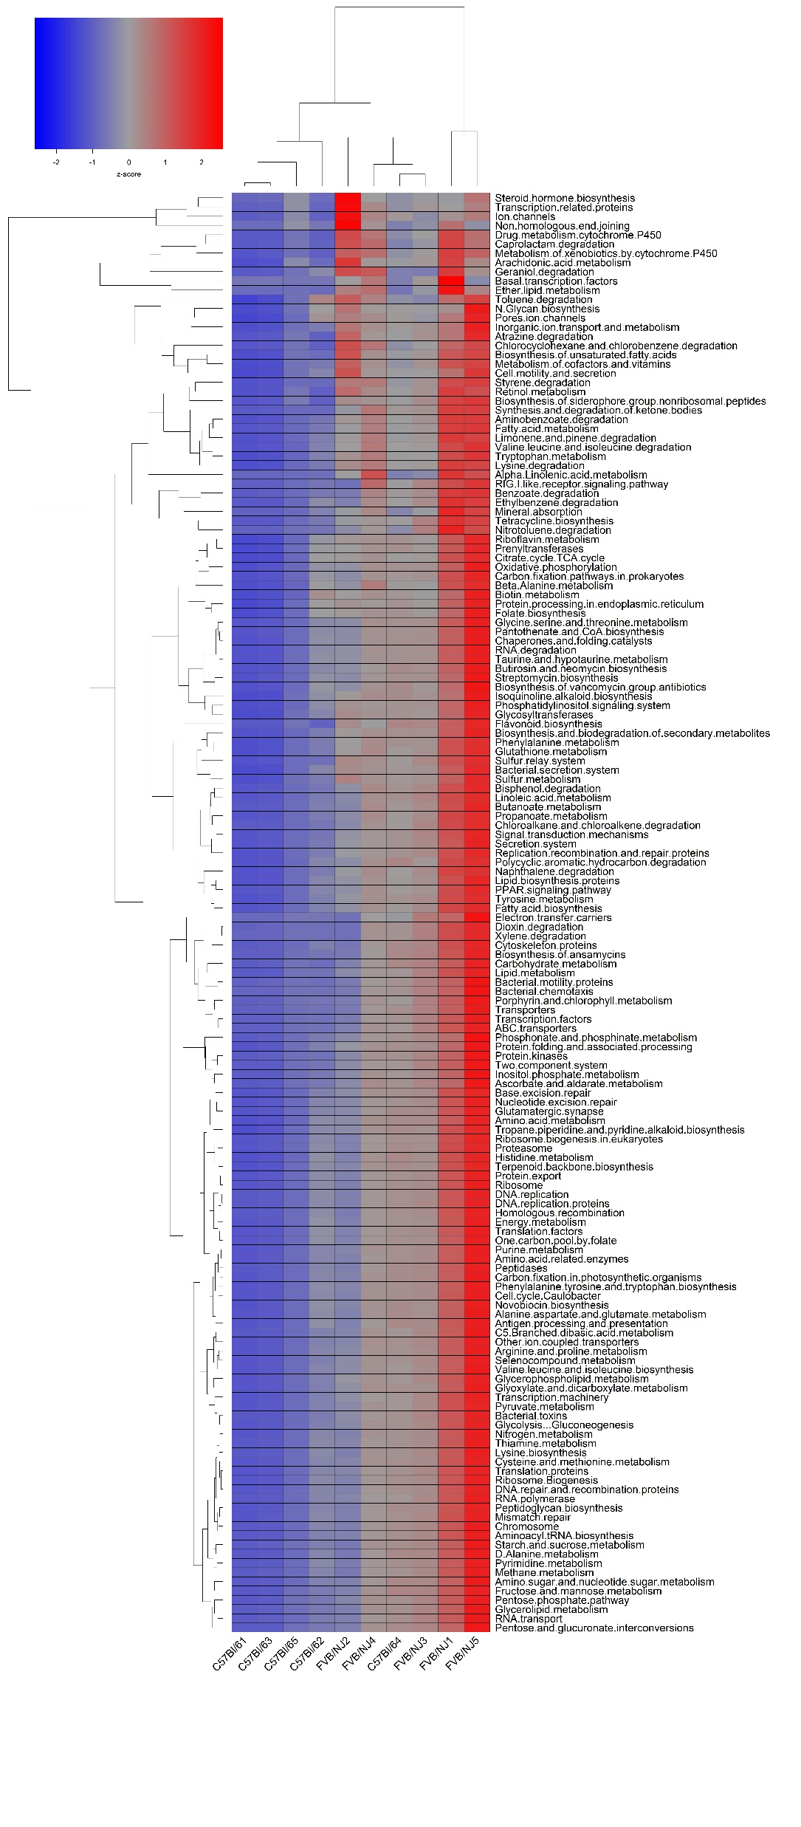
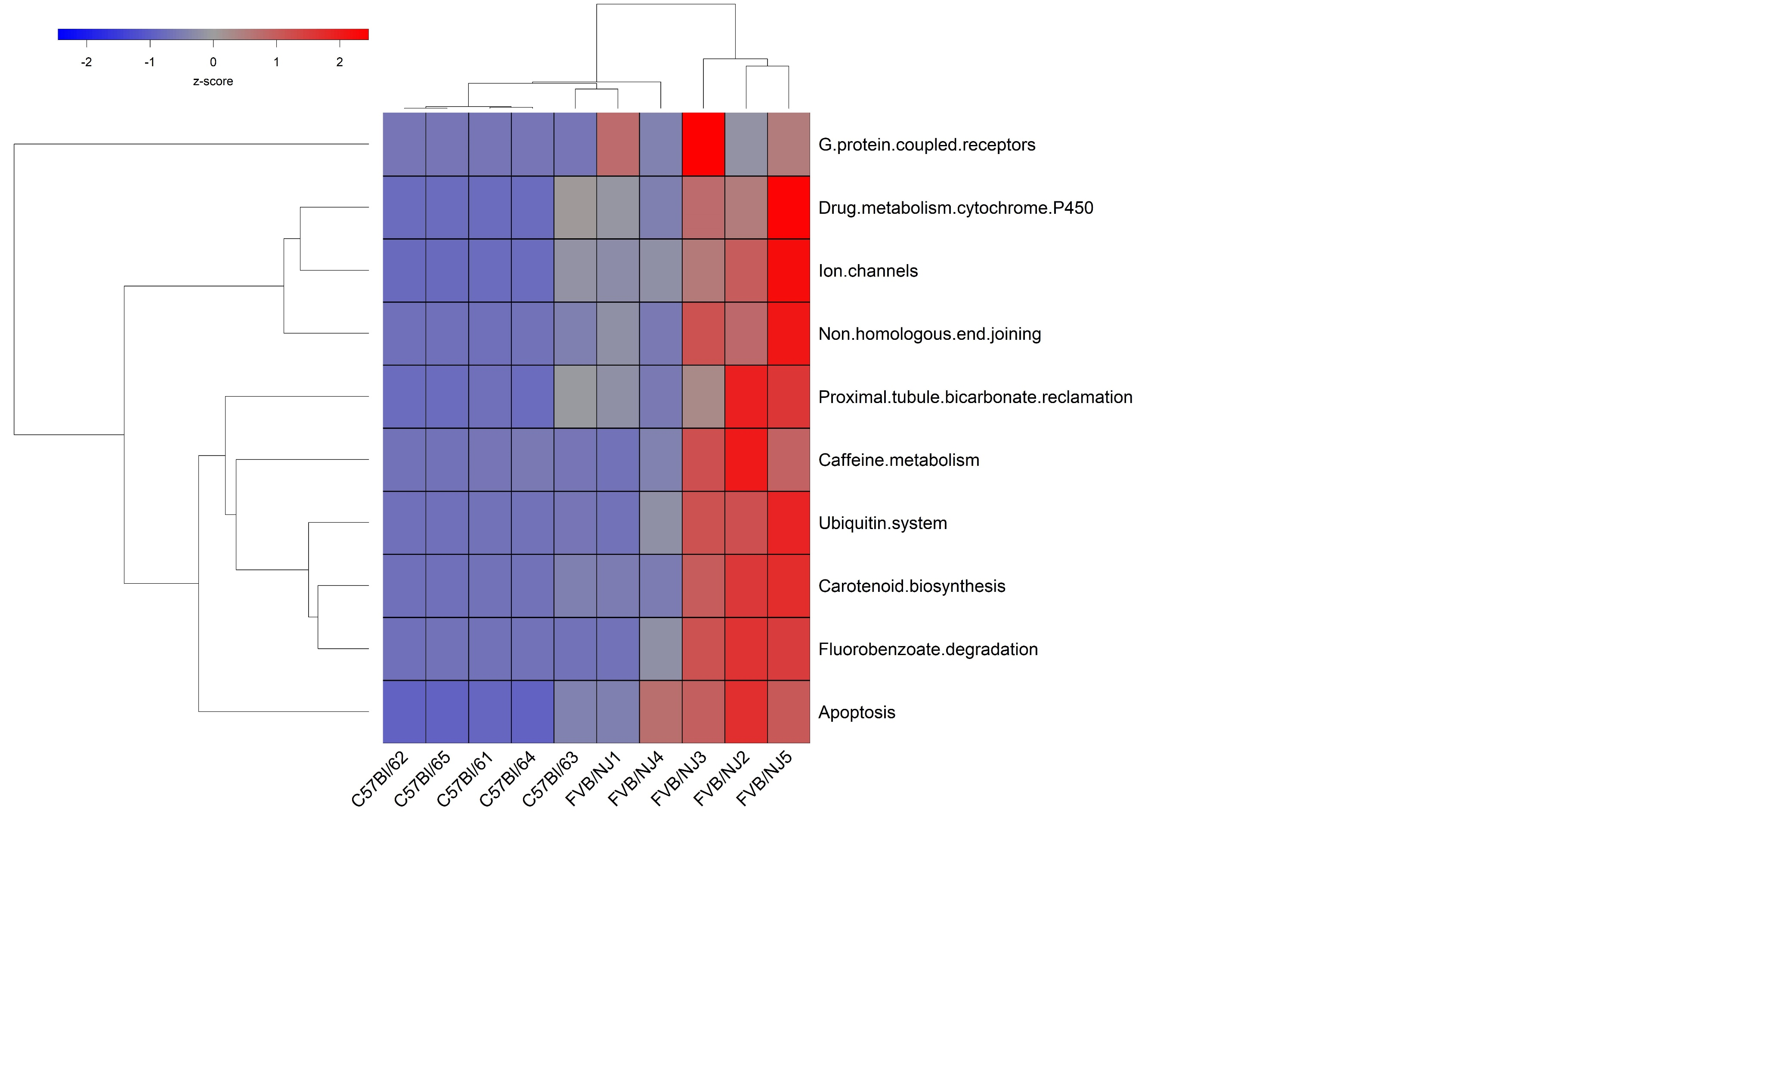
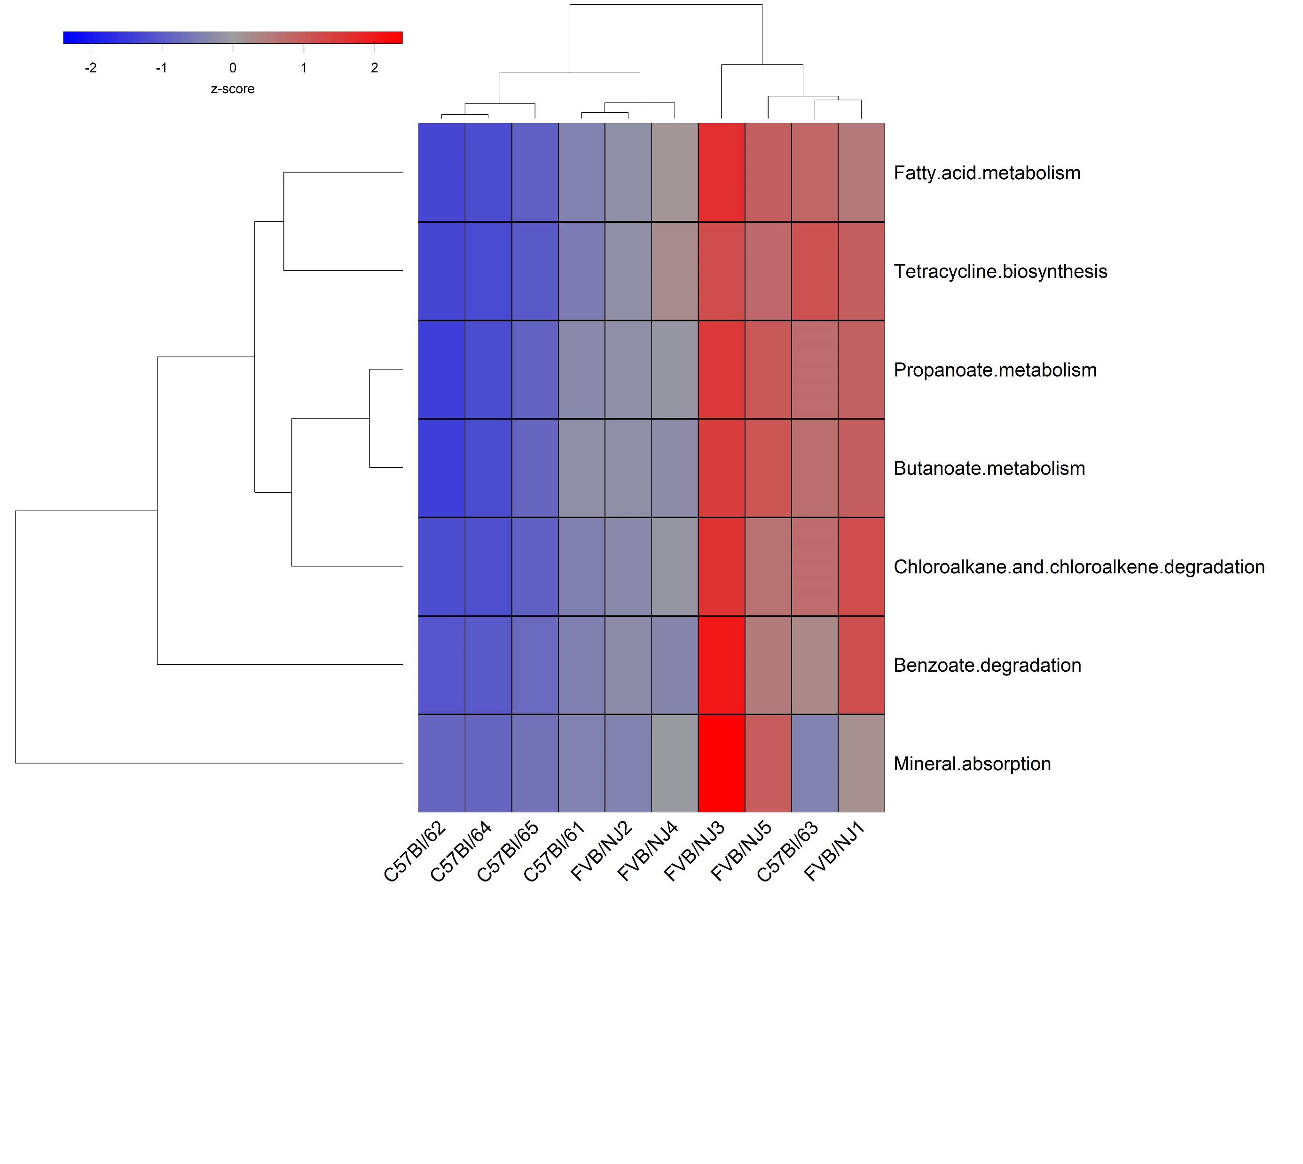
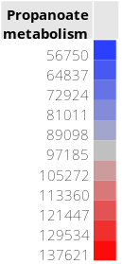
Supplemental Figure 4
Functional Predictions
A. Adolescent Males
B. Adult Males
C. Adolescent Females
D. Adult Females
Low High

Slide 5
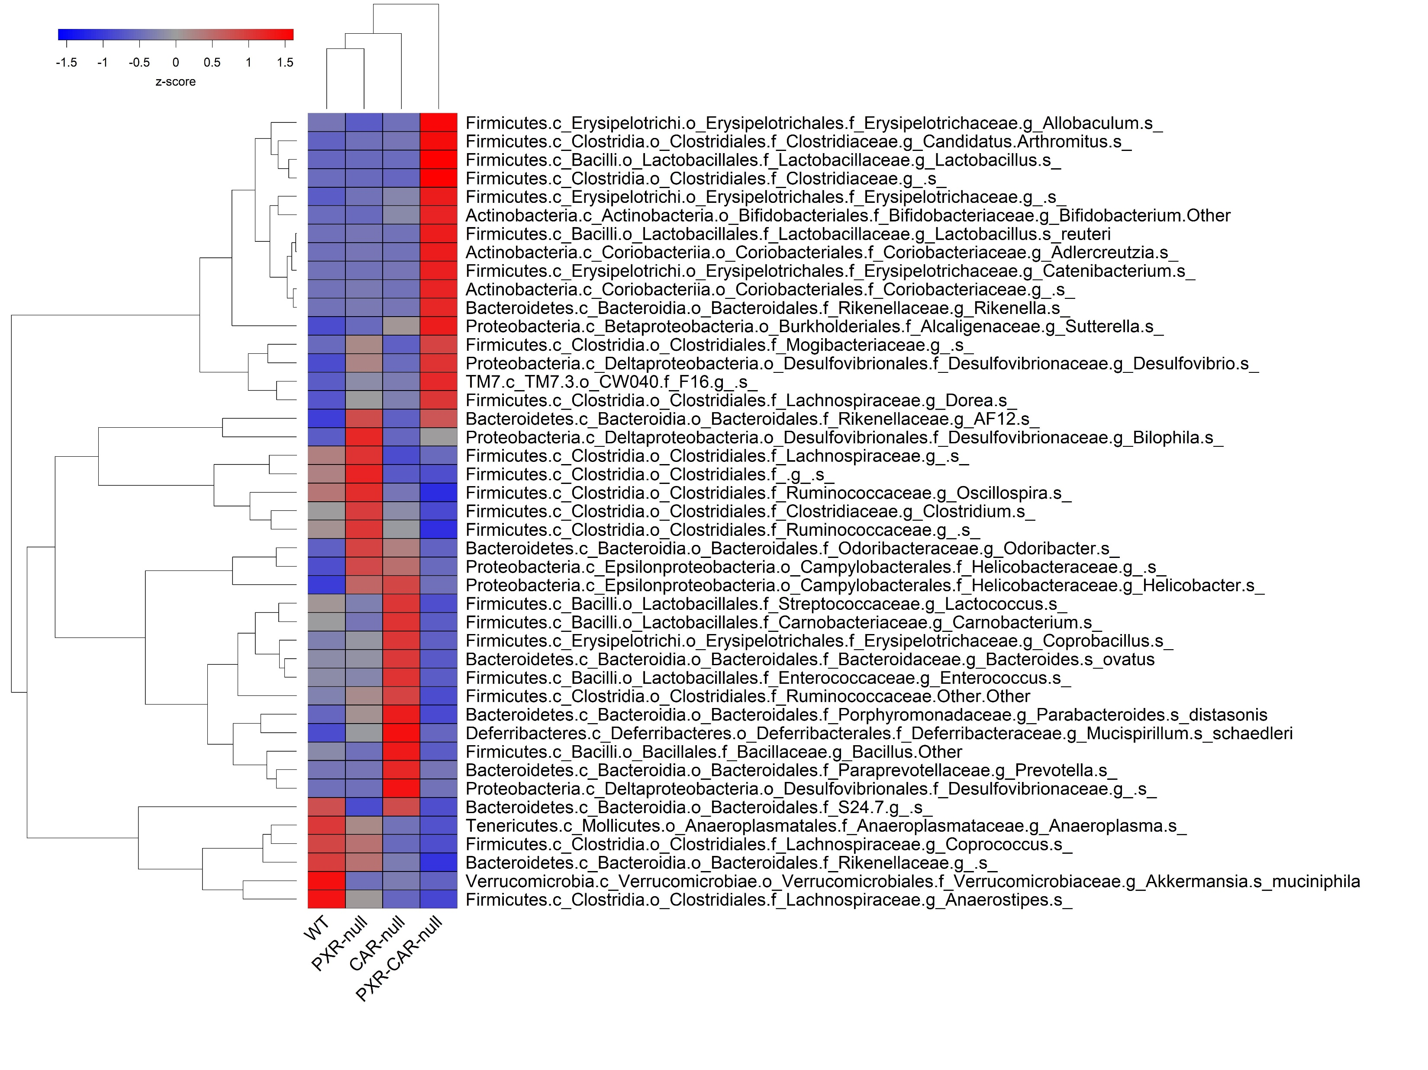
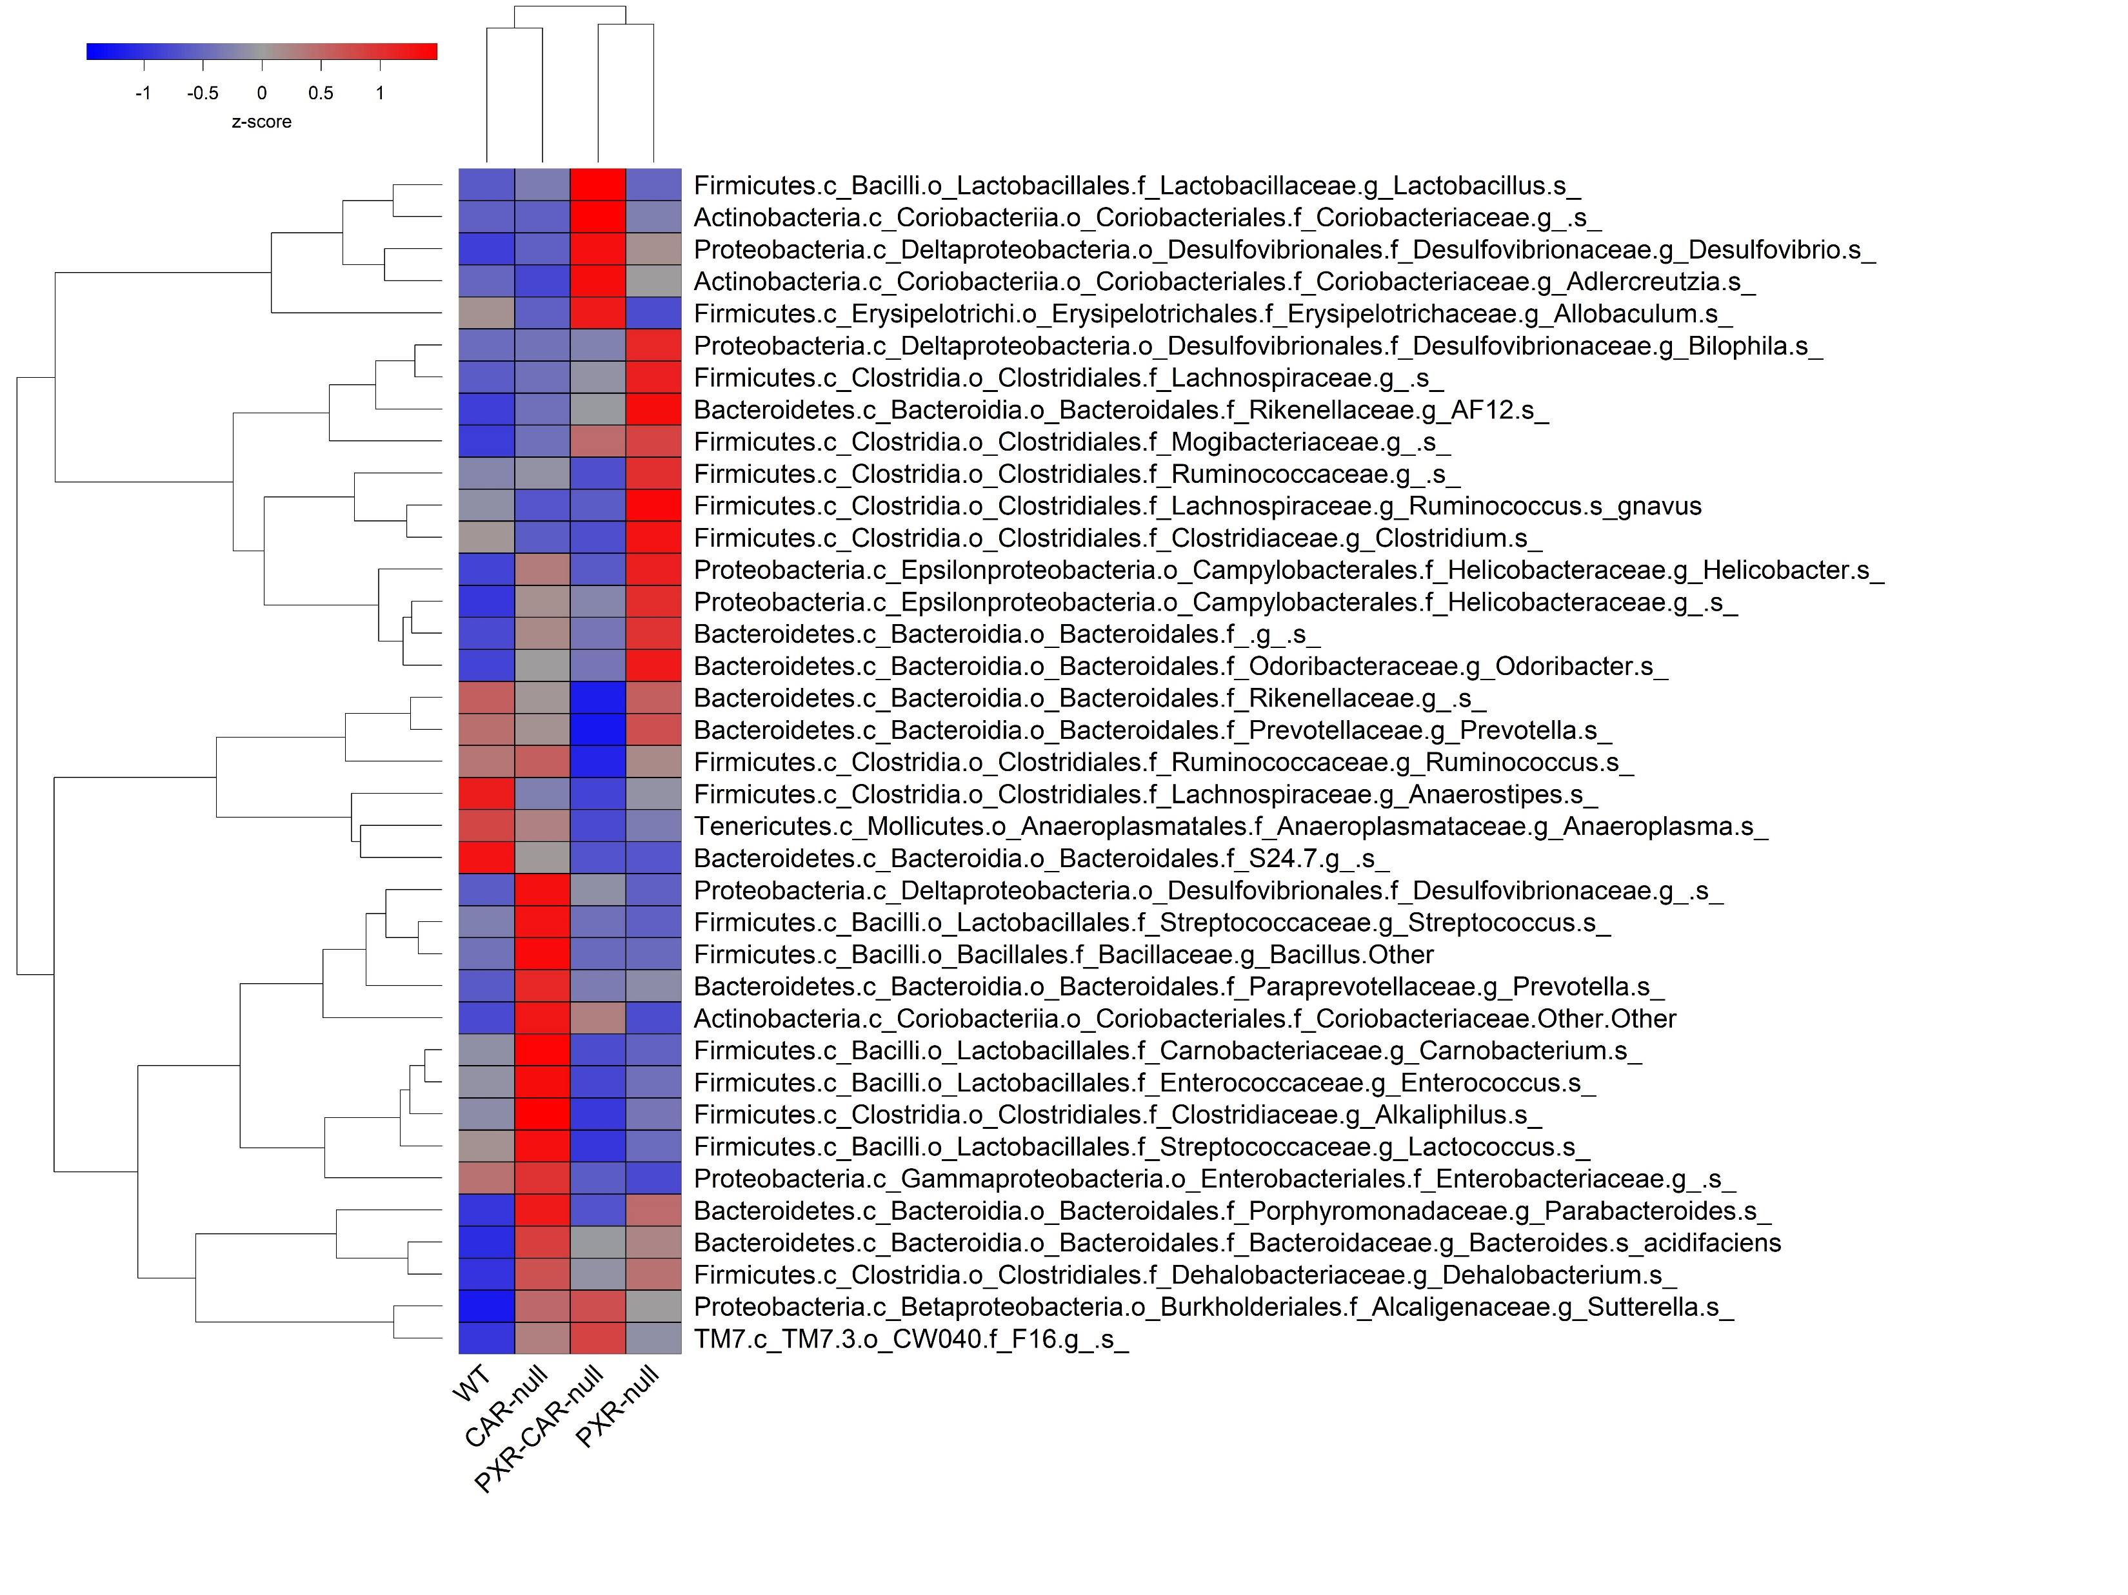
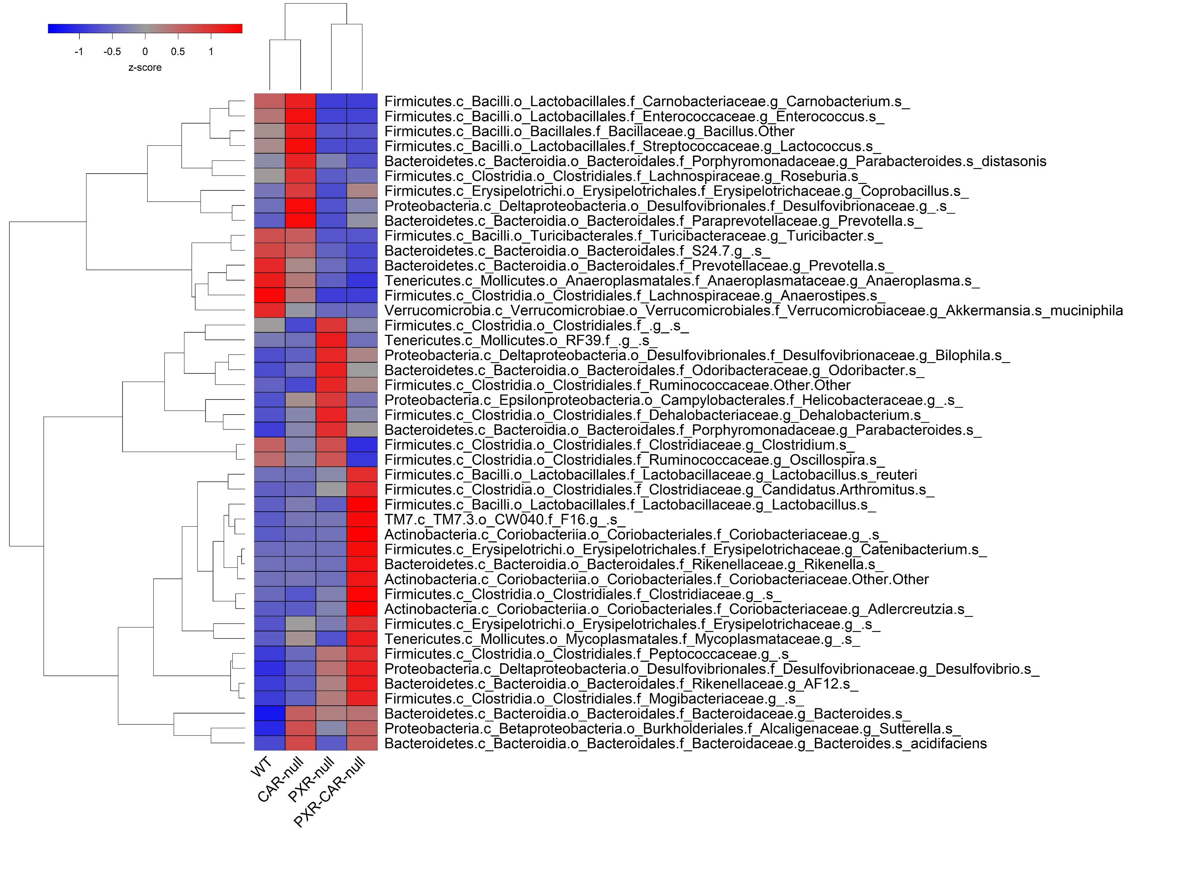
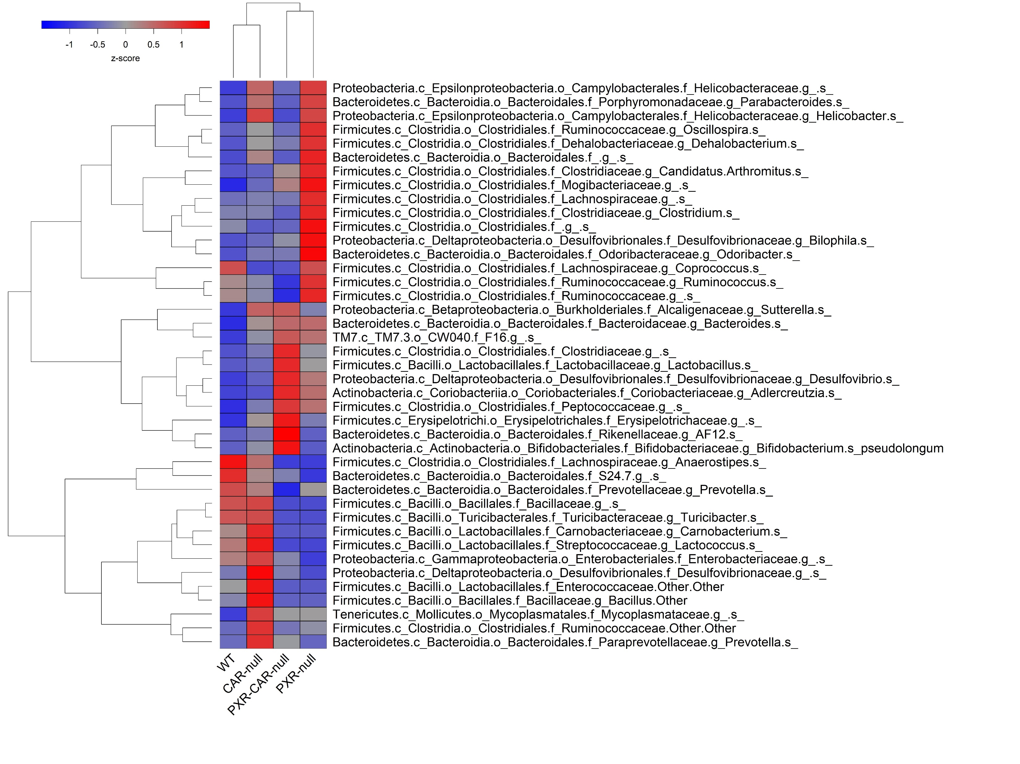
Supplemental Figure 5
A
*
*
*
*
*
*
*
*
*
*
*
*
*
*
*
*
*
*
*
*
*
Adolescent Males
*
*
*
*
*
*
*
*
*
*
*
*
*
*
*
*
*
*
*
*
*
*
*
*
*
*
*
*
*
*
*
*
*
*
*
*
*
*
*
B
*
*
*
*
*
*
*
*
*
*
*
*
*
*
*
*
*
Adult Males
*
*
*
*
*
*
*
*
*
*
*
*
*
*
*
*
*
*
*
*
*
*
*
*
*
*
*
*
*
*
*
*
*
*
*
*
*
*
*
C
*
*
*
*
*
*
*
*
*
*
*
*
*
*
*
*
*
*
*
*
*
*
*
*
*
*
*
*
*
*
*
*
Adolescent Females
*
*
*
*
*
*
*
*
*
*
*
*
*
*
*
*
*
*
*
*
*
*
*
*
*
*
*
*
*
*
*
*
*
D
*
*
*
*
*
*
*
*
*
*
*
*
*
*
*
*
*
Adult Females
*
*
*
*
*
*
*
*
*
*
*
*
*
*
*
*
*
*
*
*
*
*
*
*
*
*
*
*
*
*
*
*
*
*
*
*
*
*
*
*
*
*
*
*
*
*

Slide 6
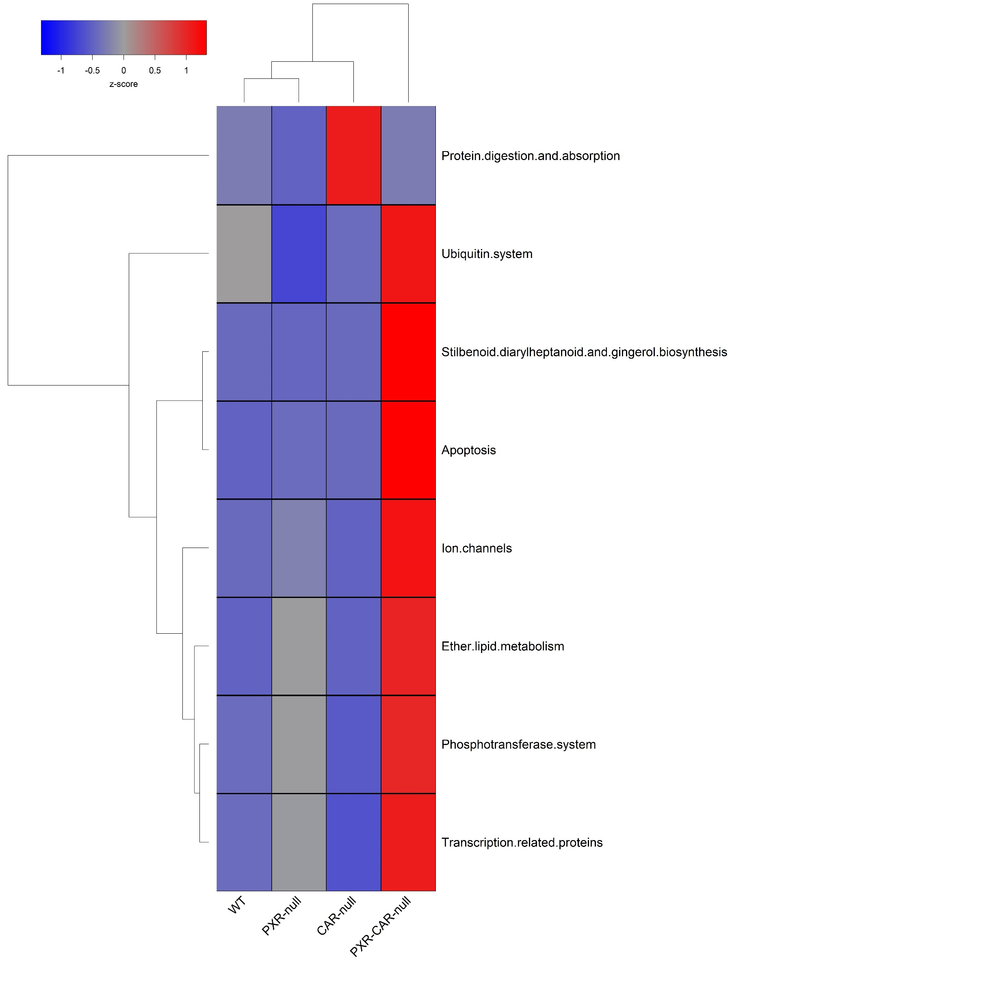
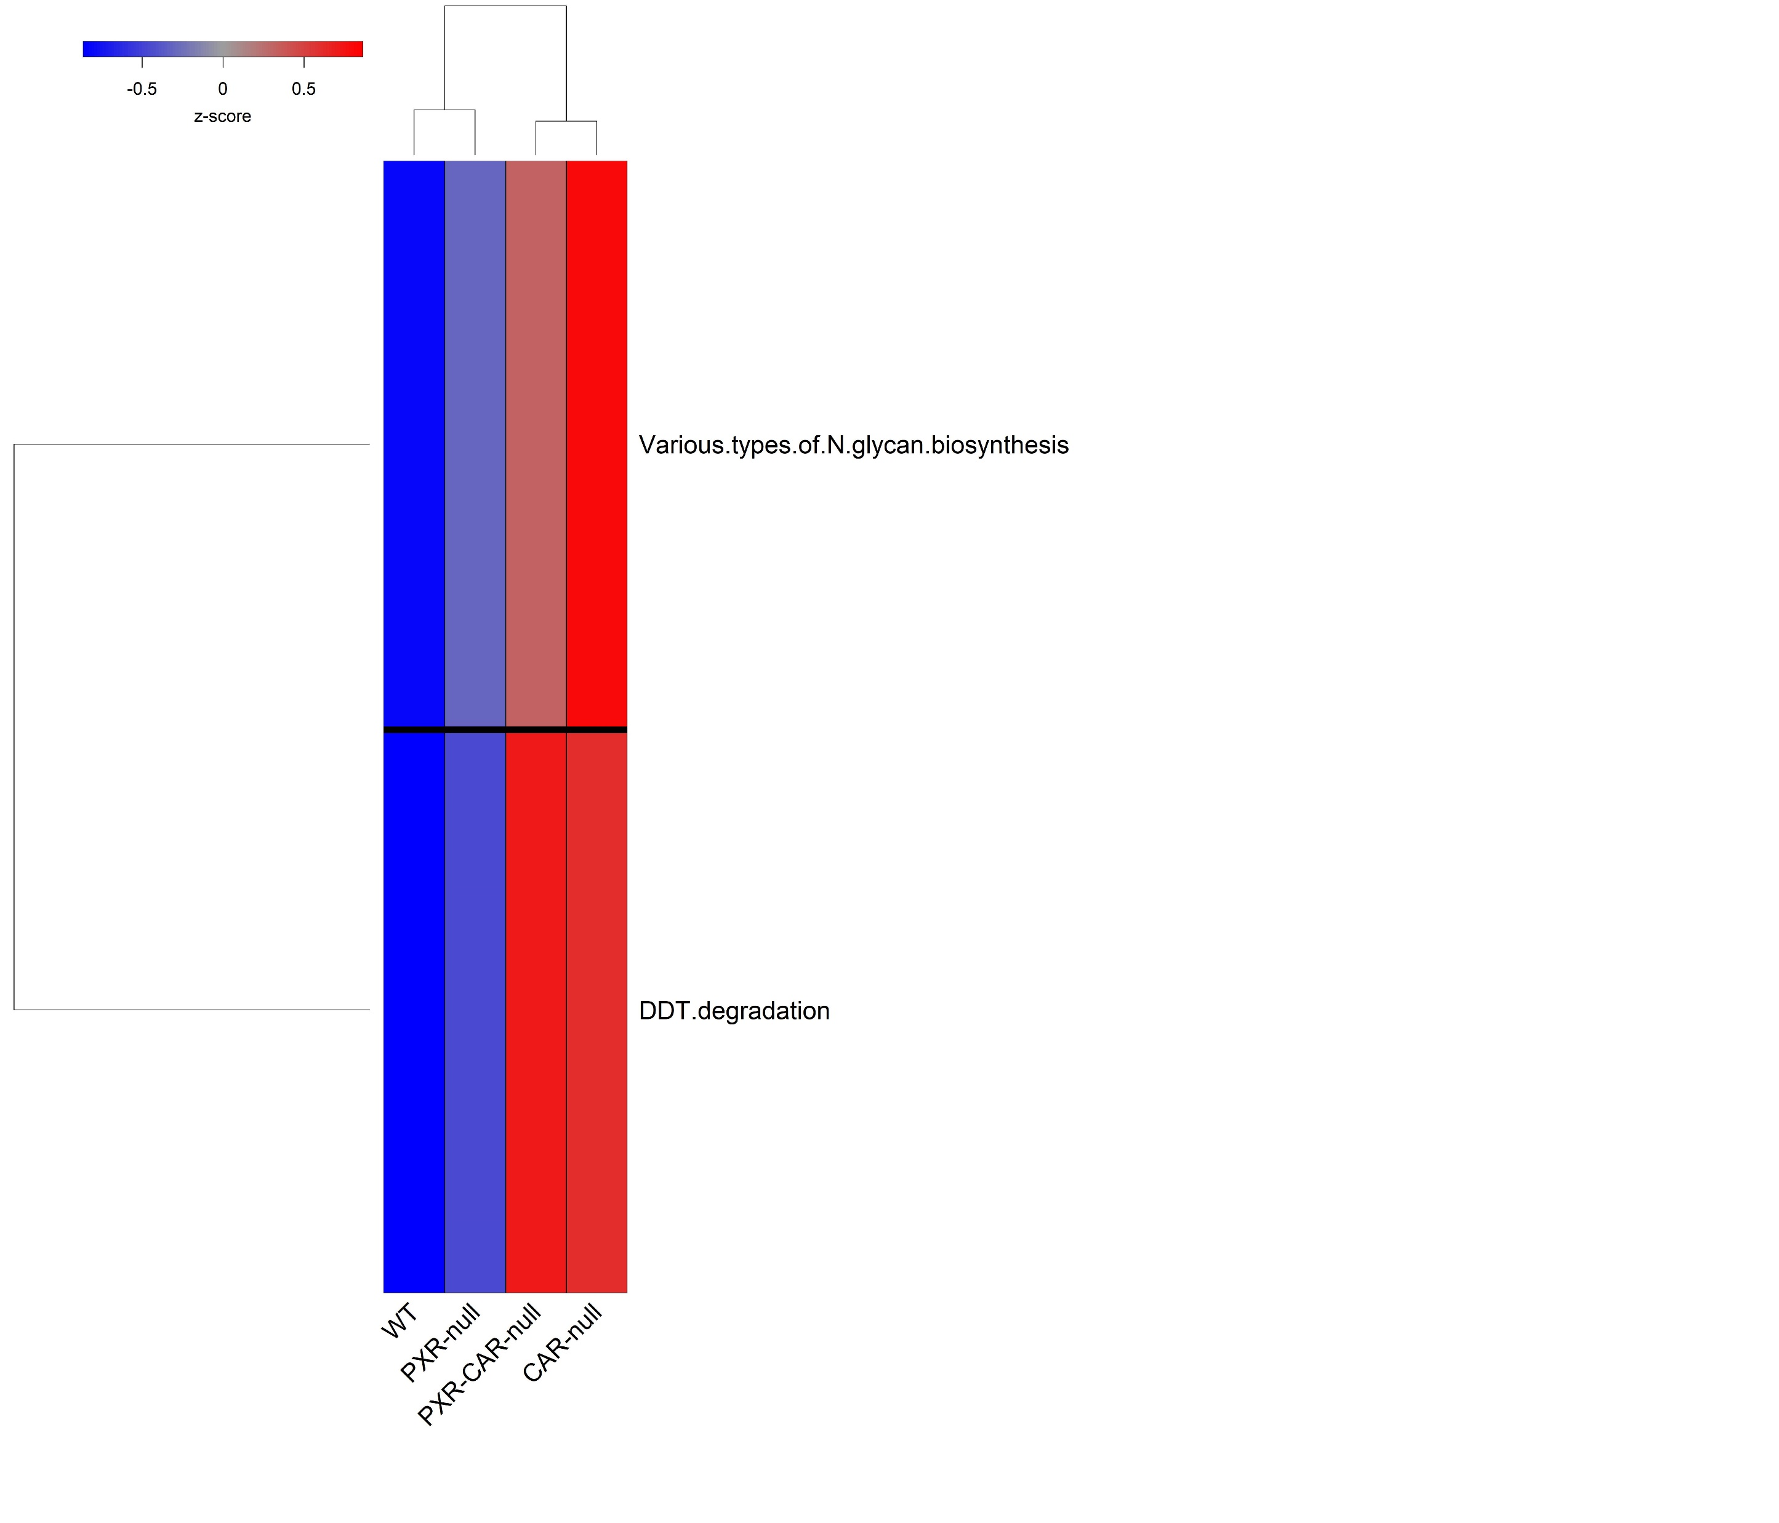
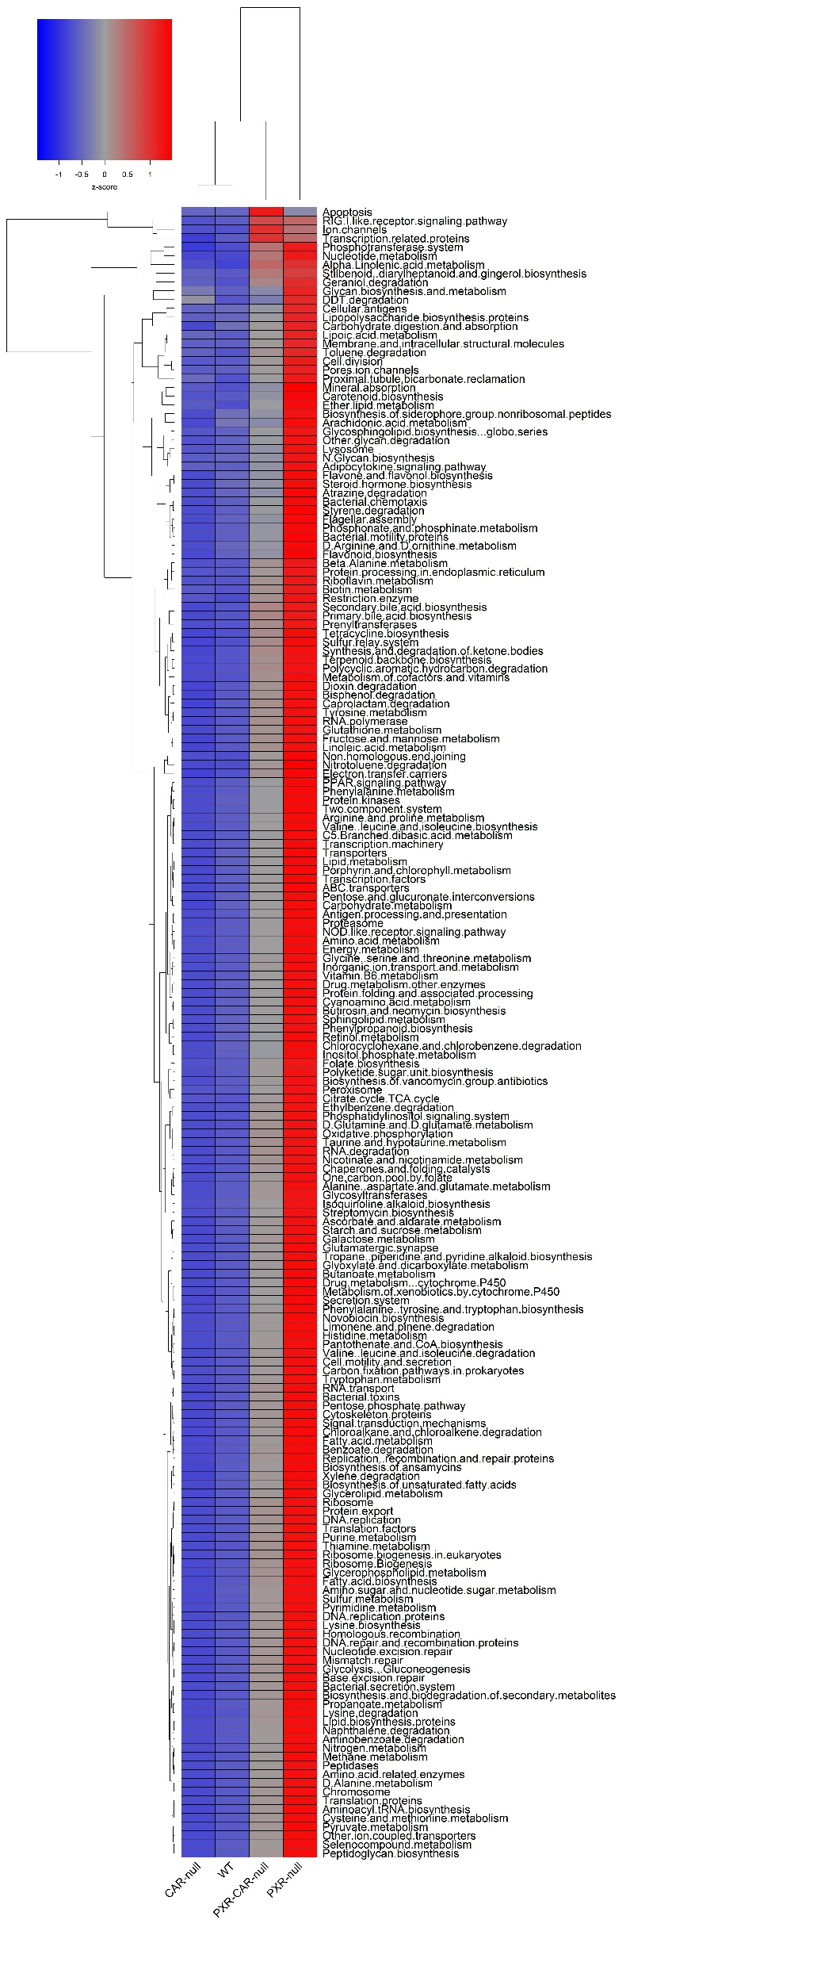
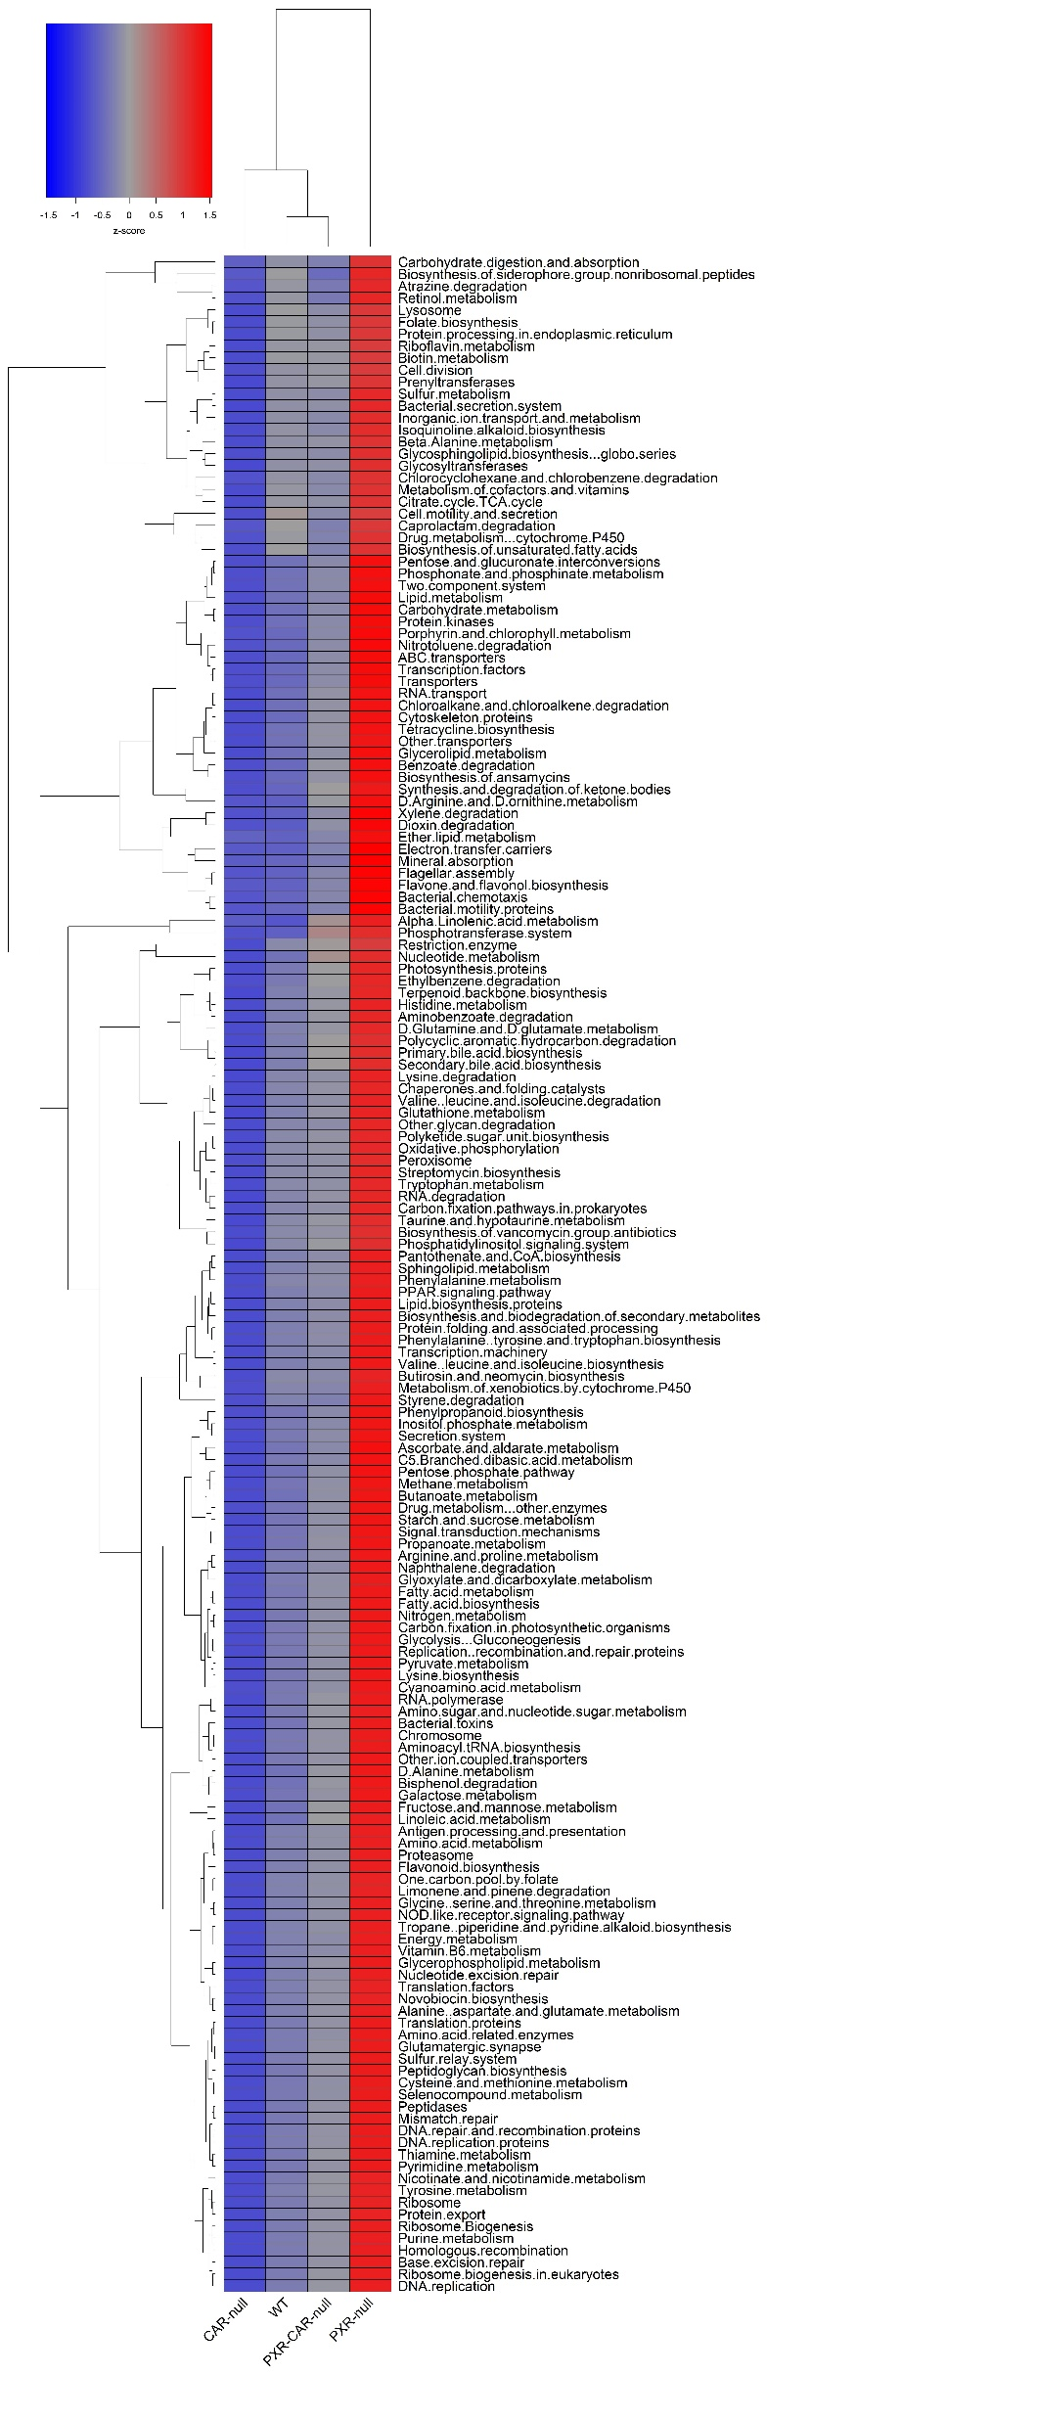
Supplemental Figure 6
Functional Predictions
A. Adolescent Males
B. Adult Males
C. Adolescent Females
D. Adult Females
Low High

Slide 7
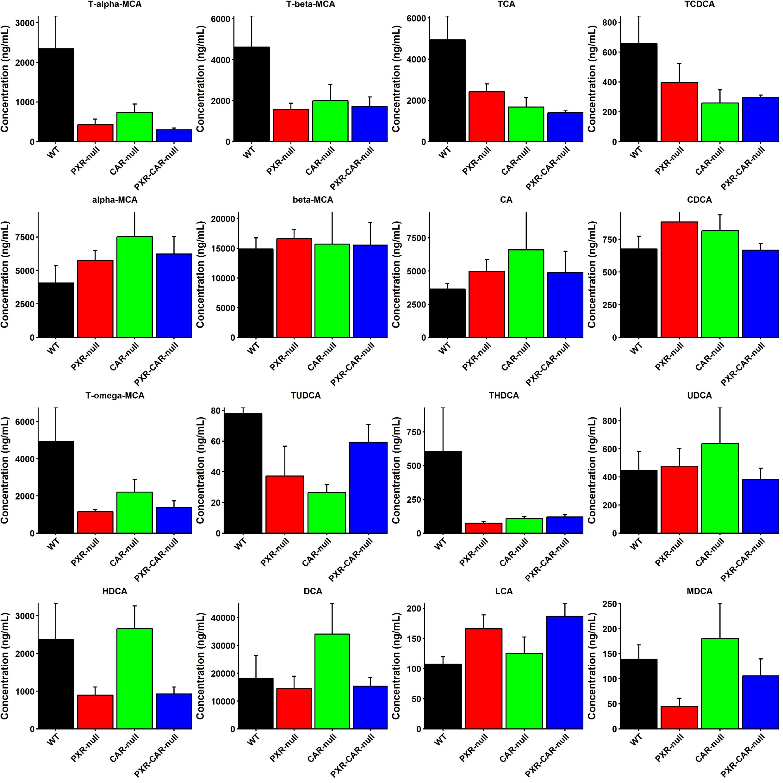
Supplemental Figure 7
C57BL/6 Adolescent Males
Primary
*
*
*
*
*
*
*
*
*
Secondary
*
*
*
*
*
*
= WT
= PXR-null
= CAR-null
= PXR-CAR-null
Notes:
Supplemental Figure 7. BA concentrations in C57BL/6 WT, PXR-null, CAR-null, and PXR-CAR-null adolescent male mice. Individual bar plots of BA concentrations (ng/mL) in adolescent male, mice as generated by the R package ggplot2. BAs were quantified by LC MS/MS as described in MATERIALS AND METHODS. Asterisks represent statistically significant differences compared to WT mice (one-way ANOVA, Duncan’s post hoc, p < 0.05).

Slide 8
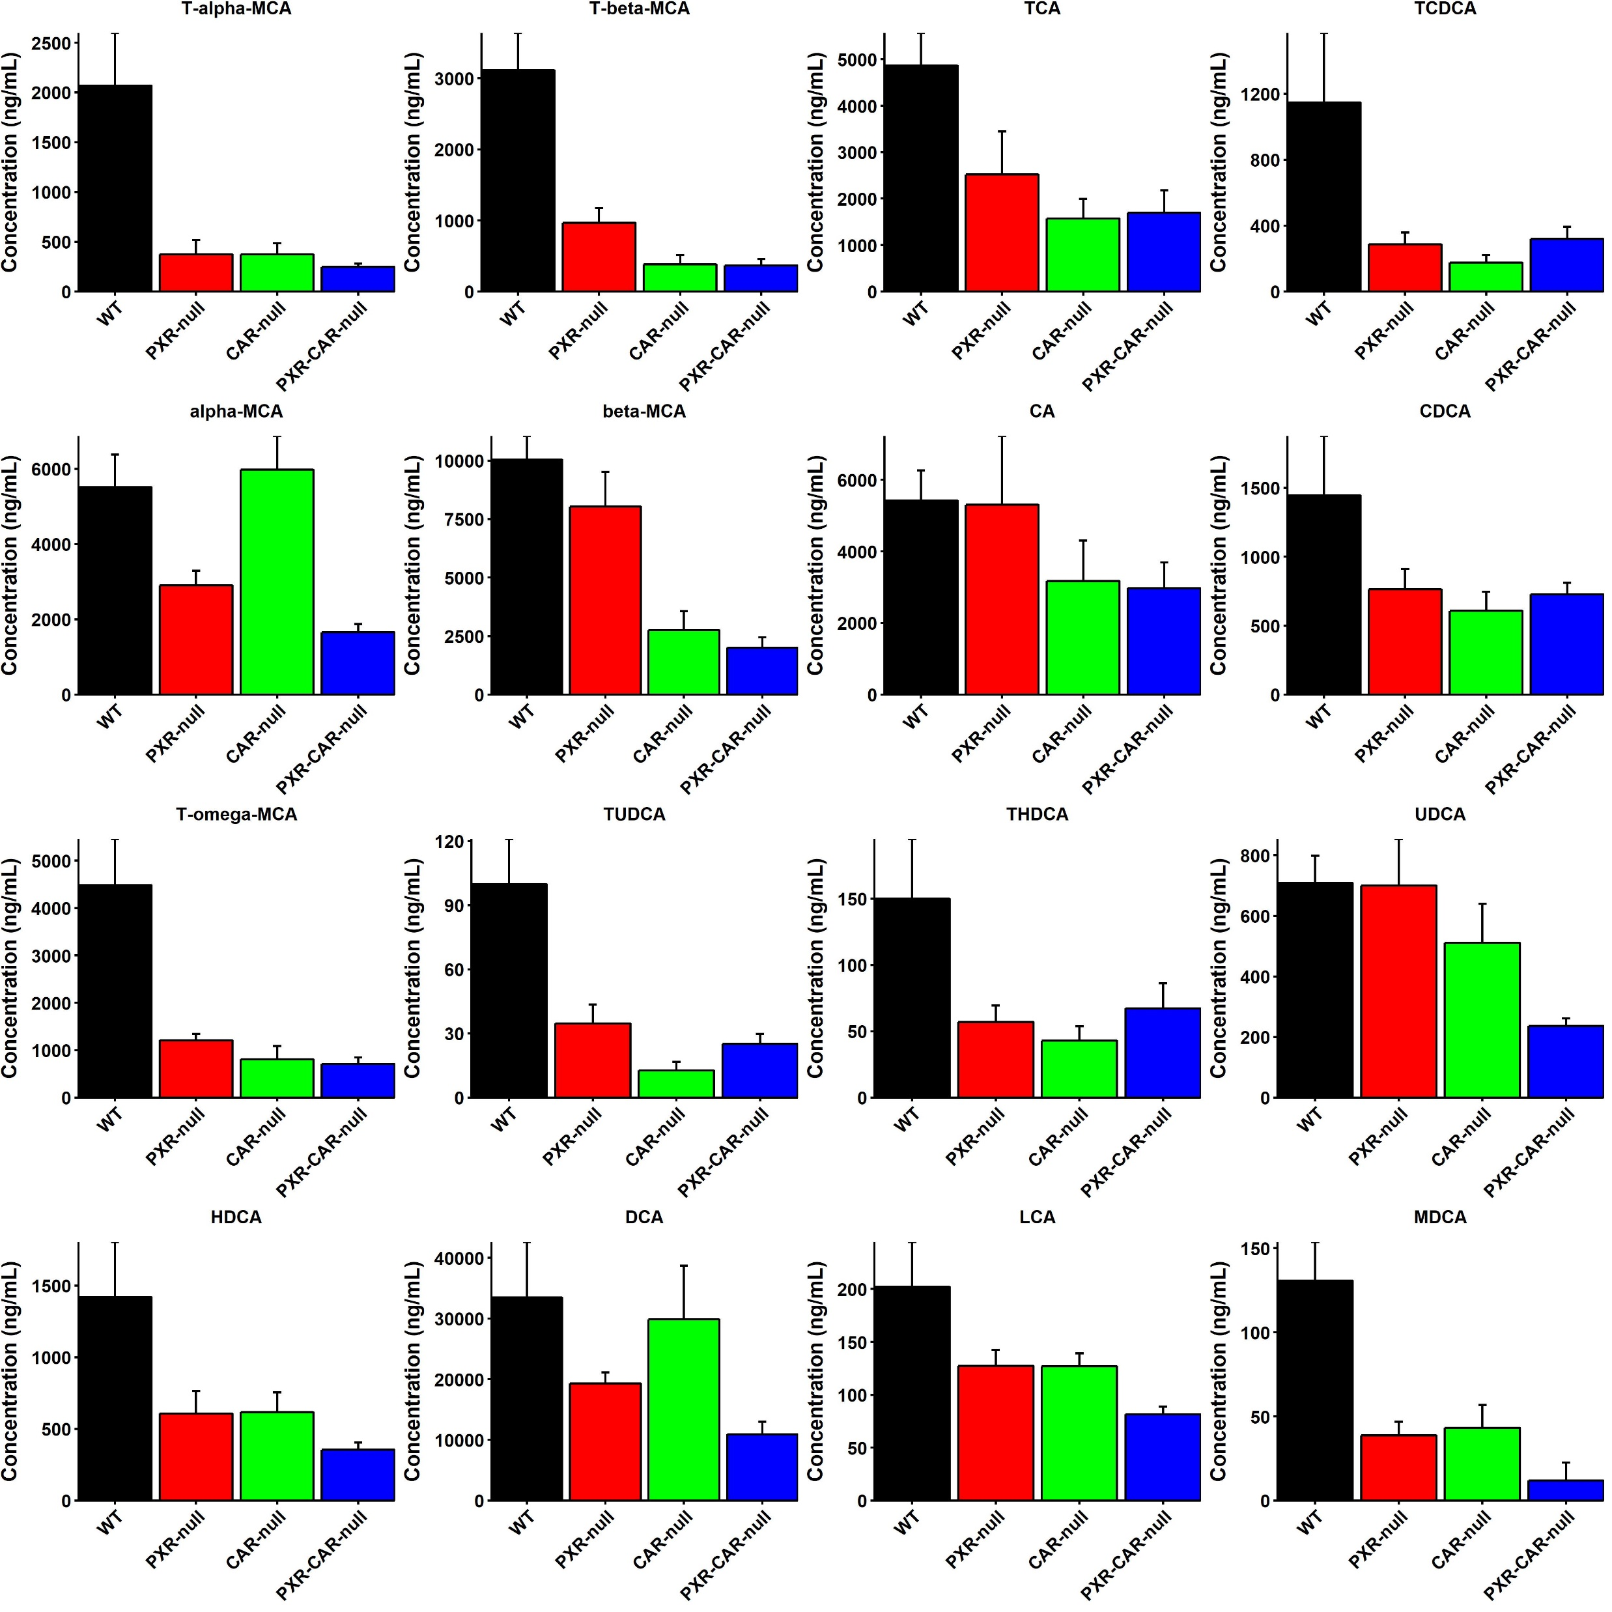
Supplemental Figure 8
C57BL/6 Adult Males
Primary
*
*
*
*
*
*
*
*
*
*
*
*
*
*
*
*
*
Secondary
*
*
*
*
*
*
*
*
*
*
*
*
*
*
*
*
*
*
*
*
= WT
= PXR-null
= CAR-null
= PXR-CAR-null
Notes:
Supplemental Figure 8. BA concentrations in C57BL/6 WT, PXR-null, CAR-null, and PXR-CAR-null adult male mice. Individual bar plots of BA concentrations (ng/mL) in adult male, mice as generated by the R package ggplot2. BAs were quantified by LC MS/MS as described in MATERIALS AND METHODS. Asterisks represent statistically significant differences compared to WT mice (one-way ANOVA, Duncan’s post hoc, p < 0.05).

Slide 9
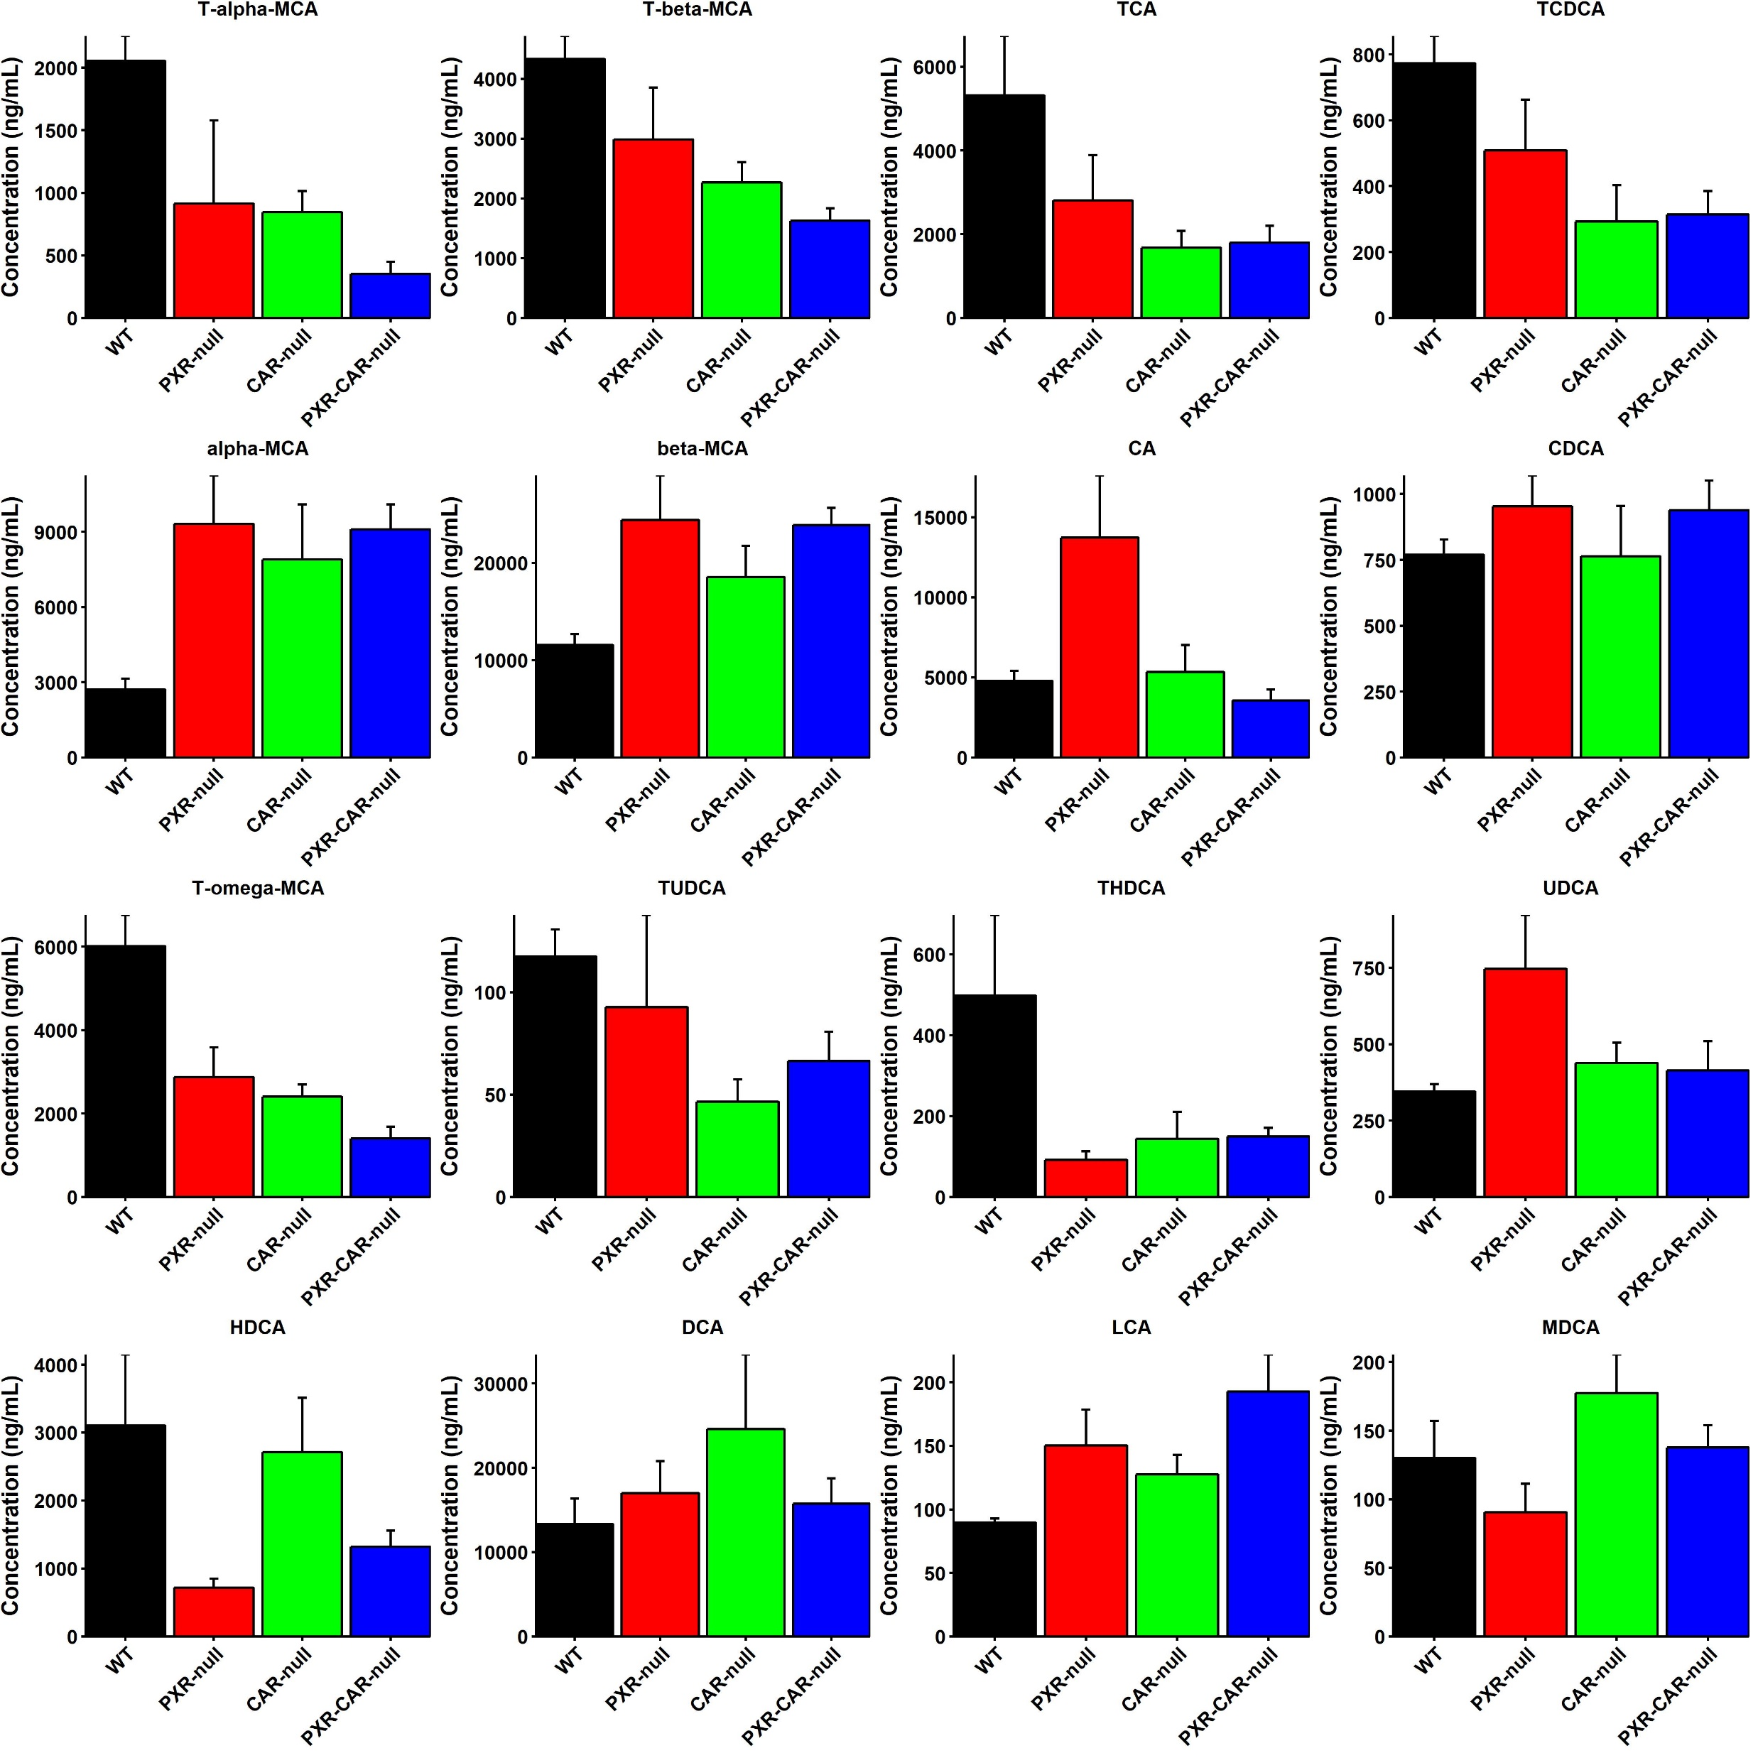
Supplemental Figure 9
C57BL/6 Adolescent Females
Primary
*
*
*
*
*
*
*
*
*
*
*
*
*
*
Secondary
*
*
*
*
*
*
*
*
*
= WT
= PXR-null
= CAR-null
= PXR-CAR-null
Notes:
Supplemental Figure 9. BA concentrations in C57BL/6 WT, PXR-null, CAR-null, and PXR-CAR-null adolescent female mice. Individual bar plots of BA concentrations (ng/mL) in adolescent female, mice as generated by the R package ggplot2. BAs were quantified by LC MS/MS as described in MATERIALS AND METHODS. Asterisks represent statistically significant differences compared to WT mice (one-way ANOVA, Duncan’s post hoc, p < 0.05).

Slide 10
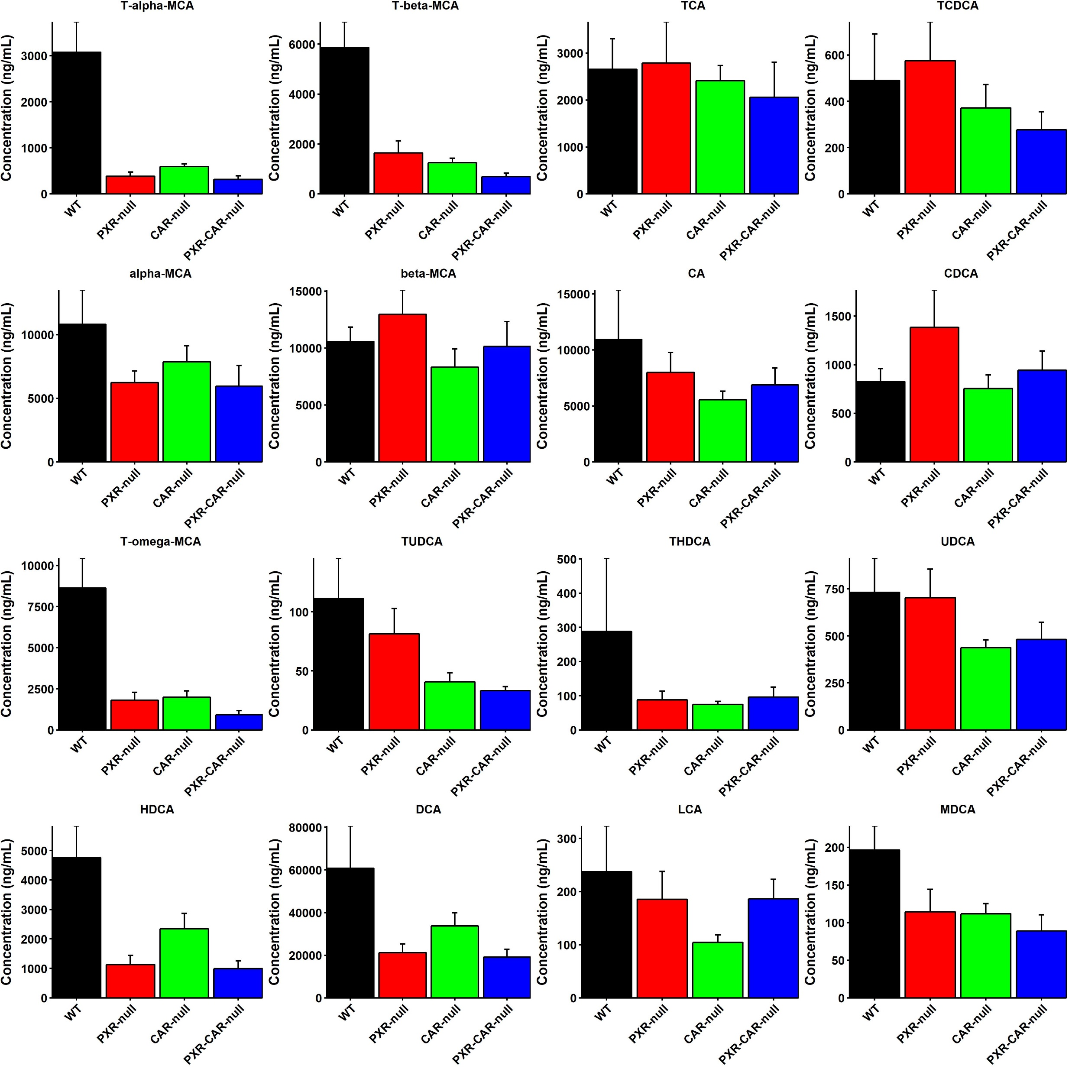
Supplemental Figure 10
C57BL/6 Adult Females
Primary
*
*
*
*
*
*
Secondary
*
*
*
*
*
*
*
*
*
*
*
*
*
= WT
= PXR-null
= CAR-null
= PXR-CAR-null
Notes:
Supplemental Figure 10. BA concentrations in C57BL/6 WT, PXR-null, CAR-null, and PXR-CAR-null adult female mice. Individual bar plots of BA concentrations (ng/mL) in adult female, mice as generated by the R package ggplot2. BAs were quantified by LC MS/MS as described in MATERIALS AND METHODS. Asterisks represent statistically significant differences compared to WT mice (one-way ANOVA, Duncan’s post hoc, p < 0.05).

Slide 11
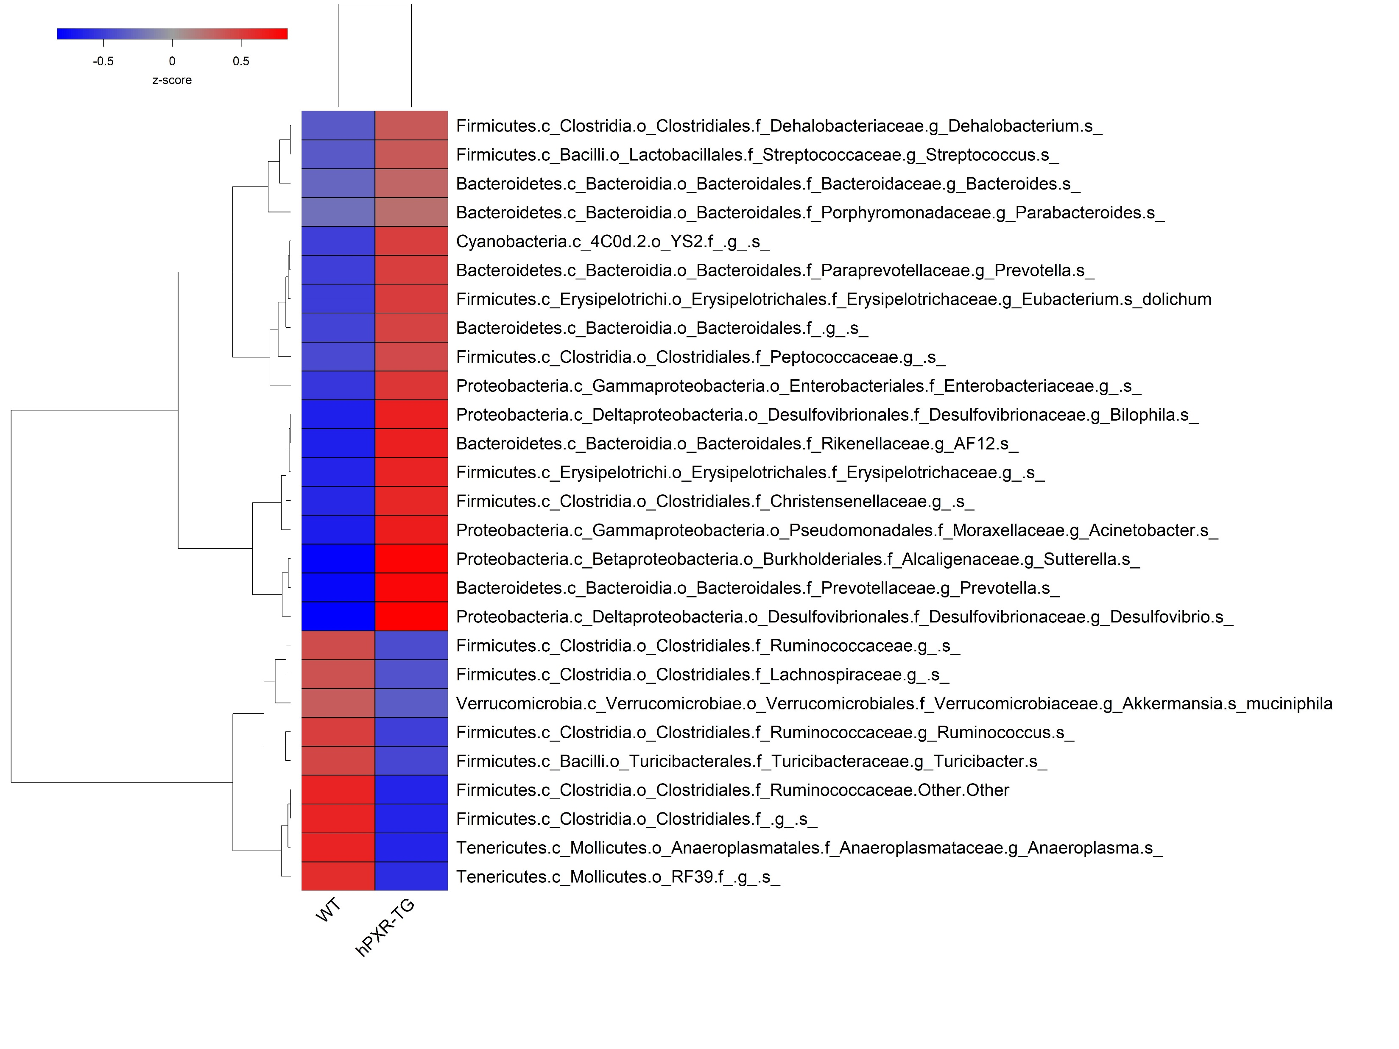
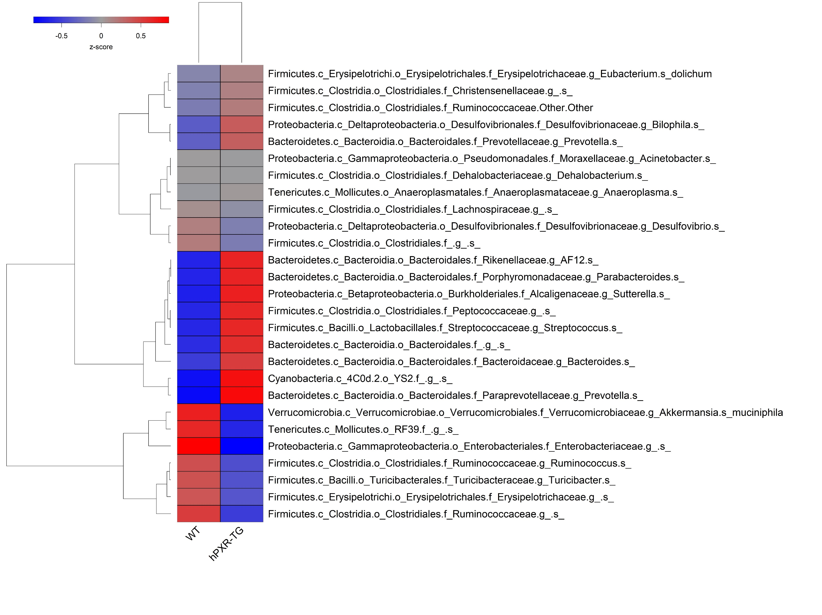
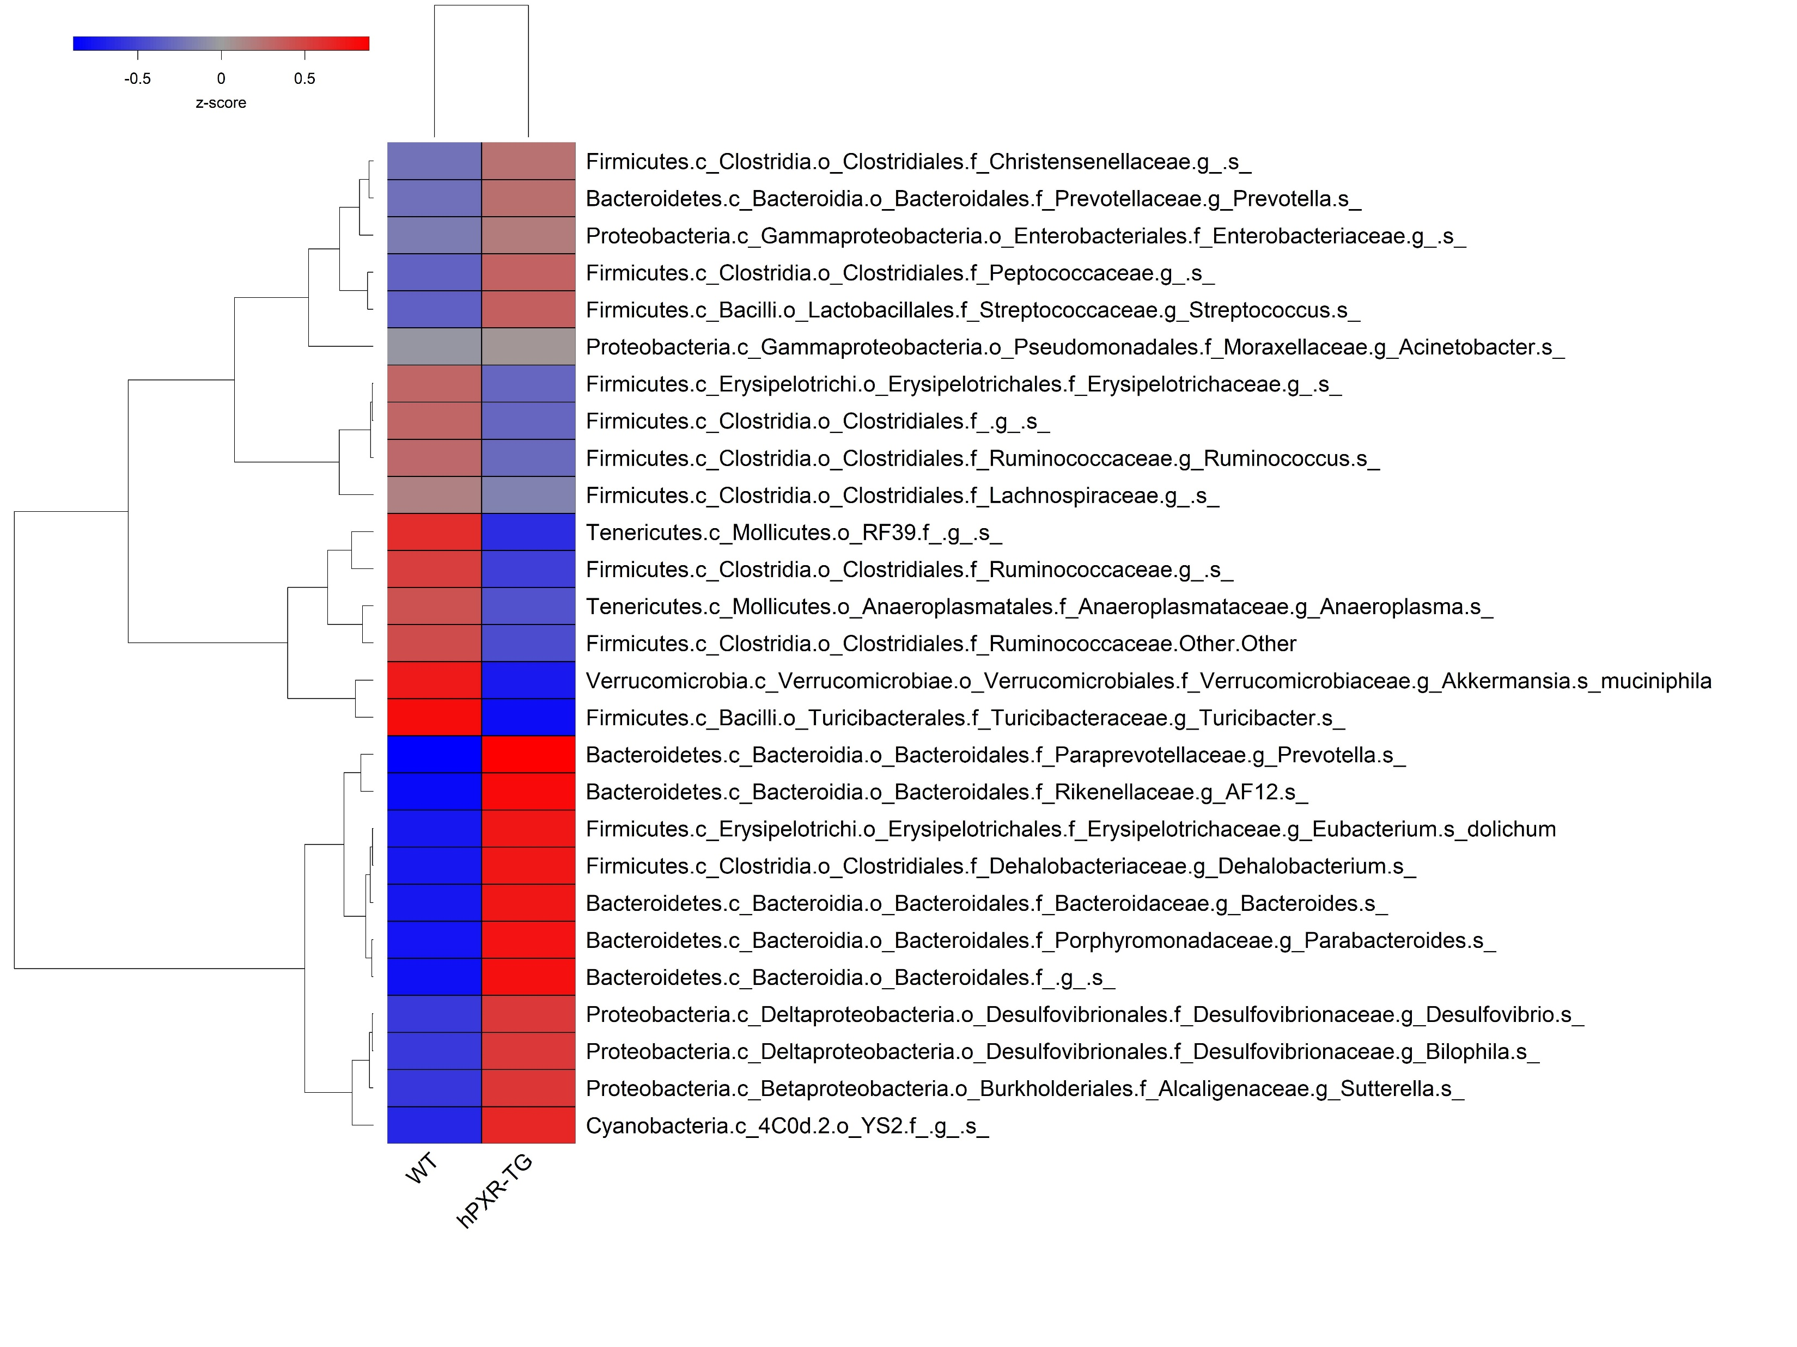
Supplemental Figure 11
A. Adolescent Males
B. Adult Males
*
*
*
*
*
*
*
*
*
*
*
*
*
*
*
*
*
*
*
*
*
*
*
C. Adolescent Females
D. Adult Females
*
*
*
*
*
*
*
*
*
*
*
*
*
*
*
*
*
*
*
*
*
*

Slide 12
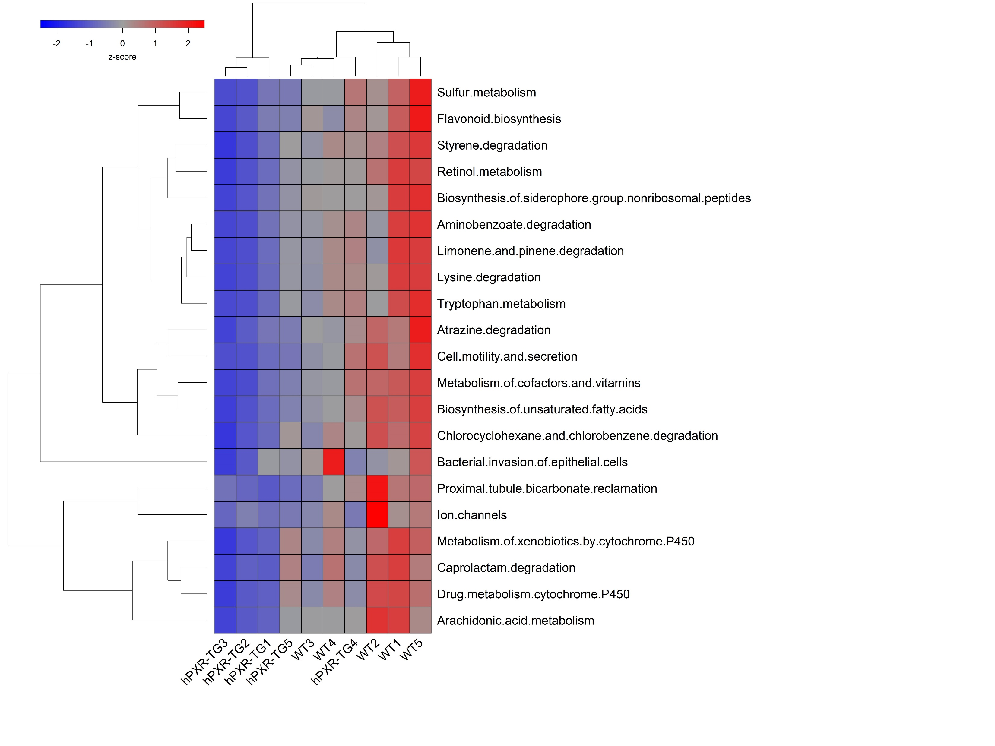
Supplemental Figure 12
Functional Predictions
Adult Males

