Slide 1
Supplementary Fig. 1
Human ALKBH2: primer targets
intron 1
exon 1
exon 2
exon 3
ALKBH2 pre-mRNA
(92 bp)
ALKBH2 mRNA
(122 bp)
Mouse ALKBH2: primer targets
intron 1
exon 1
exon 2
exon 3
exon 4
ALKBH2 pre-mRNA
(102 bp)
ALKBH2 mRNA
(106 bp)
Supplementary Fig. 1 Primer targets in qRT-PCR assay
Primer targets of ALKBH2 in qRT-PCR assay in human and mouse were graphically represented.

Slide 2
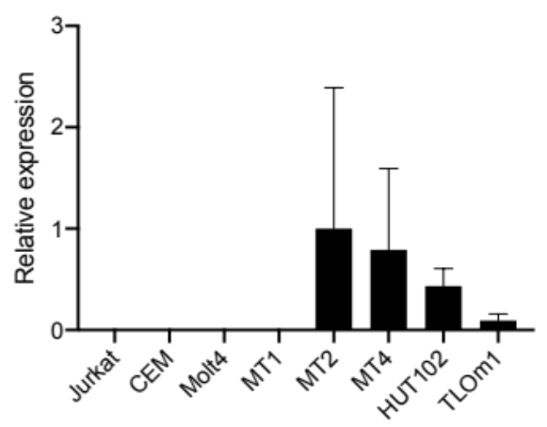
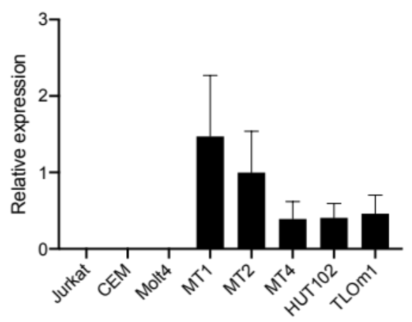
Supplementary Fig. 2
Tax
HBZ
*
Supplementary Fig. 2 Confirmation of the certainty of qRT-PCR assay for detecting Tax and HBZ mRNA by using cultured T-cell lines.
The mRNA expression of Tax and HBZ mRNA were measured by qRT-PCR in intact (Jurkat, CEM, and Molt4) and HTLV-1–related T-cell lines (MT1, MT2, MT4, HUT102, and TLOm1). Gene expression was calculated using the ΔΔCt method. The equalized data are shown as relative expression, standardized by the mean value of MT2 cells (MT2 = 1) on the y-axis. The data represent the mean ± SD of four independent experiments. Significance was analyzed by one-way ANOVA followed by Tukey’s multiple comparisons test and is indicated by an asterisk. Statistical significance was observed in the analysis of HBZ mRNA (MT1 vs. MT4: *p = 0.0330, MT1 vs. HUT102: *p = 0.0363, MT1 vs TLOm1: *p = 0.0494).

Slide 3
Supplementary Fig. 3
a)
b)
M
1
2
M
1
2
75 kDa
75 kDa
25 kDa
25 kDa
M | Precision Plus Protein Dual Color Standards (Bio-Rad)
1 | wildtype ID: #2
2 | HBZ-Tg ID: #8
Supplementary Fig.3 Original images of western blotting
Original images of western blotting for (a) ALKBH2 and (b) β-actin protein expressions in whole spleen cells of wildtype and HBZ-Tg mice. The proteins detection and imaging were performed by an Odyssey CLx infrared imaging system.

