Slide 1
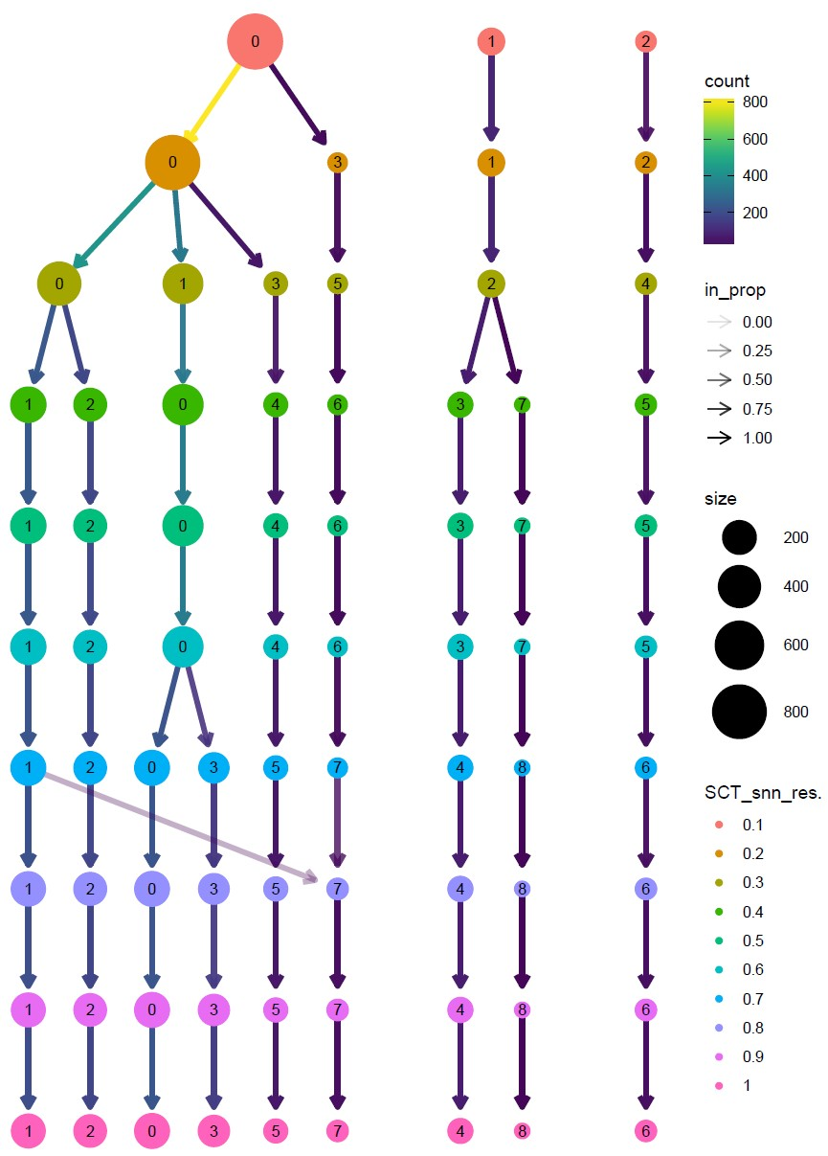
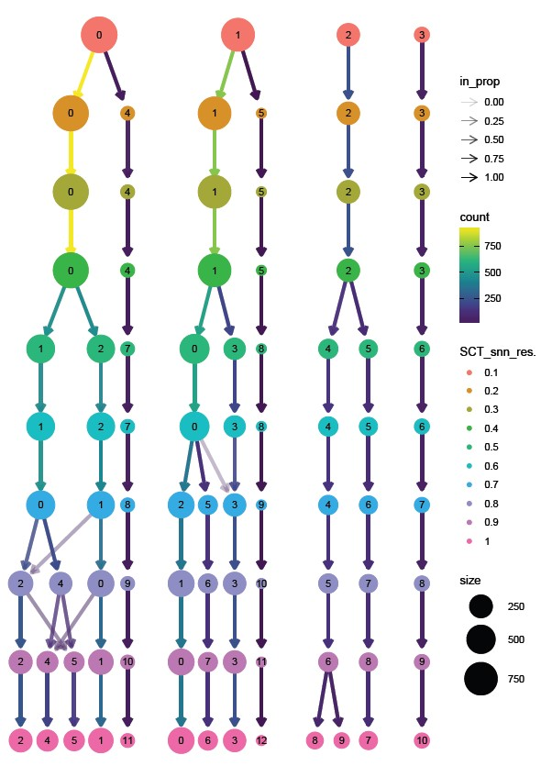
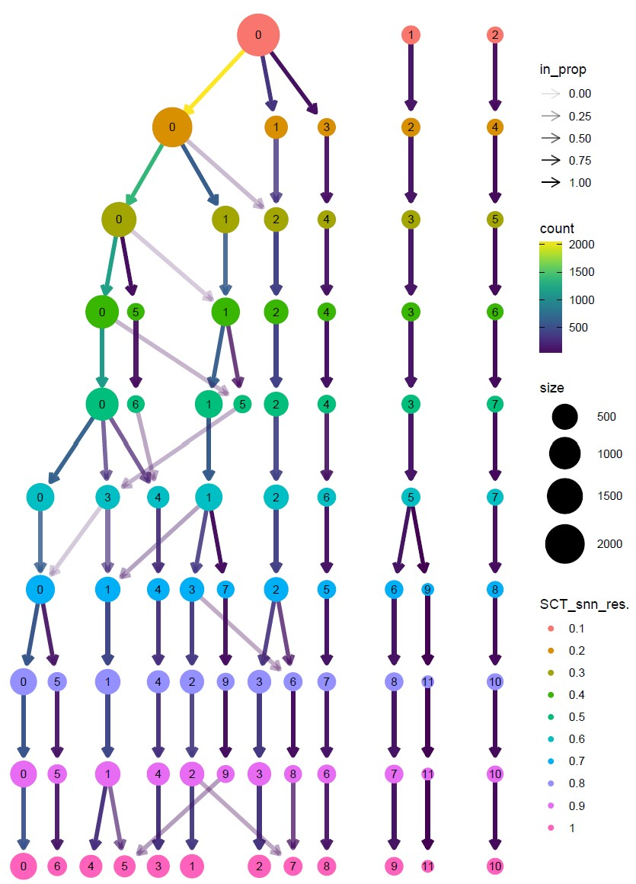

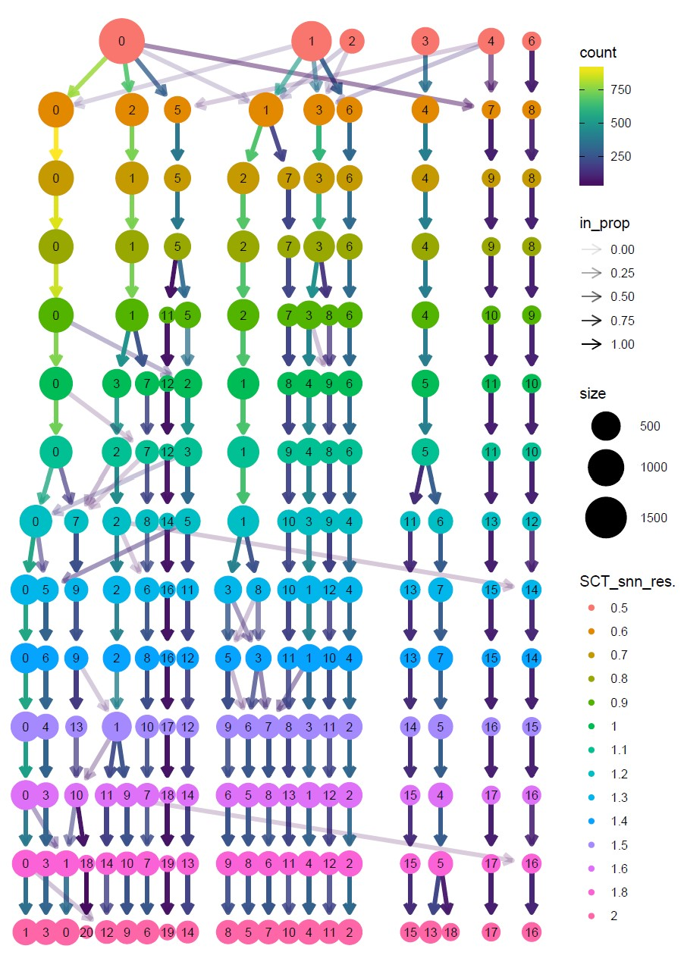
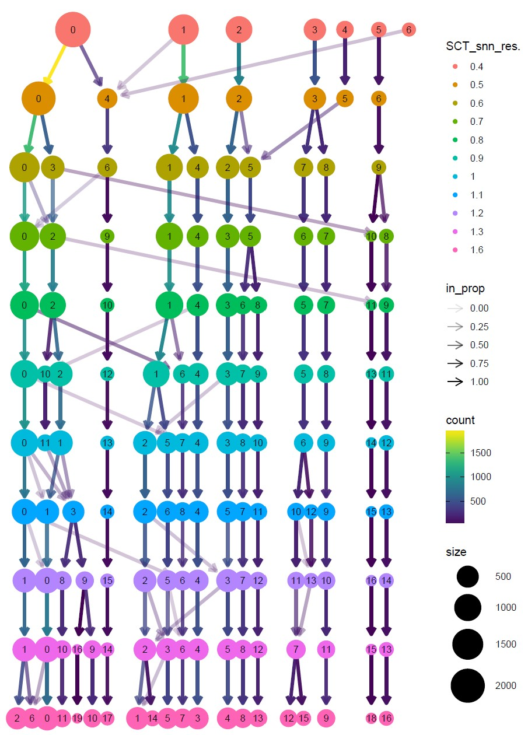
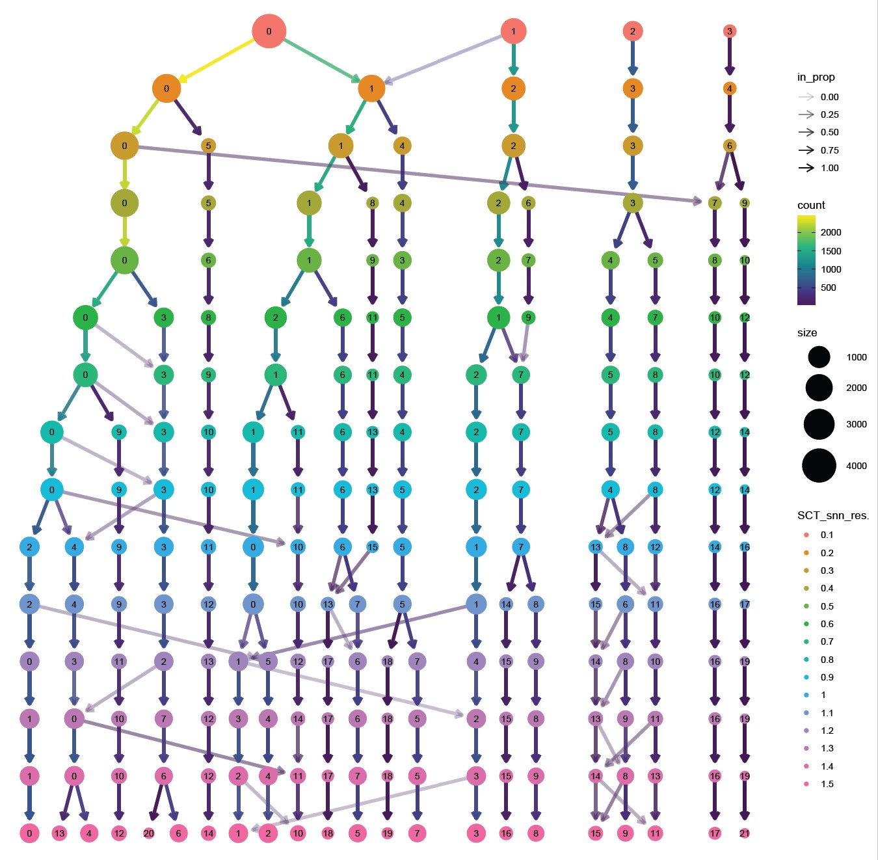
a
c
Uncultured sample
b
Ctrl sample
Gent-treated sample
d
e
f
Ctrl + Gent-treated samples
Uncultured + Ctrl + Gent-treated samples
Uncultured + Ctrl + Gent-treated samples (n=2)

