Slide 1
1013
clinical trial
Enrolled in JCOG
(n=7
41
)
Pathological material received
Endoscopic specimens
(n=
523
)
and
surgical specimens (n=136)
Assessable for
ERCC1
mRNA
(n=
426
),
TS
mRNA
(n=
449
)
with qualifiable RNA,
NCConcopanel, DNA sequence (n=124)
with qualifiable DNA,
ERCC
1
Immunohistochemistry (n=417)
Supplemental
Figure 1

Slide 2
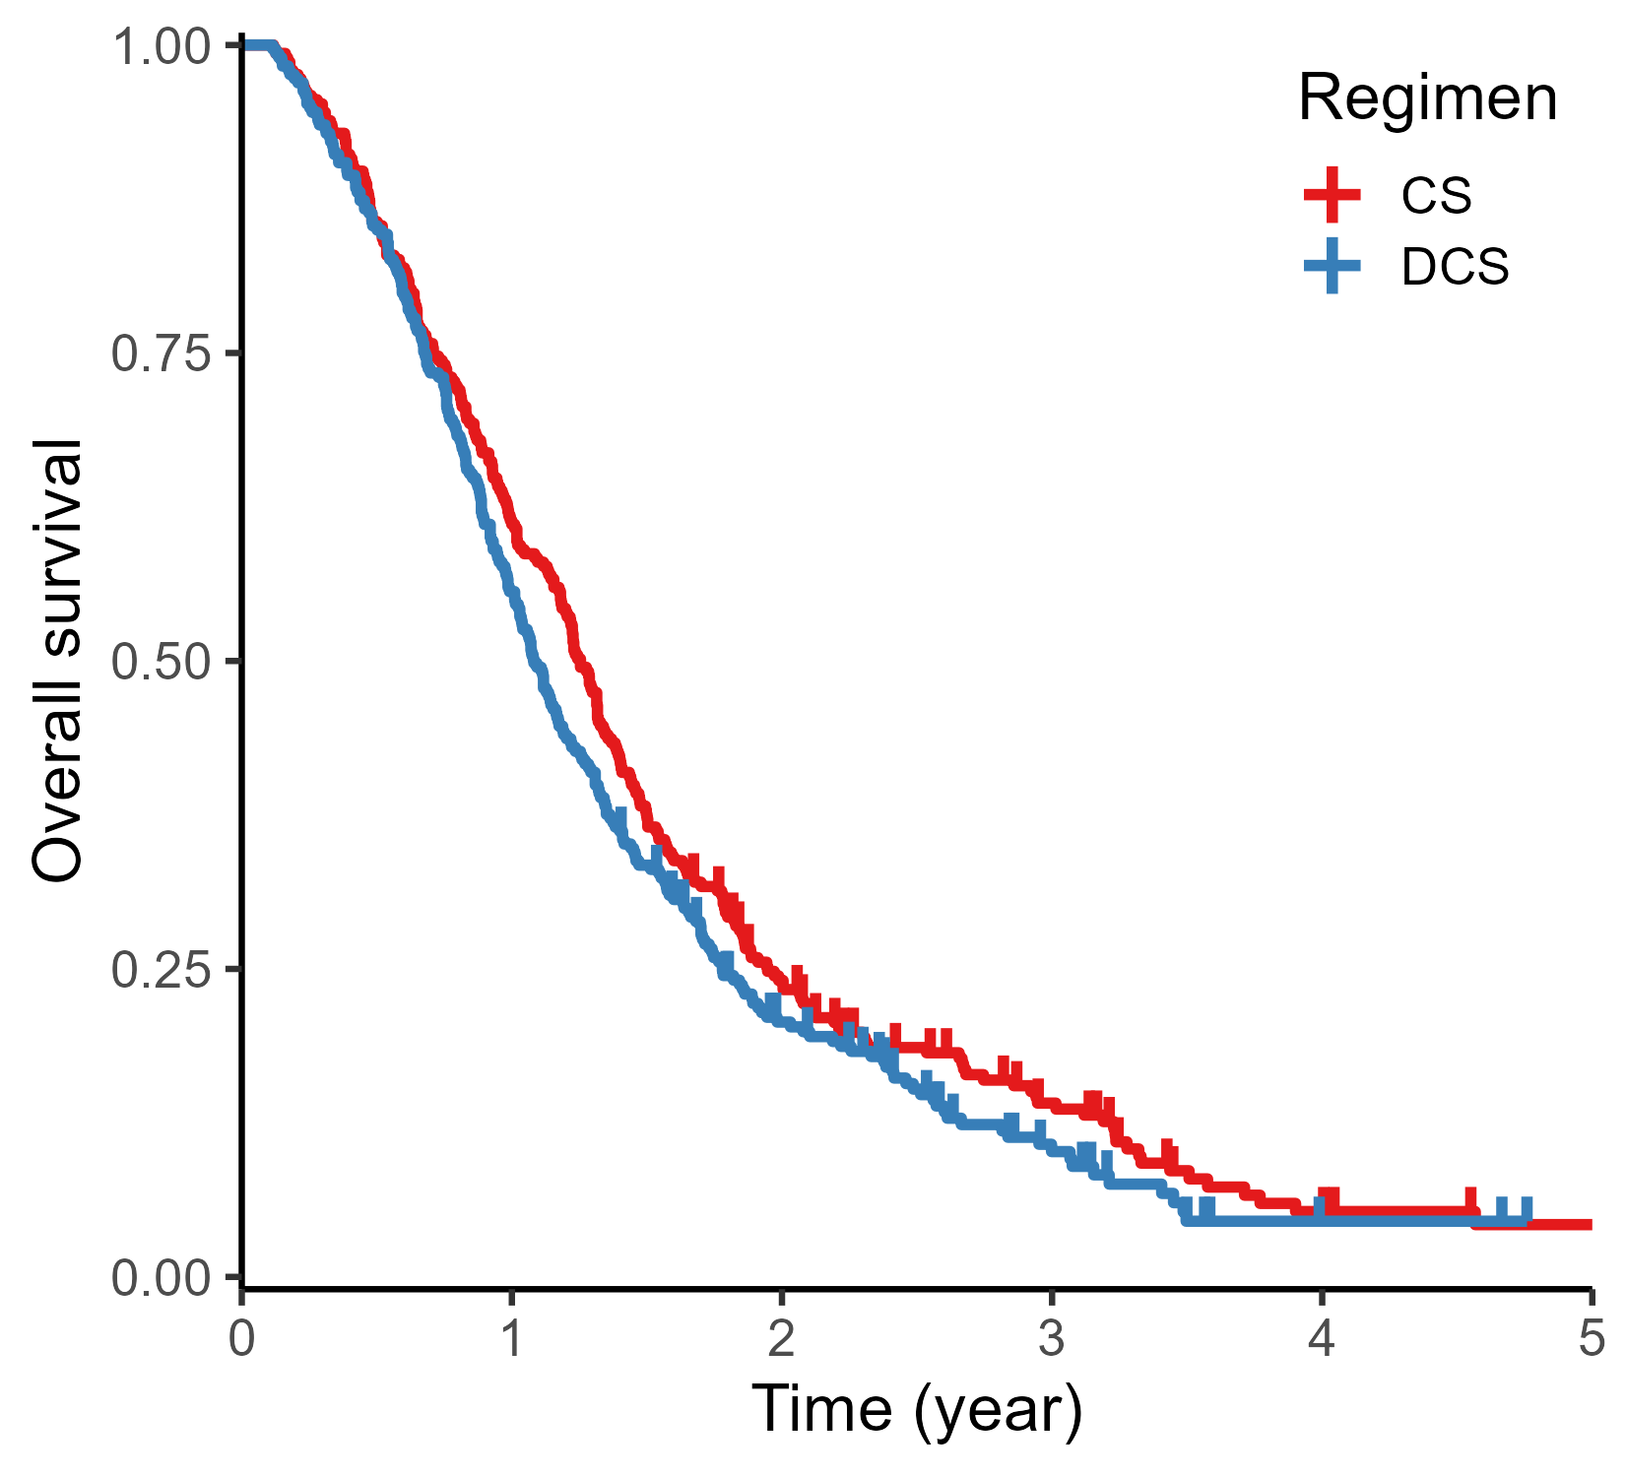
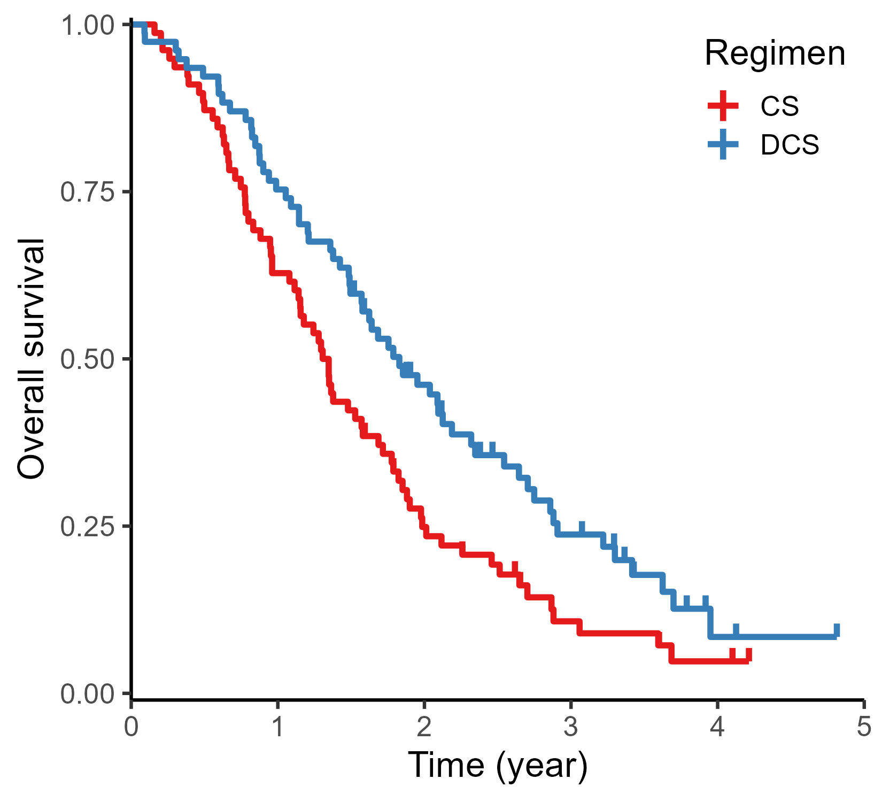
Supplemental Figure 2. Overall survival in patients with unresectable advanced or recurrent metastatic gastric cancer
a) Unresectable advanced gastric cancer (N = 586)
b) Recurrent gastric cancer after gastrectomy (N = 155)
logrank P = 0.127
HR = 1.143 [0.962, 1.358]
(DCS vs CS)
logrank P = 0.0095
HR = 0.635 [0.449, 0.897]
(DCS vs CS)
No. at risk
293 | 179 | 65 | 29 | 8 | 4
293 | 163 | 53 | 17 | 2 | 0
No. at risk
78 | 49 | 18 | 6 | 2 | 0
77 | 58 | 32 | 14 | 2 | 0
CS
CS
DCS
DCS

