Slide 1
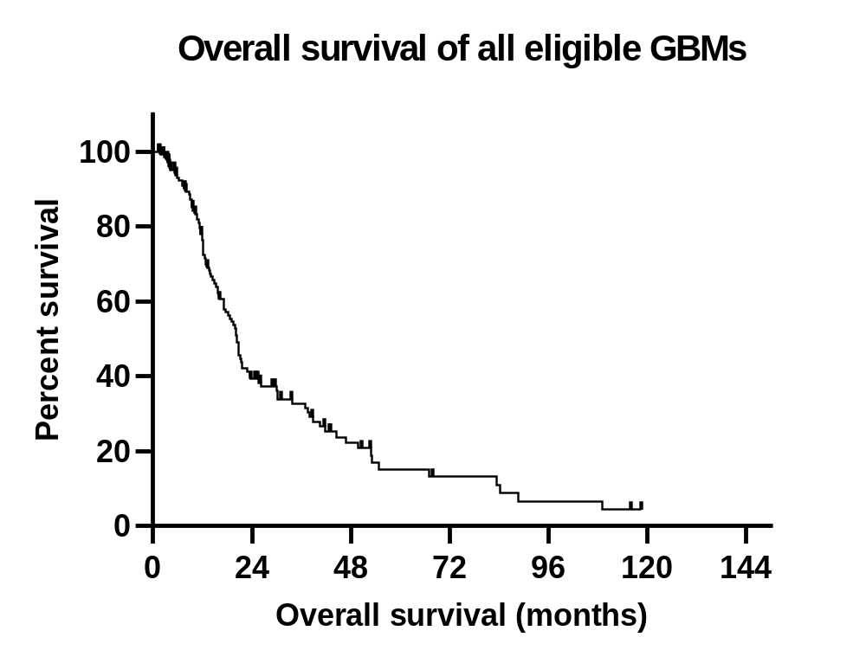
Supplement Fig 1

Slide 2
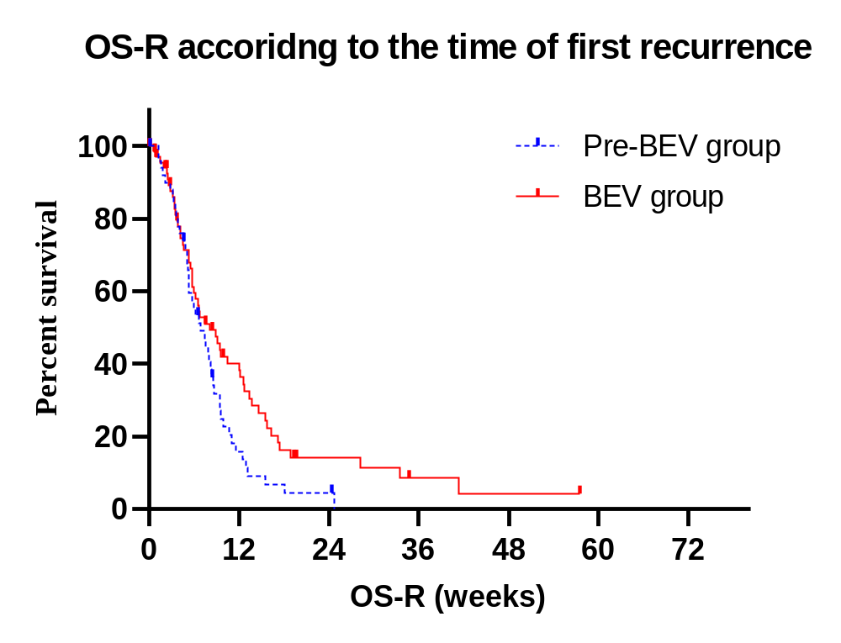
Supplement Fig 2

