Slide 1
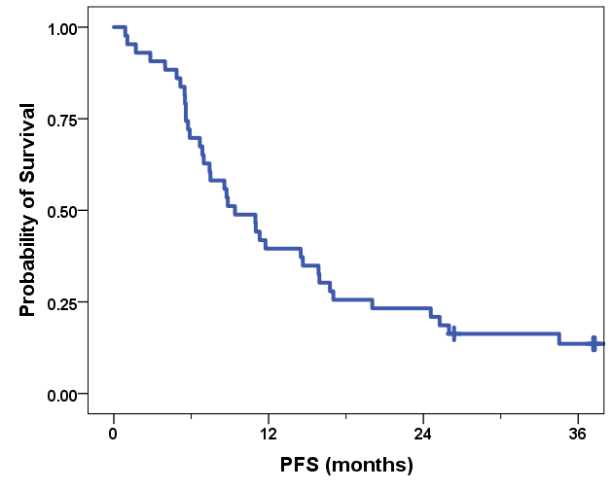
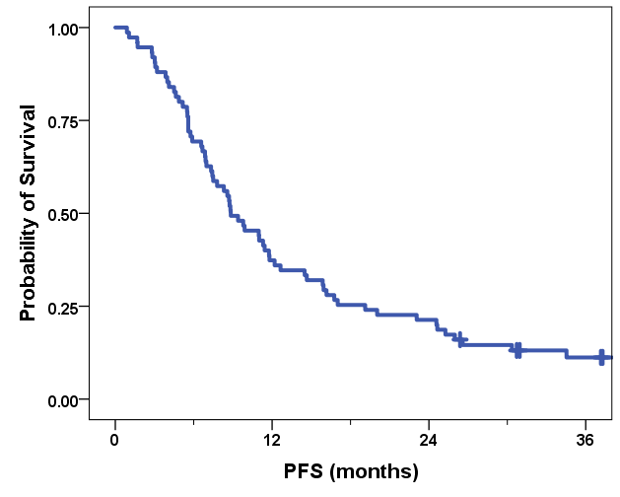
ESM 1
sHER2 ECD Cohort(N=43)
HIGHSOX (N=75)
Events: 37/43 (86.0%)
Events: 66/75 (88.0%)
mPFS: 9.4 (95%CI 6.3-12.5)
mPFS: 8.8 (95%CI 6.3-11.4)

