Slide 1
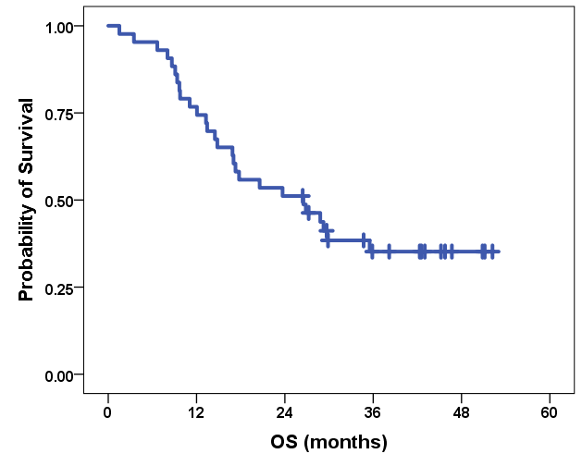
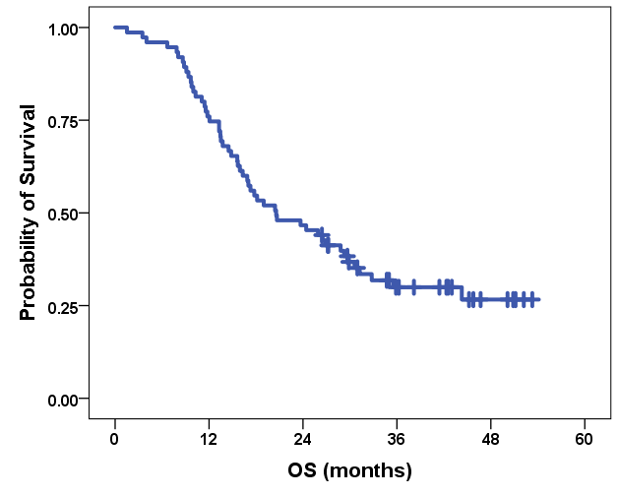
ESM 2
sHER2 ECD Cohort(N=43)
HIGHSOX (N=75)
Events:27/43 (62.8%)
Events:52/75 (69.3%)
mOS: 26.5 (95%CI 12.9-40.2)
mOS: 20.6 (95%CI 12.4-28.7)

