Slide 1
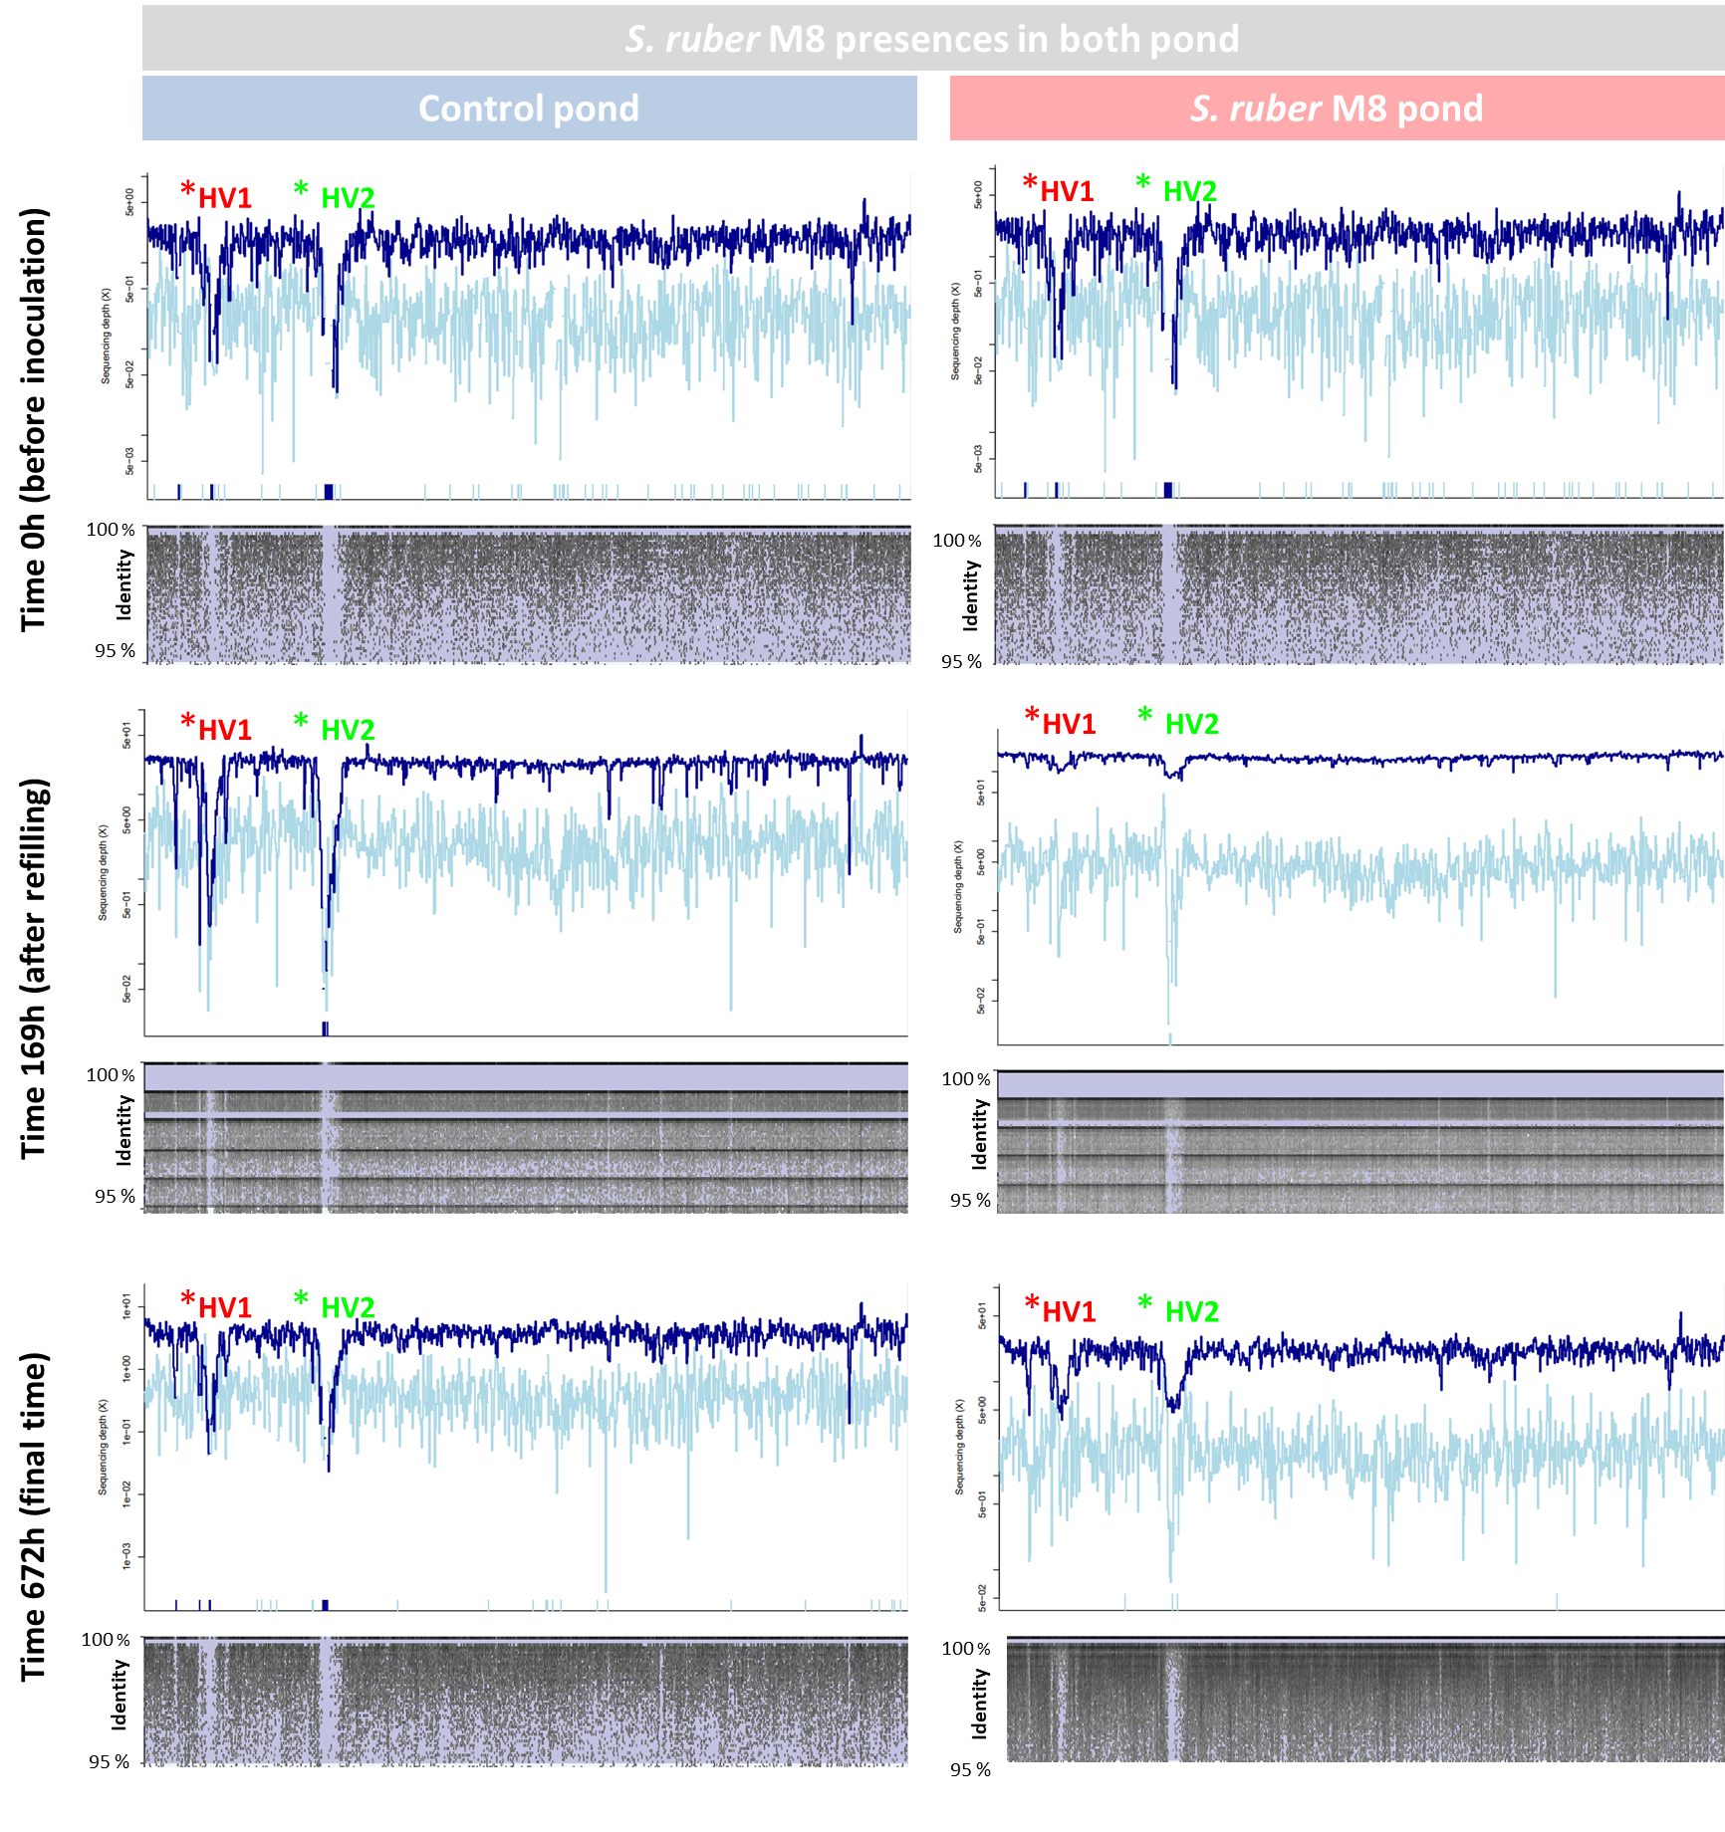
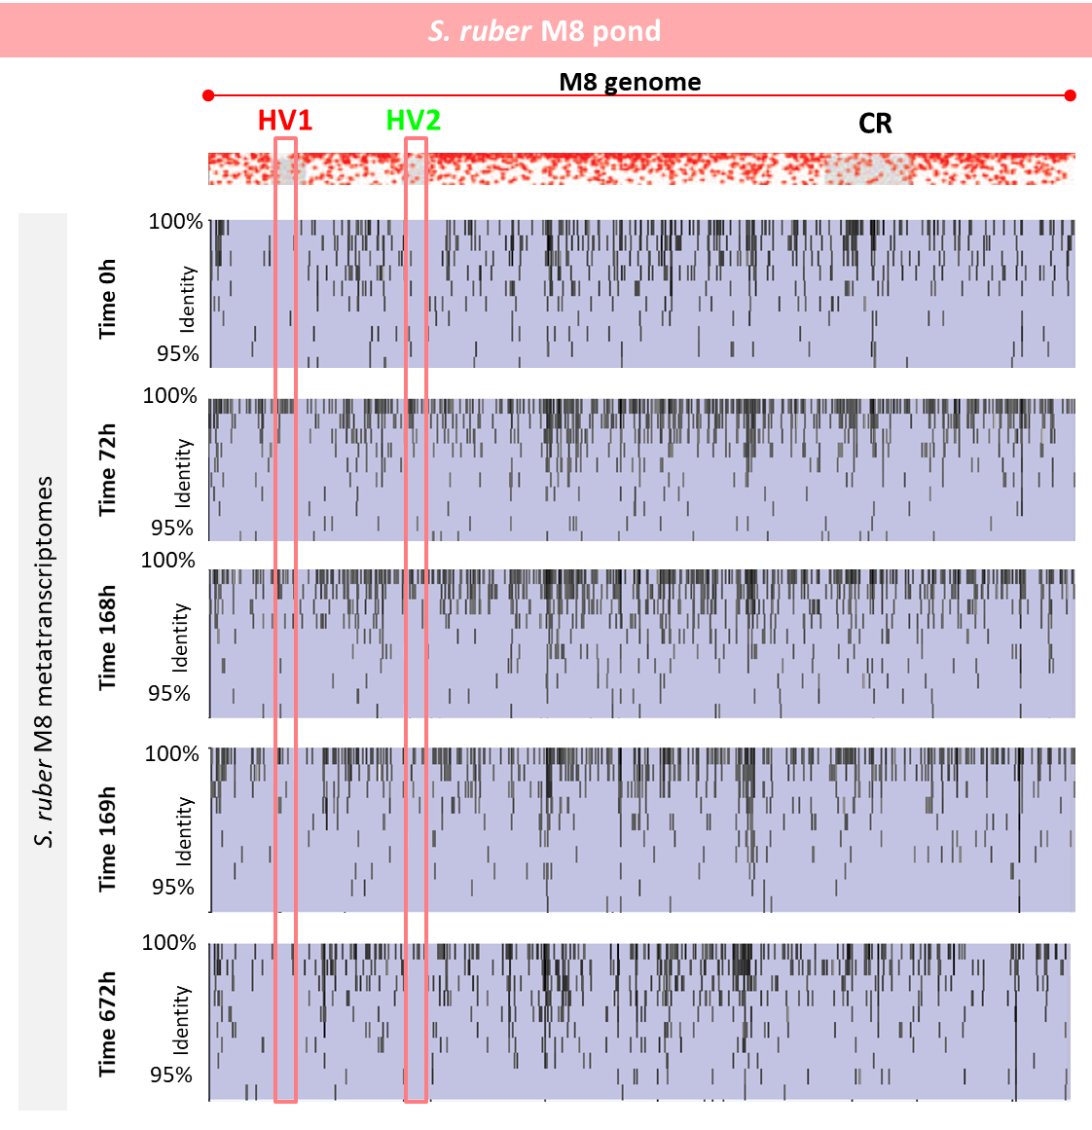
A
B
Cell metagenomes
Metatranscriptomes
Figure S1. (A) Recruitment plots of M8 genomes in the metagenomes of the control (left panels) and the amended pond (right panels) and (B) in the metatranscriptomes from the amended pond.

Slide 2
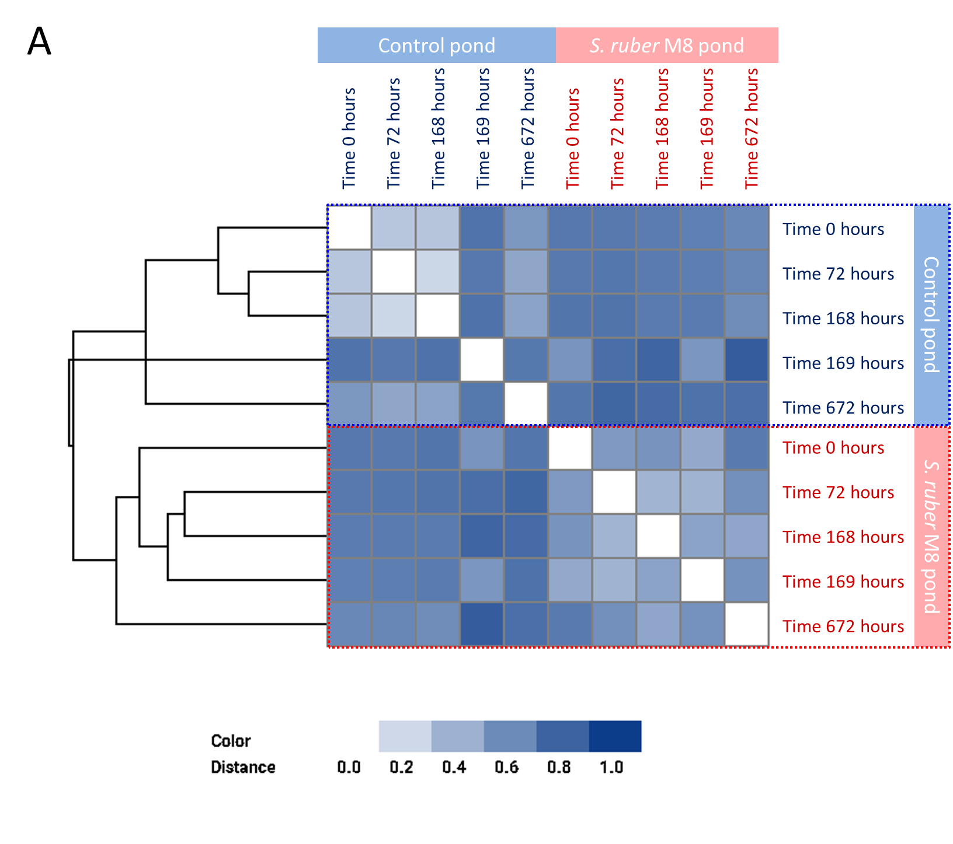
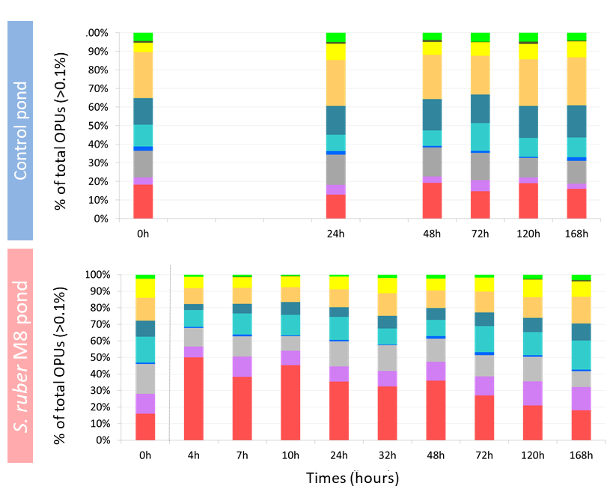
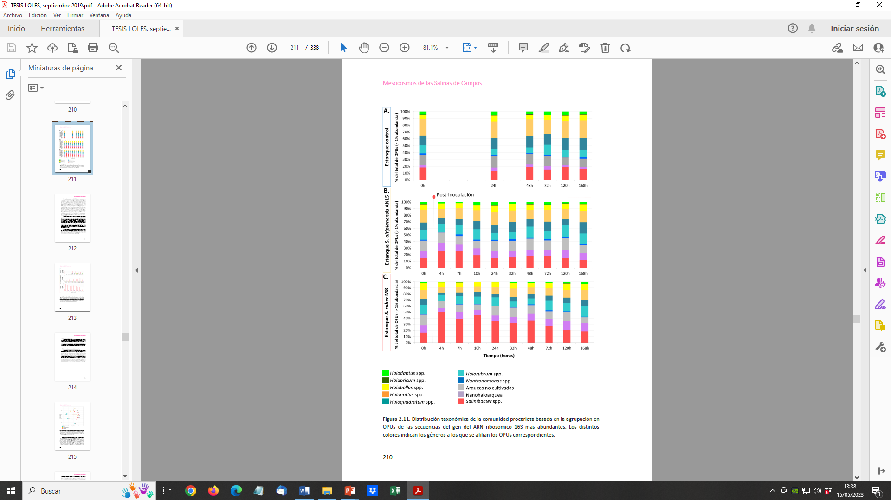
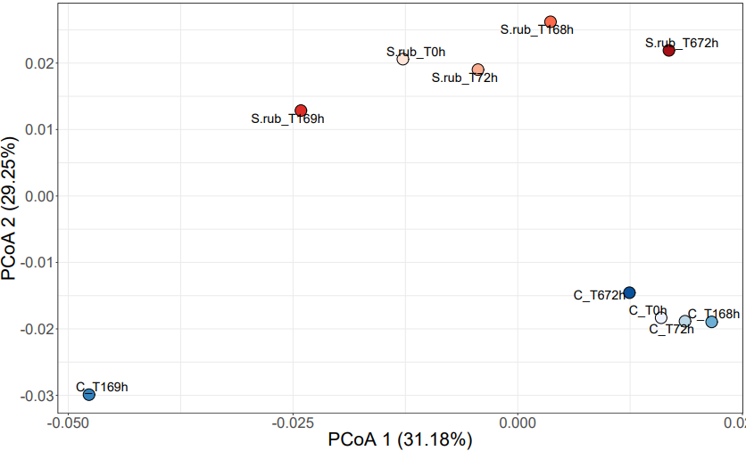
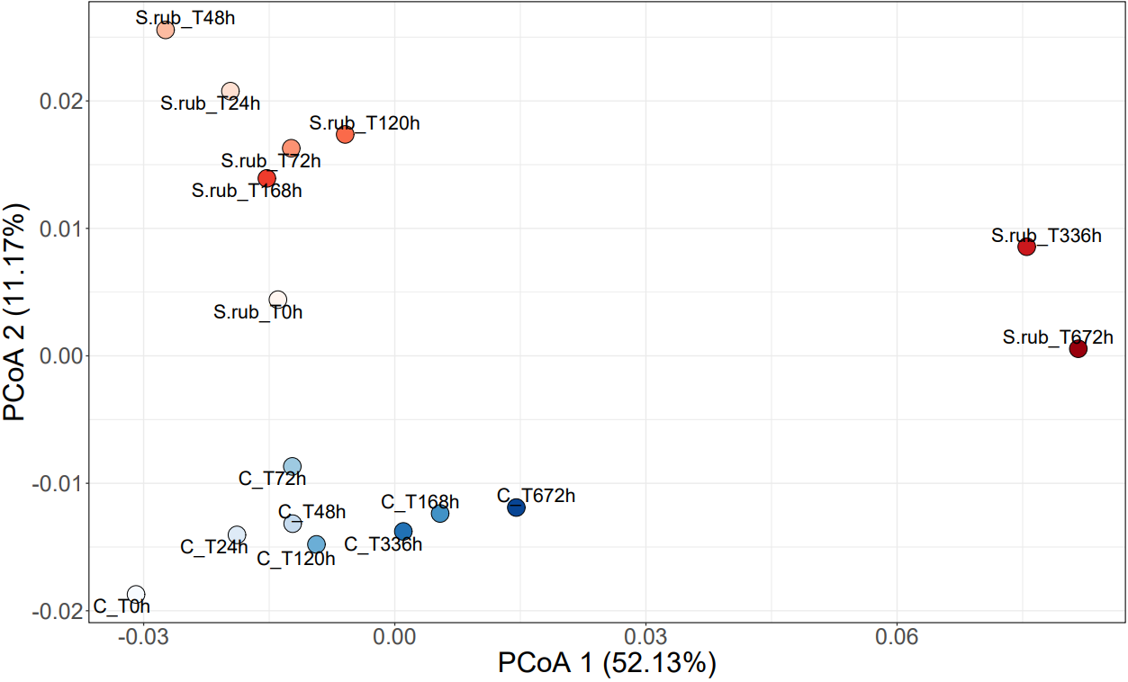
C
B
D
D
0.02
Figure S2. Dynamic of the cellular and viral communities along the experiment in the control and the amended pond. Left panel: (A) Metafast distances in the viral community (B) PCoA of viral metagenomes based on MASH distances. Right panel: (C) Taxonomic assignment of 16S rRNA based OPUs from metagenomics reads and (D) PCoA of cellular metagenomes distances.

Slide 3
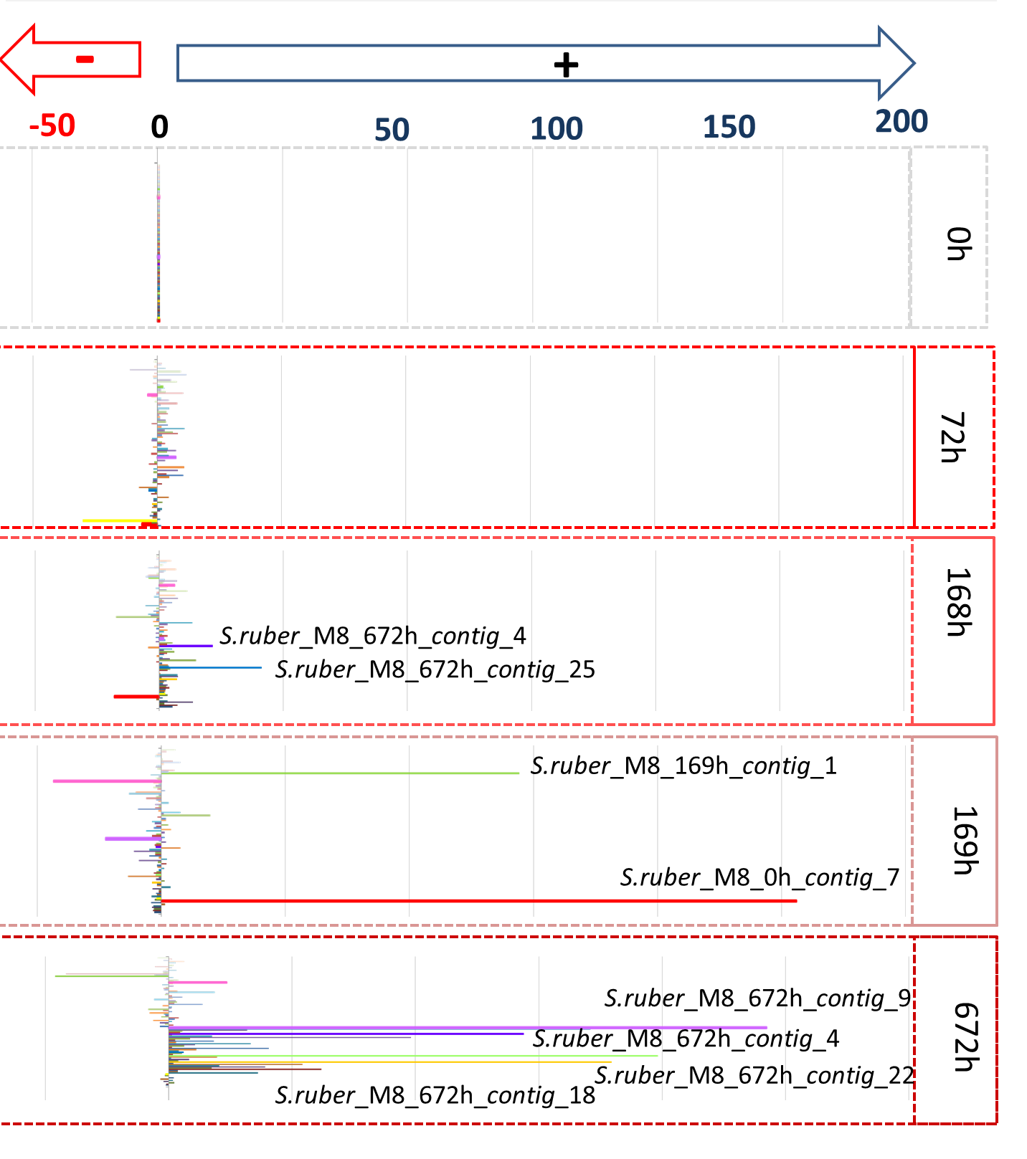
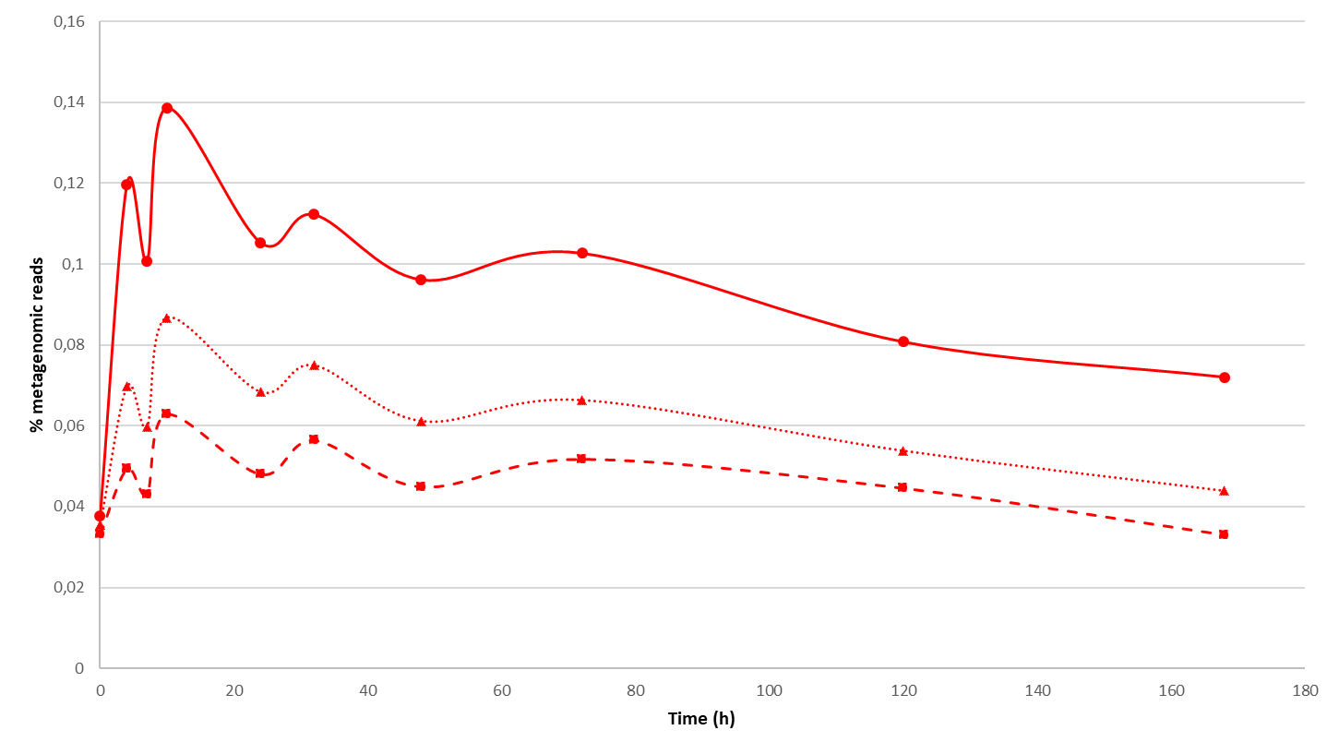
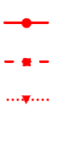
THIS FIGURE IS BEING IMPROVED
A
B
All Sal. ruber integrases
Hits to M8 integrases 99% id, 90% coverage removed
Hits to M8 integarses 100% ide, 100% coverage removed
Figure S3. Tracking Piggyback-the-Winner (PbtW) and Kill-the-Winner (KtW) dynamics during the experiment. According to PbtW, the addition of M8 to the pond should drive the integration of viruses into its genome while KtW predicts an increase of M8 infecting viruses in the extracellular fraction as a result of lytic infection. (A) PbtW was followed as in Knowles et al., (2016) by estimating the abundance of Salinibacter ruber integrases in the cellular metagenomes during the experiment in the M8 pond, considering different levels of identity and coverage against Sal. ruber M8 integrases (integrases present in M8 genome must not be considered since their increase in the metagenome is not related to virus integration but with the increase of M8). The observed increase of integrases was coincident with the dynamics of M8 in the pond and only a very modest and transient increase of integrases not belonging to the M8 genome was observed in the cellular community. This does not provide evidence of PbtW, but may be compatible with a modest and transient PbtW dynamics only in the very first stages after the addition of M8 to the pond. (B) KtW was estimated by monitoring, after the addition to M8 to the pond, changes in abundance in the extracellular viral metagenome of contigs that could be assigned to Sal. ruber. Viral contigs were retrieved from the viral metagenomes of both the control and the amended pond (Dataset S1) and their relative abundances during the experiment were calculated. Only contigs larger than 10 Kb whose relative abundances increased 50-fold in the M8 pond (the largest foldchange detected in the control pond) and were not introduced to the system during the refill were selected for further study. Among them, only 10 showed a relative abundance pattern that could be related to the decrease of Sal. ruber M8 strain. However, except their relatively high GC content, genomic analyses did not unveil any trait (e.g. CRISPR protospacers, tRNAs, etc.) that could unambiguously identify them as infecting Sal. ruber. This was also confirmed by the taxonomic assignment of the annotated genes, which largely corresponded to haloarchaea and their viruses. In addition, GC content did not increase in the viral metagenome from the M8 pond (Table 1), as one would have expected if an increase of Sal. ruber viruses had occurred.

Slide 4
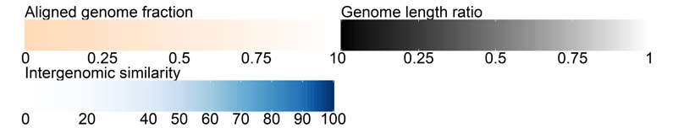
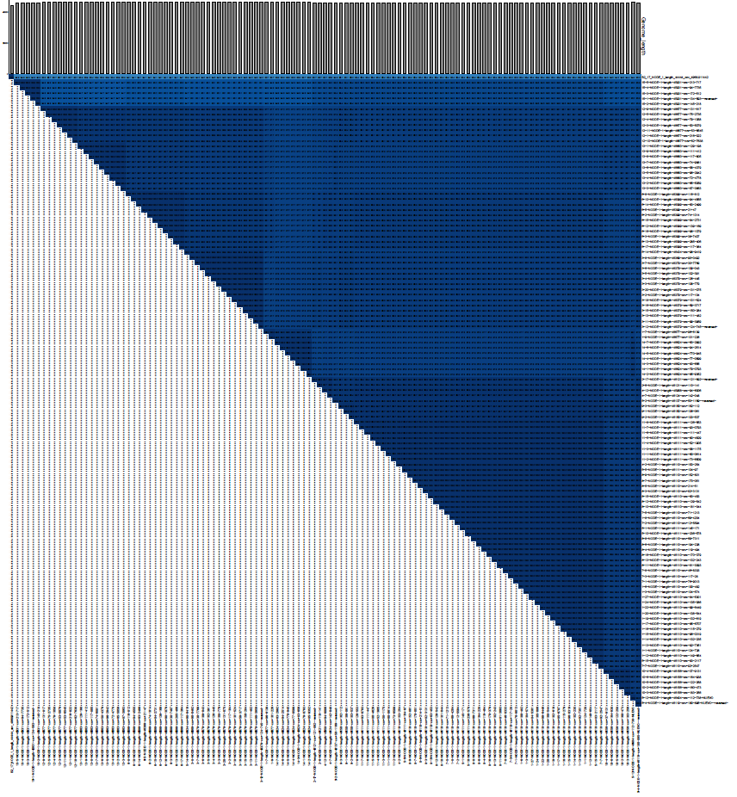
Figure S4. VIRIDIC comparison (based on BLASTn) of the 120 non redundant viral genomes isolated in the experiment showing that they constitute two viral species according to intergenomic similarity (colored according to the scale on top). A threshold of 95% intergenomic similarity was chosen for species delineation, according to the ICVT criteria. The arrow points to virus B2.17

Slide 5
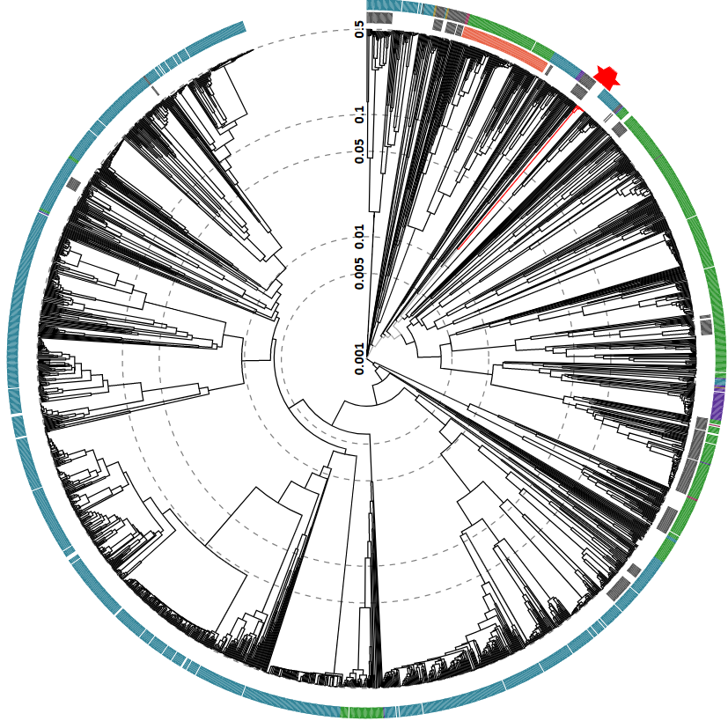
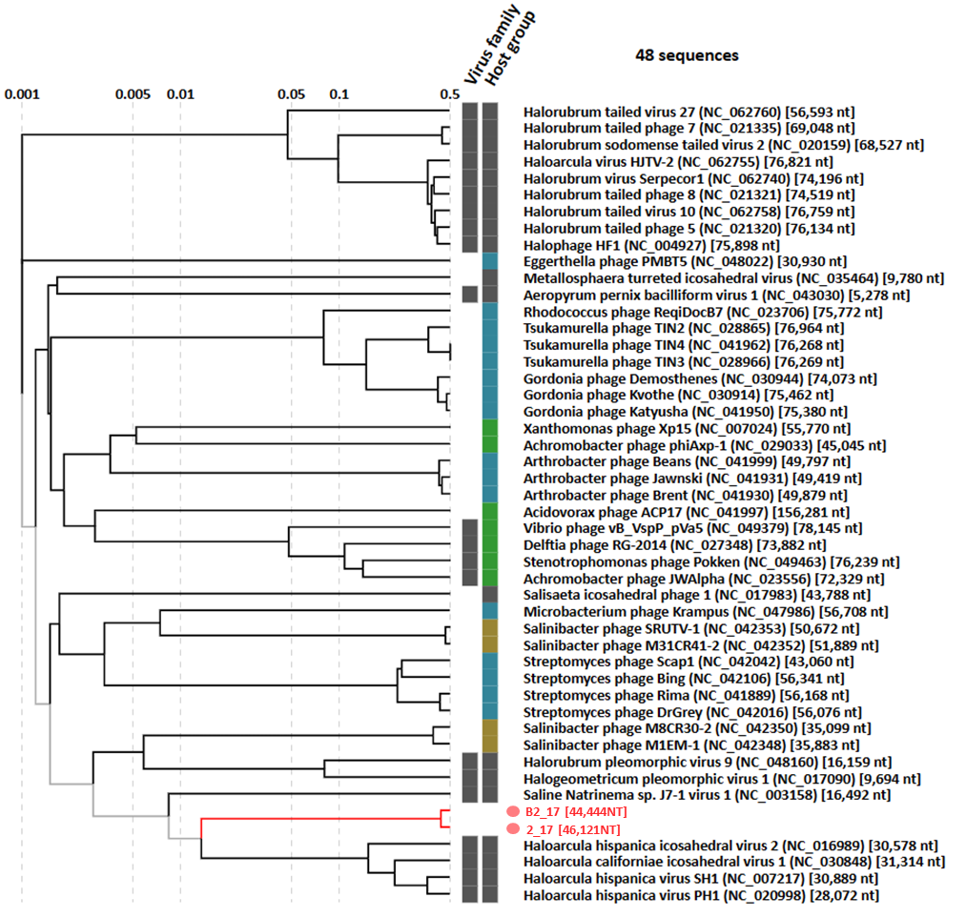
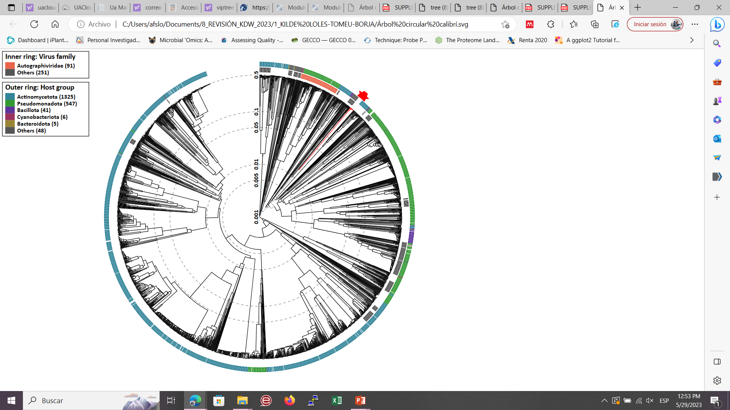
Salinibacter spp. viruses
Phoenicisaliniviruses
Figure S5. Proteomic tree calculated with VIPTREE of representatives of the two Phoenicisalinivirus species. Left panel: overview of the complete tree showing the position of the previously isolated viruses infecting Sal. ruber (red dots). Right panel: a closer look at the position of Phoenicisaliniviruses in the tree.

Slide 6
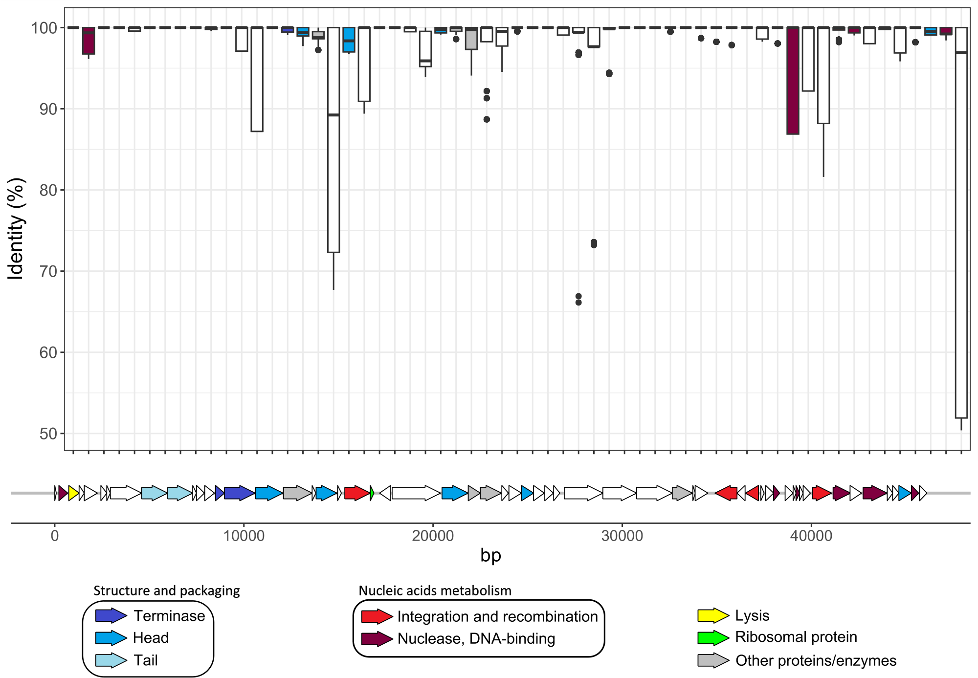
Figure S6. Diversity of Phoenecisalinivirus isolates. At the top, boxplot of the identity between the reciprocal best match genes of the 9 representative genomes of P. gimnesias. Each boxplot represent a gene and they are ordered as they appear in virus 9_3, represented at the bottom. Color indicates the function (see legend).

Slide 7
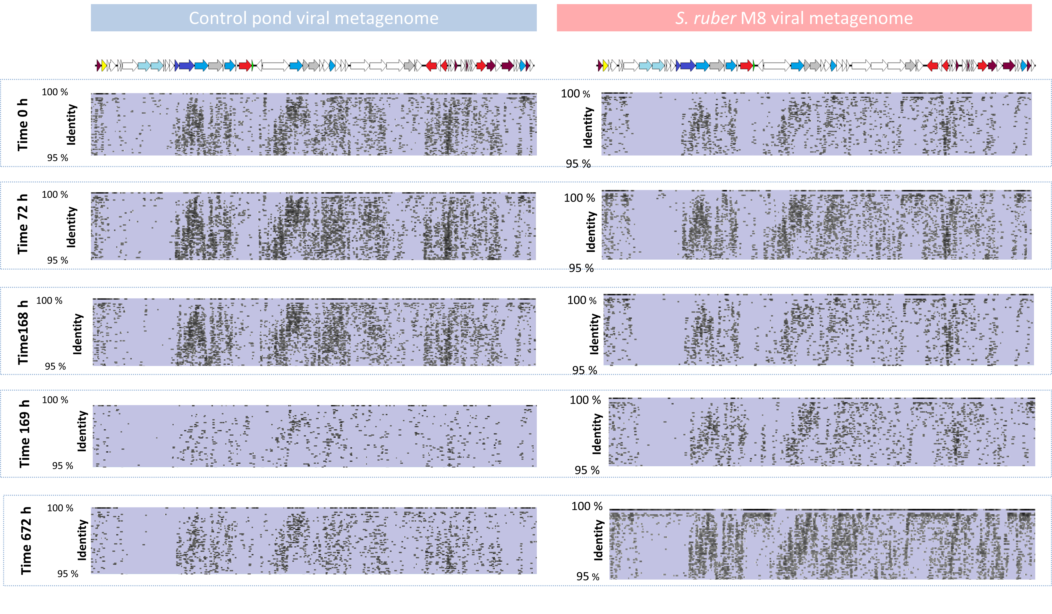
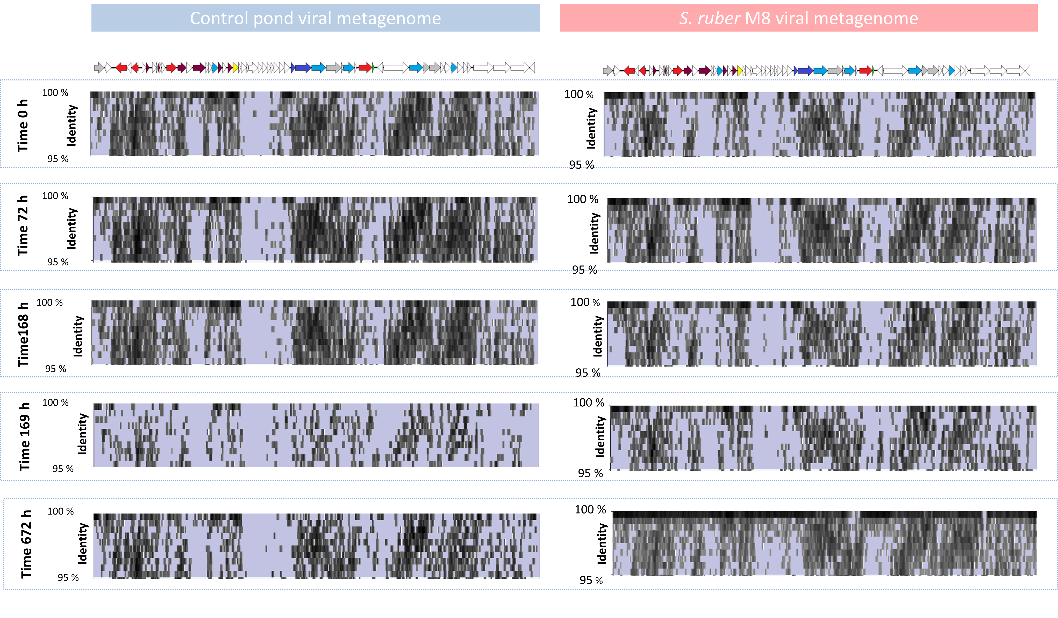
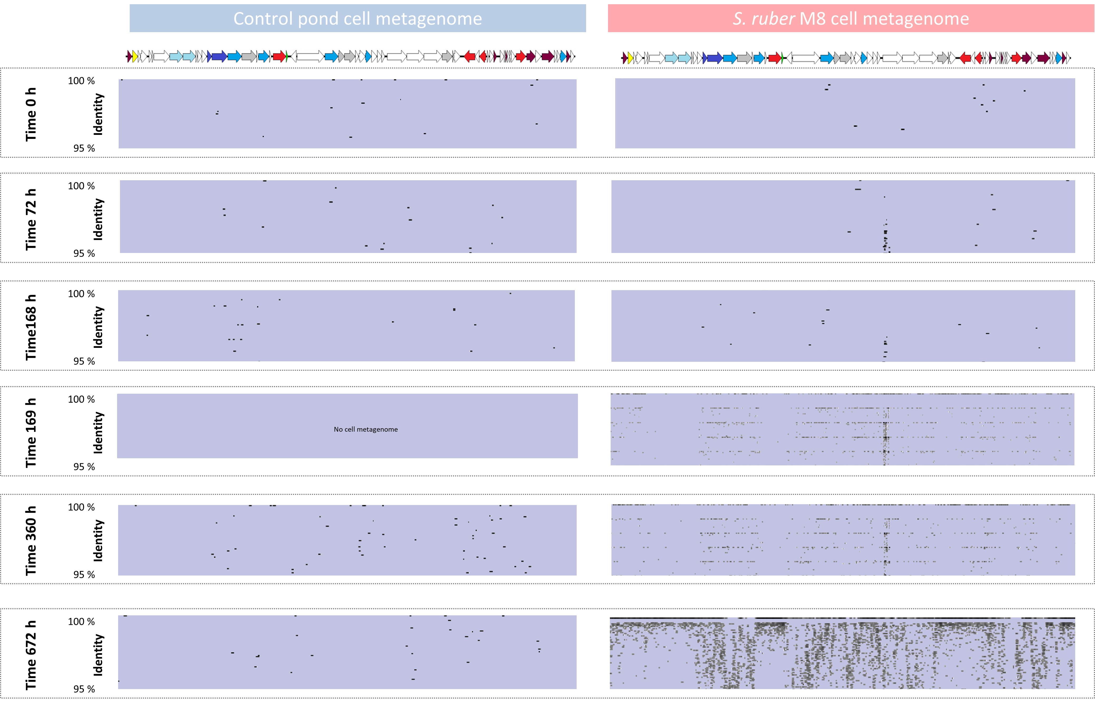
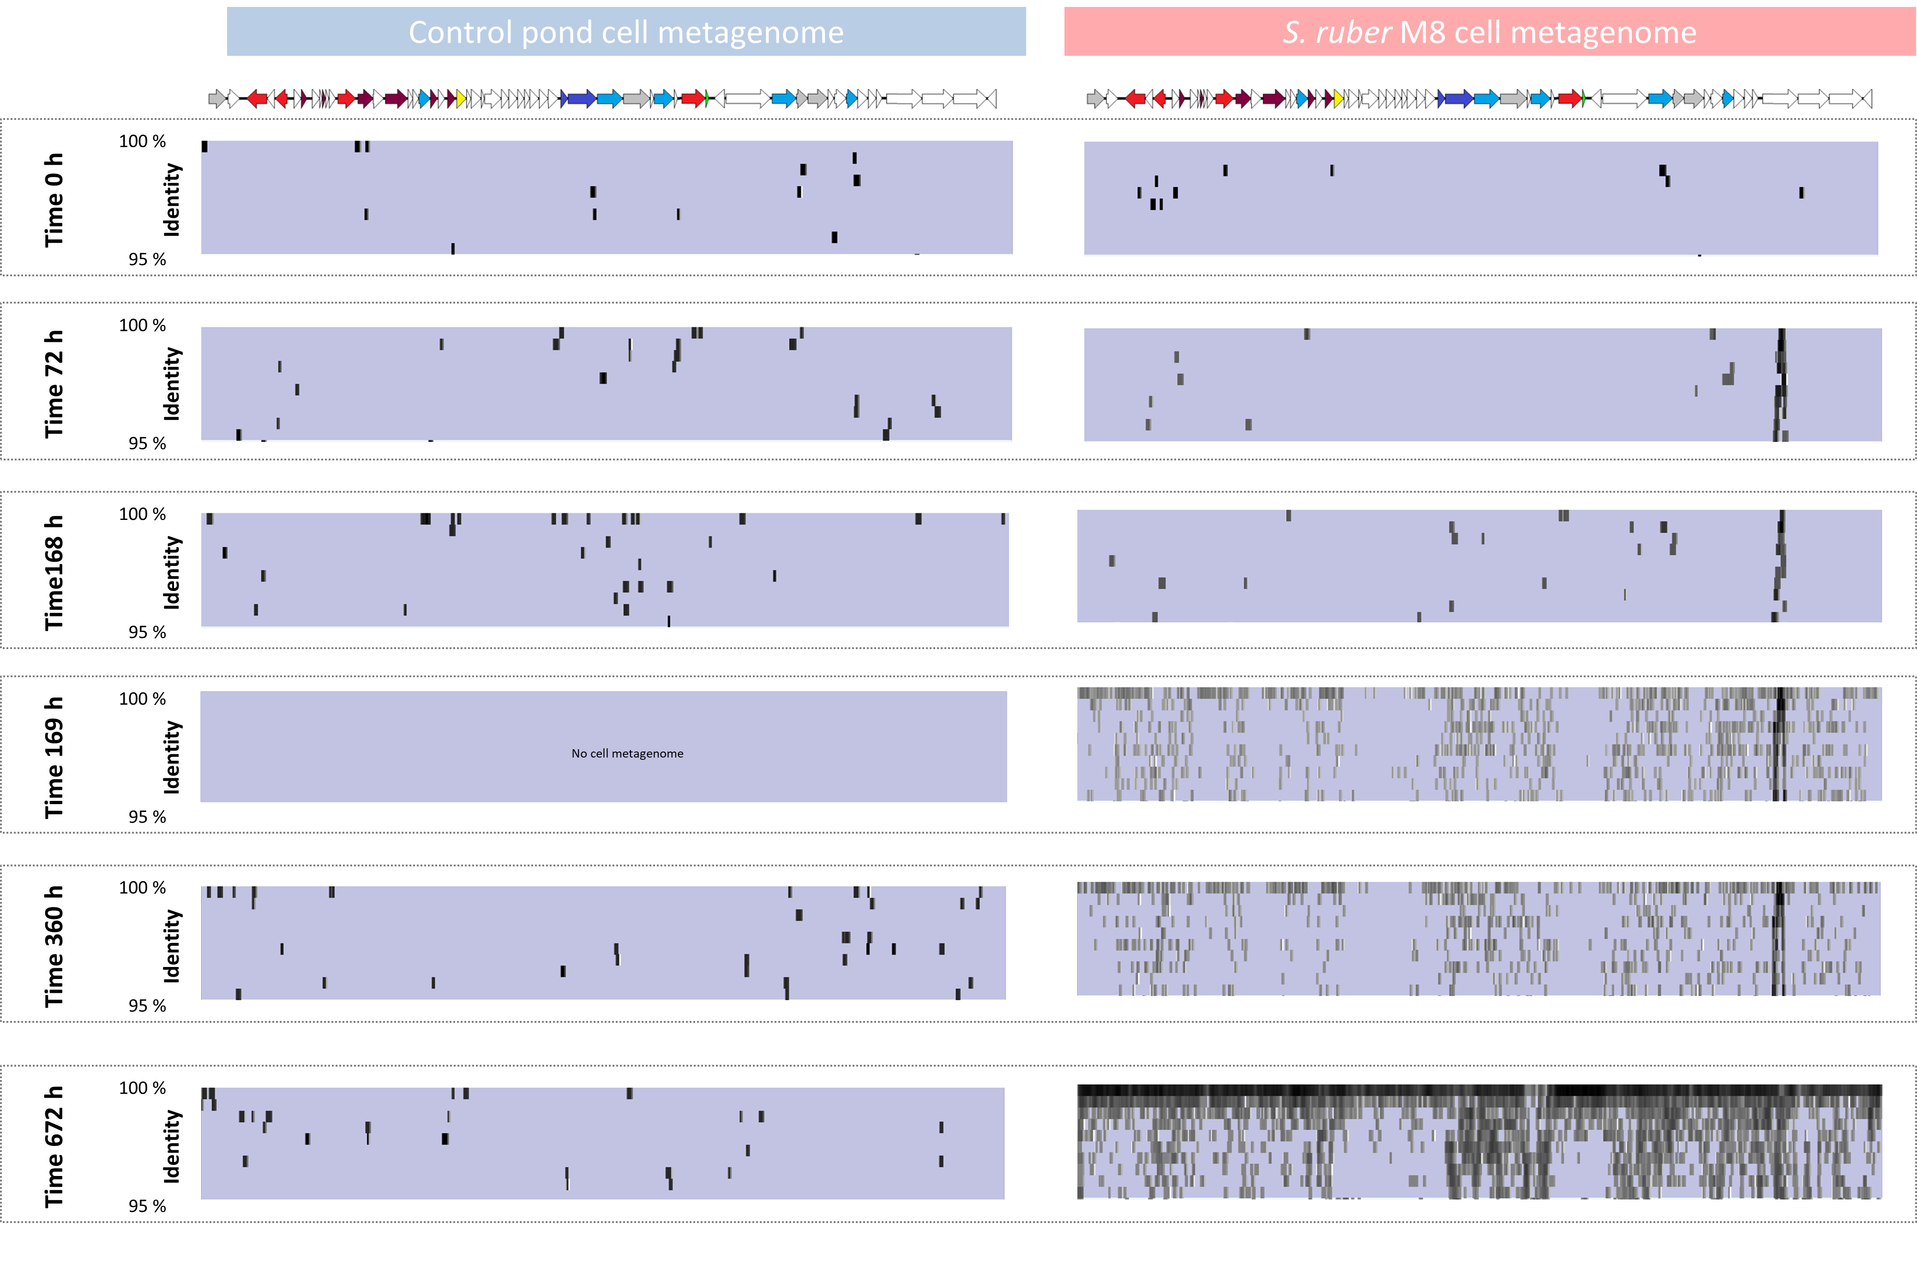
P. gimnesias (virus 1_7)
P. balearicum (virus B2_17)
Viral metagenomes
Viral metagenomes
Cell metagenomes
Cell metagenomes
Figure S7. Dynamics of the two Phoenicisalinivirus species in the control pond (blue background) and the M8 amended (red background) pond. The recruitment of the genomes against the cellular (MG) and the viral (MV) metagenomes is shown. Left panel: recruitment of P. gimnesias Right panel: P. balearicum ”.

Slide 8
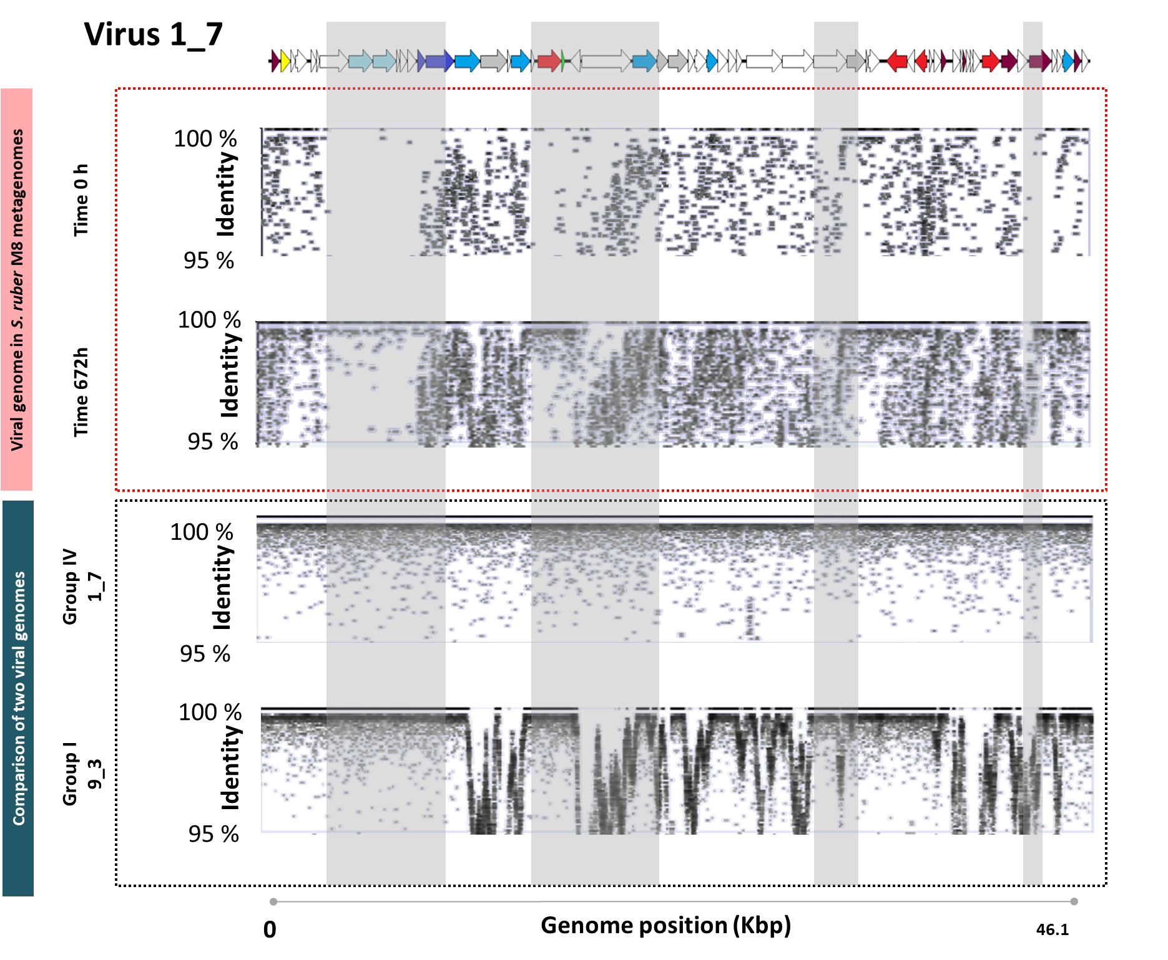
*
Figure S8. Comparison of metagenomic and genomic islands for P. gimnesias. Upper panel: viral metagenomic read recruitment against one P. gimnesias genome at the begining and the end of the experiment (the island including tail fiber coding genes is marked with an asterisk). Lower panel: comparison of two viral genomes within the virus family (reads for each genomic sequence are recruited against virus 1_7 assembled genome).

Slide 9
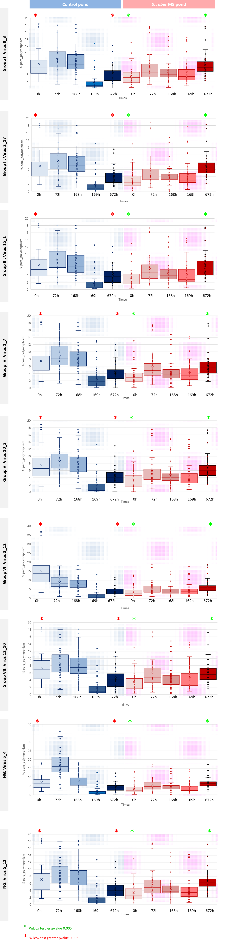
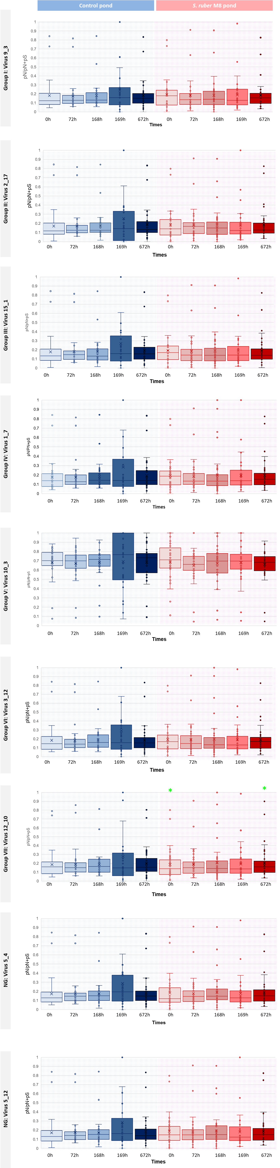
SNPs
pN/pN+pS
Figure S9. Analyses of SNPs (left) and pN/pN+pS (right) along the experiment of P. gimnesias genomes (one viral genome for each of the 9 groups is shown). Asterisks indicate whether there is a significative (Wilcox test p value <0.005) increase (green) or decrease (red) in the calculated parameters. All changes are against time zero values.

Slide 10
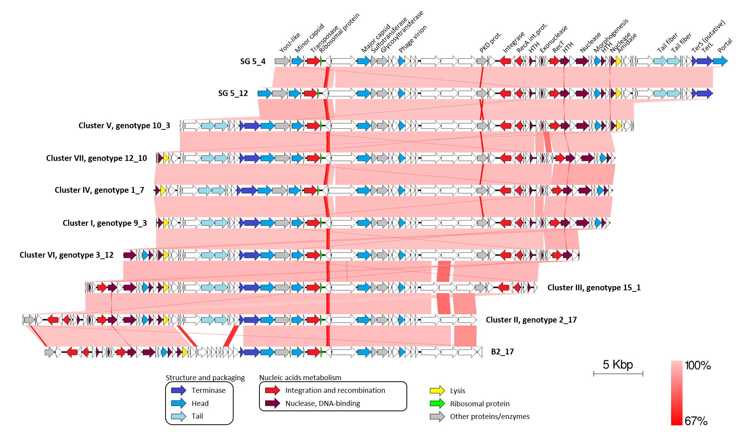
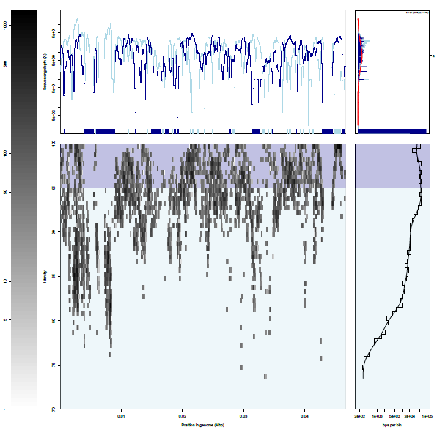
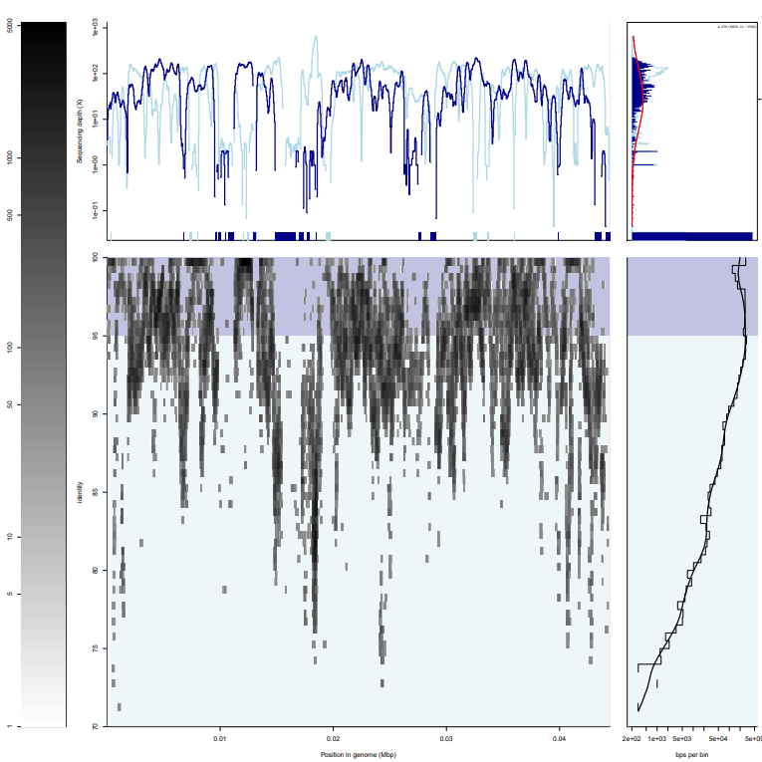
Virus 1_7
Virus B2_17
Figure S10. Persistence of Phoenicisalinivirus in the system. Recruitment of one genome of each species (left: P. gimnesias; right: P. balearicum against viral metageomic reads from a crystallizer pond from the Campos salterns taken in 2019. Viral genomes are as in Figure 3.

