Slide 1
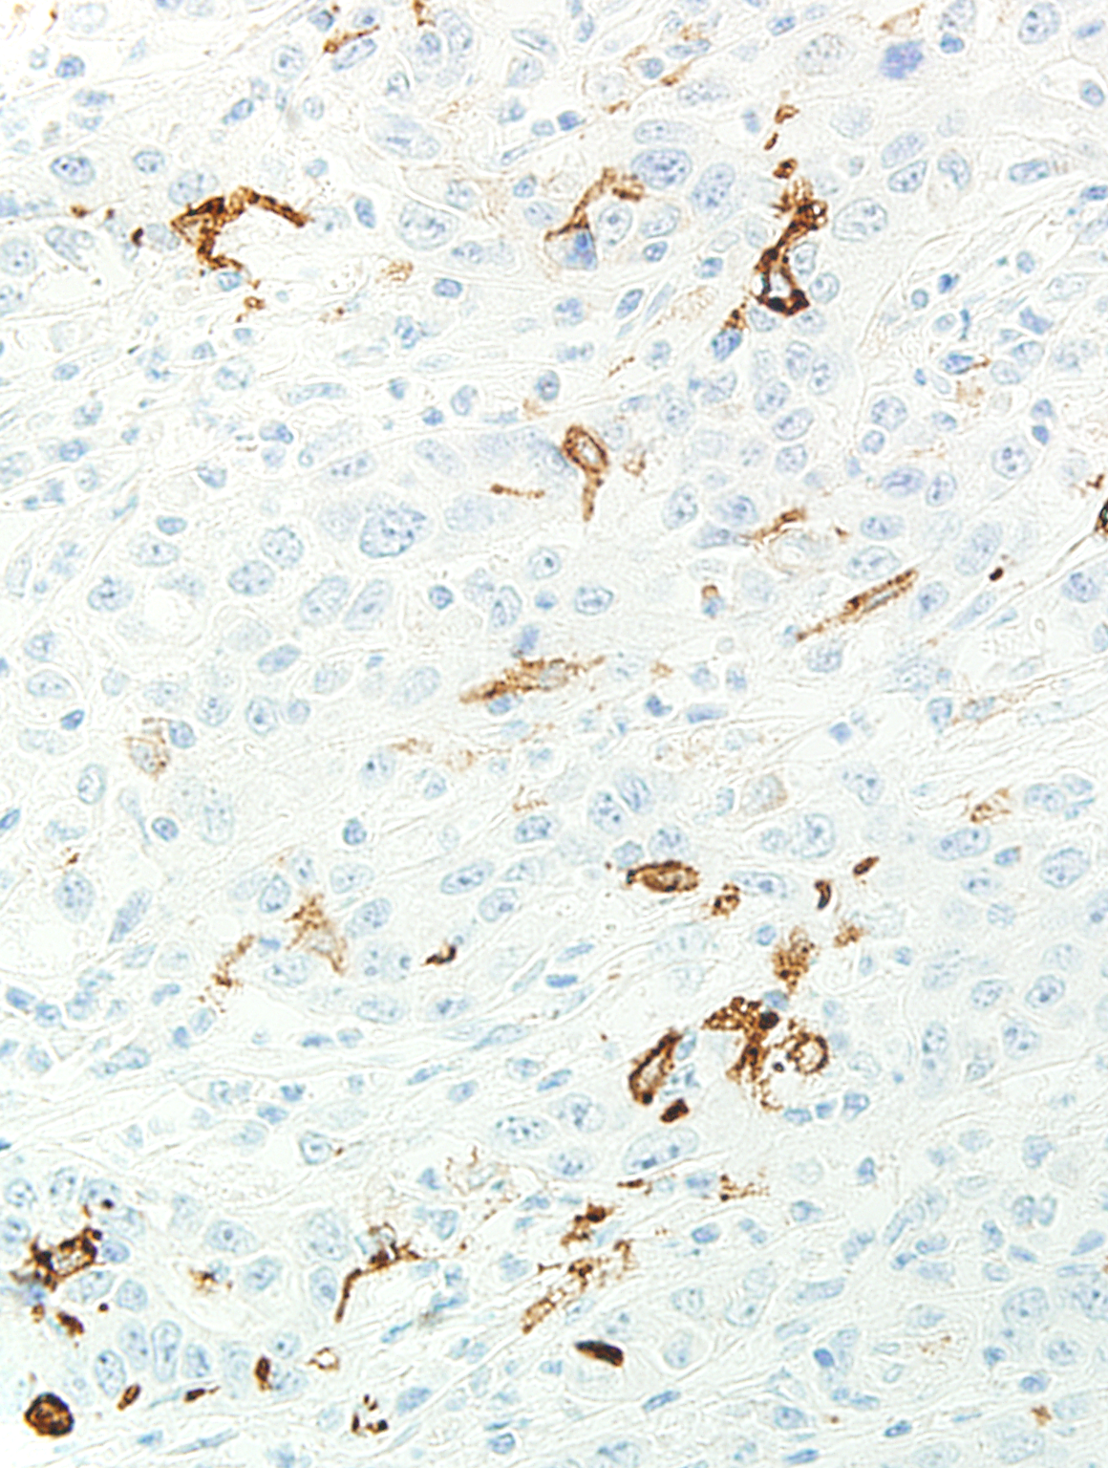
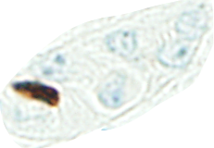
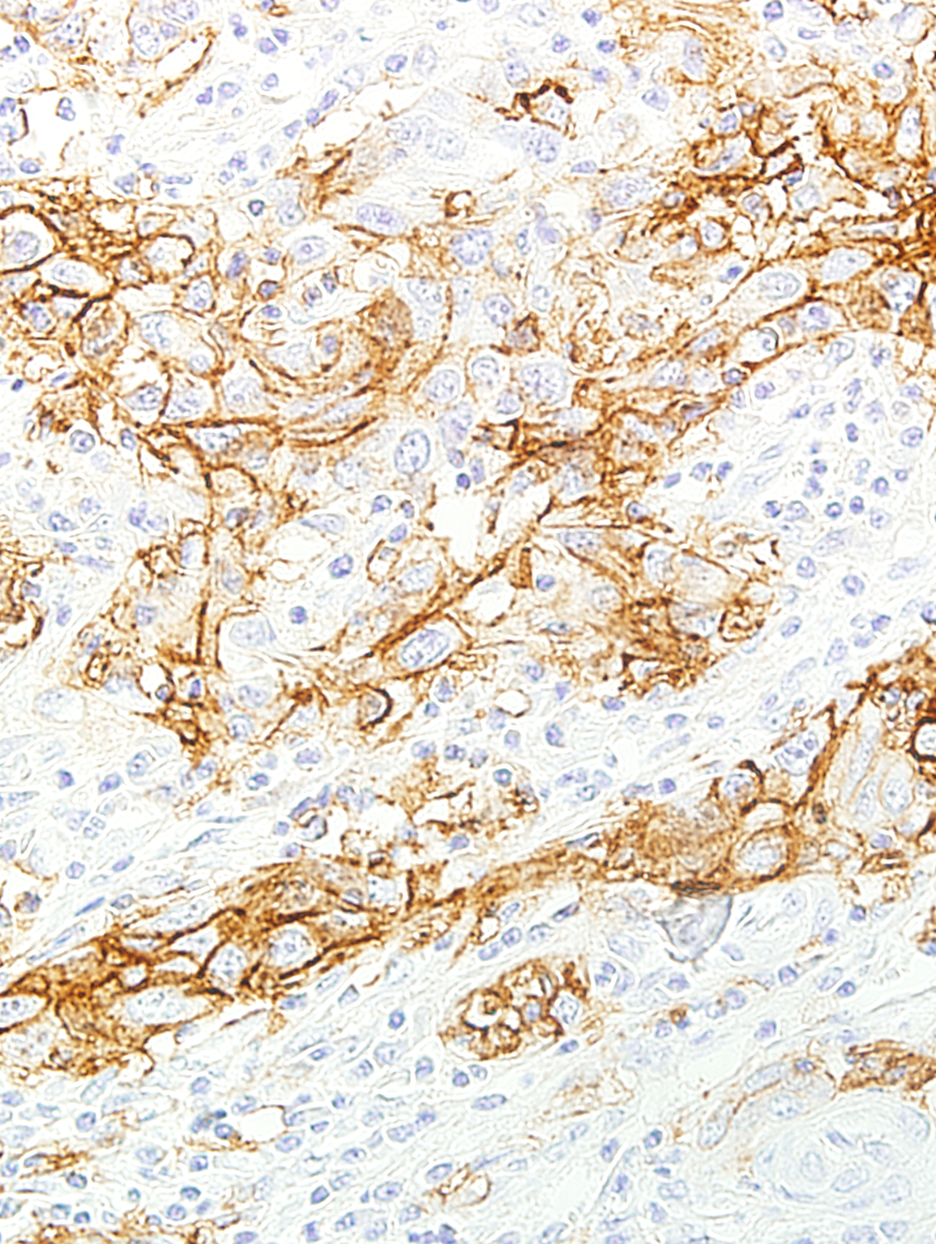
Supplement figure 1
a
b
c
d
Supplement figure 1. Methods for counting the number of positive dendritic cells (DCs) infiltrating within tumor nests of intrahepatic cholangiocarcinoma.
(1a) Immunostaining of CD1a in intrahepatic cholangiocarcinoma. Note that almost all positive DCs are present within tumor nests. (1b) The number of CD1a-positive DCs (white arrows) was counted within tumor nests excluding tumor lumen and stroma (shaded area by blue lines). (1c) Immunostaining of CD44 variant 9 (CD44v9) in intrahepatic cholangiocarcinoma. Note that almost all tumor cells forming tumor nests/nodules are positive for CD44v9 on their cell membrane. (1d) Immunostaining of CD1a on serial section of (1c). The number of CD1a-positive DCs (white arrows) within tumor nests expressing CD44v9 excluding tumor lumen and stroma (shaded area by blue lines) was counted.

