Slide 1
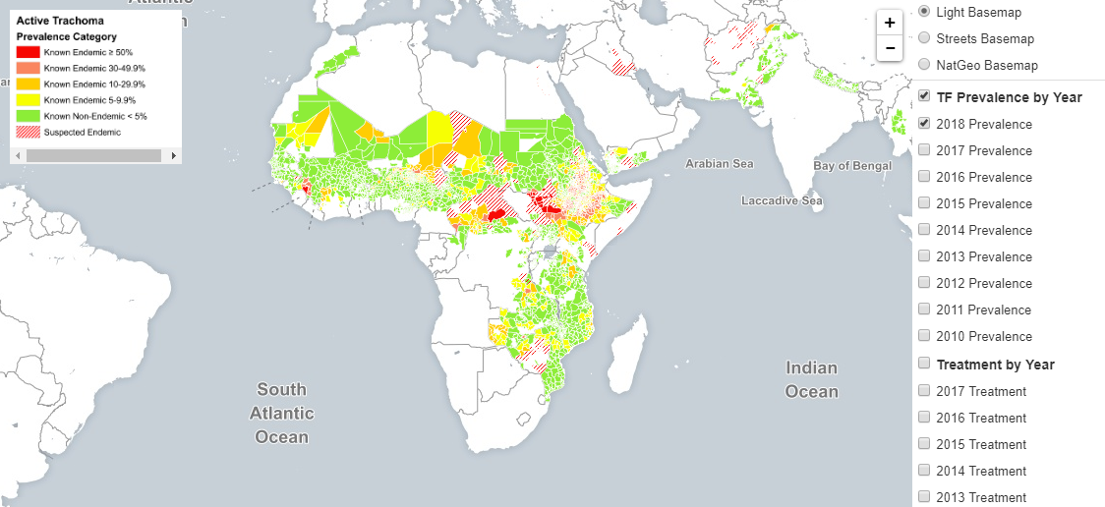
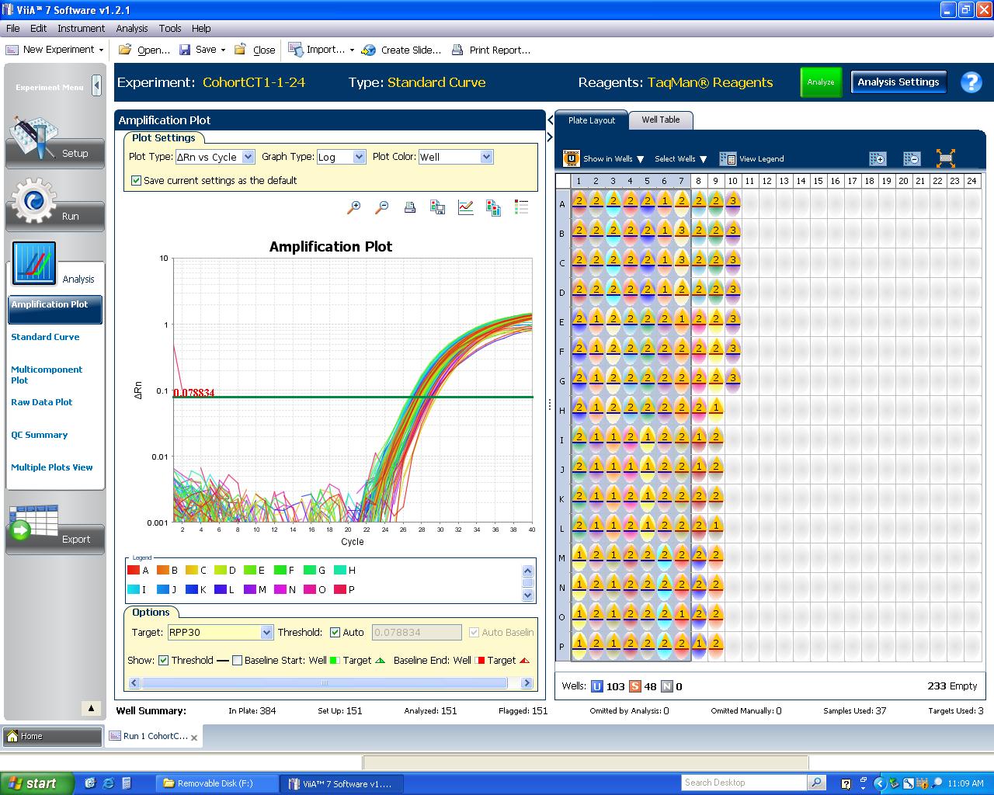

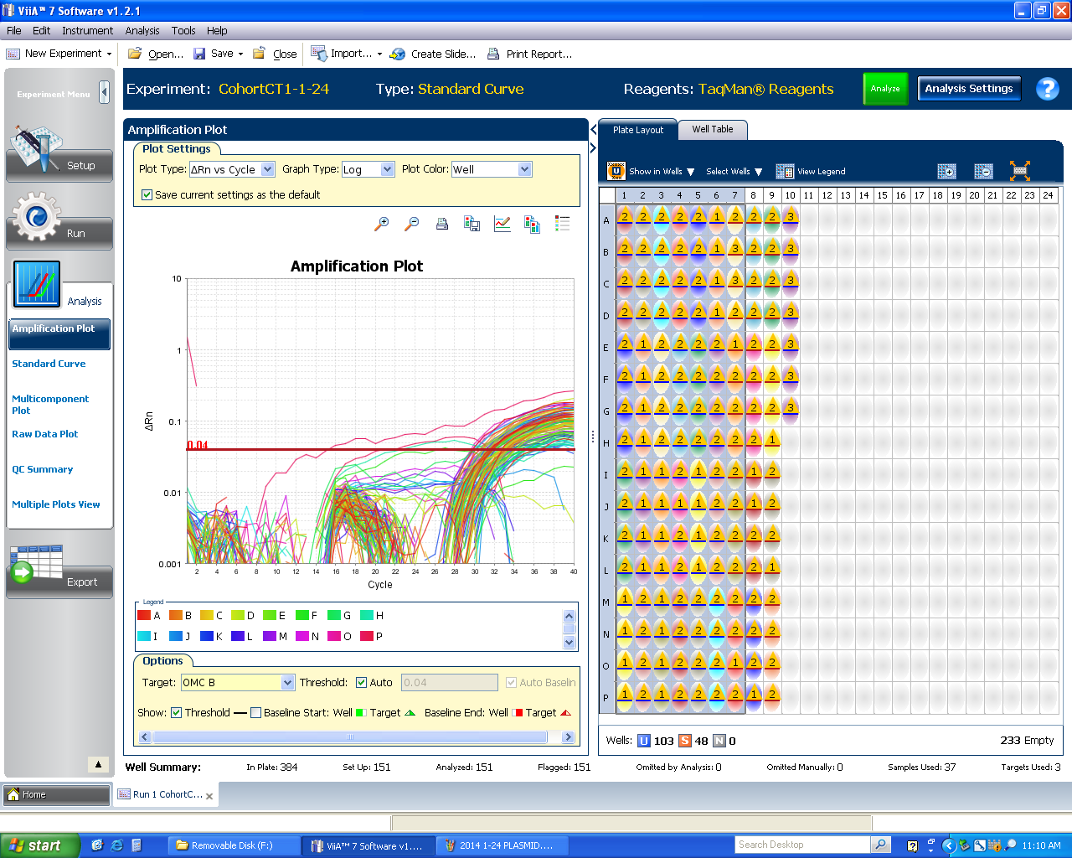
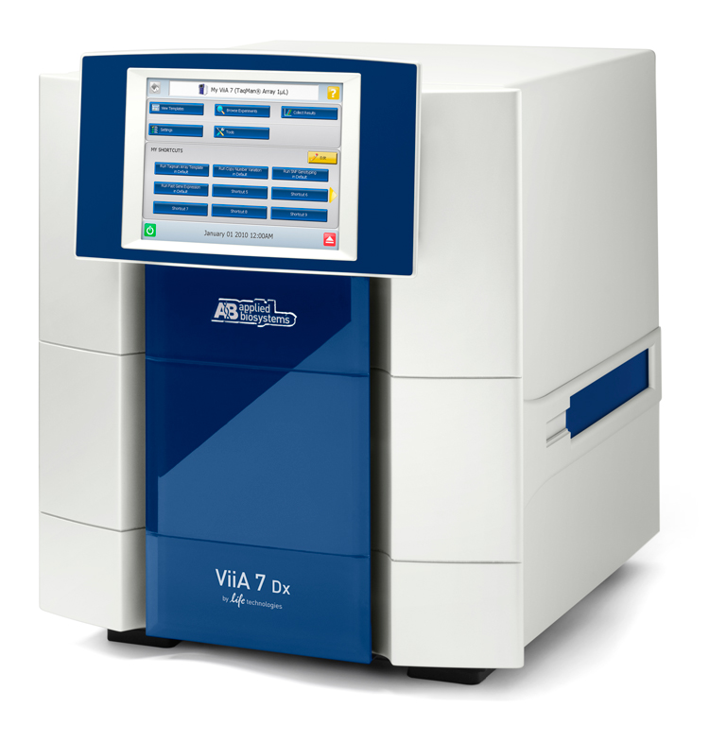

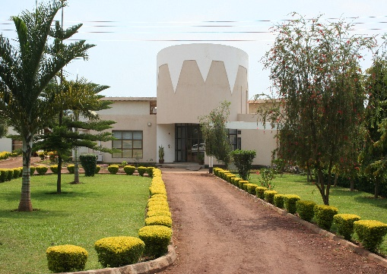
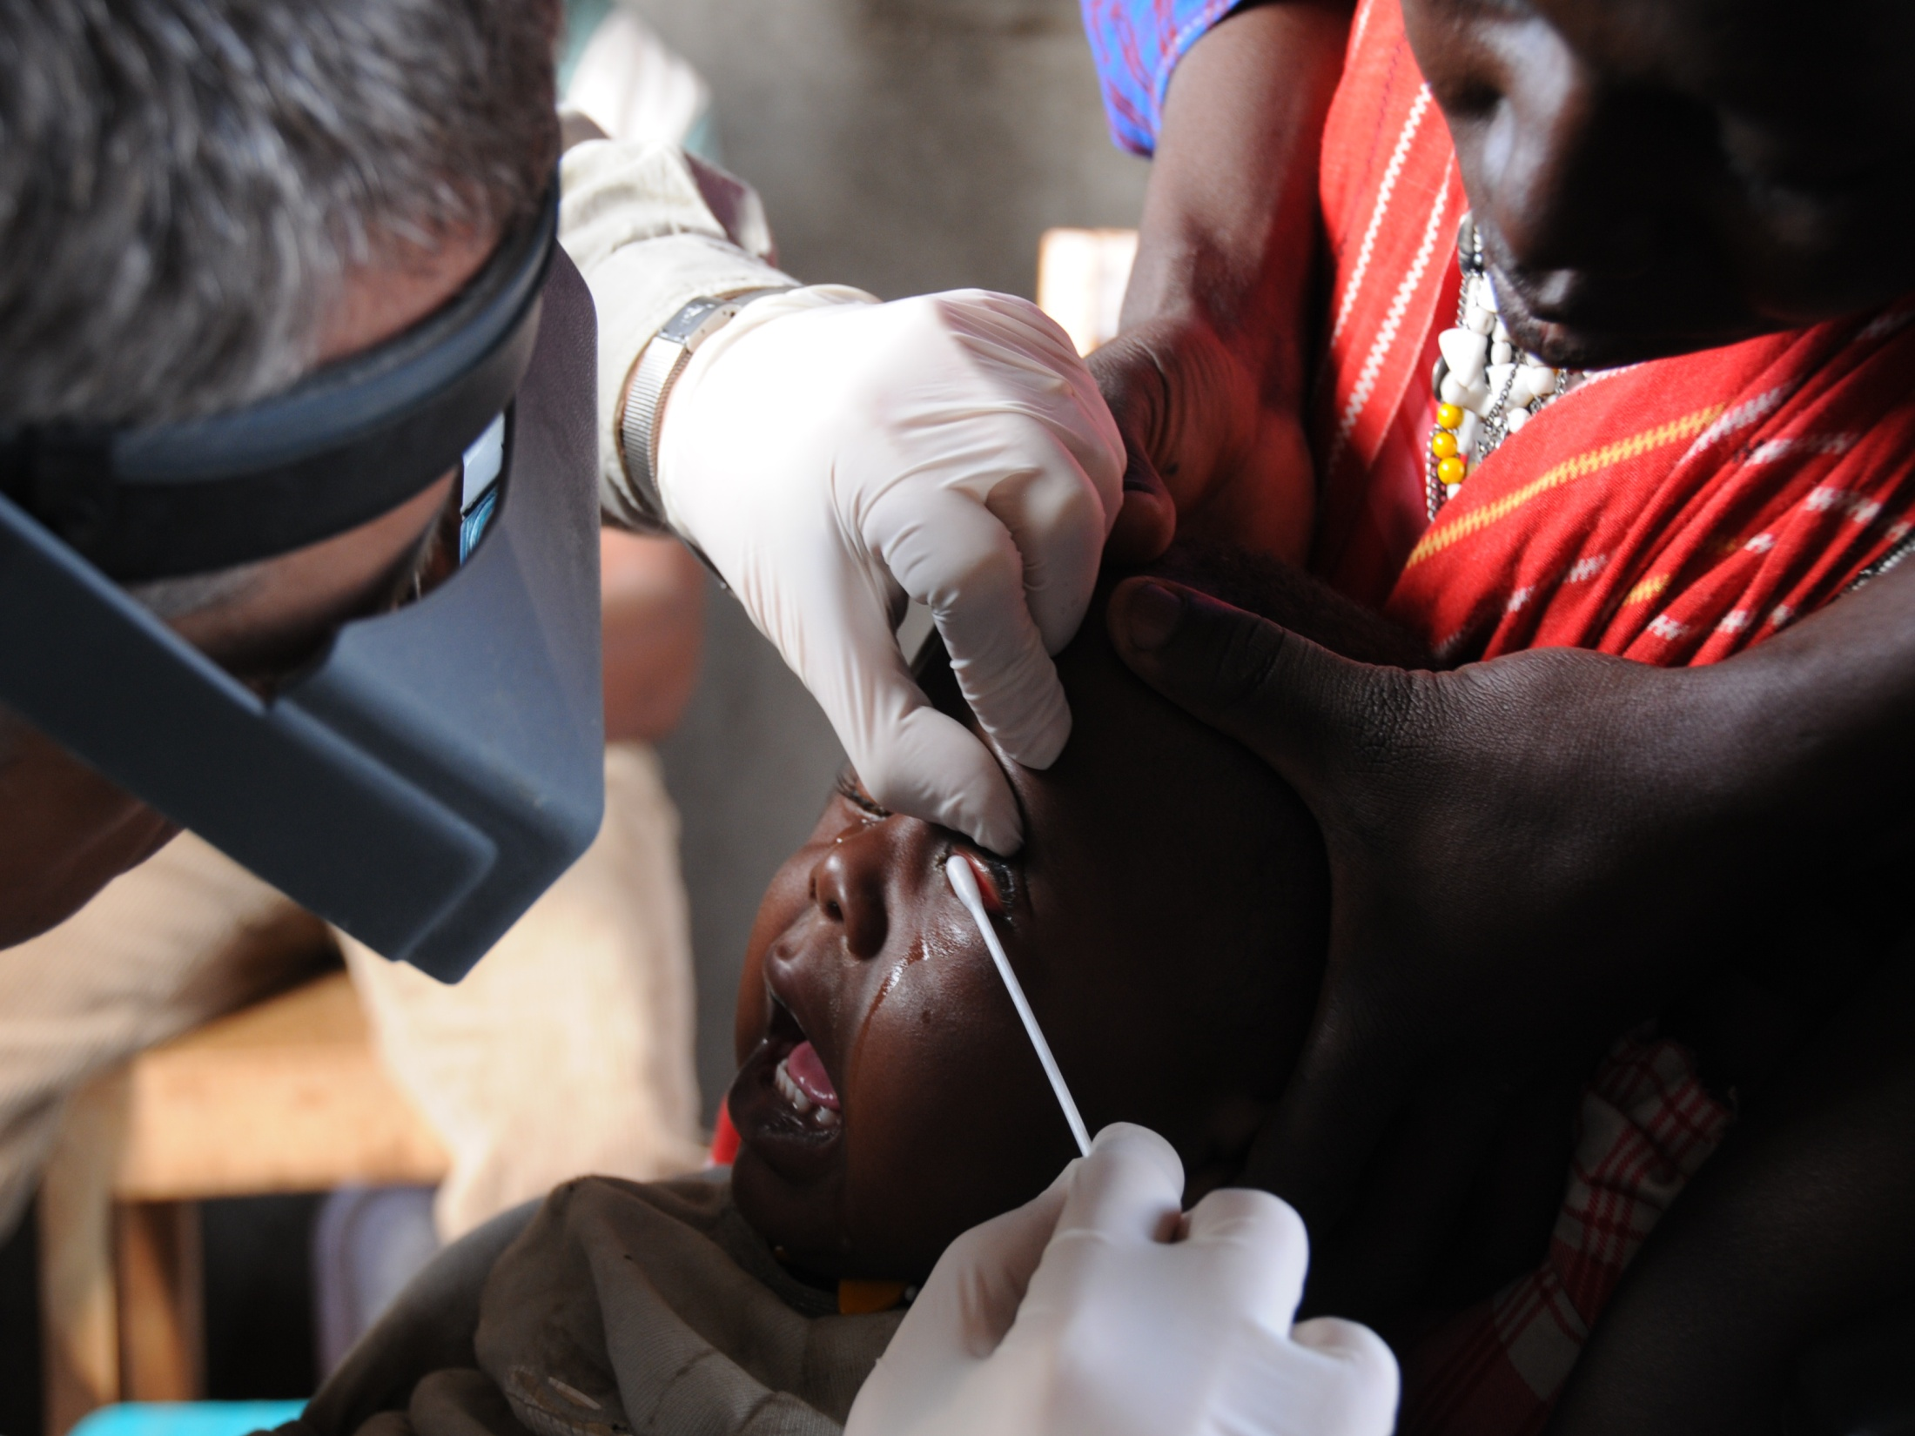
Map of district level trachoma prevalence for Africa 2018
Triplex assay for the detection of Chlamydia trachomatis Human DNA by qPCR
Viia7 Real-time qPCR assay for
Chlamydia trachomatis infection
RPP30
Plasmid
OMCB
Specimens collected in rural Tanzanian villages
DjinniChip detection (LAMP) of Chlamydia trachomatis
Sample processed
for qPCR
and
DjinniChip
Specimens transported to KCRI-Moshi
Conjunctival swabs collected and stored in a
standardized procedure for research

