Slide 1
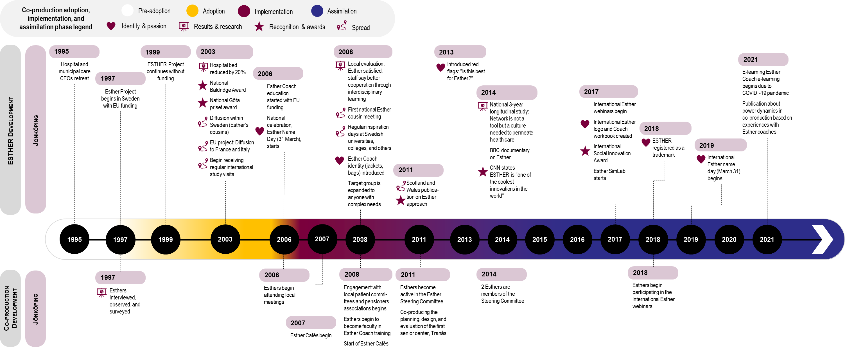
Additional file 3
Figure 1. Case 1 ESTHER coproduction adoption, implementation, and assimilation timeline

