Slide 1
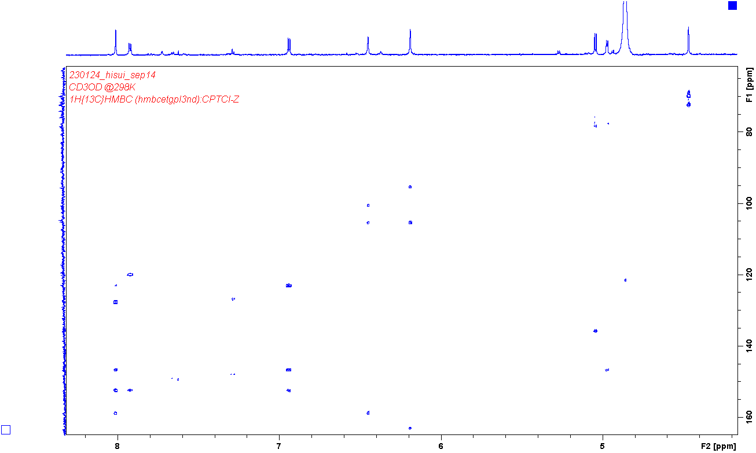
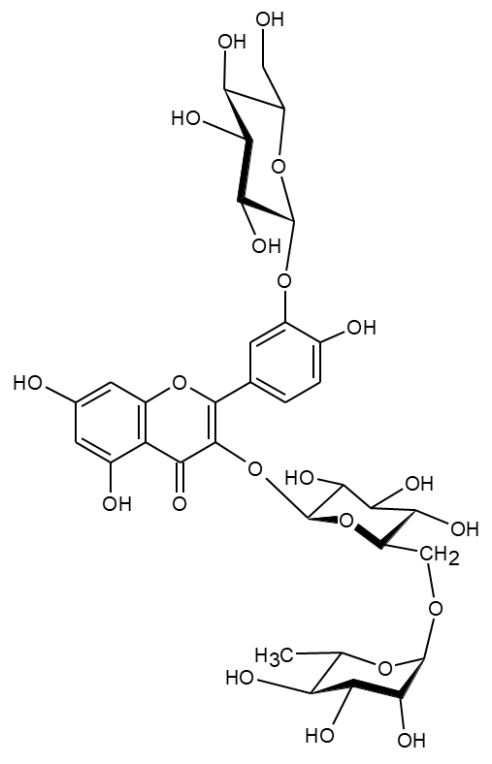
2’
6’
5’
8
6
GlcA1
GlcB1
Rham1
Rham1/GlcA6
6/8
8/6
8/10
6/10
6’/2’
5’/6’
2’/6’
2’/1’
GlcA1/3
2’/3’
5’/3’
GlcB1/3’
2’/4’
6’/4’
5’/4’
2’/2
8/9
6/5
Fig. S1. HMBC spectrum of 4. Methanol-d4 was used as the solvent.

Slide 2
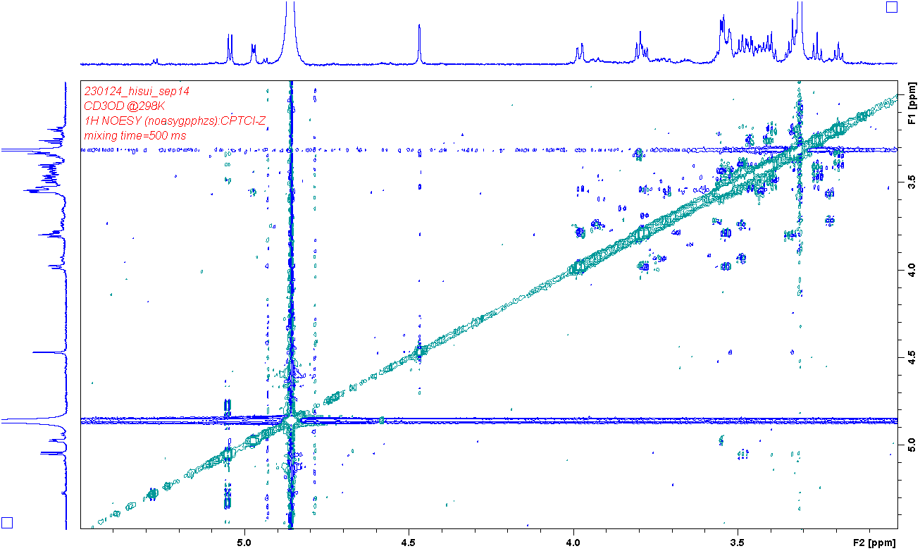
G1/G5
G6a/G4
G3/G1
G5/G1
Fig. S2. NOESY (blue, mixing time: 500 ms) spectrum of 4.

Slide 3
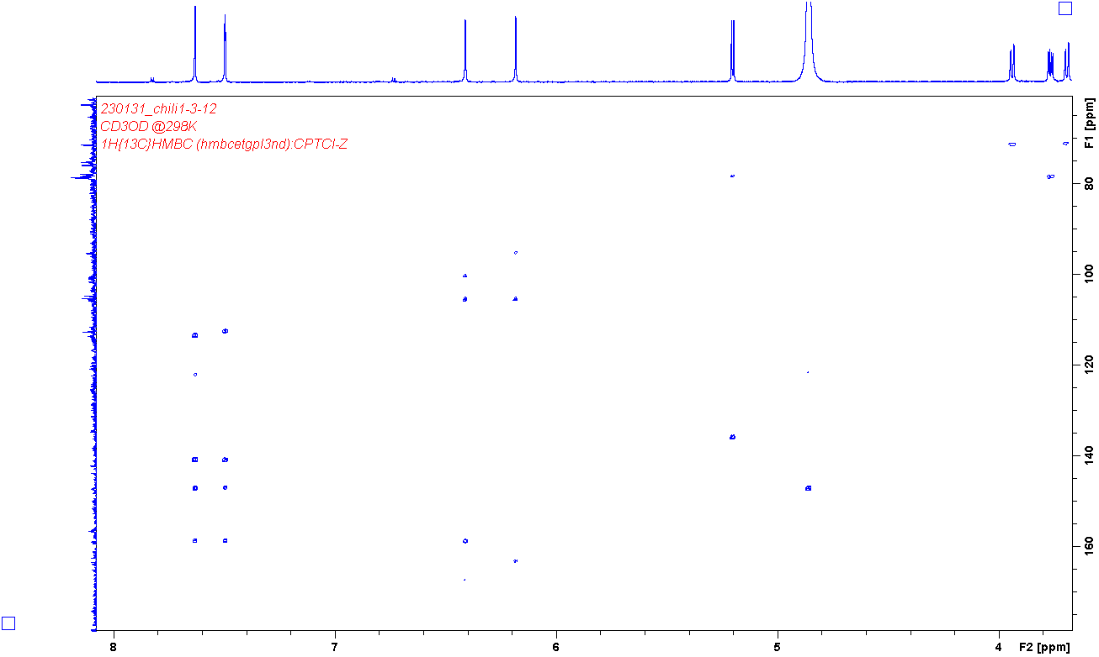
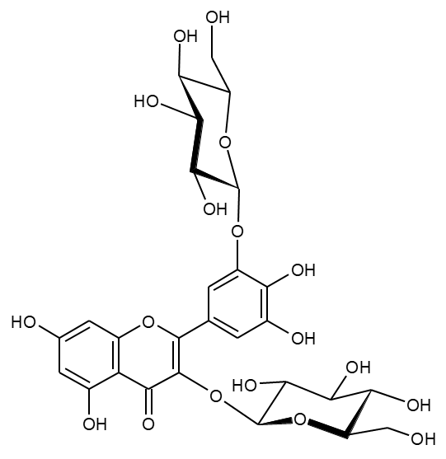
2’
6’
8
6
GlcB1
GlcA1
8/6
6/8
8/10
6/10
2’/6’
6’/2’
2’/1’
GlcA1/3
2’/4’, 5’
6’/4’,5’
GlcB1/3’
2’/3’
6’/3’
2’/2
6’/2
8/9
6/5
8/7
Fig. S3. HMBC spectrum of 12. Methanol-d4 was used as the solvent.

Slide 4
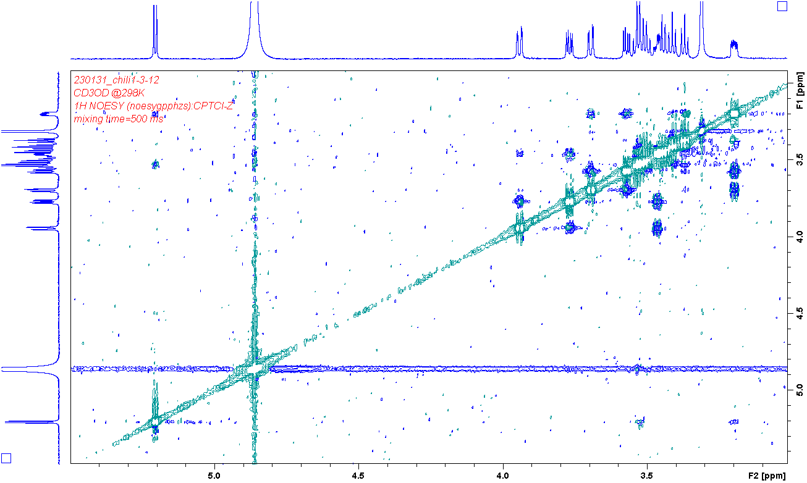
G1/G3
G1/G5
G6b/G4
G6a/G4
G6b/G4
G6a/G4
G3/G1
G5/G1
Fig. S4. NOESY (blue, mixing time: 500 ms) spectrum of 12.

Slide 5
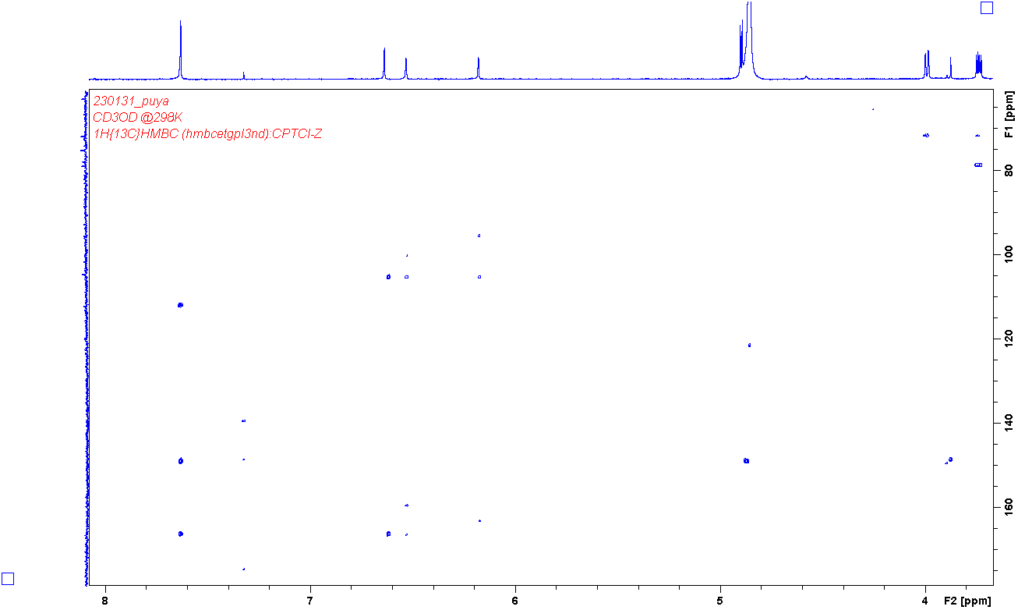
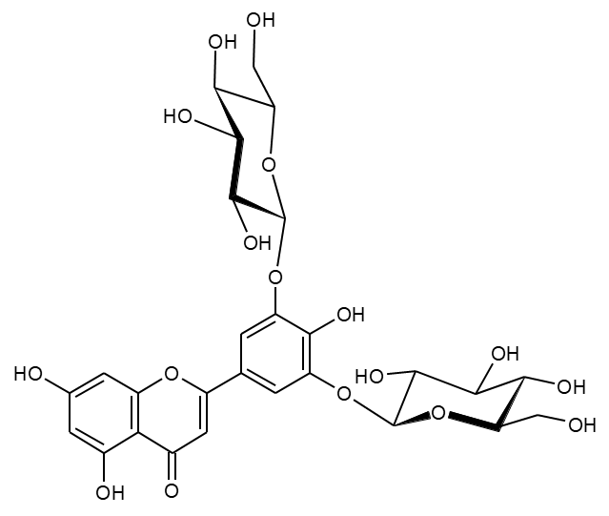
2’/6’
3
8
6
GlcA1/GlcB1
8/6
6/8
2’/6’
3/10
8/10
6/10
2’/6’/
3’/5’
GlcA1/GlcB1/3’/5’
8/9
6/5
2’/6’/2
3/2
8/7
Fig. S5. HMBC spectrum of 13. Methanol-d4 was used as the solvent.

Slide 6
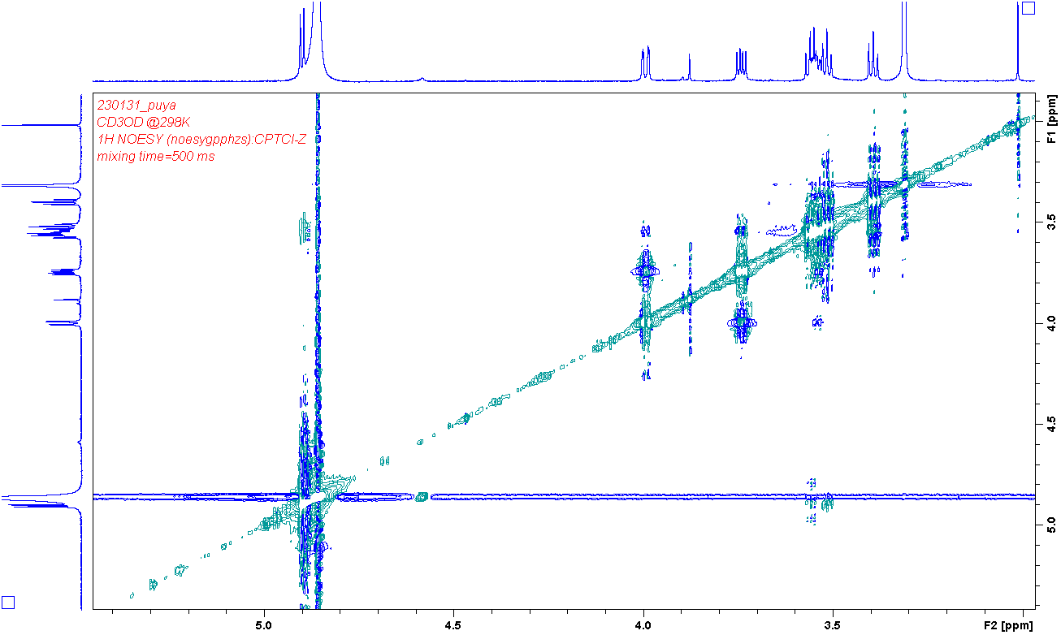
G1/G5
G6b/G4
G6a/G4
G3/G1
G5/G1
Fig. S6. NOESY (blue, mixing time: 500 ms) spectrum of 13.

Slide 7
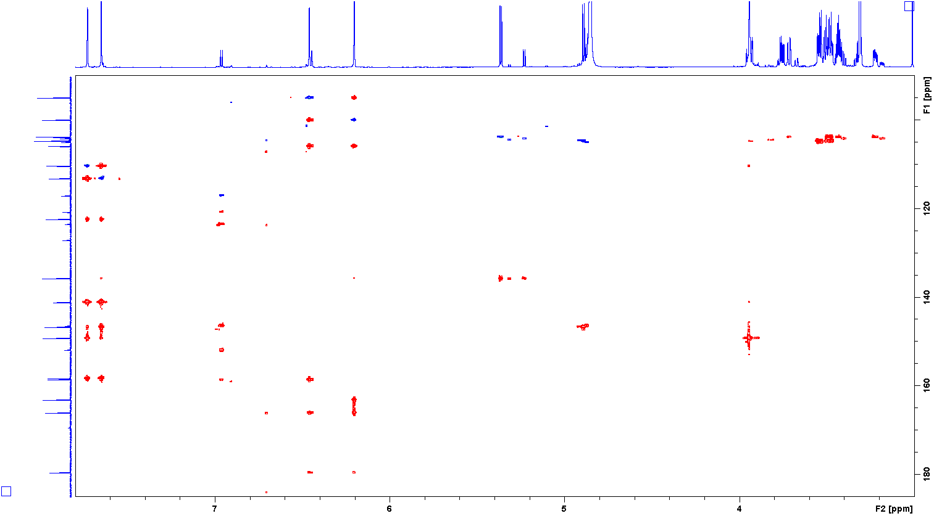
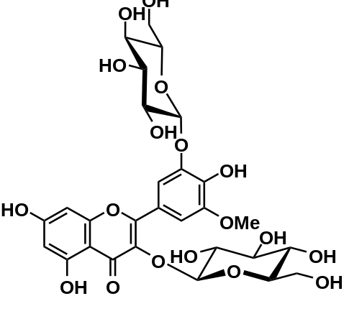
2’
6’
8
6
GlcA1
GlcB1
OMe
8
8
6/8
6
8/6
6
G1
g1
G1
g1
10
2’
6’/2’
8/10
6/10
OMe/2’
2’
6’
6’
2’/6’
1’
6’/1’
2’/1’
3
GlcA1/3
4’
2’/4’
6’/4’
OMe/4’
5’
2’/5’
6’/5’
GlcB1/5’
3’
6’/3’
OMe/3’
2’/3’
2
2’/2
6’/2
9
8/9
6/5
5
6/7
7
8/7
4
8/4
6/4
GlcB
GlcA
Fig. S7. HSQC (blue) and HMBC (red) spectra of 14. Methanol-d4 was used as the solvent.

Slide 8
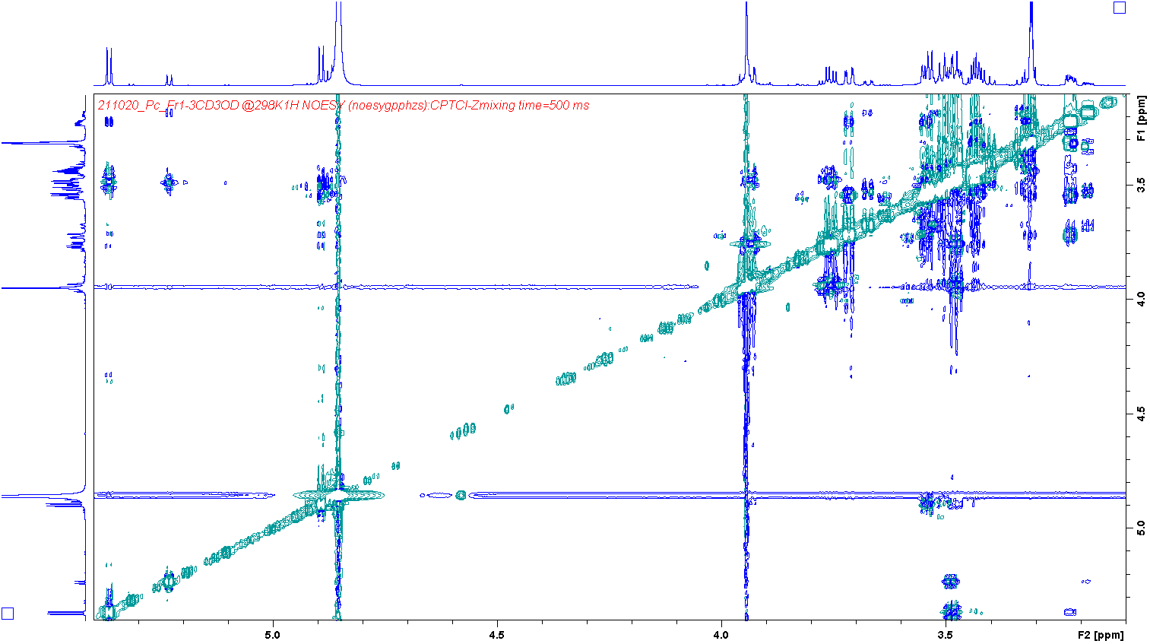

GlcA1
GlcB1
GlcB5
GlcA5
GlcA1/GlcA5
GlcB1/GlcB5
GlcB5/GlcB1
GlcA5/GlcA1
GlcB
GlcA
Fig. S8. NOESY (blue, mixing time: 500 ms) spectrum of 14.

Slide 9
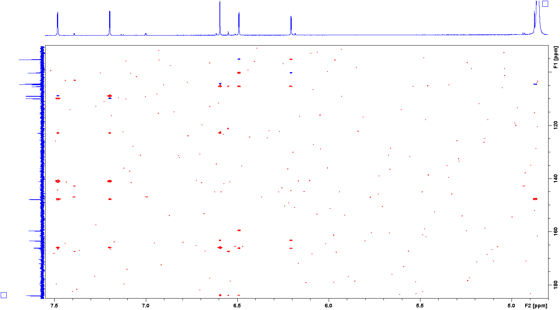
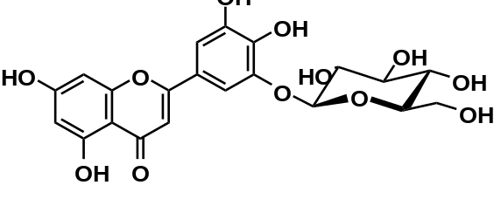
2’
6’
3
8
6
G1
8
8
6/8
6
3
8/6
6
G1
3
3/10
8/10
6/10
G1
10
2’
6’/2’
2’
6’
6’
2’/6’
1’
2’/1’
6’/1’
3/1’
4’
2’/4’
6’/4’
3’
2’/5
6’/5’
5’
G1/3’
9
8/9
5
3/5
6/5
2
7
2’/2
6’/2
3/2
8/7
6/7
4
3/4
8/4
Fig. S9. HSQC (blue) and HMBC (red) spectra of 15.

Slide 10
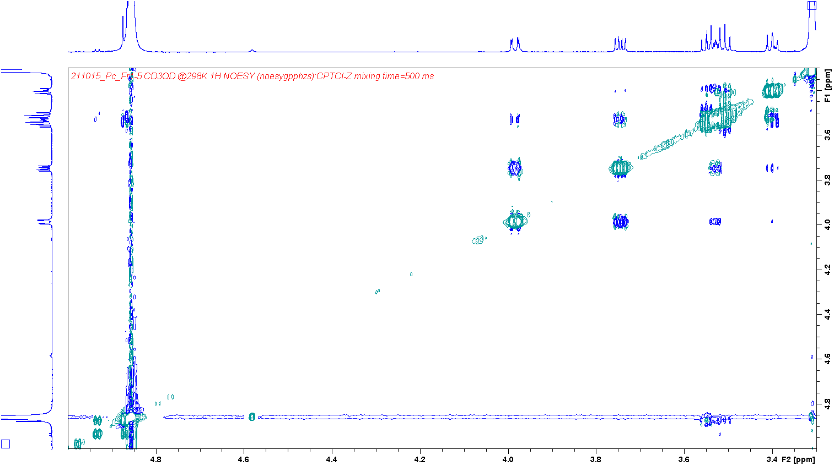
G5
G3
G1
G6b
G6a
G2
G4
G2/G4
G1/G3
G6b/G5
G6a/G4
G1/G5
Fig. S10. NOESY (blue, mixing time: 500 ms) spectrum of 15. Methanol-d4 was used as the solvent.

Slide 11
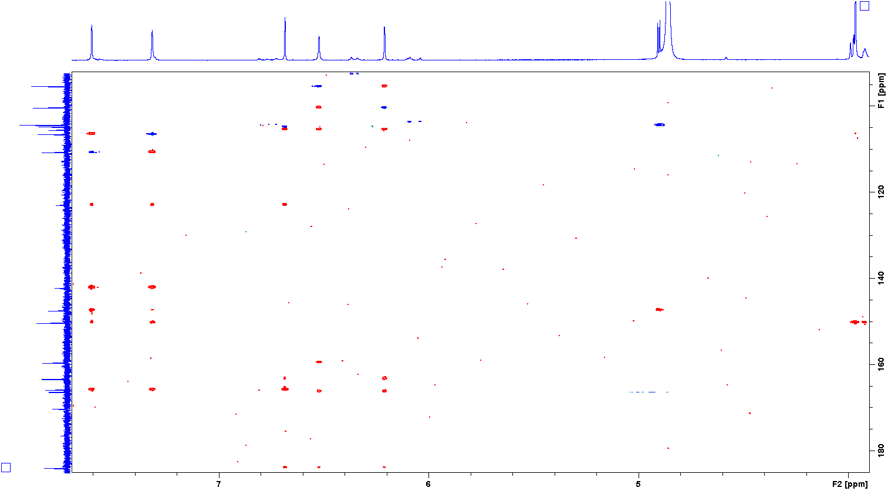
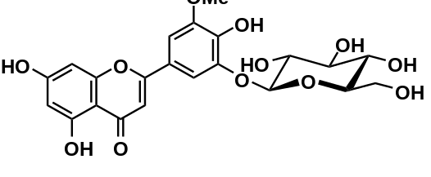
2’
6’
3
8
6
G1
OMe
8
8
6/8
6
3
8/6
6
10
6’
2’/6’
6’
3/10
8/10
6/10
G1
2’
2’
6’/2’
1’
2’/1’
6’/1’
3/1’
4’
2’/4’
6’/4’
5’
3’
2’/3’
6’/3’
G1/3’
2’/5'
6’/5’
OMe/5’
9
3/5
8/9
6/5
5
2’/2
6’/2
3/2
8/7
2
7
6/7
4
3/4
8/4
6/4
Fig. S11. HSQC (blue) and HMBC (red) spectra of 16. Methanol-d4 was used as the solvent.

Slide 12
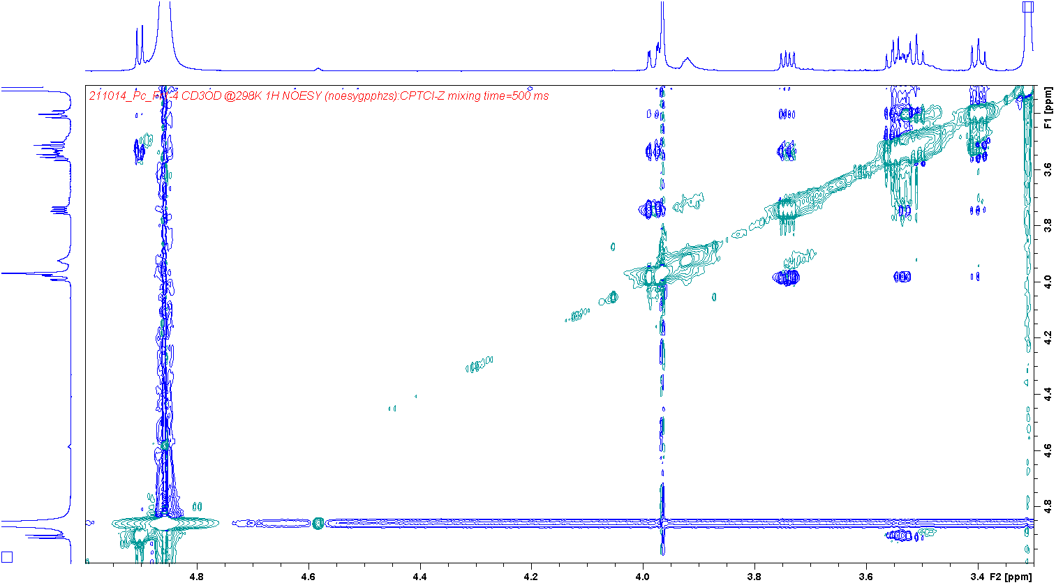
G1
G5
G6b
G6a
G2
G3
G4
G1/G3
G6b/G4
G6a/G4
G1/G5
G4/G2
G5/G1
G3/G1
Fig. S12. NOESY (blue, mixing time: 500 ms) spectrum of 16. Methanol-d4 was used as the solvent.

