Slide 1
Figure S1. Effect of avutometinib on cell viability of NCI-H358 cells.
The NCI-H358 cells were treated with avutometinib for 72 h. Cell viability was determined using the CCK-8 assay. Data are representative of three independent experiments.

Slide 2
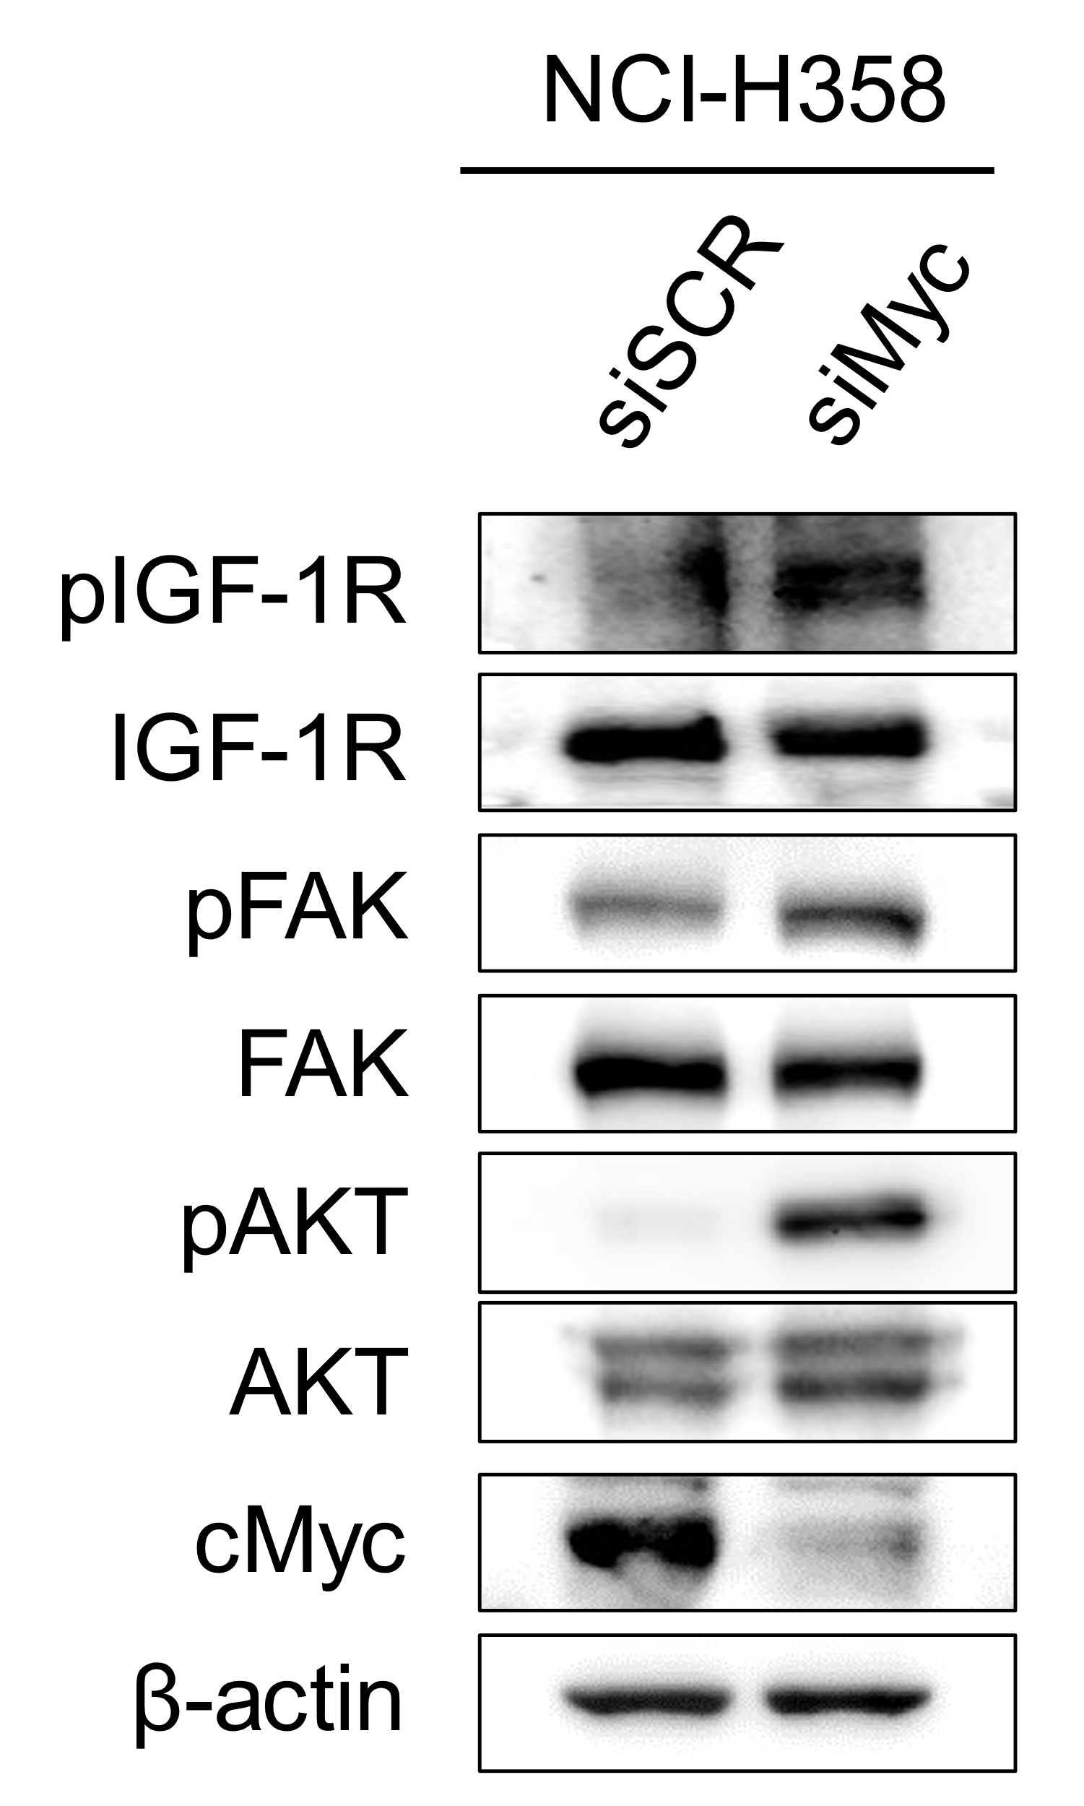
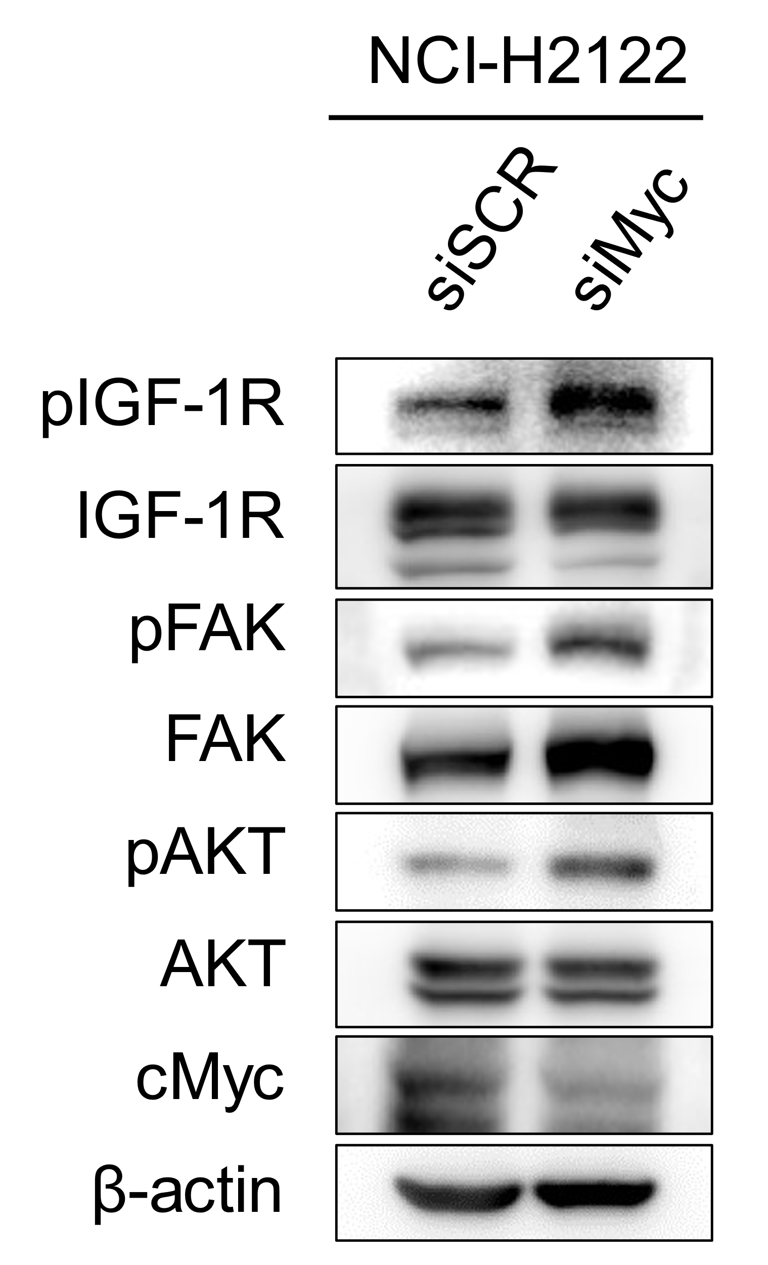
Figure S2. Knockdown effect of Myc expression on each signal in KRAS-mutated non-small cell lung cancer cells.
A
B
A nonspecific control (siSCR) or siRNA specific to Myc (siMyc) was introduced into the indicated cells. A. After incubation for 24 h, qRT-PCR was used to assess IGF-1 mRNA expression. p-values were calculated using Student's t-tests. B. After incubation for 72 h, the cells were lysed, and the indicated proteins were detected via western blotting.

Slide 3
Figure S3. Effect of avutometinib on cell viability in KRAS-mutated NSCLC cells.
A
B
C
D
A. KRAS-mutated NSCLC cells were treated with avutometinib (200 nmol/L) for 72 h. Cell viability was determined using CCK-8 assay. B. Based on the result of A, cells were further divided into groups of epithelial and mesenchymal phenotypes, and comparative data are shown (p = 0.456). C. Based on the result of A, cells were further divided into groups of KRAS G12C and non-G12C point mutation, and comparative data are shown (p = 0.926). D. Based on the result of A, cells were further divided into groups with or without LKB1 mutation, and comparative data are shown (p = 0.005). B, C, and D. p values were calculated using student's t-tests.
NSCLC, non-small cell lung cancer.

Slide 4
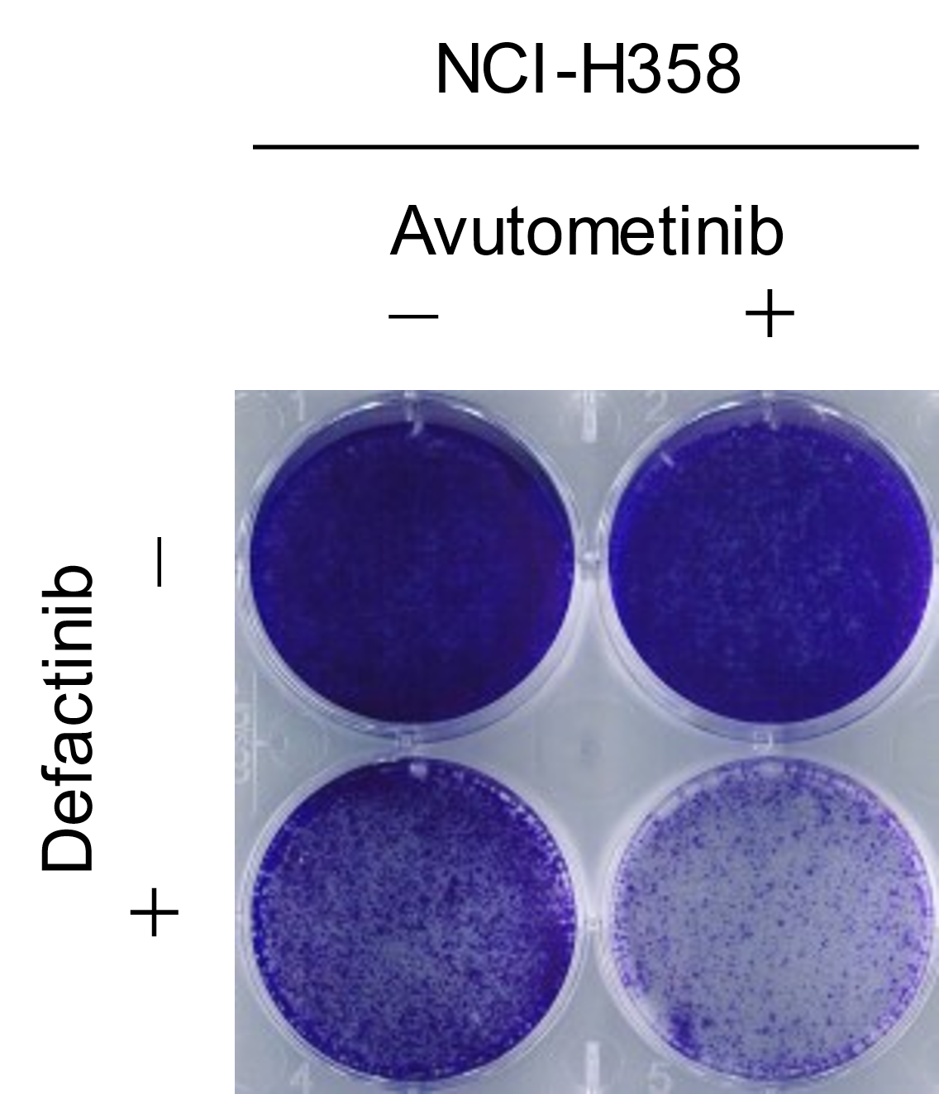
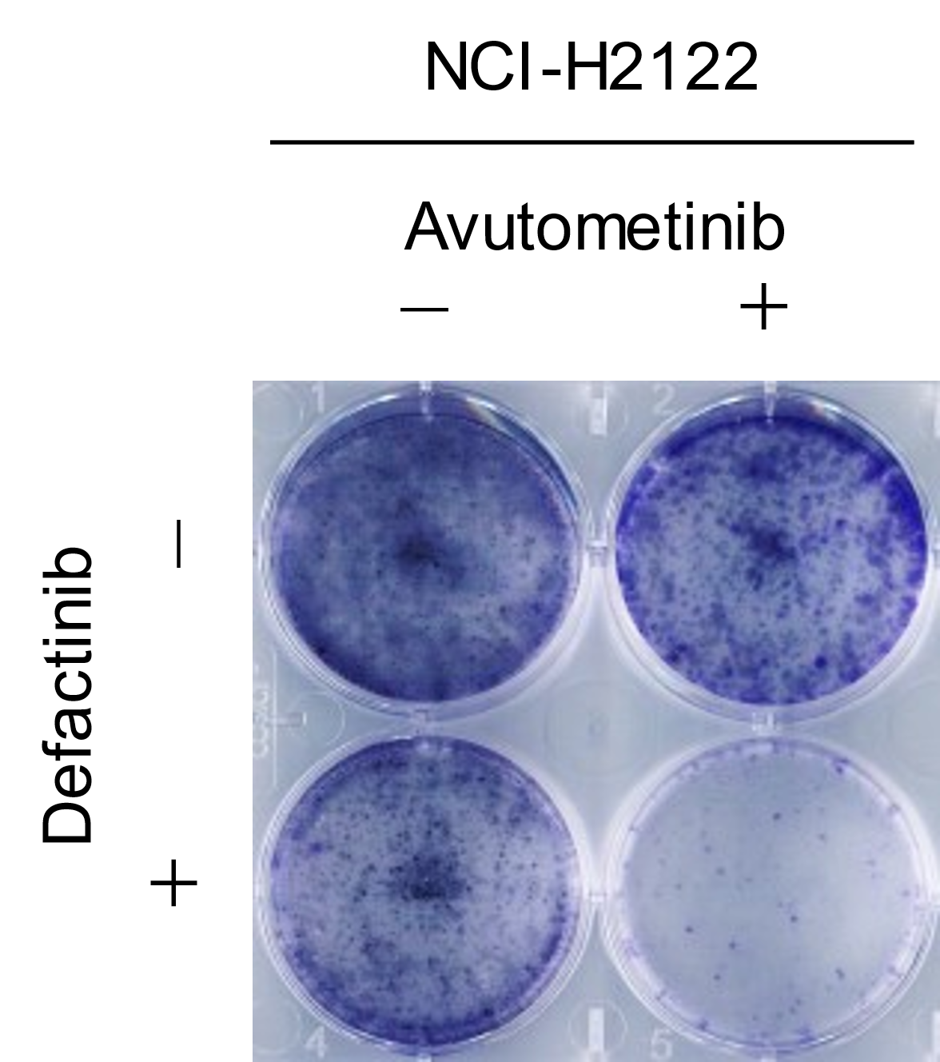
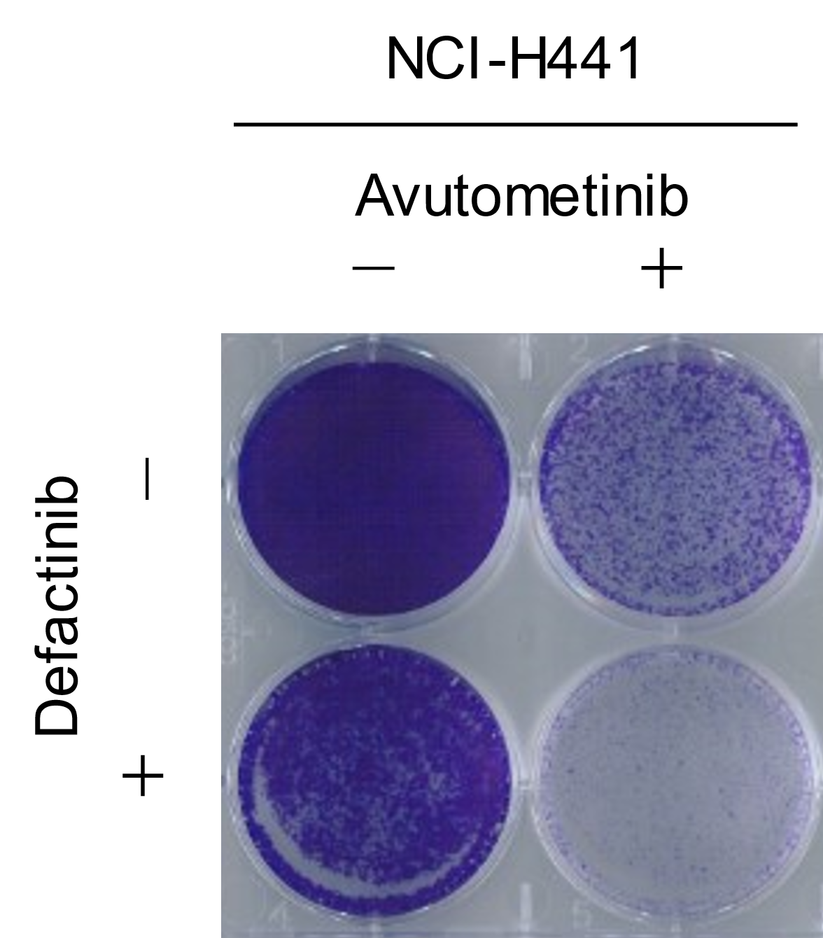
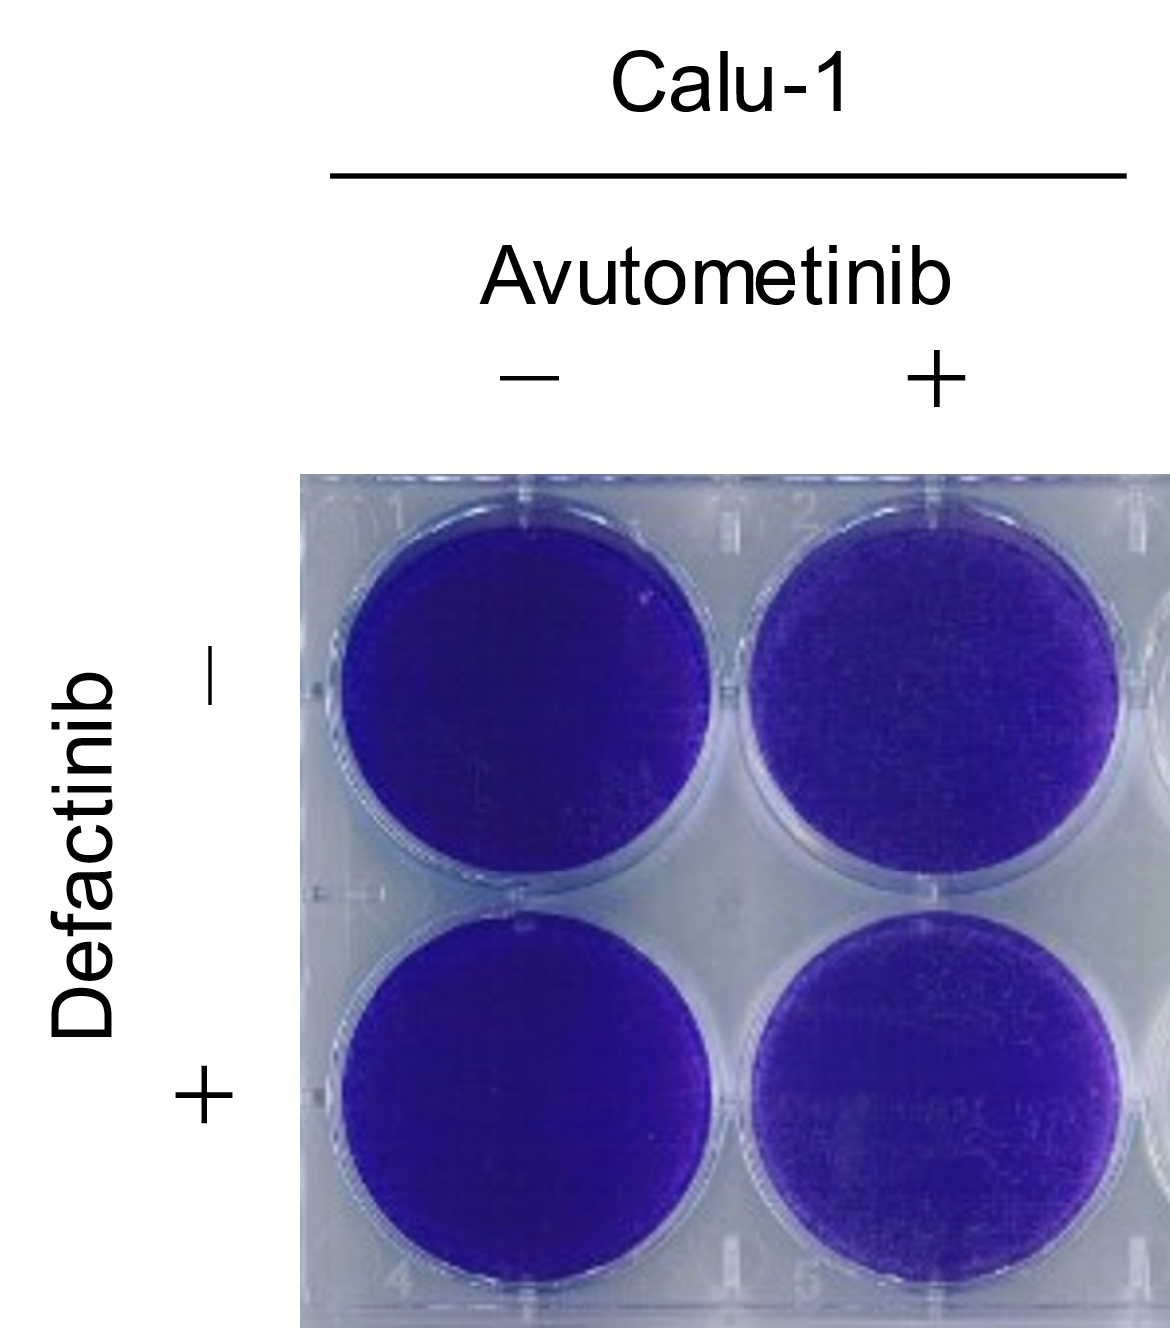
Figure S4. Effect of treatment with avutometinib plus defactinib on the cell viability of KRAS-mutated non-small cell lung cancer cells.
A
Epithelial
Mesenchymal
B
A. NCI-H358, NCI-H2122 and NCI-H441 (epithelial phenotype), and Calu-1 (mesenchymal phenotype) cells were treated with avutometinib in the presence or absence of defactinib (1 μmol/L) for 72 h, and cell viability was assessed using CCK-8 assay. The data shown is representative of three independent experiments. B. Cells were treated with DMSO, avutometinib (150 nmol/L), defactinib (1 μmol/L), or a combination with avutometinib (150 nmol/L) and defactinib (1 μmol/L) for 15 days with the drugs replenished every 72 h. The plates were stained with crystal violet. Each plate is representative of three independent experiments.

Slide 5
Figure S5. Effect of treatment with avutometinib plus defactinib on the cell cycle of KRAS-mutated non-small cell cancer cells.
NCI-H358, NCI-H2122 and NCI-H441 (epithelial phenotype), and Calu-1 (mesenchymal phenotype) cells were treated with DMSO, avutometinib (150 nmol/L), defactinib (1 μmol/L) or a combination with avutometinib (150 nmol/L) and defactinib (1 μmol/L) for 48 h (NCI-H2122 and Calu-1) or 72 h (NCI-H358 and NCI-H441), and the cell cycle was analyzed via flow cytometry using FACS Accuri. The data are representative of three independent experiments.

Slide 6
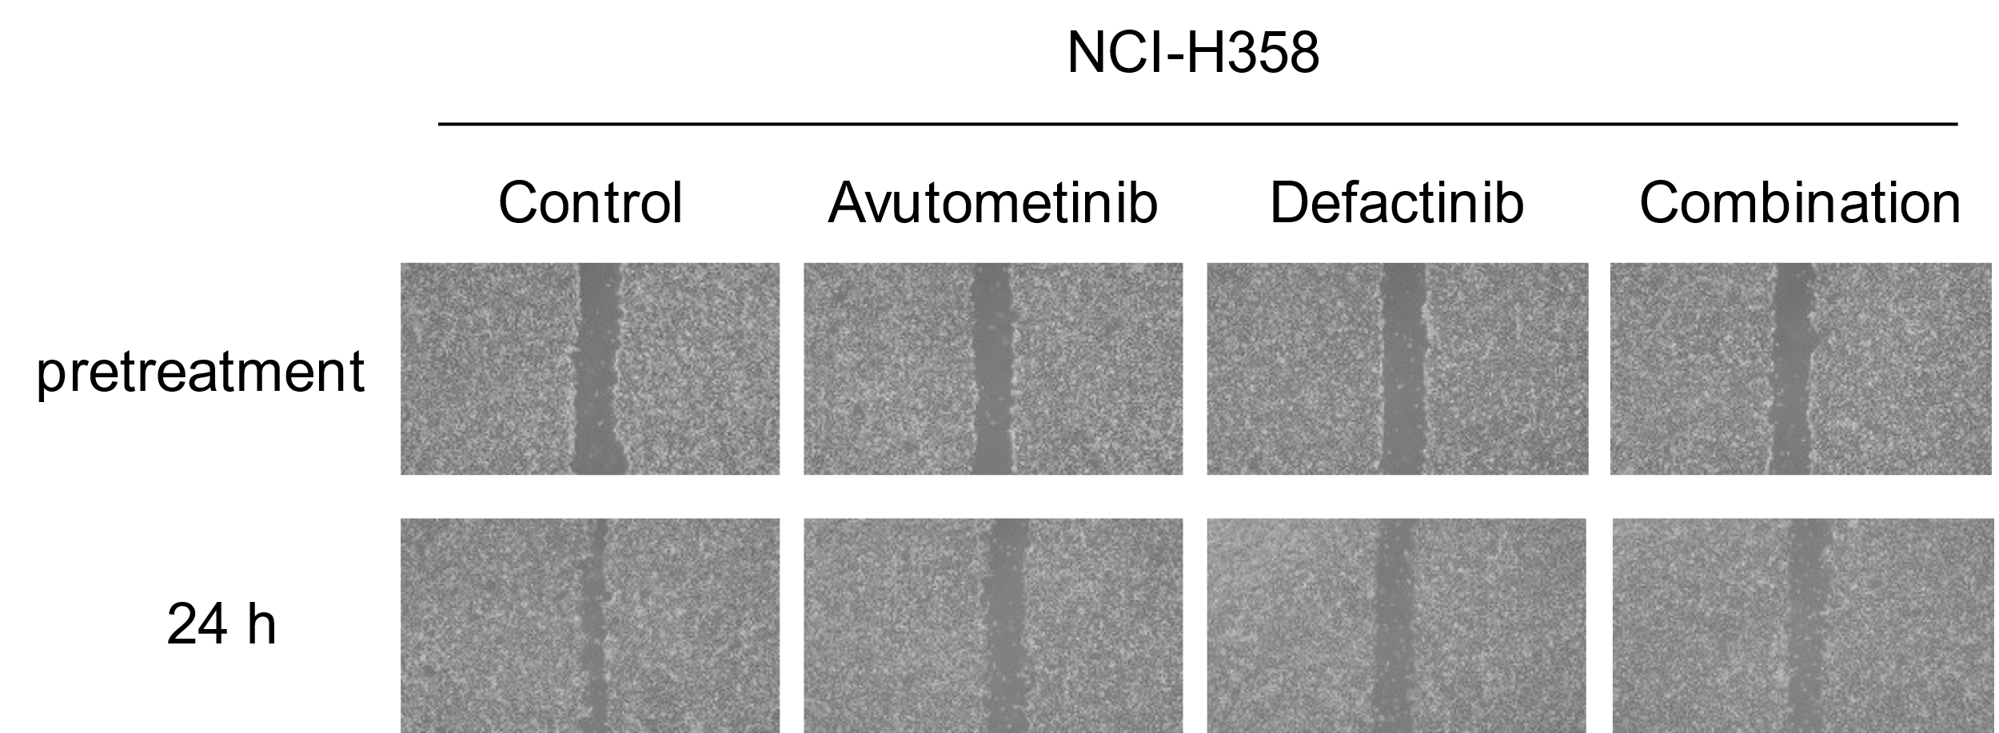
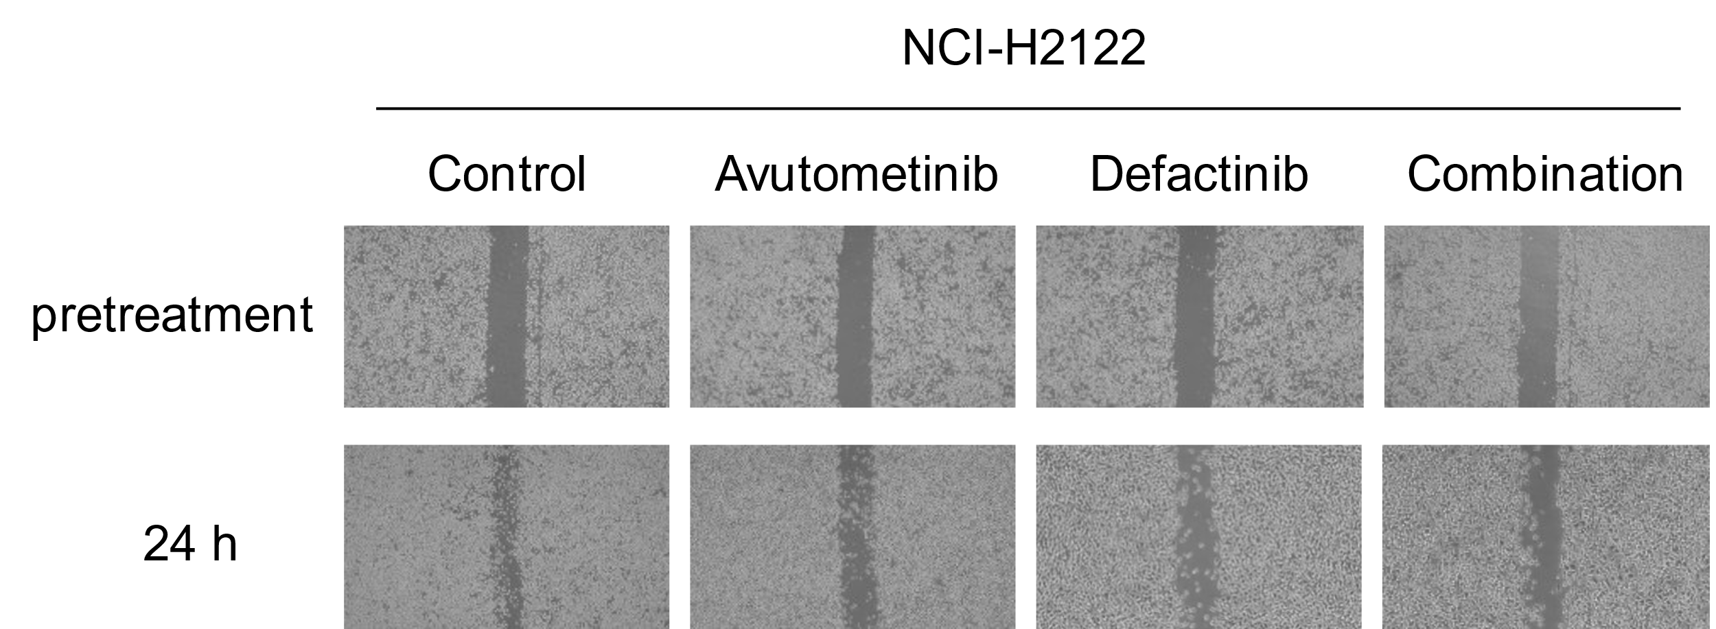
Figure S6. Effect of treatment with avutometinib plus defactinib on cell migration of KRAS-mutated non-small cell lung cancer cells.
NCI-H358 and NCI-H2122 cells were treated with DMSO, avutometinib (150 nmol/L), defactinib (1 µmol/L) or a combination with avutometinib (150 nmol/L) and defactinib (1 μmol/L) for 24 h. Cell migration was assessed using the scratch assay. Data are representative of three independent experiments.

Slide 7
Figure S7. Effect of combination with avutometinib and defactinib in NCI-H358 cells in vivo.
A
B
NCI-H358 CDX model avutometinib (28 days by oral administration with vehicle, defactinib (3.0 mg/kg) and avutometinib (0.1 mg/kg), or a combination of defactinib (3.0 mg/kg) and avutometinib (0.1 mg/kg) (n = 6 per group). A. Tumor volumes of each mouse treated with the combination treatment were measured over time from the start of treatment, and the results are shown (mean ± SEM). B. Mice were weighed twice weekly, and the results are shown (mean ± SEM).

Slide 8
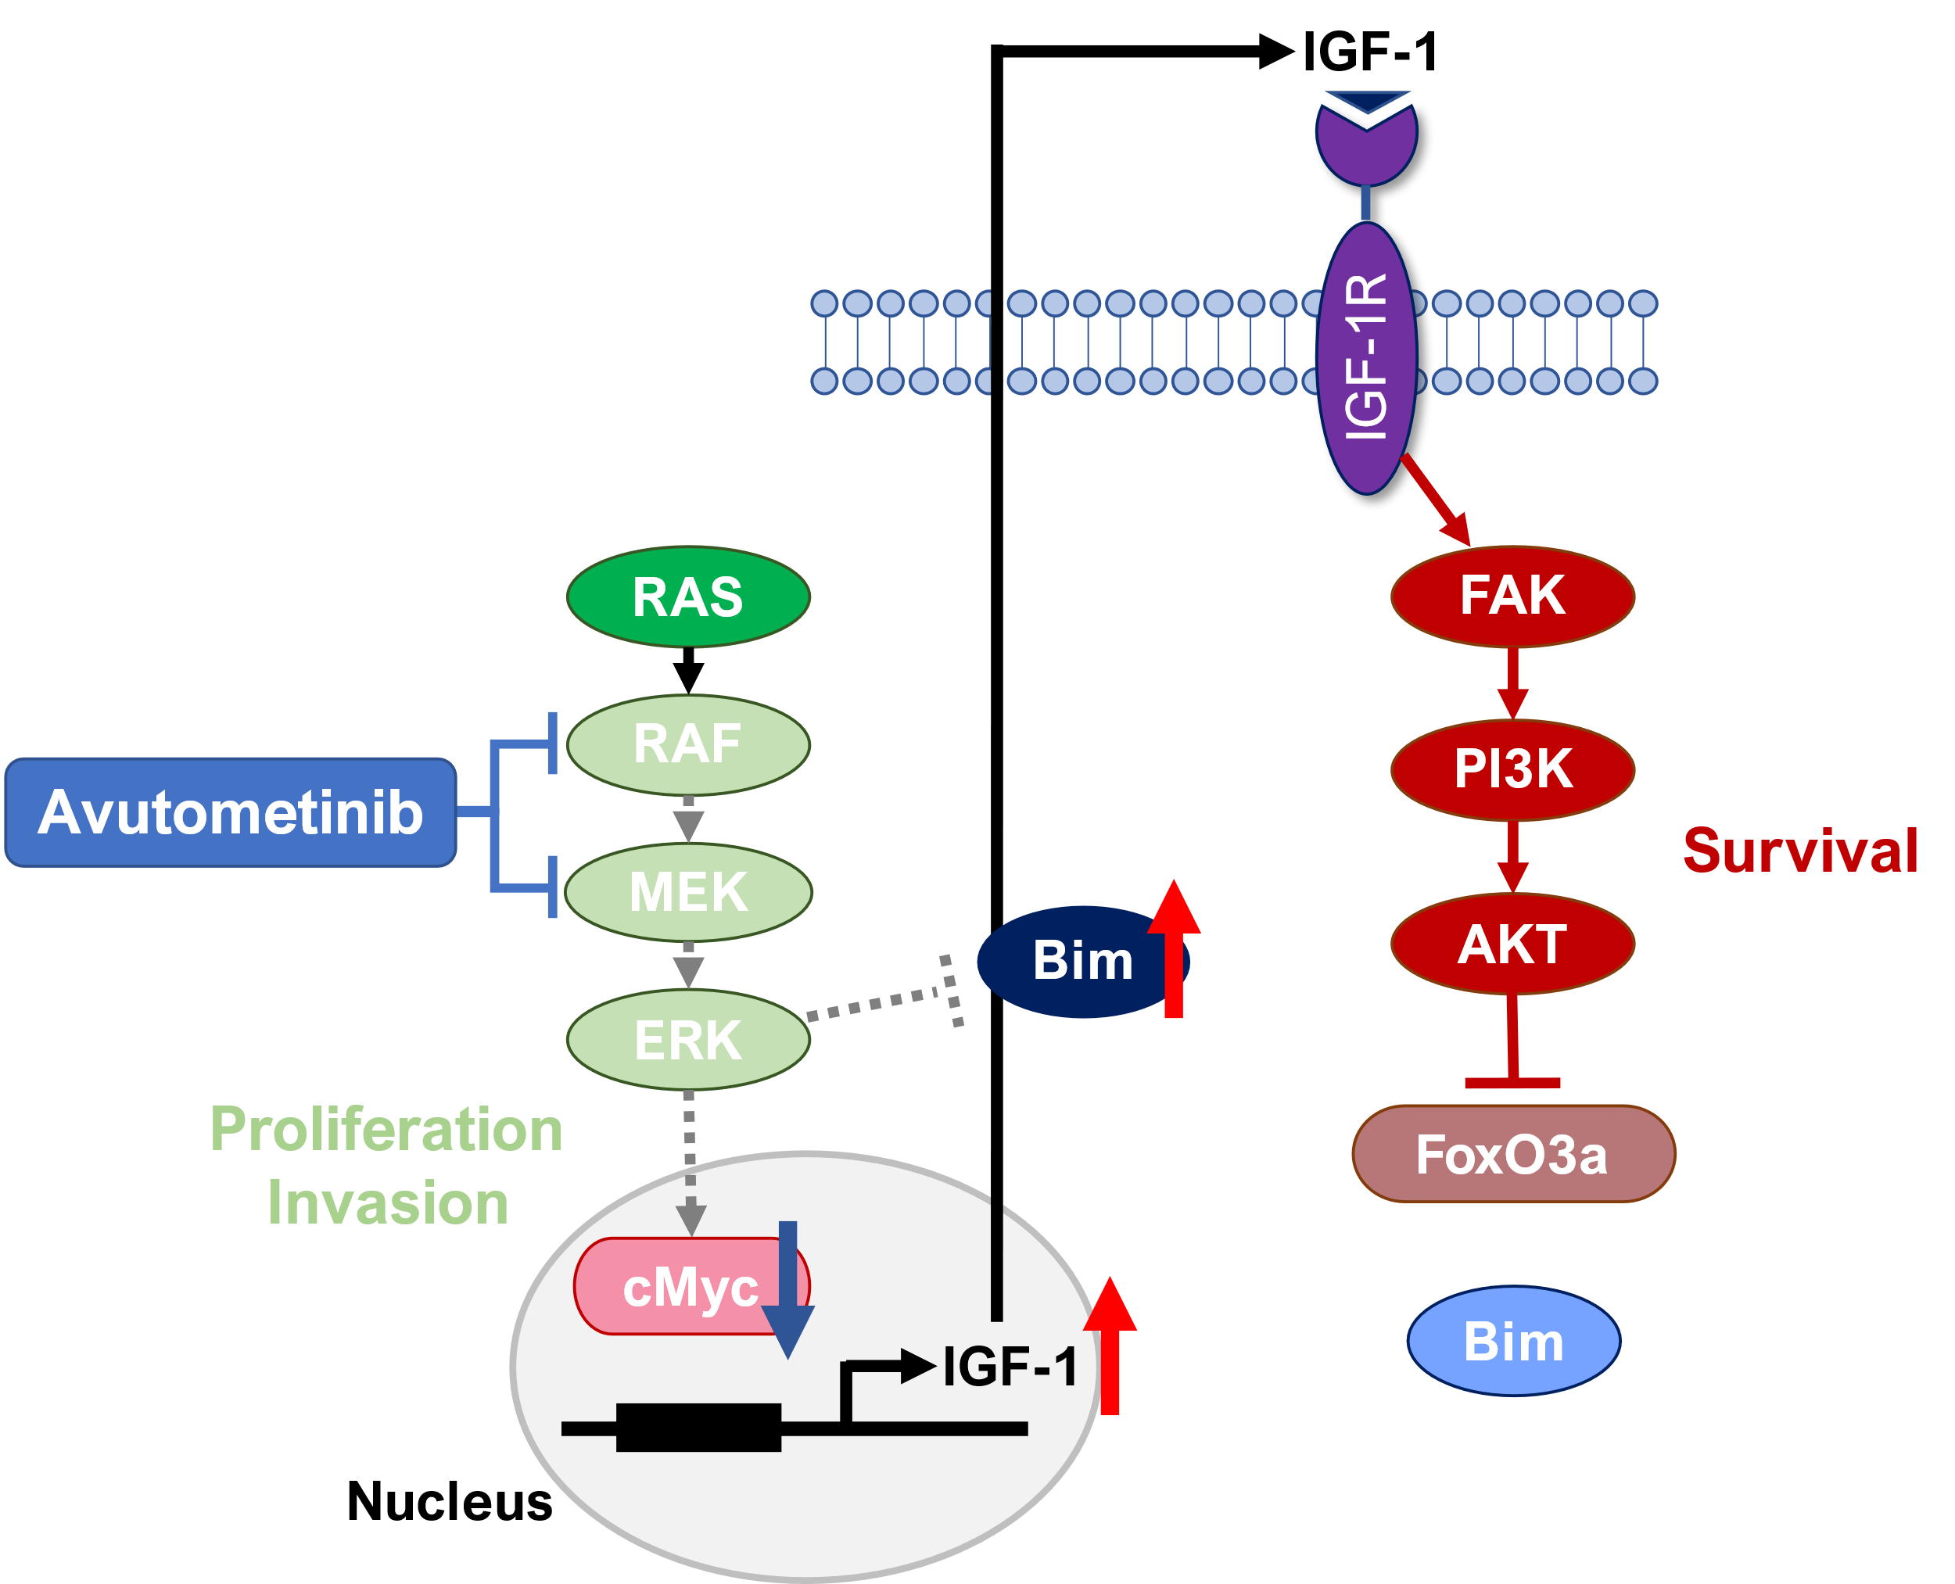
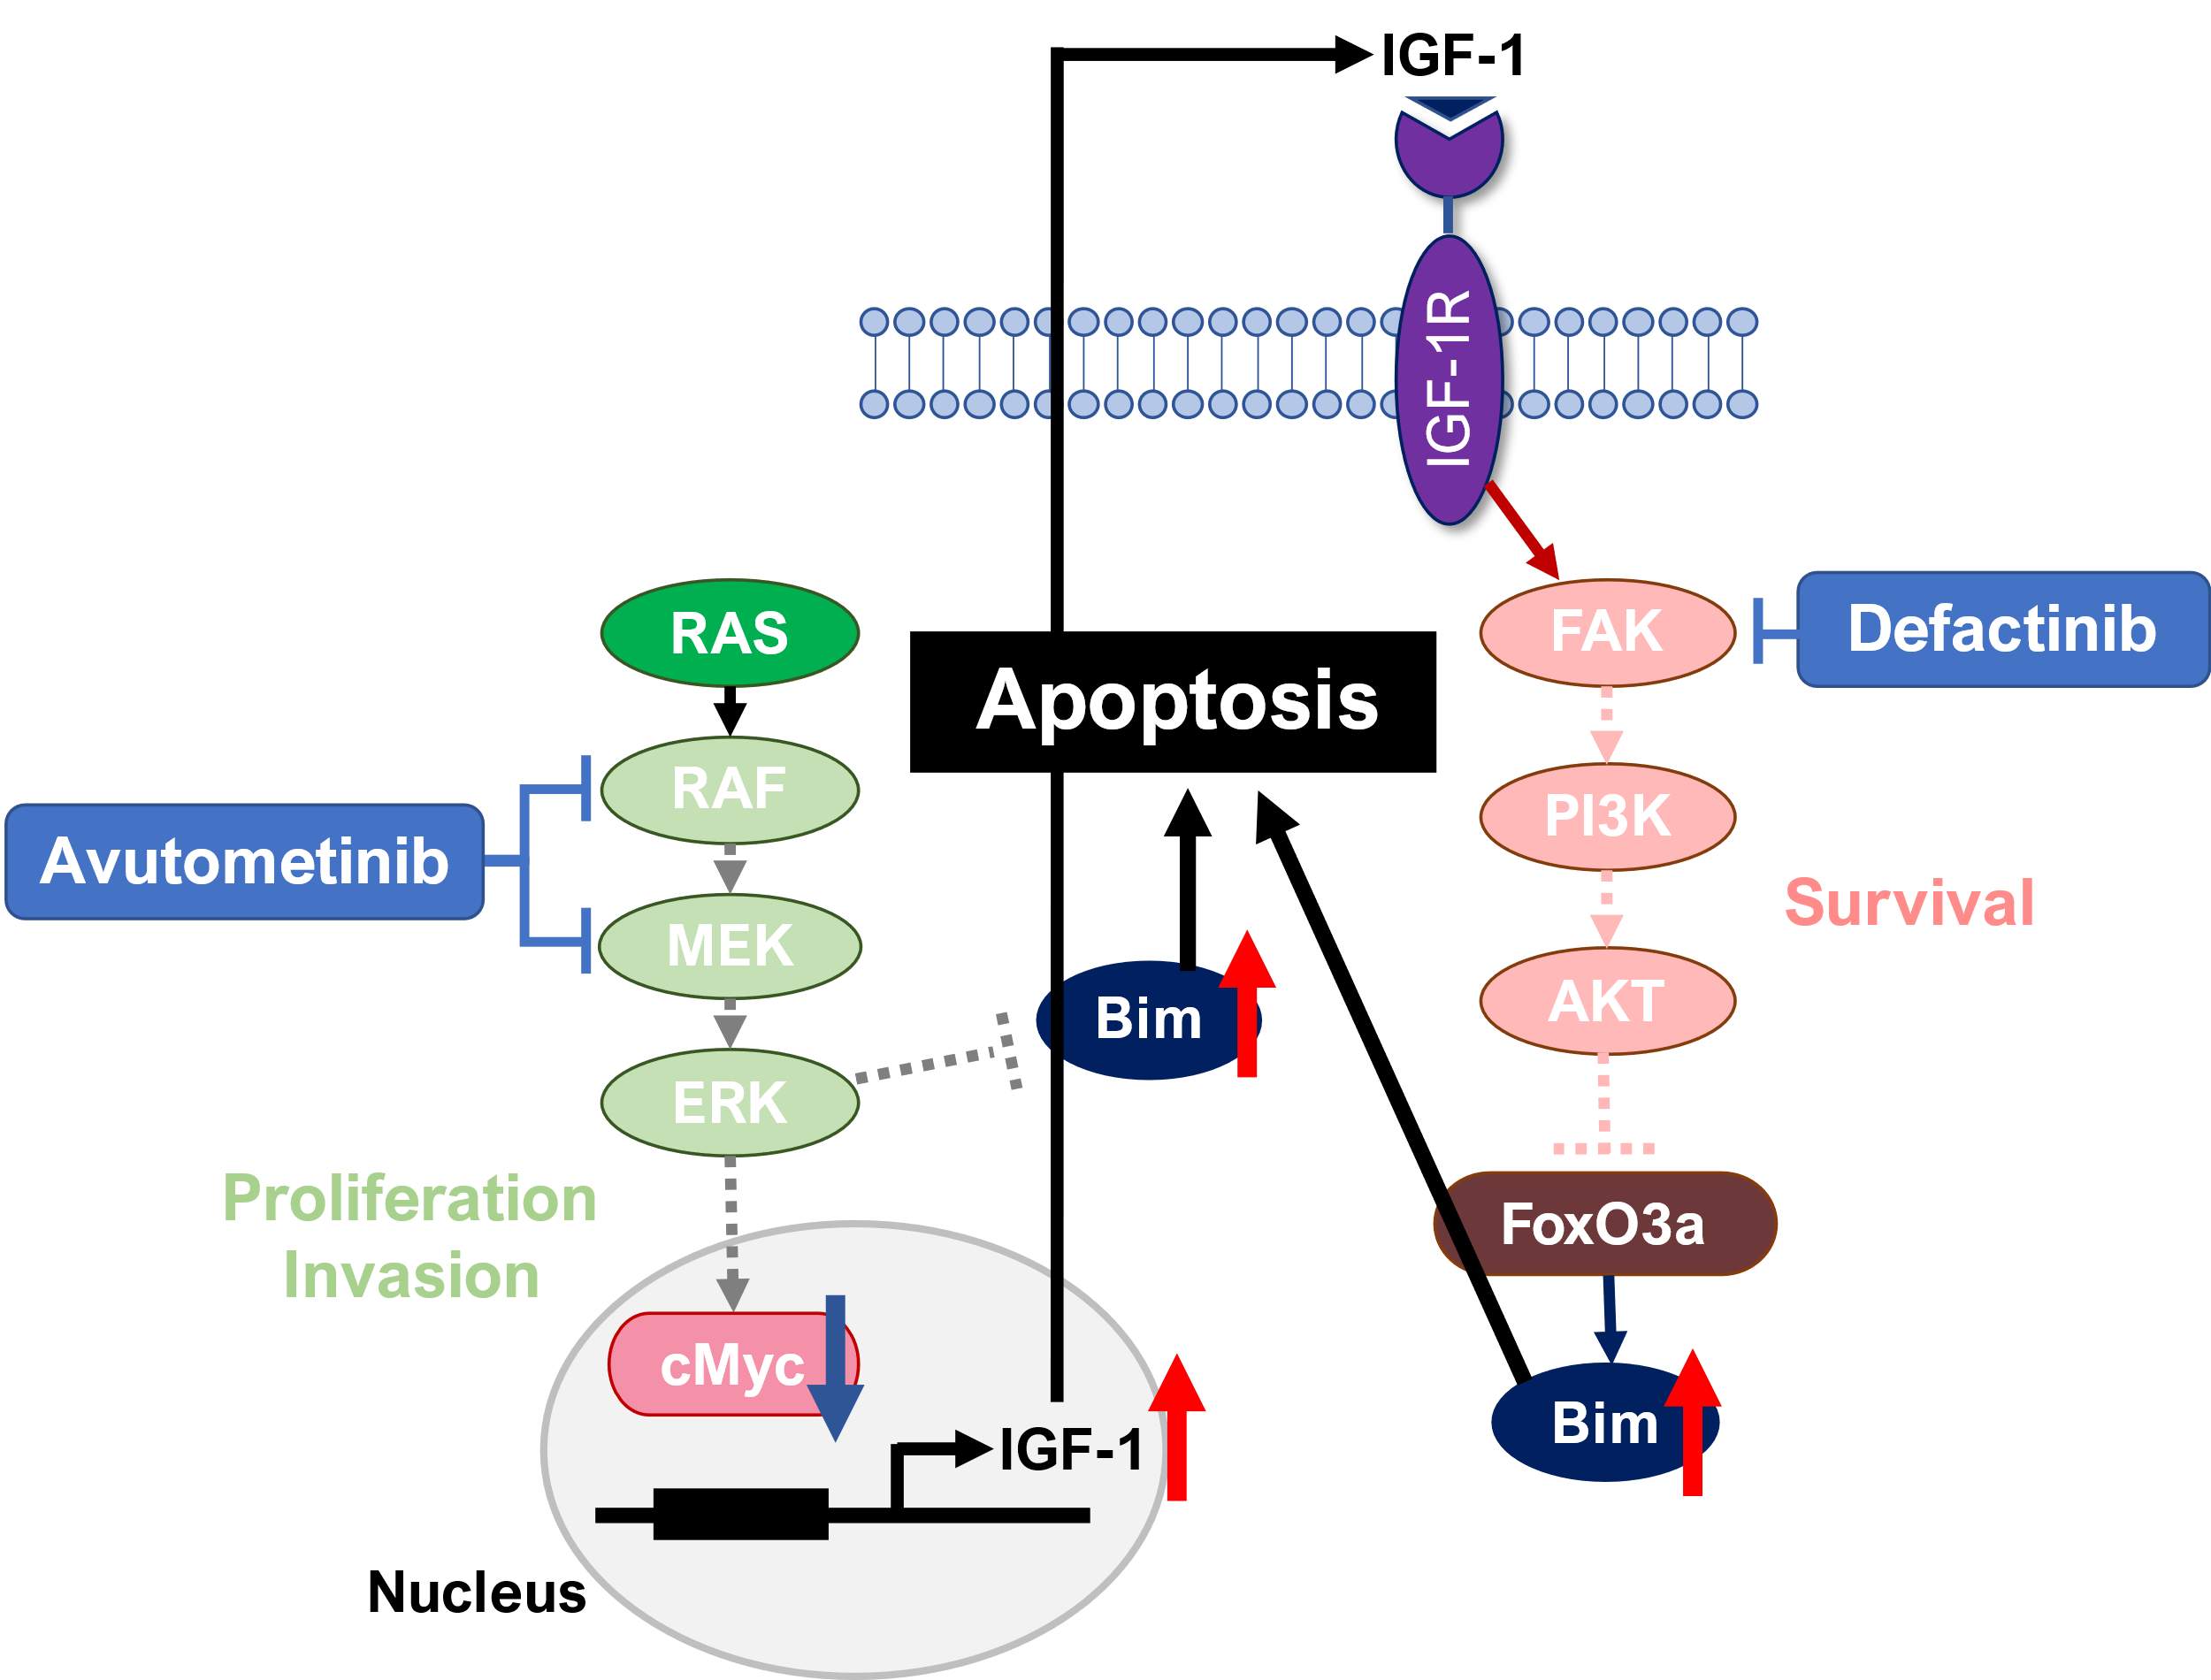
Figure S8. Schematic presentation of how combination treatment with FAK inhibitor and avutometinib induce cell apoptosis in KRAS-mutated non-small cell lung cancer cells.
Avutometinib monotherapy
Avutometinib + Defactinib

